Slide 1
ARM

Slide 2
ARM Instructions
1. Data processing instructions: These use and change only register values. For example, an instruction can add two registers and place the result in a register.
2. Data transfer instructions: These copy memory values into registers (load instructions) or copy register values into memory (store instructions). An additional form, useful only in systems code, exchanges a memory value with a register value.
3. Control flow instructions: Normal instruction execution uses instructions stored at consecutive memory addresses. Control flow instructions cause execution to switch to a different address, either permanently (branch instructions) or saving a return address to resume the original sequence (branch and link instructions). or trapping into system code (supervisor calls).

Slide 3
In common with most RISC processors, ARM employs a load-store architecture. This means that the instruction set will only process (add, subtract, and so on) values which are in registers (or specified directly within the instruction itself), and will always place the results of such processing into a register.
The only operations which apply to memory state are ones which copy memory values into registers (load instructions) or copy register values into memory (store instructions).

Slide 4
Addressing modes
1. Immediate addressing: the desired value is presented as a binary value in the instruction.
2. Absolute addressing: the instruction contains the full binary address of the desired value in memory.
3. Indirect addressing: the instruction contains the binary address of a memory location that contains the binary address of the desired value.
4. Register addressing: the desired value is in a register, and the instruction contains the register number.
5. Register indirect addressing: the instruction contains the number of a register which contains the address of the value in memory.

Slide 5
6. Base plus offset addressing: the instruction specifies a register (the base) and a binary offset to be added to the base to form the memory address.
7. Base plus index addressing: the instruction specifies a base register and another register (the index) which is added to the base to form the memory address.
8. Base plus scaled index addressing: as above, but the index is multiplied by a constant (usually the size of the data item, and usually a power of two) before being added to the base.
9. Stack addressing: an implicit or specified register (the stack pointer) points to an area of memory (the stack) where data items are written (pushed) or read (popped) on a last-in-first-out basis.

Slide 6
Register-indirect addressing
Register-indirect addressing uses a value in one register (the base register) as a memory address and either loads the value from that address into another register or stores the value from another register into that memory address.
These instructions are written in assembly language as follows:
LDR r0, [r1] ; r0 := mem32[r1]
STR r0, [r1] ;mem32[r1] := r0

Slide 7
Base plus offset addressing
If the base register does not contain exactly the right address, an offset of up to 4 Kbytes may be added to the base to compute the transfer address:
LDR r0,[r1,#4] ; r0 := mem32[r1+ 4]
This is a pre-indexed addressing mode. It allows one base register to be used to access a number of memory locations which are in the same area of memory.
Notes:
Exclamation mark pre-indexed post-indexed

Slide 8
Sometimes it is useful to modify the base register to point to the transfer address. This can be achieved by using pre-indexed addressing with auto-indexing, and allows the program to walk through a table of values:
LDR r0,[r1,#4]! ; r0 := mem32[r1+ 4]
; r1 := r1+ 4
The exclamation mark indicates that the instruction should update the base register after initiating the data transfer.

Slide 9
post-indexed addressing, allows the base to be used without an offset as the transfer address, after which it is auto-indexed:
LDR r0, [r1], #4; r0 := mem32 [r1]
;r1 := r1 + 4
This form of the instruction is exactly equivalent
to a simple register-indirect load followed by a data processing instruction, but it is faster and occupies less code space.

Slide 10
Stack addressing
A stack is usually implemented as a linear data structure which grows up (an ascending stack) or down (a descending stack) memory as data is added to it and shrinks back as data is removed.
A stack pointer holds the address of the current top of the stack, either by pointing to the last valid data item pushed onto the stack (a full stack-F),
or by pointing to the vacant slot where the next data item will be placed (an empty stack-E)

Slide 11
The ARM multiple register transfer instructions support all four forms of stack:
Full ascending: the stack grows up through increasing memory addresses and the base register points to the highest address containing a valid item.
Empty ascending: the stack grows up through increasing memory addresses and the base register points to the first empty location above the stack
Full descending: the stack grows down through decreasing memory addresses and the base register points to the lowest address containing a valid item.
Empty descending: the stack grows down through decreasing memory addresses and the base register points to the first empty location below the stack.

Slide 12
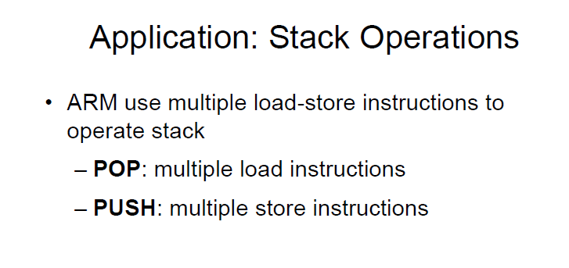

Slide 13
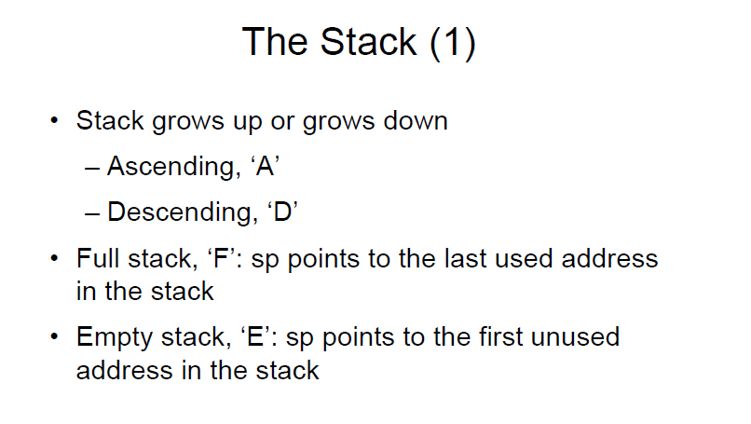

Slide 14
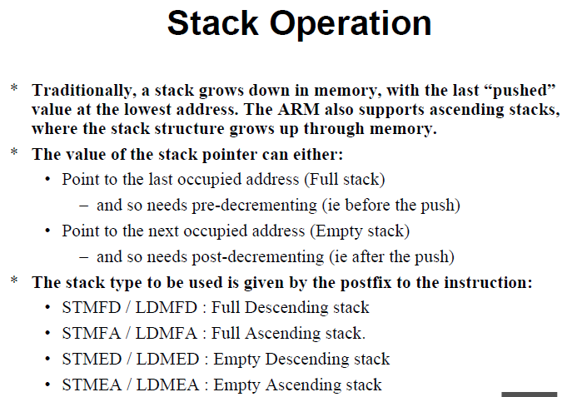

Slide 15
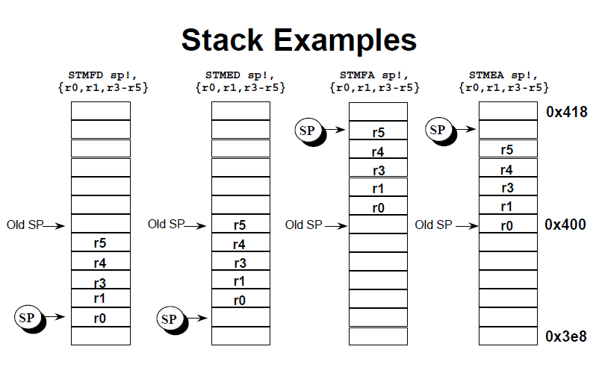

Slide 16
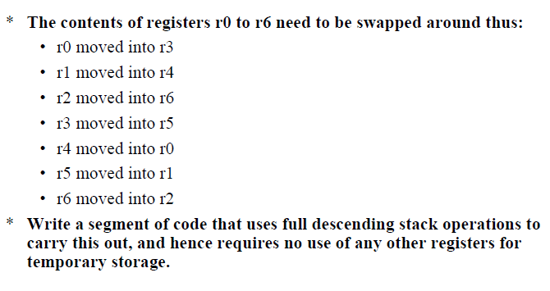

Slide 17
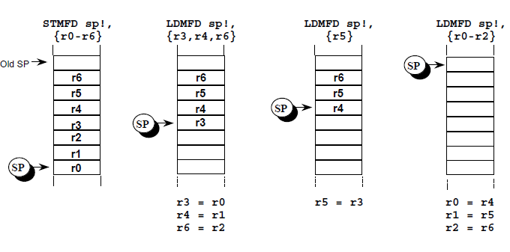

Slide 18
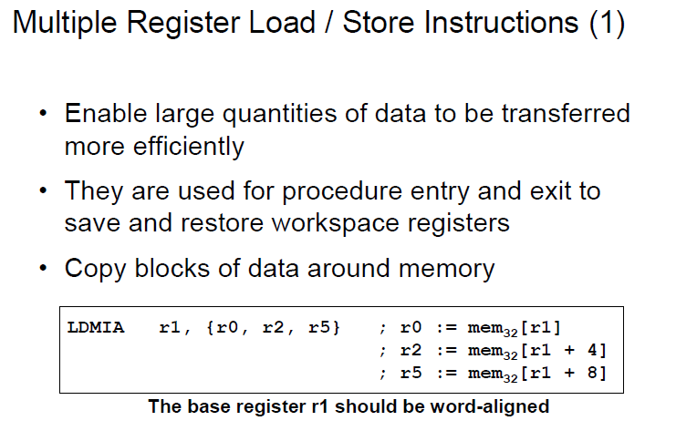

Slide 19
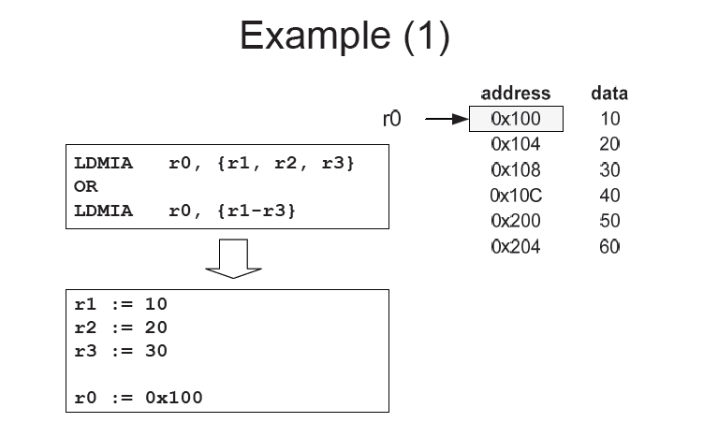

Slide 20
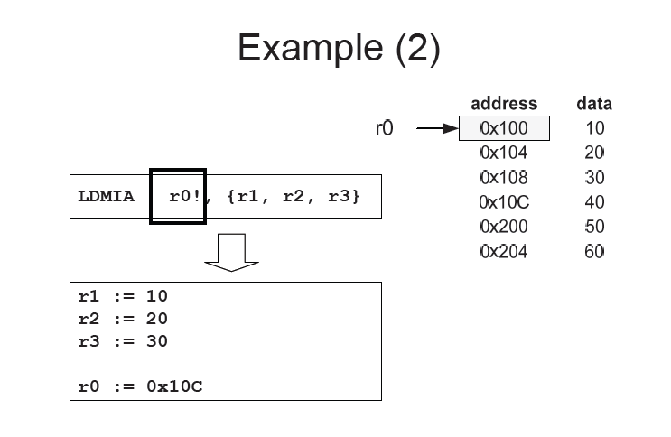

Slide 21
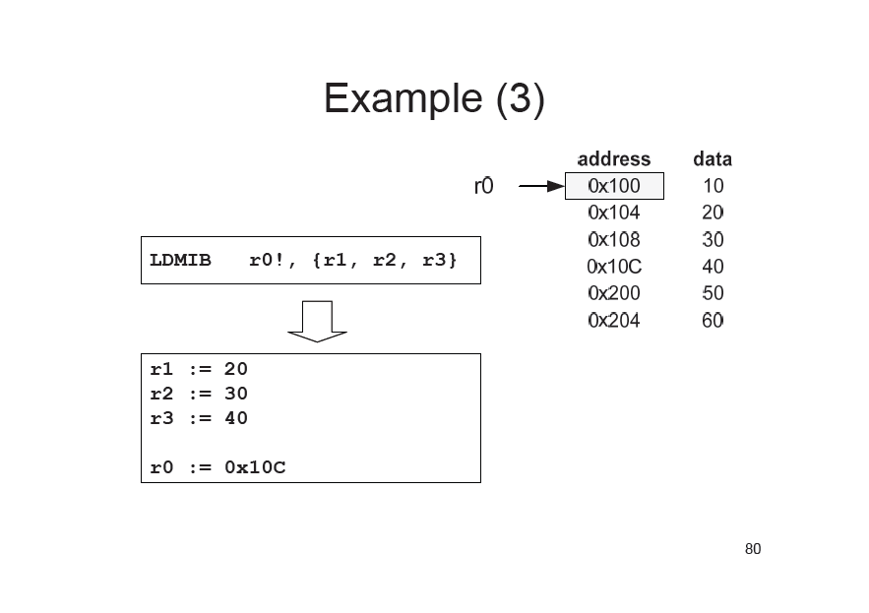

Slide 22
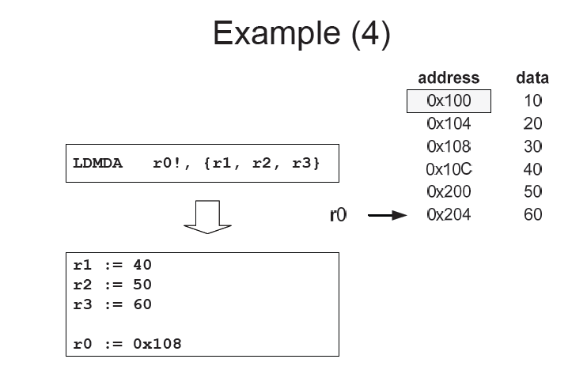

Slide 23
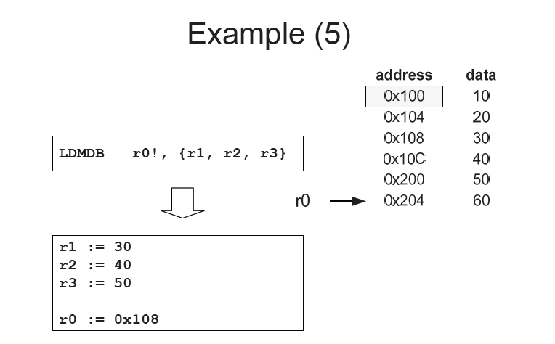

Slide 24
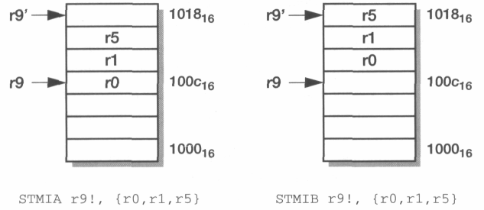

Slide 25
