Slide 1
ARM

Slide 2
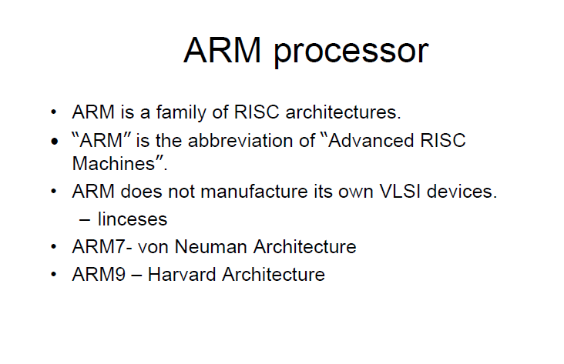

Slide 3
ARM processor features
Load/store architecture.
An orthogonal instruction set.
Mostly single-cycle execution.
Enhanced power-saving design.
64 and 32-bit execution states for scalable high performance.
Hardware virtualization support

Slide 4
ARM makes 32-bit and 64 bit RISC multi core processors.
RISC processors are designed to perform a smaller number of types of computer instructions so that they can operate at a higher speed, performing more millions of instructions per second (MIPS).
RISC processors provide outstanding performance at a fraction of the power demand of CISC

Slide 5
The ARM processor is a Reduced Instruction Set Computer (RISC).
The ARM was originally developed at Acorn Computers Limited of Cambridge, England, between 1983 and 1985. It was the first RISC microprocessor developed for commercial use and has some significant differences from subsequent RISC architectures. (Acorn RISC machine) Advanced RISC Machine,
In 1990 ARM Limited was established as a separate company specifically to widen the exploitation of ARM technology, since when the ARM has been licensed to many semiconductor manufacturers around the world.
The ARM is supported by a toolkit which includes an instruction set emulator for hardware modelling and software testing and benchmarking, an assembler, C and C++ compilers, a linker and a symbolic debugger.

Slide 6
RISC Vs CISC
RISC-Reduced Instruction set computing
One cycle execution time
Reduced complexity in hardware
Load and store separate instruction for Register
Large register set instead of memory
Ex: Sun SPARC, Power PC
CISC-complex instruction set computing
Several clock cycle execution time
complexity in hardware
Load and store instruction single for memory
Efficient use of memory
Ex: Intel 8080,80286,80386,Motorola 68000,Zilog Z80

Slide 7
CISC Architecture (complex instructions)
The CISC approach attempts to minimize the number of instructions per program, sacrificing the number of cycles per instruction.
Computers based on the CISC architecture are designed to decrease the memory cost. (since programs are shorter)
The number of instructions per program can be reduced by embedding the number of operations in a single instruction, thereby making the instructions more complex.

Slide 8
RISC Architecture (reduced instruction)
It is known as Reduced Instruction Set Computer.
It is a type of microprocessor that has a limited number of instructions.
They can execute their instructions very fast because instructions are very small and simple.
RISC reduces the cycles per instruction at the cost of the number of instructions per program
Pipelining is one of the unique feature of RISC processors.
It is performed by overlapping the execution of several instructions in a pipeline fashion.
It has a high performance advantage over CISC.

Slide 9
Pipelining
A processor executes an individual instruction in a sequence of steps.
A typical sequence might be:
1. Fetch the instruction from memory (fetch).
2. Decode it to see what sort of instruction it is (dec).
3. Access any operands that may be required from the register bank (reg).
4. Combine the operands to form the result or a memory address (ALU).
5. Access memory for a data operand, if necessary (mem).
6. Write the result back to the register bank (res).

Slide 10
Not all instructions will require every step, but most instructions will require most of them.
These steps tend to use different hardware functions, for instance the ALU is probably only used in step 4.
Therefore, if an instruction does not start before its predecessor has finished, only a small proportion of the processor hardware will be in use in any step.
An obvious way to improve the utilization of the hardware resources, and also the processor throughput, would be to start the next instruction before the current one has finished.
This technique is called pipelining, and is a very effective way of exploiting concurrency in a general-purpose processor.

Slide 11
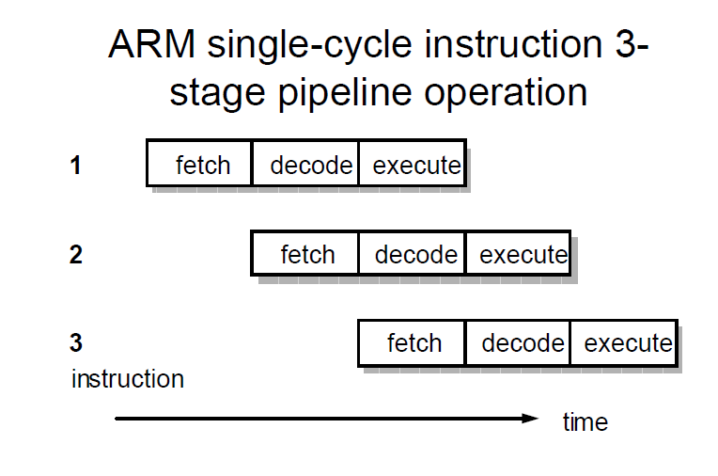

Slide 12
The ARM programmer's model
When writing user-level programs, only the 15 general-purpose 32-bit registers (r0 to r14), the program counter (r15) and the current program status register (CPSR) need be considered. The remaining registers are used only for system-level programming and for handling exceptions (for example, interrupts).

Slide 14
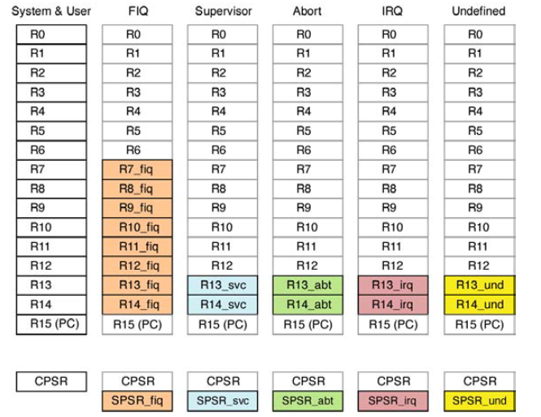

Slide 15
ARM CPSR format

Slide 16
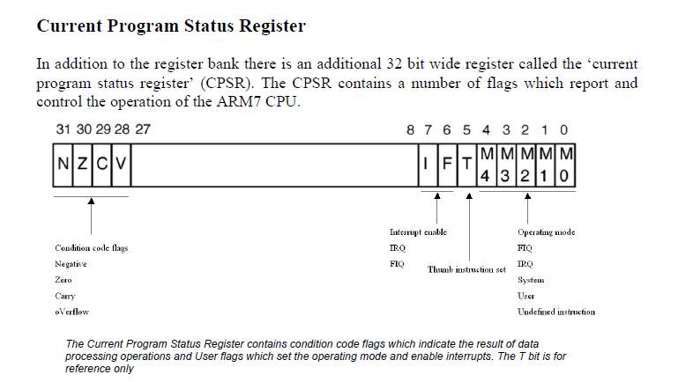

Slide 17
The CPSR is used in user-level programs to store the condition code bits.
The lower bits of the register control the processor mode, instruction set ('T) and interrupt enables ('I' and 'F ) are protected from change by the user-level program.
The condition code flags are in the higher four bits of the register and have the following meanings:
• N: Negative; the last ALU operation which changed the flags produced a negative result (the top bit of the 32-bit result was a one).
• Z: Zero; the last ALU operation which changed the flags produced a zero result (every bit of the 32-bit result was zero).
• C: Carry; the last ALU operation which changed the flags generated a carry-out, either as a result of an arithmetic operation in the ALU or from the shifter.
• V: oVerflow; the last arithmetic ALU operation which changed the flags generated an overflow into the sign bit.

Slide 18
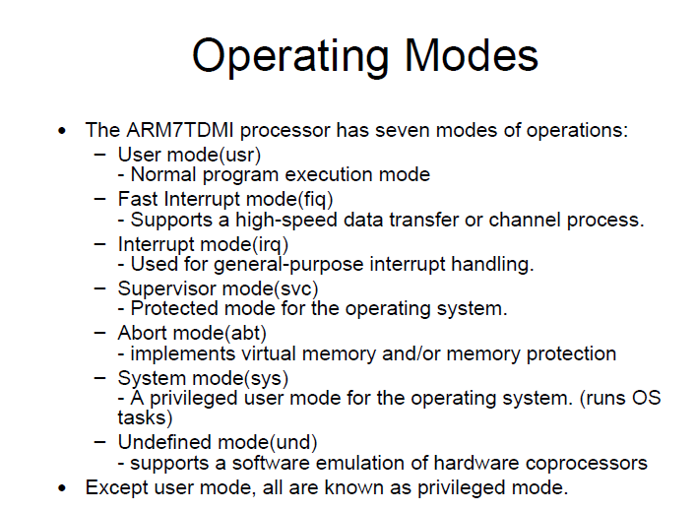

Slide 19
Memory system
In addition to the processor register state, an ARM system has memory state.
Memory may be viewed as a linear array of bytes numbered from zero up to 2³²-l.
Data items may be 8-bit bytes, 16-bit half-words or 32-bit words. Words are always aligned on 4-byte boundaries.
The memory organization (next slide) shows a small area of memory where each byte location has a unique number. A byte may occupy any of these locations, and a few examples are shown in the figure. A word-sized data item must occupy a group of four byte locations starting at a byte address which is a multiple of four, and again the figure contains a couple of examples. Half-words occupy two byte locations starting at an even byte address.

Slide 20
ARM Memory organization

Slide 21
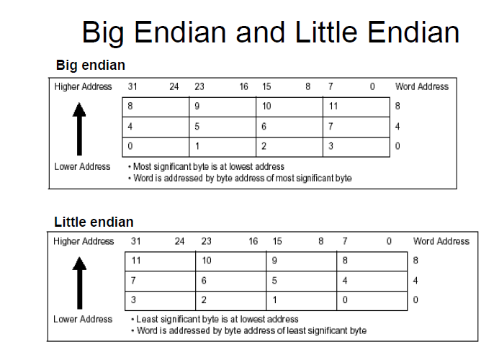

Slide 23
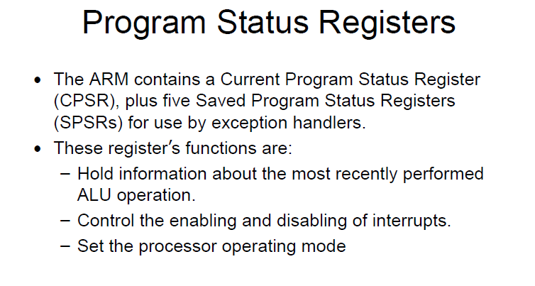

Slide 24
An attempt to access a memory location may fail, for instance, because a fault is detected in the memory subsystem. The program must therefore deviate from its planned course in
order to attempt to recover from the problem.
These cases where the change in the flow of control is not the primary intent of the programmer but is a consequence of some unexpected (and possibly unwanted) side-effect of the program are termed exceptions.

Slide 25
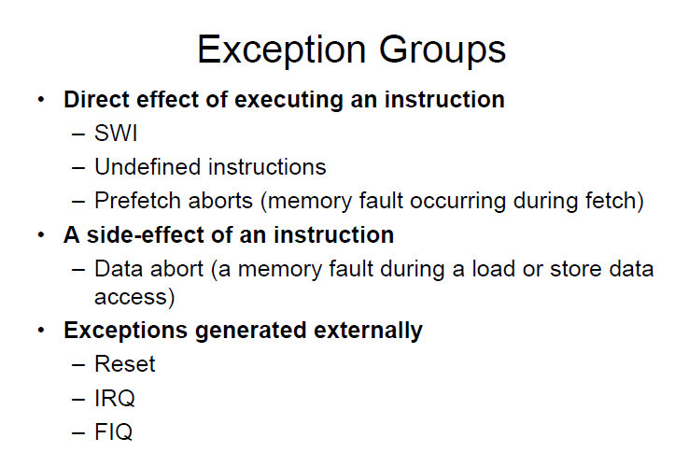

Slide 26
Entering exception mode
It changes to the operating mode corresponding to the particular exception.
It saves the address of the instruction following the exception entry instruction in r14 of the new mode.
It saves the old value of the CPSR in the SPSR of the new mode.
It disables IRQs by setting bit 7 of the CPSR and, if the exception is a fast interrupt, disables further fast interrupts by setting bit 6 of the CPSR.
It forces the PC to begin executing at the relevant vector address given in Table

Slide 27
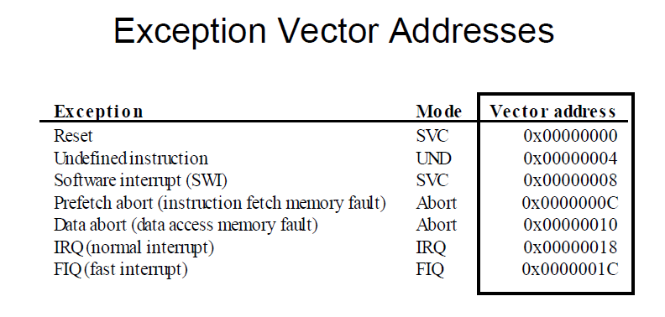

Slide 28
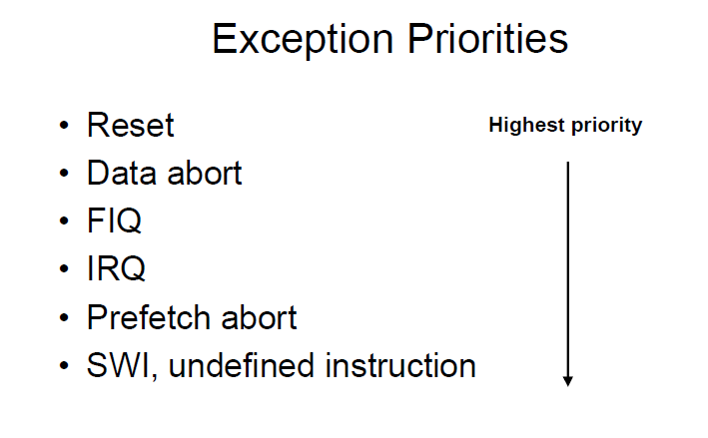

Slide 29
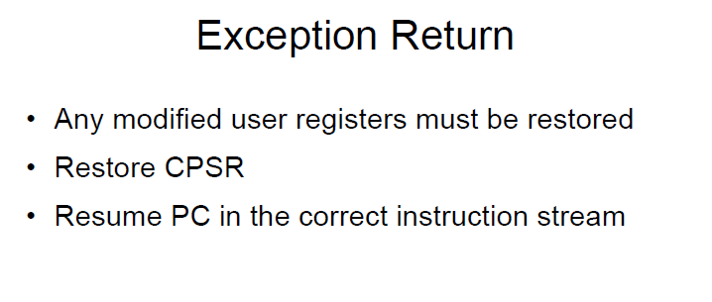
Notes:
Movs r15, r14
Subs r15, r14, #4

