Slide 1
ENGINEERING ECONOMICS
Introduction

Slide 2

In this course
Introduction to Engineering economics
Time Value of Money
Economic equivalence
Economic analysis of alternatives
Mutually exclusive alternatives
Evaluating production operations and equipment
Replacement analysis
Depreciation accounting
Financial Statement Analysis

Slide 3

Text books
Engineering economy
By Thuesen and Fabrycky
Contemporary engineering economics
By Chan S Park
Engineering Economics
By James L Riggs
Fundamentals of Financial Management By Prasanna Chandra

Slide 4
As engineers, what is our job?
Engineering :
A profession in which a knowledge of the mathematical and natural sciences is applied with judgment to develop ways to utilize economically the materials and forces of nature for the benefit of mankind.
-ABET

Slide 5
What is Economics
Economics is the study of how people choose to use resources.

Slide 6
What is engineering economics?
Engineering economics, previously known as engineering economy, is a subset of economics for application to engineering projects.
Engineers seek solutions to problems, and the economic viability of each potential solution is normally considered along with the technical aspects.

Slide 7
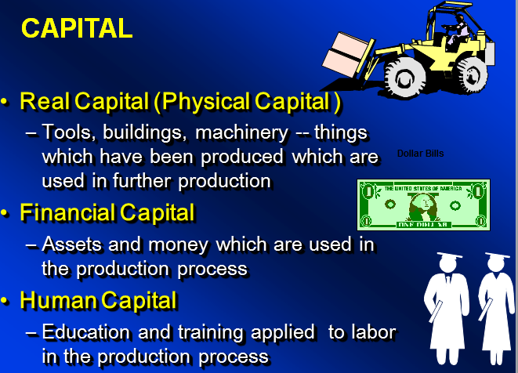
RESOURCES
LABOUR
The efforts, skills, and knowledge of people which are applied to the production or service processes.
LAND
All gifts of nature, such as: water, air, minerals, sunshine, plant and tree growth, as well as the land itself which is applied to the production process.

Slide 8
Accounting Vs. Engineering Economics.
Evaluating past performance
Evaluating and predicting future events
Accounting
Engineering Economy
Past
Present
Future

Slide 9
Two Defining Factors in Engineering Economic Decisions
The factors of time and uncertainty are the defining aspects of any engineering economic decisions

Slide 10
Principles of Engineering Economy
Focus on the Differences
Develop the Alternatives
Use a Common Unit of Measure
Use a Consistent Viewpoint
Consider All Relevant Criteria
Make Uncertainty Explicit
Revisit Your Decisions

Slide 11
Engineering Economic Analysis Procedure
1. Problem recognition, formulation, and evaluation.
2. Development of the feasible alternatives.
3. Development of the cash flows for each alternative.
4. Selection of a criterion ( or criteria).
5. Analysis and comparison of the alternatives.
6. Selection of the preferred alternative.
7. Performance monitoring and post-evaluation results.

Slide 12



Five Types of Engineering Economic Decisions in Manufacturing Sector
Service Improvement
Equipment and Process Selection
Equipment Replacement
New Product and Product Expansion
Cost Reduction/Outsourcing

Slide 13
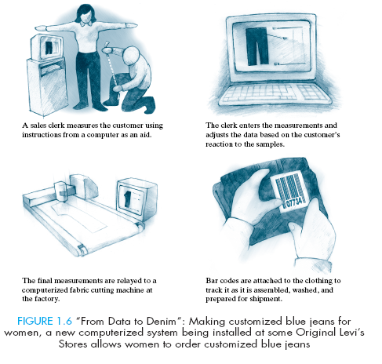
Service Improvement
How many more jeans would Levi need to sell to justify the cost of additional robotic tailors?

Slide 14
Equipment Replacement Problem
Now is the time to replace the old machine?
If not, when is the right time to replace?

Slide 15
New Product and Product Expansion
Shall we build or acquire a new facility to meet the increased demand?
Is it worth spending money to market a new product?

Slide 16


Example - MACH 3 Project
R&D investment: $750 million
Product promotion through advertising: $300 million
Priced to sell at 35% higher than Sensor Excel (about $1.50 extra per shave).
Question 1: Would consumers pay $1.50 extra for a shave with greater smoothness and less irritation?
Question 2: What would happen if the blade consumption dropped more than 10% due to the longer blade life of the new razor?
Gillette’s MACH3
Project

Slide 17
Cost Reduction/ Outsourcing
Should a company buy equipment to perform an operation now done manually?
Should spend money now in order to save more money later?

Slide 18
Service sector
Example -Healthcare Delivery
Which plan is more economically viable?
Traditional Plan: Patients visit each service provider.
New Plan: Each service provider visits patients
: patient
: service provider

Slide 19

This course covers the fundamentals of engineering economics and basic accounting. It will help students understand how an organization can utilize its capital economically when it makes capital decisions.
The two major learning objectives are:
To understand of the Economics of Engineering, which includes the Time Value of money.
Secondly students need to know how to use Figures of Merit (NPV, IRR, BC etc.) in making engineering design and business decisions

Slide 20

THANKYOU

