Slide 1

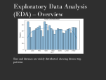

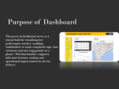


Purpose of Dashboard
Introduction
EDA
Insights
Purpose of SQL
Prepared By – SUDIPTA HALDAR

Slide 2

Introduction to Nammayatri Trips
A "Namma Yatri trip" is a ride booked through the Namma Yatri app, a Bengaluru-based mobility platform focused on fair, transparent, and affordable auto and cab services, unique for charging drivers zero commission, allowing them to keep 100% of fares and tips, leading to lower prices for riders and better earnings for drivers. It's a people-first movement aiming to revolutionize urban travel with integrated public transit (like metro) and private vehicle options, emphasizing driver welfare and community-backed services.

Slide 3

Objective of the Project
The primary objective of Namma Yatri is to offer a seamless booking experience while effectively tracking key performance metrics. This initiative aims to gather insights for improving services and meeting users expectations across various region.

Slide 4
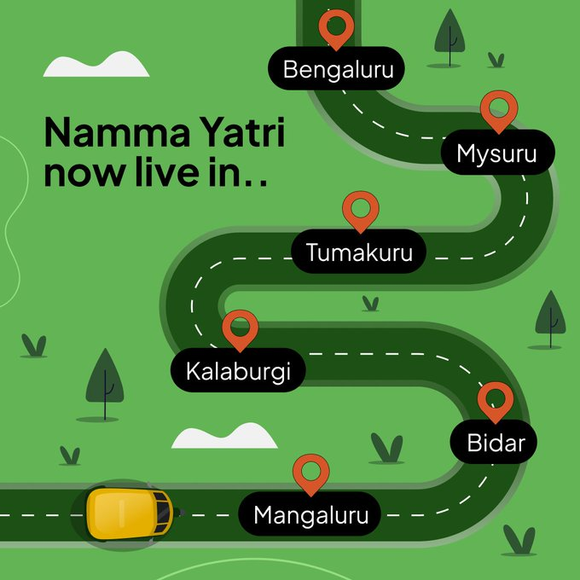
Cities covered by Namma Yatri
Namma Yatri operates across several major Indian cities , including Bengaluru, Delhi, Hyderabad, Chennai, Kochi, Mysore and Tumkur. This broad coverage ensures that diverse urban populations benefit from improved transport services.

Slide 5

Tools & Technologies
Power Query
DAX
SQL
Microsoft Excel (CSV files)
Power Bi

Slide 6
Purpose of Dashboard
Introduction
EDA
Insights
Purpose of SQL

Slide 7
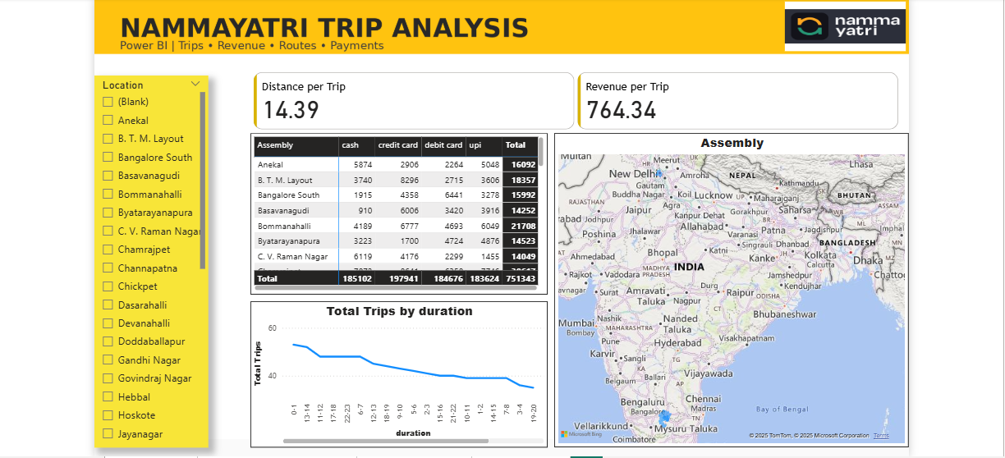
Purpose of Dashboard
The power bi dashboard serves as a central hub for visualizing key performance metrics, enabling stakeholders to track completed trips, fare estimates and user engagement at a glance. This functionality supports informed decision- making and operational improvements in service delivery.

Slide 8
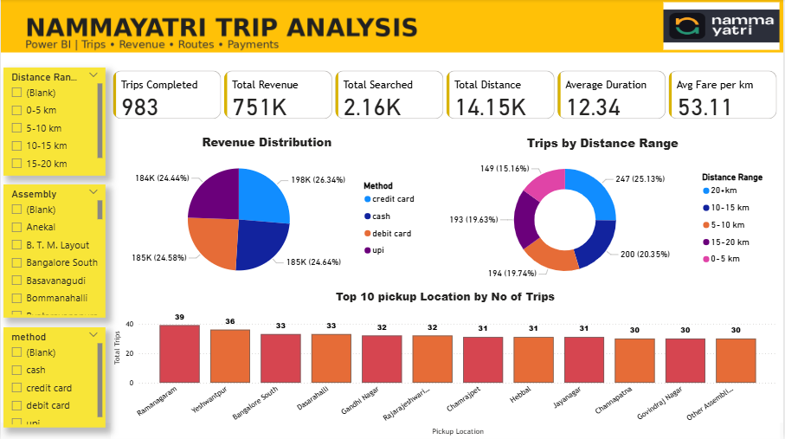
Trip Overview
This dashboard helps Namma Yatri monitor performance, optimize routes and driver deployment, understand customer payment behavior, and ensure fair pricing through interactive, data-driven analysis.
Key Insights –
Trips completed – 983
Total Revenue – 7.51 lakhs
Average fare per KM – 53.11
Average Duration – 12.34

Slide 9
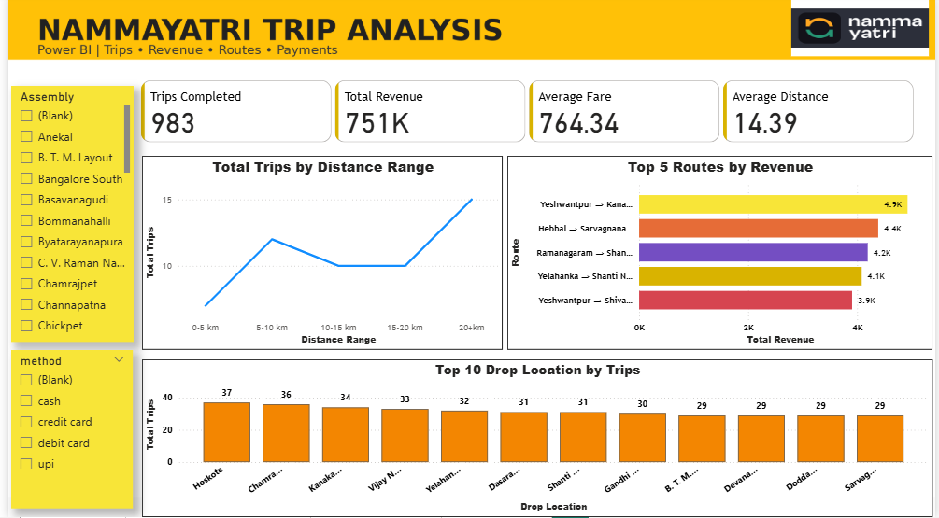
Route & Destination
The dashboard shows that Namma Yatri’s revenue is driven by medium-to-long distance trips on specific high-value routes, with clear destination hotspots that can be leveraged for driver optimization and revenue growth.
Key insights –
Routes like Yeshwantpur → Kengeri and Hebbal → Sarjapur lead revenue.
Top drop areas include Hosakote, Chamarajpet, Kengeri, Vijay Nagar.
Average fare – 764
Average distance – 14.39

Slide 10
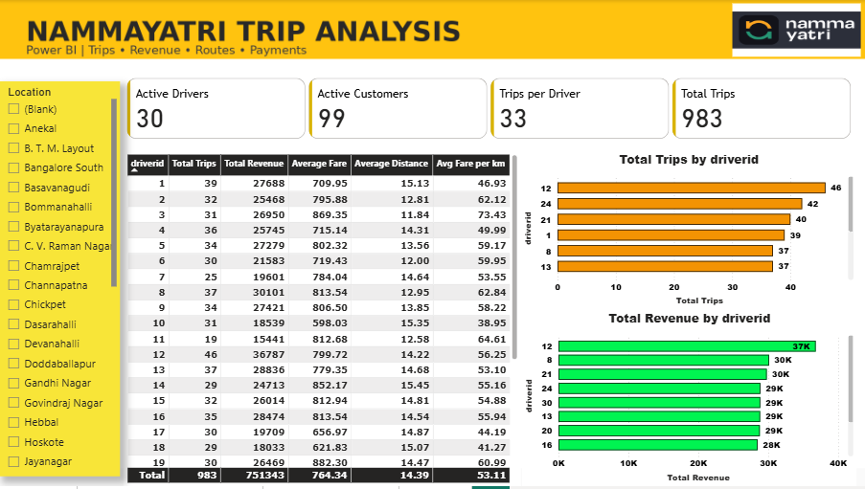
Driver & Customer
The dashboard shows that driver revenue is driven by a mix of trip volume and average distance, with consistent pricing and clear opportunities for performance-based driver incentives.
Key insights –
Some drivers with fewer trips earn higher revenue due to longer average distances and higher fares.
Top drivers complete ~40–46 trips and generate ₹30K–₹37K revenue.
Avg fare per km stays around ₹50–₹65 for most drivers.
Drivers with average distances ~14–15 km tend to earn more per trip.

Slide 11
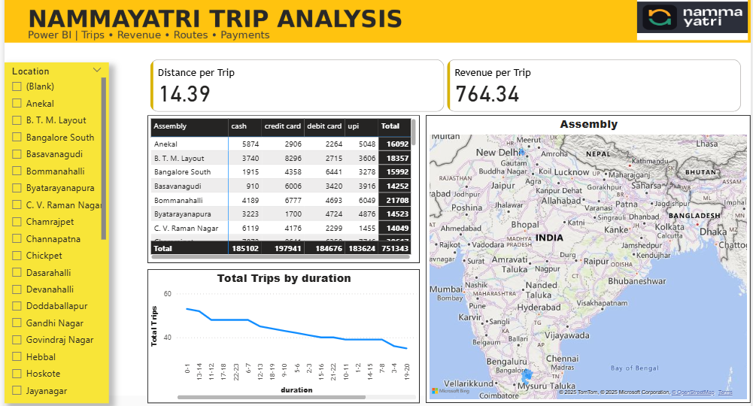
Trips & Payment Method
The dashboard shows stable trip economics, strong digital payment adoption, clustered geographic demand, and a duration mix that supports efficient driver utilization and predictable revenue.
Key insights –
UPI, credit card, and debit card contribute the majority of revenue in most assemblies.
Certain assemblies (e.g., dense urban/suburban areas) show higher total revenue across payment methods.
The map highlights hotspots where trips and revenue are concentrated.

Slide 12
Purpose of Dashboard
Introduction
EDA
Insights
Purpose of SQL

Slide 13
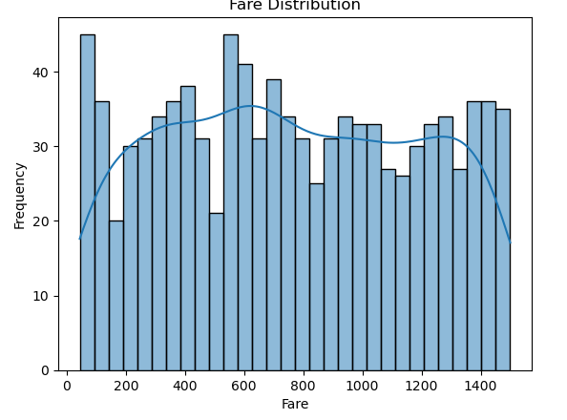
Exploratory Data Analysis (EDA) – Overview
Fare and distance are widely distributed, showing diverse trip patterns

Slide 14
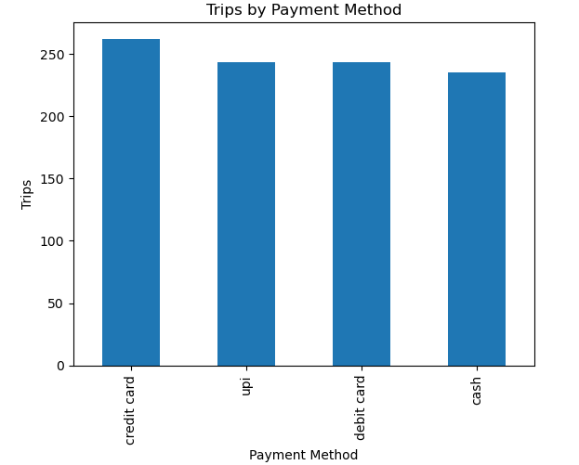
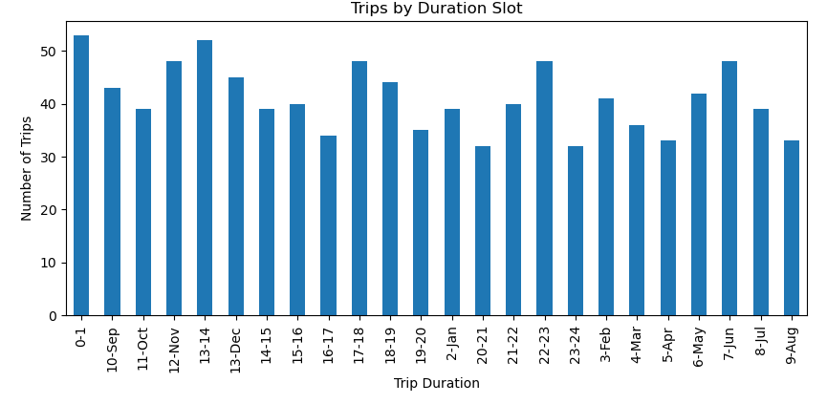
Payment & Duration Analysis
Digital payments dominate over cash
Short to medium duration trips are most frequent

Slide 15
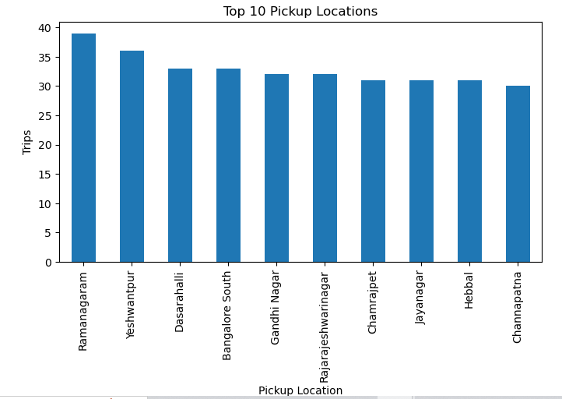
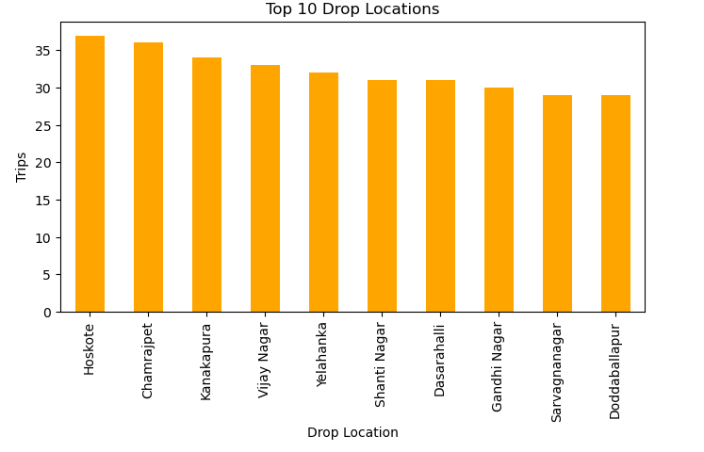
Location Analysis – Pickup & Drop
Demand is concentrated in specific urban areas
Certain locations act as major trip destinations

Slide 16
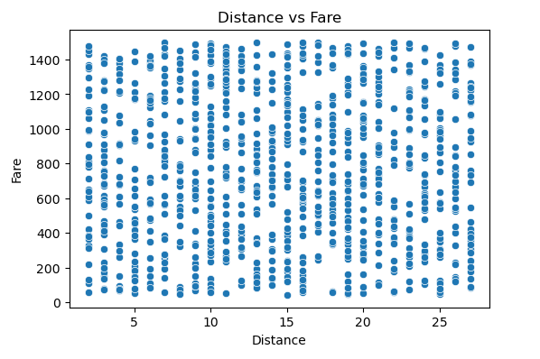
Distance vs Fare Relationship
Price variation exists due to traffic and dynamic pricing
Fare increases with distance

Slide 17
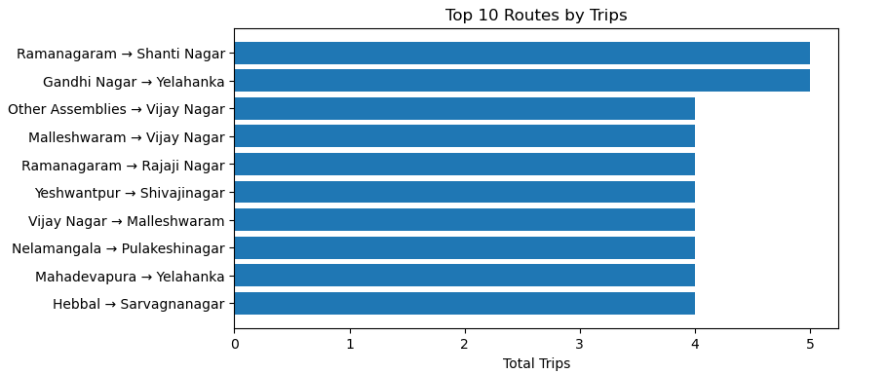
Route Analysis
Few routes generate repeated demand
Pricing remains consistent across route distances

Slide 18
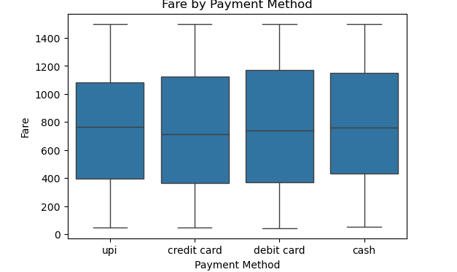
Fare by Payment Method
• Median fare is similar across all payment methods
• No significant pricing bias between UPI, cards, and cash
• High and low fare outliers exist for all payment types

Slide 19
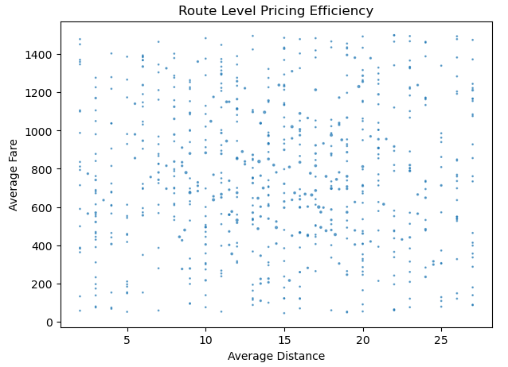
Route-Level Pricing Efficiency
• Fare generally increases with average route distance
• Some variation exists due to traffic and route complexity
• No abnormal overpricing detected across routes

Slide 20
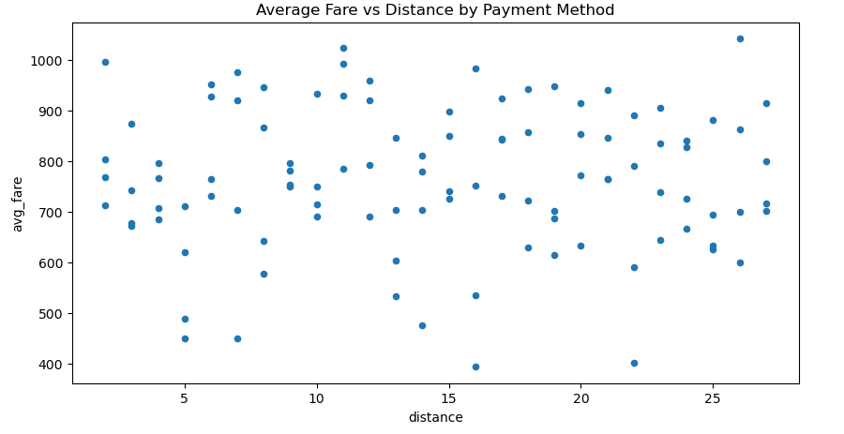
Average Fare vs Distance
• Longer trips have higher average fares
• Fare variation reflects dynamic pricing conditions
• Distance is a key driver of trip pricing

Slide 21
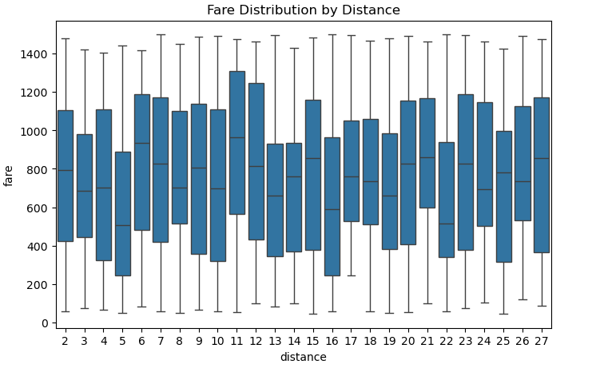
Fare Distribution by Distance
• Median fare increases gradually with distance
• Fare spread widens for longer trips
• Outliers represent premium or delayed rides

Slide 22
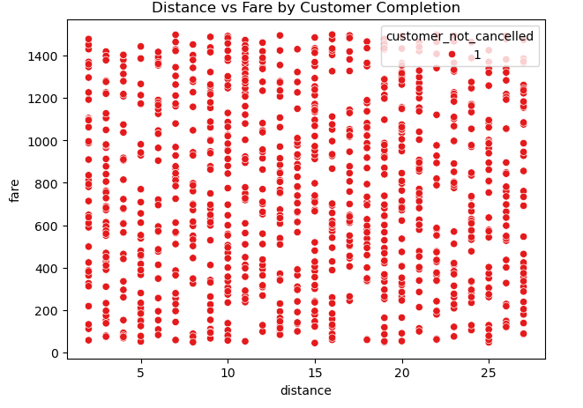
Distance vs Fare by Customer Completion
• Completed trips exist across all distance ranges
• No clear cancellation bias for long-distance trips
• Customers are comfortable completing longer rides

Slide 23
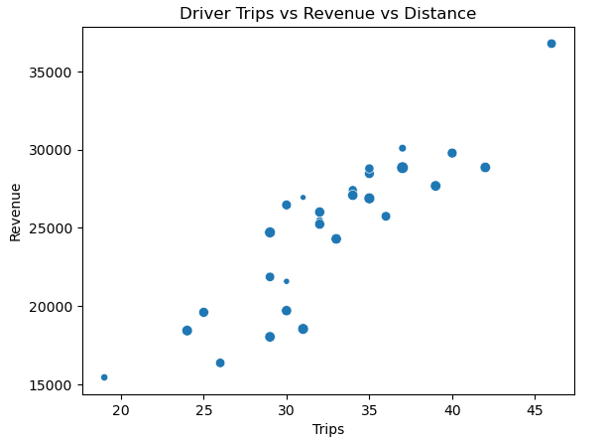
Driver Trips vs Revenue vs Distance
• Revenue increases with number of trips completed
• Some drivers earn more with fewer long-distance trips
• Earnings depend on both trip volume and distance

Slide 24
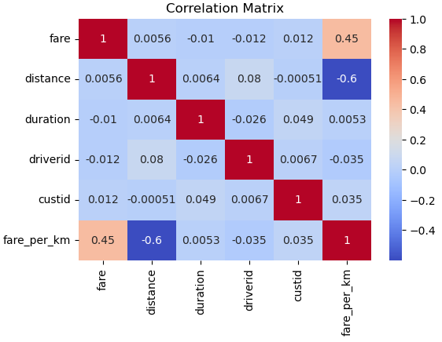
Correlation Analysis
• Fare per km decreases as distance increases
• Fare has moderate correlation with fare per km
• No strong bias across drivers or customers

Slide 25
Purpose of Dashboard
Introduction
EDA
Insights
Purpose of SQL

Slide 26
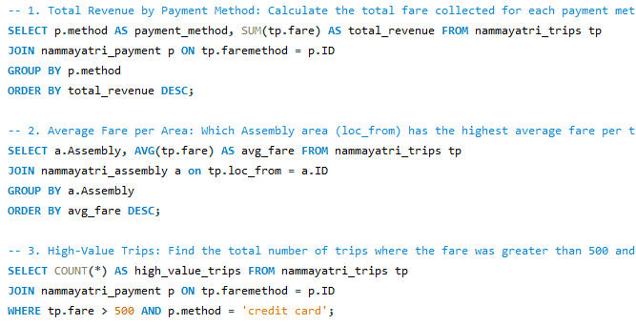
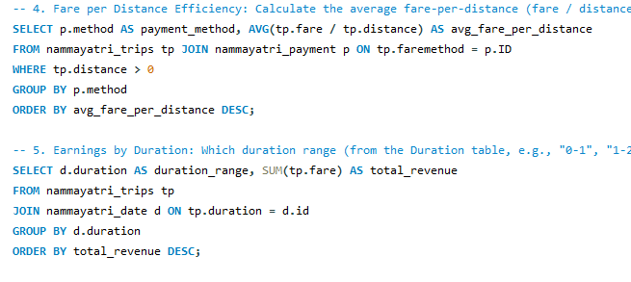
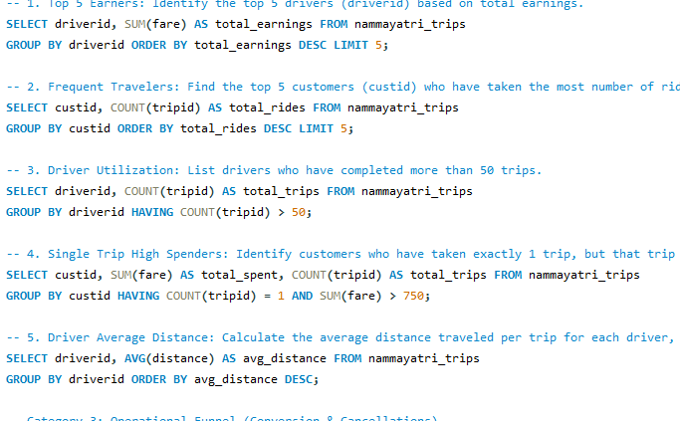
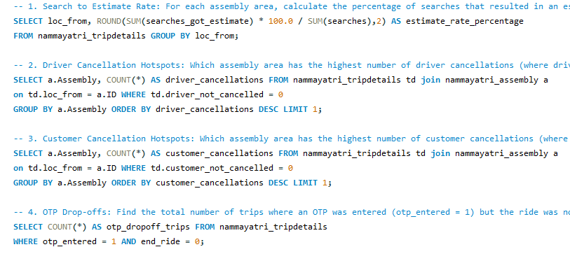
Purpose of SQL Script
Sql scripts are utilized to extract, transform, and load data into a structured format, ensuring accuracy and readiness for analysis. These are scripts are critical in maintaining data integrity across various sources for the dashboard.

Slide 27

Data Processing Steps
Data Processing involves cleaning and organizing the extracted data. These steps are essential for transforming raw information into actionable insights, which feed directly into Power Bi for visualization.

Slide 28
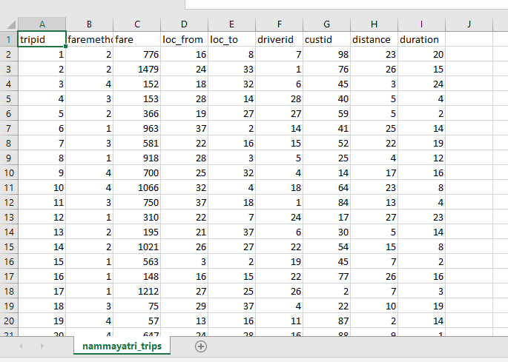
Purpose of excel in this project
Excel serve as the foundational platform for storing raw data, including trip and fare information. This organized structure supports efficient data management and serve as a primary data source for further analysis.

Slide 29
Purpose of Dashboard
Introduction
EDA
Insights
Purpose of SQL

Slide 30

Key Insights
Digital payments (UPI & cards) are preferred over cash
Few routes generate higher trip volumes and revenue
Fare increases with distance, but fare per km decreases for long trips
Low cancellation rate indicates operational stability
Urban and mid-distance trips dominate overall demand

Slide 31

Business Insights
Driver earnings vary based on trip distance and frequency
Quote acceptance rate differs by location, showing demand–supply gaps
Pricing strategy is dynamic and fair across routes and payment modes
Revenue is driven by both trip volume and long-distance rides

Slide 32

Conclusion
The Power BI dashboard provides actionable insights into Namma Yatri’s operations, pricing efficiency, and customer behavior. The analysis highlights balanced demand, fair pricing, strong digital adoption, and efficient driver utilization, enabling better decision-making and future scalability.

Slide 33
Thank You

