Slide 1


TWEET CLASSIFICATION
BY GROUP 3

Slide 2
Demo Video Link - https://drive.google.com/file/d/1uYOfG-nIFHFdfmGLAnafr2j-YZRn8pwt/view?usp=drive_link

Slide 3

INTRODUCTION
Social media sites like Twitter have emerged as the main providers of news and updates in an information-overloaded society.
But how can we distinguish the message from the noise given the vast number of news tweets?
Our main goal is to automatically categorize news tweets as relevant or irrelevant by utilizing LSTM neural networks.
The secret to extracting valuable information from the torrent of tweets is LSTM, a kind of deep learning technology.
Join us as we investigate the role of LSTM in this situation and discuss how it can affect effective information consumption.

Slide 4


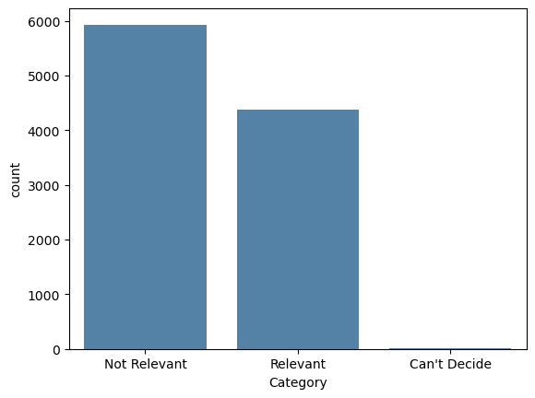
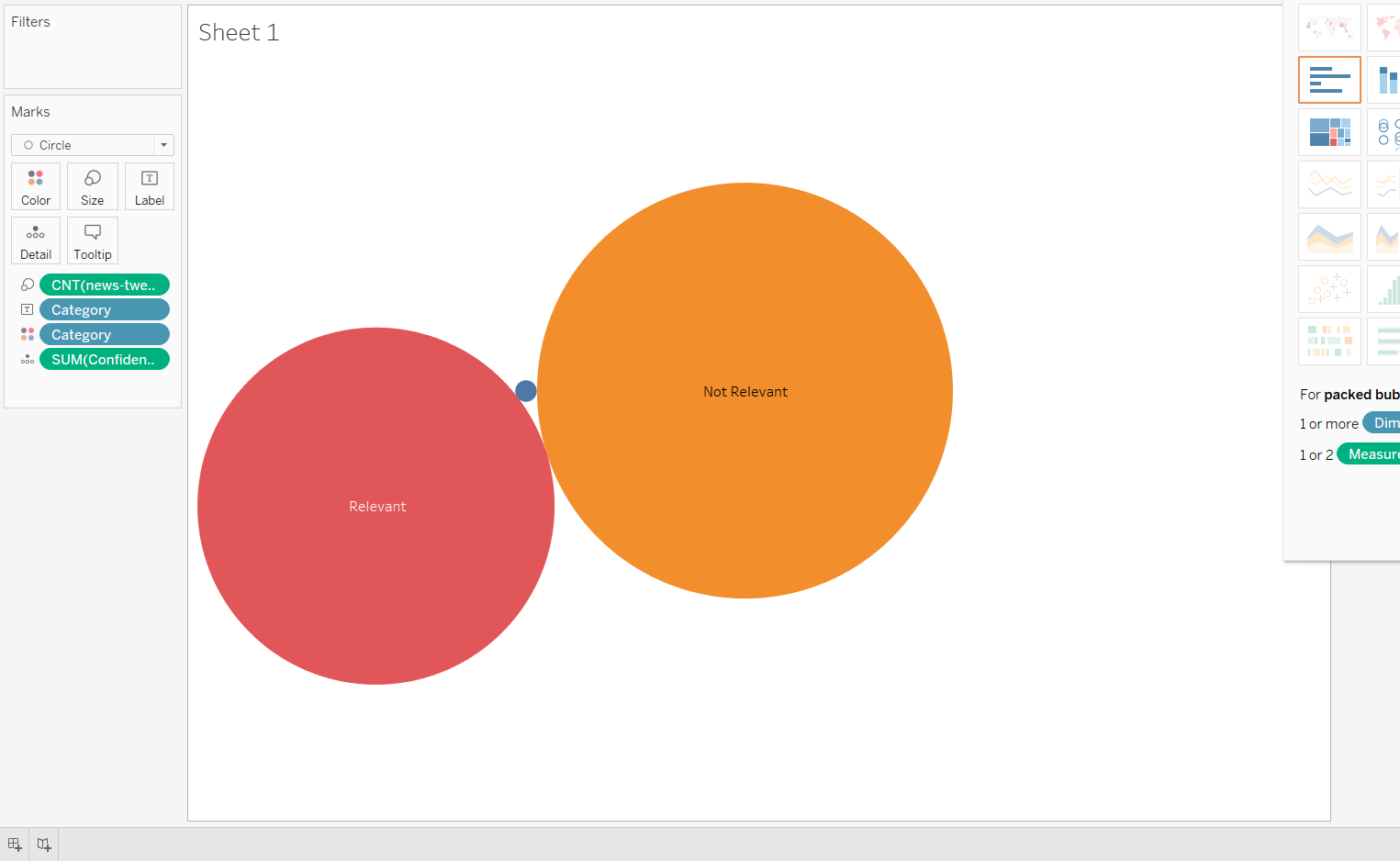
DATA COLLECTION
In the provided dataset, we identified two types of information: relevant news and irrelevant content. The plotted graphs help us visualize the data of what is relevant and what is not, helping us better understand the distinction between the two.
Additionally, there exists a category where we have difficulty making a definite decision. However, it's important to note that the number of tweets falling into this category is quite small.

Slide 5
DATA PREPROCESSING
The technique of clearing unneeded or extraneous material from news items is known as "news text sanitization.“
The removal of HTML elements, punctuation, stop words, and numerals is one of the sanitization strategies.
A clean dataset must be produced in order to do further analysis.

Slide 6


TOKENIZATION & PADDING
Tokenizing :
Breaking text into individual units called tokens (words, characters, subwords).
Each token holds semantic meaning, aiding language understanding.
Tokenization helps convert text into numerical form for model input.
Padding:
Ensuring consistent input size for neural networks.
Adding zeros or placeholders to sequences with fewer tokens.
Essential for efficient batch processing and model convergence.
Padding maintains uniformity in input dimensions for accurate processing.

Slide 7
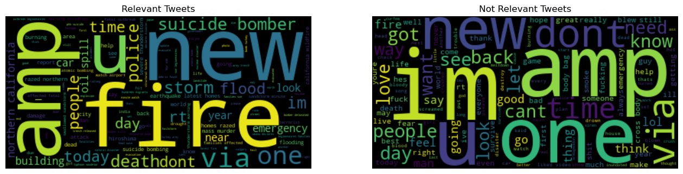
WORD CLOUD

Slide 8

WHAT ARE LSTMs?
Specifically designed for handling data sequences and patterns.
Ideal for text categorization tasks, like sorting news tweets.
Overcomes vanishing gradient issues, capturing long-term data relationships.
Comprises memory cells, control gates, and information storage.
Enables comprehensive comprehension of text and temporal connections.
Vital for accurate news tweet classification.
Offers a solution for real-time separation of important news tweets.

Slide 9
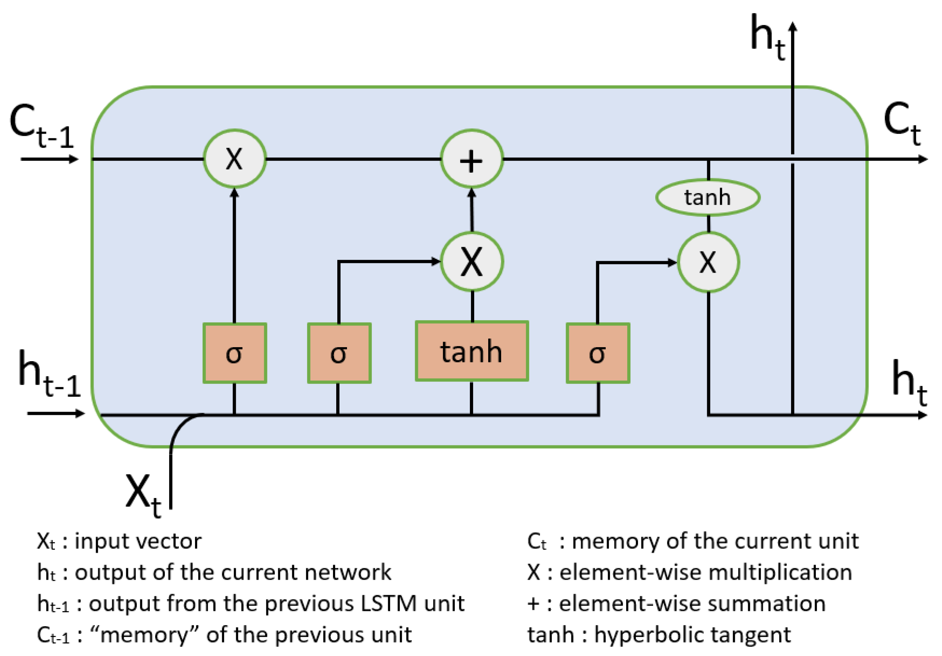
LSTM ARCHITECTURE & WORKFLOW
Information is sent through a number of gates in LSTMs that regulate the data flow. According to the supplied data, the gates can either let or prevent the data from passing through. The gates are managed by sigmoid functions, which have an output range of 0 to 1.
Additionally, LSTMs have a forget gate that has the ability to erase data from the memory cell.

Slide 10
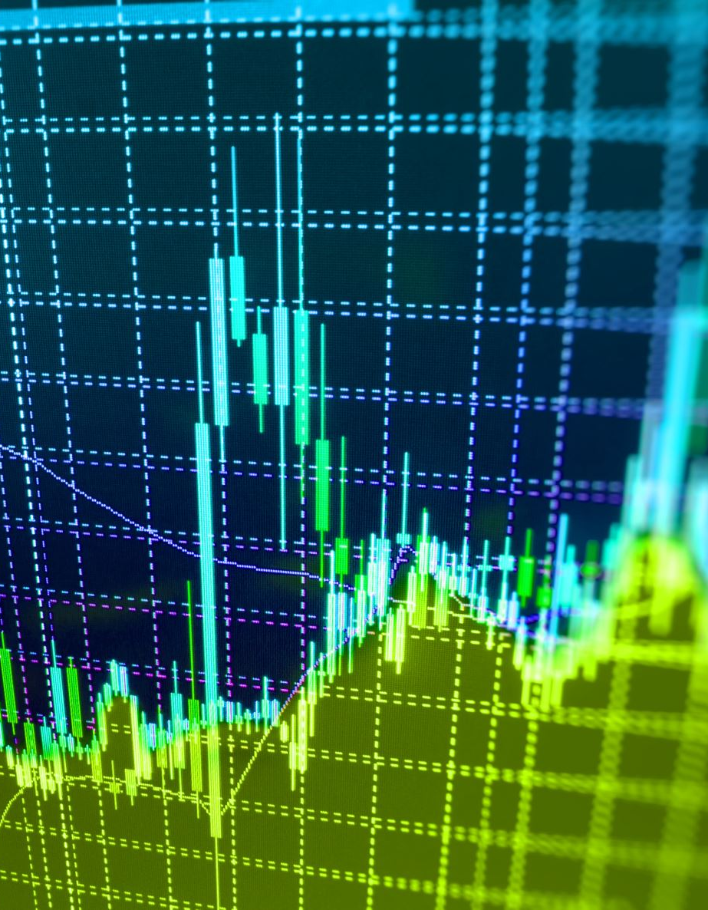
OPTIMIZING MODEL PERFORMANCE
Applied optimization techniques to reduce loss function and enhance precision.
Optimizers adjust weights and learning rates, aiding in loss reduction.
Choosing optimal weights for deep learning models is challenging due to parameter complexity.
Adam Optimizer: Achieved accuracy: 0.8387.
RMSprop Optimizer: Reached accuracy: 0.8636.
SGD Optimizer: Attained AUC: 0.5327.
AdaDelta Optimizer: AUC achieved: 0.5327.
Adamax Optimizer: AUC: 0.8566.
Bayesian Optimizer: Accuracy: 0.8086.

Slide 11
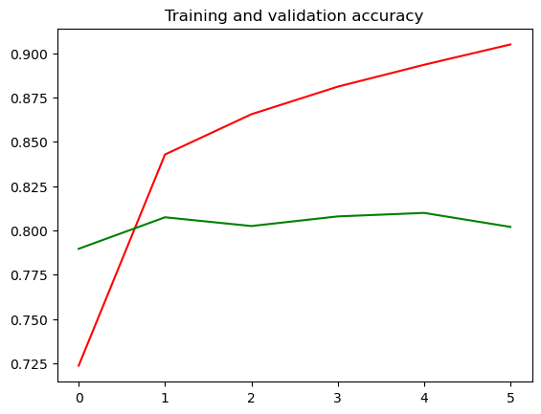
TRAINING LSTM MODEL
The labeled dataset is split into training and validation sets.
The model is trained on the training set using backpropagation and gradient descent.
Hyperparameter tuning is performed to optimize the model's performance.
While compiling we used binary cross entropy and as an optimizer, we used ADAM and RMSprop.

Slide 12
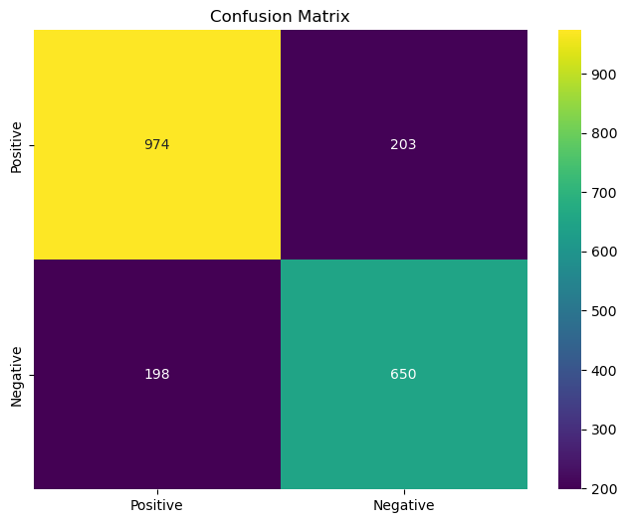
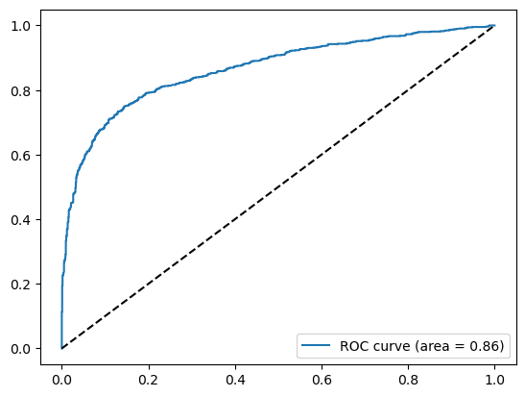
EVALUATION METRICES
The effectiveness of the LSTM model is evaluated using a variety of criteria.
The total accuracy of the model's predictions is measured by accuracy.
The model's performance is assessed individually both relevant and irrelevant news using precision, recall, and F1-score.
We obtained an accuracy of 0.8019753086419753

Slide 13

OVERCOMING OBSTACLES
The categorization of news tweets might be difficult when dealing with ambiguous tweets and noisy data.
The model's comprehension of tweet context may be strengthened by incorporating strategies like word embeddings and attention processes.
Overfitting may be avoided and generalization is enhanced by regularization strategies like dropout.

Slide 14

DASHBOARD
FLASK:
Python framework for interactive web apps.
Manages routing, templating, and dynamic content.
Integrates databases, APIs, and CSS.
Ideal for user-friendly dynamic dashboards.
RENDER:
Process of displaying dynamic content.
In Flask, uses templates and Jinja2.
Creates real-time, user-centered dashboards.

Slide 15
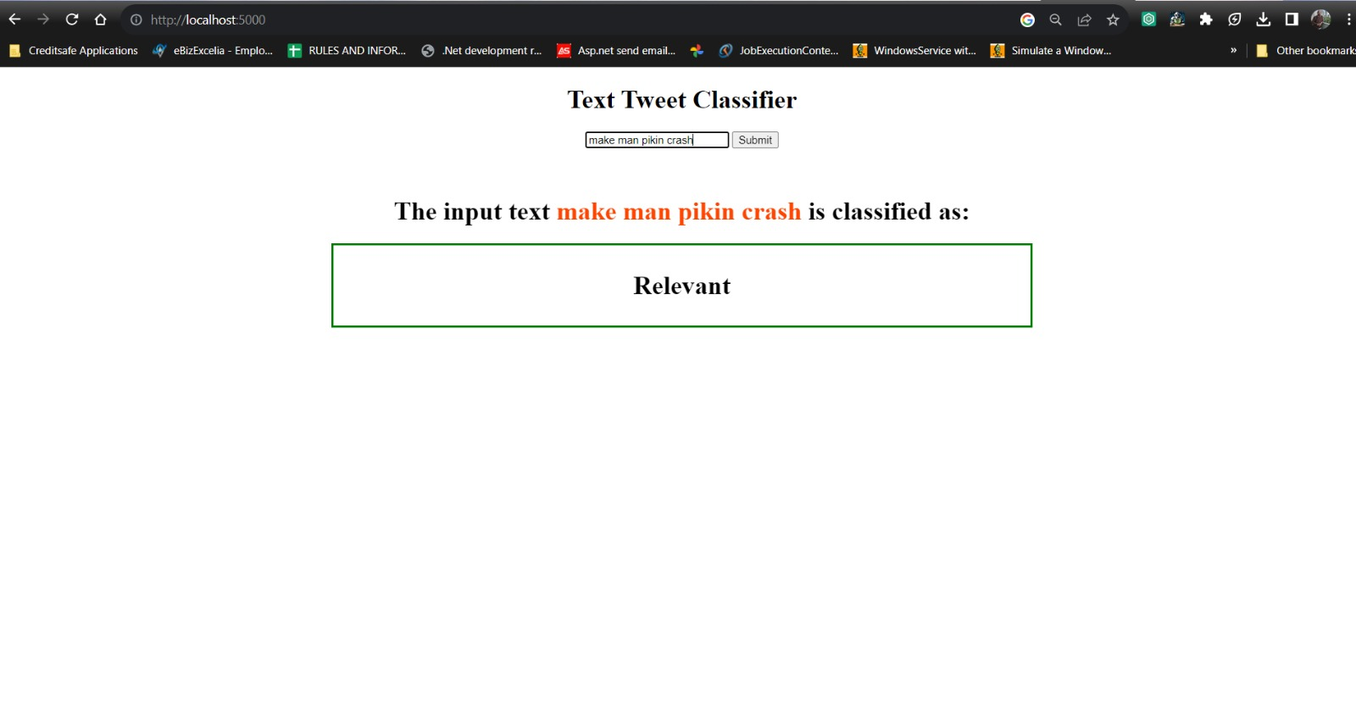
OUTPUT
The HTML code represents a basic UI for a Flask web application. This UI includes an input text box, a "Submit" button, and a space to display the classified result.
The JavaScript code captures the input value, processes it, stores a classification result in the session storage, and updates the UI to reflect the classification result UI is a simple text tweet classifier where users can enter a tweet text, click "Submit," and receive a classification result.

Slide 16
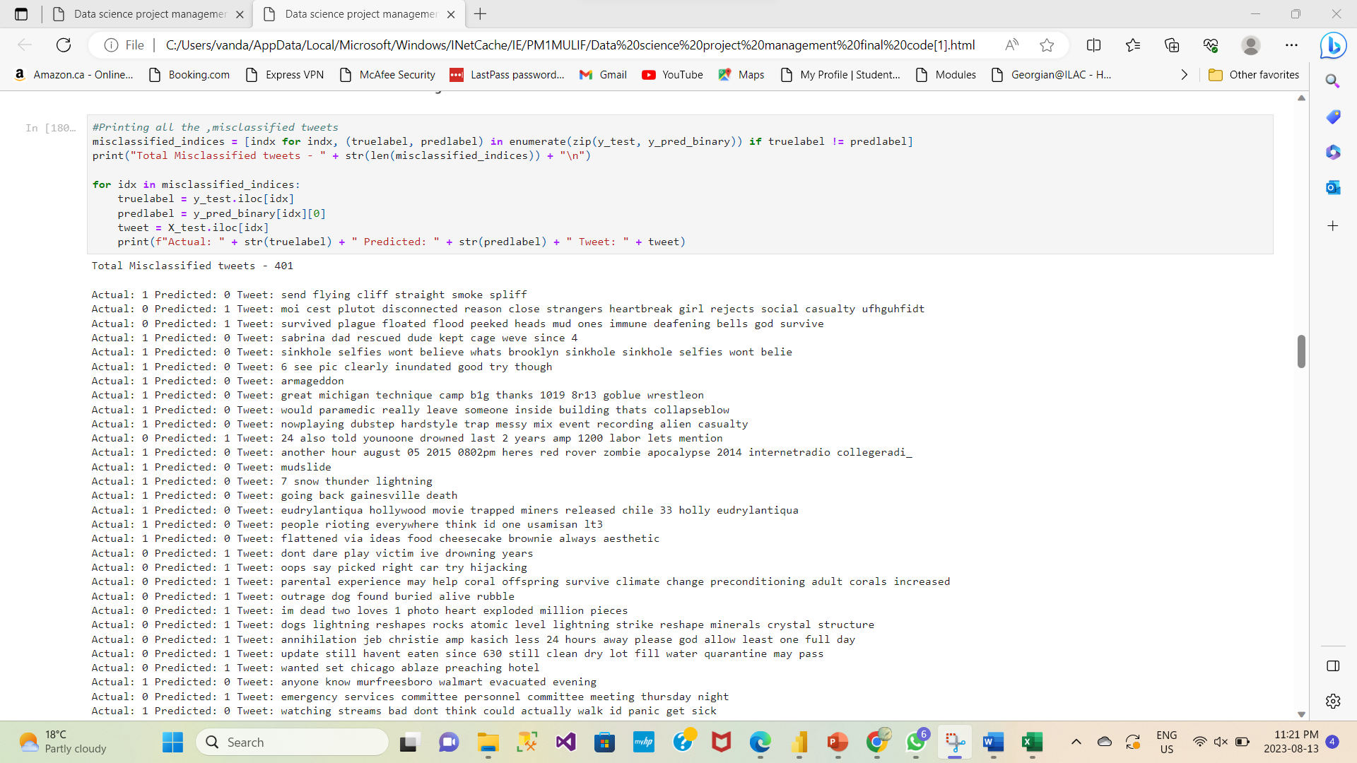
LIMITATIONS AND FUTURE DIRECTIONS
LSTM methods have a high reliance on labeled training data, which makes scaling and generalization difficult.
1
To react to changing linguistic and news trends, the model must be continuously monitored and updated.
2
For better classification accuracy, future research may investigate collaborative methods and new technologies like transformers.
3

Slide 17

CONCLUSION
In order to analyze text data and forecast its significance, LSTMs are an effective tool. When there is a need to rapidly discover critical information for breaking news articles, they can be very helpful. We can eliminate noise from social media and identify the most pertinent information by utilizing LSTMs. LSTMs will be even more crucial for processing and comprehending social media data as its volume increases.

Slide 18

REFERENCES
https://dataaspirant.com/lstm-long-short-term-memory/
https://www.geeksforgeeks.org/twitter-sentiment-analysis-webapp-using-flask/
DASHBOARD LINK
https://sampledeploymentpython.onrender.com/
GITHUB LINK
https://github.com/Sudkart/DS_ProjectManagement

