Slide 1
Contact manager
webapp

Slide 2
Team members
Dennis Gebken – Frontend
Steffen J Camarato – Frontend
Pallavi Dacre – Project Manager, API
Matthew Bonsignore – API
Adam Henderson – API
Mark Nguyen – Web hosting & Remote Database
Alexander Hunt – Web hosting & Remote Database

Slide 3
Functionalities
Providing users a secure login into a remote database
Helping users manage their contacts with the simplest interface
Add screenshots from website

Slide 4
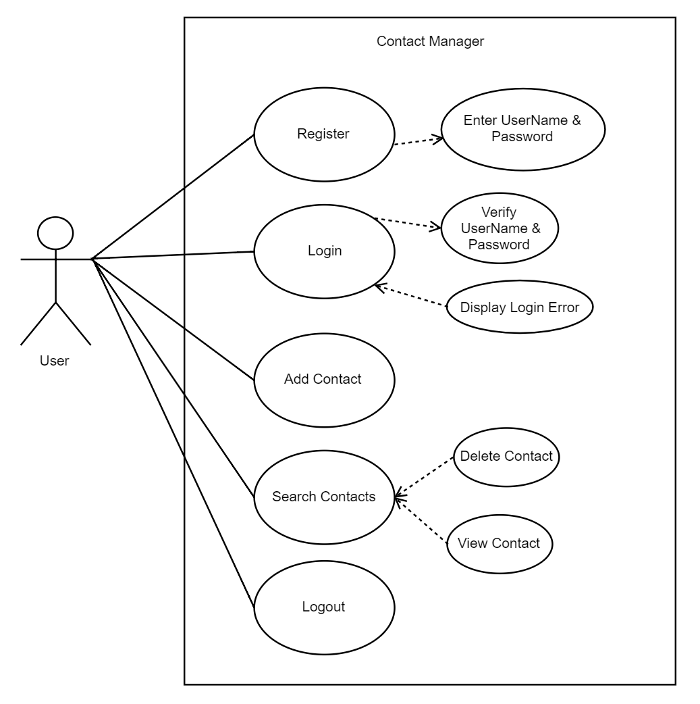
documentation
Use Case Diagram
High-level
System: Contact Manager
Actor: User (primary actor - displayed to the left)
Base Use Cases: Register, Login, Add Contact, Search Contacts, Logout
Included Use Cases: Enter UserName & Password, Verify UserName & Password
Extended Use Cases: Display Login Error, Delete Contact, View Contact; Delete and View are extended from Search, because the user must search for the contact before they can view or delete it

Slide 5
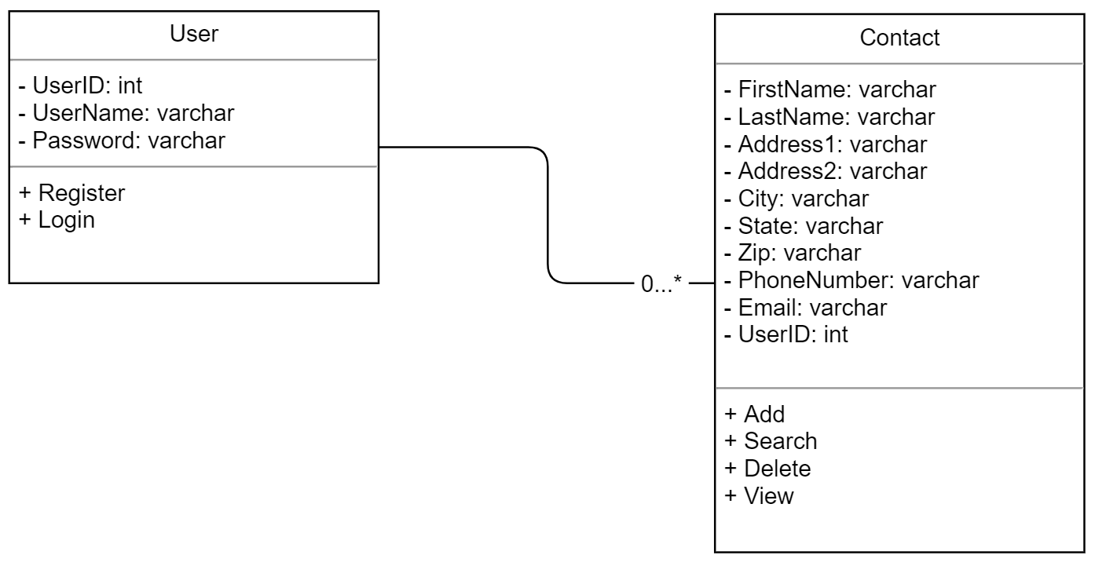
documentation
Class Diagram

Slide 6
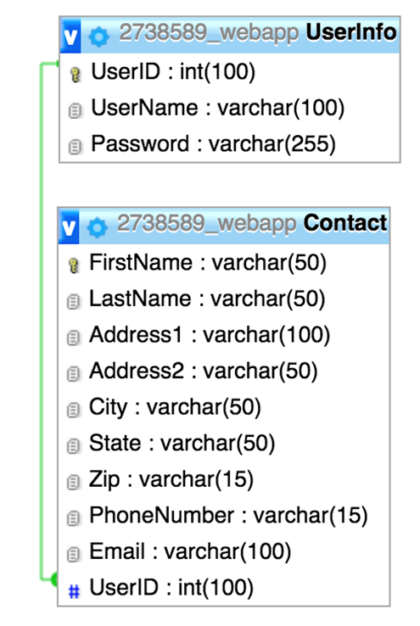
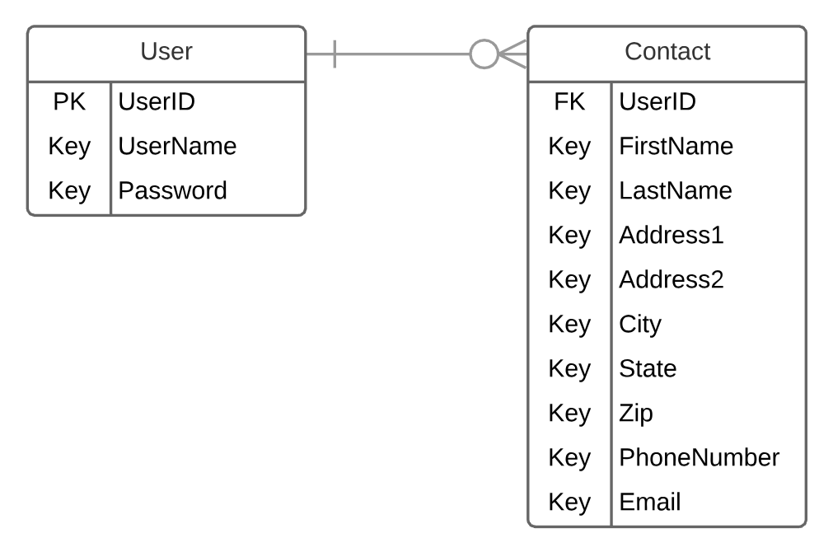
documentation
Entity Relationship Diagram

Slide 7
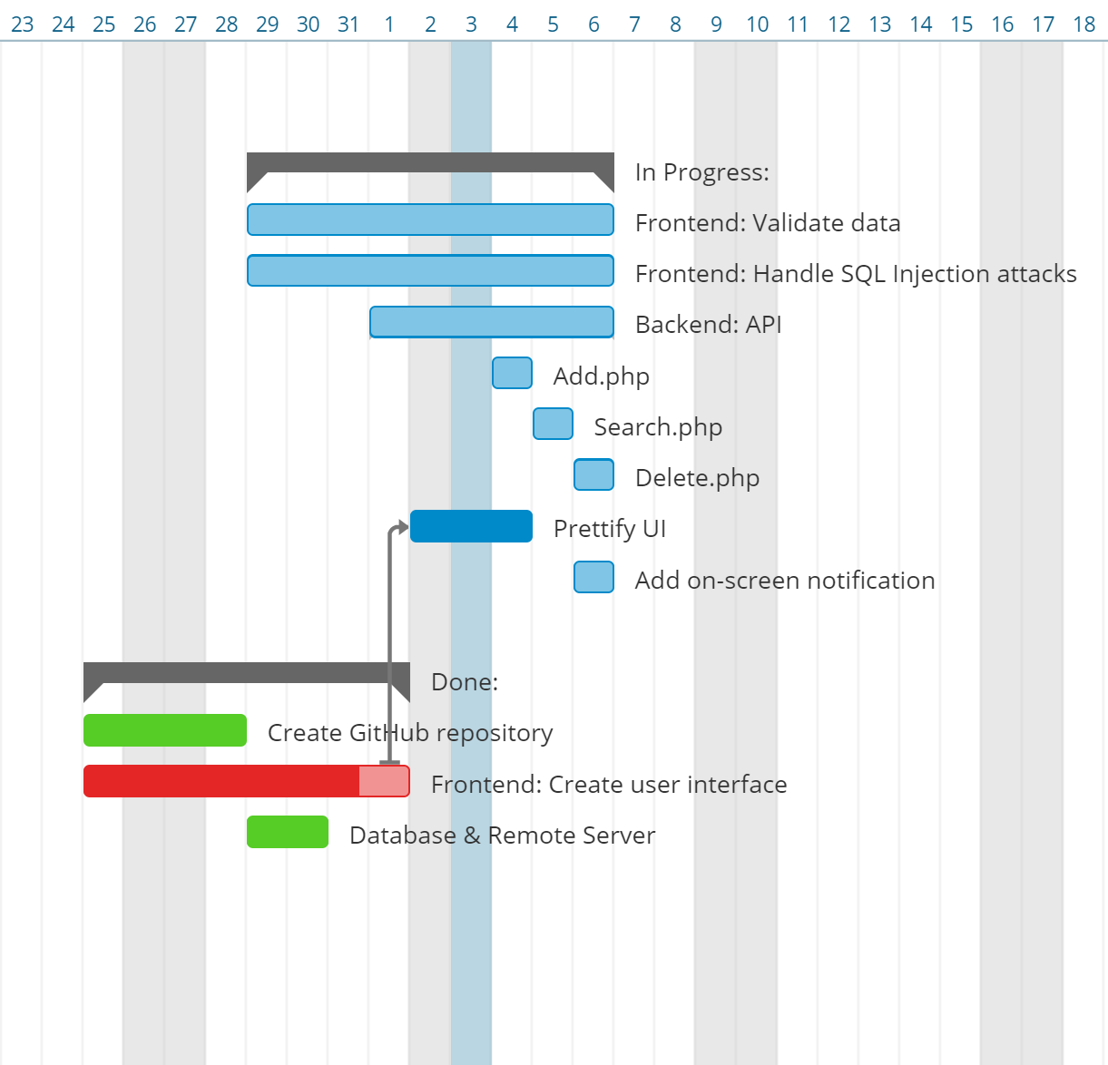
documentation
June
Gantt chart, created using Instagantt
Not that useful for small projects

Slide 8
difficulties
Frontend
API
Understanding what an API is
Learning PHP, HTML
Database and server
Having to learn from the beginning of how to run a website with remote database
The provided tool from the web hosting service is not up to date, so we implement what we need and cross fingers.

Slide 9
successes
Frontend
API
Successfully connected to our database using mysqli() and interacted with the database
Learned about database connections and how to use JSON to communicate b/w the frontend and the API
Database and server
We learned what we need to do for next time when we need to build a website.
We came up with a simple database and minimal constrain between the tables that helped the API team easily implement any query operation.

Slide 10
DEMO
Try our service out at: m4rks.site from your browser.
We have limited bandwidth, so please be patience.

Slide 11

questions

