Slide 1
Cloud base Contact manager
webapp

Slide 2
Team members
Mark Nguyen
Alexander Hunt
Pallavi Dacre
Dennis Gebken
Steffen J Camarato
Matthew Bonsignore
Adam Henderson

Slide 3
Functionalities
Providing users an secure login into a remote database.
Helping users manage their contacts with the simplest interface.

Slide 4
Team contribution
Front end:
API:
Database and server: Mark Nguyen and Alex Hunt

Slide 5
Use case diagram

Slide 6
Class diagram

Slide 7
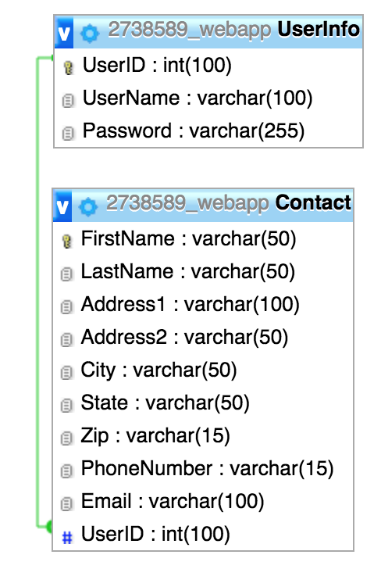
Erd(entity-relationship-model)

Slide 8
Difficulties
Front end:
API:
Database and server: Having to learn from the beginning of how to run a website with remote database. The provided tool from the web hosting service is not up to date, so we implement what we need and cross fingers.

Slide 9
successes
Front end:
API:
Database and server: We learned what we need to do for next time when we need to build a website. We come up with a simple database and minimal constrain between the tables, that may help the API team easily implement any query operation.

Slide 10
demo
Try our service out at: m4rks.site from your browser.
We have limited bandwidth, so please be patience.

Slide 11
Gantt chart

Slide 12
questions

