Slide 1


Katelyn Canedo, Aveisha Maharaj, Kayla Mastin, Alexis Haley, & Marko Vukasinovic​
March 30th
Dry Run & Weekly Update

Slide 2
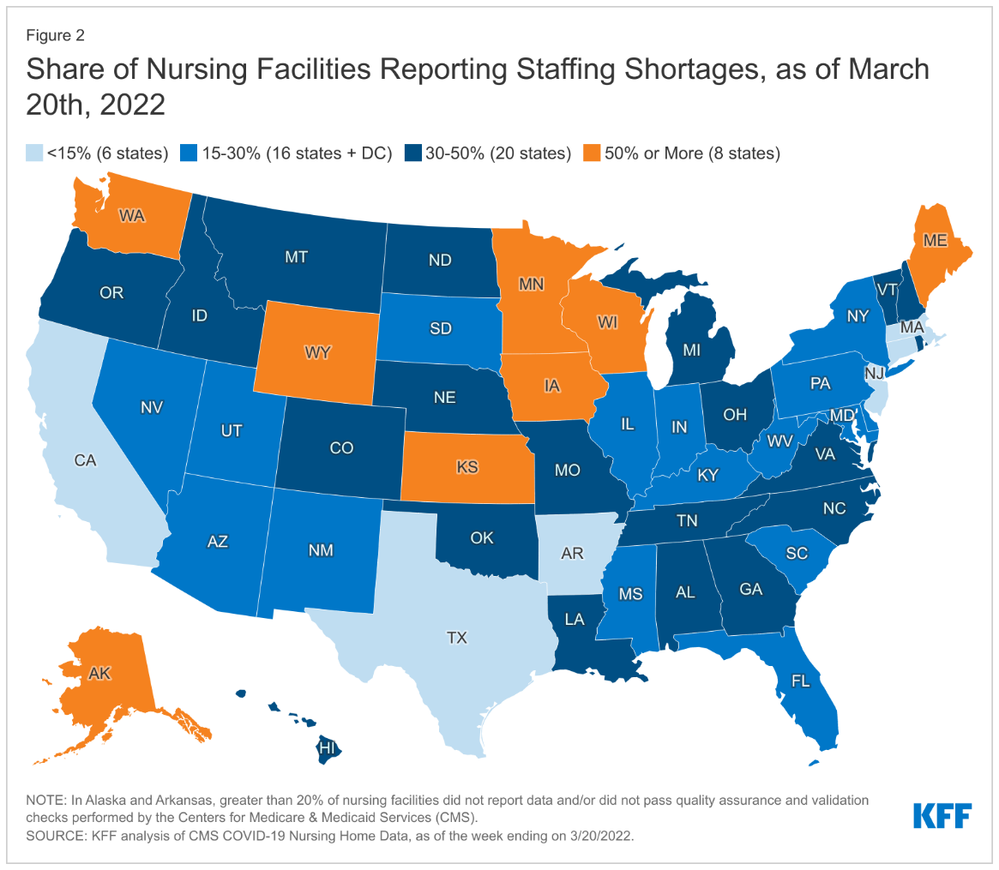
Quick Project Overview
COVID-19 pandemic caused an
influx of patients where there were
not enough hospital staff to
Accommodate
Goal of ElectroSense is to provide comfort and
close monitoring of patients within intensive
care units
Capable of monitoring heart rate, pulse oximetry, body temperature, bed temperature, and body pressure distributions
An IOS app has also been created to view the data collected from the above sensors, it also is capable of controlling heating pads and bed alarms

Slide 3
Milestone 5
Task | Progress | To Do
1. Implement, test & demo Pressure Mapping Sensor | 90% | Still need to send data through BLE module to Phone
2.Finish Testing Alarm Sensor | 100% | Will also add triggers when read levels are deemed critical
3. Finish simulating pressure sensor data and UI | 100% | UI Complete, password protected too
4. Deal with sensor concurrency issues | 100% | All issues dealt with so far

Slide 4
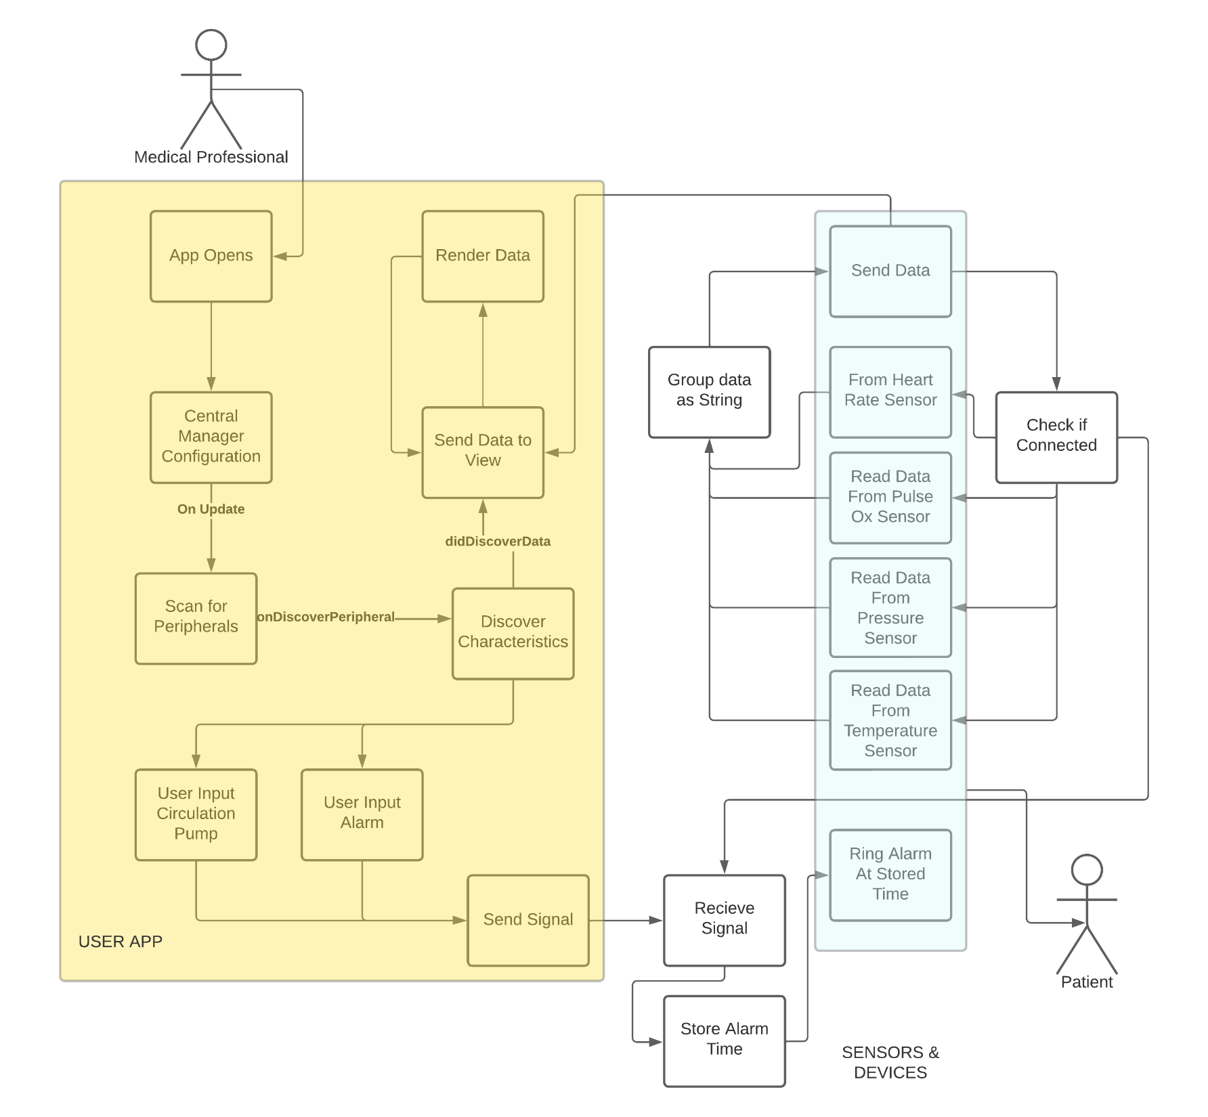

Slide 5
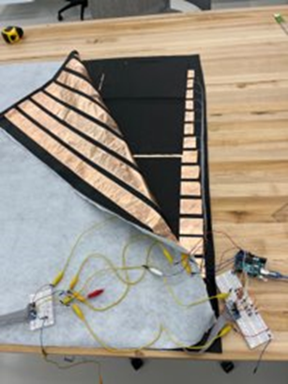
Simulated Data - Pressure
@State to_printBP = [[Double]](repeating: [Double](repeating: 0.0, count:16), count:16) //Initialize a 16x16 array of zero values
func genVals() {
generateThread() ; //GENERATE THREAD
while(self.cont_gen) {
sleep(1);
for row in 0..<limit { // FILL ARRAY WITH RANDOM VALUES
self.to_printBP1.append([Double]())
for col in 0..<limit {
self.to_printBP1[row][col] = Double.random(in: 0..<100)
}
}
}
}

Slide 6
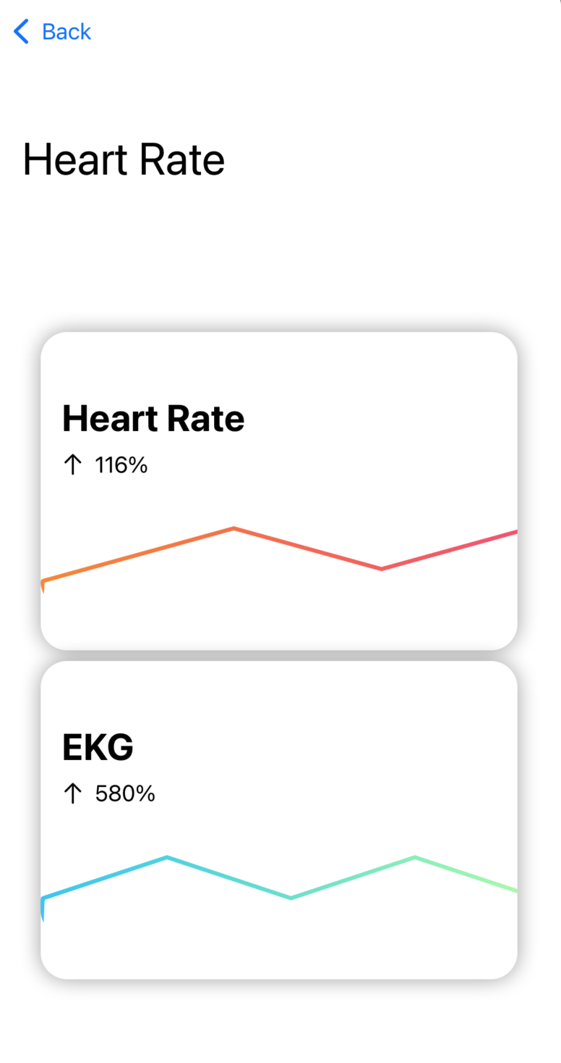
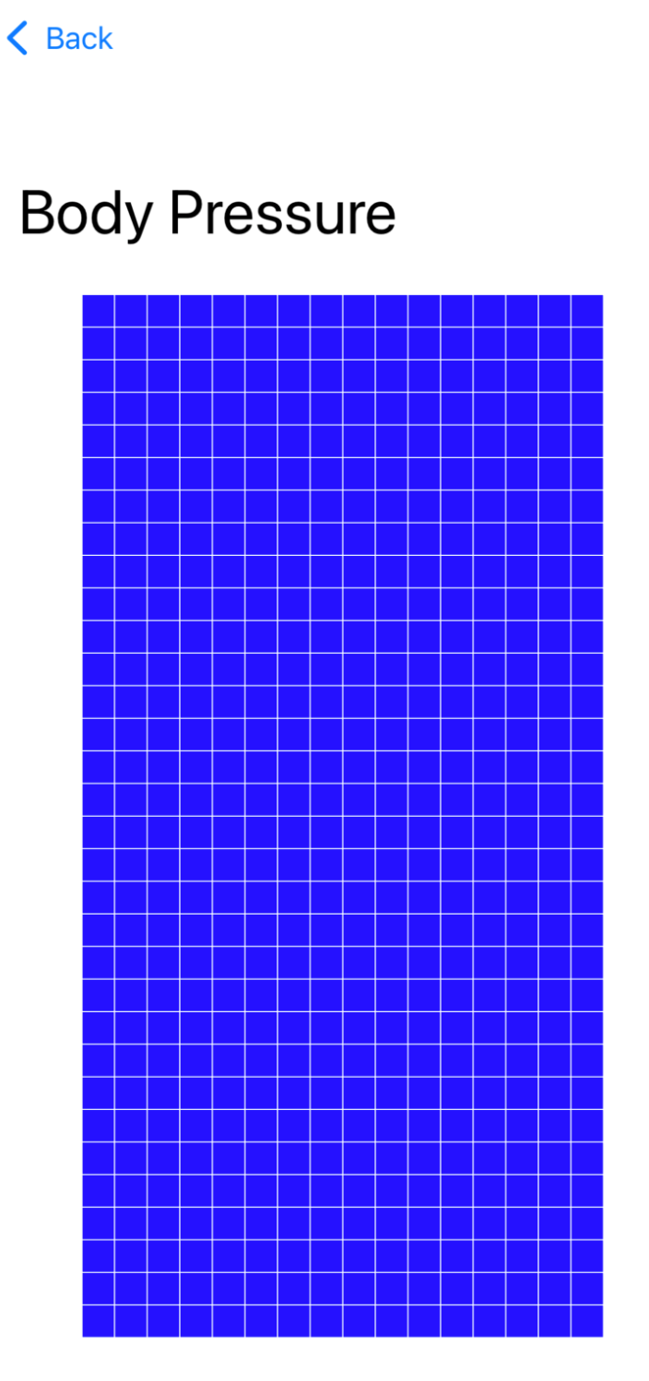
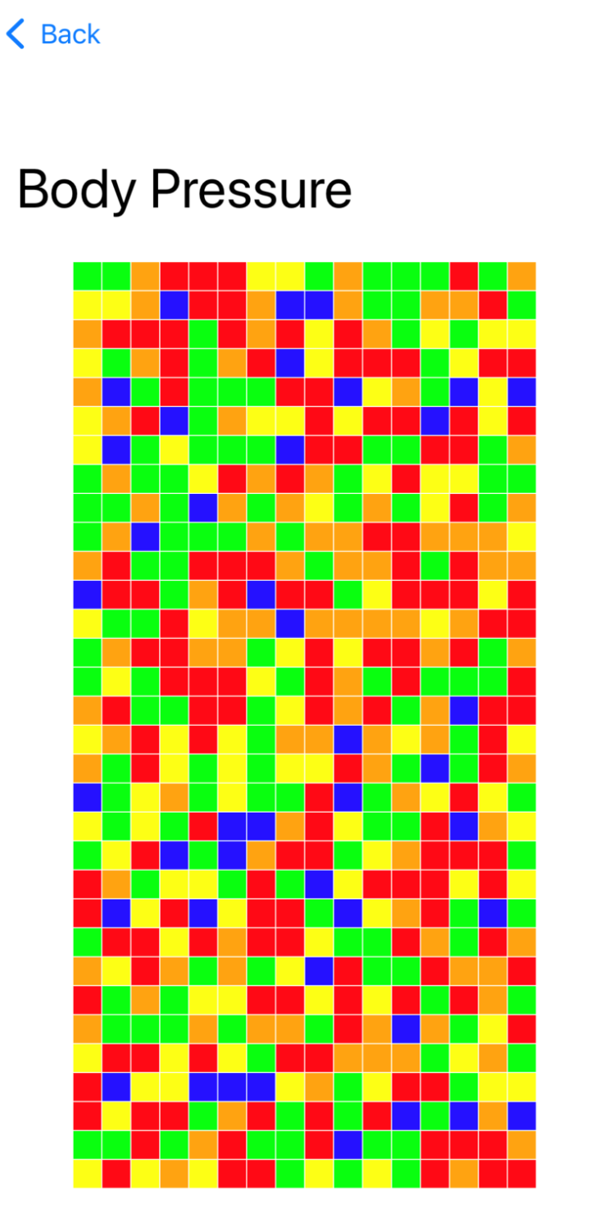
UI
generateData()

Slide 7
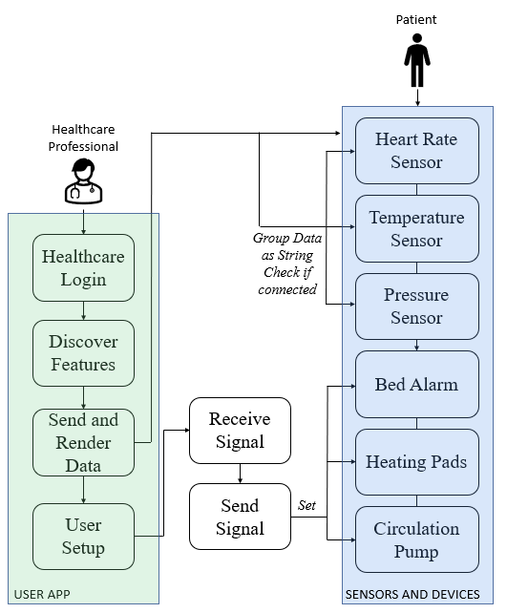
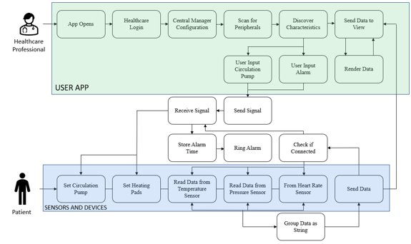
Simplified Figures
For judges’ binder
For poster

Slide 8
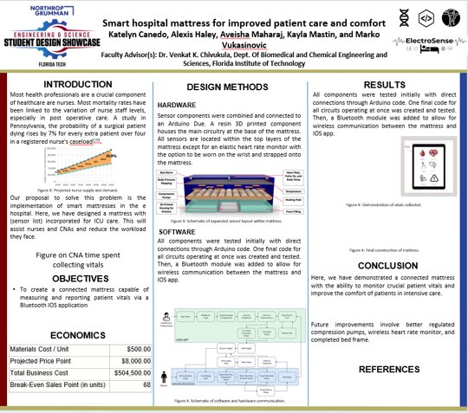

Slide 9
Milestone 6
Task | Marko
1.Iron out bugs with pressure pad | 100%
2.Circulation Pump UI | 100%
3.Full integration of the whole system/testing | 100%
4. Final presentation prep and graphics | 20%

