Slide 1

Siesta Sense
Katelyn Canedo, Aveisha Maharaj, Kayla Mastin, Alexis Haley, & Marko Vukasinovic
01/17 Presentation

Slide 2
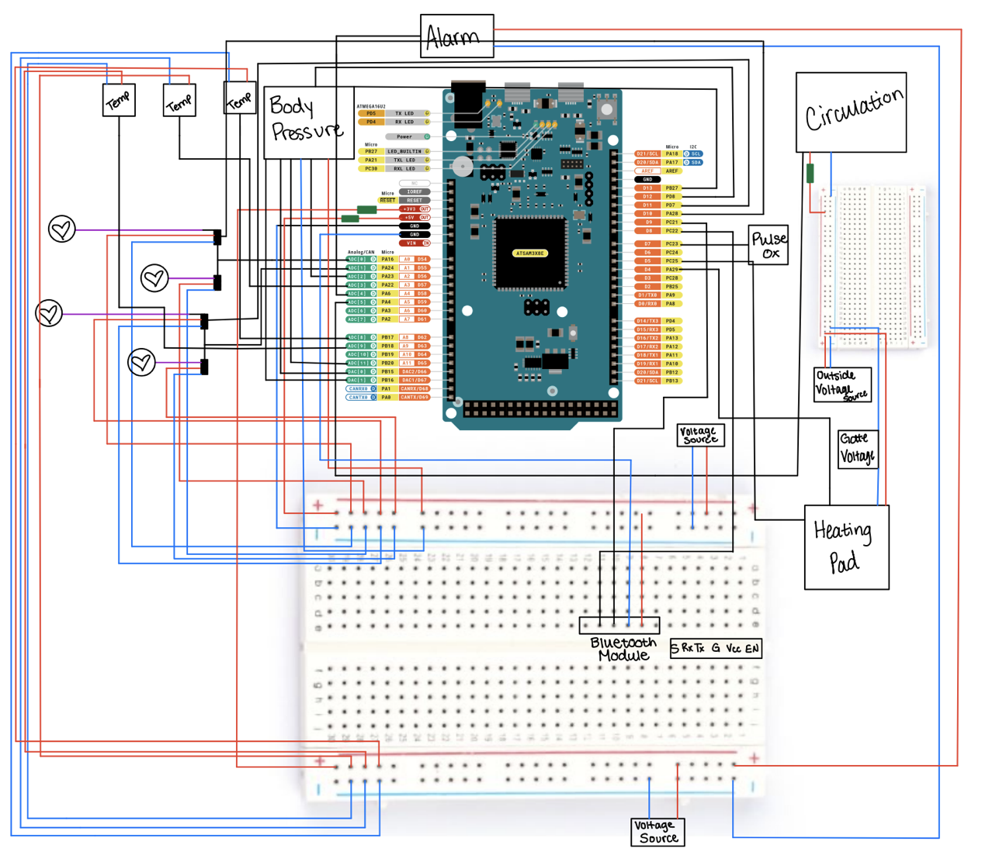
Notes:
kaitie

Slide 3
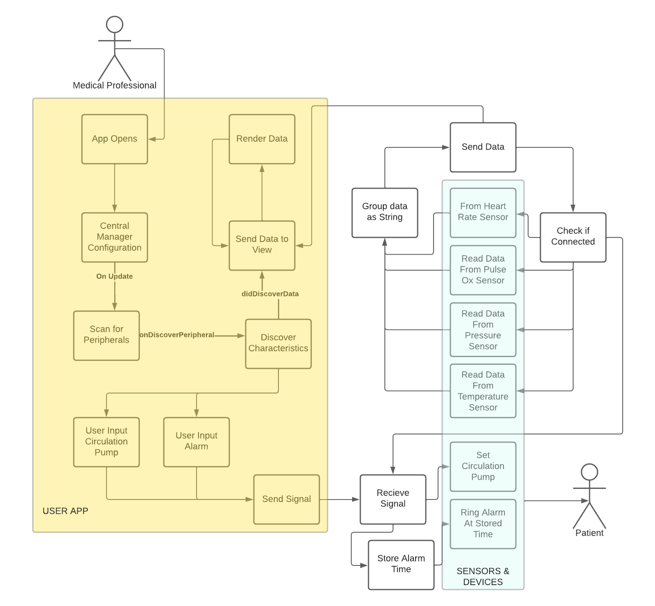
Notes:
kaitie

Slide 4
Task Matrix Milestone 4
Task | Completion
Implement, test, and demo which features/modules Alarm | 90% - Not tested with UI, just code for MOSFET
Finish simulating all of the related data streams to emulate the planned sensors in App | 90%
Improve Graphical User Interface | 90% - Need to propagate design to all displays, update icons
Send basic signal from Phone to Arduino | 100%
Notes:
alexis

Slide 5
Data Simulation Example
@State to_printHR
func genVals() {
let HR_max = 120.0; // SET INITIAL VALS
let HR_min = 60.0;
let HRdir = 0;
generateThread() ; //GENERATE THREAD
while(self.cont_gen) {
sleep(1);
// Simulate Heart Rate
if (self.to_printHR > HR_max) { // IF MORE THAN MAX CHANGE DIRECTION TO DOWN
HRdir = 0;
} else if (self.to_printHR < HR_min) { // IF LESS THAN MIN CHANGE DIRECTION TO UP
HRdir = 1;
}….
….
if (HRdir == 0) { // IF DIR DOWN LOWER STATE
self.to_printHR = self.to_printHR - 1.0;
} else {{ // IF DIR UP INCREASE NEXT STATE
self.to_printHR = self.to_printHR + 1.0;
}
}
}
Notes:
alexis

Slide 6
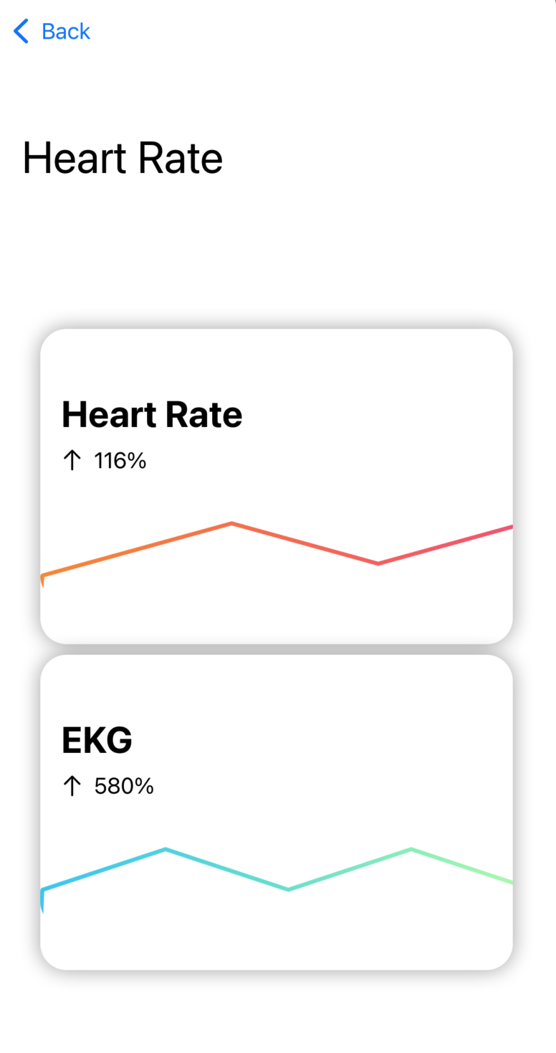
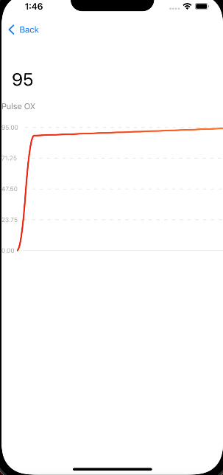
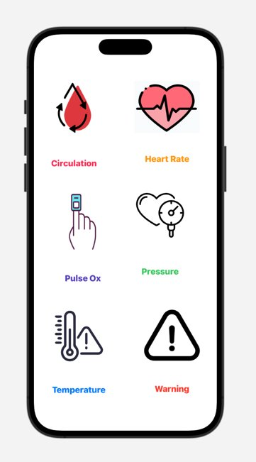
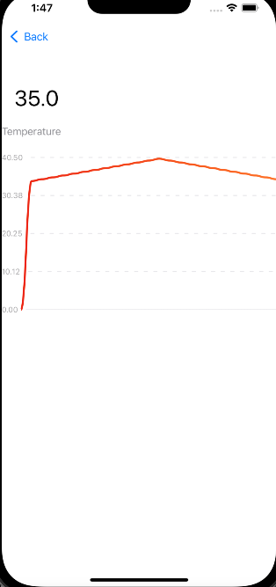
UI
Notes:
katie

Slide 7
Next Goals
Task | Marko
1. Implement, test & demo Pressure Mapping Sensor | 100%
2.Finish Testing Alarm Device | 100%
3. Finish simulating pressure sensor data and UI | 100%
4. Deal with sensor concurrency issues between Sensors | 100%

