Slide 1
CS162 Operating Systems and Systems Programming Lecture 10 Scheduling (Continued), Deadlock
February 25th, 2015
Prof. John Kubiatowicz
http://cs162.eecs.Berkeley.edu

Slide 2
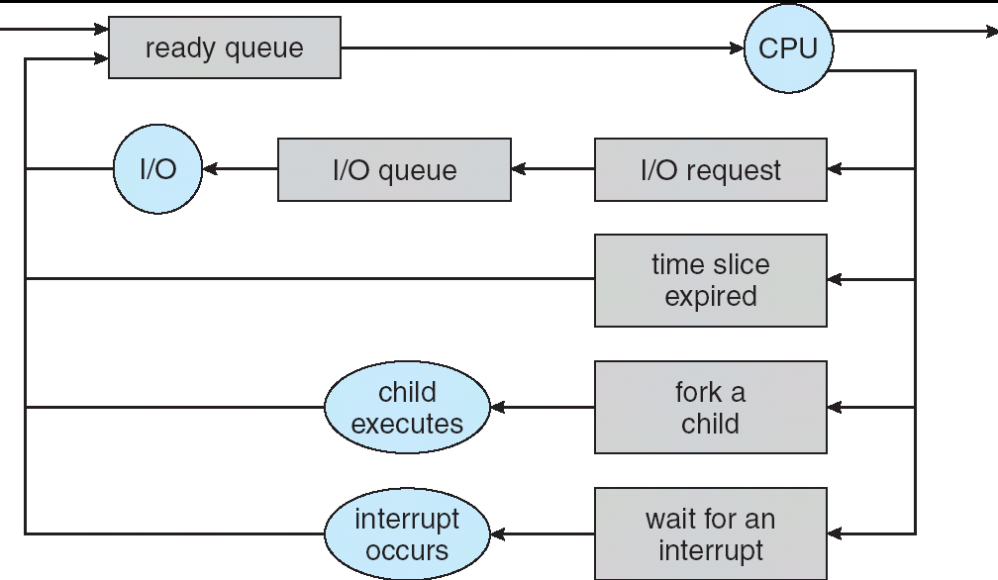
Recall: Scheduling
Question: How is the OS to decide which of several tasks to take off a queue?
Scheduling: deciding which threads are given access to resources from moment to moment
The high-level goal: Dole out CPU time to optimize some desired parameters of system
T1
T2
T3
T1
T2
Time

Slide 3
Recall: Scheduling Policy Goals/Criteria
Minimize Response Time
Minimize elapsed time to do an operation (or job)
Response time is what the user sees:
Time to echo a keystroke in editor
Time to compile a program
Real-time Tasks: Must meet deadlines imposed by World
Maximize Throughput
Maximize operations (or jobs) per second
Throughput related to response time, but not identical:
Minimizing response time will lead to more context switching than if you only maximized throughput
Two parts to maximizing throughput
Minimize overhead (for example, context-switching)
Efficient use of resources (CPU, disk, memory, etc)
Fairness
Share CPU among users in some equitable way
Fairness is not minimizing average response time:
Better average response time by making system less fair
Notes:
What does CPU scheduling have to do with efficient use of the disk?
A lot! Have to have the CPU to make a disk request
Fairness: Minimize # of angry phone calls? Minimize my response time?

Slide 4
Recall: First-Come, First-Served (FCFS) Scheduling
First-Come, First-Served (FCFS)
Also “First In, First Out” (FIFO) or “Run until done”
In early systems, FCFS meant one program scheduled until done (including I/O)
Now, means keep CPU until thread blocks
Example: Process Burst Time P₁ 24 P₂ 3 P₃ 3
Suppose processes arrive in the order: P₁ , P₂ , P₃ The Gantt Chart for the schedule is:
Waiting time for P₁ = 0; P₂ = 24; P₃ = 27
Average waiting time: (0 + 24 + 27)/3 = 17
Average Completion time: (24 + 27 + 30)/3 = 27
Convoy effect: short process behind long process
P₁
P₂
P₃
0
24
27
30

Slide 5
Round Robin (RR)
FCFS Scheme: Potentially bad for short jobs!
Depends on submit order
If you are first in line at supermarket with milk, you don’t care who is behind you, on the other hand…
Round Robin Scheme
Each process gets a small unit of CPU time (time quantum), usually 10-100 milliseconds
After quantum expires, the process is preempted and added to the end of the ready queue.
n processes in ready queue and time quantum is q ⇒
Each process gets 1/n of the CPU time
In chunks of at most q time units
No process waits more than (n-1)q time units
Performance
q large ⇒ FCFS
q small ⇒ Interleaved (really small ⇒ hyperthreading?)
q must be large with respect to context switch, otherwise overhead is too high (all overhead)

Slide 6
Example of RR with Time Quantum = 20
Example: Process Burst Time P₁ 53 P₂ 8 P₃ 68 P₄ 24
The Gantt chart is:
Waiting time for P₁=(68-20)+(112-88)=72 P₂=(20-0)=20 P₃=(28-0)+(88-48)+(125-108)=85 P₄=(48-0)+(108-68)=88
Average waiting time = (72+20+85+88)/4=66¼
Average completion time = (125+28+153+112)/4 = 104½
Thus, Round-Robin Pros and Cons:
Better for short jobs, Fair (+)
Context-switching time adds up for long jobs (-)
P₁
P₂
P₃
P₄
P₁
P₃
P₄
P₁
P₃
P₃
0
20
28
48
68
88
108
112
125
145
153

Slide 7
Round-Robin Discussion
How do you choose time slice?
What if too big?
Response time suffers
What if infinite (∞)?
Get back FIFO
What if time slice too small?
Throughput suffers!
Actual choices of timeslice:
Initially, UNIX timeslice one second:
Worked ok when UNIX was used by one or two people.
What if three compilations going on? 3 seconds to echo each keystroke!
In practice, need to balance short-job performance and long-job throughput:
Typical time slice today is between 10ms – 100ms
Typical context-switching overhead is 0.1ms – 1ms
Roughly 1% overhead due to context-switching

Slide 8
Comparisons between FCFS and Round Robin
Assuming zero-cost context-switching time, is RR always better than FCFS?
Simple example: 10 jobs, each take 100s of CPU time RR scheduler quantum of 1s All jobs start at the same time
Completion Times:
Both RR and FCFS finish at the same time
Average response time is much worse under RR!
Bad when all jobs same length
Also: Cache state must be shared between all jobs with RR but can be devoted to each job with FIFO
Total time for RR longer even for zero-cost switch!
Job # | FIFO | RR
1 | 100 | 991
2 | 200 | 992
… | … | …
9 | 900 | 999
10 | 1000 | 1000

Slide 9
Earlier Example with Different Time Quantum
P₂
[8]
P₄
[24]
P₁
[53]
P₃
[68]
Best FCFS:
0
8
32
85
153
Quantum
P₁
P₂
P₃
P₄
Average
Wait
Time
Best FCFS
32
0
85
8
31¼
Q = 1
84
22
85
57
62
Q = 5
82
20
85
58
61¼
Q = 8
80
8
85
56
57¼
Q = 10
82
10
85
68
61¼
Q = 20
72
20
85
88
66¼
Worst FCFS
68
145
0
121
83½
Completion
Time
Best FCFS
85
8
153
32
69½
Q = 1
137
30
153
81
100½
Q = 5
135
28
153
82
99½
Q = 8
133
16
153
80
95½
Q = 10
135
18
153
92
99½
Q = 20
125
28
153
112
104½
Worst FCFS
121
153
68
145
121¾

Slide 10
Handling differences in importance: Strict Priority Scheduling
Priority 3
Job 1
Job 2
Job 3
Priority 2
Job 4
Priority 1
Priority 0
Job 5
Job 6
Job 7
Execution Plan
Always execute highest-priority runable jobs to completion
Problems:
Starvation:
Lower priority jobs don’t get to run because higher priority tasks always running
Deadlock: Priority Inversion
Not strictly a problem with priority scheduling, but happens when low priority task has lock needed by high-priority task
Usually involves third, intermediate priority task that keeps running even though high-priority task should be running
How to fix problems?
Dynamic priorities – adjust base-level priority up or down based on heuristics about interactivity, locking, burst behavior, etc…

Slide 11
Scheduling Fairness
What about fairness?
Strict fixed-priority scheduling between queues is unfair (run highest, then next, etc):
long running jobs may never get CPU
In Multics, shut down machine, found 10-year-old job
Must give long-running jobs a fraction of the CPU even when there are shorter jobs to run
Tradeoff: fairness gained by hurting avg response time!
How to implement fairness?
Could give each queue some fraction of the CPU
What if one long-running job and 100 short-running ones?
Like express lanes in a supermarket—sometimes express lanes get so long, get better service by going into one of the other lines
Could increase priority of jobs that don’t get service
What is done in some variants of UNIX
This is ad hoc—what rate should you increase priorities?
And, as system gets overloaded, no job gets CPU time, so everyone increases in priority⇒Interactive jobs suffer

Slide 12
Lottery Scheduling
Yet another alternative: Lottery Scheduling
Give each job some number of lottery tickets
On each time slice, randomly pick a winning ticket
On average, CPU time is proportional to number of tickets given to each job
How to assign tickets?
To approximate SRTF, short running jobs get more, long running jobs get fewer
To avoid starvation, every job gets at least one ticket (everyone makes progress)
Advantage over strict priority scheduling: behaves gracefully as load changes
Adding or deleting a job affects all jobs proportionally, independent of how many tickets each job possesses

Slide 13
Lottery Scheduling Example
Lottery Scheduling Example
Assume short jobs get 10 tickets, long jobs get 1 ticket
What if too many short jobs to give reasonable response time?
If load average is 100, hard to make progress
One approach: log some user out
# short jobs/ # long jobs | % of CPU each short jobs gets | % of CPU each long jobs gets
1/1 | 91% | 9%
0/2 | N/A | 50%
2/0 | 50% | N/A
10/1 | 9.9% | 0.99%
1/10 | 50% | 5%

Slide 14
Administrivia
Exam in 2 weeks (Wednesday, March 11)?
Still trying to get room, so may move
2-hour exam in 3-hour slot
1 page of hand-written notes, both sides
Evening exam, no class that day
Technically, material up to previous Monday fair game
Checkpoint #2 due on Friday
Getting close to time for a survey to see how things are going…

Slide 15
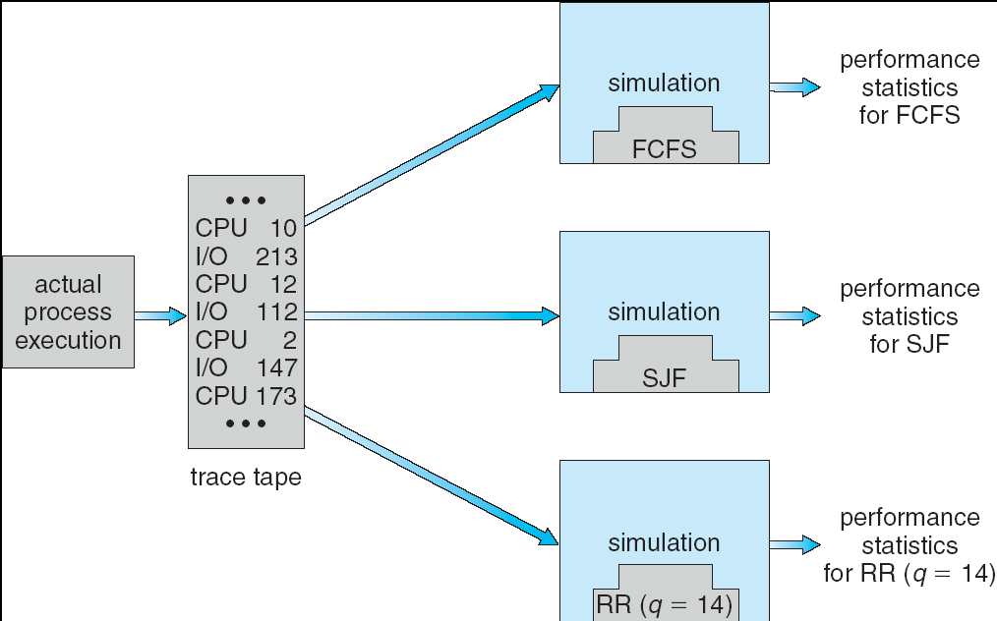
How to Evaluate a Scheduling algorithm?
Deterministic modeling
takes a predetermined workload and compute the performance of each algorithm for that workload
Queueing models
Mathematical approach for handling stochastic workloads
Implementation/Simulation:
Build system which allows actual algorithms to be run against actual data. Most flexible/general.

Slide 16
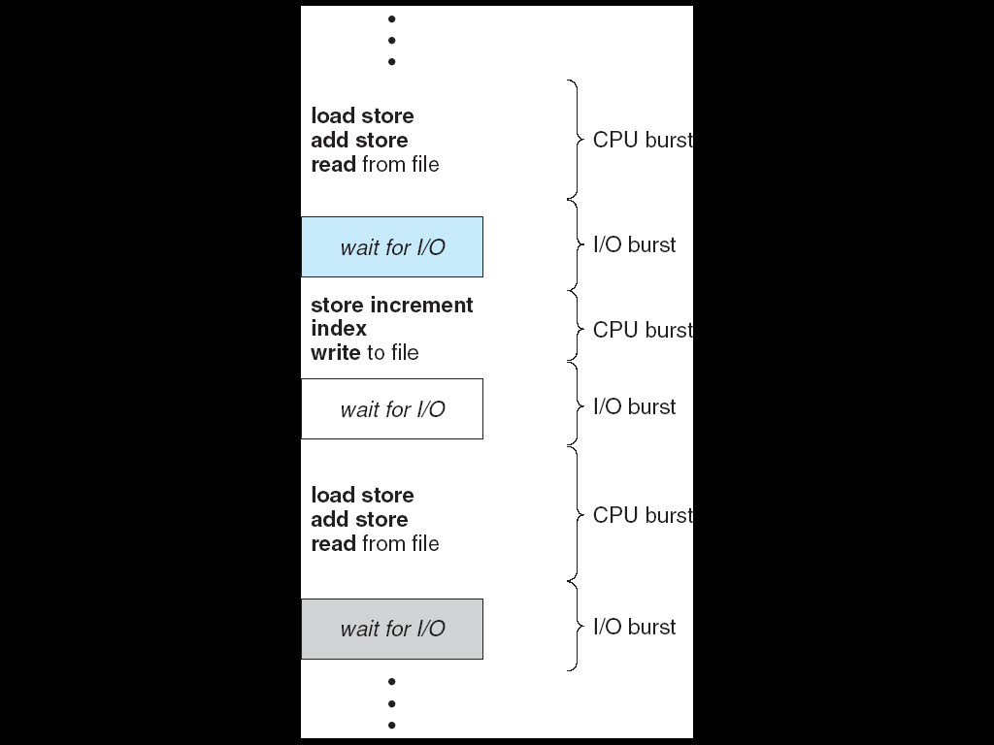
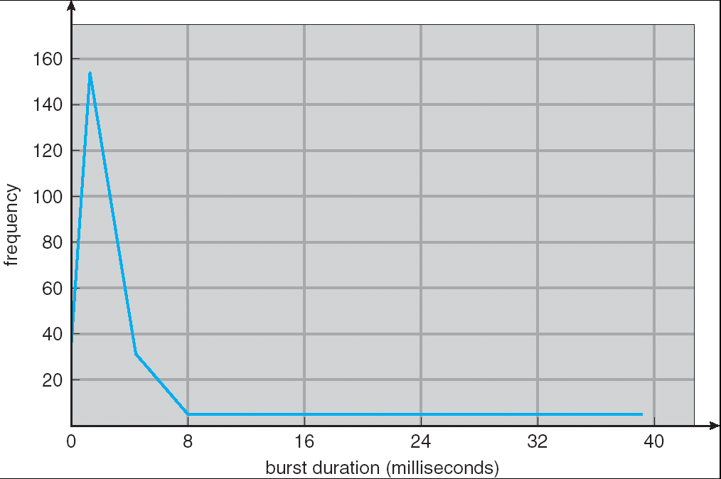
Recall: CPU Burst Behavior
Weighted toward small bursts
Execution model: programs alternate between bursts of CPU and I/O
Program typically uses the CPU for some period of time, then does I/O, then uses CPU again
Each scheduling decision is about which job to give to the CPU for use by its next CPU burst
With timeslicing, thread may be forced to give up CPU before finishing current CPU burst

Slide 17
How to handle simultaneous mix of different types of applications?
Can we use Burst Time (observed) to decide which application gets CPU time?
Consider mix of interactive and high throughput apps:
How to best schedule them?
How to recognize one from the other?
Do you trust app to say that it is “interactive”?
Should you schedule the set of apps identically on servers, workstations, pads, and cellphones?
Assumptions encoded into many schedulers:
Apps that sleep a lot and have short bursts must be interactive apps – they should get high priority
Apps that compute a lot should get low(er?) priority, since they won’t notice intermittent bursts from interactive apps
Hard to characterize apps:
What about apps that sleep for a long time, but then compute for a long time?
Or, what about apps that must run under all circumstances (say periodically)

Slide 18
What if we Knew the Future?
Could we always mirror best FCFS?
Shortest Job First (SJF):
Run whatever job has the least amount of computation to do
Sometimes called “Shortest Time to Completion First” (STCF)
Shortest Remaining Time First (SRTF):
Preemptive version of SJF: if job arrives and has a shorter time to completion than the remaining time on the current job, immediately preempt CPU
Sometimes called “Shortest Remaining Time to Completion First” (SRTCF)
These can be applied either to a whole program or the current CPU burst of each program
Idea is to get short jobs out of the system
Big effect on short jobs, only small effect on long ones
Result is better average response time
Notes:
Rich get richer, and poor get poorer = short jobs get through the system faster, long jobs take even longer

Slide 19
Discussion
SJF/SRTF are the best you can do at minimizing average response time
Provably optimal (SJF among non-preemptive, SRTF among preemptive)
Since SRTF is always at least as good as SJF, focus on SRTF
Comparison of SRTF with FCFS and RR
What if all jobs the same length?
SRTF becomes the same as FCFS (i.e. FCFS is best can do if all jobs the same length)
What if jobs have varying length?
SRTF (and RR): short jobs not stuck behind long ones

Slide 20
Example to illustrate benefits of SRTF
A or B
C
C’s
I/O
C’s
I/O
C’s
I/O
Three jobs:
A,B: both CPU bound, run for week C: I/O bound, loop 1ms CPU, 9ms disk I/O
If only one at a time, C uses 90% of the disk, A or B could use 100% of the CPU
With FIFO:
Once A or B get in, keep CPU for two weeks
What about RR or SRTF?
Easier to see with a timeline

Slide 21
SRTF Example continued:
Disk Utilization:
9/201 ~ 4.5%
C
A
B
C
RR 100ms time slice
Disk Utilization:
~90% but lots of wakeups!
C’s
I/O
C’s
I/O
CABAB…
C
RR 1ms time slice
C’s
I/O
C’s
I/O
Disk Utilization:
90%
C
A
A
A
SRTF
C’s
I/O
C’s
I/O

Slide 22
SRTF Further discussion
Starvation
SRTF can lead to starvation if many small jobs!
Large jobs never get to run
Somehow need to predict future
How can we do this?
Some systems ask the user
When you submit a job, have to say how long it will take
To stop cheating, system kills job if takes too long
But: Even non-malicious users have trouble predicting runtime of their jobs
Bottom line, can’t really know how long job will take
However, can use SRTF as a yardstick for measuring other policies
Optimal, so can’t do any better
SRTF Pros & Cons
Optimal (average response time) (+)
Hard to predict future (-)
Unfair (-)

Slide 23
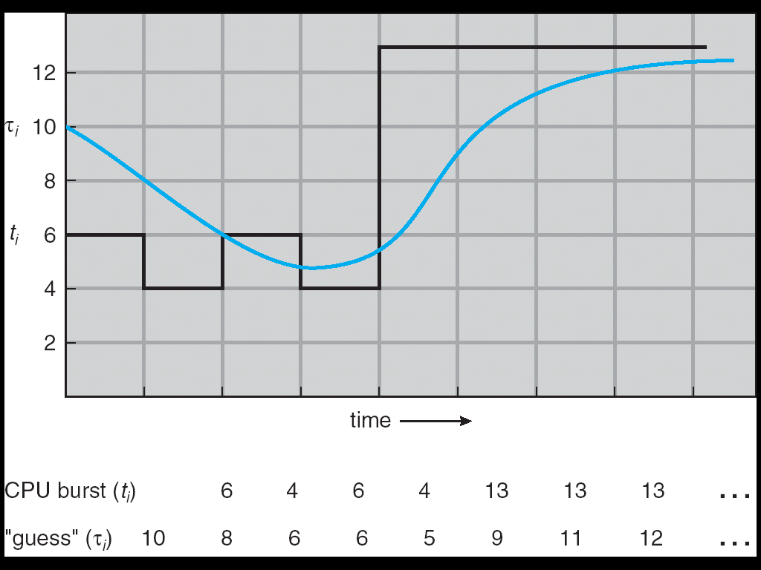
Predicting the Length of the Next CPU Burst
Adaptive: Changing policy based on past behavior
CPU scheduling, in virtual memory, in file systems, etc
Works because programs have predictable behavior
If program was I/O bound in past, likely in future
If computer behavior were random, wouldn’t help
Example: SRTF with estimated burst length
Use an estimator function on previous bursts: Let t_{n-1}, t_{n-2}, t_{n-3}, etc. be previous CPU burst lengths. Estimate next burst τ_{n} = f(t_{n-1}, t_{n-2}, t_{n-3}, …)
Function f could be one of many different time series estimation schemes (Kalman filters, etc)
For instance, exponential averaging τ_{n} = αt_{n-1}+(1-α)τ_{n-1} with (0<α≤1)

Slide 24
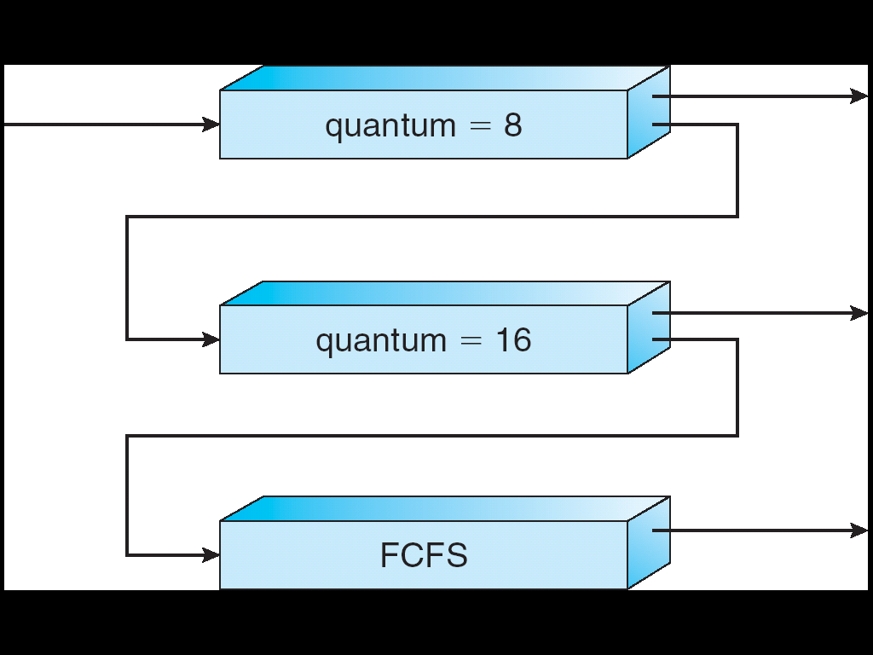
Multi-Level Feedback Scheduling
Another method for exploiting past behavior
First used in CTSS
Multiple queues, each with different priority
Higher priority queues often considered “foreground” tasks
Each queue has its own scheduling algorithm
e.g. foreground – RR, background – FCFS
Sometimes multiple RR priorities with quantum increasing exponentially (highest:1ms, next:2ms, next: 4ms, etc)
Adjust each job’s priority as follows (details vary)
Job starts in highest priority queue
If timeout expires, drop one level
If timeout doesn’t expire, push up one level (or to top)
Long-Running Compute Tasks Demoted to Low Priority

Slide 25
Scheduling Details
Result approximates SRTF:
CPU bound jobs drop like a rock
Short-running I/O bound jobs stay near top
Scheduling must be done between the queues
Fixed priority scheduling:
serve all from highest priority, then next priority, etc.
Time slice:
each queue gets a certain amount of CPU time
e.g., 70% to highest, 20% next, 10% lowest
Countermeasure: user action that can foil intent of the OS designer
For multilevel feedback, put in a bunch of meaningless I/O to keep job’s priority high
Of course, if everyone did this, wouldn’t work!
Example of Othello program:
Playing against competitor, so key was to do computing at higher priority the competitors.
Put in printf’s, ran much faster!

Slide 26
Case Study: Linux O(1) Scheduler
Kernel/Realtime Tasks
User Tasks
0
100
139
Priority-based scheduler: 140 priorities
40 for “user tasks” (set by “nice”), 100 for “Realtime/Kernel”
Lower priority value ⇒ higher priority (for nice values)
Highest priority value ⇒ Lower priority (for realtime values)
All algorithms O(1)
Timeslices/priorities/interactivity credits all computed when job finishes time slice
140-bit bit mask indicates presence or absence of job at given priority level
Two separate priority queues: “active” and “expired”
All tasks in the active queue use up their timeslices and get placed on the expired queue, after which queues swapped
Timeslice depends on priority – linearly mapped onto timeslice range
Like a multi-level queue (one queue per priority) with different timeslice at each level
Execution split into “Timeslice Granularity” chunks – round robin through priority

Slide 27
O(1) Scheduler Continued
Heuristics
User-task priority adjusted ±5 based on heuristics
p->sleep_avg = sleep_time – run_time
Higher sleep_avg ⇒ more I/O bound the task, more reward (and vice versa)
Interactive Credit
Earned when a task sleeps for a “long” time
Spend when a task runs for a “long” time
IC is used to provide hysteresis to avoid changing interactivity for temporary changes in behavior
However, “interactive tasks” get special dispensation
To try to maintain interactivity
Placed back into active queue, unless some other task has been starved for too long…
Real-Time Tasks
Always preempt non-RT tasks
No dynamic adjustment of priorities
Scheduling schemes:
SCHED_FIFO: preempts other tasks, no timeslice limit
SCHED_RR: preempts normal tasks, RR scheduling amongst tasks of same priority

Slide 28
Linux Completely Fair Scheduler (CFS)
First appeared in 2.6.23, modified in 2.6.24
“CFS doesn't track sleeping time and doesn't use heuristics to identify interactive tasks—it just makes sure every process gets a fair share of CPU within a set amount of time given the number of runnable processes on the CPU.”
Inspired by Networking “Fair Queueing”
Each process given their fair share of resources
Models an “ideal multitasking processor” in which N processes execute simultaneously as if they truly got 1/N of the processor
Tries to give each process an equal fraction of the processor
Priorities reflected by weights such that increasing a task’s priority by 1 always gives the same fractional increase in CPU time – regardless of current priority

Slide 29
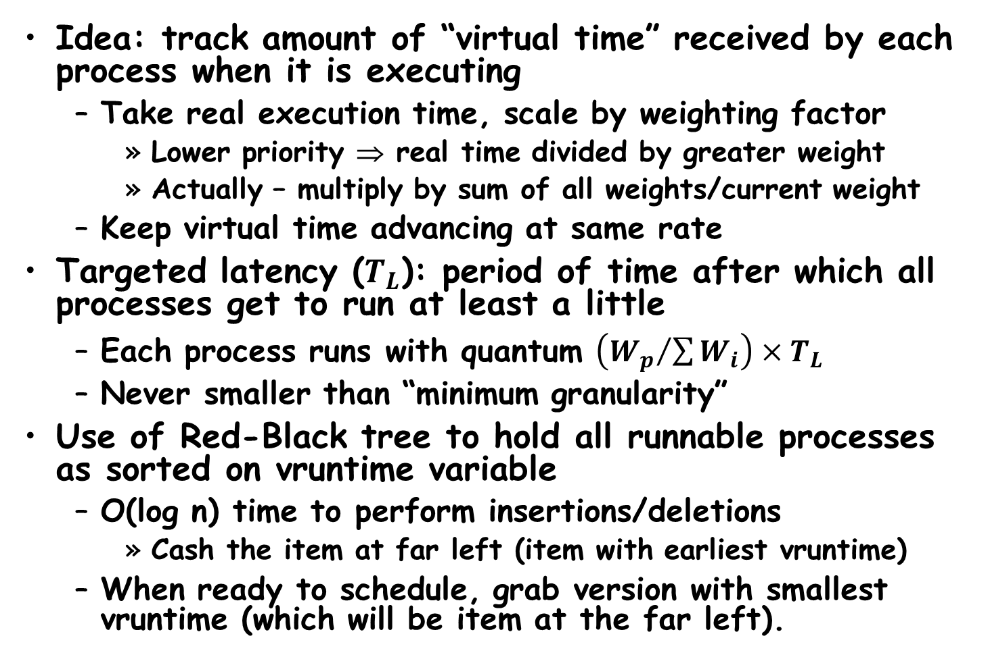
CFS (Continued)
Idea: track amount of “virtual time” received by each process when it is executing
Take real execution time, scale by weighting factor
Lower priority ⇒ real time divided by greater weight
Actually – multiply by sum of all weights/current weight
Keep virtual time advancing at same rate
Targeted latency ($T_{L}$): period of time after which all processes get to run at least a little
Each process runs with quantum $\left({W_{p}}/{\sum{W_{i}}}\right)×T_{L}$
Never smaller than “minimum granularity”
Use of Red-Black tree to hold all runnable processes as sorted on vruntime variable
O(log n) time to perform insertions/deletions
Cash the item at far left (item with earliest vruntime)
When ready to schedule, grab version with smallest vruntime (which will be item at the far left).

Slide 30
CFS Examples
Suppose Targeted latency = 20ms, Minimum Granularity = 1ms
Two CPU bound tasks with same priorities
Both switch with 10ms
Two CPU bound tasks separated by nice value of 5
One task gets 5ms, another gets 15
40 tasks: each gets 1ms (no longer totally fair)
One CPU bound task, one interactive task same priority
While interactive task sleeps, CPU bound task runs and increments vruntime
When interactive task wakes up, runs immediately, since it is behind on vruntime
Group scheduling facilities (2.6.24)
Can give fair fractions to groups (like a user or other mechanism for grouping processes)
So, two users, one starts 1 process, other starts 40, each will get 50% of CPU

Slide 31
Real-Time Scheduling (RTS)
Efficiency is important but predictability is essential:
We need to be able to predict with confidence the worst case response times for systems
In RTS, performance guarantees are:
Task- and/or class centric
Often ensured a priori
In conventional systems, performance is:
System oriented and often throughput oriented
Post-processing (… wait and see …)
Real-time is about enforcing predictability, and does not equal to fast computing!!!
Hard Real-Time
Attempt to meet all deadlines
EDF (Earliest Deadline First), LLF (Least Laxity First), RMS (Rate-Monotonic Scheduling), DM (Deadline Monotonic Scheduling)
Soft Real-Time
Attempt to meet deadlines with high probability
Minimize miss ratio / maximize completion ratio (firm real-time)
Important for multimedia applications
CBS (Constant Bandwidth Server)

Slide 32
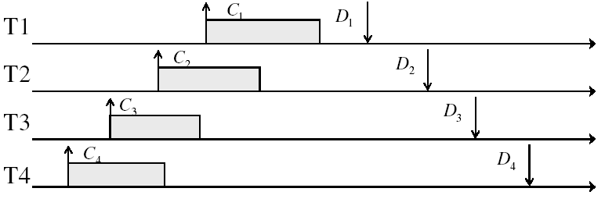
Example: Workload Characteristics
Tasks are preemptable, independent with arbitrary arrival (=release) times
Times have deadlines (D) and known computation times (C)
Example Setup:

Slide 33
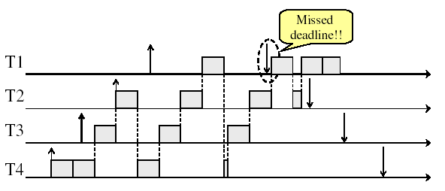
Example: Round-Robin Scheduling Doesn’t Work

Slide 34
Earliest Deadline First (EDF)
Preemptive priority-based dynamic scheduling
Each task is assigned a (current) priority based on how close the absolute deadline is.
The scheduler always schedules the active task with the closest absolute deadline.
0
5
10
15

Slide 35
EDF: Schedulability Test
Theorem (Utilization-based Schedulability Test):
A task set with is schedulable by the earliest deadline first (EDF) scheduling algorithm if
Exact schedulability test (necessary + sufficient)
Proof: [Liu and Layland, 1973]

Slide 36
Resource Contention
and
Deadlock

Slide 37
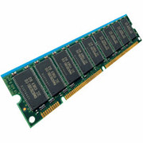
Resources
Resources – passive entities needed by threads to do their work
CPU time, disk space, memory
Two types of resources:
Preemptable – can take it away
CPU, Embedded security chip
Non-preemptable – must leave it with the thread
Disk space, plotter, chunk of virtual address space
Mutual exclusion – the right to enter a critical section
Resources may require exclusive access or may be sharable
Read-only files are typically sharable
Printers are not sharable during time of printing
One of the major tasks of an operating system is to manage resources

Slide 38
Starvation vs Deadlock
Starvation vs. Deadlock
Starvation: thread waits indefinitely
Example, low-priority thread waiting for resources constantly in use by high-priority threads
Deadlock: circular waiting for resources
Thread A owns Res 1 and is waiting for Res 2 Thread B owns Res 2 and is waiting for Res 1
Deadlock ⇒ Starvation but not vice versa
Starvation can end (but doesn’t have to)
Deadlock can’t end without external intervention
Thread
A
Wait
For
Owned
By
Res 1
Res 2
Owned
By
Wait
For
Thread
B

Slide 39
Conditions for Deadlock
Deadlock not always deterministic – Example 2 mutexes:
Thread A Thread B
x.P(); y.P();
y.P(); x.P();
y.V(); x.V();
x.V(); y.V();
Deadlock won’t always happen with this code
Have to have exactly the right timing (“wrong” timing?)
So you release a piece of software, and you tested it, and there it is, controlling a nuclear power plant…
Deadlocks occur with multiple resources
Means you can’t decompose the problem
Can’t solve deadlock for each resource independently
Example: System with 2 disk drives and two threads
Each thread needs 2 disk drives to function
Each thread gets one disk and waits for another one

Slide 40
Bridge Crossing Example
Honk!
Each segment of road can be viewed as a resource
Car must own the segment under them
Must acquire segment that they are moving into
For bridge: must acquire both halves
Traffic only in one direction at a time
Problem occurs when two cars in opposite directions on bridge: each acquires one segment and needs next
If a deadlock occurs, it can be resolved if one car backs up (preempt resources and rollback)
Several cars may have to be backed up
Starvation is possible
East-going traffic really fast ⇒ no one goes west

Slide 41
Train Example (Wormhole-Routed Network)
Circular dependency (Deadlock!)
Each train wants to turn right
Blocked by other trains
Similar problem to multiprocessor networks
Fix? Imagine grid extends in all four directions
Force ordering of channels (tracks)
Protocol: Always go east-west first, then north-south
Called “dimension ordering” (X then Y)
Disallowed
By Rule

Slide 42
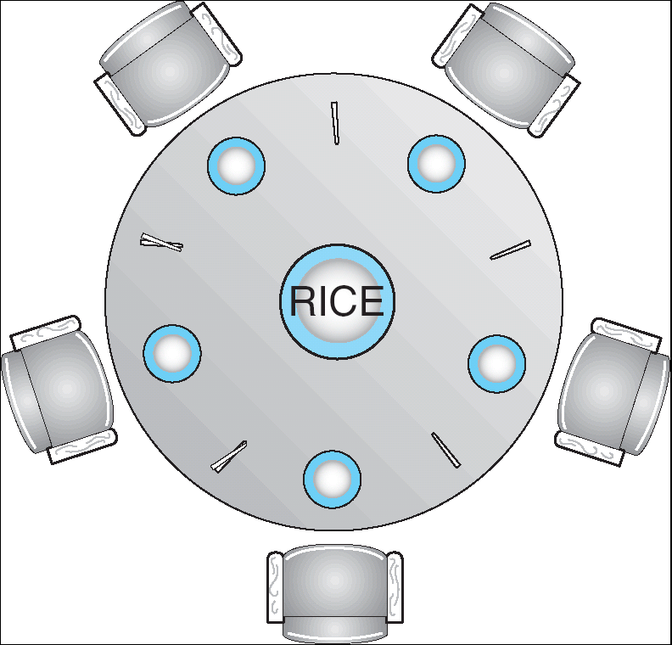
Dining Lawyers Problem
Five chopsticks/Five lawyers (really cheap restaurant)
Free-for all: Lawyer will grab any one they can
Need two chopsticks to eat
What if all grab at same time?
Deadlock!
How to fix deadlock?
Make one of them give up a chopstick (Hah!)
Eventually everyone will get chance to eat
How to prevent deadlock?
Never let lawyer take last chopstick if no hungry lawyer has two chopsticks afterwards

Slide 43
Four requirements for Deadlock
Mutual exclusion
Only one thread at a time can use a resource.
Hold and wait
Thread holding at least one resource is waiting to acquire additional resources held by other threads
No preemption
Resources are released only voluntarily by the thread holding the resource, after thread is finished with it
Circular wait
There exists a set {T₁, …, T_{n}} of waiting threads
T₁ is waiting for a resource that is held by T₂
T₂ is waiting for a resource that is held by T₃
…
T_{n} is waiting for a resource that is held by T₁

Slide 44
Resource-Allocation Graph
Symbols
System Model
A set of Threads T₁, T₂, . . ., T_{n}
Resource types R₁, R₂, . . ., R_{m}
CPU cycles, memory space, I/O devices
Each resource type R_{i} has W_{i} instances.
Each thread utilizes a resource as follows:
Request() / Use() / Release()
Resource-Allocation Graph:
V is partitioned into two types:
T = {T₁, T₂, …, T_{n}}, the set threads in the system.
R = {R₁, R₂, …, R_{m}}, the set of resource types in system
request edge – directed edge T₁ → R_{j}
assignment edge – directed edge R_{j} → T_{i}
T₁
T₂
R₁
R₂

Slide 45
Resource Allocation Graph Examples
Recall:
request edge – directed edge T₁ → R_{j}
assignment edge – directed edge R_{j} → T_{i}
R₁
R₂
R₁
R₂
R₁
T₂
T₁
T₂
T₃
T₁
T₂
T₃
T₁
T₃
R₃
T₄
R₄
R₃
R₂
R₄
Simple Resource
Allocation Graph
Allocation Graph With Deadlock
Allocation Graph With Cycle, but
No Deadlock

Slide 46
Methods for Handling Deadlocks
Allow system to enter deadlock and then recover
Requires deadlock detection algorithm
Some technique for forcibly preempting resources and/or terminating tasks
Ensure that system will never enter a deadlock
Need to monitor all lock acquisitions
Selectively deny those that might lead to deadlock
Ignore the problem and pretend that deadlocks never occur in the system
Used by most operating systems, including UNIX

Slide 47
Deadlock Detection Algorithm
Only one of each type of resource ⇒ look for loops
More General Deadlock Detection Algorithm
Let [X] represent an m-ary vector of non-negative integers (quantities of resources of each type):
[FreeResources]: Current free resources each type [Request_{X}]: Current requests from thread X [Alloc_{X}]: Current resources held by thread X
See if tasks can eventually terminate on their own
[Avail] = [FreeResources] Add all nodes to UNFINISHED do {
done = true Foreach node in UNFINISHED { if ([Request_{node}] <= [Avail]) { remove node from UNFINISHED [Avail] = [Avail] + [Alloc_{node}] done = false } } } until(done)
Nodes left in UNFINISHED ⇒ deadlocked
R₁
T₂
T₁
T₃
T₄
R₂

Slide 48
What to do when detect deadlock?
Terminate thread, force it to give up resources
In Bridge example, Godzilla picks up a car, hurls it into the river. Deadlock solved!
Shoot a dining lawyer
But, not always possible – killing a thread holding a mutex leaves world inconsistent
Preempt resources without killing off thread
Take away resources from thread temporarily
Doesn’t always fit with semantics of computation
Roll back actions of deadlocked threads
Hit the rewind button on TiVo, pretend last few minutes never happened
For bridge example, make one car roll backwards (may require others behind him)
Common technique in databases (transactions)
Of course, if you restart in exactly the same way, may reenter deadlock once again
Many operating systems use other options

Slide 49
Summary
Round-Robin Scheduling:
Give each thread a small amount of CPU time when it executes; cycle between all ready threads
Pros: Better for short jobs
Shortest Job First (SJF)/Shortest Remaining Time First (SRTF):
Run whatever job has the least amount of computation to do/least remaining amount of computation to do
Pros: Optimal (average response time)
Cons: Hard to predict future, Unfair
Multi-Level Feedback Scheduling:
Multiple queues of different priorities and scheduling algorithms
Automatic promotion/demotion of process priority in order to approximate SJF/SRTF
Lottery Scheduling:
Give each thread a priority-dependent number of tokens (short tasks⇒more tokens)
Linux CFS Scheduler: Fair fraction of CPU
Approximates a “ideal” multitasking processor
Realtime Schedulers such as EDF
Guaranteed behavior by meeting deadlines
Realtime tasks defined by tuple of compute time and period
Schedulability test: is it possible to meet deadlines with proposed set of processes?

Slide 50
Summary (2)
Starvation vs. Deadlock
Starvation: thread waits indefinitely
Deadlock: circular waiting for resources
Four conditions for deadlocks
Mutual exclusion
Only one thread at a time can use a resource
Hold and wait
Thread holding at least one resource is waiting to acquire additional resources held by other threads
No preemption
Resources are released only voluntarily by the threads
Circular wait
∃ set {T₁, …, T_{n}} of threads with a cyclic waiting pattern
Techniques for addressing Deadlock
Allow system to enter deadlock and then recover
Ensure that system will never enter a deadlock
Ignore the problem and pretend that deadlocks never occur in the system

