Slide 1
CS162 Operating Systems and Systems Programming Lecture 11 Deadlock, Address Translation
March 4th, 2015
Prof. John Kubiatowicz
http://cs162.eecs.Berkeley.edu

Slide 2
Recall: SRTF vs RR Example
Disk Utilization:
9/201 ~ 4.5%
C
A
B
C
RR 100ms time slice
Disk Utilization:
~90% but lots of wakeups!
C’s
I/O
C’s
I/O
CABAB…
C
RR 1ms time slice
C’s
I/O
C’s
I/O
Disk Utilization:
90%
C
A
A
A
SRTF
C’s
I/O
C’s
I/O

Slide 3
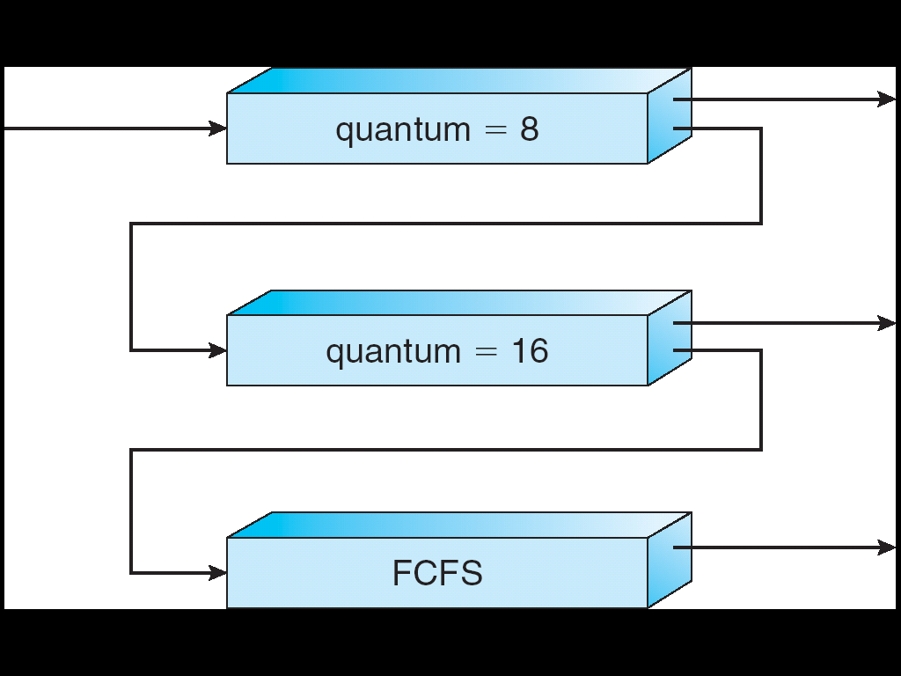
Recall: Multi-Level Feedback Scheduling
Another method for exploiting past behavior
First used in CTSS
Multiple queues, each with different priority
Higher priority queues often considered “foreground” tasks
Each queue has its own scheduling algorithm
e.g. foreground – RR, background – FCFS
Sometimes multiple RR priorities with quantum increasing exponentially (highest:1ms, next:2ms, next: 4ms, etc)
Adjust each job’s priority as follows (details vary)
Job starts in highest priority queue
If timeout expires, drop one level
If timeout doesn’t expire, push up one level (or to top)
Long-Running Compute Tasks Demoted to Low Priority

Slide 4
Recall: Linux Completely Fair Scheduler (CFS)
First appeared in 2.6.23, modified in 2.6.24
Inspired by Networking “Fair Queueing”
Each process given their fair share of resources
Models an “ideal multitasking processor” in which N processes execute simultaneously as if they truly got 1/N of the processor
Idea: track amount of “virtual time” received by each process when it is executing
Take real execution time, scale by factor to reflect time it would have gotten on ideal multiprocessor
So, for instance, multiply real time by N
Keep virtual time for every process advancing at same rate
Time sliced to achieve multiplexing
Uses a red-black tree to always find process which has gotten least amount of virtual time
Automatically track interactivity:
Interactive process runs less frequently ⇒ lower registered virtual time ⇒ will run immediately when ready to run

Slide 5
Recall: Real-Time Scheduling (RTS)
Efficiency is important but predictability is essential:
Real-time is about enforcing predictability, and does not equal to fast computing!!!
Hard Real-Time
Attempt to meet all deadlines
EDF (Earliest Deadline First), LLF (Least Laxity First), RMS (Rate-Monotonic Scheduling), DM (Deadline Monotonic Scheduling)
Soft Real-Time
Attempt to meet deadlines with high probability
Important for multimedia applications
CBS (Constant Bandwidth Server)

Slide 6
A Final Word On Scheduling
When do the details of the scheduling policy and fairness really matter?
When there aren’t enough resources to go around
When should you simply buy a faster computer?
(Or network link, or expanded highway, or …)
One approach: Buy it when it will pay for itself in improved response time
Assuming you’re paying for worse response time in reduced productivity, customer angst, etc…
Might think that you should buy a faster X when X is utilized 100%, but usually, response time goes to infinity as utilization⇒100%
An interesting implication of this curve:
Most scheduling algorithms work fine in the “linear” portion of the load curve, fail otherwise
Argues for buying a faster X when hit “knee” of curve
Response
time
100%
Utilization

Slide 7
Starvation vs Deadlock
Starvation vs. Deadlock
Starvation: thread waits indefinitely
Example, low-priority thread waiting for resources constantly in use by high-priority threads
Deadlock: circular waiting for resources
Thread A owns Res 1 and is waiting for Res 2 Thread B owns Res 2 and is waiting for Res 1
Deadlock ⇒ Starvation but not vice versa
Starvation can end (but doesn’t have to)
Deadlock can’t end without external intervention
Thread
A
Wait
For
Owned
By
Res 1
Res 2
Owned
By
Wait
For
Thread
B

Slide 8
Conditions for Deadlock
Deadlock not always deterministic – Example 2 mutexes:
Thread A Thread B
x.P(); y.P();
y.P(); x.P();
y.V(); x.V();
x.V(); y.V();
Deadlock won’t always happen with this code
Have to have exactly the right timing (“wrong” timing?)
So you release a piece of software, and you tested it, and there it is, controlling a nuclear power plant…
Deadlocks occur with multiple resources
Means you can’t decompose the problem
Can’t solve deadlock for each resource independently
Example: System with 2 disk drives and two threads
Each thread needs 2 disk drives to function
Each thread gets one disk and waits for another one

Slide 9
Bridge Crossing Example
Honk!
Each segment of road can be viewed as a resource
Car must own the segment under them
Must acquire segment that they are moving into
For bridge: must acquire both halves
Traffic only in one direction at a time
Problem occurs when two cars in opposite directions on bridge: each acquires one segment and needs next
If a deadlock occurs, it can be resolved if one car backs up (preempt resources and rollback)
Several cars may have to be backed up
Starvation is possible
East-going traffic really fast ⇒ no one goes west

Slide 10
Train Example (Wormhole-Routed Network)
Circular dependency (Deadlock!)
Each train wants to turn right
Blocked by other trains
Similar problem to multiprocessor networks
Fix? Imagine grid extends in all four directions
Force ordering of channels (tracks)
Protocol: Always go east-west first, then north-south
Called “dimension ordering” (X then Y)
Disallowed
By Rule

Slide 11
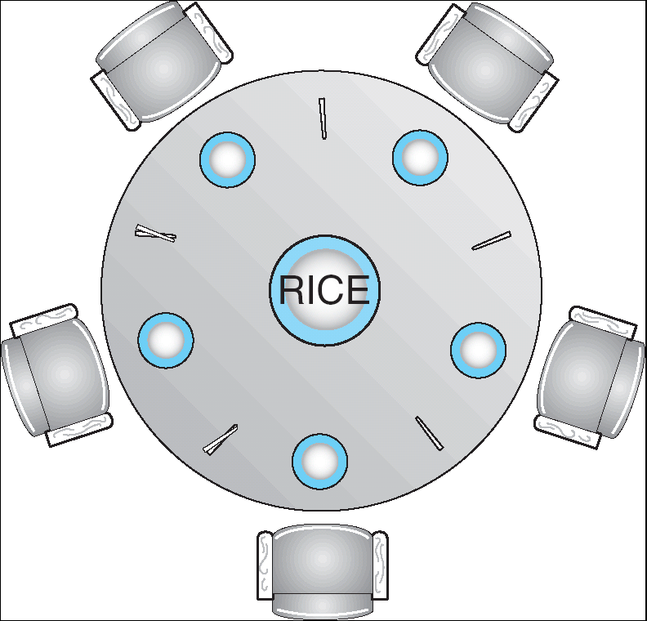
Dining Lawyers Problem
Five chopsticks/Five lawyers (really cheap restaurant)
Free-for all: Lawyer will grab any one they can
Need two chopsticks to eat
What if all grab at same time?
Deadlock!
How to fix deadlock?
Make one of them give up a chopstick (Hah!)
Eventually everyone will get chance to eat
How to prevent deadlock?
Never let lawyer take last chopstick if no hungry lawyer has two chopsticks afterwards

Slide 12
Four requirements for Deadlock
Mutual exclusion
Only one thread at a time can use a resource.
Hold and wait
Thread holding at least one resource is waiting to acquire additional resources held by other threads
No preemption
Resources are released only voluntarily by the thread holding the resource, after thread is finished with it
Circular wait
There exists a set {T₁, …, T_{n}} of waiting threads
T₁ is waiting for a resource that is held by T₂
T₂ is waiting for a resource that is held by T₃
…
T_{n} is waiting for a resource that is held by T₁

Slide 13
Resource-Allocation Graph
Symbols
System Model
A set of Threads T₁, T₂, . . ., T_{n}
Resource types R₁, R₂, . . ., R_{m}
CPU cycles, memory space, I/O devices
Each resource type R_{i} has W_{i} instances.
Each thread utilizes a resource as follows:
Request() / Use() / Release()
Resource-Allocation Graph:
V is partitioned into two types:
T = {T₁, T₂, …, T_{n}}, the set threads in the system.
R = {R₁, R₂, …, R_{m}}, the set of resource types in system
request edge – directed edge T₁ → R_{j}
assignment edge – directed edge R_{j} → T_{i}
T₁
T₂
R₁
R₂

Slide 14
Resource Allocation Graph Examples
Recall:
request edge – directed edge T₁ → R_{j}
assignment edge – directed edge R_{j} → T_{i}
R₁
R₂
R₁
R₂
R₁
T₂
T₁
T₂
T₃
T₁
T₂
T₃
T₁
T₃
R₃
T₄
R₄
R₃
R₂
R₄
Simple Resource
Allocation Graph
Allocation Graph With Deadlock
Allocation Graph With Cycle, but
No Deadlock

Slide 15
Methods for Handling Deadlocks
Allow system to enter deadlock and then recover
Requires deadlock detection algorithm
Some technique for forcibly preempting resources and/or terminating tasks
Ensure that system will never enter a deadlock
Need to monitor all lock acquisitions
Selectively deny those that might lead to deadlock
Ignore the problem and pretend that deadlocks never occur in the system
Used by most operating systems, including UNIX

Slide 16
Administrivia
Midterm I coming up in 1.5 weeks!
March 11^{th,} 7:00-10:00PM
Rooms: 1 PIMENTEL; 2060 VALLEY LSB
All topics up to and including next Monday
Closed book
1 page hand-written notes both sides
HW3 moved 1 week
Sorry about that, we had a bit of a scheduling snafu

Slide 17
Deadlock Detection Algorithm
Only one of each type of resource ⇒ look for loops
More General Deadlock Detection Algorithm
Let [X] represent an m-ary vector of non-negative integers (quantities of resources of each type):
[FreeResources]: Current free resources each type [Request_{X}]: Current requests from thread X [Alloc_{X}]: Current resources held by thread X
See if tasks can eventually terminate on their own
[Avail] = [FreeResources] Add all nodes to UNFINISHED do {
done = true Foreach node in UNFINISHED { if ([Request_{node}] <= [Avail]) { remove node from UNFINISHED [Avail] = [Avail] + [Alloc_{node}] done = false } } } until(done)
Nodes left in UNFINISHED ⇒ deadlocked
R₁
T₂
T₁
T₃
T₄
R₂

Slide 18
What to do when detect deadlock?
Terminate thread, force it to give up resources
In Bridge example, Godzilla picks up a car, hurls it into the river. Deadlock solved!
Shoot a dining lawyer
But, not always possible – killing a thread holding a mutex leaves world inconsistent
Preempt resources without killing off thread
Take away resources from thread temporarily
Doesn’t always fit with semantics of computation
Roll back actions of deadlocked threads
Hit the rewind button on TiVo, pretend last few minutes never happened
For bridge example, make one car roll backwards (may require others behind him)
Common technique in databases (transactions)
Of course, if you restart in exactly the same way, may reenter deadlock once again
Many operating systems use other options

Slide 19
Techniques for Preventing Deadlock
Infinite resources
Include enough resources so that no one ever runs out of resources. Doesn’t have to be infinite, just large
Give illusion of infinite resources (e.g. virtual memory)
Examples:
Bay bridge with 12,000 lanes. Never wait!
Infinite disk space (not realistic yet?)
No Sharing of resources (totally independent threads)
Not very realistic
Don’t allow waiting
How the phone company avoids deadlock
Call to your Mom in Toledo, works its way through the phone lines, but if blocked get busy signal.
Technique used in Ethernet/some multiprocessor nets
Everyone speaks at once. On collision, back off and retry
Inefficient, since have to keep retrying
Consider: driving to San Francisco; when hit traffic jam, suddenly you’re transported back home and told to retry!

Slide 20
Techniques for Preventing Deadlock (con’t)
Make all threads request everything they’ll need at the beginning.
Problem: Predicting future is hard, tend to over-estimate resources
Example:
If need 2 chopsticks, request both at same time
Don’t leave home until we know no one is using any intersection between here and where you want to go; only one car on the Bay Bridge at a time
Force all threads to request resources in a particular order preventing any cyclic use of resources
Thus, preventing deadlock
Example (x.P, y.P, z.P,…)
Make tasks request disk, then memory, then…
Keep from deadlock on freeways around SF by requiring everyone to go clockwise

Slide 21
Review: Train Example (Wormhole-Routed Network)
Circular dependency (Deadlock!)
Each train wants to turn right
Blocked by other trains
Similar problem to multiprocessor networks
Fix? Imagine grid extends in all four directions
Force ordering of channels (tracks)
Protocol: Always go east-west first, then north-south
Called “dimension ordering” (X then Y)
Disallowed
By Rule

Slide 22
Banker’s Algorithm for Preventing Deadlock
Toward right idea:
State maximum resource needs in advance
Allow particular thread to proceed if:
(available resources - #requested) ≥ max remaining that might be needed by any thread
Banker’s algorithm (less conservative):
Allocate resources dynamically
Evaluate each request and grant if some ordering of threads is still deadlock free afterward
Technique: pretend each request is granted, then run deadlock detection algorithm, substituting ([Max_{node}]-[Alloc_{node}] ≤ [Avail]) for ([Request_{node}] ≤ [Avail]) Grant request if result is deadlock free (conservative!)
Keeps system in a “SAFE” state, i.e. there exists a sequence {T₁, T₂, … T_{n}} with T₁ requesting all remaining resources, finishing, then T₂ requesting all remaining resources, etc..
Algorithm allows the sum of maximum resource needs of all current threads to be greater than total resources

Slide 23
Banker’s Algorithm Example
Banker’s algorithm with dining lawyers
“Safe” (won’t cause deadlock) if when try to grab chopstick either:
Not last chopstick
Is last chopstick but someone will have two afterwards
What if k-handed lawyers? Don’t allow if:
It’s the last one, no one would have k
It’s 2nd to last, and no one would have k-1
It’s 3rd to last, and no one would have k-2
…

Slide 24
Virtualizing Resources
Physical Reality: Different Processes/Threads share the same hardware
Need to multiplex CPU (Just finished: scheduling)
Need to multiplex use of Memory (Today)
Need to multiplex disk and devices (later in term)
Why worry about memory sharing?
The complete working state of a process and/or kernel is defined by its data in memory (and registers)
Consequently, cannot just let different threads of control use the same memory
Physics: two different pieces of data cannot occupy the same locations in memory
Probably don’t want different threads to even have access to each other’s memory (protection)

Slide 25
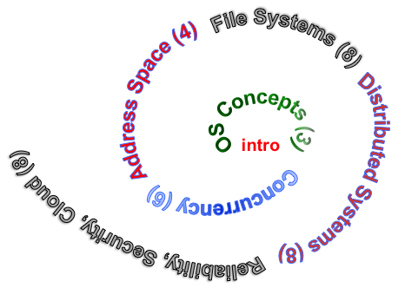
Next Objective
Dive deeper into the concepts and mechanisms of memory sharing and address translation
Enabler of many key aspects of operating systems
Protection
Multi-programming
Isolation
Memory resource management
I/O efficiency
Sharing
Inter-process communication
Debugging
Demand paging
Today: Linking, Segmentation, Paged Virtual Address

Slide 26
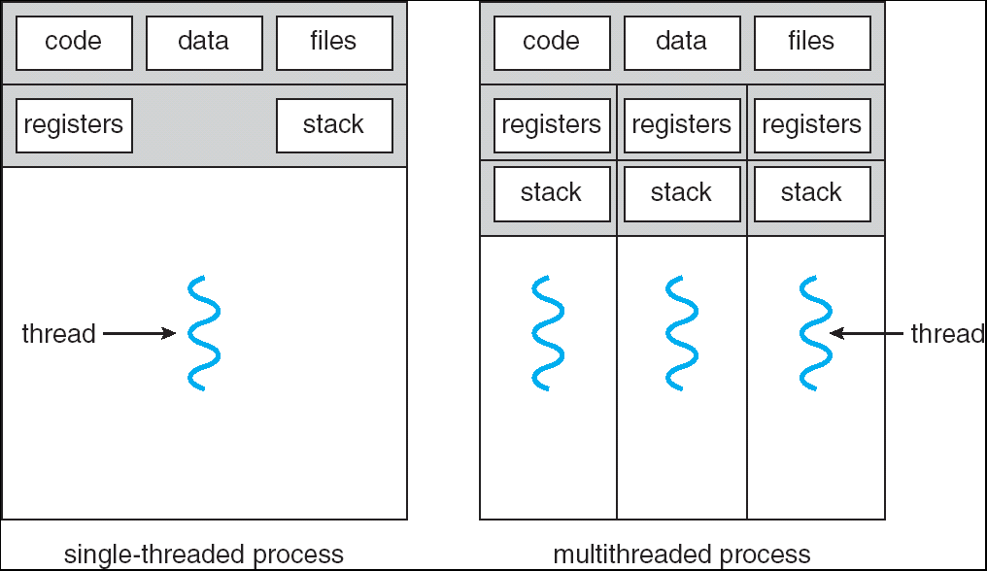
Recall: Single and Multithreaded Processes
Threads encapsulate concurrency
“Active” component of a process
Address spaces encapsulate protection
Keeps buggy program from trashing the system
“Passive” component of a process

Slide 27
Important Aspects of Memory Multiplexing
Controlled overlap:
Separate state of threads should not collide in physical memory. Obviously, unexpected overlap causes chaos!
Conversely, would like the ability to overlap when desired (for communication)
Translation:
Ability to translate accesses from one address space (virtual) to a different one (physical)
When translation exists, processor uses virtual addresses, physical memory uses physical addresses
Side effects:
Can be used to avoid overlap
Can be used to give uniform view of memory to programs
Protection:
Prevent access to private memory of other processes
Different pages of memory can be given special behavior (Read Only, Invisible to user programs, etc).
Kernel data protected from User programs
Programs protected from themselves

Slide 28
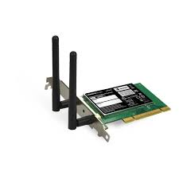
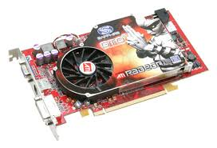


Recall: Loading
Threads
Address Spaces
Windows
Processes
Files
Sockets
Software
OS Hardware Virtualization
Hardware
ISA
Memory
Processor
Protection Boundary
OS
Ctrlr
storage
Networks
Displays
Inputs

Slide 29
Binding of Instructions and Data to Memory
Assume 4byte words
0x300 = 4 * 0x0C0
0x0C0 = 0000 1100 0000
0x300 = 0011 0000 0000
Process view of memory
Physical addresses
data1: dw 32
…
start: lw r1,0(data1)
jal checkit
loop: addi r1, r1, -1
bnz r1, loop …
checkit: …
0x0300 00000020
… …
0x0900 8C2000C0
0x0904 0C000280
0x0908 2021FFFF
0x090C 14200242
…
0x0A00

Slide 30
Binding of Instructions and Data to Memory
Physical
Memory
0x0000
0x0300
00000020
Process view of memory
Physical addresses
data1: dw 32
…
start: lw r1,0(data1)
jal checkit
loop: addi r1, r1, -1
bnz r1, loop …
checkit: …
0x0300 00000020
… …
0x0900 8C2000C0
0x0904 0C000280
0x0908 2021FFFF
0x090C 14200242
…
0x0A00
0x0900
8C2000C0
0C000340
2021FFFF
14200242
0xFFFF

Slide 31
Second copy of program from previous example
Physical
Memory
0x0000
0x0300
App X
Process view of memory
Physical addresses
data1: dw 32
…
start: lw r1,0(data1)
jal checkit
loop: addi r1, r1, -1
bnz r1, r0, loop …
checkit: …
0x300 00000020
… …
0x900 8C2000C0
0x904 0C000280
0x908 2021FFFF
0x90C 14200242
…
0x0A00
0x0900
?
0xFFFF
Need address translation!

Slide 32
Second copy of program from previous example
Physical Memory
0x0000
0x0300
App X
Process view of memory
Processor view of memory
data1: dw 32
…
start: lw r1,0(data1)
jal checkit
loop: addi r1, r1, -1
bnz r1, r0, loop …
checkit: …
0x1300 00000020
… …
0x1900 8C2004C0
0x1904 0C000680
0x1908 2021FFFF
0x190C 14200642
…
0x1A00
0x0900
0x1300
00000020
0x1900
8C2004C0
0C000680
2021FFFF
14200642
One of many possible translations!
Where does translation take place?
Compile time, Link/Load time, or Execution time?
0xFFFF

Slide 33
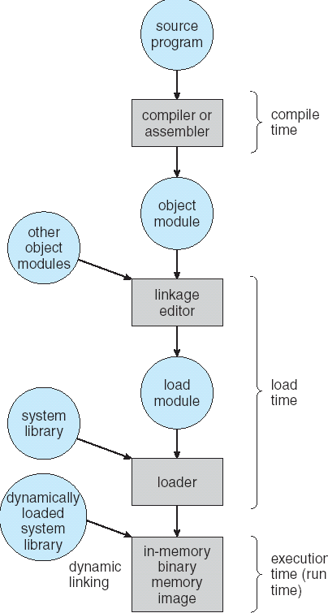
Multi-step Processing of a Program for Execution
Preparation of a program for execution involves components at:
Compile time (i.e., “gcc”)
Link/Load time (UNIX “ld” does link)
Execution time (e.g., dynamic libs)
Addresses can be bound to final values anywhere in this path
Depends on hardware support
Also depends on operating system
Dynamic Libraries
Linking postponed until execution
Small piece of code, stub, used to locate appropriate memory-resident library routine
Stub replaces itself with the address of the routine, and executes routine

Slide 34

Recall: Uniprogramming
Uniprogramming (no Translation or Protection)
Application always runs at same place in physical memory since only one application at a time
Application can access any physical address
Application given illusion of dedicated machine by giving it reality of a dedicated machine
0xFFFFFFFF
Operating
System
Valid 32-bit
Addresses
Application
0x00000000

Slide 35

Multiprogramming (primitive stage)
Multiprogramming without Translation or Protection
Must somehow prevent address overlap between threads
Use Loader/Linker: Adjust addresses while program loaded into memory (loads, stores, jumps)
Everything adjusted to memory location of program
Translation done by a linker-loader (relocation)
Common in early days (… till Windows 3.x, 95?)
With this solution, no protection: bugs in any program can cause other programs to crash or even the OS
0xFFFFFFFF
Operating
System
Application2
0x00020000
Application1
0x00000000

Slide 36
Multiprogramming (Version with Protection)
Can we protect programs from each other without translation?
Yes: use two special registers BaseAddr and LimitAddr to prevent user from straying outside designated area
If user tries to access an illegal address, cause an error
During switch, kernel loads new base/limit from PCB (Process Control Block)
User not allowed to change base/limit registers
0xFFFFFFFF
Operating
System
LimitAddr=0x10000
0x00020000
BaseAddr=0x20000
Application2
Application1
0x00000000

Slide 37
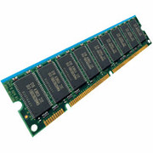
Better Solution: Address translation
Virtual
Addresses
Physical
Addresses
CPU
MMU
Untranslated read or write
Address Space:
All the addresses and state a process can touch
Each process and kernel has different address space
Consequently, two views of memory:
View from the CPU (what program sees, virtual memory)
View from memory (physical memory)
Translation box (MMU) converts between the two views
Translation essential to implementing protection
If task A cannot even gain access to task B’s data, no way for A to adversely affect B
With translation, every program can be linked/loaded into same region of user address space

Slide 38
Recall: General Address Translation
Code
Data
Heap
Stack
Data 2
Code
Data
Heap
Stack
Stack 1
Heap 1
Code 1
Stack 2
Prog 1
Virtual
Address
Space 1
Data 1
Prog 2
Virtual
Address
Space 2
Heap 2
Code 2
OS code
Translation Map 1
OS data
Translation Map 2
OS heap &
Stacks
Physical Address Space

Slide 39

Simple Base and Bounds (CRAY-1)
Base
Virtual
Address
CPU
+
DRAM
Physical
Address
<?
Limit
No: Error!
Could use base/limit for dynamic address translation – translation happens at execution:
Alter address of every load/store by adding “base”
Generate error if address bigger than limit
This gives program the illusion that it is running on its own dedicated machine, with memory starting at 0
Program gets continuous region of memory
Addresses within program do not have to be relocated when program placed in different region of DRAM

Slide 40
Issues with Simple B&B Method
process 6
process 6
process 6
process 6
process 5
process 5
process 5
process 9
process 9
process 11
process 2
process 10
OS
OS
OS
OS
Fragmentation problem
Not every process is the same size
Over time, memory space becomes fragmented
Missing support for sparse address space
Would like to have multiple chunks/program
E.g.: Code, Data, Stack
Hard to do inter-process sharing
Want to share code segments when possible
Want to share memory between processes
Helped by providing multiple segments per process

Slide 41
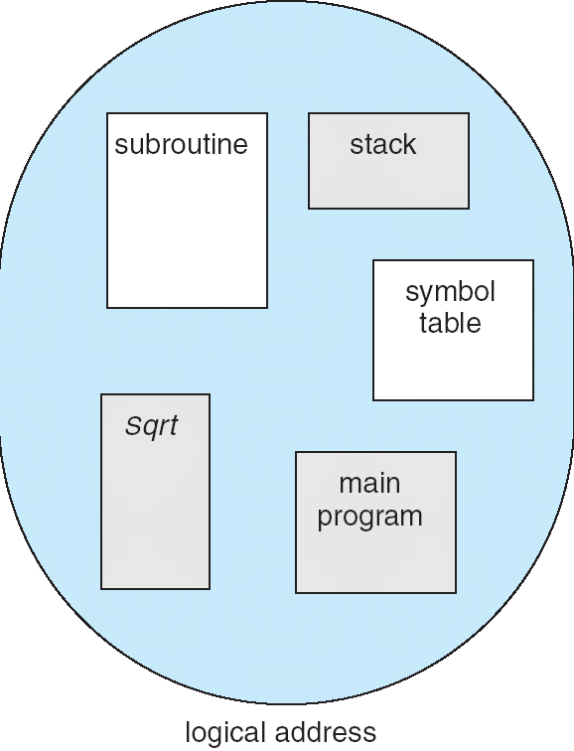
More Flexible Segmentation
1
1
1
4
2
3
2
2
4
3
user view of
memory space
physical
memory space
Logical View: multiple separate segments
Typical: Code, Data, Stack
Others: memory sharing, etc
Each segment is given region of contiguous memory
Has a base and limit
Can reside anywhere in physical memory

Slide 42
Implementation of Multi-Segment Model
Virtual
Address
offset
>
Seg #
Offset
Error
Base0
Limit0
V
Base1
Limit1
V
Base2
Limit2
V
Base2
Limit2
V
Base3
Limit3
N
+
Physical
Address
Base4
Limit4
V
Base5
Limit5
N
Base6
Limit6
N
Base7
Limit7
V
Check Valid
Segment map resides in processor
Segment number mapped into base/limit pair
Base added to offset to generate physical address
Error check catches offset out of range
As many chunks of physical memory as entries
Segment addressed by portion of virtual address
However, could be included in instruction instead:
x86 Example: mov [es:bx],ax.
What is “V/N” (valid / not valid)?
Can mark segments as invalid; requires check as well
Access
Error

Slide 43
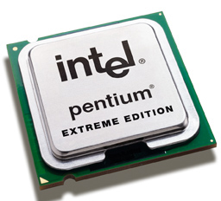
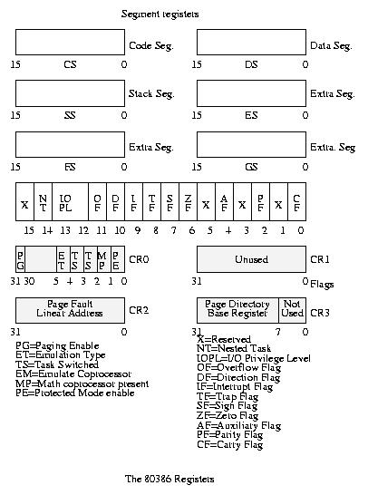
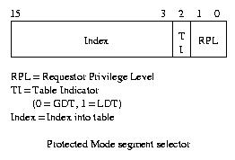
Intel x86 Special Registers
80386 Special Registers
Typical Segment Register
Current Priority is RPL
Of Code Segment (CS)

Slide 44
Example: Four Segments (16 bit addresses)
Seg ID # | Base | Limit
0 (code) | 0x4000 | 0x0800
1 (data) | 0x4800 | 0x1400
2 (shared) | 0xF000 | 0x1000
3 (stack) | 0x0000 | 0x3000
Seg
Offset
15
14
13
0
Virtual Address Format
SegID = 0
0x0000
0x0000
SegID = 1
0x4000
Might
be shared
0x4000
0x4800
0x5C00
0x8000
Space for
Other Apps
0xC000
0xF000
Shared with
Other Apps
Virtual
Address Space
Physical
Address Space

Slide 45
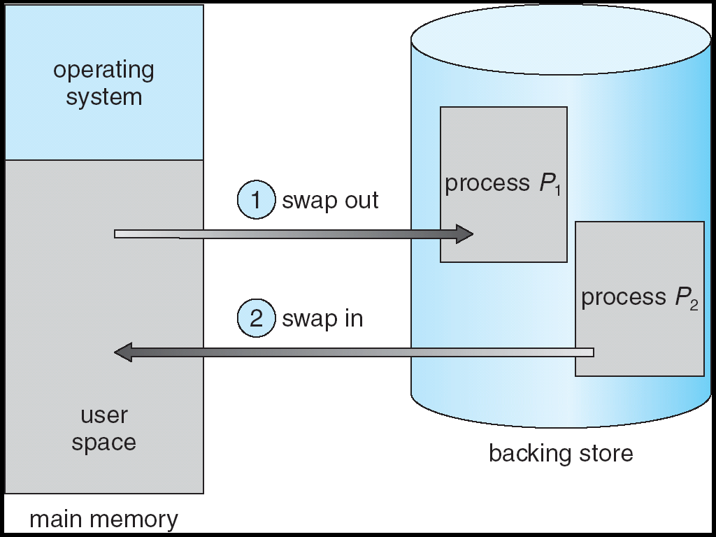
Running more programs than fit in memory: Swapping
Q: What if not all processes fit in memory?
A: Swapping: Extreme form of Context Switch
In order to make room for next process, some or all of the previous process is moved to disk
This greatly increases the cost of context-switching
Desirable alternative?
Some way to keep only active portions of a process in memory at any one time
Need finer granularity control over physical memory

Slide 46
Problems with Segmentation
Must fit variable-sized chunks into physical memory
May move processes multiple times to fit everything
Limited options for swapping to disk
Fragmentation: wasted space
External: free gaps between allocated chunks
Internal: don’t need all memory within allocated chunks

Slide 47
Paging: Physical Memory in Fixed Size Chunks
Solution to fragmentation from segments?
Allocate physical memory in fixed size chunks (“pages”)
Every chunk of physical memory is equivalent
Can use simple vector of bits to handle allocation: 00110001110001101 … 110010
Each bit represents page of physical memory 1⇒allocated, 0⇒free
Should pages be as big as our previous segments?
No: Can lead to lots of internal fragmentation
Typically have small pages (1K-16K)
Consequently: need multiple pages/segment

Slide 48
How to Implement Paging?
Virtual Address:
Virtual
Page #
Offset
PageTablePtr
page #0
V,R
Physical
Page #
Offset
page #1
V,R
page #1
V,R
page #2
V,R,W
Physical Address
PageTableSize
>
page #3
V,R,W
Check Perm
Access
Error
page #4
N
page #5
V,R,W
Access
Error
Page Table (One per process)
Resides in physical memory
Contains physical page and permission for each virtual page
Permissions include: Valid bits, Read, Write, etc
Virtual address mapping
Offset from Virtual address copied to Physical Address
Example: 10 bit offset ⇒ 1024-byte pages
Virtual page # is all remaining bits
Example for 32-bits: 32-10 = 22 bits, i.e. 4 million entries
Physical page # copied from table into physical address
Check Page Table bounds and permissions

Slide 49
Simple Page Table Example
Example (4 byte pages)
0x00
0000 0000
0x00
a
b
c
d
0001 0000
0x04
0
4
i
j
k
l
0x04
0000 0100
1
0000 1100
0x05!
e
f
g
h
3
2
1
0000 0100
0x08
0x06?
0x08
0000 1000
Page
Table
0x0C
i
j
k
l
e
f
g
h
0x09?
0x0E!
0x10
Virtual
Memory
0000 0110
0000 1110
a
b
c
d
0000 1001
0000 0101
Physical
Memory
Notes:
What is virtual address 0x6? 1|10 = 3|2 = 0xE
What is virtual address 0x9? 10|01 = 1|1 = 0x5

Slide 50
What about Sharing?
Virtual Address
(Process A):
Virtual
Page #
Offset
PageTablePtrA
page #0
V,R
page #1
V,R
page #2
V,R,W
page #2
V,R,W
page #3
V,R,W
Shared
Page
page #4
N
page #5
V,R,W
PageTablePtrB
page #0
V,R
page #1
N
This physical page
appears in address
space of both processes
page #2
V,R,W
page #3
N
page #4
V,R
page #4
V,R
page #5
V,R,W
Virtual Address
(Process B):
Virtual
Page #
Offset

Slide 51
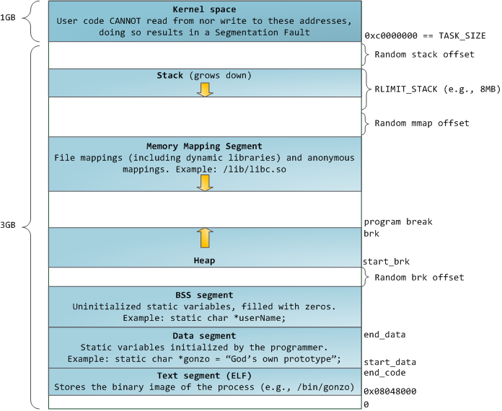
E.g., Linux 32-bit
http://static.duartes.org/img/blogPosts/linuxFlexibleAddressSpaceLayout.png

Slide 52
Summary: Paging
Page Table
Virtual memory view
Physical memory view
1111 1111
11111 11101
11110 11100
11101 null
11100 null
11011 null
11010 null
11001 null
11000 null
10111 null
10110 null
10101 null
10100 null
10011 null
10010 10000
10001 01111
10000 01110
01111 null
01110 null
01101 null
01100 null
01011 01101
01010 01100
01001 01011
01000 01010
00111 null
00110 null
00101 null
00100 null
00011 00101
00010 00100
00001 00011
00000 00010
1110 1111
1111 0000
stack
stack
1110 0000
1100 0000
heap
1000 0000
heap
0111 000
data
data
0101 000
0100 0000
code
code
0001 0000
0000 0000
0000 0000
page #
offset

Slide 53
Summary: Paging
Page Table
Virtual memory view
Physical memory view
1111 1111
11111 11101
11110 11100
11101 null
11100 null
11011 null
11010 null
11001 null
11000 null
10111 null
10110 null
10101 null
10100 null
10011 null
10010 10000
10001 01111
10000 01110
01111 null
01110 null
01101 null
01100 null
01011 01101
01010 01100
01001 01011
01000 01010
00111 null
00110 null
00101 null
00100 null
00011 00101
00010 00100
00001 00011
00000 00010
stack
1110 0000
stack
1110 0000
1100 0000
What happens if stack grows to 1110 0000?
heap
1000 0000
heap
0111 000
data
data
0101 000
0100 0000
code
code
0001 0000
0000 0000
0000 0000
page #
offset

Slide 54
Summary: Paging
Page Table
Virtual memory view
Physical memory view
1111 1111
11111 11101
11110 11100
11101 10111
11100 10110
11011 null
11010 null
11001 null
11000 null
10111 null
10110 null
10101 null
10100 null
10011 null
10010 10000
10001 01111
10000 01110
01111 null
01110 null
01101 null
01100 null
01011 01101
01010 01100
01001 01011
01000 01010
00111 null
00110 null
00101 null
00100 null
00011 00101
00010 00100
00001 00011
00000 00010
stack
1110 0000
stack
1110 0000
1100 0000
stack
Allocate new pages where room!
heap
1000 0000
heap
0111 000
data
Challenge: Table size equal to # of pages in virtual memory!
data
0101 000
0100 0000
code
code
0001 0000
0000 0000
0000 0000
page #
offset

Slide 55
Page Table Discussion
What needs to be switched on a context switch?
Page table pointer and limit
Analysis
Pros
Simple memory allocation
Easy to Share
Con: What if address space is sparse?
E.g. on UNIX, code starts at 0, stack starts at (2³¹-1).
With 1K pages, need 2 million page table entries!
Con: What if table really big?
Not all pages used all the time ⇒ would be nice to have working set of page table in memory
How about combining paging and segmentation?
Notes:
What if page size is very small? VAX had a 512-byte page size = lots of space for page table entries
What if page size is really big? Wastes space inside of page (internal fragmentation)

Slide 56
Next time: Multi-level Page Table
1K
PTEs
Two-level Page Tables
4KB
32-bit address:
10
10
12
P1 index
P2 index
page offset
4 bytes
Page: a unit of memory translatable by memory management unit (MMU)
Typically 1K – 8K
Page table structure in memory
Each user has different page table
Address Space switch: change pointer to base of table (hardware register)
Hardware traverses page table (for many architectures)
MIPS uses software to traverse table
4 bytes

Slide 57
Summary
Starvation vs. Deadlock
Starvation: thread waits indefinitely
Deadlock: circular waiting for resources
Four conditions for deadlocks
Mutual exclusion
Only one thread at a time can use a resource
Hold and wait
Thread holding at least one resource is waiting to acquire additional resources held by other threads
No preemption
Resources are released only voluntarily by the threads
Circular wait
∃ set {T₁, …, T_{n}} of threads with a cyclic waiting pattern
Techniques for addressing Deadlock
Allow system to enter deadlock and then recover
Ensure that system will never enter a deadlock
Ignore the problem and pretend that deadlocks never occur in the system

Slide 58
Summary (2)
Memory is a resource that must be multiplexed
Controlled Overlap: only shared when appropriate
Translation: Change virtual addresses into physical addresses
Protection: Prevent unauthorized sharing of resources
Simple Protection through segmentation
Base + Limit registers restrict memory accessible to user
Can be used to translate as well
Page Tables
Memory divided into fixed-sized chunks of memory
Offset of virtual address same as physical address

