Slide 1
CS162 Operating Systems and Systems Programming Lecture 12 Address Translation (Con’t)
March 4th, 2015
Prof. John Kubiatowicz
http://cs162.eecs.Berkeley.edu

Slide 2
Recall: Starvation vs Deadlock
Starvation vs. Deadlock
Starvation: thread waits indefinitely
Example, low-priority thread waiting for resources constantly in use by high-priority threads
Deadlock: circular waiting for resources
Thread A owns Res 1 and is waiting for Res 2 Thread B owns Res 2 and is waiting for Res 1
Deadlock ⇒ Starvation but not vice versa
Starvation can end (but doesn’t have to)
Deadlock can’t end without external intervention
Thread
A
Owned
By
Wait
For
Res 1
Res 2
Wait
For
Owned
By
Thread
B

Slide 3
Recall: Four requirements for Deadlock
Mutual exclusion
Only one thread at a time can use a resource.
Hold and wait
Thread holding at least one resource is waiting to acquire additional resources held by other threads
No preemption
Resources are released only voluntarily by the thread holding the resource, after thread is finished with it
Circular wait
There exists a set {T₁, …, T_{n}} of waiting threads
T₁ is waiting for a resource that is held by T₂
T₂ is waiting for a resource that is held by T₃
…
T_{n} is waiting for a resource that is held by T₁

Slide 4
Recall: Ways of preventing deadlock
Force all threads to request resources in a particular order preventing any cyclic use of resources
Example (x.P, y.P, z.P,…)
Make tasks request disk, then memory, then…
Banker’s algorithm:
Allocate resources dynamically
Evaluate each request and grant if some ordering of threads is still deadlock free afterward
Technique: pretend each request is granted, then run deadlock detection algorithm, substituting ([Max_{node}]-[Alloc_{node}] ≤ [Avail]) for ([Request_{node}] ≤ [Avail]) Grant request if result is deadlock free (conservative!)
Keeps system in a “SAFE” state, i.e. there exists a sequence {T₁, T₂, … T_{n}} with T₁ requesting all remaining resources, finishing, then T₂ requesting all remaining resources, etc..
Algorithm allows the sum of maximum resource needs of all current threads to be greater than total resources

Slide 5
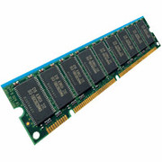
Recall: Address translation
Virtual
Addresses
Physical
Addresses
CPU
MMU
Untranslated read or write
Address Space:
All the addresses and state a process can touch
Each process and kernel has different address space
Consequently, two views of memory:
View from the CPU (what program sees, virtual memory)
View from memory (physical memory)
Translation box (MMU) converts between the two views
Translation essential to implementing protection
If task A cannot even gain access to task B’s data, no way for A to adversely affect B
With translation, every program can be linked/loaded into same region of user address space

Slide 6
Recall: General Address Translation
Code
Data
Heap
Stack
Data 2
Code
Data
Heap
Stack
Stack 1
Heap 1
Code 1
Stack 2
Prog 1
Virtual
Address
Space 1
Data 1
Prog 2
Virtual
Address
Space 2
Heap 2
Code 2
OS code
Translation Map 1
OS data
Translation Map 2
OS heap &
Stacks
Physical Address Space

Slide 7

Simple Base and Bounds (CRAY-1)
Base
Virtual
Address
CPU
+
DRAM
Physical
Address
<?
Limit
No: Error!
Could use base/limit for dynamic address translation – translation happens at execution:
Alter address of every load/store by adding “base”
Generate error if address bigger than limit
This gives program the illusion that it is running on its own dedicated machine, with memory starting at 0
Program gets continuous region of memory
Addresses within program do not have to be relocated when program placed in different region of DRAM

Slide 8
Issues with Simple B&B Method
process 6
process 6
process 6
process 6
process 5
process 5
process 5
process 9
process 9
process 11
process 2
process 10
OS
OS
OS
OS
Fragmentation problem
Not every process is the same size
Over time, memory space becomes fragmented
Missing support for sparse address space
Would like to have multiple chunks/program
E.g.: Code, Data, Stack
Hard to do inter-process sharing
Want to share code segments when possible
Want to share memory between processes
Helped by providing multiple segments per process

Slide 9
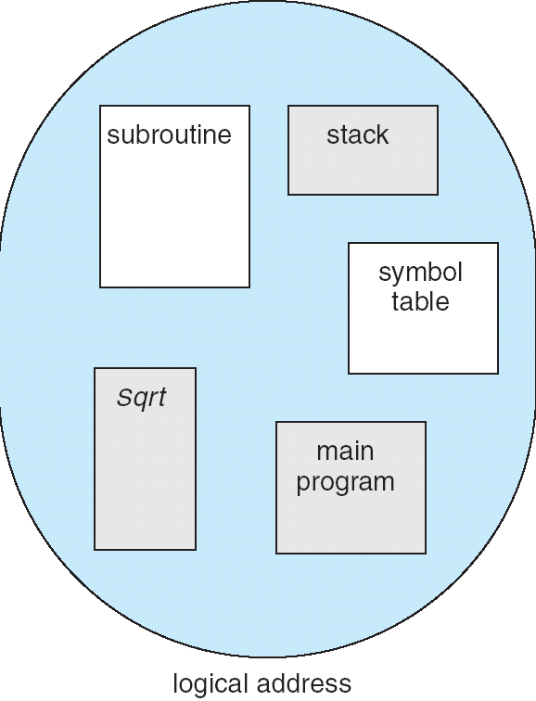
More Flexible Segmentation
1
1
1
4
2
3
2
2
4
3
user view of
memory space
physical
memory space
Logical View: multiple separate segments
Typical: Code, Data, Stack
Others: memory sharing, etc
Each segment is given region of contiguous memory
Has a base and limit
Can reside anywhere in physical memory

Slide 10
Implementation of Multi-Segment Model
Virtual
Address
offset
>
Seg #
Offset
Error
Base0
Limit0
V
Base1
Limit1
V
Base2
Limit2
V
Base2
Limit2
V
Base3
Limit3
N
+
Physical
Address
Base4
Limit4
V
Base5
Limit5
N
Base6
Limit6
N
Base7
Limit7
V
Check Valid
Segment map resides in processor
Segment number mapped into base/limit pair
Base added to offset to generate physical address
Error check catches offset out of range
As many chunks of physical memory as entries
Segment addressed by portion of virtual address
However, could be included in instruction instead:
x86 Example: mov [es:bx],ax.
What is “V/N” (valid / not valid)?
Can mark segments as invalid; requires check as well
Access
Error

Slide 11
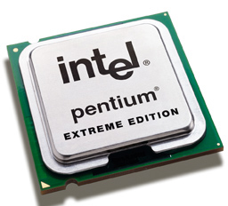
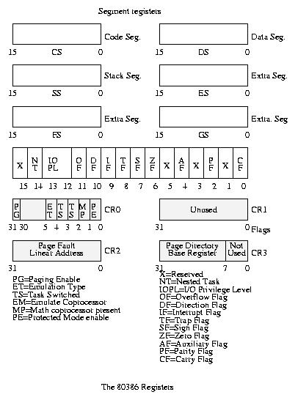
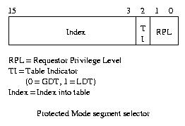
Intel x86 Special Registers
80386 Special Registers
Typical Segment Register
Current Priority is RPL
Of Code Segment (CS)

Slide 12
Example: Four Segments (16 bit addresses)
Seg ID # | Base | Limit
0 (code) | 0x4000 | 0x0800
1 (data) | 0x4800 | 0x1400
2 (shared) | 0xF000 | 0x1000
3 (stack) | 0x0000 | 0x3000
Seg
Offset
15
14
13
0
Virtual Address Format
SegID = 0
0x0000
0x0000
SegID = 1
0x4000
Might
be shared
0x4000
0x4800
0x5C00
0x8000
Space for
Other Apps
0xC000
0xF000
Shared with
Other Apps
Virtual
Address Space
Physical
Address Space

Slide 13
Example of segment translation
0x240 main: la $a0, varx 0x244 jal strlen
… …
0x360 strlen: li $v0, 0 ;count 0x364 loop: lb $t0, ($a0) 0x368 beq $r0,$t1, done
… …
0x4050 varx dw 0x314159
Seg ID # | Base | Limit
0 (code) | 0x4000 | 0x0800
1 (data) | 0x4800 | 0x1400
2 (shared) | 0xF000 | 0x1000
3 (stack) | 0x0000 | 0x3000
Let’s simulate a bit of this code to see what happens (PC=0x240):
Fetch 0x240. Virtual segment #? 0; Offset? 0x240
Physical address? Base=0x4000, so physical addr=0x4240
Fetch instruction at 0x4240. Get “la $a0, varx”
Move 0x4050 → $a0, Move PC+4→PC
Fetch 0x244. Translated to Physical=0x4244. Get “jal strlen” Move 0x0248 → $ra (return address!), Move 0x0360 → PC
Fetch 0x360. Translated to Physical=0x4360. Get “li $v0,0” Move 0x0000 → $v0, Move PC+4→PC
Fetch 0x364. Translated to Physical=0x4364. Get “lb $t0,($a0)” Since $a0 is 0x4050, try to load byte from 0x4050
Translate 0x4050. Virtual segment #? 1; Offset? 0x50 Physical address? Base=0x4800, Physical addr = 0x4850,
Load Byte from 0x4850→$t0, Move PC+4→PC

Slide 14
Administrivia
Midterm I coming up in next Wednesday!
March 11^{th,} 7:00-10:00PM
Rooms: 1 PIMENTEL; 2060 VALLEY LSB
Will be dividing up in advance – watch for Piazza post
All topics up to and including next Monday
Closed book
1 page hand-written notes both sides
Review Session
This Sunday, 4-6 PM, 306 Soda Hall
HW3 moved 1 week
Sorry about that, we had a bit of a scheduling snafu

Slide 15
Observations about Segmentation
Virtual address space has holes
Segmentation efficient for sparse address spaces
A correct program should never address gaps (except as mentioned in moment)
If it does, trap to kernel and dump core
When it is OK to address outside valid range:
This is how the stack and heap are allowed to grow
For instance, stack takes fault, system automatically increases size of stack
Need protection mode in segment table
For example, code segment would be read-only
Data and stack would be read-write (stores allowed)
Shared segment could be read-only or read-write
What must be saved/restored on context switch?
Segment table stored in CPU, not in memory (small)
Might store all of processes memory onto disk when switched (called “swapping”)

Slide 16
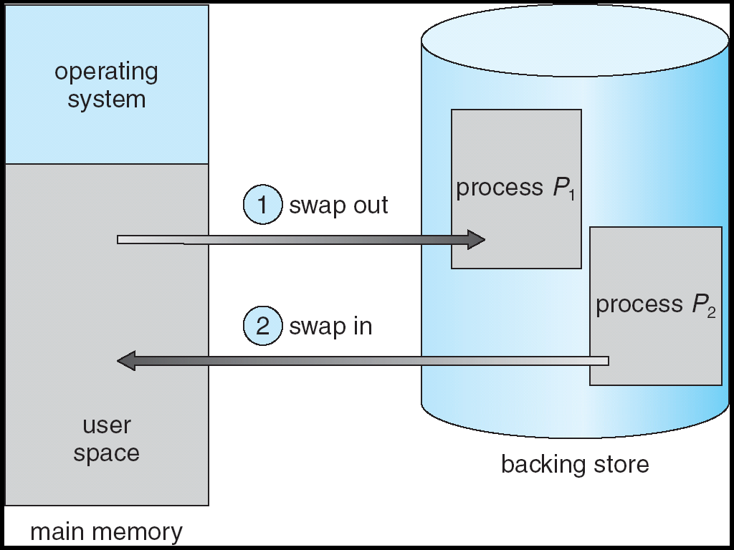
What if segments than will fit into memory?
Extreme form of Context Switch: Swapping
In order to make room for next process, some or all of the previous process is moved to disk
Likely need to send out complete segments
This greatly increases the cost of context-switching
Desirable alternative?
Some way to keep only active portions of a process in memory at any one time
Need finer granularity control over physical memory

Slide 17
Problems with Segmentation
Must fit variable-sized chunks into physical memory
May move processes multiple times to fit everything
Limited options for swapping to disk
Fragmentation: wasted space
External: free gaps between allocated chunks
Internal: don’t need all memory within allocated chunks

Slide 18
Paging: Physical Memory in Fixed Size Chunks
Solution to fragmentation from segments?
Allocate physical memory in fixed size chunks (“pages”)
Every chunk of physical memory is equivalent
Can use simple vector of bits to handle allocation: 00110001110001101 … 110010
Each bit represents page of physical memory 1⇒allocated, 0⇒free
Should pages be as big as our previous segments?
No: Can lead to lots of internal fragmentation
Typically have small pages (1K-16K)
Consequently: need multiple pages/segment

Slide 19
How to Implement Paging?
Virtual Address:
Virtual
Page #
Offset
PageTablePtr
page #0
V,R
Physical
Page #
Offset
page #1
V,R
page #1
V,R
page #2
V,R,W
Physical Address
PageTableSize
>
page #3
V,R,W
Check Perm
Access
Error
page #4
N
page #5
V,R,W
Access
Error
Page Table (One per process)
Resides in physical memory
Contains physical page and permission for each virtual page
Permissions include: Valid bits, Read, Write, etc
Virtual address mapping
Offset from Virtual address copied to Physical Address
Example: 10 bit offset ⇒ 1024-byte pages
Virtual page # is all remaining bits
Example for 32-bits: 32-10 = 22 bits, i.e. 4 million entries
Physical page # copied from table into physical address
Check Page Table bounds and permissions

Slide 20
Simple Page Table Example
Example (4 byte pages)
0x00
0000 0000
0x00
a
b
c
d
0001 0000
0x04
0
4
i
j
k
l
0x04
0000 0100
1
0000 1100
0x05!
e
f
g
h
3
2
1
0000 0100
0x08
0x06?
0x08
0000 1000
Page
Table
0x0C
i
j
k
l
e
f
g
h
0x09?
0x0E!
0x10
Virtual
Memory
0000 0110
0000 1110
a
b
c
d
0000 1001
0000 0101
Physical
Memory
Notes:
What is virtual address 0x6? 1|10 = 3|2 = 0xE
What is virtual address 0x9? 10|01 = 1|1 = 0x5

Slide 21
What about Sharing?
Virtual Address
(Process A):
Virtual
Page #
Offset
PageTablePtrA
page #0
V,R
page #1
V,R
page #2
V,R,W
page #2
V,R,W
page #3
V,R,W
Shared
Page
page #4
N
page #5
V,R,W
PageTablePtrB
page #0
V,R
page #1
N
This physical page
appears in address
space of both processes
page #2
V,R,W
page #3
N
page #4
V,R
page #4
V,R
page #5
V,R,W
Virtual Address
(Process B):
Virtual
Page #
Offset

Slide 22
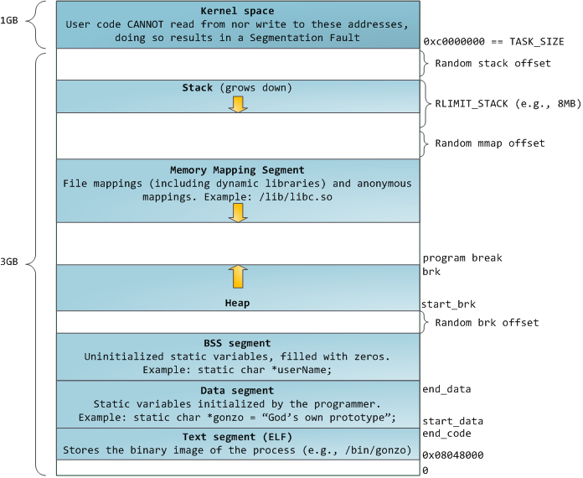
Memory Layout for Linux 32-bit
http://static.duartes.org/img/blogPosts/linuxFlexibleAddressSpaceLayout.png

Slide 23
Summary: Simple Page Table
Page Table
Virtual memory view
Physical memory view
1111 1111
11111 11101
11110 11100
11101 null
11100 null
11011 null
11010 null
11001 null
11000 null
10111 null
10110 null
10101 null
10100 null
10011 null
10010 10000
10001 01111
10000 01110
01111 null
01110 null
01101 null
01100 null
01011 01101
01010 01100
01001 01011
01000 01010
00111 null
00110 null
00101 null
00100 null
00011 00101
00010 00100
00001 00011
00000 00010
1110 1111
1111 0000
stack
stack
1110 0000
1100 0000
heap
1000 0000
heap
0111 000
data
data
0101 000
0100 0000
code
code
0001 0000
0000 0000
0000 0000
page #
offset

Slide 24
Summary: Simple Page Table
Page Table
Virtual memory view
Physical memory view
1111 1111
11111 11101
11110 11100
11101 null
11100 null
11011 null
11010 null
11001 null
11000 null
10111 null
10110 null
10101 null
10100 null
10011 null
10010 10000
10001 01111
10000 01110
01111 null
01110 null
01101 null
01100 null
01011 01101
01010 01100
01001 01011
01000 01010
00111 null
00110 null
00101 null
00100 null
00011 00101
00010 00100
00001 00011
00000 00010
stack
1110 0000
stack
1110 0000
1100 0000
What happens if stack grows to 1110 0000?
heap
1000 0000
heap
0111 000
data
data
0101 000
0100 0000
code
code
0001 0000
0000 0000
0000 0000
page #
offset

Slide 25
Summary: Simple Page Table
Page Table
Virtual memory view
Physical memory view
1111 1111
11111 11101
11110 11100
11101 10111
11100 10110
11011 null
11010 null
11001 null
11000 null
10111 null
10110 null
10101 null
10100 null
10011 null
10010 10000
10001 01111
10000 01110
01111 null
01110 null
01101 null
01100 null
01011 01101
01010 01100
01001 01011
01000 01010
00111 null
00110 null
00101 null
00100 null
00011 00101
00010 00100
00001 00011
00000 00010
stack
1110 0000
stack
1110 0000
1100 0000
stack
Allocate new pages where room!
heap
1000 0000
heap
0111 000
data
Challenge: Table size equal to # of pages in virtual memory!
data
0101 000
0100 0000
code
code
0001 0000
0000 0000
0000 0000
page #
offset

Slide 26
Page Table Discussion
What needs to be switched on a context switch?
Page table pointer and limit
Analysis
Pros
Simple memory allocation
Easy to Share
Con: What if address space is sparse?
E.g. on UNIX, code starts at 0, stack starts at (2³¹-1).
With 1K pages, need 2 million page table entries!
Con: What if table really big?
Not all pages used all the time ⇒ would be nice to have working set of page table in memory
How about combining paging and segmentation?
Segments with pages inside them?
Need some sort of multi-level translation
Notes:
What if page size is very small? VAX had a 512-byte page size = lots of space for page table entries
What if page size is really big? Wastes space inside of page (internal fragmentation)

Slide 27
Fix for sparse address space: The two-level page table
Physical
Address:
Physical
Page #
Offset
10 bits
10 bits
12 bits
Virtual
Address:
Virtual
P1 index
Virtual
P2 index
Offset
4KB
PageTablePtr
4 bytes
Tree of Page Tables
Tables fixed size (1024 entries)
On context-switch: save single PageTablePtr register
Valid bits on Page Table Entries
Don’t need every 2nd-level table
Even when exist, 2nd-level tables can reside on disk if not in use
4 bytes

Slide 28
Summary: Two-Level Paging
Virtual memory view
Page Tables
(level 2)
Physical memory view
1111 1111
stack
11 11101
10 11100
01 10111
00 10110
stack
1110 0000
1111 0000
1100 0000
Page Table
(level 1)
stack
111
110 null
101 null
100
011 null
010
001 null
000
11 null
10 10000
01 01111
00 01110
heap
1000 0000
heap
0111 000
11 01101
10 01100
01 01011
00 01010
data
data
0101 000
0100 0000
11 00101
10 00100
01 00011
00 00010
code
page2 #
code
0001 0000
0000 0000
0000 0000
page1 #
offset

Slide 29
Summary: Two-Level Paging
Virtual memory view
Page Tables
(level 2)
Physical memory view
stack
11 11101
10 11100
01 10111
00 10110
stack
1110 0000
Page Table
(level 1)
stack
111
110 null
101 null
100
011 null
010
001 null
000
11 null
10 10000
01 01111
00 01110
1001 0000
(0x90)
heap
heap
1000 0000
(0x80)
In best case, total size of page tables ≈ number of pages used by program virtual memory. Requires two additional memory access!
11 01101
10 01100
01 01011
00 01010
data
data
11 00101
10 00100
01 00011
00 00010
code
code
0001 0000
0000 0000

Slide 30
Multi-level Translation: Segments + Pages
What about a tree of tables?
Lowest level page table⇒memory still allocated with bitmap
Higher levels often segmented
Could have any number of levels. Example (top segment):
What must be saved/restored on context switch?
Contents of top-level segment registers (for this example)
Pointer to top-level table (page table)
Virtual
Address:
Virtual
Seg #
Virtual
Page #
Offset
page #0
V,R
Base0
Limit0
V
page #1
V,R
Physical
Page #
Offset
page #2
V,R,W
Base1
Limit1
V
page #2
V,R,W
Physical Address
Base2
Limit2
V
page #3
V,R,W
Base2
Limit2
V
Base3
Limit3
N
page #4
N
Base4
Limit4
V
page #5
V,R,W
Check Perm
Base5
Limit5
N
Base6
Limit6
N
Base7
Limit7
V
>
Access
Error
Access
Error

Slide 31
What about Sharing (Complete Segment)?
Process
A
Virtual
Seg #
Virtual
Page #
Offset
page #0
V,R
page #1
V,R
page #2
V,R,W
Base0
Limit0
V
page #3
V,R,W
Base1
Limit1
V
page #4
N
Base2
Limit2
V
Base2
Limit2
V
page #5
V,R,W
Base3
Limit3
N
Base4
Limit4
V
Shared Segment
Base5
Limit5
N
Base6
Limit6
N
Base0
Limit0
V
Base7
Limit7
V
Base1
Limit1
V
Base2
Base2
Limit2
Limit2
V
V
Base3
Limit3
N
Base4
Limit4
V
Base5
Limit5
N
Base6
Limit6
N
Base7
Limit7
V
Process
B
Virtual
Seg #
Virtual
Page #
Offset

Slide 32
Multi-level Translation Analysis
Pros:
Only need to allocate as many page table entries as we need for application
In other wards, sparse address spaces are easy
Easy memory allocation
Easy Sharing
Share at segment or page level (need additional reference counting)
Cons:
One pointer per page (typically 4K – 16K pages today)
Page tables need to be contiguous
However, previous example keeps tables to exactly one page in size
Two (or more, if >2 levels) lookups per reference
Seems very expensive!

Slide 33
Inverted Page Table
With all previous examples (“Forward Page Tables”)
Size of page table is at least as large as amount of virtual memory allocated to processes
Physical memory may be much less
Much of process space may be out on disk or not in use
Answer: use a hash table
Called an “Inverted Page Table”
Size is independent of virtual address space
Directly related to amount of physical memory
Very attractive option for 64-bit address spaces
Cons: Complexity of managing hash changes
Often in hardware!
Virtual
Page #
Offset
Hash
Table
Physical
Page #
Offset

Slide 34
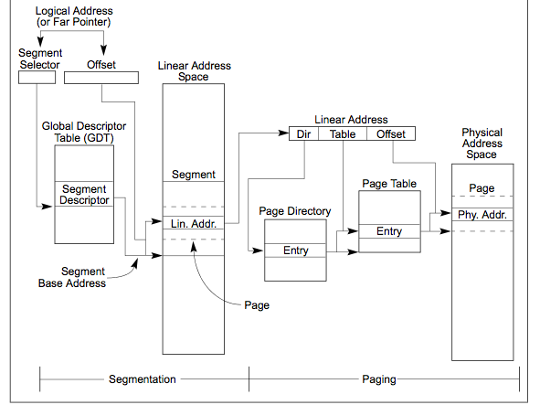
Making it real: X86 Memory model with segmentation (16/32-bit)

Slide 35

X86 Segment Descriptors (32-bit Protected Mode)
Segments are either implicit in the instruction (say for code segments) or actually part of the instruction
There are 6 registers: SS, CS, DS, ES, FS, GS
What is in a segment register?
A pointer to the actual segment description: G/L selects between GDT and LDT tables (global vs local descriptor tables)
Two registers: GDTR and LDTR hold pointers to the global and local descriptor tables in memory
Includes length of table (for < 2¹³) entries
Descriptor format (64 bits):
G: Granularity of segment (0: 16bit, 1: 4KiB unit) DB: Default operand size (0; 16bit, 1: 32bit) A: Freely available for use by software P: Segment present DPL: Descriptor Privilege Level S: System Segment (0: System, 1: code or data) Type: Code, Data, Segment
Segment selector [13 bits]
G/L
RPL

Slide 36
What is in a Page Table Entry?
What is in a Page Table Entry (or PTE)?
Pointer to next-level page table or to actual page
Permission bits: valid, read-only, read-write, write-only
Example: Intel x86 architecture PTE:
Address same format previous slide (10, 10, 12-bit offset)
Intermediate page tables called “Directories”
P: Present (same as “valid” bit in other architectures)
W: Writeable
U: User accessible
PWT: Page write transparent: external cache write-through
PCD: Page cache disabled (page cannot be cached)
A: Accessed: page has been accessed recently
D: Dirty (PTE only): page has been modified recently
L: L=1⇒4MB page (directory only). Bottom 22 bits of virtual address serve as offset
Page Frame Number
(Physical Page Number)
Free
(OS)
0
L
D
A
PCD
PWT
U
W
P
31-12
11-9
8
7
6
5
4
3
2
1
0

Slide 37
Examples of how to use a PTE
How do we use the PTE?
Invalid PTE can imply different things:
Region of address space is actually invalid or
Page/directory is just somewhere else than memory
Validity checked first
OS can use other (say) 31 bits for location info
Usage Example: Demand Paging
Keep only active pages in memory
Place others on disk and mark their PTEs invalid
Usage Example: Copy on Write
UNIX fork gives copy of parent address space to child
Address spaces disconnected after child created
How to do this cheaply?
Make copy of parent’s page tables (point at same memory)
Mark entries in both sets of page tables as read-only
Page fault on write creates two copies
Usage Example: Zero Fill On Demand
New data pages must carry no information (say be zeroed)
Mark PTEs as invalid; page fault on use gets zeroed page
Often, OS creates zeroed pages in background

Slide 38
How is the translation accomplished?
Virtual
Addresses
Physical
Addresses
CPU
MMU
What, exactly happens inside MMU?
One possibility: Hardware Tree Traversal
For each virtual address, takes page table base pointer and traverses the page table in hardware
Generates a “Page Fault” if it encounters invalid PTE
Fault handler will decide what to do
More on this next lecture
Pros: Relatively fast (but still many memory accesses!)
Cons: Inflexible, Complex hardware
Another possibility: Software
Each traversal done in software
Pros: Very flexible
Cons: Every translation must invoke Fault!
In fact, need way to cache translations for either case!

Slide 39
Recall: Dual-Mode Operation
Can a process modify its own translation tables?
NO!
If it could, could get access to all of physical memory
Has to be restricted somehow
To Assist with Protection, Hardware provides at least two modes (Dual-Mode Operation):
“Kernel” mode (or “supervisor” or “protected”)
“User” mode (Normal program mode)
Mode set with bits in special control register only accessible in kernel-mode
Intel processor actually has four “rings” of protection:
PL (Priviledge Level) from 0 – 3
PL0 has full access, PL3 has least
Privilege Level set in code segment descriptor (CS)
Mirrored “IOPL” bits in condition register gives permission to programs to use the I/O instructions
Typical OS kernels on Intel processors only use PL0 (“kernel”) and PL3 (“user”)

Slide 40
How to get from Kernel→User
What does the kernel do to create a new user process?
Allocate and initialize address-space control block
Read program off disk and store in memory
Allocate and initialize translation table
Point at code in memory so program can execute
Possibly point at statically initialized data
Run Program:
Set machine registers
Set hardware pointer to translation table
Set processor status word for user mode
Jump to start of program
How does kernel switch between processes?
Same saving/restoring of registers as before
Save/restore PSL (hardware pointer to translation table)

Slide 41
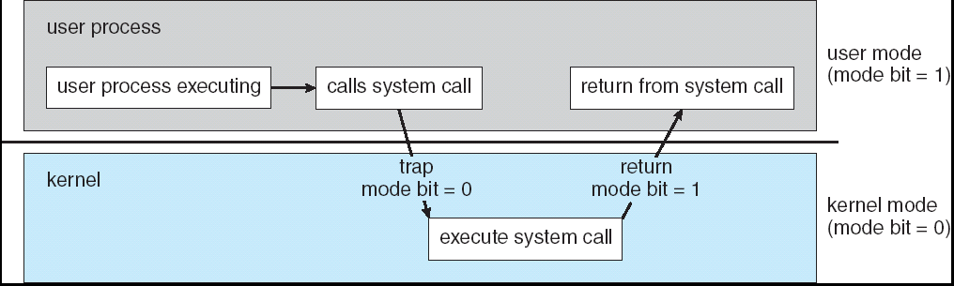
Recall: User→Kernel (System Call)
Can’t let inmate (user) get out of padded cell on own
Would defeat purpose of protection!
So, how does the user program get back into kernel?
System call: Voluntary procedure call into kernel
Hardware for controlled User→Kernel transition
Can any kernel routine be called?
No! Only specific ones.
System call ID encoded into system call instruction
Index forces well-defined interface with kernel

Slide 42
System Call Continued
What are some system calls?
I/O: open, close, read, write, lseek
Files: delete, mkdir, rmdir, truncate, chown, chgrp, ..
Process: fork, exit, wait (like join)
Network: socket create, set options
Are system calls constant across operating systems?
Not entirely, but there are lots of commonalities
Also some standardization attempts (POSIX)
What happens at beginning of system call?
On entry to kernel, sets system to kernel mode
Handler address fetched from table/Handler started
System Call argument passing:
In registers (not very much can be passed)
Write into user memory, kernel copies into kernel mem
User addresses must be translated!
Kernel has different view of memory than user
Every Argument must be explicitly checked!

Slide 43
User→Kernel (Exceptions: Traps and Interrupts)
A system call instruction causes a synchronous exception (or “trap”)
In fact, often called a software “trap” instruction
Other sources of Synchronous Exceptions (“Trap”):
Divide by zero, Illegal instruction, Bus error (bad address, e.g. unaligned access)
Segmentation Fault (address out of range)
Page Fault (for illusion of infinite-sized memory)
Interrupts are Asynchronous Exceptions
Examples: timer, disk ready, network, etc….
Interrupts can be disabled, traps cannot!
On system call, exception, or interrupt:
Hardware enters kernel mode with interrupts disabled
Saves PC, then jumps to appropriate handler in kernel
For some processors (x86), processor also saves registers, changes stack, etc.
Actual handler typically saves registers, other CPU state, and switches to kernel stack

Slide 44
Closing thought: Protection without Hardware
Does protection require hardware support for translation and dual-mode behavior?
No: Normally use hardware, but anything you can do in hardware can also do in software (possibly expensive)
Protection via Strong Typing
Restrict programming language so that you can’t express program that would trash another program
Loader needs to make sure that program produced by valid compiler or all bets are off
Example languages: LISP, Ada, Modula-3 and Java
Protection via software fault isolation:
Language independent approach: have compiler generate object code that provably can’t step out of bounds
Compiler puts in checks for every “dangerous” operation (loads, stores, etc). Again, need special loader.
Alternative, compiler generates “proof” that code cannot do certain things (Proof Carrying Code)
Or: use virtual machine to guarantee safe behavior (loads and stores recompiled on fly to check bounds)

Slide 45
Summary (1/2)
Segment Mapping
Segment registers within processor
Segment ID associated with each access
Often comes from portion of virtual address
Can come from bits in instruction instead (x86)
Each segment contains base and limit information
Offset (rest of address) adjusted by adding base
Page Tables
Memory divided into fixed-sized chunks of memory
Virtual page number from virtual address mapped through page table to physical page number
Offset of virtual address same as physical address
Large page tables can be placed into virtual memory
Multi-Level Tables
Virtual address mapped to series of tables
Permit sparse population of address space
Inverted page table
Size of page table related to physical memory size

Slide 46
Summary (2/2)
PTE: Page Table Entries
Includes physical page number
Control info (valid bit, writeable, dirty, user, etc)
Dual-Mode
Kernel/User distinction: User restricted
User→Kernel: System calls, Traps, or Interrupts
Inter-process communication: shared memory, or through kernel (system calls)
Exceptions
Synchronous Exceptions: Traps (including system calls)
Asynchronous Exceptions: Interrupts

