Slide 1
CS162 Operating Systems and Systems Programming Lecture 15 Demand Paging (Finished), General I/O
March 18th, 2015
Prof. John Kubiatowicz
http://cs162.eecs.Berkeley.edu

Slide 2
Recall: Precise Exceptions
Precise ⇒ state of the machine is preserved as if program executed up to the offending instruction
All previous instructions completed
Offending instruction and all following instructions act as if they have not even started
Same system code will work on different implementations
Difficult in the presence of pipelining, out-of-order execution, ...
MIPS takes this position
Imprecise ⇒ system software has to figure out what is where and put it all back together
Performance goals often lead designers to forsake precise interrupts
system software developers, user, markets etc. usually wish they had not done this
Modern techniques for out-of-order execution and branch prediction help implement precise interrupts

Slide 3
Recall: Demand Paging Mechanisms
PTE helps us implement demand paging
Valid ⇒ Page in memory, PTE points at physical page
Not Valid ⇒ Page not in memory; use info in PTE to find it on disk when necessary
Suppose user references page with invalid PTE?
Memory Management Unit (MMU) traps to OS
Resulting trap is a “Page Fault”
What does OS do on a Page Fault?:
Choose an old page to replace
If old page modified (“D=1”), write contents back to disk
Change its PTE and any cached TLB to be invalid
Load new page into memory from disk
Update page table entry, invalidate TLB for new entry
Continue thread from original faulting location
TLB for new page will be loaded when thread continued!
While pulling pages off disk for one process, OS runs another process from ready queue
Suspended process sits on wait queue
Cache

Slide 4
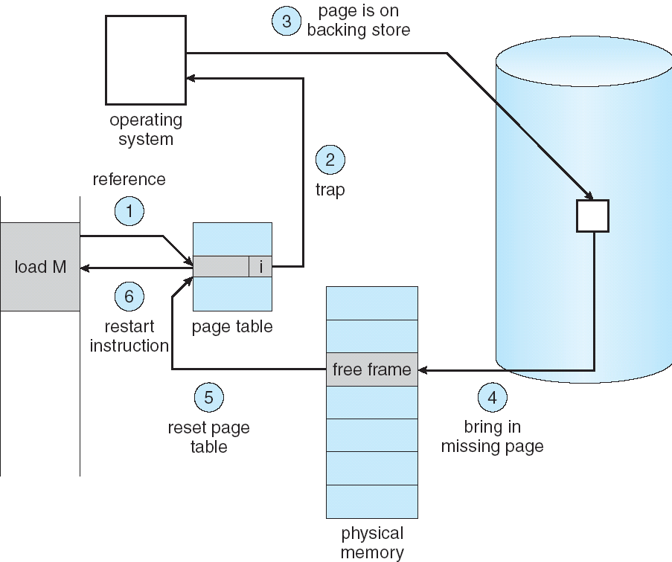
Summary: Steps in Handling a Page Fault

Slide 5
Management & Access to the Memory Hierarchy
Managed in Hardware
Managed in Software - OS
?
Processor
Secondary Storage (Disk)
TLB
PT
L2 Cache
Registers
L1 Cache
Secondary Storage (SSD)
PT
PT
Main
Memory
(DRAM)
PT
TLB
L3 Cache (shared)
L2 Cache
Registers
L1 Cache
Accessed in Hardware
Speed (ns):
0.3
1
3
10-30
100
100,000 (0.1 ms)
10,000,000
(10 ms)
Size (bytes):
100Bs
10kBs
100kBs
MBs
GBs
100GBs
TBs
Notes:
The design goal is to present the user with as much memory as is available in the cheapest technology (points to the disk).
While by taking advantage of the principle of locality, we like to provide the user an average access speed that is very close to the speed that is offered by the fastest technology.
(We will go over this slide in details in the next lecture on caches).
+1 = 16 min. (X:56)

Slide 6
Some questions for this lecture!
During a page fault, where does the OS get a free frame?
Keeps a free list
Unix runs a “reaper” if memory gets too full
As a last resort, evict a dirty page first
How can we organize these mechanisms?
Work on the replacement policy
How many page frames/process?
Like thread scheduling, need to “schedule” memory resources:
utilization? fairness? priority?
allocation of disk paging bandwidth

Slide 7
Demand Paging Cost Model
Since Demand Paging like caching, can compute average access time! (“Effective Access Time”)
EAT = Hit Rate x Hit Time + Miss Rate x Miss Time
EAT = Hit Time + Miss Rate x Miss Penalty
Example:
Memory access time = 200 nanoseconds
Average page-fault service time = 8 milliseconds
Suppose p = Probability of miss, 1-p = Probably of hit
Then, we can compute EAT as follows:
EAT = 200ns + p x 8 ms
= 200ns + p x 8,000,000ns
If one access out of 1,000 causes a page fault, then EAT = 8.2 μs:
This is a slowdown by a factor of 40!
What if want slowdown by less than 10%?
200ns x 1.1 < EAT ⇒ p < 2.5 x 10⁻⁶
This is about 1 page fault in 400000!

Slide 8
What Factors Lead to Misses?
Compulsory Misses:
Pages that have never been paged into memory before
How might we remove these misses?
Prefetching: loading them into memory before needed
Need to predict future somehow! More later.
Capacity Misses:
Not enough memory. Must somehow increase size.
Can we do this?
One option: Increase amount of DRAM (not quick fix!)
Another option: If multiple processes in memory: adjust percentage of memory allocated to each one!
Conflict Misses:
Technically, conflict misses don’t exist in virtual memory, since it is a “fully-associative” cache
Policy Misses:
Caused when pages were in memory, but kicked out prematurely because of the replacement policy
How to fix? Better replacement policy

Slide 9
Page Replacement Policies
Why do we care about Replacement Policy?
Replacement is an issue with any cache
Particularly important with pages
The cost of being wrong is high: must go to disk
Must keep important pages in memory, not toss them out
FIFO (First In, First Out)
Throw out oldest page. Be fair – let every page live in memory for same amount of time.
Bad, because throws out heavily used pages instead of infrequently used pages
MIN (Minimum):
Replace page that won’t be used for the longest time
Great, but can’t really know future…
Makes good comparison case, however
RANDOM:
Pick random page for every replacement
Typical solution for TLB’s. Simple hardware
Pretty unpredictable – makes it hard to make real-time guarantees

Slide 10
Replacement Policies (Con’t)
LRU (Least Recently Used):
Replace page that hasn’t been used for the longest time
Programs have locality, so if something not used for a while, unlikely to be used in the near future.
Seems like LRU should be a good approximation to MIN.
How to implement LRU? Use a list!
On each use, remove page from list and place at head
LRU page is at tail
Problems with this scheme for paging?
Need to know immediately when each page used so that can change position in list…
Many instructions for each hardware access
In practice, people approximate LRU (more later)
Page 6
Page 7
Page 1
Page 2
Head
Tail (LRU)

Slide 11
Example: FIFO
Suppose we have 3 page frames, 4 virtual pages, and following reference stream:
A B C A B D A D B C B
Consider FIFO Page replacement:
FIFO: 7 faults.
When referencing D, replacing A is bad choice, since need A again right away
Ref:
Page:
A
B
C
A
B
D
A
D
B
C
B
1
A
D
C
2
B
A
3
C
B

Slide 12
Example: MIN
Suppose we have the same reference stream:
A B C A B D A D B C B
Consider MIN Page replacement:
MIN: 5 faults
Where will D be brought in? Look for page not referenced farthest in future.
What will LRU do?
Same decisions as MIN here, but won’t always be true!
Ref:
Page:
A
B
C
A
B
D
A
D
B
C
B
1
A
C
2
B
3
C
D

Slide 13
When will LRU perform badly?
Consider the following: A B C D A B C D A B C D
LRU Performs as follows (same as FIFO here):
Every reference is a page fault!
MIN Does much better:
Ref:
Page:
A
B
C
D
A
B
C
D
A
B
C
D
1
A
D
C
B
2
B
A
D
C
3
C
B
A
D
Ref:
Page:
A
B
C
D
A
B
C
D
A
B
C
D
1
A
B
2
B
C
3
C
D

Slide 14
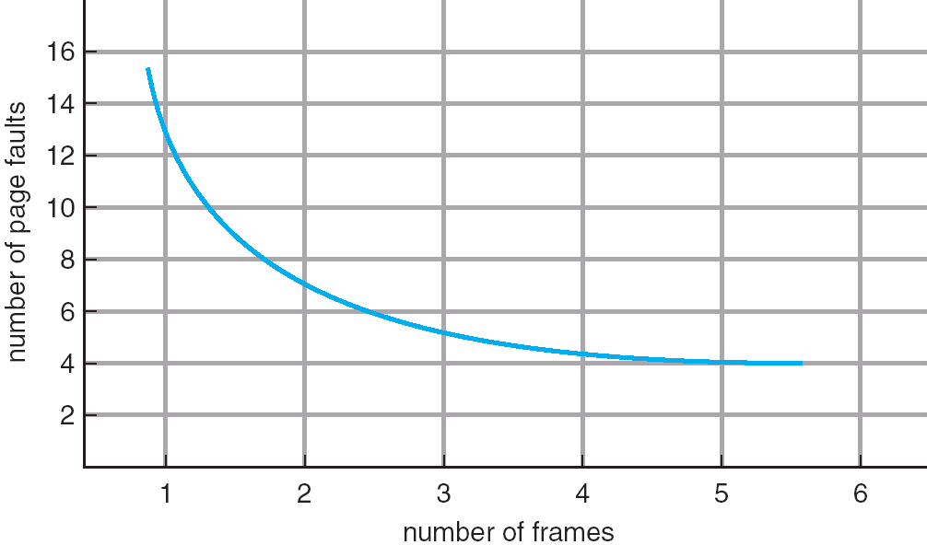
Graph of Page Faults Versus The Number of Frames
One desirable property: When you add memory the miss rate goes down
Does this always happen?
Seems like it should, right?
No: BeLady’s anomaly
Certain replacement algorithms (FIFO) don’t have this obvious property!

Slide 15
Adding Memory Doesn’t Always Help Fault Rate
Does adding memory reduce number of page faults?
Yes for LRU and MIN
Not necessarily for FIFO! (Called Belady’s anomaly)
After adding memory:
With FIFO, contents can be completely different
In contrast, with LRU or MIN, contents of memory with X pages are a subset of contents with X+1 Page
Ref:
Page:
A
B
C
D
A
B
E
A
B
C
D
E
1
A
D
E
2
B
A
C
3
C
B
D
Ref:
Page:
A
B
C
D
A
B
E
A
B
C
D
E
1
A
E
D
2
B
A
E
3
C
B
4
D
C

Slide 16
Administrivia
Problems with website (cs162.eecs.Berkeley.edu)
Ran out of space/crashed yesterday
Restore of bad checkpoint caused phantom HW3 to appear (it was last year’s version)
Everything should be ok now – please check
No sections this week!
Spring Break is next week!
No class!
Still working on the grading of exams
No deadline yet, will let you know
Solutions are done!
Will be posted on new handout link shortly
Checkpoint 1 moved to after Spring Break
Monday, 3/30

Slide 17
Implementing LRU
Perfect:
Timestamp page on each reference
Keep list of pages ordered by time of reference
Too expensive to implement in reality for many reasons
Clock Algorithm: Arrange physical pages in circle with single clock hand
Approximate LRU (approx to approx to MIN)
Replace an old page, not the oldest page
Details:
Hardware “use” bit per physical page:
Hardware sets use bit on each reference
If use bit isn’t set, means not referenced in a long time
Nachos hardware sets use bit in the TLB; you have to copy this back to page table when TLB entry gets replaced
On page fault:
Advance clock hand (not real time)
Check use bit: 1→used recently; clear and leave alone 0→selected candidate for replacement
Will always find a page or loop forever?
Even if all use bits set, will eventually loop around⇒FIFO

Slide 18
Clock Algorithm: Not Recently Used
Set of all pages
in Memory
Single Clock Hand:
Advances only on page fault!
Check for pages not used recently
Mark pages as not used recently
What if hand moving slowly?
Good sign or bad sign?
Not many page faults and/or find page quickly
What if hand is moving quickly?
Lots of page faults and/or lots of reference bits set
One way to view clock algorithm:
Crude partitioning of pages into two groups: young and old
Why not partition into more than 2 groups?

Slide 19
N^{th} Chance version of Clock Algorithm
N^{th} chance algorithm: Give page N chances
OS keeps counter per page: # sweeps
On page fault, OS checks use bit:
1⇒clear use and also clear counter (used in last sweep)
0⇒increment counter; if count=N, replace page
Means that clock hand has to sweep by N times without page being used before page is replaced
How do we pick N?
Why pick large N? Better approx to LRU
If N ~ 1K, really good approximation
Why pick small N? More efficient
Otherwise might have to look a long way to find free page
What about dirty pages?
Takes extra overhead to replace a dirty page, so give dirty pages an extra chance before replacing?
Common approach:
Clean pages, use N=1
Dirty pages, use N=2 (and write back to disk when N=1)

Slide 20
Clock Algorithms: Details
Which bits of a PTE entry are useful to us?
Use: Set when page is referenced; cleared by clock algorithm
Modified: set when page is modified, cleared when page written to disk
Valid: ok for program to reference this page
Read-only: ok for program to read page, but not modify
For example for catching modifications to code pages!
Do we really need hardware-supported “modified” bit?
No. Can emulate it (BSD Unix) using read-only bit
Initially, mark all pages as read-only, even data pages
On write, trap to OS. OS sets software “modified” bit, and marks page as read-write.
Whenever page comes back in from disk, mark read-only

Slide 21
Clock Algorithms Details (continued)
Do we really need a hardware-supported “use” bit?
No. Can emulate it similar to above:
Mark all pages as invalid, even if in memory
On read to invalid page, trap to OS
OS sets use bit, and marks page read-only
Get modified bit in same way as previous:
On write, trap to OS (either invalid or read-only)
Set use and modified bits, mark page read-write
When clock hand passes by, reset use and modified bits and mark page as invalid again
Remember, however, that clock is just an approximation of LRU
Can we do a better approximation, given that we have to take page faults on some reads and writes to collect use information?
Need to identify an old page, not oldest page!
Answer: second chance list

Slide 22
Second-Chance List Algorithm (VAX/VMS)
LRU victim
Directly
Mapped Pages
Marked: RW
List: FIFO
Overflow
Second
Chance List
Marked: Invalid
List: LRU
Access
New
Active
Pages
New
SC
Victims
Page-in
From disk
Split memory in two: Active list (RW), SC list (Invalid)
Access pages in Active list at full speed
Otherwise, Page Fault
Always move overflow page from end of Active list to front of Second-chance list (SC) and mark invalid
Desired Page On SC List: move to front of Active list, mark RW
Not on SC list: page in to front of Active list, mark RW; page out LRU victim at end of SC list

Slide 23
Second-Chance List Algorithm (con’t)
How many pages for second chance list?
If 0 ⇒ FIFO
If all ⇒ LRU, but page fault on every page reference
Pick intermediate value. Result is:
Pro: Few disk accesses (page only goes to disk if unused for a long time)
Con: Increased overhead trapping to OS (software / hardware tradeoff)
With page translation, we can adapt to any kind of access the program makes
Later, we will show how to use page translation / protection to share memory between threads on widely separated machines
Question: why didn’t VAX include “use” bit?
Strecker (architect) asked OS people, they said they didn’t need it, so didn’t implement it
He later got blamed, but VAX did OK anyway

Slide 24
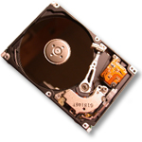
Free List
Set of all pages
in Memory
Single Clock Hand:
Advances as needed to keep freelist full (“background”)
D
D
Free Pages
For Processes
Keep set of free pages ready for use in demand paging
Freelist filled in background by Clock algorithm or other technique (“Pageout demon”)
Dirty pages start copying back to disk when enter list
Like VAX second-chance list
If page needed before reused, just return to active set
Advantage: Faster for page fault
Can always use page (or pages) immediately on fault

Slide 25
Demand Paging (more details)
Does software-loaded TLB need use bit? Two Options:
Hardware sets use bit in TLB; when TLB entry is replaced, software copies use bit back to page table
Software manages TLB entries as FIFO list; everything not in TLB is Second-Chance list, managed as strict LRU
Core Map
Page tables map virtual page → physical page
Do we need a reverse mapping (i.e. physical page → virtual page)?
Yes. Clock algorithm runs through page frames. If sharing, then multiple virtual-pages per physical page
Can’t push page out to disk without invalidating all PTEs

Slide 26
Allocation of Page Frames (Memory Pages)
How do we allocate memory among different processes?
Does every process get the same fraction of memory? Different fractions?
Should we completely swap some processes out of memory?
Each process needs minimum number of pages
Want to make sure that all processes that are loaded into memory can make forward progress
Example: IBM 370 – 6 pages to handle SS MOVE instruction:
instruction is 6 bytes, might span 2 pages
2 pages to handle from
2 pages to handle to
Possible Replacement Scopes:
Global replacement – process selects replacement frame from set of all frames; one process can take a frame from another
Local replacement – each process selects from only its own set of allocated frames

Slide 27
Fixed/Priority Allocation
Equal allocation (Fixed Scheme):
Every process gets same amount of memory
Example: 100 frames, 5 processes⇒process gets 20 frames
Proportional allocation (Fixed Scheme)
Allocate according to the size of process
Computation proceeds as follows:
s_{i} = size of process p_{i} and S = Σs_{i}
m = total number of frames
a_{i} = allocation for p_{i} =
Priority Allocation:
Proportional scheme using priorities rather than size
Same type of computation as previous scheme
Possible behavior: If process p_{i} generates a page fault, select for replacement a frame from a process with lower priority number
Perhaps we should use an adaptive scheme instead???
What if some application just needs more memory?

Slide 28
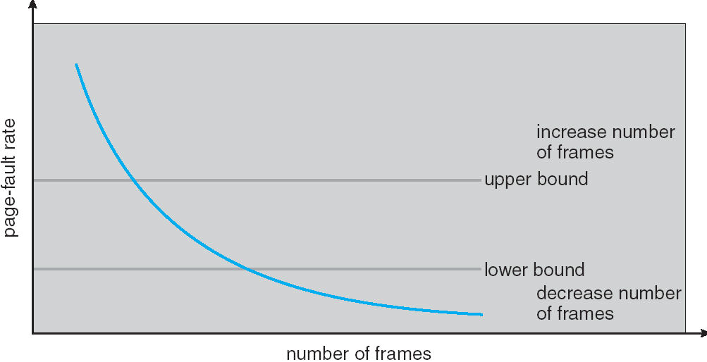
Page-Fault Frequency Allocation
Can we reduce Capacity misses by dynamically changing the number of pages/application?
Establish “acceptable” page-fault rate
If actual rate too low, process loses frame
If actual rate too high, process gains frame
Question: What if we just don’t have enough memory?

Slide 29
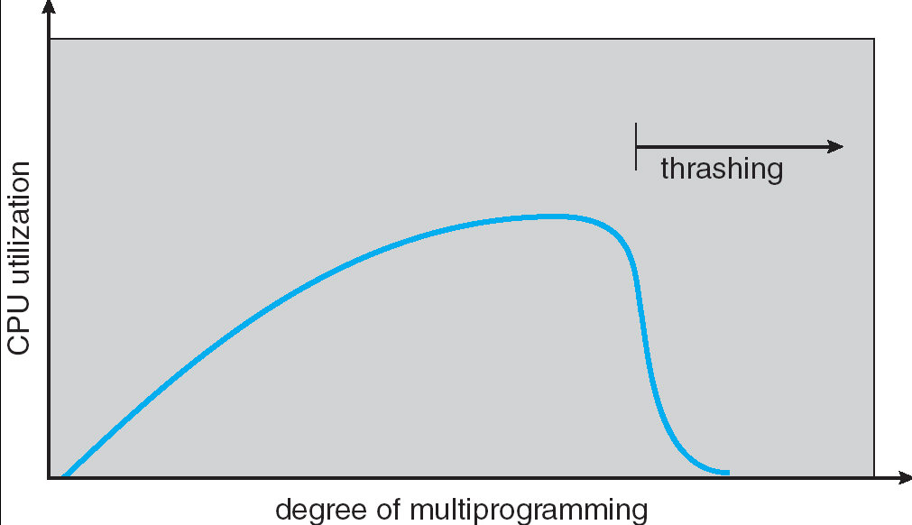
Thrashing
If a process does not have “enough” pages, the page-fault rate is very high. This leads to:
low CPU utilization
operating system spends most of its time swapping to disk
Thrashing ≡ a process is busy swapping pages in and out
Questions:
How do we detect Thrashing?
What is best response to Thrashing?
Notes:
Example: one program, touches 50 pages (each equally likely). Have only 40 physical page frames.
How bad is this?
- Does your program run at 80% speed?
- Does your program run at 20% speed?
Performance is really bad
If we have enough pages, 200 ns/ref, but if too few pages, assume every 5th page reference causes a page fault
= 4 refs x 200 ns
1 page fault x 10 ms for disk I/O
= 5 refs, 10 ms + 800 ns => 2 ms/ref (not 100 MIPS, but 500 IPS! Factor of 10,000)
Machine appears to have stopped!

Slide 30
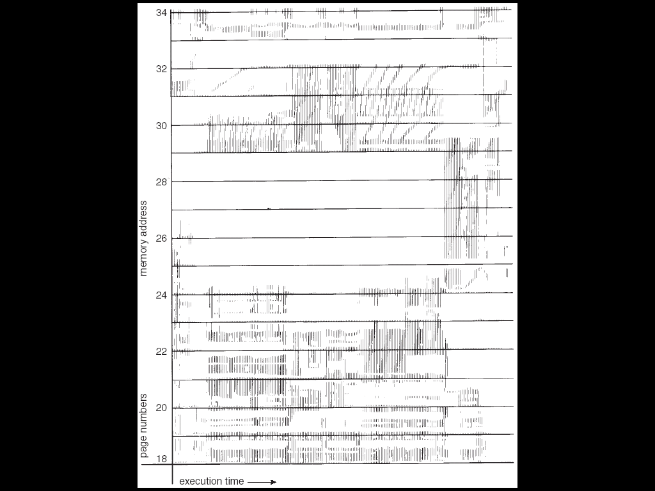
Locality In A Memory-Reference Pattern
Program Memory Access Patterns have temporal and spatial locality
Group of Pages accessed along a given time slice called the “Working Set”
Working Set defines minimum number of pages needed for process to behave well
Not enough memory for Working Set⇒Thrashing
Better to swap out process?

Slide 31
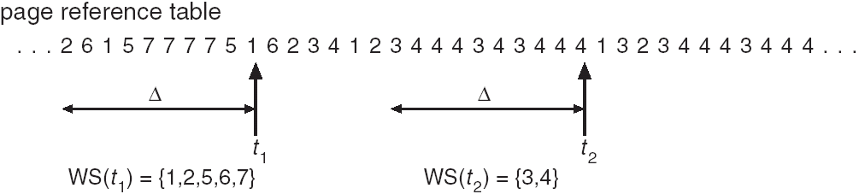
Working-Set Model
Δ ≡ working-set window ≡ fixed number of page references
Example: 10,000 instructions
WS_{i} (working set of Process P_{i}) = total set of pages referenced in the most recent Δ (varies in time)
if Δ too small will not encompass entire locality
if Δ too large will encompass several localities
if Δ = ∞ ⇒ will encompass entire program
D = Σ|WS_{i}| ≡ total demand frames
if D > m ⇒ Thrashing
Policy: if D > m, then suspend/swap out processes
This can improve overall system behavior by a lot!

Slide 32
What about Compulsory Misses?
Recall that compulsory misses are misses that occur the first time that a page is seen
Pages that are touched for the first time
Pages that are touched after process is swapped out/swapped back in
Clustering:
On a page-fault, bring in multiple pages “around” the faulting page
Since efficiency of disk reads increases with sequential reads, makes sense to read several sequential pages
Working Set Tracking:
Use algorithm to try to track working set of application
When swapping process back in, swap in working set

Slide 33
You are here …

Slide 34
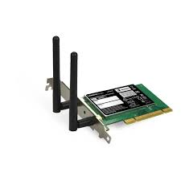
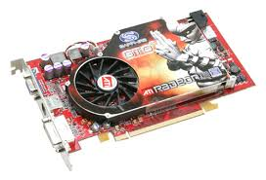


OS Basics: I/O
Threads
Address Spaces
Windows
Processes
Files
Sockets
Software
OS Hardware Virtualization
Hardware
ISA
Memory
Processor
Protection Boundary
OS
Ctrlr
storage
Networks
Displays
Inputs

Slide 35
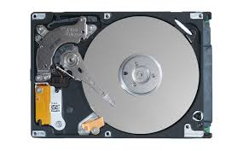
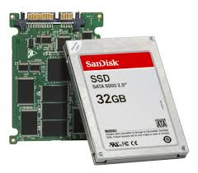
In a picture
Read / Write
wires
Processor
I/O
Controllers
Secondary Storage (Disk)
Core
L2 Cache
Registers
L1 Cache
interrupts
Secondary Storage (SSD)
Read / Write
Main
Memory
(DRAM)
DMA transfer
L3 Cache (shared)
Core
L2 Cache
Registers
L1 Cache
I/O devices you recognize are supported by I/O Controllers
Processors accesses them by reading and writing IO registers as if they were memory
Write commands and arguments, read status and results

Slide 36
The Requirements of I/O
So far in this course:
We have learned how to manage CPU, memory
What about I/O?
Without I/O, computers are useless (disembodied brains?)
But… thousands of devices, each slightly different
How can we standardize the interfaces to these devices?
Devices unreliable: media failures and transmission errors
How can we make them reliable???
Devices unpredictable and/or slow
How can we manage them if we don’t know what they will do or how they will perform?
Some operational parameters:
Byte/Block
Some devices provide single byte at a time (e.g. keyboard)
Others provide whole blocks (e.g. disks, networks, etc)
Sequential/Random
Some devices must be accessed sequentially (e.g. tape)
Others can be accessed randomly (e.g. disk, cd, etc.)
Polling/Interrupts
Some devices require continual monitoring
Others generate interrupts when they need service

Slide 37

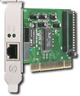
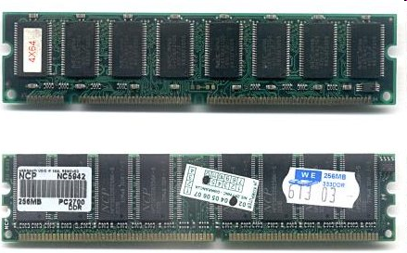
Kernel Device Structure
The System Call Interface
Process
Management
Memory Management
Filesystems
Device Control
Networking
Concurrency, multitasking
Virtual memory
Files and dirs: the VFS
TTYs and device access
Connectivity
Architecture
Dependent
Code
Memory Manager
File System Types
Device Control
Network Subsystem
Block Devices
IF drivers

Slide 38
The Goal of the I/O Subsystem
Provide Uniform Interfaces, Despite Wide Range of Different Devices
This code works on many different devices:
FILE fd = fopen(“/dev/something”,”rw”); for (int i = 0; i < 10; i++) { fprintf(fd,”Count %d\n”,i); } close(fd);
Why? Because code that controls devices (“device driver”) implements standard interface.
We will try to get a flavor for what is involved in actually controlling devices in rest of lecture
Can only scratch surface!

Slide 39
Want Standard Interfaces to Devices
Block Devices: e.g. disk drives, tape drives, DVD-ROM
Access blocks of data
Commands include open(), read(), write(), seek()
Raw I/O or file-system access
Memory-mapped file access possible
Character Devices: e.g. keyboards, mice, serial ports, some USB devices
Single characters at a time
Commands include get(), put()
Libraries layered on top allow line editing
Network Devices: e.g. Ethernet, Wireless, Bluetooth
Different enough from block/character to have own interface
Unix and Windows include socket interface
Separates network protocol from network operation
Includes select() functionality
Usage: pipes, FIFOs, streams, queues, mailboxes

Slide 40
How Does User Deal with Timing?
Blocking Interface: “Wait”
When request data (e.g. read() system call), put process to sleep until data is ready
When write data (e.g. write() system call), put process to sleep until device is ready for data
Non-blocking Interface: “Don’t Wait”
Returns quickly from read or write request with count of bytes successfully transferred
Read may return nothing, write may write nothing
Asynchronous Interface: “Tell Me Later”
When request data, take pointer to user’s buffer, return immediately; later kernel fills buffer and notifies user
When send data, take pointer to user’s buffer, return immediately; later kernel takes data and notifies user

Slide 41
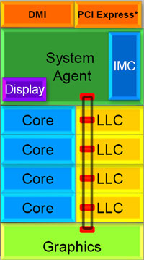
Chip-scale features of Recent x86 (SandyBridge)
Significant pieces:
Four OOO cores
New Advanced Vector eXtensions (256-bit FP)
AES instructions
Instructions to help with Galois-Field mult
4 μ-ops/cycle
Integrated GPU
System Agent (Memory and Fast I/O)
Shared L3 cache divided in 4 banks
On-chip Ring bus network
Both coherent and non-coherent transactions
High-BW access to L3 Cache
Integrated I/O
Integrated memory controller (IMC)
Two independent channels of DDR3 DRAM
High-speed PCI-Express (for Graphics cards)
DMI Connection to SouthBridge (PCH)

Slide 42
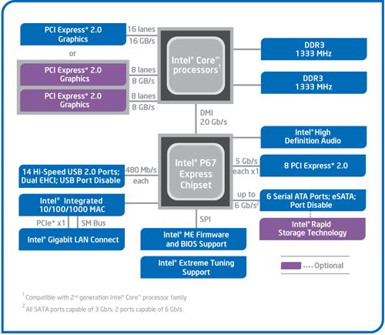
SandyBridge I/O: PCH
Platform Controller Hub
Used to be “SouthBridge,” but no “NorthBridge” now
Connected to processor with proprietary bus
Direct Media Interface
Code name “Cougar Point” for SandyBridge processors
Types of I/O on PCH:
USB
Ethernet
Audio
BIOS support
More PCI Express (lower speed than on Processor)
Sata (for Disks)
SandyBridge
System Configuration

Slide 43
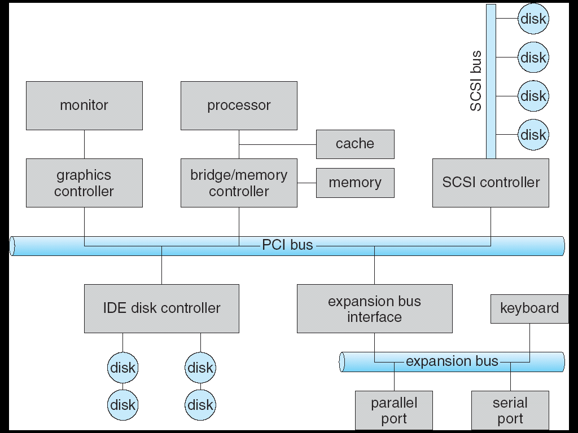


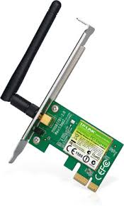

Modern I/O Systems
network

Slide 44
Example: PCI Architecture
RAM
Memory
Bus
CPU
Host Bridge
PCI #0
ISA Bridge
PCI Bridge
PCI #1
ISA Controller
PCI Slots
USB Controller
SCSI Controller
Scanner
Legacy Devices
Root Hub
Hard Disk
CD ROM
Hub
Webcam
Mouse
Keyboard

Slide 45
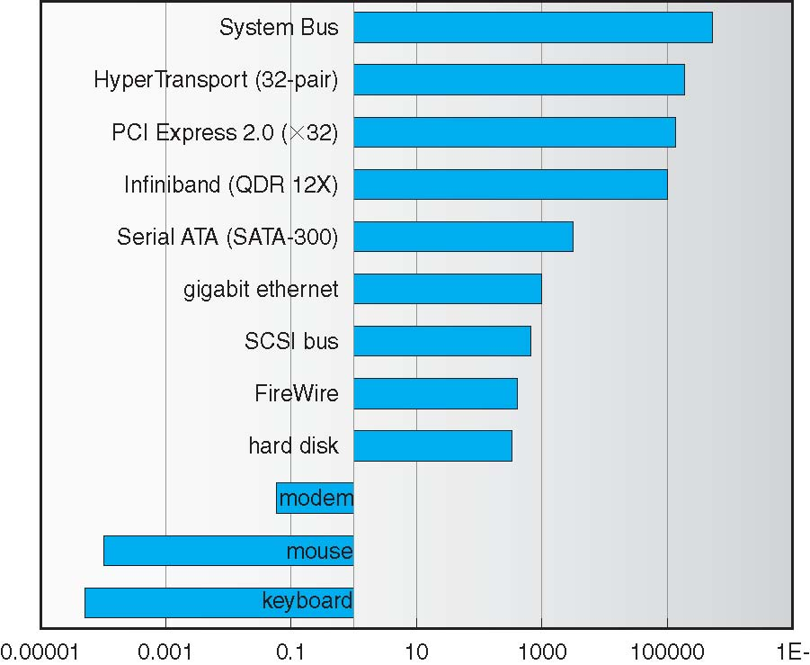
Example Device-Transfer Rates in Mb/s (Sun Enterprise 6000)
10m
Device Rates vary over 12 orders of magnitude !!!
System better be able to handle this wide range
Better not have high overhead/byte for fast devices!
Better not waste time waiting for slow devices

Slide 46
How does the processor actually talk to the device?
Processor Memory Bus
Regular
Memory
CPU
Bus
Adaptor
Bus
Adaptor
Device
Controller
Address+
Data
Other Devices
or Buses
Bus
Interface
Hardware
Controller
Interrupt
Controller
Interrupt Request
read
Addressable
Memory
and/or
Queues
write
CPU interacts with a Controller
Contains a set of registers that can be read and written
May contain memory for request queues or bit-mapped images
Regardless of the complexity of the connections and buses, processor accesses registers in two ways:
I/O instructions: in/out instructions
Example from the Intel architecture: out 0x21,AL
Memory mapped I/O: load/store instructions
Registers/memory appear in physical address space
I/O accomplished with load and store instructions
control
status
Registers
(port 0x20)
Memory Mapped
Region: 0x8f008020

Slide 47
Example: Memory-Mapped Display Controller
Memory-Mapped:
Hardware maps control registers and display memory into physical address space
Addresses set by hardware jumpers or programming at boot time
Simply writing to display memory (also called the “frame buffer”) changes image on screen
Addr: 0x8000F000—0x8000FFFF
Writing graphics description to command-queue area
Say enter a set of triangles that describe some scene
Addr: 0x80010000—0x8001FFFF
Writing to the command register may cause on-board graphics hardware to do something
Say render the above scene
Addr: 0x0007F004
Can protect with address translation
0x80020000
Graphics
Command
Queue
0x80010000
Display
Memory
0x8000F000
0x0007F004
Command
0x0007F000
Status
Physical Address
Space

Slide 48
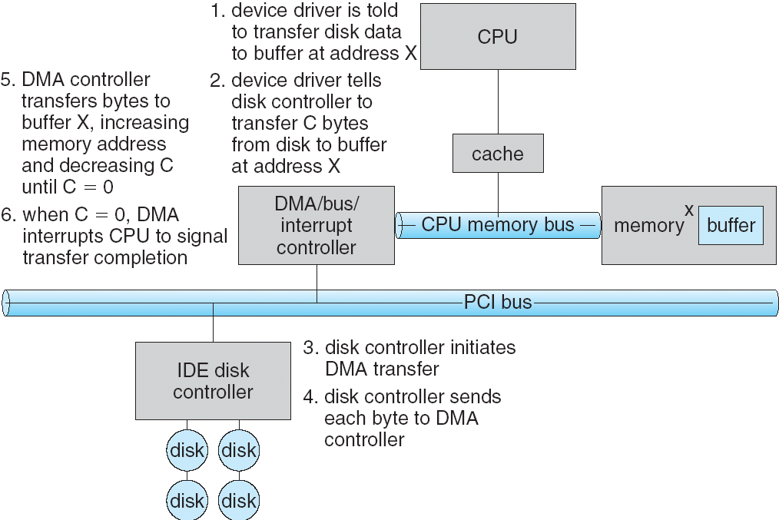
Transferring Data To/From Controller
Programmed I/O:
Each byte transferred via processor in/out or load/store
Pro: Simple hardware, easy to program
Con: Consumes processor cycles proportional to data size
Direct Memory Access:
Give controller access to memory bus
Ask it to transfer data blocks to/from memory directly
Sample interaction with DMA controller (from OSC):
addr
len

Slide 49
I/O Device Notifying the OS
The OS needs to know when:
The I/O device has completed an operation
The I/O operation has encountered an error
I/O Interrupt:
Device generates an interrupt whenever it needs service
Pro: handles unpredictable events well
Con: interrupts relatively high overhead
Polling:
OS periodically checks a device-specific status register
I/O device puts completion information in status register
Pro: low overhead
Con: may waste many cycles on polling if infrequent or unpredictable I/O operations
Actual devices combine both polling and interrupts
For instance – High-bandwidth network adapter:
Interrupt for first incoming packet
Poll for following packets until hardware queues are empty
Notes:
After the OS has issued a command to the I/O device either via a special I/O instruction or by writing to a location in the I/O address space, the OS needs to be notified when:
(a) The I/O device has completed the operation.
(b) Or when the I/O device has encountered an error.
This can be accomplished in two different ways: Polling and I/O interrupt.
+1 = 58 min. (Y:38)

Slide 50
Summary (1/2)
Precise Exception specifies a single instruction for which:
All previous instructions have completed (committed state)
No following instructions nor actual instruction have started
Replacement policies
FIFO: Place pages on queue, replace page at end
MIN: Replace page that will be used farthest in future
LRU: Replace page used farthest in past
Clock Algorithm: Approximation to LRU
Arrange all pages in circular list
Sweep through them, marking as not “in use”
If page not “in use” for one pass, than can replace
N^{th}-chance clock algorithm: Another approx LRU
Give pages multiple passes of clock hand before replacing
Second-Chance List algorithm: Yet another approx LRU
Divide pages into two groups, one of which is truly LRU and managed on page faults.

Slide 51
Summary (2/2)
Working Set:
Set of pages touched by a process recently
Thrashing: a process is busy swapping pages in and out
Process will thrash if working set doesn’t fit in memory
Need to swap out a process
I/O Devices Types:
Many different speeds (0.1 bytes/sec to GBytes/sec)
Different Access Patterns:
Block Devices, Character Devices, Network Devices
Different Access Timing:
Blocking, Non-blocking, Asynchronous
I/O Controllers: Hardware that controls actual device
Processor Accesses through I/O instructions, load/store to special physical memory
Report their results through either interrupts or a status register that processor looks at occasionally (polling)

