Slide 1
CS162 Operating Systems and Systems Programming Lecture 16 Demand Paging (Finished), General I/O
March 30th, 2015
Prof. John Kubiatowicz
http://cs162.eecs.Berkeley.edu

Slide 2
Recall: Clock Algorithm (Not Recently Used)
Set of all pages
in Memory
Single Clock Hand:
Advances only on page fault!
Check for pages not used recently
Mark pages as not used recently
Which bits of a PTE entry are useful to us?
Use: Set when page is referenced; cleared by clock algorithm
Modified: set when page is modified, cleared when page written to disk
Valid: ok for program to reference this page
Read-only: ok for program to read page, but not modify
For example for catching modifications to code pages!
Clock Algorithm: pages arranged in a ring
On page fault:
Advance clock hand (not real time)
Check use bit: 1→used recently; clear and leave alone 0→selected candidate for replacement
Crude partitioning of pages into two groups: young and old

Slide 3
Recall: Second-Chance List Algorithm (VAX/VMS)
LRU victim
Directly
Mapped Pages
Marked: RW
List: FIFO
Overflow
Second
Chance List
Marked: Invalid
List: LRU
Access
New
Active
Pages
New
SC
Victims
Page-in
From disk
Split memory in two: Active list (RW), SC list (Invalid)
Access pages in Active list at full speed
Otherwise, Page Fault
Always move overflow page from end of Active list to front of Second-chance list (SC) and mark invalid
Desired Page On SC List: move to front of Active list, mark RW
Not on SC list: page in to front of Active list, mark RW; page out LRU victim at end of SC list

Slide 4
Reverse Page Mapping (Sometimes called “Coremap”)
Physical page frames often shared by many different address spaces/page tables
All children forked from given process
Shared memory pages between processes
Whatever reverse mapping mechanism that is in place must be very fast
Must hunt down all page tables pointing at given page frame when freeing a page
Must hunt down all PTEs when seeing if pages “active”
Implementation options:
For every page descriptor, keep linked list of page table entries that point to it
Management nightmare – expensive
Linux 2.6: Object-based reverse mapping
Link together memory region descriptors instead (much coarser granularity)

Slide 5
Linux Memory Details?
Memory management in Linux considerably more complex that the previous indications
Memory Zones: physical memory categories
ZONE_DMA: < 16MB memory, DMAable on ISA bus
ZONE_NORMAL: 16MB ⇒ 896MB (mapped at 0xC0000000)
ZONE_HIGHMEM: Everything else (> 896MB)
Each zone has 1 freelist, 2 LRU lists (Active/Inactive)
Many different types of allocation
SLAB allocators, per-page allocators, mapped/unmapped
Many different types of allocated memory:
Anonymous memory (not backed by a file, heap/stack)
Mapped memory (backed by a file)
Allocation priorities
Is blocking allowed/etc

Slide 6
Recall: Linux Virtual memory map
0xFFFFFFFF
0xFFFFFFFFFFFFFFFF
Kernel Addresses
1GB
Kernel Addresses
128TiB
896MB Physical
64 TiB Physical
0xC0000000
User Addresses
0xFFFF800000000000
3GB Total
Empty
Space
“Canonical Hole”
0x00007FFFFFFFFFFF
128TiB
User
Addresses
0x00000000
0x0000000000000000
32-Bit Virtual Address Space
64-Bit Virtual Address Space

Slide 7
Virtual Map (Details)
Kernel memory not generally visible to user
Exception: special VDSO facility that maps kernel code into user space to aid in system calls (and to provide certain actual system calls such as gettimeofday().
Every physical page described by a “page” structure
Collected together in lower physical memory
Can be accessed in kernel virtual space
Linked together in various “LRU” lists
For 32-bit virtual memory architectures:
When physical memory < 896MB
All physical memory mapped at 0xC0000000
When physical memory >= 896MB
Not all physical memory mapped in kernel space all the time
Can be temporarily mapped with addresses > 0xCC000000
For 64-bit virtual memory architectures:
All physical memory mapped above 0xFFFF800000000000

Slide 8
Internal Interfaces: Allocating Memory
One mechanism for requesting pages: everything else on top of this mechanism:
Allocate contiguous group of pages of size 2^{order} bytes given the specified mask: struct page * alloc_pages(gfp_t gfp_mask, unsigned int order)
Allocate one page: struct page * alloc_page(gfp_t gfp_mask)
Convert page to logical address (assuming mapped): void * page_address(struct page *page)
Also routines for freeing pages
Zone allocator uses “buddy” allocator that tries to keep memory unfragmented
Allocation routines pick from proper zone, given flags

Slide 9
Page Frame Reclaiming Algorithm (PFRA)
Several entrypoints:
Low on Memory Reclaiming: The kernel detects a “low on memory” condition
Hibernation reclaiming: The kernel must free memory because it is entering in the suspend-to-disk state
Periodic reclaiming: A kernel thread is activated periodically to perform memory reclaiming, if necessary
Low on Memory reclaiming:
Start flushing out dirty pages to disk
Start looping over all memory nodes in the system
try_to_free_pages()
shrink_slab()
pdflush kernel thread writing out dirty pages
Periodic reclaiming:
Kswapd kernel threads: checks if number of free page frames in some zone has fallen below pages_high watermark
Each zone keeps two LRU lists: Active and Inactive
Each page has a last-chance algorithm with 2 count
Active page lists moved to inactive list when they have been idle for two cycles through the list
Pages reclaimed from Inactive list

Slide 10
SLAB Allocator
Replacement for free-lists that are hand-coded by users
Consolidation of all of this code under kernel control
Efficient when objects allocated and freed frequently
Objects segregated into “caches”
Each cache stores different type of object
Data inside cache divided into “slabs”, which are continuous groups of pages (often only 1 page)
Key idea: avoid memory fragmentation
Obj 1
SLAB
Obj 2
Obj 3
Cache
Obj 4
SLAB
Obj 5

Slide 11
SLAB Allocator Details
Based on algorithm first introduced for SunOS
Observation: amount of time required to initialize a regular object in the kernel exceeds the amount of time required to allocate and deallocate it
Resolves around object caching
Allocate once, keep reusing objects
Avoids memory fragmentation:
Caching of similarly sized objects, avoid fragmentation
Similar to custom freelist per object
Reuse of allocation
When new object first allocated, constructor runs
On subsequent free/reallocation, constructor does not need to be reexecuted

Slide 12
SLAB Allocator: Cache Use
Example: task_struct_cachep = kmem_cache_create(“task_struct”, sizeof(struct task_struct), ARCH_MIN_TASKALIGN, SLAB_PANIC | SLAB_NOTRACK, NULL);
Use of example: struct task_struct *tsk; tsk = kmem_cache_alloc(task_struct_cachep, GFP_KERNEL); if (!tsk) return NULL; kmem_free(task_struct_cachep,tsk);

Slide 13
SLAB Allocator Details (Con’t)
Caches can be later destroyed with: int kmem_cache_destroy(struct kmem_cache *cachep);
Assuming that all objects freed
No one ever tries to use cache again
All caches kept in global list
Including global caches set up with objects of powers of 2 from 2⁵ to 2¹⁷
General kernel allocation (kmalloc/kfree) uses least-fit for requested cache size
Reclamation of memory
Caches keep sorted list of empty, partial, and full slabs
Easy to manage – slab metadata contains reference count
Objects within slabs linked together
Ask individual caches for full slabs for reclamation

Slide 14
Administrivia
Welcome back from Spring Break!
Midterm I: still grading
But almost done!
Checkpoint 1 for Proj 2 due tonight

Slide 15
You are here …

Slide 16
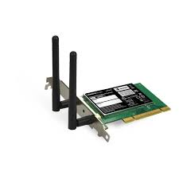
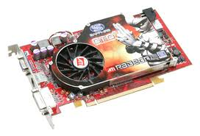
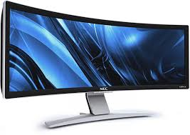

OS Basics: I/O
Threads
Address Spaces
Windows
Processes
Files
Sockets
Software
OS Hardware Virtualization
Hardware
ISA
Memory
Processor
Protection Boundary
OS
Ctrlr
storage
Networks
Displays
Inputs

Slide 17
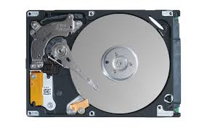
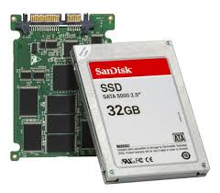
In a picture
Read / Write
wires
Processor
I/O
Controllers
Secondary Storage (Disk)
Core
L2 Cache
Registers
L1 Cache
interrupts
Secondary Storage (SSD)
Read / Write
Main
Memory
(DRAM)
DMA transfer
L3 Cache (shared)
Core
L2 Cache
Registers
L1 Cache
I/O devices you recognize are supported by I/O Controllers
Processors accesses them by reading and writing IO registers as if they were memory
Write commands and arguments, read status and results

Slide 18
The Requirements of I/O
So far in this course:
We have learned how to manage CPU, memory
What about I/O?
Without I/O, computers are useless (disembodied brains?)
But… thousands of devices, each slightly different
How can we standardize the interfaces to these devices?
Devices unreliable: media failures and transmission errors
How can we make them reliable???
Devices unpredictable and/or slow
How can we manage them if we don’t know what they will do or how they will perform?

Slide 19
Operational Parameters for I/O
Data granularity: Byte vs. Block
Some devices provide single byte at a time (e.g., keyboard)
Others provide whole blocks (e.g., disks, networks, etc.)
Access pattern: Sequential vs. Random
Some devices must be accessed sequentially (e.g., tape)
Others can be accessed “randomly” (e.g., disk, cd, etc.)
Fixed overhead to start sequential transfer (more later)
Transfer Notification: Polling vs. Interrupts
Some devices require continual monitoring
Others generate interrupts when they need service
Transfer Mechanism: Programmed IO and DMA

Slide 20

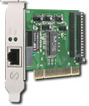
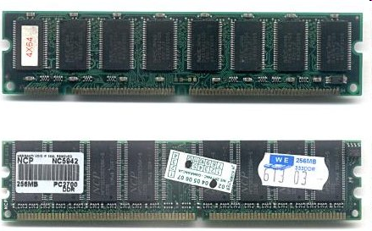
Kernel Device Structure
The System Call Interface
Process
Management
Memory Management
Filesystems
Device Control
Networking
Concurrency, multitasking
Virtual memory
Files and dirs: the VFS
TTYs and device access
Connectivity
Architecture
Dependent
Code
Memory Manager
File System Types
Device Control
Network Subsystem
Block Devices
IF drivers

Slide 21
The Goal of the I/O Subsystem
Provide Uniform Interfaces, Despite Wide Range of Different Devices
This code works on many different devices:
FILE fd = fopen(“/dev/something”,”rw”); for (int i = 0; i < 10; i++) { fprintf(fd,”Count %d\n”,i); } close(fd);
Why? Because code that controls devices (“device driver”) implements standard interface.
We will try to get a flavor for what is involved in actually controlling devices in rest of lecture
Can only scratch surface!

Slide 22
Want Standard Interfaces to Devices
Block Devices: e.g. disk drives, tape drives, DVD-ROM
Access blocks of data
Commands include open(), read(), write(), seek()
Raw I/O or file-system access
Memory-mapped file access possible
Character Devices: e.g. keyboards, mice, serial ports, some USB devices
Single characters at a time
Commands include get(), put()
Libraries layered on top allow line editing
Network Devices: e.g. Ethernet, Wireless, Bluetooth
Different enough from block/character to have own interface
Unix and Windows include socket interface
Separates network protocol from network operation
Includes select() functionality
Usage: pipes, FIFOs, streams, queues, mailboxes

Slide 23
How Does User Deal with Timing?
Blocking Interface: “Wait”
When request data (e.g. read() system call), put process to sleep until data is ready
When write data (e.g. write() system call), put process to sleep until device is ready for data
Non-blocking Interface: “Don’t Wait”
Returns quickly from read or write request with count of bytes successfully transferred
Read may return nothing, write may write nothing
Asynchronous Interface: “Tell Me Later”
When request data, take pointer to user’s buffer, return immediately; later kernel fills buffer and notifies user
When send data, take pointer to user’s buffer, return immediately; later kernel takes data and notifies user

Slide 24
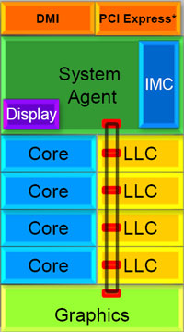
Chip-scale features of Recent x86 (SandyBridge)
Significant pieces:
Four OOO cores
New Advanced Vector eXtensions (256-bit FP)
AES instructions
Instructions to help with Galois-Field mult
4 μ-ops/cycle
Integrated GPU
System Agent (Memory and Fast I/O)
Shared L3 cache divided in 4 banks
On-chip Ring bus network
Both coherent and non-coherent transactions
High-BW access to L3 Cache
Integrated I/O
Integrated memory controller (IMC)
Two independent channels of DDR3 DRAM
High-speed PCI-Express (for Graphics cards)
DMI Connection to SouthBridge (PCH)

Slide 25
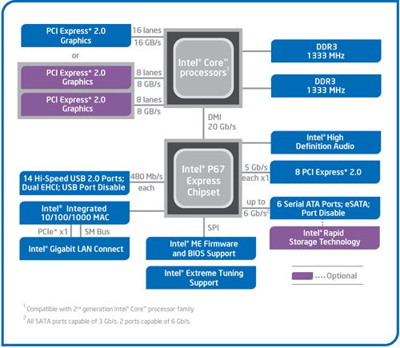
SandyBridge I/O: PCH
Platform Controller Hub
Used to be “SouthBridge,” but no “NorthBridge” now
Connected to processor with proprietary bus
Direct Media Interface
Code name “Cougar Point” for SandyBridge processors
Types of I/O on PCH:
USB
Ethernet
Audio
BIOS support
More PCI Express (lower speed than on Processor)
Sata (for Disks)
SandyBridge
System Configuration

Slide 26
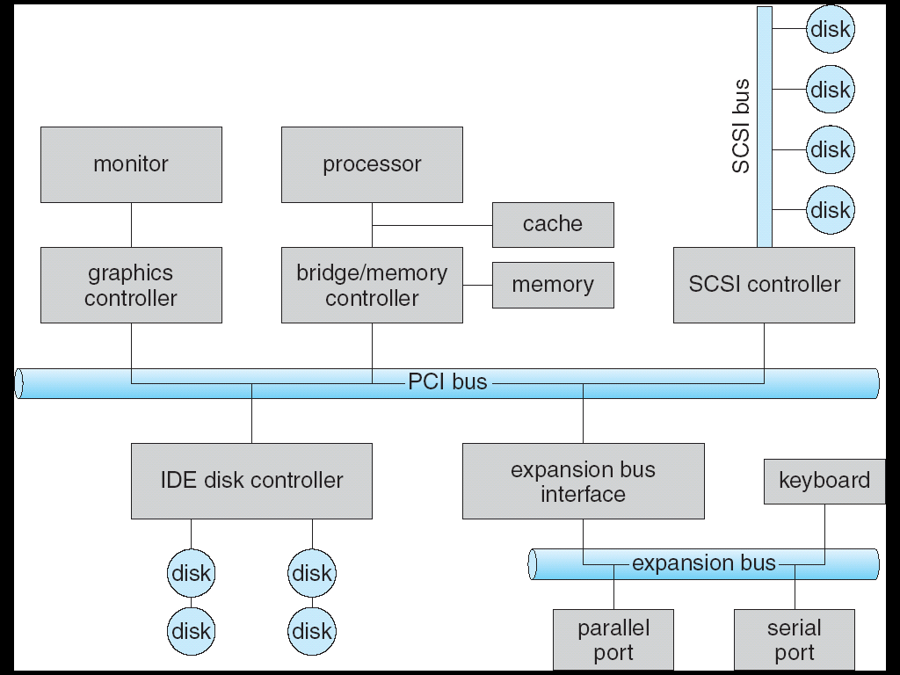

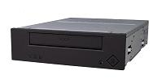
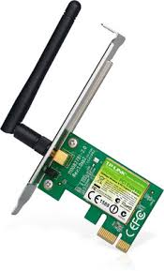
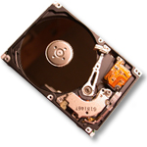

Modern I/O Systems
network

Slide 27
Example: PCI Architecture
RAM
Memory
Bus
CPU
Host Bridge
PCI #0
ISA Bridge
PCI Bridge
PCI #1
ISA Controller
PCI Slots
USB Controller
SCSI Controller
Scanner
Legacy Devices
Root Hub
Hard Disk
CD ROM
Hub
Webcam
Mouse
Keyboard

Slide 28
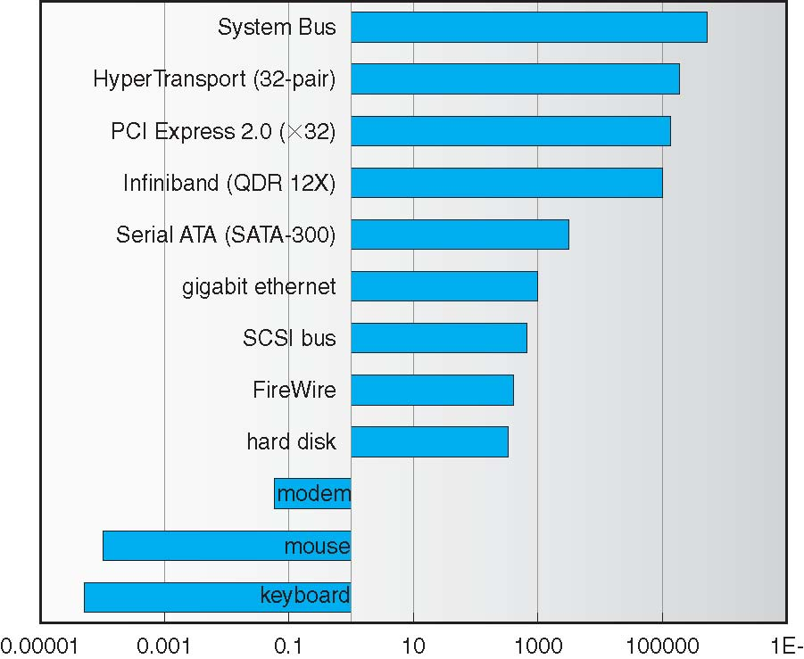
Example Device-Transfer Rates in Mb/s (Sun Enterprise 6000)
10m
Device Rates vary over 12 orders of magnitude !!!
System better be able to handle this wide range
Better not have high overhead/byte for fast devices!
Better not waste time waiting for slow devices

Slide 29
How does the processor actually talk to the device?
Processor Memory Bus
Regular
Memory
CPU
Bus
Adaptor
Bus
Adaptor
Device
Controller
Address+
Data
Other Devices
or Buses
Bus
Interface
Hardware
Controller
Interrupt
Controller
Interrupt Request
read
Addressable
Memory
and/or
Queues
write
CPU interacts with a Controller
Contains a set of registers that can be read and written
May contain memory for request queues or bit-mapped images
Regardless of the complexity of the connections and buses, processor accesses registers in two ways:
I/O instructions: in/out instructions
Example from the Intel architecture: out 0x21,AL
Memory mapped I/O: load/store instructions
Registers/memory appear in physical address space
I/O accomplished with load and store instructions
control
status
Registers
(port 0x20)
Memory Mapped
Region: 0x8f008020

Slide 30
Example: Memory-Mapped Display Controller
Memory-Mapped:
Hardware maps control registers and display memory into physical address space
Addresses set by hardware jumpers or programming at boot time
Simply writing to display memory (also called the “frame buffer”) changes image on screen
Addr: 0x8000F000—0x8000FFFF
Writing graphics description to command-queue area
Say enter a set of triangles that describe some scene
Addr: 0x80010000—0x8001FFFF
Writing to the command register may cause on-board graphics hardware to do something
Say render the above scene
Addr: 0x0007F004
Can protect with address translation
0x80020000
Graphics
Command
Queue
0x80010000
Display
Memory
0x8000F000
0x0007F004
Command
0x0007F000
Status
Physical Address
Space

Slide 31
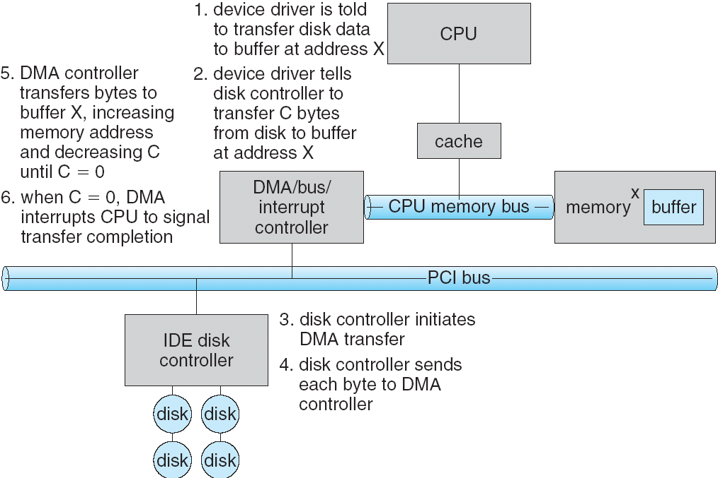
Transferring Data To/From Controller
Programmed I/O:
Each byte transferred via processor in/out or load/store
Pro: Simple hardware, easy to program
Con: Consumes processor cycles proportional to data size
Direct Memory Access:
Give controller access to memory bus
Ask it to transfer data blocks to/from memory directly
Sample interaction with DMA controller (from OSC):
addr
len

Slide 32
I/O Device Notifying the OS
The OS needs to know when:
The I/O device has completed an operation
The I/O operation has encountered an error
I/O Interrupt:
Device generates an interrupt whenever it needs service
Pro: handles unpredictable events well
Con: interrupts relatively high overhead
Polling:
OS periodically checks a device-specific status register
I/O device puts completion information in status register
Pro: low overhead
Con: may waste many cycles on polling if infrequent or unpredictable I/O operations
Actual devices combine both polling and interrupts
For instance – High-bandwidth network adapter:
Interrupt for first incoming packet
Poll for following packets until hardware queues are empty
Notes:
After the OS has issued a command to the I/O device either via a special I/O instruction or by writing to a location in the I/O address space, the OS needs to be notified when:
(a) The I/O device has completed the operation.
(b) Or when the I/O device has encountered an error.
This can be accomplished in two different ways: Polling and I/O interrupt.
+1 = 58 min. (Y:38)

Slide 33
Device Drivers
Device Driver: Device-specific code in the kernel that interacts directly with the device hardware
Supports a standard, internal interface
Same kernel I/O system can interact easily with different device drivers
Special device-specific configuration supported with the ioctl() system call
Device Drivers typically divided into two pieces:
Top half: accessed in call path from system calls
implements a set of standard, cross-device calls like open(), close(), read(), write(), ioctl(), strategy()
This is the kernel’s interface to the device driver
Top half will start I/O to device, may put thread to sleep until finished
Bottom half: run as interrupt routine
Gets input or transfers next block of output
May wake sleeping threads if I/O now complete

Slide 34
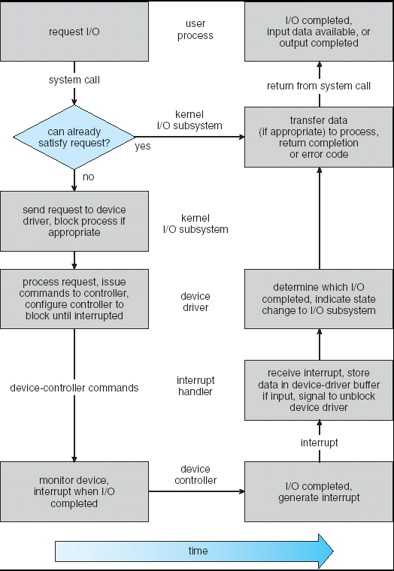
Life Cycle of An I/O Request
User
Program
Kernel I/O
Subsystem
Device Driver
Top Half
Device Driver
Bottom Half
Device
Hardware

Slide 35
Basic Performance Concepts
Response Time or Latency: Time to perform an operation (s)
Bandwidth or Throughput: Rate at which operations are performed (op/s)
Files: mB/s, Networks: mb/s, Arithmetic: GFLOP/s
Start up or “Overhead”: time to initiate an operation
Most I/O operations are roughly linear
Latency (n) = Ovhd + n/Bandwidth

Slide 36
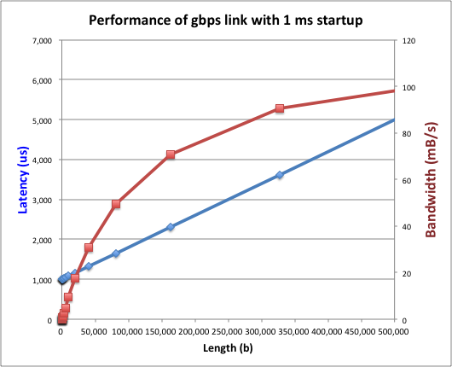
Example (fast network)
Consider a gpbs link (125 MB/s)
With a startup cost S = 1 ms
Theorem: half-power point occurs at n=S*B:
When transfer time = startup T(S*B) = S + S*B/B

Slide 37
Example: at 10 ms startup (disk)

Slide 38
What determines peak BW for I/O ?
Bus Speed
PCI-X: 1064 MB/s = 133 MHz x 64 bit (per lane)
ULTRA WIDE SCSI: 40 MB/s
Serial Attached SCSI & Serial ATA & IEEE 1394 (firewire) : 1.6 Gbps full duplex (200 MB/s)
USB 1.5 – 12 mb/s
Device Transfer Bandwidth
Rotational speed of disk
Write / Read rate of nand flash
Signaling rate of network link
Whatever is the bottleneck in the path

Slide 39
Storage Devices
Magnetic disks
Storage that rarely becomes corrupted
Large capacity at low cost
Block level random access
Slow performance for random access
Better performance for streaming access
Flash memory
Storage that rarely becomes corrupted
Capacity at intermediate cost (50x disk ???)
Block level random access
Good performance for reads; worse for random writes
Erasure requirement in large blocks
Wear patterns

Slide 40
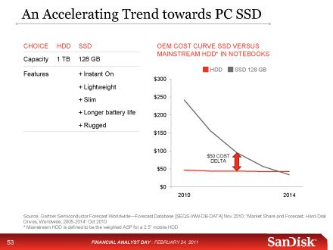
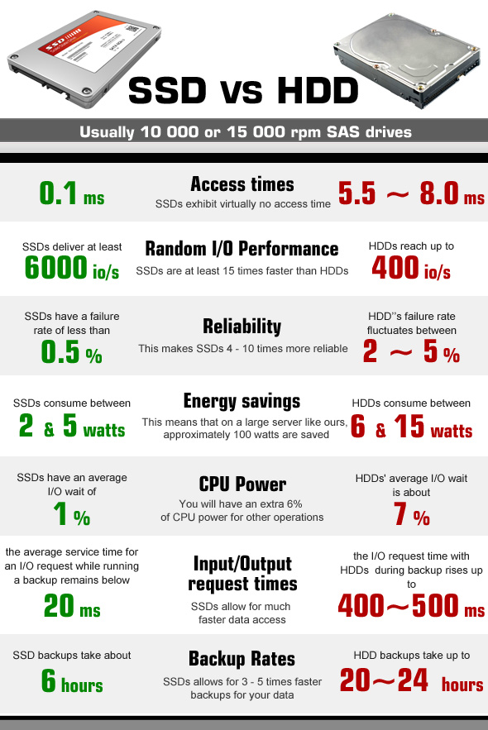
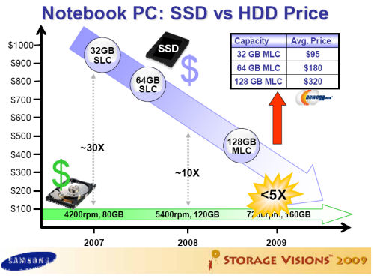
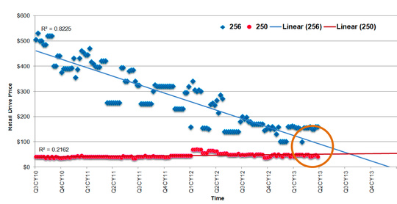
Are we in an inflection point?

Slide 41
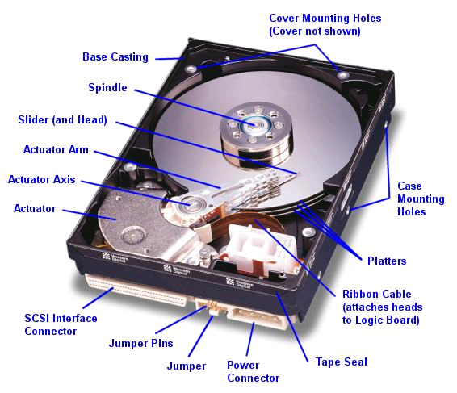
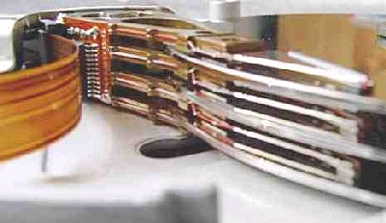
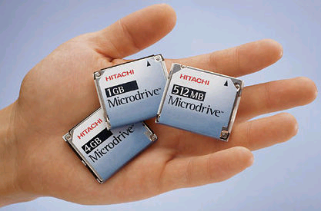
Hard Disk Drives (HDDs)
Read/Write Head
Side View
Western Digital Drive
http://www.storagereview.com/guide/
IBM Personal Computer/AT (1986)
30 MB hard disk - $500
30-40ms seek time
0.7-1 MB/s (est.)
IBM/Hitachi Microdrive
Notes:
Winchester disk drives developed by IBM: 1973 first drive
Uses “sealed” assembly with heads floating on air bearings – Bernoulli effect

Slide 42
The Amazing Magnetic Disk
Unit of Transfer: Sector
Ring of sectors form a track
Stack of tracks form a cylinder
Heads position on cylinders
Disk Tracks ~ 1µm (micron) wide
Wavelength of light is ~ 0.5µm
Resolution of human eye: 50µm
100K on a typical 2.5” disk
Separated by unused guard regions
Reduces likelihood neighboring tracks are corrupted during writes (still a small non-zero chance)
Track length varies across disk
Outside: More sectors per track, higher bandwidth
Disk is organized into regions of tracks with same # of sectors/track
Only outer half of radius is used
Most of the disk area in the outer regions of the disk

Slide 43
Magnetic Disk Characteristic
Sector
Cylinder: all the tracks under the head at a given point on all surfaces
Read/write: three-stage process:
Seek time: position the head/arm over the proper track (into proper cylinder)
Rotational latency: wait for the desired sector to rotate under the read/write head
Transfer time: transfer a block of bits (sector) under the read-write head
Disk Latency = Queuing Time + Controller time + Seek Time + Rotation Time + Xfer Time
Highest Bandwidth:
Transfer large group of blocks sequentially from one track
Head
Track
Cylinder
Platter
Software
Queue
(Device Driver)
Hardware
Controller
Media Time
(Seek+Rot+Xfer)
Request
Result
Notes:
To read write information into a sector, a movable arm containing a read/write head is located over each surface.
The term cylinder is used to refer to all the tracks under the read/write head at a given point on all surfaces.
To access data, the operating system must direct the disk through a 3-stage process.
(a) The first step is to position the arm over the proper track. This is the seek operation and the time to complete this operation is called the seek time.
(b) Once the head has reached the correct track, we must wait for the desired sector to rotate under the read/write head. This is referred to as the rotational latency.
(c) Finally, once the desired sector is under the read/write head, the data transfer can begin.
The average seek time as reported by the manufacturer is in the range of 12 ms to 20ms and is calculated as the sum of the time for all possible seeks divided by the number of possible seeks.
This number is usually on the pessimistic side because due to locality of disk reference, the actual average seek time may only be 25 to 33% of the number published.
+2 = 34 min. (Y:14)

Slide 44
Typical Numbers for Magnetic Disk
Parameter | Info / Range
Space/Density | Space: 8TB in 3½ inch form factor! (Seagate, Nov 2014) Areal Density: over 1Terabit/square inch (SMR)
Average seek time | Typically 5-10 milliseconds. Depending on reference locality, actual cost may be 25-33% of this number.
Average rotational latency | Most laptop/desktop disks rotate at 3600-7200 RPM (16-8 ms/rotation). Server disks up to 15,000 RPM. Average latency is halfway around disk yielding corresponding times of 8-4 milliseconds
Controller time | Depends on controller hardware
Transfer time | Typically 50 to 100 MB/s. Depends on: Transfer size (usually a sector): 512B – 1KB per sector Rotation speed: 3600 RPM to 15000 RPM Recording density: bits per inch on a track Diameter: ranges from 1 in to 5.25 in
Cost | Drops by a factor of two every 1.5 years (or even faster). $0.03-0.07/GB in 2013
Notes:
As far as rotational latency is concerned, most disks rotate at 3,600 RPM or approximately 16 ms per revolution.
Since on average, the information you desired is half way around the disk, the average rotational latency will be 8ms.
The transfer time is a function of transfer size, rotation speed, and recording density.
The typical transfer speed is 2 to 4 MB per second.
Notice that the transfer time is much faster than the rotational latency and seek time.
This is similar to the DRAM situation where the DRAM access time is much shorter than the DRAM cycle time.
***** Do anybody remember what we did to take advantage of the short access time versus cycle time? Well, we interleave!
New International Disk Drive, Equipment, and Materials Association standard is 4KB sectors instead of 512 byte sectors
+2 = 36 min. (Y:16)

Slide 45
Intelligence in the controller
Sectors contain sophisticated error correcting codes
Disk head magnet has a field wider than track
Hide corruptions due to neighboring track writes
Sector sparing
Remap bad sectors transparently to spare sectors on the same surface
Slip sparing
Remap all sectors (when there is a bad sector) to preserve sequential behavior
Track skewing
Sector numbers offset from one track to the next, to allow for disk head movement for sequential ops
…

Slide 46
Summary
I/O Devices Types:
Many different speeds (0.1 bytes/sec to GBytes/sec)
Different Access Patterns:
Block Devices, Character Devices, Network Devices
Different Access Timing:
Blocking, Non-blocking, Asynchronous
I/O Controllers: Hardware that controls actual device
Processor Accesses through I/O instructions, load/store to special physical memory
Report their results through either interrupts or a status register that processor looks at occasionally (polling)
Notification mechanisms
Interrupts
Polling: Report results through status register that processor looks at periodically
Drivers interface to I/O devices
Provide clean Read/Write interface to OS above
Manipulate devices through PIO, DMA & interrupt handling
2 types: block, character, and network

