Slide 1
CS162 Operating Systems and Systems Programming Lecture 17 Performance Storage Devices, Queueing Theory
April 1st, 2015
Prof. John Kubiatowicz
http://cs162.eecs.Berkeley.edu

Slide 2
Recall: Memory-Mapped Display Controller
Memory-Mapped:
Hardware maps control registers and display memory into physical address space
Addresses set by hardware jumpers or programming at boot time
Simply writing to display memory (also called the “frame buffer”) changes image on screen
Addr: 0x8000F000—0x8000FFFF
Writing graphics description to command-queue area
Say enter a set of triangles that describe some scene
Addr: 0x80010000—0x8001FFFF
Writing to the command register may cause on-board graphics hardware to do something
Say render the above scene
Addr: 0x0007F004
Can protect with address translation
0x80020000
Graphics
Command
Queue
0x80010000
Display
Memory
0x8000F000
0x0007F004
Command
0x0007F000
Status
Physical Address
Space

Slide 3
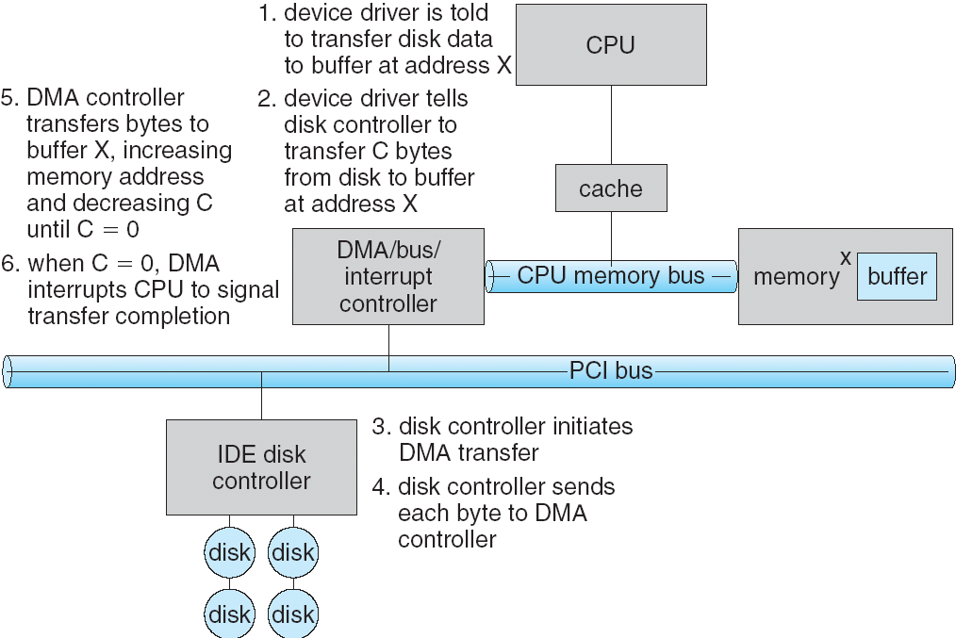
Recall: Transferring Data To/From Controller
Programmed I/O:
Each byte transferred via processor in/out or load/store
Pro: Simple hardware, easy to program
Con: Consumes processor cycles proportional to data size
Direct Memory Access:
Give controller access to memory bus
Ask it to transfer data blocks to/from memory directly
Sample interaction with DMA controller (from OSC):
addr
len

Slide 4
Goals for Today
Discussion of performance
Disks and SSDs
Hardware performance parameters
Queuing Theory
File Systems
Structure,… Naming, Directories, and Caching
Note: Some slides and/or pictures in the following are
adapted from slides ©2005 Silberschatz, Galvin, and Gagne
Note: Some slides and/or pictures in the following are
adapted from slides ©2005 Silberschatz, Galvin, and Gagne. Many slides generated from my lecture notes by Kubiatowicz.

Slide 5
Basic Performance Concepts
Response Time or Latency: Time to perform an operation (s)
Bandwidth or Throughput: Rate at which operations are performed (op/s)
Files: mB/s, Networks: mb/s, Arithmetic: GFLOP/s
Start up or “Overhead”: time to initiate an operation
Most I/O operations are roughly linear
Latency (n) = Ovhd + n/Bandwidth

Slide 6
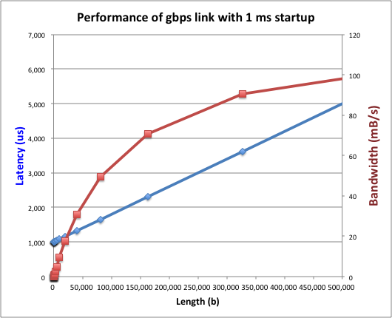
Example (fast network)
Consider a gpbs link (125 MB/s)
With a startup cost S = 1 ms
Theorem: half-power point occurs at n=S*B:
When transfer time = startup T(S*B) = S + S*B/B

Slide 7
Example: at 10 ms startup (like Disk)

Slide 8
What determines peak BW for I/O ?
Bus Speed
PCI-X: 1064 MB/s = 133 MHz x 64 bit (per lane)
ULTRA WIDE SCSI: 40 MB/s
Serial Attached SCSI & Serial ATA & IEEE 1394 (firewire) : 1.6 Gbps full duplex (200 MB/s)
USB 1.5 – 12 mb/s
Device Transfer Bandwidth
Rotational speed of disk
Write / Read rate of NAND flash
Signaling rate of network link
Whatever is the bottleneck in the path

Slide 9
Administrivia
Peer evaluations for project 1 not all in!
Will not release final project grades until you do this
Zero-sum game – if you do not contribute, you don’t get full credit!
Do not come to office hours with questions like:
“Why doesn’t this work?”
“I have no idea what is wrong”
If you have a clear failing test, perhaps we can help
Midterm I: still grading (Really sorry!)
But almost done!
Hopefully done by section tomorrow
Regrades:
You have 1 week after grades are released to request a regrade
Be sure: If we receive a request, we may regrade whole exam (could lose points)
Midterm II: coming up
April 22nd; More details upcoming

Slide 10
Storage Devices
Magnetic disks
Storage that rarely becomes corrupted
Large capacity at low cost
Block level random access (except for SMR – later!)
Slow performance for random access
Better performance for streaming access
Flash memory
Storage that rarely becomes corrupted
Capacity at intermediate cost (50x disk ???)
Block level random access
Good performance for reads; worse for random writes
Erasure requirement in large blocks
Wear patterns

Slide 11
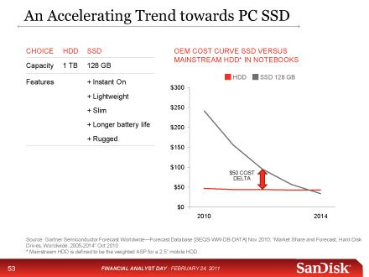
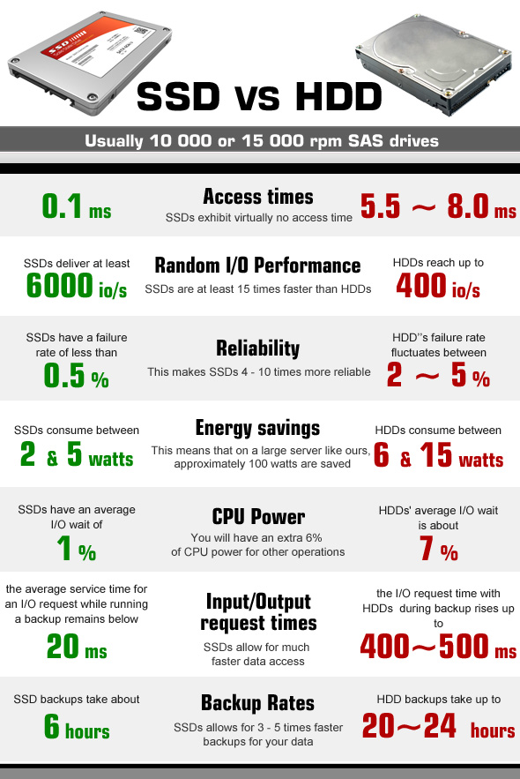
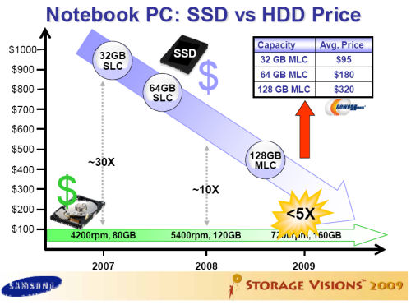
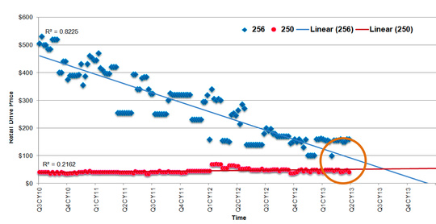
Are we in an inflection point?

Slide 12
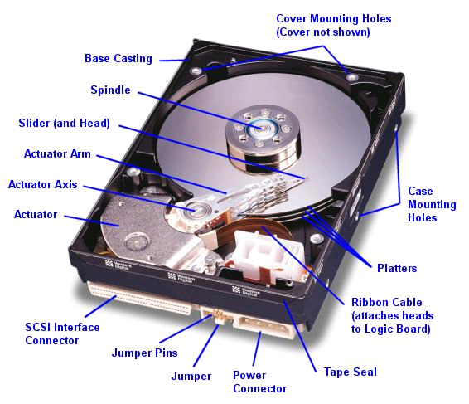
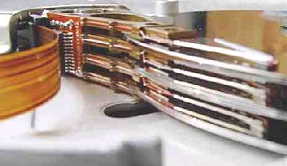
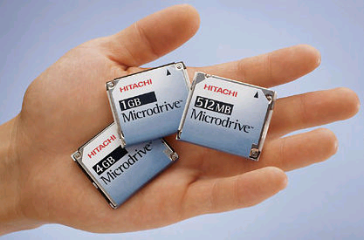
Hard Disk Drives (HDDs)
Read/Write Head
Side View
Western Digital Drive
http://www.storagereview.com/guide/
IBM Personal Computer/AT (1986)
30 MB hard disk - $500
30-40ms seek time
0.7-1 MB/s (est.)
IBM/Hitachi Microdrive
Notes:
Winchester disk drives developed by IBM: 1973 first drive
Uses “sealed” assembly with heads floating on air bearings – Bernoulli effect

Slide 13
The Amazing Magnetic Disk
Unit of Transfer: Sector
Ring of sectors form a track
Stack of tracks form a cylinder
Heads position on cylinders
Disk Tracks ~ 1µm (micron) wide
Wavelength of light is ~ 0.5µm
Resolution of human eye: 50µm
100K on a typical 2.5” disk
Separated by unused guard regions
Reduces likelihood neighboring tracks are corrupted during writes
Track length varies across disk
Outside: More sectors per track, higher bandwidth
Disk is organized into regions of tracks with same # of sectors/track
Only outer half of radius is used
Most of the disk area in the outer regions of the disk
New: Shingled Magnetic Recording (SMR)
Overlapping tracks ⇒ greater density, restrictions on writing
Seagate (8TB), Hitachi (10TB)

Slide 14
Magnetic Disk Characteristic
Sector
Cylinder: all the tracks under the head at a given point on all surfaces
Read/write: three-stage process:
Seek time: position the head/arm over the proper track (into proper cylinder)
Rotational latency: wait for the desired sector to rotate under the read/write head
Transfer time: transfer a block of bits (sector) under the read-write head
Disk Latency = Queuing Time + Controller time + Seek Time + Rotation Time + Xfer Time
Highest Bandwidth:
Transfer large group of blocks sequentially from one track
Head
Track
Cylinder
Platter
Software
Queue
(Device Driver)
Hardware
Controller
Media Time
(Seek+Rot+Xfer)
Request
Result
Notes:
To read write information into a sector, a movable arm containing a read/write head is located over each surface.
The term cylinder is used to refer to all the tracks under the read/write head at a given point on all surfaces.
To access data, the operating system must direct the disk through a 3-stage process.
(a) The first step is to position the arm over the proper track. This is the seek operation and the time to complete this operation is called the seek time.
(b) Once the head has reached the correct track, we must wait for the desired sector to rotate under the read/write head. This is referred to as the rotational latency.
(c) Finally, once the desired sector is under the read/write head, the data transfer can begin.
The average seek time as reported by the manufacturer is in the range of 12 ms to 20ms and is calculated as the sum of the time for all possible seeks divided by the number of possible seeks.
This number is usually on the pessimistic side because due to locality of disk reference, the actual average seek time may only be 25 to 33% of the number published.
+2 = 34 min. (Y:14)

Slide 15
Typical Numbers for Magnetic Disk
Parameter | Info / Range
Space/Density | Space: 8TB (Seagate), 10TB (Hitachi) in 3½ inch form factor! (Introduced in Fall of 2014) Areal Density: ≥ 1Terabit/square inch! (SMR, Helium, …)
Average seek time | Typically 5-10 milliseconds. Depending on reference locality, actual cost may be 25-33% of this number.
Average rotational latency | Most laptop/desktop disks rotate at 3600-7200 RPM (16-8 ms/rotation). Server disks up to 15,000 RPM. Average latency is halfway around disk yielding corresponding times of 8-4 milliseconds
Controller time | Depends on controller hardware
Transfer time | Typically 50 to 100 MB/s. Depends on: Transfer size (usually a sector): 512B – 1KB per sector Rotation speed: 3600 RPM to 15000 RPM Recording density: bits per inch on a track Diameter: ranges from 1 in to 5.25 in
Cost | Drops by a factor of two every 1.5 years (or even faster). $0.03-0.07/GB in 2013
Notes:
As far as rotational latency is concerned, most disks rotate at 3,600 RPM or approximately 16 ms per revolution.
Since on average, the information you desired is half way around the disk, the average rotational latency will be 8ms.
The transfer time is a function of transfer size, rotation speed, and recording density.
The typical transfer speed is 2 to 4 MB per second.
Notice that the transfer time is much faster than the rotational latency and seek time.
This is similar to the DRAM situation where the DRAM access time is much shorter than the DRAM cycle time.
***** Do anybody remember what we did to take advantage of the short access time versus cycle time? Well, we interleave!
New International Disk Drive, Equipment, and Materials Association standard is 4KB sectors instead of 512 byte sectors
+2 = 36 min. (Y:16)

Slide 16
Disk Performance Example
Assumptions:
Ignoring queuing and controller times for now
Avg seek time of 5ms,
7200RPM ⇒ Time for rotation: 60000(ms/M)/7200(rev/M) ~= 8ms
Transfer rate of 4MByte/s, sector size of 1 Kbyte ⇒ 1024 bytes/4×10⁶ (bytes/s) = 256 × 10⁻⁶ sec ≅ .26 ms
Read sector from random place on disk:
Seek (5ms) + Rot. Delay (4ms) + Transfer (0.26ms)
Approx 10ms to fetch/put data: 100 KByte/sec
Read sector from random place in same cylinder:
Rot. Delay (4ms) + Transfer (0.26ms)
Approx 5ms to fetch/put data: 200 KByte/sec
Read next sector on same track:
Transfer (0.26ms): 4 MByte/sec
Key to using disk effectively (especially for file systems) is to minimize seek and rotational delays

Slide 17
Intelligence in the controller
Sectors contain sophisticated error correcting codes
Disk head magnet has a field wider than track
Hide corruptions due to neighboring track writes
Sector sparing
Remap bad sectors transparently to spare sectors on the same surface
Slip sparing
Remap all sectors (when there is a bad sector) to preserve sequential behavior
Track skewing
Sector numbers offset from one track to the next, to allow for disk head movement for sequential ops
…

Slide 18
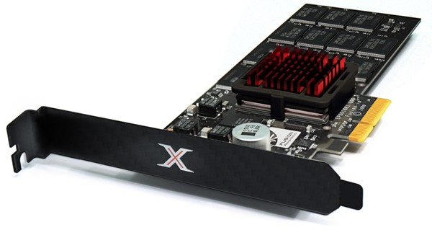
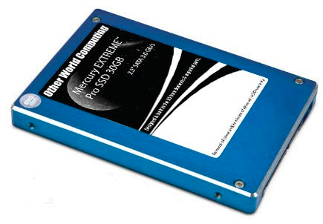
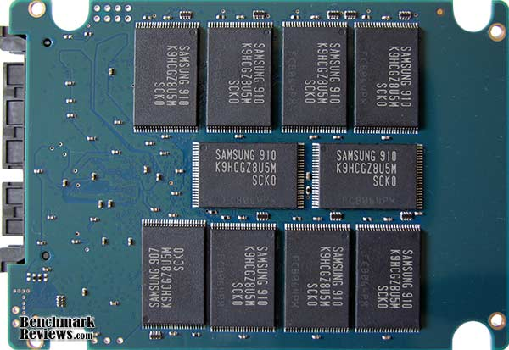
Solid State Disks (SSDs)
1995 – Replace rotating magnetic media with non-volatile memory (battery backed DRAM)
2009 – Use NAND Multi-Level Cell (2 or 3-bit/cell) flash memory
Sector (4 KB page) addressable, but stores 4-64 “pages” per memory block
Trapped electrons distinguish between 1 and 0
No moving parts (no rotate/seek motors)
Eliminates seek and rotational delay (0.1-0.2ms access time)
Very low power and lightweight
Limited “write cycles”
Rapid advance in capacity and cost ever since

Slide 19
SSD Architecture – Reads
NAND
NAND
NAND
NAND
NAND
NAND
NAND
NAND
Host
Buffer
Manager
(software
Queue)
Flash
Memory
Controller
NAND
NAND
NAND
NAND
SATA
NAND
NAND
NAND
NAND
NAND
NAND
NAND
NAND
DRAM
NAND
NAND
NAND
NAND
NAND
NAND
NAND
NAND
NAND
NAND
NAND
NAND
Read 4 KB Page: ~25 usec
No seek or rotational latency
Transfer time: transfer a 4KB page
SATA: 300-600MB/s => ~4 x10³ b / 400 x 10⁶ bps => 10 us
Latency = Queuing Time + Controller time + Xfer Time
Highest Bandwidth: Sequential OR Random reads

Slide 20
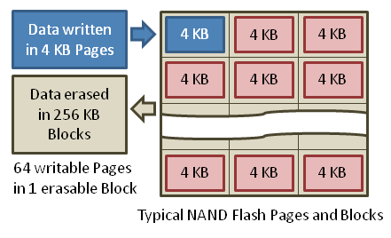
SSD Architecture – Writes (I)
Writing data is complex! (~200μs – 1.7ms )
Can only write empty pages in a block
Erasing a block takes ~1.5ms
Controller maintains pool of empty blocks by coalescing used pages (read, erase, write), also reserves some % of capacity
Rule of thumb: writes 10x reads, erasure 10x writes
https://en.wikipedia.org/wiki/Solid-state_drive

Slide 21
Amusing calculation: is a full Kindle heavier than an empty one?
Actually, “Yes”, but not by much
Flash works by trapping electrons:
So, erased state lower energy than written state
Assuming that:
Kindle has 4GB flash
½ of all bits in full Kindle are in high-energy state
High-energy state about 10⁻¹⁵ joules higher
Then: Full Kindle is 1 attogram (10⁻¹⁸gram) heavier (Using E = mc²)
Of course, this is less than most sensitive scale (which can measure 10⁻⁹grams)
Of course, this weight difference overwhelmed by battery discharge, weight from getting warm, ….
According to John Kubiatowicz, New York Times, Oct 24, 2011

Slide 22
Storage Performance & Price (jan 13)
 | Bandwidth (Sequential R/W) | Cost/GB | Size
HDD² | 50-100 MB/s | $0.03-0.07/GB | 2-4 TB
SSD^{1,2} | 200-550 MB/s (SATA) 6 GB/s (read PCI) 4.4 GB/s (write PCI) | $0.87-1.13/GB | 200GB-1TB
DRAM² | 10-16 GB/s | $4-14*/GB *SK Hynix 9/4/13 fire | 64GB-256GB
¹http://www.fastestssd.com/featured/ssd-rankings-the-fastest-solid-state-drives/
²http://www.extremetech.com/computing/164677-storage-pricewatch-hard-drive-and-ssd-prices-drop-making-for-a-good-time-to-buy
BW: SSD up to x10 than HDD, DRAM > x10 than SSD
Price: HDD x20 less than SSD, SSD x5 less than DRAM

Slide 23
SSD Summary
Pros (vs. hard disk drives):
Low latency, high throughput (eliminate seek/rotational delay)
No moving parts:
Very light weight, low power, silent, very shock insensitive
Read at memory speeds (limited by controller and I/O bus)
Cons
Small storage (0.1-0.5x disk), expensive (20x disk ???)
Hybrid alternative: combine small SSD with large HDD
Asymmetric block write performance: read pg/erase/write pg
Controller garbage collection (GC) algorithms have major effect on performance
Limited drive lifetime
1-10K writes/page for MLC NAND
Avg failure rate is 6 years, life expectancy is 9–11 years
These are changing rapidly

Slide 24
What goes into startup cost for I/O?
Syscall overhead
Operating system processing
Controller Overhead
Device Startup
Mechanical latency for a disk
Media Access + Speed of light + Routing for network
Queuing (next topic)

Slide 25
I/O Performance
300
Response
Time (ms)
Controller
User
Thread
I/O
device
200
Queue
[OS Paths]
100
Response Time = Queue + I/O device service time
0
0%
100%
Performance of I/O subsystem
Metrics: Response Time, Throughput
Effective BW per op = transfer size / response time
EffBW(n) = n / (S + n/B) = B / (1 + SB/n )
Contributing factors to latency:
Software paths (can be loosely modeled by a queue)
Hardware controller
I/O device service time
Queuing behavior:
Can lead to big increases of latency as utilization increases
Solutions?
Throughput (Utilization)
(% total BW)

Slide 26
A Simple Deterministic World
arrivals
Queue
Server
departures
T_{Q}
T_{S}
T_{A}
T_{A}
T_{A}
Assume requests arrive at regular intervals, take a fixed time to process, with plenty of time between …
Service rate (μ = 1/T_{S}) - operations per sec
Arrival rate: (λ = 1/T_{A}) - requests per second
Utilization: U = λ/μ , where λ < μ
Average rate is the complete story

Slide 27
A Ideal Linear World
Saturation
1
1
Delivered Throughput
Delivered Throughput
Empty Queue
Unbounded
0
1
0
1
Offered Load (T_{A}/T_{S})
Offered Load (T_{A}/T_{S})
Queue delay
Queue delay
time
time
What does the queue wait time look like?
Grows unbounded at a rate ~ (T_{s}/T_{A}) till request rate subsides

Slide 28
A Bursty World
arrivals
Queue
Server
departures
T _{Q}
T _{S}
Arrivals
Q depth
Server
Requests arrive in a burst, must queue up till served
Same average arrival time, but almost all of the requests experience large queue delays
Even though average utilization is low

Slide 29
So how do we model the burstiness of arrival?
Elegant mathematical framework if you start with exponential distribution
Probability density function of a continuous random variable with a mean of 1/λ
f(x) = λe^{-λx}
“Memoryless”
Likelihood of an event occuring is independent of how long we’ve been waiting
mean arrival interval (1/λ)
Lots of short arrival intervals (i.e., high instantaneous rate)
Few long gaps (i.e., low instantaneous rate)
x (λ)

Slide 30
Background: General Use of random distributions
Server spends variable time with customers
Mean (Average) m1 = Σp(T)×T
Variance σ² = Σp(T)×(T-m1)² = Σp(T)×T²-m1²
Squared coefficient of variance: C = σ²/m1² Aggregate description of the distribution.
Important values of C:
No variance or deterministic ⇒ C=0
“memoryless” or exponential ⇒ C=1
Past tells nothing about future
Many complex systems (or aggregates) well described as memoryless
Disk response times C ≈ 1.5 (majority seeks < avg)
Mean
(m1)
σ
Distribution
of service times
mean
Memoryless

Slide 31
Introduction to Queuing Theory
Controller
Arrivals
Disk
Departures
Queue
Queuing System
What about queuing time??
Let’s apply some queuing theory
Queuing Theory applies to long term, steady state behavior ⇒ Arrival rate = Departure rate
Arrivals characterized by some probabilistic distribution
Departures characterized by some probabilistic distribution
Notes:
Old and New Testament by Kleirock
Regret skipping as grad student

Slide 32
Little’s Law
N
arrivals
departures
B
L
In any stable system
Average arrival rate = Average departure rate
the average number of tasks in the system (N) is equal to the throughput (B) times the response time (L)
N (ops) = B (ops/s) x L (s)
Regardless of structure, bursts of requests, variation in service
instantaneous variations, but it washes out in the average
Overall requests match departures

Slide 33
A Little Queuing Theory: Some Results
Assumptions:
System in equilibrium; No limit to the queue
Time between successive arrivals is random and memoryless
Parameters that describe our system:
λ: mean number of arriving customers/second
T_{ser}: mean time to service a customer (“m1”)
C: squared coefficient of variance = σ²/m1²
μ: service rate = 1/T_{ser}
u: server utilization (0≤u≤1): u = λ/μ = λ × T_{ser}
Parameters we wish to compute:
T_{q}: Time spent in queue
L_{q}: Length of queue = λ × T_{q} (by Little’s law)
Results:
Memoryless service distribution (C = 1):
Called M/M/1 queue: T_{q} = T_{ser} x u/(1 – u)
General service distribution (no restrictions), 1 server:
Called M/G/1 queue: T_{q} = T_{ser} x ½(1+C) x u/(1 – u))
Queue
Server
Arrival Rate
λ
Service Rate
μ=1/T_{ser}

Slide 34
A Little Queuing Theory: An Example
Example Usage Statistics:
User requests 10 x 8KB disk I/Os per second
Requests & service exponentially distributed (C=1.0)
Avg. service = 20 ms (From controller+seek+rot+trans)
Questions:
How utilized is the disk?
Ans: server utilization, u = λT_{ser}
What is the average time spent in the queue?
Ans: T_{q}
What is the number of requests in the queue?
Ans: L_{q}
What is the avg response time for disk request?
Ans: T_{sys} = T_{q} + T_{ser}
Computation:
λ (avg # arriving customers/s) = 10/s
T_{ser} (avg time to service customer) = 20 ms (0.02s)
u (server utilization) = λ x T_{ser}= 10/s x .02s = 0.2
T_{q} (avg time/customer in queue) = T_{ser} x u/(1 – u) = 20 x 0.2/(1-0.2) = 20 x 0.25 = 5 ms (0 .005s)
L_{q} (avg length of queue) = λ x T_{q}=10/s x .005s = 0.05
T_{sys} (avg time/customer in system) =T_{q} + T_{ser}= 25 ms

Slide 35
Queuing Theory Resources
Handouts page contains Queueing Theory Resources:
Scanned pages from Patterson and Hennesey book that gives further discussion and simple proof for general eq.
A complete website full of resources
Midterms with queueing theory questions:
Midterm IIs from previous years that I’ve taught
Assume that Queueing theory is fair game for Midterm II and/or the final!

Slide 36
Optimize I/O Performance
Controller
300
Response
Time (ms)
User
Thread
I/O
device
200
Queue
[OS Paths]
100
Response Time = Queue + I/O device service time
0
0%
100%
Howto improve performance?
Make everything faster ☺
More Decoupled (Parallelism) systems
multiple independent buses or controllers
Optimize the bottleneck to increase service rate
Use the queue to optimize the service
Do other useful work while waiting
Queues absorb bursts and smooth the flow
Admissions control (finite queues)
Limits delays, but may introduce unfairness and livelock
Throughput (Utilization)
(% total BW)

Slide 37
When is the disk performance highest
When there are big sequential reads, or
When there is so much work to do that they can be piggy backed (c-scan)
OK, to be inefficient when things are mostly idle
Bursts are both a threat and an opportunity
<your idea for optimization goes here>
Waste space for speed?

Slide 38
Disk Scheduling
Disk can do only one request at a time; What order do you choose to do queued requests?
FIFO Order
Fair among requesters, but order of arrival may be to random spots on the disk ⇒ Very long seeks
SSTF: Shortest seek time first
Pick the request that’s closest on the disk
Although called SSTF, today must include rotational delay in calculation, since rotation can be as long as seek
Con: SSTF good at reducing seeks, but may lead to starvation
SCAN: Implements an Elevator Algorithm: take the closest request in the direction of travel
No starvation, but retains flavor of SSTF
C-SCAN: Circular-Scan: only goes in one direction
Skips any requests on the way back
Fairer than SCAN, not biased towards pages in middle
User
Requests
2,2
5,2
7,2
3,10
2,1
2,3
Head
3
Disk Head
2
1
4

Slide 39
Building a File System
File System: Layer of OS that transforms block interface of disks (or other block devices) into Files, Directories, etc.
File System Components
Disk Management: collecting disk blocks into files
Naming: Interface to find files by name, not by blocks
Protection: Layers to keep data secure
Reliability/Durability: Keeping of files durable despite crashes, media failures, attacks, etc
User vs. System View of a File
User’s view:
Durable Data Structures
System’s view (system call interface):
Collection of Bytes (UNIX)
Doesn’t matter to system what kind of data structures you want to store on disk!
System’s view (inside OS):
Collection of blocks (a block is a logical transfer unit, while a sector is the physical transfer unit)
Block size ≥ sector size; in UNIX, block size is 4KB

Slide 40
Translating from User to System View
File
System
What happens if user says: give me bytes 2—12?
Fetch block corresponding to those bytes
Return just the correct portion of the block
What about: write bytes 2—12?
Fetch block
Modify portion
Write out Block
Everything inside File System is in whole size blocks
For example, getc(), putc() ⇒ buffers something like 4096 bytes, even if interface is one byte at a time
From now on, file is a collection of blocks

Slide 41
Disk Management Policies
Basic entities on a disk:
File: user-visible group of blocks arranged sequentially in logical space
Directory: user-visible index mapping names to files (next lecture)
Access disk as linear array of sectors. Two Options:
Identify sectors as vectors [cylinder, surface, sector]. Sort in cylinder-major order. Not used much anymore.
Logical Block Addressing (LBA). Every sector has integer address from zero up to max number of sectors.
Controller translates from address ⇒ physical position
First case: OS/BIOS must deal with bad sectors
Second case: hardware shields OS from structure of disk
Need way to track free disk blocks
Link free blocks together ⇒ too slow today
Use bitmap to represent free space on disk
Need way to structure files: File Header
Track which blocks belong at which offsets within the logical file structure
Optimize placement of files’ disk blocks to match access and usage patterns

Slide 42
Summary
Devices have complex protocols for interaction and performance characteristics
Response time (Latency) = Queue + Overhead + Transfer
Effective BW = BW * T/(S+T)
HDD: controller + seek + rotation + transfer
SDD: controller + transfer (erasure & wear)
Bursts & High Utilization introduce queuing delays
Systems (e.g., file system) designed to optimize performance and reliability
Relative to performance characteristics of underlying device
Disk Performance:
Queuing time + Controller + Seek + Rotational + Transfer
Rotational latency: on average ½ rotation
Transfer time: spec of disk depends on rotation speed and bit storage density
Queuing Latency:
M/M/1 and M/G/1 queues: simplest to analyze
As utilization approaches 100%, latency → ∞
T_{q} = T_{ser} x ½(1+C) x u/(1 – u))

