Slide 1
CS162 Operating Systems and Systems Programming Lecture 18 File Systems
April 6th, 2015
Prof. John Kubiatowicz
http://cs162.eecs.Berkeley.edu

Slide 2
Recall: I/O Performance
300
Response
Time (ms)
Controller
User
Thread
I/O
device
200
Queue
[OS Paths]
100
Response Time = Queue + I/O device service time
0
0%
100%
Performance of I/O subsystem
Metrics: Response Time, Throughput
Effective BW per op = transfer size / response time
EffBW(n) = n / (S + n/B) = B / (1 + SB/n )
Contributing factors to latency:
Software paths (can be loosely modeled by a queue)
Hardware controller
I/O device service time
Queuing behavior:
Can lead to big increases of latency as utilization increases
Solutions?
Throughput (Utilization)
(% total BW)

Slide 3
Recall: A Little Queuing Theory: Some Results
Assumptions:
System in equilibrium; No limit to the queue
Time between successive arrivals is random and memoryless
Parameters that describe our system:
λ: mean number of arriving customers/second
T_{ser}: mean time to service a customer (“m1”)
C: squared coefficient of variance = σ²/m1²
μ: service rate = 1/T_{ser}
u: server utilization (0≤u≤1): u = λ/μ = λ × T_{ser}
Parameters we wish to compute:
T_{q}: Time spent in queue
L_{q}: Length of queue = λ × T_{q} (by Little’s law)
Results:
Memoryless service distribution (C = 1):
Called M/M/1 queue: T_{q} = T_{ser} x u/(1 – u)
General service distribution (no restrictions), 1 server:
Called M/G/1 queue: T_{q} = T_{ser} x ½(1+C) x u/(1 – u))
Queue
Server
Arrival Rate
λ
Service Rate
μ=1/T_{ser}

Slide 4
When is the disk performance highest?
When there are big sequential reads, or
When there is so much work to do that they can be piggy backed (reordering queues—one moment)
OK, to be inefficient when things are mostly idle
Bursts are both a threat and an opportunity
<your idea for optimization goes here>
Waste space for speed?
Other techniques:
Reduce overhead through user level drivers
Reduce the impact of I/O delays by doing other useful work in the meantime

Slide 5
Disk Scheduling
Disk can do only one request at a time; What order do you choose to do queued requests?
Request denoted by (track, sector)
Scheduling algorithms:
First In First Out (FIFO)
Shortest Seek Time First
SCAN
C-SCAN
In our examples we ignore the sector
Consider only track #
User
Requests
2,2
5,2
7,2
3,10
2,1
2,3
Head
3
Disk Head
2
1
4

Slide 6
FIFO: First In First Out
Schedule requests in the order they arrive in the queue
Example:
Request queue: 2, 1, 3, 6, 2, 5
Scheduling order: 2, 1, 3, 6, 2, 5
16 tracks, 6 seeks
Pros: Fair among requesters
Cons: Order of arrival may be to random spots on the disk ⇒ Very long seeks
6
Disk Head
5
4
3
2
1

Slide 7
SSTF: Shortest Seek Time First
Pick the request that’s closest to the head on the disk
Although called SSTF, include rotational delay in calculation, as rotation can be as long as seek
Example:
Request queue: 2, 1, 3, 6, 2, 5
Scheduling order: 5, 6, 3, 2, 2, 1
6 tracks, 4 seeks
Pros: reduce seeks
Cons: may lead to starvation
Greedy. Not optimal
6
Disk Head
5
4
3
2
1

Slide 8
SCAN
Implements an Elevator Algorithm: take the closest request in the direction of travel
Example:
Request queue: 2, 1, 3, 6, 2, 5
Head is moving towards center
Scheduling order: 5, 3, 2, 2, 1, 6
8 tracks, 4 seeks
Pros:
No starvation
Low seek
Cons: favors middle tracks
May spend time on sparse tracks while dense requests elsewhere
6
Disk Head
5
4
3
2
1

Slide 9
C-SCAN
Like SCAN but only serves request in only one direction
Example:
Request queue: 2, 1, 3, 6, 2, 5
Head only serves request on its way from center towards edge
Scheduling order: 5, 6, 1, 2, 2, 3
8 tracks, 5 seeks
Pros:
Fairer than SCAN
Accumulate work in remote region then go get it
Cons: longer seeks on the way back
Optimization: dither to pickup nearby requests as you go
6
Disk Head
5
4
3
2
1

Slide 10
Review: Device Drivers
Device Driver: Device-specific code in the kernel that interacts directly with the device hardware
Supports a standard, internal interface
Same kernel I/O system can interact easily with different device drivers
Special device-specific configuration supported with the ioctl() system call
Device Drivers typically divided into two pieces:
Top half: accessed in call path from system calls
implements a set of standard, cross-device calls like open(), close(), read(), write(), ioctl(), strategy()
This is the kernel’s interface to the device driver
Top half will start I/O to device, may put thread to sleep until finished
Bottom half: run as interrupt routine
Gets input or transfers next block of output
May wake sleeping threads if I/O now complete

Slide 11
Kernel vs User-level I/O
Both are popular/practical for different reasons:
Kernel-level drivers for critical devices that must keep running, e.g. display drivers.
Programming is a major effort, correct operation of the rest of the kernel depends on correct driver operation.
User-level drivers for devices that are non-threatening, e.g USB devices in Linux (libusb).
Provide higher-level primitives to the programmer, avoid every driver doing low-level I/O register tweaking.
The multitude of USB devices can be supported by Less-Than-Wizard programmers.
New drivers don’t have to be compiled for each version of the OS, and loaded into the kernel.

Slide 12
Kernel vs User-level Programming Styles
Kernel-level drivers
Have a much more limited set of resources available:
Only a fraction of libc routines typically available.
Memory allocation (e.g. Linux kmalloc) much more limited in capacity and required to be physically contiguous.
Should avoid blocking calls.
Can use asynchrony with other kernel functions but tricky with user code.
User-level drivers
Similar to other application programs but:
Will be called often – should do its work fast, or postpone it – or do it in the background.
Can use threads, blocking operations (usually much simpler) or non-blocking or asynchronous.

Slide 13
Performance: multiple outstanding requests
Queue
Server
Suppose each read takes 10 ms to service.
If a process works for 100 ms after each read, what is the utilization of the disk?
U = 10 ms / 110ms = 9%
What it there are two such processes?
U = (10 ms + 10 ms) / 110ms = 18%
What if each of those processes have two such threads?

Slide 14
Recall: How do we hide I/O latency?
Blocking Interface: “Wait”
When request data (e.g., read() system call), put process to sleep until data is ready
When write data (e.g., write() system call), put process to sleep until device is ready for data
Non-blocking Interface: “Don’t Wait”
Returns quickly from read or write request with count of bytes successfully transferred to kernel
Read may return nothing, write may write nothing
Asynchronous Interface: “Tell Me Later”
When requesting data, take pointer to user’s buffer, return immediately; later kernel fills buffer and notifies user
When sending data, take pointer to user’s buffer, return immediately; later kernel takes data and notifies user

Slide 15
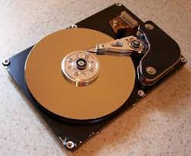
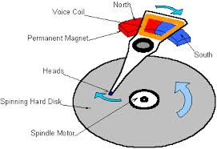
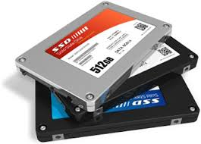

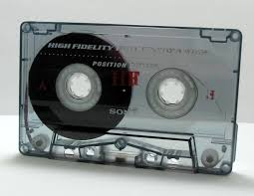
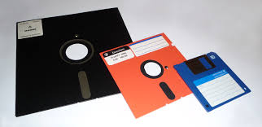
I/O & Storage Layers
Operations, Entities and Interface
Application / Service
streams
High Level I/O
Low Level I/O
handles
Syscall
registers
file_open, file_read, … on struct file * & void *
File System
descriptors
we are here …
I/O Driver
Commands and Data Transfers
Disks, Flash, Controllers, DMA

Slide 16
Recall: C Low level I/O
Operations on File Descriptors – as OS object representing the state of a file
User has a “handle” on the descriptor
#include <fcntl.h>
#include <unistd.h>
#include <sys/types.h>
int open (const char *filename, int flags [, mode_t mode])
int creat (const char *filename, mode_t mode)
int close (int filedes)
Bit vector of:
Access modes (Rd, Wr, …)
Open Flags (Create, …)
Operating modes (Appends, …)
Bit vector of Permission Bits:
User|Group|Other X R|W|X
http://www.gnu.org/software/libc/manual/html_node/Opening-and-Closing-Files.html

Slide 17
Recall: C Low Level Operations
ssize_t read (int filedes, void *buffer, size_t maxsize)
- returns bytes read, 0 => EOF, -1 => error
ssize_t write (int filedes, const void *buffer, size_t size)
- returns bytes written
off_t lseek (int filedes, off_t offset, int whence)
int fsync (int fildes) – wait for i/o to finish
void sync (void) – wait for ALL to finish
When write returns, data is on its way to disk and can be read, but it may not actually be permanent!

Slide 18
Building a File System
File System: Layer of OS that transforms block interface of disks (or other block devices) into Files, Directories, etc.
File System Components
Disk Management: collecting disk blocks into files
Naming: Interface to find files by name, not by blocks
Protection: Layers to keep data secure
Reliability/Durability: Keeping of files durable despite crashes, media failures, attacks, etc
User vs. System View of a File
User’s view:
Durable Data Structures
System’s view (system call interface):
Collection of Bytes (UNIX)
Doesn’t matter to system what kind of data structures you want to store on disk!
System’s view (inside OS):
Collection of blocks (a block is a logical transfer unit, while a sector is the physical transfer unit)
Block size ≥ sector size; in UNIX, block size is 4KB

Slide 19
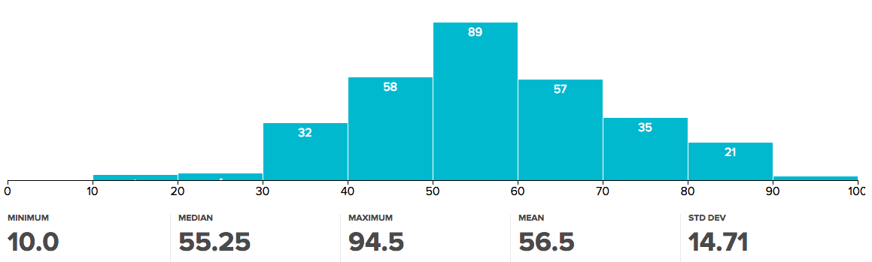
Administrivia
Midterm I grading finished!
Mean: 56.5
StDev: 14.71
Clearly this exam was harder than intended!
Regrades:
You have until Thursday (4/9) to request a regrade
Be sure: If we receive a request, we may regrade whole exam (could lose points)
Midterm II: coming up
April 22nd; More details upcoming

Slide 20
Translating from User to System View
File
System
What happens if user says: give me bytes 2—12?
Fetch block corresponding to those bytes
Return just the correct portion of the block
What about: write bytes 2—12?
Fetch block
Modify portion
Write out Block
Everything inside File System is in whole size blocks
For example, getc(), putc() ⇒ buffers something like 4096 bytes, even if interface is one byte at a time
From now on, file is a collection of blocks

Slide 21
So you are going to design a file system …
What factors are critical to the design choices?
Durable data store => it’s all on disk
Disks Performance !!!
Maximize sequential access, minimize seeks
Open before Read/Write
Can perform protection checks and look up where the actual file resource are, in advance
Size is determined as they are used !!!
Can write (or read zeros) to expand the file
Start small and grow, need to make room
Organized into directories
What data structure (on disk) for that?
Need to allocate / free blocks
Such that access remains efficient

Slide 22
Disk Management Policies
Basic entities on a disk:
File: user-visible group of blocks arranged sequentially in logical space
Directory: user-visible index mapping names to files (next lecture)
Access disk as linear array of sectors. Two Options:
Identify sectors as vectors [cylinder, surface, sector]. Sort in cylinder-major order. Not used much anymore.
Logical Block Addressing (LBA). Every sector has integer address from zero up to max number of sectors.
Controller translates from address ⇒ physical position
First case: OS/BIOS must deal with bad sectors
Second case: hardware shields OS from structure of disk
Need way to track free disk blocks
Link free blocks together ⇒ too slow today
Use bitmap to represent free space on disk
Need way to structure files: File Header
Track which blocks belong at which offsets within the logical file structure
Optimize placement of files’ disk blocks to match access and usage patterns

Slide 23
Components of a File System
File path
Directory
Structure
File Index
Structure
File number
Data blocks
…

Slide 24
Components of a file system
file name
offset
file number
offset
Storage block
directory
index structure
Open performs name resolution
Translates pathname into a “file number”
Used as an “index” to locate the blocks
Creates a file descriptor in PCB within kernel
Returns a “handle” (another int) to user process
Read, Write, Seek, and Sync operate on handle
Mapped to descriptor and to blocks

Slide 25
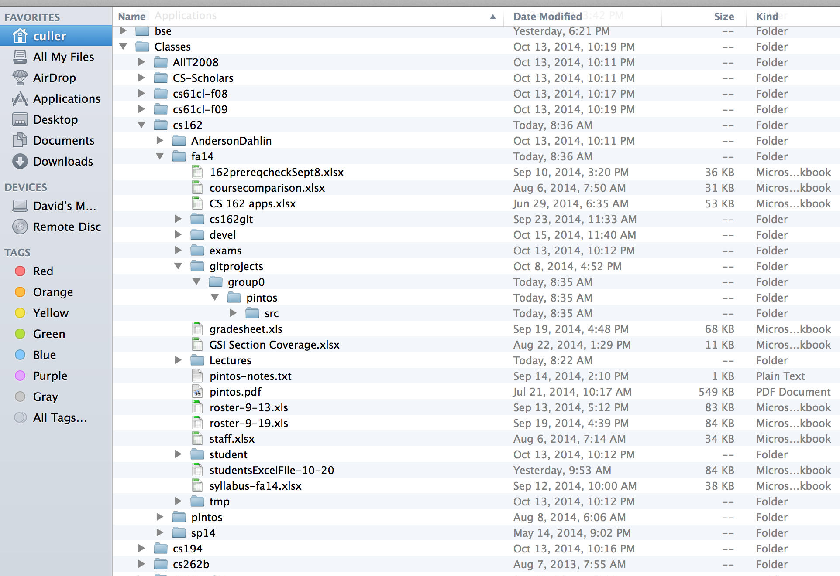
Directories

Slide 26
Directory
Basically a hierarchical structure
Each directory entry is a collection of
Files
Directories
A link to another entries
Each has a name and attributes
Files have data
Links (hard links) make it a DAG, not just a tree
Softlinks (aliases) are another name for an entry

Slide 27
I/O & Storage Layers
Application / Service
streams
High Level I/O
Low Level I/O
handles
#4 - handle
Syscall
registers
File System
descriptors
I/O Driver
Commands and Data Transfers
Data blocks
Disks, Flash, Controllers, DMA
…
Directory Structure

Slide 28
File
Named permanent storage
Contains
Data
Blocks on disk somewhere
Metadata (Attributes)
Owner, size, last opened, …
Access rights
R, W, X
Owner, Group, Other (in Unix systems)
Access control list in Windows system
Data blocks
File handle
…
File descriptor
Fileobject (inode)
Position

Slide 29
FAT (File Allocation Table)
Assume (for now) we have a way to translate a path to a “file number”
i.e., a directory structure
Disk Storage is a collection of Blocks
Just hold file data
Example: file_read 31, < 2, x >
Index into FAT with file number
Follow linked list to block
Read the block from disk into mem
FAT
Disk Blocks
file number
0:
0:
31:
File 31, Block 0
File 31, Block 1
File 31, Block 2
N-1:
N-1:
mem

Slide 30
FAT Properties
File is collection of disk blocks
FAT is linked list 1-1 with blocks
File Number is index of root of block list for the file
File offset (o = B:x )
Follow list to get block #
Unused blocks ⬄ FAT free list
FAT
Disk Blocks
file number
0:
0:
31:
File 31, Block 0
File 31, Block 1
free
File 31, Block 2
N-1:
N-1:
mem

Slide 31
FAT Properties
File is collection of disk blocks
FAT is linked list 1-1 with blocks
File Number is index of root of block list for the file
File offset (o = B:x )
Follow list to get block #
Unused blocks ⬄ FAT free list
Ex: file_write(51, <3, y> )
Grab blocks from free list
Linking them into file
FAT
Disk Blocks
file number
0:
0:
31:
File 31, Block 0
File 31, Block 1
File 31, Block 3
free
File 31, Block 2
N-1:
N-1:
mem

Slide 32
FAT Properties
File is collection of disk blocks
FAT is linked list 1-1 with blocks
File Number is index of root of block list for the file
Grow file by allocating free blocks and linking them in
Ex: Create file, write, write
FAT
Disk Blocks
file number
0:
0:
31:
File 31, Block 0
File 31, Block 1
File 63, Block 1
File 31, Block 3
free
63:
File 63, Block 0
File 2 number
File 31, Block 2
N-1:
N-1:
mem

Slide 33
FAT Assessment
Used in DOS, Windows, thumb drives, …
Where is FAT stored?
On Disk, restore on boot, copy in memory
What happens when you format a disk?
Zero the blocks, link up the FAT free-list
Simple
FAT
Disk Blocks
file number
0:
0:
31:
File 31, Block 0
File 31, Block 1
File 63, Block 1
File 31, Block 3
free
63:
File 63, Block 0
File 2 number
File 31, Block 2
N-1:
N-1:
mem

Slide 34
FAT Assessment
Time to find block (large files) ??
Free list usually just a bit vector
Next fit algorithm
Block layout for file ???
Sequential Access ???
Random Access ???
Fragmentation ???
Small files ???
Big files ???
FAT
Disk Blocks
file number
0:
0:
31:
File 31, Block 0
File 31, Block 1
File 63, Block 1
File 31, Block 3
free
63:
File 63, Block 0
File 2 number
File 31, Block 2
N-1:
N-1:
mem

Slide 35
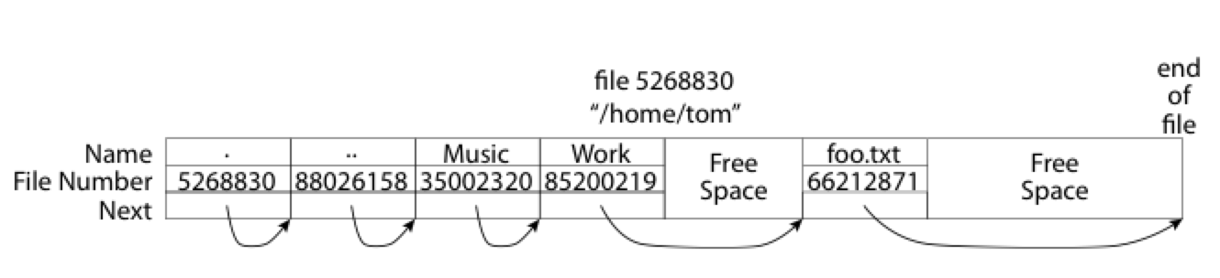
What about the Directory?
Essentially a file containing <file_name: file_number> mappings
Free space for new entries
In FAT: attributes kept in directory (!!!)
Each directory a linked list of entries
Where do you find root directory ( “/” )?

Slide 36
Directory Structure (Con’t)
How many disk accesses to resolve “/my/book/count”?
Read in file header for root (fixed spot on disk)
Read in first data block for root
Table of file name/index pairs. Search linearly – ok since directories typically very small
Read in file header for “my”
Read in first data block for “my”; search for “book”
Read in file header for “book”
Read in first data block for “book”; search for “count”
Read in file header for “count”
Current working directory: Per-address-space pointer to a directory (inode) used for resolving file names
Allows user to specify relative filename instead of absolute path (say CWD=“/my/book” can resolve “count”)

Slide 37
Big FAT security holes
FAT has no access rights
FAT has no header in the file blocks
Just gives and index into the FAT
(file number = block number)

Slide 38
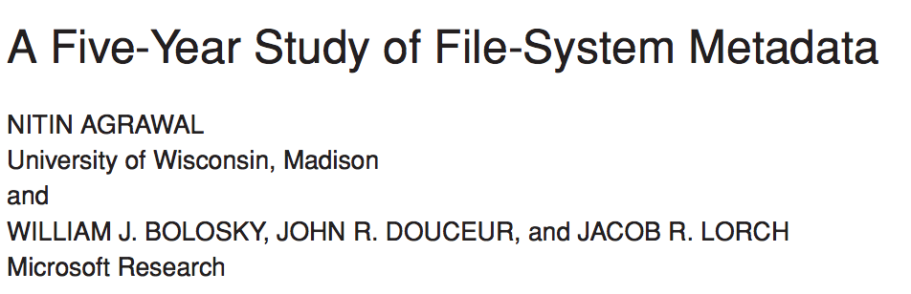
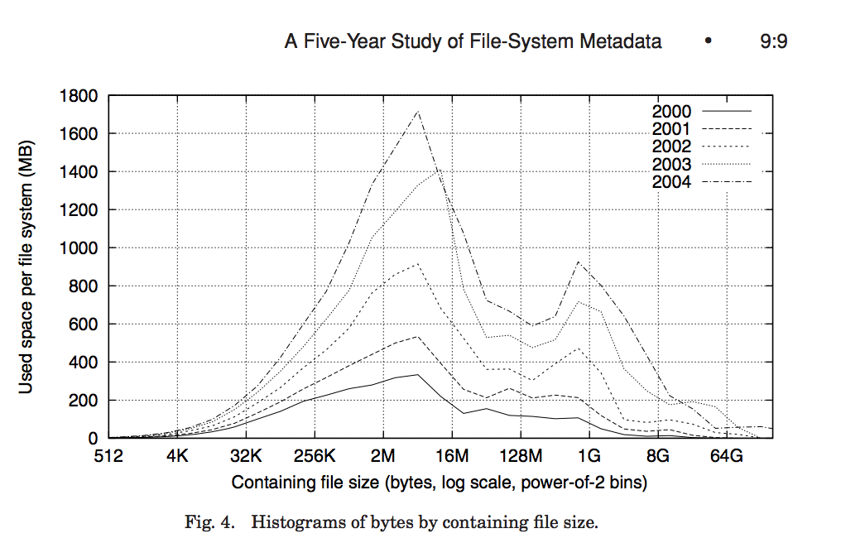
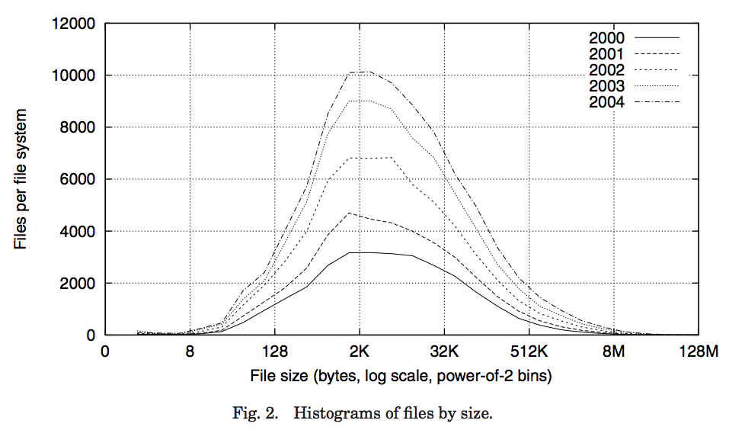
Characteristics of Files
Most files are small
Most of the space is occupied by the rare big ones

Slide 39
So what about a “real” file system
Meet the inode
file_number

Slide 40
Unix Fast File System (Optimization on Unix Filesystem)
Original inode format appeared in BSD 4.1
Berkeley Standard Distribution Unix
Part of your heritage!
File Number is index into inode arrays
Multi-level index structure
Great for little to large files
Asymmetric tree with fixed sized blocks
Metadata associated with the file
Rather than in the directory that points to it
UNIX FFS: BSD 4.2: Locality Heuristics
Block group placement
Reserve space
Scalable directory structure

Slide 41
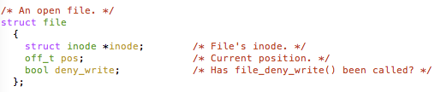
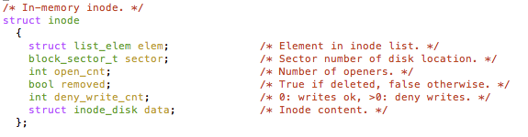
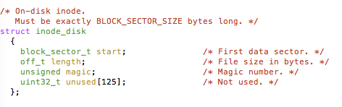
An “almost real” file system
Pintos: src/filesys/file.c, inode.c
file_number

Slide 42
FFS: File Attributes
Inode metadata
User
Group
9 basic access control bits
- UGO x RWX
Setuid bit
- execute at owner permissions
- rather than user
Getgid bit
- execute at group’s permissions

Slide 43
FFS: Data Storage
Small files: 12 pointers direct to data blocks
Direct pointers
4kB blocks ⇒ sufficient For files up to 48KB

Slide 44
FFS: Data Storage
Large files: 1,2,3 level indirect pointers
Indirect pointers
- point to a disk block
containing only pointers
- 4 kB blocks => 1024 ptrs
=> 4 MB @ level 2
=> 4 GB @ level 3
=> 4 TB @ level 4
48 KB
+4 MB
+4 GB
+4 TB

Slide 45
Freespace Management
Bit vector with a bit per storage block
Stored at a fixed location within the file system

Slide 46
Where are inodes stored?
In early UNIX and DOS/Windows’ FAT file system, headers stored in special array in outermost cylinders
Header not stored anywhere near the data blocks. To read a small file, seek to get header, seek back to data.
Fixed size, set when disk is formatted. At formatting time, a fixed number of inodes were created (They were each given a unique number, called an “inumber”)

Slide 47
Where are inodes stored?
Later versions of UNIX moved the header information to be closer to the data blocks
Often, inode for file stored in same “cylinder group” as parent directory of the file (makes an ls of that directory run fast).
Pros:
UNIX BSD 4.2 puts a portion of the file header array on each of many cylinders. For small directories, can fit all data, file headers, etc. in same cylinder ⇒ no seeks!
File headers much smaller than whole block (a few hundred bytes), so multiple headers fetched from disk at same time
Reliability: whatever happens to the disk, you can find many of the files (even if directories disconnected)
Part of the Fast File System (FFS)
General optimization to avoid seeks

Slide 48
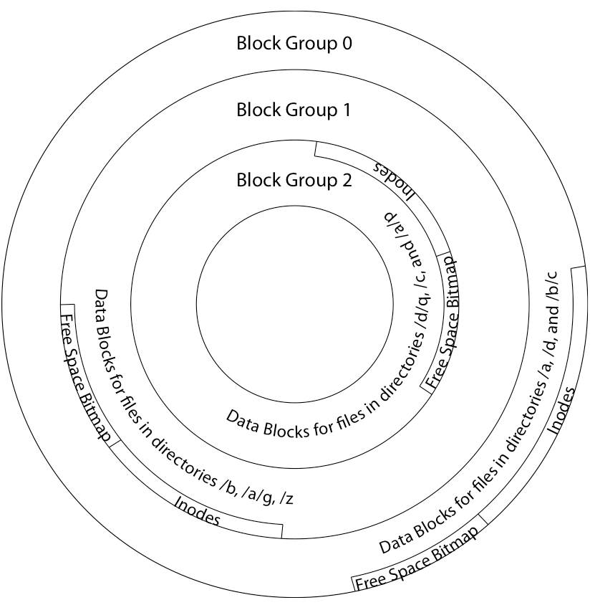
Locality: Block Groups
File system volume is divided into a set of block groups
Close set of tracks
File data blocks, metadata, and free space are interleaved within block group
Avoid huge seeks between user data and system structure
Put directory and its files in common block group
First-Free allocation of new file block
Few little holes at start, big sequential runs at end of group
Avoids fragmentation
Sequential layout for big
Reserve space in the BG

Slide 49
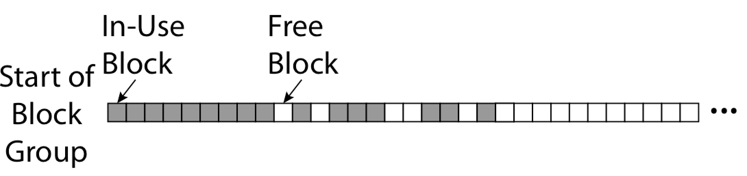
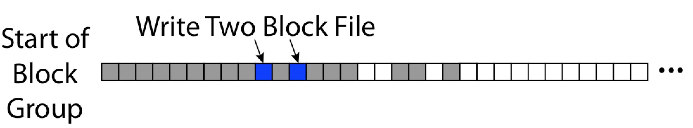
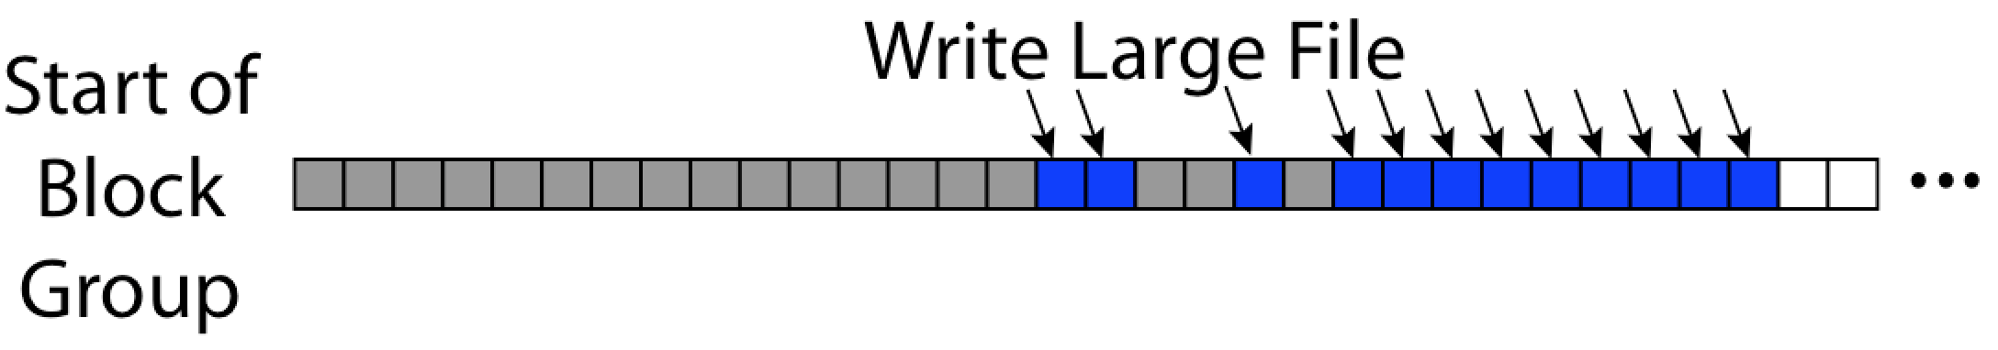
FFS First Fit Block Allocation
Fills in the small holes at the start of block group
Avoids fragmentation, leaves contiguous free space at end

Slide 50
FFS
Pros
Efficient storage for both small and large files
Locality for both small and large files
Locality for metadata and data
Cons
Inefficient for tiny files (a 1 byte file requires both an inode and a data block)
Inefficient encoding when file is mostly contiguous on disk (no equivalent to superpages)
Need to reserve 10-20% of free space to prevent fragmentation

Slide 51
File System Summary
File System:
Transforms blocks into Files and Directories
Optimize for access and usage patterns
Maximize sequential access, allow efficient random access
File (and directory) defined by header, called “inode”
Multilevel Indexed Scheme
Inode contains file info, direct pointers to blocks,
indirect blocks, doubly indirect, etc..
4.2 BSD Multilevel index files
Inode contains pointers to actual blocks, indirect blocks, double indirect blocks, etc.
Optimizations for sequential access: start new files in open ranges of free blocks, rotational Optimization
Naming: act of translating from user-visible names to actual system resources
Directories used for naming for local file systems

