Slide 1
CS162 Operating Systems and Systems Programming Lecture 19 File Systems (Con’t), MMAP, Transactions, COW
April 8th, 2015
Prof. John Kubiatowicz
http://cs162.eecs.Berkeley.edu

Slide 2
Recall: Building a File System
File System: Layer of OS that transforms block interface of disks (or other block devices) into Files, Directories, etc.
File System Components
Disk Management: collecting disk blocks into files
Naming: Interface to find files by name, not by blocks
Protection: Layers to keep data secure
Reliability/Durability: Keeping of files durable despite crashes, media failures, attacks, etc
User vs. System View of a File
User’s view:
Durable Data Structures
System’s view (system call interface):
Collection of Bytes (UNIX)
Doesn’t matter to system what kind of data structures you want to store on disk!
System’s view (inside OS):
Collection of blocks (a block is a logical transfer unit, while a sector is the physical transfer unit)
Block size ≥ sector size; in UNIX, block size is 4KB

Slide 3
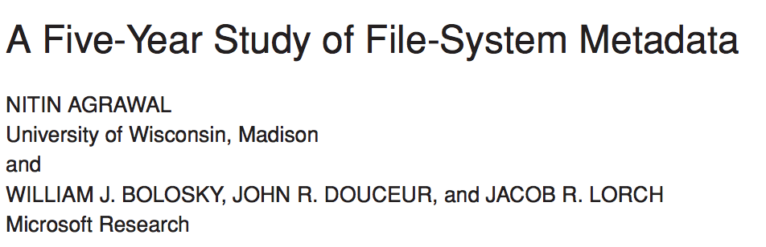
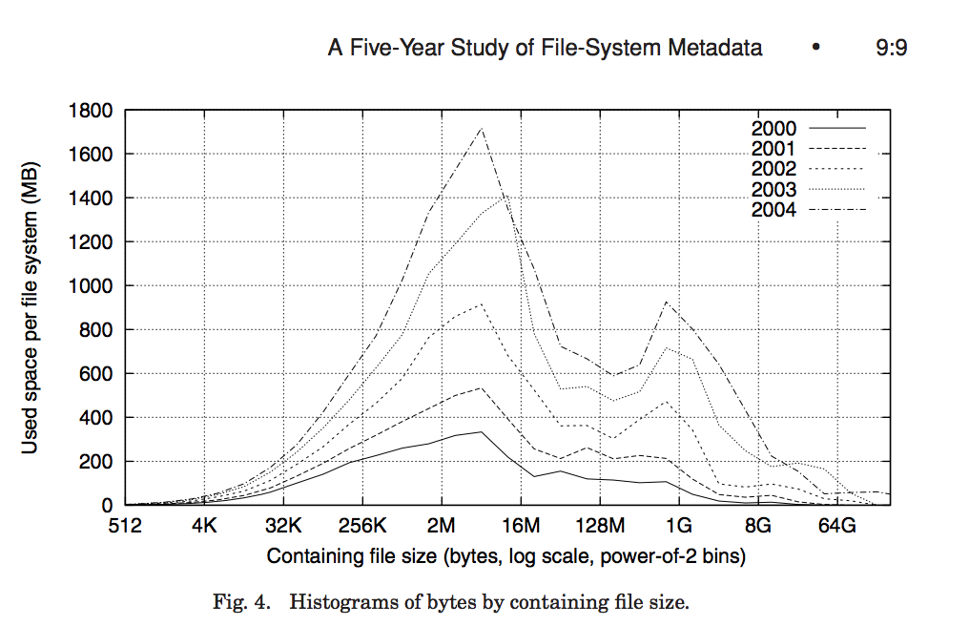
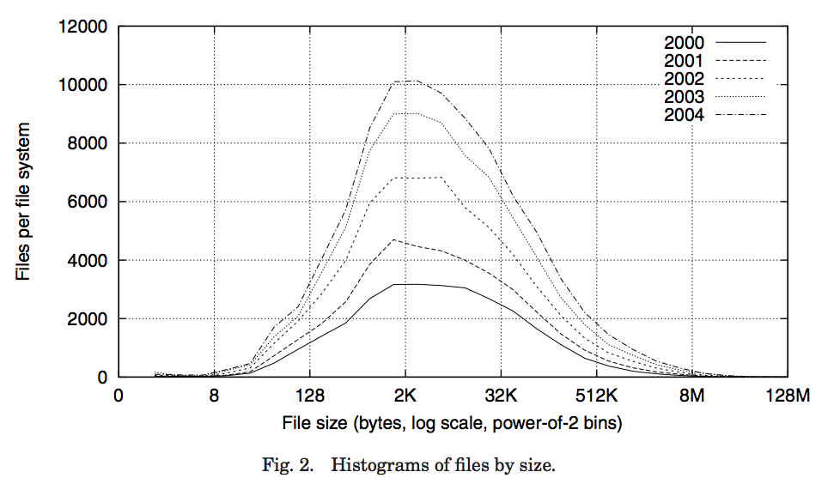
Recall: Characteristics of Files
Most files are small
Most of the space is occupied by the rare big ones

Slide 4
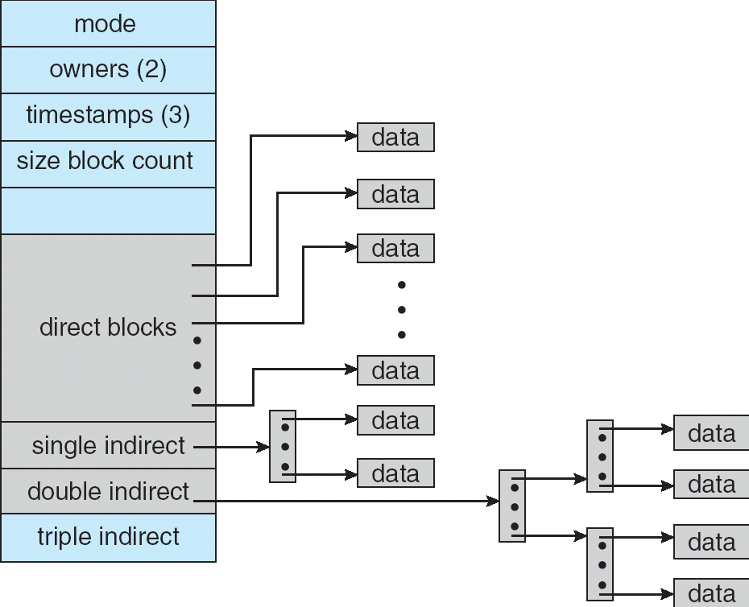
Recall: Multilevel Indexed Files (Original 4.1 BSD)
Sample file in multilevel indexed format:
10 direct ptrs, 1K blocks
How many accesses for block #23? (assume file header accessed on open)?
Two: One for indirect block, one for data
How about block #5?
One: One for data
Block #340?
Three: double indirect block, indirect block, and data
UNIX 4.1 Pros and cons
Pros: Simple (more or less) Files can easily expand (up to a point) Small files particularly cheap and easy
Cons: Lots of seeks Very large files must read many indirect block (four I/Os per block!)

Slide 5
UNIX BSD 4.2
Same as BSD 4.1 (same file header and triply indirect blocks), except incorporated ideas from Cray DEMOS:
Uses bitmap allocation in place of freelist
Attempt to allocate files contiguously
10% reserved disk space
Skip-sector positioning (mentioned next slide)
Problem: When create a file, don’t know how big it will become (in UNIX, most writes are by appending)
How much contiguous space do you allocate for a file?
In BSD 4.2, just find some range of free blocks
Put each new file at the front of different range
To expand a file, you first try successive blocks in bitmap, then choose new range of blocks
Also in BSD 4.2: store files from same directory near each other
Fast File System (FFS)
Allocation and placement policies for BSD 4.2

Slide 6
Attack of the Rotational Delay
Problem 2: Missing blocks due to rotational delay
Issue: Read one block, do processing, and read next block. In meantime, disk has continued turning: missed next block! Need 1 revolution/block!
Solution1: Skip sector positioning (“interleaving”)
Place the blocks from one file on every other block of a track: give time for processing to overlap rotation
Solution2: Read ahead: read next block right after first, even if application hasn’t asked for it yet.
This can be done either by OS (read ahead)
By disk itself (track buffers). Many disk controllers have internal RAM that allows them to read a complete track
Important Aside: Modern disks+controllers do many complex things “under the covers”
Track buffers, elevator algorithms, bad block filtering
Skip Sector
Track Buffer
(Holds complete track)

Slide 7
Where are inodes stored?
In early UNIX and DOS/Windows’ FAT file system, headers stored in special array in outermost cylinders
Header not stored anywhere near the data blocks. To read a small file, seek to get header, seek back to data.
Fixed size, set when disk is formatted. At formatting time, a fixed number of inodes were created (They were each given a unique number, called an “inumber”)

Slide 8
Where are inodes stored?
Later versions of UNIX moved the header information to be closer to the data blocks
Often, inode for file stored in same “cylinder group” as parent directory of the file (makes an ls of that directory run fast).
Pros:
UNIX BSD 4.2 puts a portion of the file header array on each of many cylinders. For small directories, can fit all data, file headers, etc. in same cylinder ⇒ no seeks!
File headers much smaller than whole block (a few hundred bytes), so multiple headers fetched from disk at same time
Reliability: whatever happens to the disk, you can find many of the files (even if directories disconnected)
Part of the Fast File System (FFS)
General optimization to avoid seeks

Slide 9
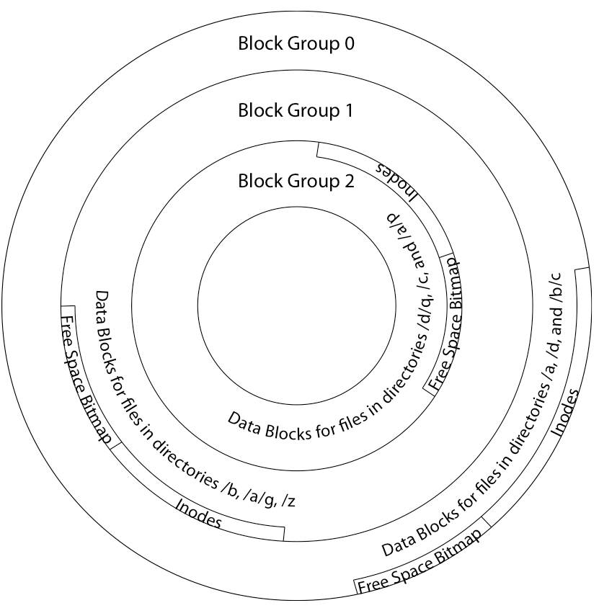
4.2 BSD Locality: Block Groups
File system volume is divided into a set of block groups
Close set of tracks
Data blocks, metadata, and free space interleaved within block group
Avoid huge seeks between user data and system structure
Put directory and its files in common block group
First-Free allocation of new file blocks
To expand file, first try successive blocks in bitmap, then choose new range of blocks
Few little holes at start, big sequential runs at end of group
Avoids fragmentation
Sequential layout for big files
Important: keep 10% or more free!
Reserve space in the BG

Slide 10
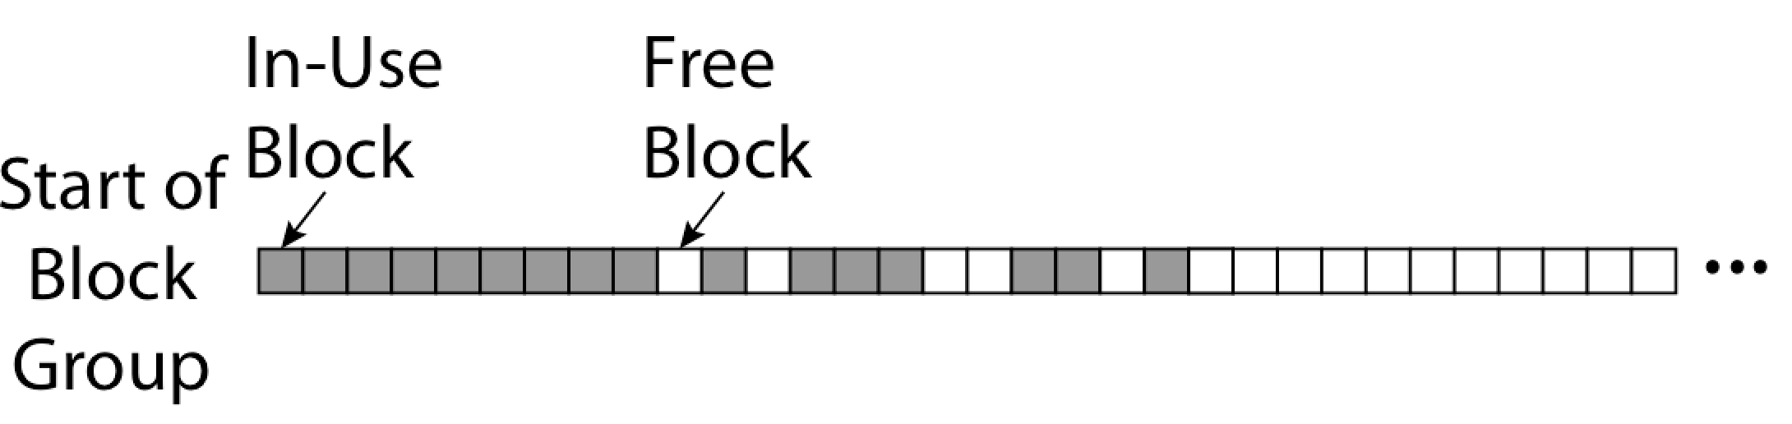
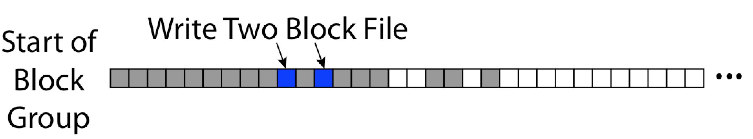
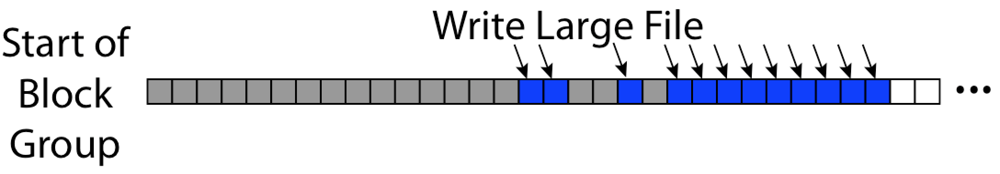
FFS First Fit Block Allocation
Fills in the small holes at the start of block group
Avoids fragmentation, leaves contiguous free space at end

Slide 11
FFS
Pros
Efficient storage for both small and large files
Locality for both small and large files
Locality for metadata and data
Cons
Inefficient for tiny files (a 1 byte file requires both an inode and a data block)
Inefficient encoding when file is mostly contiguous on disk (no equivalent to superpages)
Need to reserve 10-20% of free space to prevent fragmentation

Slide 12
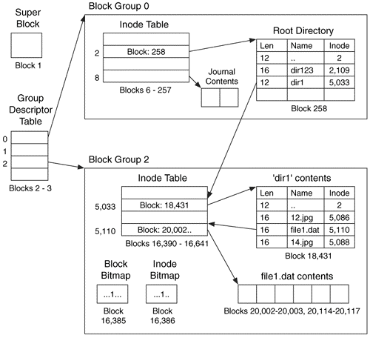
Linux Example: Ext2/3 Disk Layout
Disk divided into block groups
Provides locality
Each group has two block-sized bitmaps (free blocks/inodes)
Block sizes settable at format time: 1K, 2K, 4K, 8K…
Actual Inode structure similar to 4.2BSD
with 12 direct pointers
Ext3: Ext2 w/Journaling
Several degrees of protection with more or less cost
Example: create a file1.dat under /dir1/ in Ext3

Slide 13
A bit more on directories
Stored in files, can be read, but typically don’t
System calls to access directories
Open / Creat traverse the structure
mkdir /rmdir add/remove entries
Link / Unlink
Link existing file to a directory
Not in FAT !
Forms a DAG
When can file be deleted?
Maintain ref-count of links to the file
Delete after the last reference is gone.
libc support
DIR * opendir (const char *dirname)
struct dirent * readdir (DIR *dirstream)
int readdir_r (DIR *dirstream, struct dirent *entry, struct dirent **result)
/usr
/usr/lib
/usr/lib4.3
/usr/lib/foo
/usr/lib4.3/foo

Slide 14
Links
Hard link
Sets another directory entry to contain the file number for the file
Creates another name (path) for the file
Each is “first class”
Soft link or Symbolic Link
Directory entry contains the name of the file
Map one name to another name

Slide 15
Large Directories: B-Trees (dirhash)

Slide 16
Administrivia
Midterm II
Wednesday, 4/22
Topics up until Monday class (4/20)
1 page of hand-written notes, both sides
HW 4 handed out next Monday

Slide 17
NTFS
New Technology File System (NTFS)
Common on Microsoft Windows systems
Variable length extents
Rather than fixed blocks
Everything (almost) is a sequence of <attribute:value> pairs
Meta-data and data
Mix direct and indirect freely
Directories organized in B-tree structure by default

Slide 18
NTFS
Master File Table
DataBase with Flexible 1KB entries for metadata/data
Variable-sized attribute records (data or metadata)
Extend with variable depth tree (non-resident)
Extents – variable length contiguous regions
Block pointers cover runs of blocks
Similar approach in Linux (ext4)
File create can provide hint as to size of file
Journalling for reliability
Discussed later

Slide 19
NTFS Small File
Create time, modify time, access time,
Owner id, security specifier, flags (ro, hid, sys)
data attribute
Attribute list

Slide 20
NTFS Medium File

Slide 21
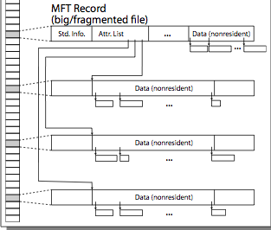
NTFS Multiple Indirect Blocks

Slide 23
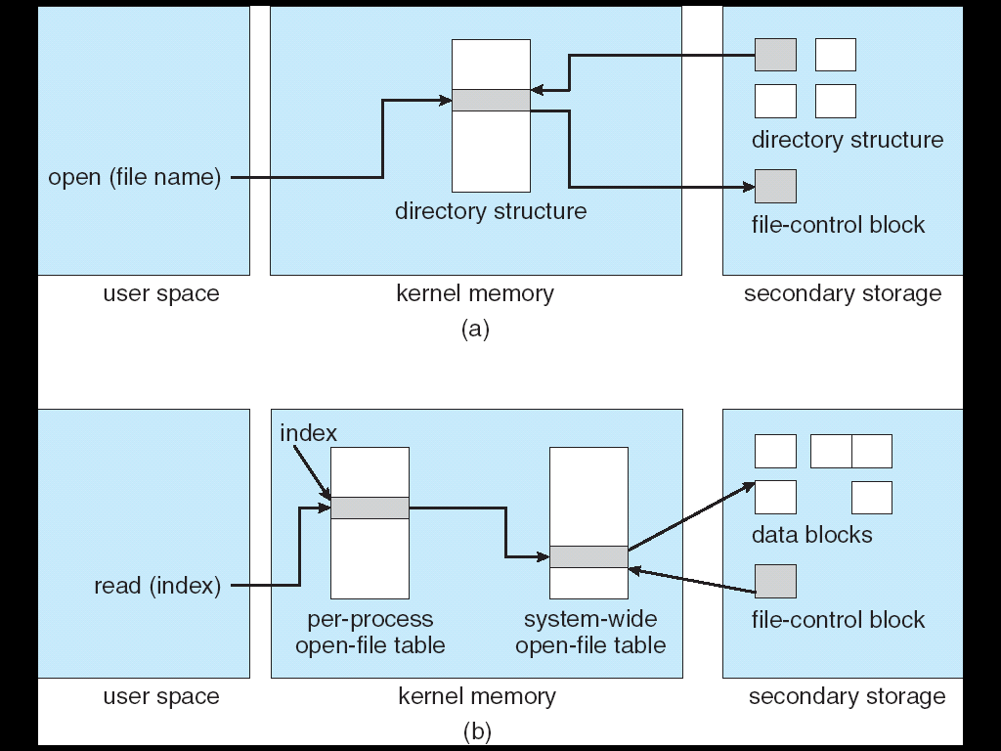
In-Memory File System Structures
Open system call:
Resolves file name, finds file control block (inode)
Makes entries in per-process and system-wide tables
Returns index (called “file handle”) in open-file table

Slide 24
In-Memory File System Structures
Read/write system calls:
Use file handle to locate inode
Perform appropriate reads or writes

Slide 25
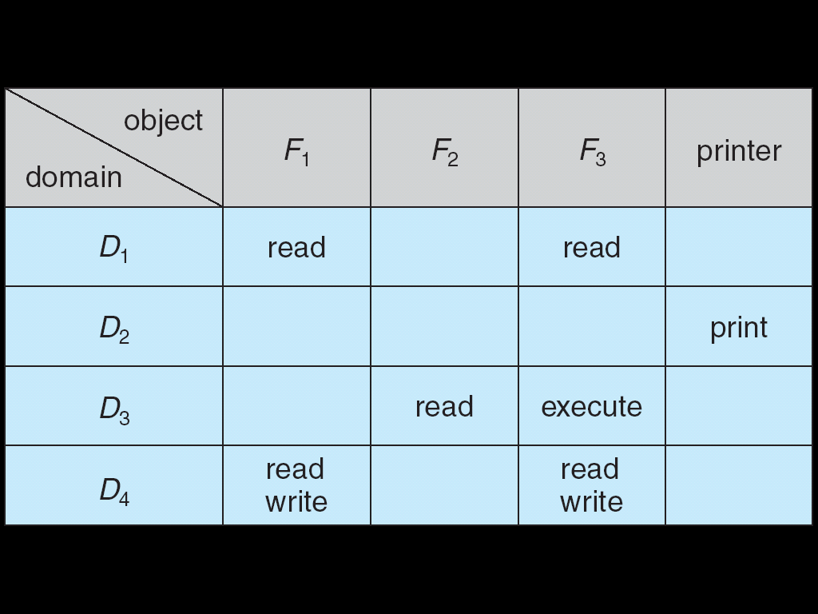
Authorization: Who Can Do What?
How do we decide who is authorized to do actions in the system?
Access Control Matrix: contains all permissions in the system
Resources across top
Files, Devices, etc…
Domains in columns
A domain might be a user or a group of users
E.g. above: User D3 can read F2 or execute F3
In practice, table would be huge and sparse!

Slide 26
Authorization: Two Implementation Choices
Access Control Lists: store permissions with object
Still might be lots of users!
UNIX limits each file to: r,w,x for owner, group, world
More recent systems allow definition of groups of users and permissions for each group
ACLs allow easy changing of an object’s permissions
Example: add Users C, D, and F with rw permissions
Capability List: each process tracks which objects has permission to touch
Popular in the past, idea out of favor today
Consider page table: Each process has list of pages it has access to, not each page has list of processes …
Capability lists allow easy changing of a domain’s permissions
Example: you are promoted to system administrator and should be given access to all system files

Slide 27

Authorization: Combination Approach
Users have capabilities, called “groups” or “roles”
Everyone with particular group access is “equivalent” when accessing group resource
Like passport (which gives access to country of origin)
Objects have ACLs
ACLs can refer to users or groups
Change object permissions object by modifying ACL
Change broad user permissions via changes in group membership
Possessors of proper credentials get access

Slide 28
Authorization: How to Revoke?
How does one revoke someone’s access rights to a particular object?
Easy with ACLs: just remove entry from the list
Takes effect immediately since the ACL is checked on each object access
Harder to do with capabilities since they aren’t stored with the object being controlled:
Not so bad in a single machine: could keep all capability lists in a well-known place (e.g., the OS capability table).
Very hard in distributed system, where remote hosts may have crashed or may not cooperate (more in a future lecture)

Slide 29
Revoking Capabilities
Various approaches to revoking capabilities:
Put expiration dates on capabilities and force reacquisition
Put epoch numbers on capabilities and revoke all capabilities by bumping the epoch number (which gets checked on each access attempt)
Maintain back pointers to all capabilities that have been handed out (Tough if capabilities can be copied)
Maintain a revocation list that gets checked on every access attempt

Slide 30
Memory Mapped Files
Traditional I/O involves explicit transfers between buffers in process address space to regions of a file
This involves multiple copies into caches in memory, plus system calls
What if we could “map” the file directly into an empty region of our address space
Implicitly “page it in” when we read it
Write it and “eventually” page it out
Executable file is treated this way when we exec the process !!

Slide 31
Recall: Who does what, when?
Process
virtual address
physical address
MMU
page#
PT
instruction
frame#
retry
page fault
offset
exception
frame#
Operating System
offset
update PT entry
Page Fault Handler
load page from disk
scheduler

Slide 32
Using Paging to mmap files
Process
virtual address
physical address
MMU
page#
PT
instruction
frame#
offset
retry
page fault
exception
Read File contents
from memory!
Operating System
Create PT entries
for mapped region
as “backed” by file
Page Fault Handler
File
scheduler
mmap file to region of VAS

Slide 33
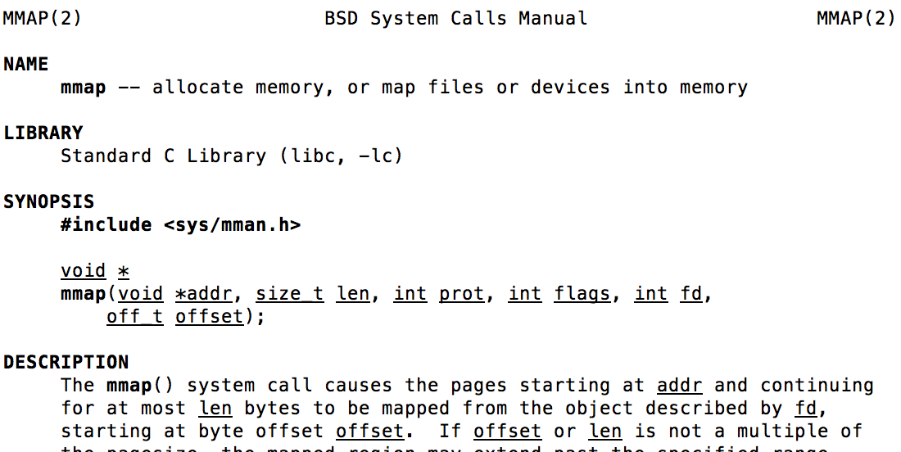
mmap system call
May map a specific region or let the system find one for you
Tricky to know where the holes are
Used both for manipulating files and for sharing between processes

Slide 34
An example
#include <sys/mman.h>
int something = 162;
int main (int argc, char *argv[]) {
int myfd;
char *mfile;
printf("Data at: %16lx\n", (long unsigned int) &something);
printf("Heap at : %16lx\n", (long unsigned int) malloc(1));
printf("Stack at: %16lx\n", (long unsigned int) &mfile);
/* Open the file */
myfd = open(argv[1], O_RDWR | O_CREATE);
if (myfd < 0) { perror((“open failed!”);exit(1); }
/* map the file */
mfile = mmap(0, 10000, PROT_READ|PROT_WRITE, MAP_FILE|MAP_SHARED, myfd, 0);
if (mfile == MAP_FAILED) {perror("mmap failed"); exit(1);}
printf("mmap at : %16lx\n", (long unsigned int) mfile);
puts(mfile);
strcpy(mfile+20,"Let's write over it");
close(myfd);
return 0;
}

Slide 35
Sharing through Mapped Files
VAS 1
VAS 2
0x000…
0x000…
instructions
instructions
data
data
File
heap
heap
Memory
stack
stack
OS
OS
0xFFF…
0xFFF…

Slide 36
File System Caching
Key Idea: Exploit locality by caching data in memory
Name translations: Mapping from paths→inodes
Disk blocks: Mapping from block address→disk content
Buffer Cache: Memory used to cache kernel resources, including disk blocks and name translations
Can contain “dirty” blocks (blocks yet on disk)
Replacement policy? LRU
Can afford overhead of timestamps for each disk block
Advantages:
Works very well for name translation
Works well in general as long as memory is big enough to accommodate a host’s working set of files.
Disadvantages:
Fails when some application scans through file system, thereby flushing the cache with data used only once
Example: find . –exec grep foo {} \;
Other Replacement Policies?
Some systems allow applications to request other policies
Example, ‘Use Once’:
File system can discard blocks as soon as they are used

Slide 37
File System Caching (con’t)
Cache Size: How much memory should the OS allocate to the buffer cache vs virtual memory?
Too much memory to the file system cache ⇒ won’t be able to run many applications at once
Too little memory to file system cache ⇒ many applications may run slowly (disk caching not effective)
Solution: adjust boundary dynamically so that the disk access rates for paging and file access are balanced
Read Ahead Prefetching: fetch sequential blocks early
Key Idea: exploit fact that most common file access is sequential by prefetching subsequent disk blocks ahead of current read request (if they are not already in memory)
Elevator algorithm can efficiently interleave groups of prefetches from concurrent applications
How much to prefetch?
Too many imposes delays on requests by other applications
Too few causes many seeks (and rotational delays) among concurrent file requests

Slide 38
File System Caching (con’t)
Delayed Writes: Writes to files not immediately sent out to disk
Instead, write() copies data from user space buffer to kernel buffer (in cache)
Enabled by presence of buffer cache: can leave written file blocks in cache for a while
If some other application tries to read data before written to disk, file system will read from cache
Flushed to disk periodically (e.g. in UNIX, every 30 sec)
Advantages:
Disk scheduler can efficiently order lots of requests
Disk allocation algorithm can be run with correct size value for a file
Some files need never get written to disk! (e..g temporary scratch files written /tmp often don’t exist for 30 sec)
Disadvantages
What if system crashes before file has been written out?
Worse yet, what if system crashes before a directory file has been written out? (lose pointer to inode!)

Slide 39
Important “ilities”
Availability: the probability that the system can accept and process requests
Often measured in “nines” of probability. So, a 99.9% probability is considered “3-nines of availability”
Key idea here is independence of failures
Durability: the ability of a system to recover data despite faults
This idea is fault tolerance applied to data
Doesn’t necessarily imply availability: information on pyramids was very durable, but could not be accessed until discovery of Rosetta Stone
Reliability: the ability of a system or component to perform its required functions under stated conditions for a specified period of time (IEEE definition)
Usually stronger than simply availability: means that the system is not only “up”, but also working correctly
Includes availability, security, fault tolerance/durability
Must make sure data survives system crashes, disk crashes, other problems

Slide 40
How to make file system durable?
Disk blocks contain Reed-Solomon error correcting codes (ECC) to deal with small defects in disk drive
Can allow recovery of data from small media defects
Make sure writes survive in short term
Either abandon delayed writes or
use special, battery-backed RAM (called non-volatile RAM or NVRAM) for dirty blocks in buffer cache.
Make sure that data survives in long term
Need to replicate! More than one copy of data!
Important element: independence of failure
Could put copies on one disk, but if disk head fails…
Could put copies on different disks, but if server fails…
Could put copies on different servers, but if building is struck by lightning….
Could put copies on servers in different continents…
RAID: Redundant Arrays of Inexpensive Disks
Data stored on multiple disks (redundancy)
Either in software or hardware
In hardware case, done by disk controller; file system may not even know that there is more than one disk in use

Slide 41
RAID 1: Disk Mirroring/Shadowing
recovery
group
Each disk is fully duplicated onto its "shadow“
For high I/O rate, high availability environments
Most expensive solution: 100% capacity overhead
Bandwidth sacrificed on write:
Logical write = two physical writes
Highest bandwidth when disk heads and rotation fully synchronized (hard to do exactly)
Reads may be optimized
Can have two independent reads to same data
Recovery:
Disk failure ⇒ replace disk and copy data to new disk
Hot Spare: idle disk already attached to system to be used for immediate replacement

Slide 42
RAID 5+: High I/O Rate Parity
Stripe
Unit
Data stripped across multiple disks
Successive blocks stored on successive (non-parity) disks
Increased bandwidth over single disk
Parity block (in green) constructed by XORing data bocks in stripe
P0=D0⊕D1⊕D2⊕D3
Can destroy any one disk and still reconstruct data
Suppose D3 fails, then can reconstruct: D3=D0⊕D1⊕D2⊕P0
Later in term: talk about spreading information widely across internet for durability.
D0
D1
D2
D3
P0
D4
D5
D6
P1
Increasing
Logical
Disk
Addresses
D7
D8
D9
P2
D10
D11
D12
P3
D13
D14
D15
P4
D16
D17
D18
D19
D20
D21
D22
D23
P5
Disk 1
Disk 2
Disk 3
Disk 4
Disk 5

Slide 43
Hardware RAID: Subsystem Organization
CPU
host
adapter
array
controller
single board
disk
controller
manages interface
to host, DMA
single board
disk
controller
control, buffering,
parity logic
single board
disk
controller
physical device
control
single board
disk
controller
Some systems duplicate all hardware, namely controllers, busses, etc.
often piggy-backed
in small format devices

Slide 44
Higher Durability/Reliability through Geographic Replication
Highly durable – hard to destroy bits
Highly available for reads
Low availability for writes
Can’t write if any one is not up
Or – need relaxed consistency model
Reliability?

Slide 45
File System Reliability
What can happen if disk loses power or machine software crashes?
Some operations in progress may complete
Some operations in progress may be lost
Overwrite of a block may only partially complete
Having RAID doesn’t necessarily protect against all such failures
Bit-for-bit protection of bad state?
What if one disk of RAID group not written?
File system wants durability (as a minimum!)
Data previously stored can be retrieved (maybe after some recovery step), regardless of failure

Slide 46
Achieving File System Reliability
Problem posed by machine/disk failures
Transaction concept
Approaches to reliability
Careful sequencing of file system operations
Copy-on-write (WAFL, ZFS)
Journalling (NTFS, linux ext4)
Log structure (flash storage)
Approaches to availability
RAID

Slide 47
Storage Reliability Problem
Single logical file operation can involve updates to multiple physical disk blocks
inode, indirect block, data block, bitmap, …
With remapping, single update to physical disk block can require multiple (even lower level) updates
At a physical level, operations complete one at a time
Want concurrent operations for performance
How do we guarantee consistency regardless of when crash occurs?

Slide 48
Threats to Reliability
Interrupted Operation
Crash or power failure in the middle of a series of related updates may leave stored data in an inconsistent state.
e.g.: transfer funds from BofA to Schwab. What if transfer is interrupted after withdrawal and before deposit
Loss of stored data
Failure of non-volatile storage media may cause previously stored data to disappear or be corrupted

Slide 49
Log Structured and Journaled File Systems
Better reliability through use of log
All changes are treated as transactions
A transaction is committed once it is written to the log
Data forced to disk for reliability
Process can be accelerated with NVRAM
Although File system may not be updated immediately, data preserved in the log
Difference between “Log Structured” and “Journaled”
In a Log Structured filesystem, data stays in log form
In a Journaled filesystem, Log used for recovery
For Journaled system:
Log used to asynchronously update filesystem
Log entries removed after used
After crash:
Remaining transactions in the log performed (“Redo”)
Modifications done in way that can survive crashes
Examples of Journaled File Systems:
Ext3 (Linux), XFS (Unix), etc.

Slide 50
More General Solutions
Transactions for Atomic Updates
Ensure that multiple related updates are performed atomically
i.e., if a crash occurs in the middle, the state of the systems reflects either all or none of the updates
Most modern file systems use transactions internally to update the many pieces
Many applications implement their own transactions
Redundancy for media failures
Redundant representation (error correcting codes)
Replication
E.g., RAID disks

Slide 51
Transactions
Closely related to critical sections in manipulating shared data structures
Extend concept of atomic update from memory to stable storage
Atomically update multiple persistent data structures
Like flags for threads, many ad hoc approaches
FFS carefully ordered the sequence of updates so that if a crash occurred while manipulating directory or inodes the disk scan on reboot would detect and recover the error, -- fsck
Applications use temporary files and rename

Slide 52
Key concept: Transaction
An atomic sequence of actions (reads/writes) on a storage system (or database)
That takes it from one consistent state to another
transaction
consistent state 1
consistent state 2

Slide 53
Typical Structure
Begin a transaction – get transaction id
Do a bunch of updates
If any fail along the way, roll-back
Or, if any conflicts with other transactions, roll-back
Commit the transaction

Slide 54
“Classic” Example: Transaction
BEGIN; --BEGIN TRANSACTION
UPDATE accounts SET balance = balance - 100.00 WHERE name = 'Alice';
UPDATE branches SET balance = balance - 100.00 WHERE name = (SELECT branch_name FROM accounts WHERE name = 'Alice');
UPDATE accounts SET balance = balance + 100.00 WHERE name = 'Bob';
UPDATE branches SET balance = balance + 100.00 WHERE name = (SELECT branch_name FROM accounts WHERE name = 'Bob');
COMMIT; --COMMIT WORK
Transfer $100 from Alice’s account to Bob’s account

Slide 55
The ACID properties of Transactions
Atomicity: all actions in the transaction happen, or none happen
Consistency: transactions maintain data integrity, e.g.,
Balance cannot be negative
Cannot reschedule meeting on February 30
Isolation: execution of one transaction is isolated from that of all others; no problems from concurrency
Durability: if a transaction commits, its effects persist despite crashes

Slide 56
Poor-man’s transactions: Toward Copy-on-Write
Files are for durable storage AND flexible process-independent, protected namespace
Files grow incrementally as written
Update-in-place file systems start with a basic chunk and append (possibly larger) chunks as file grows
Transition from random access to large sequential
Disks trends: huge and cheap, high startup
Design / Memory trends: cache everything
Reads satisfied from cache, buffer multiple writes and do them all together
Application trends: make multiple related changes to a file and commit all or nothing
What if want to be able to undo changes later?

Slide 57
Emulating COW @ user level
Transform file foo to a new version
Open/Create a new file foo.v
where v is the version #
Do all the updates based on the old foo
Reading from foo and writing to foo.v
Including copying over any unchanged parts
Update the link
ln –f foo foo.v
Does it work?
What if multiple updaters at same time?
How to keep track of every version of file?
Would we want to do that?

Slide 58
Creating a New Version
old version
new version
Write
If file represented as a tree of blocks, just need to update the leading fringe

Slide 59
Creating a New Version
old version
new version
Write
If file represented as a tree of blocks, just need to update the leading fringe

Slide 60
ZFS
Variable sized blocks: 512 B – 128 KB
Symmetric tree
Know if it is large or small when we make the copy
Store version number with pointers
Can create new version by adding blocks and new pointers
Buffers a collection of writes before creating a new version with them
Free space represented as tree of extents in each block group
Delay updates to freespace (in log) and do them all when block group is activated

Slide 61
File System Summary (1/2)
File System:
Transforms blocks into Files and Directories
Optimize for size, access and usage patterns
Maximize sequential access, allow efficient random access
Projects the OS protection and security regime (UGO vs ACL)
File defined by header, called “inode”
Naming: act of translating from user-visible names to actual system resources
Directories used for naming for local file systems
Linked or tree structure stored in files
Multilevel Indexed Scheme
inode contains file info, direct pointers to blocks, indirect blocks, doubly indirect, etc..
NTFS uses variable extents, rather than fixed blocks, and tiny files data is in the header
4.2 BSD Multilevel index files
Inode contains pointers to actual blocks, indirect blocks, double indirect blocks, etc.
Optimizations for sequential access: start new files in open ranges of free blocks, rotational Optimization

Slide 62
File System Summary (2/2)
File layout driven by freespace management
Integrate freespace, inode table, file blocks and directories into block group
Deep interactions between memory management, file system, and sharing
Important system properties
Availability: how often is the resource available?
Durability: how well is data preserved against faults?
Reliability: how often is resource performing correctly?
RAID: Redundant Arrays of Inexpensive Disks
RAID1: mirroring, RAID5: Parity block
Use of Log to improve Reliability
Journaled file systems such as ext3
Copy-on-write creates new (better positioned) version of file upon burst of writes

