Slide 1
CS162 Operating Systems and Systems Programming Lecture 20 Reliability, Transactions Distributed Systems
April 13th, 2015
Prof. John Kubiatowicz
http://cs162.eecs.Berkeley.edu

Slide 2
Recall: File System Caching
Buffer Cache: Memory used to cache kernel resources, including disk blocks and name translations
Can contain “dirty” blocks (blocks yet on disk)
Read Ahead Prefetching: fetch sequential blocks early
Exploit fact that most common file access is sequential
Elevator algorithm can efficiently interleave prefetches from different apps
How much to prefetch? It’s a balance!
Delayed Writes: Writes not immediately sent to disk
write() copies data from user space buffer to kernel buffer
Other applications read data from cache instead of disk
Flushed to disk periodically (e.g. in UNIX, every 30 sec)
Advantages:
Disk scheduler can efficiently order lots of requests
Disk allocation algorithm can be run with correct size value for a file
Some files need never get written to disk! (e..g temporary scratch files written /tmp often don’t exist for 30 sec)
Disadvantages
What if system crashes before file has been written out?
Worse yet, what if system crashes before a directory file has been written out? (lose pointer to inode!)

Slide 3
Recall: Important “ilities”
Availability: the probability that the system can accept and process requests
Often measured in “nines” of probability. So, a 99.9% probability is considered “3-nines of availability”
Key idea here is independence of failures
Durability: the ability of a system to recover data despite faults
This idea is fault tolerance applied to data
Doesn’t necessarily imply availability: information on pyramids was very durable, but could not be accessed until discovery of Rosetta Stone
Reliability: the ability of a system or component to perform its required functions under stated conditions for a specified period of time (IEEE definition)
Usually stronger than simply availability: means that the system is not only “up”, but also working correctly
Includes availability, security, fault tolerance/durability
Must make sure data survives system crashes, disk crashes, other problems

Slide 4
Recall: RAID 5+: High I/O Rate Parity
Stripe
Unit
Data stripped across multiple disks
Successive blocks stored on successive (non-parity) disks
Increased bandwidth over single disk
Parity block (in green) constructed by XORing data bocks in stripe
P0=D0⊕D1⊕D2⊕D3
Can destroy any one disk and still reconstruct data
Suppose D3 fails, then can reconstruct: D3=D0⊕D1⊕D2⊕P0
Raid 6: More powerful code ⇒ can lose 2 disks of stripe
D0
D1
D2
D3
P0
D4
D5
D6
P1
Increasing
Logical
Disk
Addresses
D7
D8
D9
P2
D10
D11
D12
P3
D13
D14
D15
P4
D16
D17
D18
D19
D20
D21
D22
D23
P5
Disk 1
Disk 2
Disk 3
Disk 4
Disk 5

Slide 5
File System Reliability
What can happen if disk loses power or machine software crashes?
Some operations in progress may complete
Some operations in progress may be lost
Overwrite of a block may only partially complete
Having RAID doesn’t necessarily protect against all such failures
Bit-for-bit protection of bad state?
What if one disk of RAID group not written?
File system wants durability (as a minimum!)
Data previously stored can be retrieved (maybe after some recovery step), regardless of failure

Slide 6
Storage Reliability Problem
Single logical file operation can involve updates to multiple physical disk blocks
inode, indirect block, data block, bitmap, …
With remapping, single update to physical disk block can require multiple (even lower level) updates
At a physical level, operations complete one at a time
Want concurrent operations for performance
How do we guarantee consistency regardless of when crash occurs?

Slide 7
Threats to Reliability
Interrupted Operation
Crash or power failure in the middle of a series of related updates may leave stored data in an inconsistent state.
e.g.: transfer funds from BofA to Schwab. What if transfer is interrupted after withdrawal and before deposit
Loss of stored data
Failure of non-volatile storage media may cause previously stored data to disappear or be corrupted

Slide 8

Fast AND Right ???
The concepts related to transactions appear in many aspects of systems
File Systems
Data Base systems
Concurrent Programming
Example of a powerful, elegant concept simplifying implementation AND achieving better performance.
The key is to recognize that the system behavior is viewed from a particular perspective.
Properties are met from that perspective
Reliability
Performance

Slide 9
Reliability Approach #1: Careful Ordering
Sequence operations in a specific order
Careful design to allow sequence to be interrupted safely
Post-crash recovery
Read data structures to see if there were any operations in progress
Clean up/finish as needed
Approach taken in FAT, FFS (fsck), and many app-level recovery schemes (e.g., Word)

Slide 10
FFS: Create a File
Normal operation:
Allocate data block
Write data block
Allocate inode
Write inode block
Update bitmap of free blocks
Update directory with file name -> file number
Update modify time for directory
Recovery:
Scan inode table
If any unlinked files (not in any directory), delete
Compare free block bitmap against inode trees
Scan directories for missing update/access times
Time proportional to size of disk

Slide 11
Application Level
Normal operation:
Write name of each open file to app folder
Write changes to backup file
Rename backup file to be file (atomic operation provided by file system)
Delete list in app folder on clean shutdown
Recovery:
On startup, see if any files were left open
If so, look for backup file
If so, ask user to compare versions

Slide 12
Reliability Approach #2: Copy on Write File Layout
To update file system, write a new version of the file system containing the update
Never update in place
Reuse existing unchanged disk blocks
Seems expensive! But
Updates can be batched
Almost all disk writes can occur in parallel
Approach taken in network file server appliances (WAFL, ZFS)

Slide 13
Emulating COW @ user level
Transform file foo to a new version
Open/Create a new file foo.v
where v is the version #
Do all the updates based on the old foo
Reading from foo and writing to foo.v
Including copying over any unchanged parts
Update the link
ln –f foo foo.v
Does it work?
What if multiple updaters at same time?
How to keep track of every version of file?
Would we want to do that?

Slide 14
COW integrated with file system
old version
new version
Write
If file represented as a tree of blocks, just need to update the leading fringe

Slide 15
COW with smaller-radix blocks
old version
new version
Write
If file represented as a tree of blocks, just need to update the leading fringe

Slide 16
ZFS
Variable sized blocks: 512 B – 128 KB
Symmetric tree
Know if it is large or small when we make the copy
Store version number with pointers
Can create new version by adding blocks and new pointers
Buffers a collection of writes before creating a new version with them
Free space represented as tree of extents in each block group
Delay updates to freespace (in log) and do them all when block group is activated

Slide 17
More General Solutions
Transactions for Atomic Updates
Ensure that multiple related updates are performed atomically
i.e., if a crash occurs in the middle, the state of the systems reflects either all or none of the updates
Most modern file systems use transactions internally to update the many pieces
Many applications implement their own transactions
Redundancy for media failures
Redundant representation (error correcting codes)
Replication
E.g., RAID disks

Slide 18
Transactions
Closely related to critical sections in manipulating shared data structures
Extend concept of atomic update from memory to stable storage
Atomically update multiple persistent data structures
Like flags for threads, many ad hoc approaches
FFS carefully ordered the sequence of updates so that if a crash occurred while manipulating directory or inodes the disk scan on reboot would detect and recover the error, -- fsck
Applications use temporary files and rename

Slide 19
Key concept: Transaction
An atomic sequence of actions (reads/writes) on a storage system (or database)
That takes it from one consistent state to another
transaction
consistent state 1
consistent state 2

Slide 20
Typical Structure
Begin a transaction – get transaction id
Do a bunch of updates
If any fail along the way, roll-back
Or, if any conflicts with other transactions, roll-back
Commit the transaction

Slide 21
“Classic” Example: Transaction
BEGIN; --BEGIN TRANSACTION
UPDATE accounts SET balance = balance - 100.00 WHERE name = 'Alice';
UPDATE branches SET balance = balance - 100.00 WHERE name = (SELECT branch_name FROM accounts WHERE name = 'Alice');
UPDATE accounts SET balance = balance + 100.00 WHERE name = 'Bob';
UPDATE branches SET balance = balance + 100.00 WHERE name = (SELECT branch_name FROM accounts WHERE name = 'Bob');
COMMIT; --COMMIT WORK
Transfer $100 from Alice’s account to Bob’s account

Slide 22
The ACID properties of Transactions
Atomicity: all actions in the transaction happen, or none happen
Consistency: transactions maintain data integrity, e.g.,
Balance cannot be negative
Cannot reschedule meeting on February 30
Isolation: execution of one transaction is isolated from that of all others; no problems from concurrency
Durability: if a transaction commits, its effects persist despite crashes

Slide 23
Transactional File Systems
Better reliability through use of log
All changes are treated as transactions
A transaction is committed once it is written to the log
Data forced to disk for reliability
Process can be accelerated with NVRAM
Although File system may not be updated immediately, data preserved in the log
Difference between “Log Structured” and “Journaled”
In a Log Structured filesystem, data stays in log form
In a Journaled filesystem, Log used for recovery
Journaling File System
Applies updates to system metadata using transactions (using logs, etc.)
Updates to non-directory files (i.e., user stuff) can be done in place (without logs), full logging optional
Ex: NTFS, Apple HFS+, Linux XFS, JFS, ext3, ext4
Full Logging File System
All updates to disk are done in transactions

Slide 24
Logging File Systems
Instead of modifying data structures on disk directly, write changes to a journal/log
Intention list: set of changes we intend to make
Log/Journal is append-only
Single commit record commits transaction
Once changes are in the log, it is safe to apply changes to data structures on disk
Recovery can read log to see what changes were intended
Can take our time making the changes
As long as new requests consult the log first
Once changes are copied, safe to remove log
But, …
If the last atomic action is not done … poof … all gone
Basic assumption:
Updates to sectors are atomic and ordered
Not necessarily true unless very careful, but key assumption

Slide 25
Redo Logging
Prepare
Write all changes (in transaction) to log
Commit
Single disk write to make transaction durable
Redo
Copy changes to disk
Garbage collection
Reclaim space in log
Recovery
Read log
Redo any operations for committed transactions
Garbage collect log

Slide 26
Example: Creating a file
Find free data block(s)
Find free inode entry
Find dirent insertion point
--------------------------
Write map (i.e., mark used)
Write inode entry to point to block(s)
Write dirent to point to inode
Free Space map
Data blocks
…
Inode table
Directory
entries

Slide 27
Ex: Creating a file (as a transaction)
Find free data block(s)
Find free inode entry
Find dirent insertion point
--------------------------
Write map (used)
Write inode entry to point to block(s)
Write dirent to point to inode
Free Space map
Data blocks
…
Inode table
Directory
entries
tail
head
done
pending
start
commit
Log in non-volatile storage (Flash or on Disk)

Slide 28
ReDo log
After Commit
All access to file system first looks in log
Eventually copy changes to disk
Free Space map
Data blocks
…
Inode table
Directory
entries
tail
tail
tail
tail
tail
head
done
start
commit
Log in non-volatile storage (Flash)
pending

Slide 29
Crash during logging - Recover
Upon recovery scan the long
Detect transaction start with no commit
Discard log entries
Disk remains unchanged
Free Space map
Data blocks
…
Inode table
Directory
entries
tail
head
done
pending
start
Log in non-volatile storage (Flash or on Disk)

Slide 30
Recovery After Commit
Scan log, find start
Find matching commit
Redo it as usual
Or just let it happen later
Free Space map
Data blocks
…
Inode table
Directory
entries
tail
head
done
pending
start
commit
Log in non-volatile storage (Flash or on Disk)

Slide 31
What if had already started writing back the transaction ?
Idempotent – the result does not change if the operation is repeat several times.
Just write them again during recovery

Slide 32
What if the uncommitted transaction was discarded on recovery?
Do it again from scratch
Nothing on disk was changed

Slide 33
What if we crash again during recovery?
Idempotent
Just redo whatever part of the log hasn’t been garbage collected

Slide 34
Redo Logging
Prepare
Write all changes (in transaction) to log
Commit
Single disk write to make transaction durable
Redo
Copy changes to disk
Garbage collection
Reclaim space in log
Recovery
Read log
Redo any operations for committed transactions
Ignore uncommitted ones
Garbage collect log

Slide 35
Can we interleave transactions in the log?
tail
head
start
start
pending
commit
commit
This is a very subtle question
The answer is “if they are serializable”
i.e., would be possible to reorder them in series without violating any dependences
Deep theory around consistency, serializability, and memory models in the OS, Database, and Architecture fields, respectively
A bit more later --- and in the graduate course…

Slide 36
Back of the Envelope …
Assume 5 ms average seek+rotation
And 100 MB/s transfer
4 KB block => .04 ms
100 random small create & write
4 blocks each (free, inode, dirent + data)
NO DISK HEAD OPTIMIZATION! = FIFO
Must do them in order
100 x 4 x 5 ms = 2 sec
Log writes: 5 ms + 400 x 0.04 ms = 6.6 ms
Get to respond to the user almost immediately
Get to optimize write-backs in the background
Group them for sequential, seek optimization
What if the data blocks were huge?
Reliability
Performance

Slide 37
Performance
Log written sequentially
Often kept in flash storage
Asynchronous write back
Any order as long as all changes are logged before commit, and all write backs occur after commit
Can process multiple transactions
Transaction ID in each log entry
Transaction completed ⇔ its commit record is in log

Slide 38
Redo Log Implementation

Slide 39
Isolation
Process A:
move foo from dir x to dir y
mv x/foo y/
Process B:
grep across a and b
grep 162 a/* b/* > log
Assuming 162 appears only in foo,
what are the possible outcomes of B without transactions?
What if x, y and a,b are disjoint?
What if x == a and y == b?
Must prevent interleaving so as to provide clean semantics….

Slide 40
What do we use to prevent interleaving?
Locks!
But here we need to acquire multiple locks
We didn’t cover it specifically, but wherever we are acquiring multiple locks there is the possibility of deadlock!
More on how to avoid that later

Slide 41
Locks – in a new form
“Locks” to control access to data
Two types of locks:
shared (S) lock – multiple concurrent transactions allowed to operate on data
exclusive (X) lock – only one transaction can operate on data at a time
Lock
Compatibility
Matrix
 | S | X
S | √ | –
X | – | –

Slide 42
Two-Phase Locking (2PL)
1) Each transaction must obtain:
S (shared) or X (exclusive) lock on data before reading,
X (exclusive) lock on data before writing
2) A transaction can not request additional locks once it releases any locks
Thus, each transaction has a “growing phase” followed by a “shrinking phase”
Lock Point!
Growing
Phase
Shrinking
Phase
Avoid deadlock by acquiring locks in some lexicographic order

Slide 43
Two-Phase Locking (2PL)
2PL guarantees that the dependency graph of a schedule is acyclic.
For every pair of transactions with a conflicting lock, one acquires it first → ordering of those two → total ordering.
Therefore 2PL-compatible schedules are conflict serializable
Note: 2PL can still lead to deadlocks since locks are acquired incrementally.
An important variant of 2PL is strict 2PL, where all locks are released at the end of the transaction
Prevents a process from seeing results of another transaction that might not commit
Easier to recover from aborts

Slide 44
Transaction Isolation
Process A:
LOCK x, y
move foo from dir x to dir y
mv x/foo y/
Commit and Release x, y
Process B:
LOCK x, y and log
grep across x and y
grep 162 x/* y/* > log
Commit and Release x, y, log
grep appears either before or after move
Need log/recover AND 2PL to get ACID

Slide 45
Serializability
With two phase locking and redo logging, transactions appear to occur in a sequential order (serializability)
Either: grep then move or move then grep
If the operations from different transactions get interleaved in the log, it is because it is OK
2PL prevents it if serializability would be violated
Typically, because they were independent
Other implementations can also provide serializability
Optimistic concurrency control: abort any transaction that would conflict with serializability

Slide 46
Caveat
Most file systems implement a transactional model internally
Copy on write
Redo logging
Most file systems provide a transactional model for individual system calls
File rename, move, …
Most file systems do NOT provide a transactional model for user data
Historical artifact ? - quite likely
Unfamiliar model (other than within OS’s and DB’s)?
perhaps

Slide 47
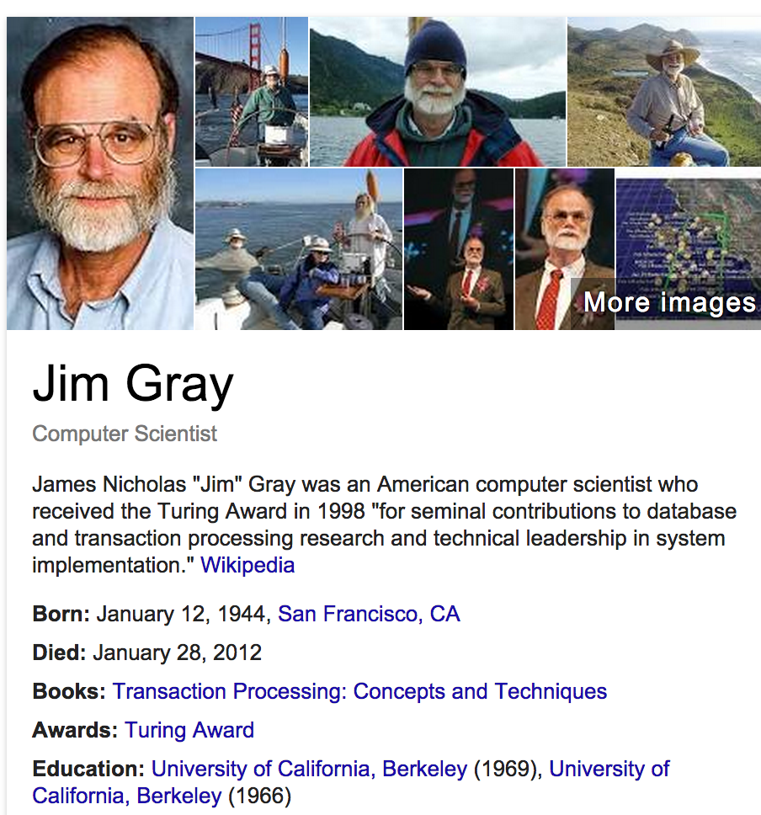

Slide 48
Review: Atomicity
A transaction
might commit after completing all its operations, or
it could abort (or be aborted) after executing some operations
Atomic Transactions: a user can think of a transaction as always either executing all its operations, or not executing any operations at all
Database/storage system logs all actions so that it can undo the actions of aborted transactions

Slide 49
Review: Consistency
Data follows integrity constraints (ICs)
If database/storage system is consistent before transaction, it will be after
System checks ICs and if they fail, the transaction rolls back (i.e., is aborted)
A database enforces some ICs, depending on the ICs declared when the data has been created
Beyond this, database does not understand the semantics of the data (e.g., it does not understand how the interest on a bank account is computed)

Slide 50
Review: Isolation
Each transaction executes as if it was running by itself
It cannot see the partial results of another transaction
Techniques:
Pessimistic – don’t let problems arise in the first place
Optimistic – assume conflicts are rare, deal with them after they happen

Slide 51
Review: Durability
Data should survive in the presence of
System crash
Disk crash → need backups
All committed updates and only those updates are reflected in the file system or database
Some care must be taken to handle the case of a crash occurring during the recovery process!

Slide 52
Centralized vs Distributed Systems
Server
Client/Server Model
Peer-to-Peer Model
Centralized System: System in which major functions are performed by a single physical computer
Originally, everything on single computer
Later: client/server model
Distributed System: physically separate computers working together on some task
Early model: multiple servers working together
Probably in the same room or building
Often called a “cluster”
Later models: peer-to-peer/wide-spread collaboration

Slide 53
Distributed Systems: Motivation/Issues
Why do we want distributed systems?
Cheaper and easier to build lots of simple computers
Easier to add power incrementally
Users can have complete control over some components
Collaboration: Much easier for users to collaborate through network resources (such as network file systems)
The promise of distributed systems:
Higher availability: one machine goes down, use another
Better durability: store data in multiple locations
More security: each piece easier to make secure
Reality has been disappointing
Worse availability: depend on every machine being up
Lamport: “a distributed system is one where I can’t do work because some machine I’ve never heard of isn’t working!”
Worse reliability: can lose data if any machine crashes
Worse security: anyone in world can break into system
Coordination is more difficult
Must coordinate multiple copies of shared state information (using only a network)
What would be easy in a centralized system becomes a lot more difficult

Slide 54
Distributed Systems: Goals/Requirements
Transparency: the ability of the system to mask its complexity behind a simple interface
Possible transparencies:
Location: Can’t tell where resources are located
Migration: Resources may move without the user knowing
Replication: Can’t tell how many copies of resource exist
Concurrency: Can’t tell how many users there are
Parallelism: System may speed up large jobs by spliting them into smaller pieces
Fault Tolerance: System may hide varoius things that go wrong in the system
Transparency and collaboration require some way for different processors to communicate with one another

Slide 55
Networking Definitions
Network: physical connection that allows two computers to communicate
Packet: unit of transfer, sequence of bits carried over the network
Network carries packets from one CPU to another
Destination gets interrupt when packet arrives
Protocol: agreement between two parties as to how information is to be transmitted

Slide 56
Summary
Important system properties
Availability: how often is the resource available?
Durability: how well is data preserved against faults?
Reliability: how often is resource performing correctly?
RAID: Redundant Arrays of Inexpensive Disks
RAID1: mirroring, RAID5: Parity block
Use of Log to improve Reliability
Journaled file systems such as ext3, NTFS
Transactions: ACID semantics
Atomicity
Consistency
Isolation
Durability
2-phase Locking
First Phase: acquire all locks
Second Phase: release locks in opposite order

