Slide 1
CS162 Operating Systems and Systems Programming Lecture 22 Distributed Systems, Networking, TCP/IP, RPC,VFS
April 15th, 2015
Prof. John Kubiatowicz
http://cs162.eecs.Berkeley.edu

Slide 2
Recall: Network Protocols
Protocol: Agreement between two parties as to how information is to be transmitted
Example: system calls are the protocol between the operating system and application
Networking examples: many levels
Physical level: mechanical and electrical network (e.g. how are 0 and 1 represented)
Link level: packet formats/error control (for instance, the CSMA/CD protocol)
Network level: network routing, addressing
Transport Level: reliable message delivery
Protocols on today’s Internet:
WWW
e-mail
NFS
ssh
RPC
Transport
UDP
TCP
Network
IP
Physical/Link
Ethernet
ATM
Packet radio

Slide 3
Recall: Window-based acknowledgements
Windowing protocol (not quite TCP):
Send up to N packets without ack
Allows pipelining of packets
Window size (N) < queue at destination
Each packet has sequence number
Receiver acknowledges each packet
Ack says “received all packets up to sequence number X”/send more
Acks serve dual purpose:
Reliability: Confirming packet received
Ordering: Packets can be reordered at destination
What if packet gets garbled/dropped?
Sender will timeout waiting for ack packet
Resend missing packets⇒ Receiver gets packets out of order!
Should receiver discard packets that arrive out of order?
Simple, but poor performance
Alternative: Keep copy until sender fills in missing pieces?
Reduces # of retransmits, but more complex
What if ack gets garbled/dropped?
Timeout and resend just the un-acknowledged packets
A
B
N=5
pkt#0
pkt#4
Queue
ack#0
ack#4

Slide 4
Transmission Control Protocol (TCP)
Stream in:
Stream out:
Router
Router
..zyxwvuts
gfedcba
Transmission Control Protocol (TCP)
TCP (IP Protocol 6) layered on top of IP
Reliable byte stream between two processes on different machines over Internet (read, write, flush)
TCP Details
Fragments byte stream into packets, hands packets to IP
IP may also fragment by itself
Uses window-based acknowledgement protocol (to minimize state at sender and receiver)
“Window” reflects storage at receiver – sender shouldn’t overrun receiver’s buffer space
Also, window should reflect speed/capacity of network – sender shouldn’t overload network
Automatically retransmits lost packets
Adjusts rate of transmission to avoid congestion
A “good citizen”

Slide 5
TCP Windows and Sequence Numbers
Sequence Numbers
Sent
acked
Sent
not acked
Not yet
sent
Sender
Received
Given to app
Received
Buffered
Not yet
received
Receiver
Sender has three regions:
Sequence regions
sent and ack’ed
Sent and not ack’ed
not yet sent
Window (colored region) adjusted by sender
Receiver has three regions:
Sequence regions
received and ack’ed (given to application)
received and buffered
not yet received (or discarded because out of order)

Slide 6
Window-Based Acknowledgements (TCP)
100
140
190
230
260
300
340
380
400
Seq:100
Size:40
Seq:140
Size:50
Seq:190
Size:40
Seq:230
Size:30
Seq:260
Size:40
Seq:300
Size:40
Seq:340
Size:40
Seq:380
Size:20
A:100/300
Seq:100
A:140/260
Seq:140
A:190/210
Seq:230
A:190/210
Seq:260
A:190/210
Seq:300
A:190/210
Retransmit!
Seq:190
A:340/60
Seq:340
A:380/20
Seq:380
A:400/0

Slide 7
Selective Acknowledgement Option (SACK)
IP Header
(20 bytes)
IP Header
(20 bytes)
Sequence Number
Sequence Number
TCP Header
Ack Number
TCP Header
Ack Number
Vanilla TCP Acknowledgement
Every message encodes Sequence number and Ack
Can include data for forward stream and/or ack for reverse stream
Selective Acknowledgement
Acknowledgement information includes not just one number, but rather ranges of received packets
Must be specially negotiated at beginning of TCP setup
Not widely in use (although in Windows since Windows 98)

Slide 8
Congestion Avoidance
Congestion
How long should timeout be for re-sending messages?
Too long→wastes time if message lost
Too short→retransmit even though ack will arrive shortly
Stability problem: more congestion ⇒ ack is delayed ⇒ unnecessary timeout ⇒ more traffic ⇒ more congestion
Closely related to window size at sender: too big means putting too much data into network
How does the sender’s window size get chosen?
Must be less than receiver’s advertised buffer size
Try to match the rate of sending packets with the rate that the slowest link can accommodate
Sender uses an adaptive algorithm to decide size of N
Goal: fill network between sender and receiver
Basic technique: slowly increase size of window until acknowledgements start being delayed/lost
TCP solution: “slow start” (start sending slowly)
If no timeout, slowly increase window size (throughput) by 1 for each ack received
Timeout ⇒ congestion, so cut window size in half
“Additive Increase, Multiplicative Decrease”

Slide 9
Open Connection: 3-Way Handshaking
Goal: agree on a set of parameters, i.e., the start sequence number for each side
Starting sequence number: sequence of first byte in stream
Starting sequence numbers are random

Slide 10
Open Connection: 3-Way Handshaking
Server waits for new connection calling listen()
Sender call connect() passing socket which contains server’s IP address and port number
OS sends a special packet (SYN) containing a proposal for first sequence number, x
Client (initiator)
Server
Active Open
connect()
listen()
SYN, SeqNum = x
Passive Open
time

Slide 11
Open Connection: 3-Way Handshaking
If it has enough resources, server calls accept() to accept connection, and sends back a SYN ACK packet containing
Client’s sequence number incremented by one, (x + 1)
Why is this needed?
A sequence number proposal, y, for first byte server will send
Client (initiator)
Server
Active Open
connect()
listen()
SYN, SeqNum = x
Passive Open
accept()
SYN and ACK, SeqNum = y and Ack = x + 1
time
ACK, Ack = y + 1
allocate buffer space

Slide 12
3-Way Handshaking (cont’d)
Three-way handshake adds 1 RTT delay
Why do it this way?
Congestion control: SYN (40 byte) acts as cheap probe
Protects against delayed packets from other connection (would confuse receiver)

Slide 13
Close Connection
Goal: both sides agree to close the connection
4-way connection tear down
Host 1
Host 2
close
FIN
FIN ACK
data
FIN
close
FIN ACK
closed
Can retransmit FIN ACK if it is lost
timeout
closed

Slide 14
Sequence-Number Initialization
How do you choose an initial sequence number?
When machine boots, ok to start with sequence #0?
No: could send two messages with same sequence #!
Receiver might end up discarding valid packets, or duplicate ack from original transmission might hide lost packet
Also, if it is possible to predict sequence numbers, might be possible for attacker to hijack TCP connection
Some ways of choosing an initial sequence number:
Time to live: each packet has a deadline.
If not delivered in X seconds, then is dropped
Thus, can re-use sequence numbers if wait for all packets in flight to be delivered or to expire
Epoch #: uniquely identifies which set of sequence numbers are currently being used
Epoch # stored on disk, Put in every message
Epoch # incremented on crash and/or when run out of sequence #
Pseudo-random increment to previous sequence number
Used by several protocol implementations

Slide 15
Administrivia
Midterm II: Wednesday (4/22)
Time: 6:30PM – 9:30PM
Location: Dwinelle: 145/155
Logins aa-ee, in Dwinelle 145
Logins ef-nk, in Dwinelle 155
All topics from Midterm I, up to next Monday, including:
Address Translation/TLBs/Paging
I/O subsystems, Storage Layers, Disks/SSD
Performance and Queueing Theory
File systems
Distributed systems, TCP/IP, RPC
NFS/AFS, Key-Value Store
Closed book, one page of notes – both sides
Bring Calculator!

Slide 16
Use of TCP: Sockets
Socket: an abstraction of a network I/O queue
Embodies one side of a communication channel
Same interface regardless of location of other end
Could be local machine (called “UNIX socket”) or remote machine (called “network socket”)
First introduced in 4.2 BSD UNIX: big innovation at time
Now most operating systems provide some notion of socket
Using Sockets for Client-Server (C/C++ interface):
On server: set up “server-socket”
Create socket, Bind to protocol (TCP), local address, port
Call listen(): tells server socket to accept incoming requests
Perform multiple accept() calls on socket to accept incoming connection request
Each successful accept() returns a new socket for a new connection; can pass this off to handler thread
On client:
Create socket, Bind to protocol (TCP), remote address, port
Perform connect() on socket to make connection
If connect() successful, have socket connected to server

Slide 17
Socket Setup over TCP/IP
Server
Socket
Request Connection
new
socket
socket
socket
connection
Client
Server
Server Socket: Listens for new connections
Produces new sockets for each unique connection
Things to remember:
Connection involves 5 values: [ Client Addr, Client Port, Server Addr, Server Port, Protocol ]
Often, Client Port “randomly” assigned
Done by OS during client socket setup
Server Port often “well known”
80 (web), 443 (secure web), 25 (sendmail), etc
Well-known ports from 0—1023

Slide 18
Recall: Sockets in concept
Client
Server
Create Server Socket
Bind it to an Address
(host:port)
Create Client Socket
Connect it to server (host:port)
Listen for Connection
Connection Socket
Accept connection
Connection Socket
write request
read request
read response
write response
Close Client Socket
Close Connection Socket
Close Server Socket

Slide 19
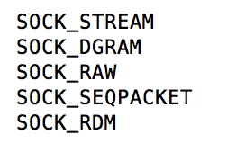
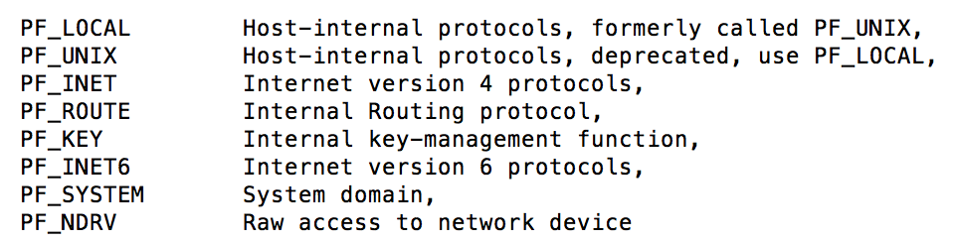
Recall: Client Protocol
char *hostname;
int sockfd, portno;
struct sockaddr_in serv_addr;
struct hostent *server;
server = buildServerAddr(&serv_addr, hostname, portno);
/* Create a TCP socket */
sockfd = socket(AF_INET, SOCK_STREAM, 0)
/* Connect to server on port */
connect(sockfd, (struct sockaddr *) &serv_addr, sizeof(serv_addr)
printf("Connected to %s:%d\n",server->h_name, portno);
/* Carry out Client-Server protocol */
client(sockfd);
/* Clean up on termination */
close(sockfd);

Slide 20
Recall: Server Protocol (v1)
/* Create Socket to receive requests*/
lstnsockfd = socket(AF_INET, SOCK_STREAM, 0);
/* Bind socket to port */
bind(lstnsockfd, (struct sockaddr *)&serv_addr,sizeof(serv_addr));
while (1) {
/* Listen for incoming connections */
listen(lstnsockfd, MAXQUEUE);
/* Accept incoming connection, obtaining a new socket for it */
consockfd = accept(lstnsockfd, (struct sockaddr *) &cli_addr,
&clilen);
server(consockfd);
close(consockfd);
}
close(lstnsockfd);

Slide 21
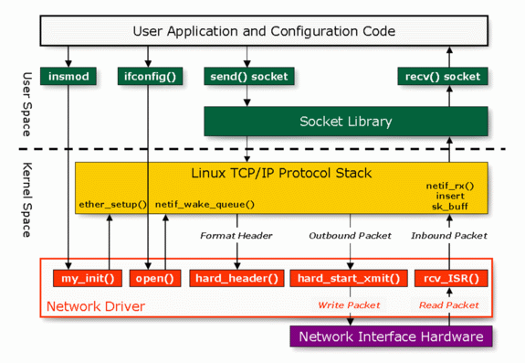
Linux Network Architecture

Slide 22
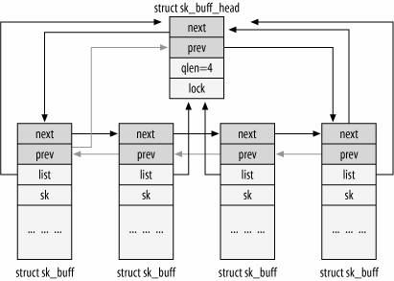
Network Details: sk_buff structure
Socket Buffers: sk_buff structure
The I/O buffers of sockets are lists of sk_buff
Pointers to such structures usually called “skb”
Complex structures with lots of manipulation routines
Packet is linked list of sk_buff structures

Slide 23
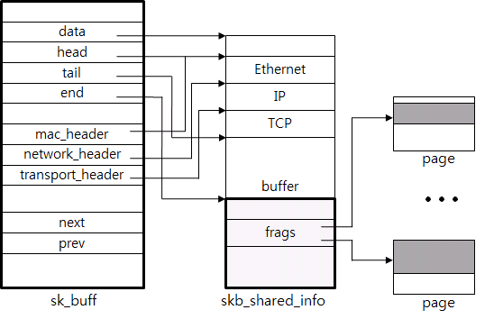
Headers, Fragments, and All That
The “linear region”:
Space from skb->data to skb->end
Actual data from skb->head to skb->tail
Header pointers point to parts of packet
The fragments (in skb_shared_info):
Right after skb->end, each fragment has pointer to pages, start of data, and length

Slide 24
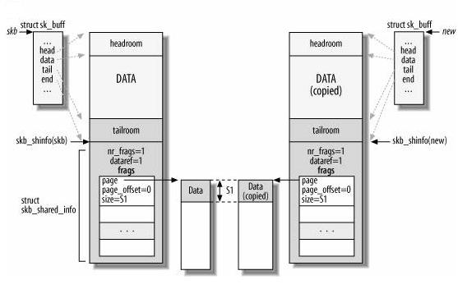
Copies, manipulation, etc
Lots of sk_buff manipulation functions for:
removing and adding headers, merging data, pulling it up into linear region
Copying/cloning sk_buff structures

Slide 25
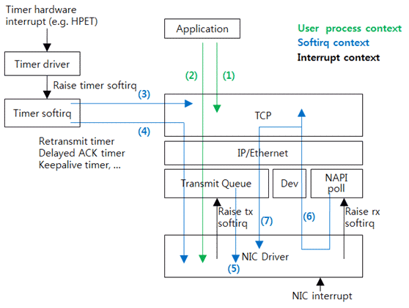
Network Processing Contexts

Slide 26
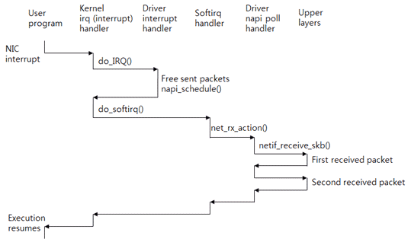
Avoiding Interrupts: NAPI
New API (NAPI): Use polling to receive packets
Only some drivers actually implement this
Exit hard interrupt context as quickly as possible
Do housekeeping and free up sent packets
Schedule soft interrupt for further actions
Soft Interrupts: Handles receiption and delivery

Slide 27
Distributed Applications
How do you actually program a distributed application?
Need to synchronize multiple threads, running on different machines
No shared memory, so cannot use test&set
One Abstraction: send/receive messages
Already atomic: no receiver gets portion of a message and two receivers cannot get same message
Interface:
Mailbox (mbox): temporary holding area for messages
Includes both destination location and queue
Send(message,mbox)
Send message to remote mailbox identified by mbox
Receive(buffer,mbox)
Wait until mbox has message, copy into buffer, and return
If threads sleeping on this mbox, wake up one of them
Send
Network
Receive

Slide 28
Using Messages: Send/Receive behavior
When should send(message,mbox) return?
When receiver gets message? (i.e. ack received)
When message is safely buffered on destination?
Right away, if message is buffered on source node?
Actually two questions here:
When can the sender be sure that receiver actually received the message?
When can sender reuse the memory containing message?
Mailbox provides 1-way communication from T1→T2
T1→buffer→T2
Very similar to producer/consumer
Send = V, Receive = P
However, can’t tell if sender/receiver is local or not!

Slide 29
Messaging for Producer-Consumer Style
Using send/receive for producer-consumer style:
Producer: int msg1[1000]; while(1) { prepare message; send(msg1,mbox); }
Consumer: int buffer[1000]; while(1) { receive(buffer,mbox); process message; }
No need for producer/consumer to keep track of space in mailbox: handled by send/receive
One of the roles of the window in TCP: window is size of buffer on far end
Restricts sender to forward only what will fit in buffer
Send
Message
Receive
Message

Slide 30
General’s Paradox
General’s paradox:
Constraints of problem:
Two generals, on separate mountains
Can only communicate via messengers
Messengers can be captured
Problem: need to coordinate attack
If they attack at different times, they all die
If they attack at same time, they win
Named after Custer, who died at Little Big Horn because he arrived a couple of days too early
Can messages over an unreliable network be used to guarantee two entities do something simultaneously?
Remarkably, “no”, even if all messages get through
No way to be sure last message gets through!
11 am ok?
Yes, 11 works
So, 11 it is?
Yeah, but what if you
Don’t get this ack?

Slide 31
Two Phase (2PC) Commit
Since we can’t solve the General’s Paradox (i.e. simultaneous action), let’s solve a related problem
Distributed transaction: Two or more machines agree to do something, or not do it, atomically
Two Phase Commit: High-level problem statement
If no node fails and all nodes are ready to commit, then all nodes COMMIT
Otherwise ABORT at all nodes
Developed by Turing award winner Jim Gray (first Berkeley CS PhD, 1969)

Slide 32
2PC Algorithm
One coordinator
N workers (replicas)
High level algorithm description
Coordinator asks all workers if they can commit
If all workers reply “VOTE-COMMIT”, then coordinator broadcasts “GLOBAL-COMMIT”,
Otherwise coordinator broadcasts “GLOBAL-ABORT”
Workers obey the GLOBAL messages
Use a persistent, stable log on each machine to keep track of what you are doing
If a machine crashes, when it wakes up it first checks its log to recover state of world at time of crash

Slide 33
Detailed Algorithm
Coordinator Algorithm
Worker Algorithm
Coordinator sends VOTE-REQ to all workers
Wait for VOTE-REQ from coordinator
If ready, send VOTE-COMMIT to coordinator
If not ready, send VOTE-ABORT to coordinator
And immediately abort
If receive VOTE-COMMIT from all N workers, send GLOBAL-COMMIT to all workers
If doesn’t receive VOTE-COMMIT from all N workers, send GLOBAL-ABORT to all workers
If receive GLOBAL-COMMIT then commit
If receive GLOBAL-ABORT then abort

Slide 34
Failure Free Example Execution
coordinator
VOTE-REQ
GLOBAL-COMMIT
worker 1
worker 2
VOTE-COMMIT
worker 3
time

Slide 35
State Machine of Coordinator
Coordinator implements simple state machine:
INIT
Recv: START
Send: VOTE-REQ
WAIT
Recv: VOTE-ABORT
Send: GLOBAL-ABORT
Recv: all VOTE-COMMIT
Send: GLOBAL-COMMIT
ABORT
COMMIT

Slide 36
State Machine of Workers
INIT
Recv: VOTE-REQ
Send: VOTE-ABORT
Recv: VOTE-REQ
Send: VOTE-COMMIT
READY
Recv: GLOBAL-ABORT
Recv: GLOBAL-COMMIT
ABORT
COMMIT

Slide 37
Dealing with Worker Failures
How to deal with worker failures?
Failure only affects states in which the node is waiting for messages
Coordinator only waits for votes in “WAIT” state
In WAIT, if doesn’t receive
N votes, it times out and sends
GLOBAL-ABORT
INIT
Recv: START
Send: VOTE-REQ
WAIT
Recv: VOTE-ABORT
Send: GLOBAL-ABORT
Recv: VOTE-COMMIT
Send: GLOBAL-COMMIT
ABORT
COMMIT

Slide 38
Example of Worker Failure
INIT
WAIT
coordinator
ABORT
COMM
timeout
GLOBAL-ABORT
VOTE-REQ
worker 1
VOTE-COMMIT
worker 2
worker 3
time

Slide 39
Dealing with Coordinator Failure
How to deal with coordinator failures?
worker waits for VOTE-REQ in INIT
Worker can time out and abort (coordinator handles it)
worker waits for GLOBAL-* message in READY
If coordinator fails, workers must
BLOCK waiting for coordinator
to recover and send
GLOBAL_* message
INIT
Recv: VOTE-REQ
Send: VOTE-ABORT
Recv: VOTE-REQ
Send: VOTE-COMMIT
READY
Recv: GLOBAL-ABORT
Recv: GLOBAL-COMMIT
ABORT
COMMIT

Slide 40
Example of Coordinator Failure #1
INIT
READY
coordinator
ABORT
COMM
VOTE-REQ
timeout
worker 1
VOTE-ABORT
worker 2
timeout
timeout
worker 3

Slide 41
Example of Coordinator Failure #2
INIT
READY
ABORT
COMM
coordinator
restarted
VOTE-REQ
worker 1
VOTE-COMMIT
GLOBAL-ABORT
worker 2
block waiting for coordinator
worker 3

Slide 42
Durability
All nodes use stable storage* to store which state they are in
Upon recovery, it can restore state and resume:
Coordinator aborts in INIT, WAIT, or ABORT
Coordinator commits in COMMIT
Worker aborts in INIT, ABORT
Worker commits in COMMIT
Worker asks Coordinator in READY
* - stable storage is non-volatile storage (e.g. backed by disk) that guarantees atomic writes.

Slide 43
Blocking for Coordinator to Recover
A worker waiting for global decision can ask fellow workers about their state
If another worker is in ABORT or COMMIT state then coordinator must have sent GLOBAL-*
Thus, worker can safely abort or commit, respectively
If another worker is still in INIT state then both workers can decide to abort
If all workers are in ready, need to BLOCK (don’t know if coordinator wanted to abort or commit)
INIT
Recv: VOTE-REQ
Send: VOTE-ABORT
Recv: VOTE-REQ
Send: VOTE-COMMIT
READY
Recv: GLOBAL-ABORT
Recv: GLOBAL-COMMIT
ABORT
COMMIT

Slide 44
Distributed Decision Making Discussion
Why is distributed decision making desirable?
Fault Tolerance!
A group of machines can come to a decision even if one or more of them fail during the process
Simple failure mode called “failstop” (different modes later)
After decision made, result recorded in multiple places
Undesirable feature of Two-Phase Commit: Blocking
One machine can be stalled until another site recovers:
Site B writes “prepared to commit” record to its log, sends a “yes” vote to the coordinator (site A) and crashes
Site A crashes
Site B wakes up, check its log, and realizes that it has voted “yes” on the update. It sends a message to site A asking what happened. At this point, B cannot decide to abort, because update may have committed
B is blocked until A comes back
A blocked site holds resources (locks on updated items, pages pinned in memory, etc) until learns fate of update
PAXOS: An alternative used by GOOGLE and others that does not have this blocking problem
What happens if one or more of the nodes is malicious?
Malicious: attempting to compromise the decision making

Slide 45
Byzantine General’s Problem
Lieutenant
Attack!
Attack!
Attack!
Attack!
Retreat!
Attack!
Attack!
Lieutenant
Retreat!
General
Attack!
Malicious!
Lieutenant
Byazantine General’s Problem (n players):
One General
n-1 Lieutenants
Some number of these (f) can be insane or malicious
The commanding general must send an order to his n-1 lieutenants such that:
IC1: All loyal lieutenants obey the same order
IC2: If the commanding general is loyal, then all loyal lieutenants obey the order he sends

Slide 46
Byzantine General’s Problem (con’t)
Impossibility Results:
Cannot solve Byzantine General’s Problem with n=3 because one malicious player can mess up things
With f faults, need n > 3f to solve problem
Various algorithms exist to solve problem
Original algorithm has #messages exponential in n
Newer algorithms have message complexity O(n²)
One from MIT, for instance (Castro and Liskov, 1999)
Use of BFT (Byzantine Fault Tolerance) algorithm
Allow multiple machines to make a coordinated decision even if some subset of them (< n/3 ) are malicious
General
General
Attack!
Attack!
Attack!
Retreat!
Lieutenant
Lieutenant
Lieutenant
Lieutenant
Retreat!
Retreat!
Request
Distributed
Decision

Slide 47
Summary
TCP: Reliable byte stream between two processes on different machines over Internet (read, write, flush)
Uses window-based acknowledgement protocol
Congestion-avoidance dynamically adapts sender window to account for congestion in network
Two-phase commit: distributed decision making
First, make sure everyone guarantees that they will commit if asked (prepare)
Next, ask everyone to commit
Byzantine General’s Problem: distributed decision making with malicious failures
One general, n-1 lieutenants: some number of them may be malicious (often “f” of them)
All non-malicious lieutenants must come to same decision
If general not malicious, lieutenants must follow general
Only solvable if n ≥ 3f+1
Remote Procedure Call (RPC): Call procedure on remote machine
Provides same interface as procedure
Automatic packing and unpacking of arguments without user programming (in stub)

