Slide 1
CS162 Operating Systems and Systems Programming Lecture 23 Distributed Storage, Key-Value Stores, Security
April 27th, 2015
Prof. John Kubiatowicz
http://cs162.eecs.Berkeley.edu

Slide 2
Recall: Two Phase (2PC) Commit
Distributed transaction: Two or more machines agree to do something, or not do it, atomically
Two Phase Commit:
One coordinator
N workers (replicas)
High level algorithm description
Coordinator asks all workers if they can commit
If all workers reply “VOTE-COMMIT”, then coordinator broadcasts “GLOBAL-COMMIT”,
Otherwise coordinator broadcasts “GLOBAL-ABORT”
Workers obey the GLOBAL messages
Use a persistent, stable log on each machine to keep track of what you are doing
If a machine crashes, when it wakes up it first checks its log to recover state of world at time of crash

Slide 3
Brief aside: Remote Procedure Call
Raw messaging is a bit too low-level for programming
Must wrap up information into message at source
Must decide what to do with message at destination
May need to sit and wait for multiple messages to arrive
Better option: Remote Procedure Call (RPC)
Calls a procedure on a remote machine
Client calls: remoteFileSystem→Read(“rutabaga”);
Translated automatically into call on server: fileSys→Read(“rutabaga”);
Implementation:
Request-response message passing (under covers!)
“Stub” provides glue on client/server
Client stub is responsible for “marshalling” arguments and “unmarshalling” the return values
Server-side stub is responsible for “unmarshalling” arguments and “marshalling” the return values.
Marshalling involves (depending on system)
Converting values to a canonical form, serializing objects, copying arguments passed by reference, etc.

Slide 4
RPC Information Flow
bundle
args
Client
(caller)
call
Client
Stub
send
Packet
Handler
return
receive
unbundle
ret vals
mbox2
Machine A
Network
Network
Machine B
bundle
ret vals
mbox1
Server
(callee)
return
Server
Stub
send
Packet
Handler
call
receive
unbundle
args

Slide 5
RPC Details
Equivalence with regular procedure call
Parameters ⇔ Request Message
Result ⇔ Reply message
Name of Procedure: Passed in request message
Return Address: mbox2 (client return mail box)
Stub generator: Compiler that generates stubs
Input: interface definitions in an “interface definition language (IDL)”
Contains, among other things, types of arguments/return
Output: stub code in the appropriate source language
Code for client to pack message, send it off, wait for result, unpack result and return to caller
Code for server to unpack message, call procedure, pack results, send them off
Cross-platform issues:
What if client/server machines are different architectures or in different languages?
Convert everything to/from some canonical form
Tag every item with an indication of how it is encoded (avoids unnecessary conversions).

Slide 6
RPC Details (continued)
How does client know which mbox to send to?
Need to translate name of remote service into network endpoint (Remote machine, port, possibly other info)
Binding: the process of converting a user-visible name into a network endpoint
This is another word for “naming” at network level
Static: fixed at compile time
Dynamic: performed at runtime
Dynamic Binding
Most RPC systems use dynamic binding via name service
Name service provides dynamic translation of service→mbox
Why dynamic binding?
Access control: check who is permitted to access service
Fail-over: If server fails, use a different one
What if there are multiple servers?
Could give flexibility at binding time
Choose unloaded server for each new client
Could provide same mbox (router level redirect)
Choose unloaded server for each new request
Only works if no state carried from one call to next
What if multiple clients?
Pass pointer to client-specific return mbox in request

Slide 7
Problems with RPC
Non-Atomic failures
Different failure modes in distributed system than on a single machine
Consider many different types of failures
User-level bug causes address space to crash
Machine failure, kernel bug causes all processes on same machine to fail
Some machine is compromised by malicious party
Before RPC: whole system would crash/die
After RPC: One machine crashes/compromised while others keep working
Can easily result in inconsistent view of the world
Did my cached data get written back or not?
Did server do what I requested or not?
Answer? Distributed transactions/Byzantine Commit
Performance
Cost of Procedure call « same-machine RPC « network RPC
Means programmers must be aware that RPC is not free
Caching can help, but may make failure handling complex

Slide 8
Cross-Domain Communication/Location Transparency
How do address spaces communicate with one another?
Shared Memory with Semaphores, monitors, etc…
File System
Pipes (1-way communication)
“Remote” procedure call (2-way communication)
RPC’s can be used to communicate between address spaces on different machines or the same machine
Services can be run wherever it’s most appropriate
Access to local and remote services looks the same
Examples of modern RPC systems:
CORBA (Common Object Request Broker Architecture)
DCOM (Distributed COM)
RMI (Java Remote Method Invocation)

Slide 9
Microkernel operating systems
Example: split kernel into application-level servers.
File system looks remote, even though on same machine
Why split the OS into separate domains?
Fault isolation: bugs are more isolated (build a firewall)
Enforces modularity: allows incremental upgrades of pieces of software (client or server)
Location transparent: service can be local or remote
For example in the X windowing system: Each X client can be on a separate machine from X server; Neither has to run on the machine with the frame buffer.
App
App
App
App
File
sys
windows
file system
Windowing
address
spaces
RPC
VM
Networking
Threads
threads
Monolithic Structure
Microkernel Structure

Slide 10

Network-Attached Storage and the CAP Theorem
Network
Consistency:
Changes appear to everyone in the same serial order
Availability:
Can get a result at any time
Partition-Tolerance
System continues to work even when network becomes partitioned
Consistency, Availability, Partition-Tolerance (CAP) Theorem: Cannot have all three at same time
Otherwise known as “Brewer’s Theorem”

Slide 11

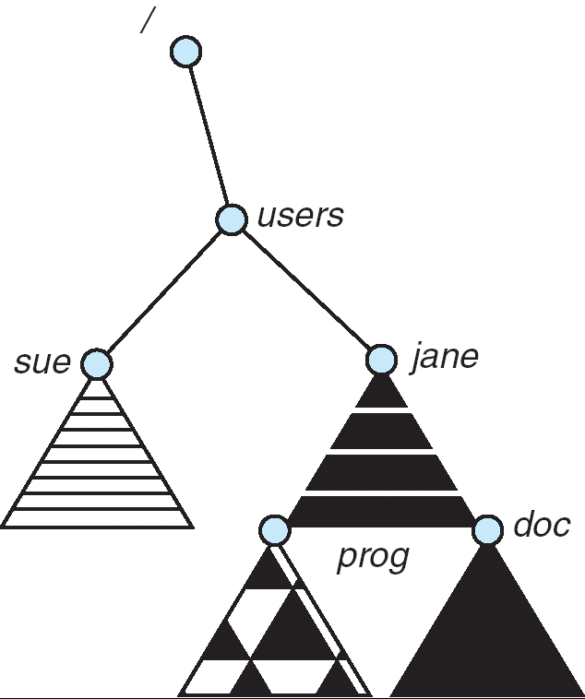
Distributed File Systems
Read File
Network
Data
Client
Server
Distributed File System:
Transparent access to files stored on a remote disk
Naming choices (always an issue):
Hostname:localname: Name files explicitly
No location or migration transparency
Mounting of remote file systems
System manager mounts remote file system by giving name and local mount point
Transparent to user: all reads and writes look like local reads and writes to user e.g. /users/sue/foo→/sue/foo on server
A single, global name space: every file in the world has unique name
Location Transparency: servers can change and files can move without involving user
mount
kubi:/jane
mount
coeus:/sue
mount
kubi:/prog

Slide 12
Simple Distributed File System
Read (RPC)
Return (Data)
Client
Write (RPC)
Server
cache
ACK
Client
Remote Disk: Reads and writes forwarded to server
Use Remote Procedure Calls (RPC) to translate file system calls into remote requests
No local caching/can be caching at server-side
Advantage: Server provides completely consistent view of file system to multiple clients
Problems? Performance!
Going over network is slower than going to local memory
Lots of network traffic/not well pipelined
Server can be a bottleneck

Slide 13
Use of caching to reduce network load
Crash!
Crash!
read(f1)
→V1
cache
Read (RPC)
read(f1)→V1
read(f1)→V1
F1:V1
Return (Data)
read(f1)→V1
Client
Write (RPC)
Server
cache
F1:V1
F1:V2
ACK
cache
write(f1)
→OK
F1:V2
read(f1)→V2
Client
Idea: Use caching to reduce network load
In practice: use buffer cache at source and destination
Advantage: if open/read/write/close can be done locally, don’t need to do any network traffic…fast!
Problems:
Failure:
Client caches have data not committed at server
Cache consistency!
Client caches not consistent with server/each other

Slide 14
Failures
Crash!
What if server crashes? Can client wait until server comes back up and continue as before?
Any data in server memory but not on disk can be lost
Shared state across RPC: What if server crashes after seek? Then, when client does “read”, it will fail
Message retries: suppose server crashes after it does UNIX “rm foo”, but before acknowledgment?
Message system will retry: send it again
How does it know not to delete it again? (could solve with two-phase commit protocol, but NFS takes a more ad hoc approach)
Stateless protocol: A protocol in which all information required to process a request is passed with request
Server keeps no state about client, except as hints to help improve performance (e.g. a cache)
Thus, if server crashes and restarted, requests can continue where left off (in many cases)
What if client crashes?
Might lose modified data in client cache

Slide 15
Administrivia
Midterm 2 grading
In progress. Hopefully done by end of week.
Solutions have been posted
Final Exam
Friday, May 15th, 2015.
3-6P, Wheeler Auditorium
All material from the course
With slightly more focus on second half, but you are still responsible for all the material
Two sheets of notes, both sides
Will need dumb calculator
Should be working on Project 3!
Checkpoint 1 this Wednesday

Slide 16
Administrivia (con’t)
Final Lecture topics submitted to me:
Real Time Operating systems
Peer to peer systems and/or Distributed Systems
OS trends in the mobile phone industry (Android, etc)
Differences from traditional OSes?
GPU and ManyCore programming (and/or OSes?)
Virtual Machines and/or Trusted Hardware for security
Systems programming for non-standard computer systems
i.e. Quantum Computers, Biological Computers, …
Net Neutrality and/or making the Internet Faster
Mesh networks
Device drivers
A couple of votes for Dragons…
This is a lot of topics…

Slide 17
Network File System (NFS)
Three Layers for NFS system
UNIX file-system interface: open, read, write, close calls + file descriptors
VFS layer: distinguishes local from remote files
Calls the NFS protocol procedures for remote requests
NFS service layer: bottom layer of the architecture
Implements the NFS protocol
NFS Protocol: RPC for file operations on server
Reading/searching a directory
manipulating links and directories
accessing file attributes/reading and writing files
Write-through caching: Modified data committed to server’s disk before results are returned to the client
lose some of the advantages of caching
time to perform write() can be long
Need some mechanism for readers to eventually notice changes! (more on this later)

Slide 18
NFS Continued
NFS servers are stateless; each request provides all arguments require for execution
E.g. reads include information for entire operation, such as ReadAt(inumber,position), not Read(openfile)
No need to perform network open() or close() on file – each operation stands on its own
Idempotent: Performing requests multiple times has same effect as performing it exactly once
Example: Server crashes between disk I/O and message send, client resend read, server does operation again
Example: Read and write file blocks: just re-read or re-write file block – no side effects
Example: What about “remove”? NFS does operation twice and second time returns an advisory error
Failure Model: Transparent to client system
Is this a good idea? What if you are in the middle of reading a file and server crashes?
Options (NFS Provides both):
Hang until server comes back up (next week?)
Return an error. (Of course, most applications don’t know they are talking over network)

Slide 19
NFS Cache consistency
NFS protocol: weak consistency
Client polls server periodically to check for changes
Polls server if data hasn’t been checked in last 3-30 seconds (exact timeout it tunable parameter).
Thus, when file is changed on one client, server is notified, but other clients use old version of file until timeout.
What if multiple clients write to same file?
In NFS, can get either version (or parts of both)
Completely arbitrary!
cache
F1 still ok?
F1:V2
F1:V1
No: (F1:V2)
Client
Write (RPC)
Server
cache
F1:V2
ACK
cache
F1:V2
Client

Slide 20
Sequential Ordering Constraints
What sort of cache coherence might we expect?
i.e. what if one CPU changes file, and before it’s done, another CPU reads file?
Example: Start with file contents = “A”
What would we actually want?
Assume we want distributed system to behave exactly the same as if all processes are running on single system
If read finishes before write starts, get old copy
If read starts after write finishes, get new copy
Otherwise, get either new or old copy
For NFS:
If read starts more than 30 seconds after write, get new copy; otherwise, could get partial update
Client 1:
Read: gets A
Write B
Read: parts of B or C
Client 2:
Read: gets A or B
Write C
Client 3:
Read: parts of B or C
Time

Slide 21
Andrew File System
Andrew File System (AFS, late 80’s) → DCE DFS (commercial product)
Callbacks: Server records who has copy of file
On changes, server immediately tells all with old copy
No polling bandwidth (continuous checking) needed
Write through on close
Changes not propagated to server until close()
Session semantics: updates visible to other clients only after the file is closed
As a result, do not get partial writes: all or nothing!
Although, for processes on local machine, updates visible immediately to other programs who have file open
In AFS, everyone who has file open sees old version
Don’t get newer versions until reopen file

Slide 22
Andrew File System (con’t)
Data cached on local disk of client as well as memory
On open with a cache miss (file not on local disk):
Get file from server, set up callback with server
On write followed by close:
Send copy to server; tells all clients with copies to fetch new version from server on next open (using callbacks)
What if server crashes? Lose all callback state!
Reconstruct callback information from client: go ask everyone “who has which files cached?”
AFS Pro: Relative to NFS, less server load:
Disk as cache ⇒ more files can be cached locally
Callbacks ⇒ server not involved if file is read-only
For both AFS and NFS: central server is bottleneck!
Performance: all writes→server, cache misses→server
Availability: Server is single point of failure
Cost: server machine’s high cost relative to workstation

Slide 23
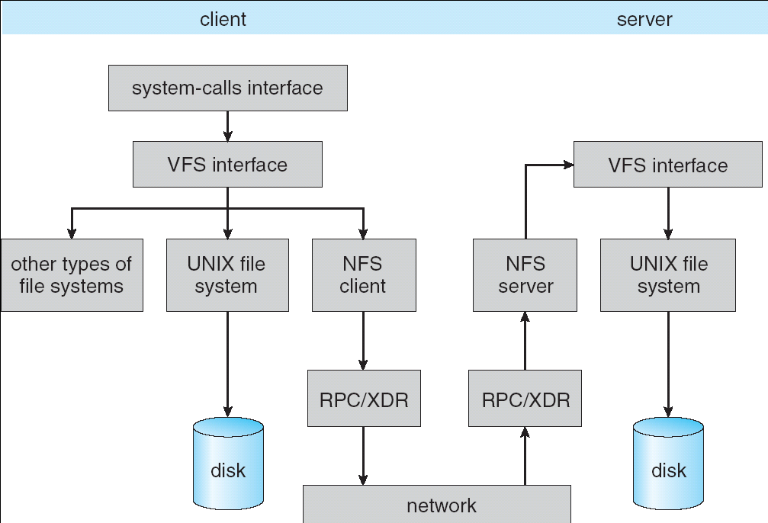
Implementation of NFS

Slide 24
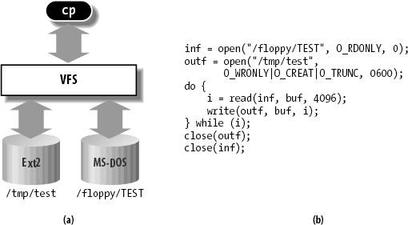
Enabling Factor: Virtual Filesystem (VFS)
VFS: Virtual abstraction similar to local file system
Provides virtual superblocks, inodes, files, etc
Compatible with a variety of local and remote file systems
provides object-oriented way of implementing file systems
VFS allows the same system call interface (the API) to be used for different types of file systems
The API is to the VFS interface, rather than any specific type of file system
In linux, “VFS” stands for “Virtual Filesystem Switch”

Slide 25
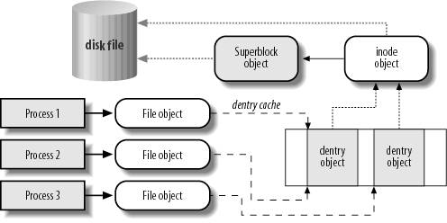
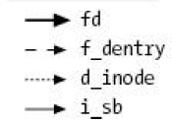
VFS Common File Model in Linux
Four primary object types for VFS:
superblock object: represents a specific mounted filesystem
inode object: represents a specific file
dentry object: represents a directory entry
file object: represents open file associated with process
There is no specific directory object (VFS treats directories as files)
May need to fit the model by faking it
Example: make it look like directories are files
Example: make it look like have inodes, superblocks, etc.

Slide 26
Linux VFS
write()
sys_write()
filesystem’s
write method
physical
media
user-space
VFS
filesystem
An operations object is contained within each primary object type to set operations of specific filesystems
“super_operations”: methods that kernel can invoke on a specific filesystem, i.e. write_inode() and sync_fs().
“inode_operations”: methods that kernel can invoke on a specific file, such as create() and link()
“dentry_operations”: methods that kernel can invoke on a specific directory entry, such as d_compare() or d_delete()
“file_operations”: methods that process can invoke on an open file, such as read() and write()
There are a lot of operations

Slide 27
Key Value Storage
Handle huge volumes of data, e.g., PBs
Store (key, value) tuples
Simple interface
put(key, value); // insert/write “value” associated with “key”
value = get(key); // get/read data associated with “key”
Used sometimes as a simpler but more scalable “database”

Slide 28





Key Values: Examples
Amazon:
Key: customerID
Value: customer profile (e.g., buying history, credit card, ..)
Facebook, Twitter:
Key: UserID
Value: user profile (e.g., posting history, photos, friends, …)
iCloud/iTunes:
Key: Movie/song name
Value: Movie, Song

Slide 29
Examples
Amazon
DynamoDB: internal key value store used to power Amazon.com (shopping cart)
Simple Storage System (S3)
BigTable/HBase/Hypertable: distributed, scalable data storage
Cassandra: “distributed data management system” (developed by Facebook)
Memcached: in-memory key-value store for small chunks of arbitrary data (strings, objects)
eDonkey/eMule: peer-to-peer sharing system
…

Slide 30
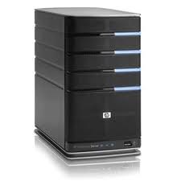
Key Value Store
Also called Distributed Hash Tables (DHT)
Main idea: partition set of key-values across many machines
key, value
…

Slide 31
Challenges
…
Fault Tolerance: handle machine failures without losing data and without degradation in performance
Scalability:
Need to scale to thousands of machines
Need to allow easy addition of new machines
Consistency: maintain data consistency in face of node failures and message losses
Heterogeneity (if deployed as peer-to-peer systems):
Latency: 1ms to 1000ms
Bandwidth: 32Kb/s to 100Mb/s

Slide 32
Key Questions
put(key, value): where do you store a new (key, value) tuple?
get(key): where is the value associated with a given “key” stored?
And, do the above while providing
Fault Tolerance
Scalability
Consistency

Slide 33
Directory-Based Architecture
Have a node maintain the mapping between keys and the machines (nodes) that store the values associated with the keys
Master/Directory
put(K14, V14)
K5
N2
K14
N3
K105
N50
put(K14, V14)
K5
V5
K14
V14
K105
V105
…
N₁
N₂
N₃
N₅₀

Slide 34
Directory-Based Architecture
Have a node maintain the mapping between keys and the machines (nodes) that store the values associated with the keys
Master/Directory
get(K14)
K5
N2
V14
K14
N3
K105
N50
get(K14)
V14
K5
V5
K14
V14
K105
V105
…
N₁
N₂
N₃
N₅₀

Slide 35
Directory-Based Architecture
Having the master relay the requests → recursive query
Another method: iterative query (this slide)
Return node to requester and let requester contact node
Master/Directory
put(K14, V14)
K5
N2
N3
K14
N3
K105
N50
put(K14, V14)
K5
V5
K14
V14
K105
V105
…
N₁
N₂
N₃
N₅₀

Slide 36
Directory-Based Architecture
Having the master relay the requests → recursive query
Another method: iterative query
Return node to requester and let requester contact node
Master/Directory
get(K14)
N3
K5
N2
K14
N3
V14
K105
N50
get(K14)
K5
V5
K14
V14
K105
V105
…
N₁
N₂
N₃
N₅₀

Slide 37
Discussion: Iterative vs. Recursive Query
Master/Directory
Master/Directory
get(K14)
get(K14)
V14
K14
N3
N3
K14
N3
V14
get(K14)
get(K14)
Recursive
V14
Iterative
K14
V14
K14
V14
…
…
N1
N2
N3
N50
N1
N2
N3
N50
Recursive Query:
Advantages:
Faster, as typically master/directory closer to nodes
Easier to maintain consistency, as master/directory can serialize puts()/gets()
Disadvantages: scalability bottleneck, as all “Values” go through master/directory
Iterative Query
Advantages: more scalable
Disadvantages: slower, harder to enforce data consistency

Slide 38
Fault Tolerance
Replicate value on several nodes
Usually, place replicas on different racks in a datacenter to guard against rack failures
Master/Directory
put(K14, V14)
K5
N2
N1, N3
K14
N1,N3
K105
N50
put(K14, V14)
put(K14, V14), N1
K14
V14
K5
V5
K14
V14
K105
V105
…
N₁
N₂
N₃
N₅₀

Slide 39
Fault Tolerance
Again, we can have
Recursive replication (previous slide)
Iterative replication (this slide)
Master/Directory
put(K14, V14)
K5
N2
N1, N3
K14
N1,N3
K105
N50
put(K14, V14)
put(K14, V14)
K14
V14
K5
V5
K14
V14
K105
V105
…
N₁
N₂
N₃
N₅₀

Slide 40
Fault Tolerance
Or we can use recursive query and iterative replication…
Master/Directory
put(K14, V14)
K5
N2
K14
N1,N3
K105
N50
put(K14, V14)
put(K14, V14)
K14
V14
K5
V5
K14
V14
K105
V105
…
N₁
N₂
N₃
N₅₀

Slide 41
Scalability
Storage: use more nodes
Number of requests:
Can serve requests from all nodes on which a value is stored in parallel
Master can replicate a popular value on more nodes
Master/directory scalability:
Replicate it
Partition it, so different keys are served by different masters/directories
How do you partition?

Slide 42
Scalability: Load Balancing
Directory keeps track of the storage availability at each node
Preferentially insert new values on nodes with more storage available
What happens when a new node is added?
Cannot insert only new values on new node. Why?
Move values from the heavy loaded nodes to the new node
What happens when a node fails?
Need to replicate values from fail node to other nodes

Slide 43
Consistency
Need to make sure that a value is replicated correctly
How do you know a value has been replicated on every node?
Wait for acknowledgements from every node
What happens if a node fails during replication?
Pick another node and try again
What happens if a node is slow?
Slow down the entire put()? Pick another node?
In general, with multiple replicas
Slow puts and fast gets

Slide 44
Consistency (cont’d)
If concurrent updates (i.e., puts to same key) may need to make sure that updates happen in the same order
put(K14, V14’) and put(K14, V14’’) reach N1 and N3 in reverse order
What does get(K14) return?
Undefined!
Master/Directory
put(K14, V14’)
K5
N2
put(K14, V14’’)
K14
N1,N3
K105
N50
put(K14, V14’’)
put(K14, V14’)
put(K14, V14’')
put(K14, V14’)
K14
K14
V14
V14’
K5
V5
K14
K14
V14
V14’’
K105
V105
…
N₁
N₂
N₃
N₅₀

Slide 45
Consistency (cont’d)
Large variety of consistency models:
Atomic consistency (linearizability): reads/writes (gets/puts) to replicas appear as if there was a single underlying replica (single system image)
Think “one updated at a time”
Transactions
Eventual consistency: given enough time all updates will propagate through the system
One of the weakest form of consistency; used by many systems in practice
And many others: causal consistency, sequential consistency, strong consistency, …

Slide 46
Quorum Consensus
Improve put() and get() operation performance
Define a replica set of size N
put() waits for acknowledgements from at least W replicas
get() waits for responses from at least R replicas
W+R > N
Why does it work?
There is at least one node that contains the update
Why might you use W+R > N+1?

Slide 47
Quorum Consensus Example
N=3, W=2, R=2
Replica set for K14: {N1, N2, N4}
Assume put() on N3 fails
put(K14, V14)
ACK
put(K14, V14)
put(K14, V14)
ACK
K14
V14
K14
V14
N₁
N₂
N₃
N₄

Slide 48
Quorum Consensus Example
Now, issuing get() to any two nodes out of three will return the answer
get(K14)
get(K14)
V14
nill
K14
V14
K14
V14
N₁
N₂
N₃
N₄

Slide 49
Scaling Up Directory
Challenge:
Directory contains a number of entries equal to number of (key, value) tuples in the system
Can be tens or hundreds of billions of entries in the system!
Solution: consistent hashing
Associate to each node a unique id in an uni-dimensional space 0..2^{m}-1
Partition this space across m machines
Assume keys are in same uni-dimensional space
Each (Key, Value) is stored at the node with the smallest ID larger than Key

Slide 50
Key to Node Mapping Example
m = 6 → ID space: 0..63
Node 8 maps keys [5,8]
Node 15 maps keys [9,15]
Node 20 maps keys [16, 20]
…
Node 4 maps keys [59, 4]
63
0
4
58
8
14
V14
15
44
20
35
32

Slide 51
Lookup in Chord-like system (with Leaf Set)
Assign IDs to nodes
Map hash values to node with closest ID
Leaf set is successors and predecessors
All that’s needed for correctness
Routing table matches successively longer prefixes
Allows efficient lookups
Data Replication:
On leaf set
Source
111…
0…
110…
Response
10…
Lookup ID
Notes:
Each node is assigned an ID randomly
IDs are arranged into a ring by numerical order, top ID wraps around to 0
Each node maintains two sets of neighbors, its leaf set and routing table
Leaf set is immediate predecessor and successor
Routing table neighbors resolve successively longer matching prefixes of node’s own ID
Lookup queries are routed greedily to node with closest matching ID (numerically, not lexigraphically)
Response is sent directly to querying node
Lookup handled differently in other DHTs; see Gummadi et al.’s SIGCOMM paper for details

Slide 52
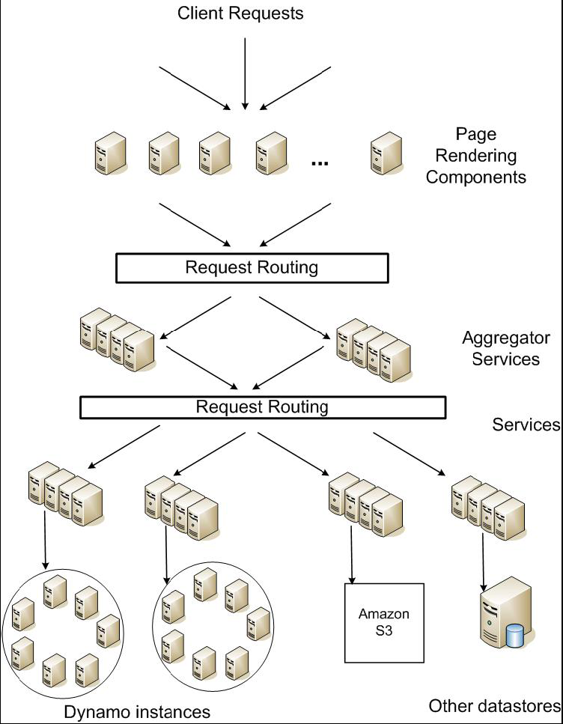
DynamoDB Example: Service Level Agreements (SLA)
Application can deliver its functionality in a bounded time:
Every dependency in the platform needs to deliver its functionality with even tighter bounds.
Example: service guaranteeing that it will provide a response within 300ms for 99.9% of its requests for a peak client load of 500 requests per second
Contrast to services which focus on mean response time
Service-oriented architecture of
Amazon’s platform

Slide 53
What is Computer Security Today?
Computing in the presence of an adversary!
Adversary is the security field’s defining characteristic
Reliability, robustness, and fault tolerance
Dealing with Mother Nature (random failures)
Security
Dealing with actions of a knowledgeable attacker dedicated to causing harm
Surviving malice, and not just mischance
Wherever there is an adversary, there is a computer security problem!

Slide 54
Protection vs. Security
Protection: mechanisms for controlling access of programs, processes, or users to resources
Page table mechanism
Round-robin schedule
Data encryption
Security: use of protection mech. to prevent misuse of resources
Misuse defined with respect to policy
E.g.: prevent exposure of certain sensitive information
E.g.: prevent unauthorized modification/deletion of data
Need to consider external environment the system operates in
Most well-constructed system cannot protect information if user accidentally reveals password – social engineering challenge

Slide 55
Security Requirements
Authentication
Ensures that a user is who is claiming to be
Data integrity
Ensure that data is not changed from source to destination or after being written on a storage device
Confidentiality
Ensures that data is read only by authorized users
Non-repudiation
Sender/client can’t later claim didn’t send/write data
Receiver/server can’t claim didn’t receive/write data

Slide 56


Authentication: Identifying Users
How to identify users to the system?
Passwords
Shared secret between two parties
Since only user knows password, someone types correct password ⇒ must be user typing it
Very common technique
Smart Cards
Electronics embedded in card capable of providing long passwords or satisfying challenge → response queries
May have display to allow reading of password
Or can be plugged in directly; several credit cards now in this category
Biometrics
Use of one or more intrinsic physical or behavioral traits to identify someone
Examples: fingerprint reader, palm reader, retinal scan
Becoming quite a bit more common

Slide 57
Passwords: Secrecy
System must keep copy of secret to check against passwords
What if malicious user gains access to list of passwords?
Need to obscure information somehow
Mechanism: utilize a transformation that is difficult to reverse without the right key (e.g. encryption)
Example: UNIX /etc/passwd file
passwd→one way transform(hash)→encrypted passwd
System stores only encrypted version, so OK even if someone reads the file!
When you type in your password, system compares encrypted version
Problem: Can you trust encryption algorithm?
Example: one algorithm thought safe had back door
Governments want back door so they can snoop
Also, security through obscurity doesn’t work
GSM encryption algorithm was secret; accidentally released; Berkeley grad students cracked in a few hours
“eggplant”

Slide 58
Passwords: How easy to guess?
Ways of Compromising Passwords
Password Guessing:
Often people use obvious information like birthday, favorite color, girlfriend’s name, etc…
Dictionary Attack:
Work way through dictionary and compare encrypted version of dictionary words with entries in /etc/passwd
Dumpster Diving:
Find pieces of paper with passwords written on them
(Also used to get social-security numbers, etc)
Paradox:
Short passwords are easy to crack
Long ones, people write down!
Technology means we have to use longer passwords
UNIX initially required lowercase, 5-letter passwords: total of 26⁵=10million passwords
In 1975, 10ms to check a password→1 day to crack
In 2005, .01μs to check a password→0.1 seconds to crack
Even faster today (use multiple processors)
Takes less time to check for all words in the dictionary!

Slide 59
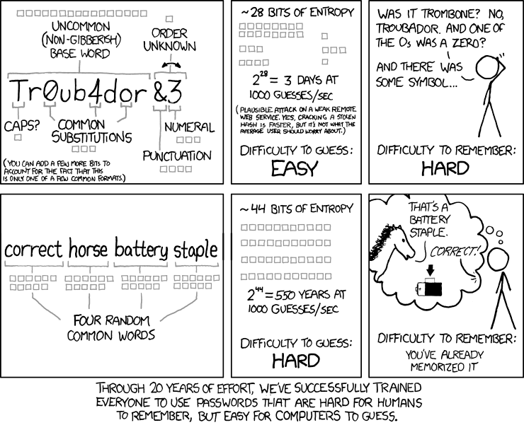
https://xkcd.com/936/

Slide 60
Securing Communication: Cryptography
Cryptography: communication in the presence of adversaries
Studied for thousands of years
See the Simon Singh’s The Code Book for an excellent, highly readable history
Central goal: confidentiality
How to encode information so that an adversary can’t extract it, but a friend can
General premise: there is a key, possession of which allows decoding, but without which decoding is infeasible
Thus, key must be kept secret and not guessable

Slide 61
Using Symmetric Keys
Same key for encryption and decryption
Achieves confidentiality
Vulnerable to tampering and replay attacks
Plaintext (m)
m
Internet
Encrypt with
secret key
Decrypt with
secret key
Ciphertext

Slide 62
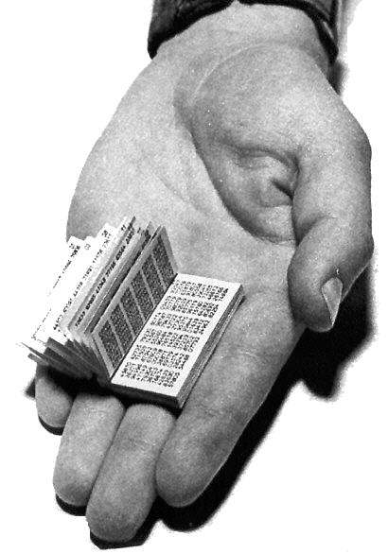
Symmetric Keys
Can just XOR plaintext with the key
Easy to implement, but easy to break using frequency analysis
Unbreakable alternative: XOR with one-time pad
Use a different key for each message

Slide 63
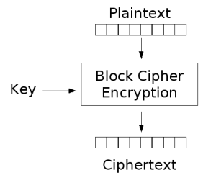
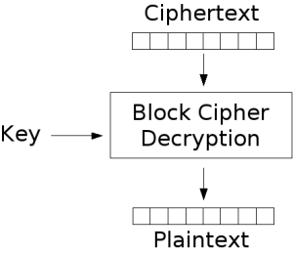
Symmetric Keys
More sophisticated (e.g., block cipher) algorithms
Works with a block size (e.g., 64 bits)
To encrypt a stream, can encrypt blocks separately, or link them

Slide 64
Symmetric Key Ciphers - DES & AES
Data Encryption Standard (DES)
Developed by IBM in 1970s, standardized by NBS/NIST
56-bit key (decreased from 64 bits at NSA’s request)
Still fairly strong other than brute-forcing the key space
But custom hardware can crack a key in < 24 hours
Today many financial institutions use Triple DES
DES applied 3 times, with 3 keys totaling 168 bits
Advanced Encryption Standard (AES)
Replacement for DES standardized in 2002
Key size: 128, 192 or 256 bits
How fundamentally strong are they?
No one knows (no proofs exist)

Slide 65
Authentication via Secret Key
Main idea: entity proves identity by decrypting a secret encrypted with its own key
K – secret key shared only by A and B
A can asks B to authenticate itself by decrypting a nonce, i.e., random value, x
Avoid replay attacks (attacker impersonating client or server)
Vulnerable to man-in-the middle attack
A
B
E(x, K)
Notation: E(m,k) – encrypt message m with key k
x

Slide 66
Integrity: Cryptographic Hashes
Basic building block for integrity: cryptographic hashing
Associate hash with byte-stream, receiver verifies match
Assures data hasn’t been modified, either accidentally – or maliciously
Approach:
Sender computes a secure digest of message m using H(x)
H(x) is a publicly known hash function
Digest d = HMAC (K, m) = H (K | H (K | m))
HMAC(K, m) is a hash-based message authentication function
Send digest d and message m to receiver
Upon receiving m and d, receiver uses shared secret key, K, to recompute HMAC(K, m) and see whether result agrees with d

Slide 67
Using Hashing for Integrity
plaintext (m)
corrupted msg
m
NO
=
digest’
Internet
Digest
HMAC(K,m)
Digest
HMAC(K,m)
Encrypted Digest
Unencrypted Message
Can encrypt m for confidentiality

Slide 68
Standard Cryptographic Hash Functions
MD5 (Message Digest version 5)
Developed in 1991 (Rivest), produces 128 bit hashes
Widely used (RFC 1321)
Broken (1996-2008): attacks that find collisions
SHA-1 (Secure Hash Algorithm)
Developed in 1995 (NSA) as MD5 successor with 160 bit hashes
Widely used (SSL/TLS, SSH, PGP, IPSEC)
Broken in 2005, government use discontinued in 2010
SHA-2 (2001)
Family of SHA-224, SHA-256, SHA-384, SHA-512 functions
HMAC’s are secure even with older “insecure” hash functions

Slide 69
Asymmetric Encryption (Public Key)
Idea: use two different keys, one to encrypt (e) and one to decrypt (d)
A key pair
Crucial property: knowing e does not give away d
Therefore e can be public: everyone knows it!
If Alice wants to send to Bob, she fetches Bob’s public key (say from Bob’s home page) and encrypts with it
Alice can’t decrypt what she’s sending to Bob …
… but then, neither can anyone else (except Bob)

Slide 70
Public Key / Asymmetric Encryption
Sender uses receiver’s public key
Advertised to everyone
Receiver uses complementary private key
Must be kept secret
Plaintext
Plaintext
Internet
Encrypt with
public key
Decrypt with
private key
Ciphertext

Slide 71
Public Key Cryptography
Invented in the 1970s
Revolutionized cryptography
(Was actually invented earlier by British intelligence)
How can we construct an encryption/decryption algorithm using a key pair with the public/private properties?
Answer: Number Theory
Most fully developed approach: RSA
Rivest / Shamir / Adleman, 1977; RFC 3447
Based on modular multiplication of very large integers
Very widely used (e.g., ssh, SSL/TLS for https)

Slide 72
Properties of RSA
Requires generating large, random prime numbers
Algorithms exist for quickly finding these (probabilistic!)
Requires exponentiating very large numbers
Again, fairly fast algorithms exist
Overall, much slower than symmetric key crypto
One general strategy: use public key crypto to exchange a (short) symmetric session key
Use that key then with AES or such
How difficult is recovering d, the private key?
Equivalent to finding prime factors of a large number
Many have tried - believed to be very hard (= brute force only)
(Though quantum computers can do so in polynomial time!)
Notes:
Shor’s algorithm is polynomial in log N

Slide 73
Simple Public Key Authentication
Each side need only to know the other side’s public key
No secret key need be shared
A encrypts a nonce (random num.) x
Avoid replay attacks, e.g., attacker impersonating client or server
B proves it can recover x
A can authenticate itself to B in the same way
Many more details to make this work securely in practice!
A
B
E({x, A}, Public_{B})
E({x, y, B}, Public_{A})
E({y, A}, Public_{B})
Notation: E(m,k) – encrypt message m with key k

Slide 74
Summary (1/2)
Distributed File System:
Transparent access to files stored on a remote disk
Caching for performance
Cache Consistency: Keeping client caches consistent with one another
If multiple clients, some reading and some writing, how do stale cached copies get updated?
NFS: check periodically for changes
AFS: clients register callbacks to be notified by server of changes
Remote Procedure Call (RPC): Call procedure on remote machine
Provides same interface as procedure
Automatic packing and unpacking of arguments (in stub)
VFS: Virtual File System layer
Provides mechanism which gives same system call interface for different types of file systems

Slide 75
Summary
Key-Value Store:
Two operations
put(key, value)
value = get(key)
Challenges
Fault Tolerance → replication
Scalability → serve get()’s in parallel; replicate/cache hot tuples
Consistency → quorum consensus to improve put() performance
Distributed identity: Use cryptography
Symmetrical (or Private Key) Encryption
Single Key used to encode and decode
Introduces key-distribution problem
Public-Key Encryption
Two keys: a public key and a private key
Slower than private key, but simplifies key-distribution
Secure Hash Function
Used to summarize data
Hard to find another block of data with same hash

