Slide 1
CS162 Operating Systems and Systems Programming Lecture 24 Security Cloud Computing
April 29th, 2015
Prof. John Kubiatowicz
http://cs162.eecs.Berkeley.edu

Slide 2
What is Computer Security Today?
Computing in the presence of an adversary!
Adversary is the security field’s defining characteristic
Reliability, robustness, and fault tolerance
Dealing with Mother Nature (random failures)
Security
Dealing with actions of a knowledgeable attacker dedicated to causing harm
Surviving malice, and not just mischance
Wherever there is an adversary, there is a computer security problem!

Slide 3
Protection vs. Security
Protection: mechanisms for controlling access of programs, processes, or users to resources
Page table mechanism
Round-robin schedule
Data encryption
Security: use of protection mech. to prevent misuse of resources
Misuse defined with respect to policy
E.g.: prevent exposure of certain sensitive information
E.g.: prevent unauthorized modification/deletion of data
Need to consider external environment the system operates in
Most well-constructed system cannot protect information if user accidentally reveals password – social engineering challenge

Slide 4
Security Requirements
Authentication
Ensures that a user is who is claiming to be
Data integrity
Ensure that data is not changed from source to destination or after being written on a storage device
Confidentiality
Ensures that data is read only by authorized users
Non-repudiation
Sender/client can’t later claim didn’t send/write data
Receiver/server can’t claim didn’t receive/write data

Slide 5
Securing Communication: Cryptography
Cryptography: communication in the presence of adversaries
Studied for thousands of years
See the Simon Singh’s The Code Book for an excellent, highly readable history
Central goal: confidentiality
How to encode information so that an adversary can’t extract it, but a friend can
General premise: there is a key, possession of which allows decoding, but without which decoding is infeasible
Thus, key must be kept secret and not guessable

Slide 6
Using Symmetric Keys
Same key for encryption and decryption
Achieves confidentiality
Vulnerable to tampering and replay attacks
Plaintext (m)
m
Internet
Encrypt with
secret key
Decrypt with
secret key
Ciphertext

Slide 7
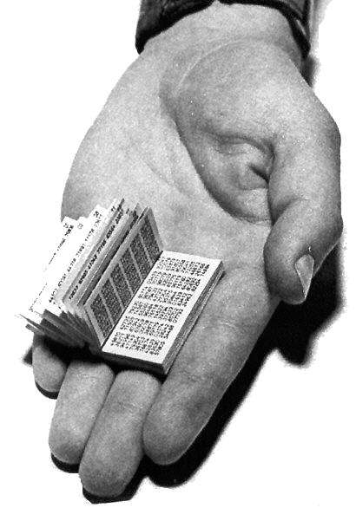
Symmetric Keys
Can just XOR plaintext with the key
Easy to implement, but easy to break using frequency analysis
Unbreakable alternative: XOR with one-time pad
Use a different key for each message

Slide 8
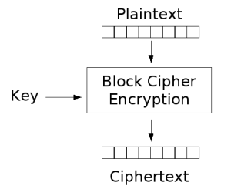
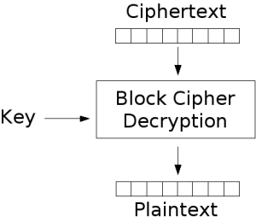
Symmetric Keys
More sophisticated (e.g., block cipher) algorithms
Works with a block size (e.g., 64 bits)
To encrypt a stream, can encrypt blocks separately, or link them

Slide 9
Symmetric Key Ciphers - DES & AES
Data Encryption Standard (DES)
Developed by IBM in 1970s, standardized by NBS/NIST
56-bit key (decreased from 64 bits at NSA’s request)
Still fairly strong other than brute-forcing the key space
But custom hardware can crack a key in < 24 hours
Today many financial institutions use Triple DES
DES applied 3 times, with 3 keys totaling 168 bits
Advanced Encryption Standard (AES)
Replacement for DES standardized in 2002
Key size: 128, 192 or 256 bits
How fundamentally strong are they?
No one knows (no proofs exist)

Slide 10
Authentication via Secret Key
Main idea: entity proves identity by decrypting a secret encrypted with its own key
K – secret key shared only by A and B
A can asks B to authenticate itself by decrypting a nonce, i.e., random value, x
Avoid replay attacks (attacker impersonating client or server)
Vulnerable to man-in-the middle attack
A
B
E(x, K)
Notation: E(m,k) – encrypt message m with key k
x

Slide 11
Integrity: Cryptographic Hashes
Basic building block for integrity: cryptographic hashing
Associate hash with byte-stream, receiver verifies match
Assures data hasn’t been modified, either accidentally – or maliciously
Approach:
Sender computes a secure digest of message m using H(x)
H(x) is a publicly known hash function
Digest d = HMAC (K, m) = H (K | H (K | m))
HMAC(K, m) is a hash-based message authentication function
Send digest d and message m to receiver
Upon receiving m and d, receiver uses shared secret key, K, to recompute HMAC(K, m) and see whether result agrees with d

Slide 12
Using Hashing for Integrity
plaintext (m)
corrupted msg
m
NO
=
digest’
Internet
Digest
HMAC(K,m)
Digest
HMAC(K,m)
Encrypted Digest
Unencrypted Message
Can encrypt m for confidentiality

Slide 13
Standard Cryptographic Hash Functions
MD5 (Message Digest version 5)
Developed in 1991 (Rivest), produces 128 bit hashes
Widely used (RFC 1321)
Broken (1996-2008): attacks that find collisions
SHA-1 (Secure Hash Algorithm)
Developed in 1995 (NSA) as MD5 successor with 160 bit hashes
Widely used (SSL/TLS, SSH, PGP, IPSEC)
Broken in 2005, government use discontinued in 2010
SHA-2 (2001)
Family of SHA-224, SHA-256, SHA-384, SHA-512 functions
HMAC’s are secure even with older “insecure” hash functions

Slide 14
Asymmetric Encryption (Public Key)
Idea: use two different keys, one to encrypt (e) and one to decrypt (d)
A key pair
Crucial property: knowing e does not give away d
Therefore e can be public: everyone knows it!
If Alice wants to send to Bob, she fetches Bob’s public key (say from Bob’s home page) and encrypts with it
Alice can’t decrypt what she’s sending to Bob …
… but then, neither can anyone else (except Bob)

Slide 15
Public Key / Asymmetric Encryption
Sender uses receiver’s public key
Advertised to everyone
Receiver uses complementary private key
Must be kept secret
Plaintext
Plaintext
Internet
Encrypt with
public key
Decrypt with
private key
Ciphertext

Slide 16
Public Key Cryptography
Invented in the 1970s
Revolutionized cryptography
(Was actually invented earlier by British intelligence)
How can we construct an encryption/decryption algorithm using a key pair with the public/private properties?
Answer: Number Theory
Most fully developed approach: RSA
Rivest / Shamir / Adleman, 1977; RFC 3447
Based on modular multiplication of very large integers
Very widely used (e.g., ssh, SSL/TLS for https)
Also mature approach: Eliptic Curve Cryptography (ECC)
Based on curves in a Galois-field space
Shorter keys and signatures than RSA

Slide 17
Properties of RSA
Requires generating large, random prime numbers
Algorithms exist for quickly finding these (probabilistic!)
Requires exponentiating very large numbers
Again, fairly fast algorithms exist
Overall, much slower than symmetric key crypto
One general strategy: use public key crypto to exchange a (short) symmetric session key
Use that key then with AES or such
How difficult is recovering d, the private key?
Equivalent to finding prime factors of a large number
Many have tried - believed to be very hard (= brute force only)
(Though quantum computers could do so in polynomial time!)
Notes:
Shor’s algorithm is polynomial in log N

Slide 18
Simple Public Key Authentication
Each side need only to know the other side’s public key
No secret key need be shared
A encrypts a nonce (random num.) x
Avoid replay attacks, e.g., attacker impersonating client or server
B proves it can recover x, generates second nonce y
A can authenticate itself to B in the same way
Many more details to make this work securely in practice!
A
B
E({x, A}, Public_{B})
E({x, y, B}, Public_{A})
E({y, A}, Public_{B})
Notation: E(m,k) – encrypt message m with key k

Slide 19
Non-Repudiation: RSA Crypto & Signatures
Suppose Alice has published public key KE
If she wishes to prove who she is, she can send a message x encrypted with her private key KD (i.e., she sends E(x, KD))
Anyone knowing Alice’s public key KE can recover x, verify that Alice must have sent the message
It provides a signature
Alice can’t deny it ⇒ non-repudiation
Could simply encrypt a hash of the data to sign a document that you wanted to be in clear text
Note that either of these signature techniques work perfectly well with any data (not just messages)
Could sign every datum in a database, for instance

Slide 20
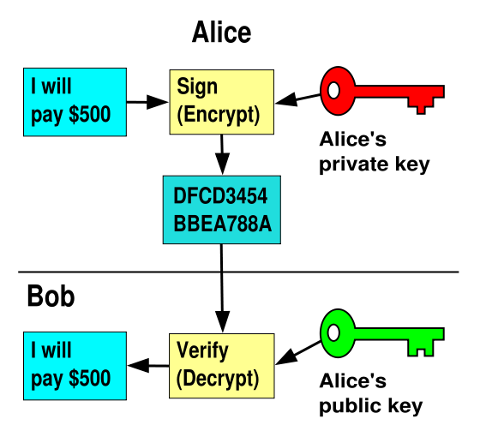
RSA Crypto & Signatures (cont’d)
I will pay Bob $500
I will pay Bob $500

Slide 21
Digital Certificates
How do you know K_{E} is Alice’s public key?
Trusted authority (e.g., Verisign) signs binding between Alice and K_{E} with its private key KV_{private}
C = E({Alice, K_{E}}, KV_{private})
C: digital certificate
Alice: distribute her digital certificate, C
Anyone: use trusted authority’s KV_{public}, to extract Alice’s public key from C
D(C, KV_{public}) = D(E({Alice, K_{E}}, KV_{private}), KV_{public}) = {Alice, K_{E}}

Slide 22
Summary of Our Crypto Toolkit
If we can securely distribute a key, then
Symmetric ciphers (e.g., AES) offer fast, presumably strong confidentiality
Public key cryptography does away with (potentially major) problem of secure key distribution
But: not as computationally efficient
Often addressed by using public key crypto to exchange a session key
Digital signature binds the public key to an entity

Slide 23
Putting It All Together - HTTPS
What happens when you click on https://www.amazon.com?
https = “Use HTTP over SSL/TLS”
SSL = Secure Socket Layer
TSL = Transport Layer Security
Successor to SSL
Provides security layer (authentication, encryption) on top of TCP
Fairly transparent to applications

Slide 24
HTTPS Connection (SSL/TLS) (cont’d)
Browser (client) connects via TCP to Amazon’s HTTPS server
Client sends over list of crypto protocols it supports
Server picks protocols to use for this session
Server sends over its certificate
(all of this is in the clear)
Browser
Amazon
Hello. I support
(TLS+RSA+AES128+SHA2) or
(SSL+RSA+3DES+MD5) or …
Let’s use
TLS+RSA+AES128+SHA2
Here’s my cert
~1 KB of data

Slide 25
Inside the Server’s Certificate
Name associated with cert (e.g., Amazon)
Amazon’s RSA public key
A bunch of auxiliary info (physical address, type of cert, expiration time)
Name of certificate’s signatory (who signed it)
A public-key signature of a hash (SHA-256) of all this
Constructed using the signatory’s private RSA key, i.e.,
Cert = E(H_{SHA256}(KA_{public}, www.amazon.com, …), KS_{private}))
KA_{public}: Amazon’s public key
KS_{private}: signatory (certificate authority) private key
…

Slide 26
Validating Amazon’s Identity
How does the browser authenticate certificate signatory?
Certificates of several certificate authorities (e.g., Verisign) are hardwired into the browser (or OS)
If can’t find cert, warn user that site has not been verified
And may ask whether to continue
Note, can still proceed, just without authentication
Browser uses public key in signatory’s cert to decrypt signature
Compares with its own SHA-256 hash of Amazon’s cert
Assuming signature matches, now have high confidence it’s indeed Amazon …
… assuming signatory is trustworthy
DigiNotar CA breach (July-Sept 2011): Google, Yahoo!, Mozilla, Tor project, Wordpress, … (531 total certificates)
Notes:
Wikipedia: DigiNotar was a Dutch certificate authority owned by VASCO Data Security International.^{[1]} On September 3, 2011, after it had become clear that a security breach had resulted in the fraudulent issuing of certificates, the Dutch government took over operational management of DigiNotar's systems.^{[2]} That same month, the company was declared bankrupt. (Wikipedia)

Slide 27
Certificate Validation
Certificate
E(H_{SHA256}(KA_{public}, www.amazon.com, …), KS_{private})),
KA_{public}, www.amazon.com, …
E(H_{SHA256}(…), KS_{public}))
(recall, KS_{public} hardwired)
H_{SHA256}(KA_{public}, www.amazon.com, ..)
H_{SHA256}(KA_{public}, www.amazon.com, …)
H_{SHA256}(KA_{public}, www.amazon.com, …)
No
=
Validation failed
Yes
Validation successful
Can also validate using peer approach: https://www.eff.org/observatory

Slide 28
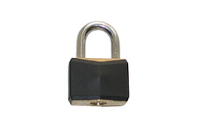
HTTPS Connection (SSL/TLS) cont’d
Browser constructs a random session key K used for data communication
Private key for bulk crypto
Browser encrypts K using Amazon’s public key
Browser sends E(K, KA_{public}) to server
Browser displays
All subsequent comm. encrypted w/ symmetric cipher (e.g., AES128) using key K
E.g., client can authenticate using a password
Browser
Amazon
Here’s my cert
~1 KB of data
K
E(K, KA_{public})
Agreed
K
E(password …, K)
E(response …, K)

Slide 29
Administrivia
Midterm 2 grading
In progress. To be done by Sunday
Solutions have been posted
Project grades
Project 1 done by tomorrow
Project 2 done by middle of RRR
Final Exam
Friday, May 15th, 2015.
3-6P, Wheeler Auditorium
All material from the course
Two sheets of notes, both sides
Will need dumb calculator
Targeted reviews: See posts on Piazza
Possibly 3 different sessions focused on parts of course

Slide 30
Administrivia (2)
Final topics (Monday, 5/4):
Go to poll on Piazza!
Current front runners:
Internet of Things
Quantum Computing
Mobile OS

Slide 31
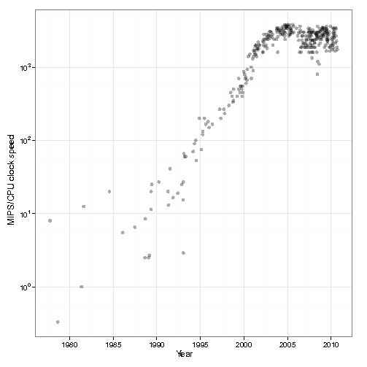
Background of Cloud Computing
1980’s and 1990’s: 52% growth in performance per year!
2002: The thermal wall
Speed (frequency) peaks, but transistors keep shrinking
2000’s: Multicore revolution
15-20 years later than predicted, we have hit the performance wall
2010’s: Rise of Big Data

Slide 32
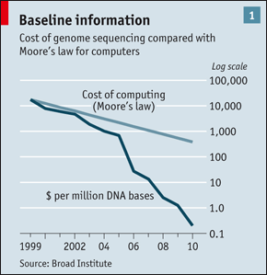







Sources Driving Big Data
It’s All Happening On-line
User Generated (Web & Mobile)
Every:
Click
Ad impression
Billing event
Fast Forward, pause,…
Friend Request
Transaction
Network message
Fault
…
…..
Internet of Things / M2M
Scientific Computing

Slide 33
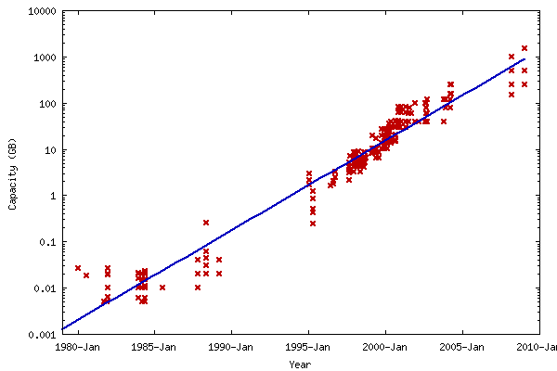
Data Deluge
Billions of users connected through the net
WWW, FB, twitter, cell phones, …
80% of the data on FB was produced last year
Storage getting cheaper
Store more data!

Slide 34
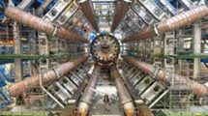
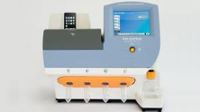
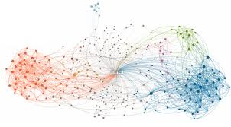
Data Grows Faster than Moore’s Law
Projected Growth
Increase over 2010

Slide 35
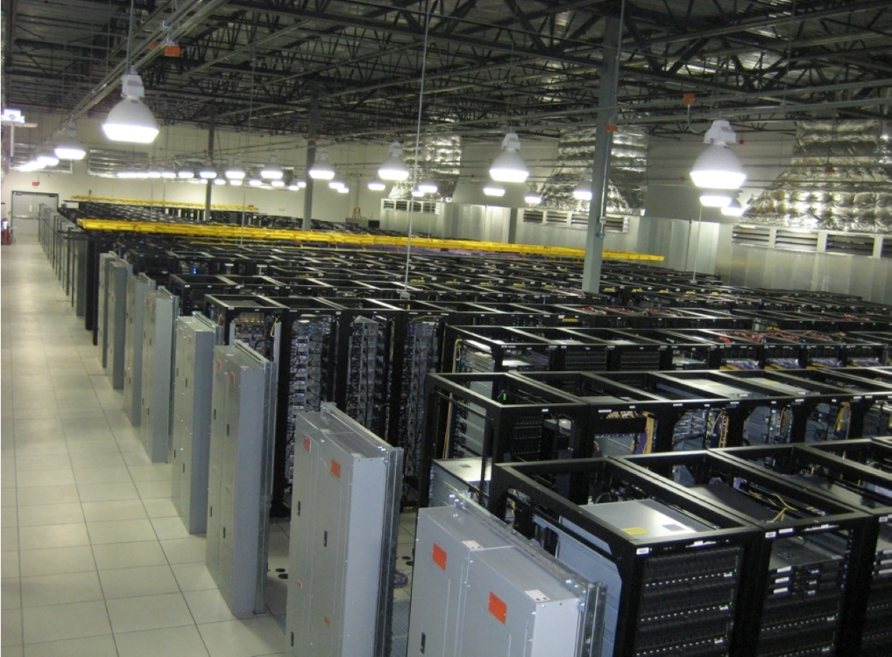
Solving the Impedance Mismatch
Computers not getting faster, and we are drowning in data
How to resolve the dilemma?
Solution adopted by web-scale companies
Go massively distributed and parallel

Slide 36
Enter the World of Distributed Systems
Distributed Systems/Computing
Loosely coupled set of computers, communicating through message passing, solving a common goal
Tools: Msg passing, Distributed shared memory, RPC
Distributed computing is challenging
Dealing with partial failures (examples?)
Dealing with asynchrony (examples?)
Dealing with scale (examples?)
Dealing with consistency (examples?)
Distributed Computing versus Parallel Computing?
distributed computing ⇒ parallel computing + partial failures
Notes:
Partial failures, network and computers
Asynchrony, network, computers,

Slide 37
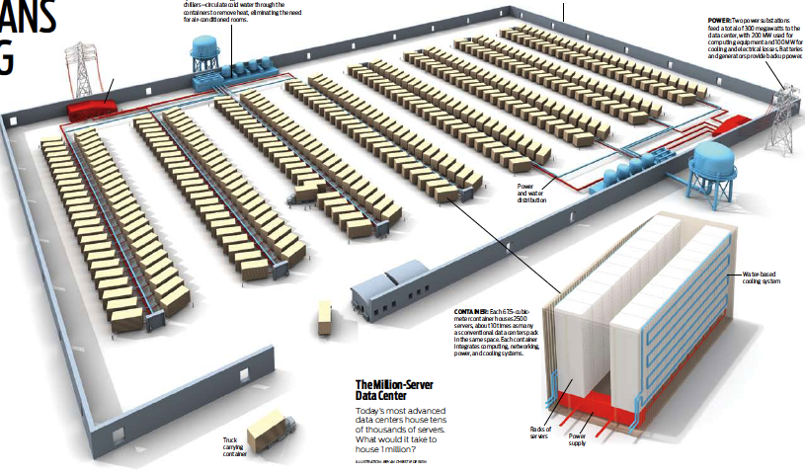

The Datacenter is the new Computer
“The datacenter as a computer” still in its infancy
Special purpose clusters, e.g., Hadoop cluster
Built from less reliable components
Highly variable performance
Complex concepts are hard to program (low-level primitives)
?
=
Notes:
During the last few years many have claimed that the datacenter is the new computer. This transformation is still in its infancy.

Slide 38
Datacenter/Cloud Computing OS
If the datacenter/cloud is the new computer
What is its Operating System?
Note that we are not talking about a host OS
Could be equivalent in benefit as the LAMP stack was to the .com boom – every startup secretly implementing the same functionality!
Open source stack for a Web 2.0 company:
Linux OS
Apache web server
MySQL, MariaDB or MongoDB DBMS
PHP, Perl, or Python languages for dynamic web pages

Slide 39
Classical Operating Systems
Data sharing
Inter-Process Communication, RPC, files, pipes, …
Programming Abstractions
Libraries (libc), system calls, …
Multiplexing of resources
Scheduling, virtual memory, file allocation/protection, …

Slide 40
Datacenter/Cloud Operating System
Data sharing
Google File System, key/value stores
Apache project: Hadoop Distributed File System
Programming Abstractions
Google MapReduce
Apache projects: Hadoop, Pig, Hive, Spark
Multiplexing of resources
Apache projects: Mesos, YARN (MapReduce v2), ZooKeeper, BookKeeper, …

Slide 41
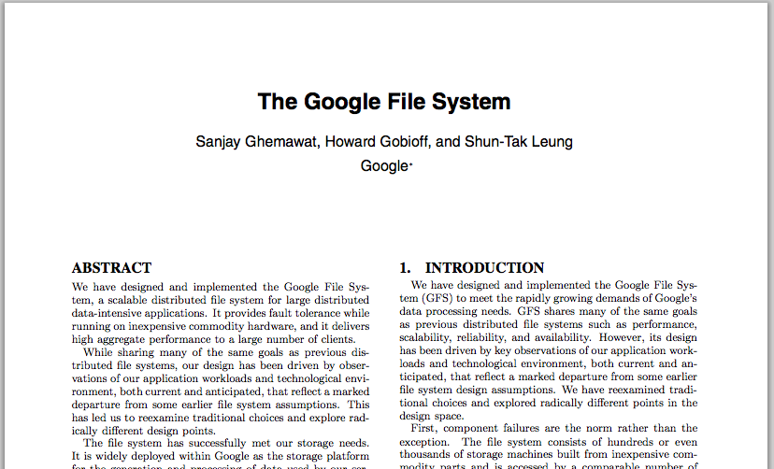
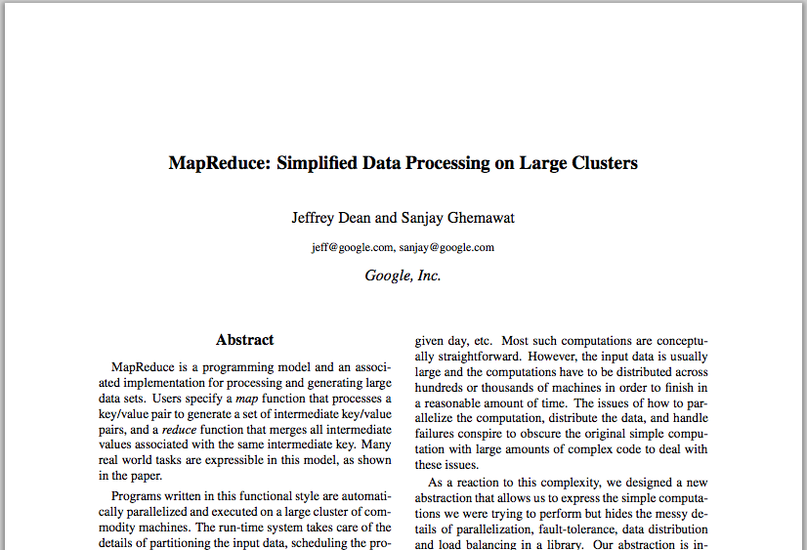
Google Cloud Infrastructure
Google File System (GFS), 2003
Distributed File System for entire cluster
Single namespace
Google MapReduce (MR), 2004
Runs queries/jobs on data
Manages work distribution & fault- tolerance
Collocated with file system
Apache open source versions: Hadoop DFS and Hadoop MR

Slide 42
GFS/HDFS Insights
Petabyte storage
Files split into large blocks (128 MB) and replicated across several nodes
Big blocks allow high throughput sequential reads/writes
Data striped on hundreds/thousands of servers
Scan 100 TB on 1 node @ 50 MB/s = 24 days
Scan on 1000-node cluster = 35 minutes
Notes:
Large block: throughput, smaller metadata to central
Stripe: would take forever to read

Slide 43
GFS/HDFS Insights (2)
Failures will be the norm
Mean time between failures for 1 node = 3 years
Mean time between failures for 1000 nodes = 1 day
Use commodity hardware
Failures are the norm anyway, buy cheaper hardware
No complicated consistency models
Single writer, append-only data
Notes:
Large block: throughput, smaller metadata to central
Stripe: would take forever to read

Slide 44
MapReduce Programming Model
Data type: key-value records
Map function:
(K_{in}, V_{in}) ➔ list(K_{inter}, V_{inter})
Reduce function:
(K_{inter}, list(V_{inter})) ➔ list(K_{out}, V_{out})

Slide 45
Word Count Execution
Input
Map
Shuffle & Sort
Reduce
Output
the, 1
brown, 1
fox, 1
the quick
brown fox
brown, 2
fox, 2
how, 1
now, 1
the, 3
Map
Reduce
the, 1
fox, 1
the, 1
the fox ate the mouse
Map
quick, 1
how, 1
now, 1
brown, 1
ate, 1
cow, 1
mouse, 1
quick, 1
ate, 1
mouse, 1
Reduce
how now
brown cow
Map
cow, 1

Slide 46
MapReduce Insights
Restricted key-value model
Same fine-grained operation (Map & Reduce) repeated on big data
Operations must be deterministic
Operations must be idempotent/no side effects
Only communication is through the shuffle
Operation (Map & Reduce) output saved (on disk)

Slide 47
What is MapReduce Used For?
At Google:
Index building for Google Search
Article clustering for Google News
Statistical machine translation
At Yahoo!:
Index building for Yahoo! Search
Spam detection for Yahoo! Mail
At Facebook:
Data mining
Ad optimization
Spam detection

Slide 48
MapReduce Pros
Distribution is completely transparent
Not a single line of distributed programming (ease, correctness)
Automatic fault-tolerance
Determinism enables running failed tasks somewhere else again
Saved intermediate data enables just re-running failed reducers
Automatic scaling
As operations as side-effect free, they can be distributed to any number of machines dynamically
Automatic load-balancing
Move tasks and speculatively execute duplicate copies of slow tasks (stragglers)
Notes:
Transparent: not a single line of code

Slide 49
MapReduce Cons
Restricted programming model
Not always natural to express problems in this model
Low-level coding necessary
Little support for iterative jobs (lots of disk access)
High-latency (batch processing)
Addressed by follow-up research and Apache projects
Pig and Hive for high-level coding
Spark for iterative and low-latency jobs
Notes:
Expressitivity; can however do graph algos, even simulate other parallel models (PRAM and BSP

Slide 50
Example Problem
Given user data in one file, and website data in another, find the top 5 most visited pages by users aged 18-25
Load Users
Load Pages
Filter by age
Join on name
Group on url
Count clicks
Order by clicks
Take top 5
Example from http://wiki.apache.org/pig-data/attachments/PigTalksPapers/attachments/ApacheConEurope09.ppt

Slide 51
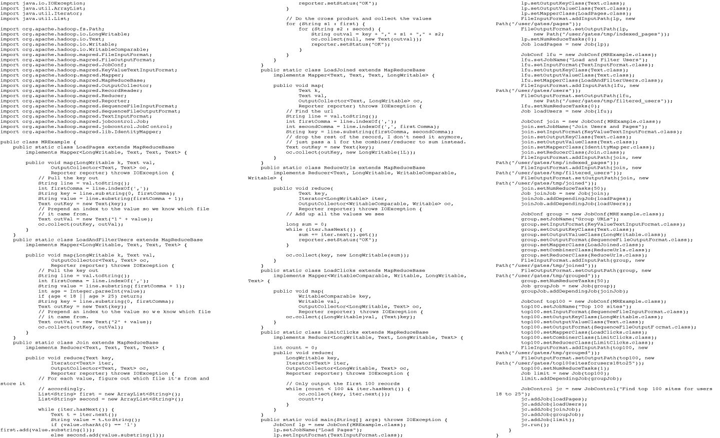
In MapReduce
Example from http://wiki.apache.org/pig-data/attachments/PigTalksPapers/attachments/ApacheConEurope09.ppt
Notes:
My point in putting in the java code isn’t too actually walk through it. It’s just to show that you have to hand code a fair amount of java. That way I can just point and say “look how much java you’d have to write to accomplish this”

Slide 52

Apache Pig
High-level language:
Expresses sequences of MapReduce jobs
Provides relational (SQL) operators (JOIN, GROUP BY, etc)
Easy to plug in Java functions
Started at Yahoo! Research
Runs about 50% of Yahoo!’s jobs
https://pig.apache.org/
Similar to Google’s (internal) Sawzall project

Slide 53
In Pig Latin
Users = load ‘users’ as (name, age); Filtered = filter Users by age >= 18 and age <= 25; Pages = load ‘pages’ as (user, url); Joined = join Filtered by name, Pages by user; Grouped = group Joined by url; Summed = foreach Grouped generate group, count(Joined) as clicks; Sorted = order Summed by clicks desc; Top5 = limit Sorted 5;
store Top5 into ‘top5sites’;
Example from http://wiki.apache.org/pig-data/attachments/PigTalksPapers/attachments/ApacheConEurope09.ppt
Notes:
Rather than using capital letters, which makes Pig Latin look like SQL, I added Eclipse style highlighting instead. Hopefully this makes clear what are the key words without making it look like a Matisse painting.

Slide 54
Translation to MapReduce
Notice how naturally the components of the job translate into Pig Latin
Load Users
Load Pages
Users = load … Filtered = filter … Pages = load … Joined = join … Grouped = group … Summed = … count()… Sorted = order … Top5 = limit …
Filter by age
Join on name
Job 1
Group on url
Job 2
Count clicks
Order by clicks
Job 3
Take top 5
Example from http://wiki.apache.org/pig-data/attachments/PigTalksPapers/attachments/ApacheConEurope09.ppt
Notes:
No need to think about how many map reduce jobs this decomposes into, or connecting data flows between map reduces jobs, or even that this is taking place on top of map reduce at all.

Slide 55
Future?
Complete location transparency
Mobile Data, encrypted all the time
Computation anywhere any time
Cryptographic-based identities
Large Cloud-centers,
Internet of Things?
Everything connected, all the time!
Huge Potential
Very Exciting and Scary at same time
Perhaps talk about this on Monday

Slide 56
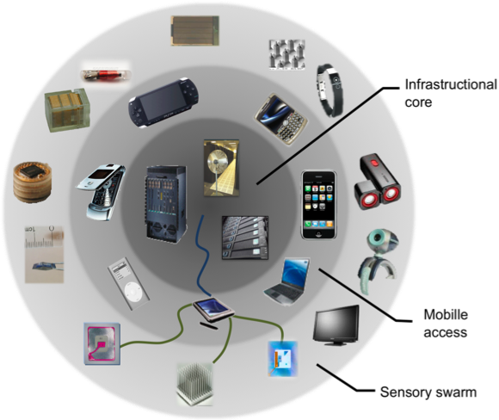

Truly Distributed Apps: The Swarm of Resources
Cloud/FOG Services
The Local Swarm:
Person, House, Office, Café
Enterprise Services

Slide 57
Thank you!
File Systems
Address Space
Concurrency
Reliability, Security, Cloud
Distributed Systems
OS Concepts
intro
Let’s Thank the TAs!
Thanks for helping us with this experimental version of the course… I think that it is going to be great!
Good Bye!

