Slide 1
CS162 Operating Systems and Systems Programming Lecture 5 Introduction to Networking (Finished), Concurrency (Processes and Threads)
February 4th, 2015
Prof. John Kubiatowicz
http://cs162.eecs.Berkeley.edu

Slide 2
Recall: Namespaces for communication over IP
Hostname
www.eecs.berkeley.edu
IP address
128.32.244.172 (ipv6?)
Port Number
0-1023 are “well known” or “system” ports
Superuser privileges to bind to one
1024 – 49151 are “registered” ports (registry)
Assigned by IANA for specific services
49152–65535 (2¹⁵+2¹⁴ to 2¹⁶−1) are “dynamic” or “private”
Automatically allocated as “ephemeral Ports”

Slide 3
Recall: Use of Sockets in TCP
Socket: an abstraction of a network I/O queue
Embodies one side of a communication channel
Same interface regardless of location of other end
Could be local machine (called “UNIX socket”) or remote machine (called “network socket”)
First introduced in 4.2 BSD UNIX: big innovation at time
Now most operating systems provide some notion of socket
Using Sockets for Client-Server (C/C++ interface):
On server: set up “server-socket”
Create socket, Bind to protocol (TCP), local address, port
Call listen(): tells server socket to accept incoming requests
Perform multiple accept() calls on socket to accept incoming connection request
Each successful accept() returns a new socket for a new connection; can pass this off to handler thread
On client:
Create socket, Bind to protocol (TCP), remote address, port
Perform connect() on socket to make connection
If connect() successful, have socket connected to server

Slide 4
Recall: Socket Setup over TCP/IP
Server
Socket
Request Connection
new
socket
socket
socket
connection
Client
Server
Server Socket: Listens for new connections
Produces new sockets for each unique connection
Things to remember:
Connection involves 5 values: [ Client Addr, Client Port, Server Addr, Server Port, Protocol ]
Often, Client Port “randomly” assigned
Done by OS during client socket setup
Server Port often “well known”
80 (web), 443 (secure web), 25 (sendmail), etc
Well-known ports from 0—1023

Slide 5
Example: Server Protection and Parallelism
Client
Server
Create Server Socket
Bind it to an Address
(host:port)
Create Client Socket
Connect it to server (host:port)
Listen for Connection
Accept connection
child
Connection Socket
Parent
Close Listen Socket
Close Connection Socket
write request
read request
read response
write response
Close Connection Socket
Close Client Socket
Close Server Socket

Slide 6
Recall: Server Protocol (v3)
while (1) {
listen(lstnsockfd, MAXQUEUE);
consockfd = accept(lstnsockfd, (struct sockaddr *) &cli_addr,
&clilen);
cpid = fork(); /* new process for connection */
if (cpid > 0) { /* parent process */
close(consockfd);
} else if (cpid == 0) { /* child process */
close(lstnsockfd); /* let go of listen socket */
server(consockfd);
close(consockfd);
exit(EXIT_SUCCESS); /* exit child normally */
}
}
close(lstnsockfd);

Slide 7
Server Address - itself
memset((char *) &serv_addr,0, sizeof(serv_addr));
serv_addr.sin_family = AF_INET;
serv_addr.sin_addr.s_addr = INADDR_ANY;
serv_addr.sin_port = htons(portno);
Simple form
Internet Protocol
accepting any connections on the specified port
In “network byte ordering”

Slide 8
Client: getting the server address
struct hostent *buildServerAddr(struct sockaddr_in *serv_addr,
char *hostname, int portno) {
struct hostent *server;
/* Get host entry associated with a hostname or IP address */
server = gethostbyname(hostname);
if (server == NULL) {
fprintf(stderr,"ERROR, no such host\n");
exit(1);
}
/* Construct an address for remote server */
memset((char *) serv_addr, 0, sizeof(struct sockaddr_in));
serv_addr->sin_family = AF_INET;
bcopy((char *)server->h_addr,
(char *)&(serv_addr->sin_addr.s_addr), server->h_length);
serv_addr->sin_port = htons(portno);
return server;
}

Slide 9
BIG OS Concepts so far
Processes
Address Space
Protection
Dual Mode
Interrupt handlers (including syscall and trap)
File System
Integrates processes, users, cwd, protection
Key Layers: OS Lib, Syscall, Subsystem, Driver
User handler on OS descriptors
Process control
fork, wait, signal, exec
Communication through sockets
Client-Server Protocol

Slide 10
Course Structure: Spiral
File Systems (8)
Address Space (4)
Concurrency (6)
Reliability, Security, Cloud (8)
Distributed Systems (8)
OS Concepts (3)
intro

Slide 11
Recall: Traditional UNIX Process
Process: Operating system abstraction to represent what is needed to run a single program
Often called a “HeavyWeight Process”
No concurrency in a “HeavyWeight Process”
Two parts:
Sequential program execution stream
Code executed as a sequential stream of execution (i.e., thread)
Includes State of CPU registers
Protected resources:
Main memory state (contents of Address Space)
I/O state (i.e. file descriptors)

Slide 12
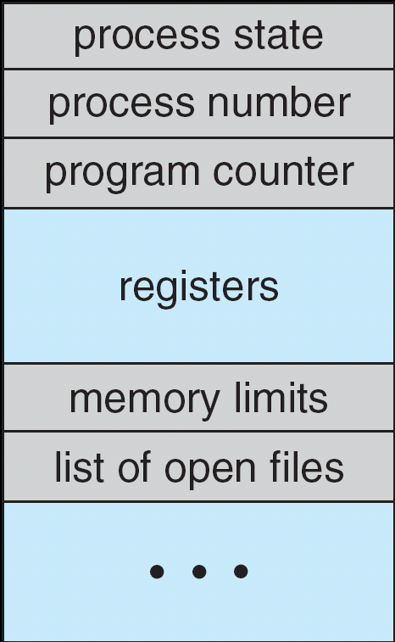
How do we Multiplex Processes?
The current state of process held in a process control block (PCB):
This is a “snapshot” of the execution and protection environment
Only one PCB active at a time
Give out CPU time to different processes (Scheduling):
Only one process “running” at a time
Give more time to important processes
Give pieces of resources to different processes (Protection):
Controlled access to non-CPU resources
Example mechanisms:
Memory Mapping: Give each process their own address space
Kernel/User duality: Arbitrary multiplexing of I/O through system calls
Process Control
Block

Slide 13
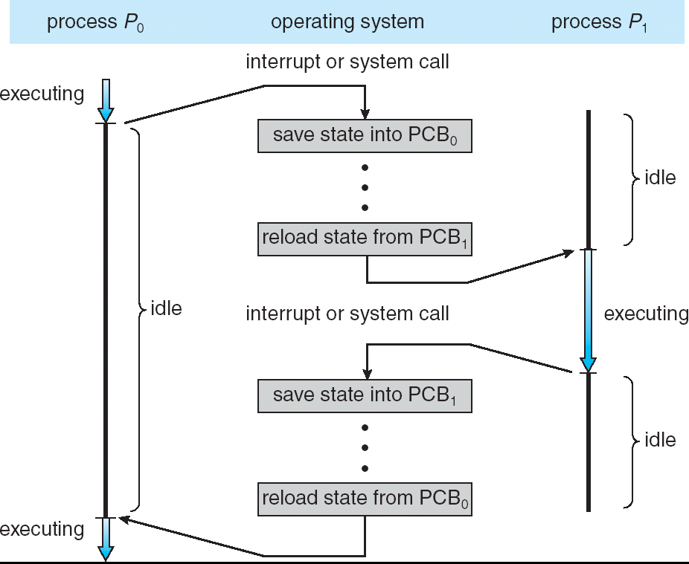
CPU Switch From Process to Process
This is also called a “context switch”
Code executed in kernel above is overhead
Overhead sets minimum practical switching time
Less overhead with SMT/hyperthreading, but… contention for resources instead

Slide 14
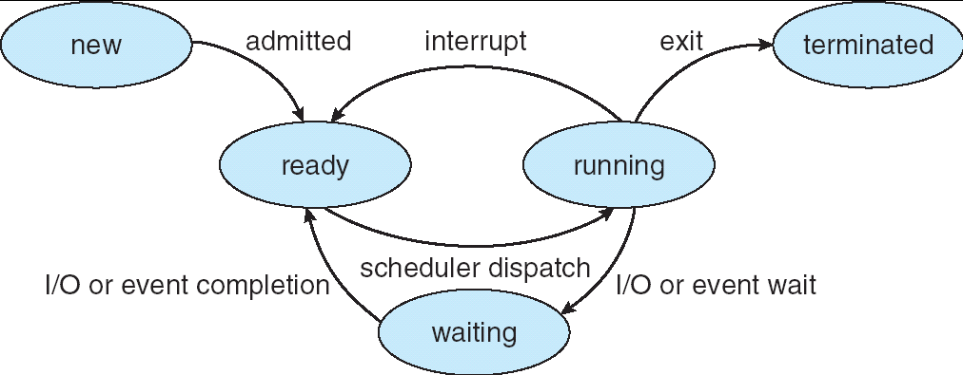
Lifecycle of a Process
As a process executes, it changes state:
new: The process is being created
ready: The process is waiting to run
running: Instructions are being executed
waiting: Process waiting for some event to occur
terminated: The process has finished execution

Slide 15
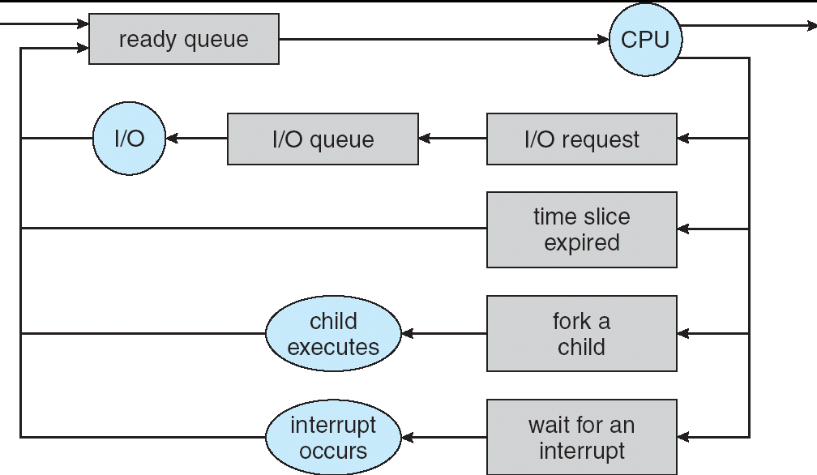
Process Scheduling
PCBs move from queue to queue as they change state
Decisions about which order to remove from queues are Scheduling decisions
Many algorithms possible (few weeks from now)

Slide 16
Ready Queue And Various I/O Device Queues
Thread not running ⇒ TCB is in some scheduler queue
Separate queue for each device/signal/condition
Each queue can have a different scheduler policy
Ready
Queue
Head
Other
State
TCB₉
Link
Other
State
TCB₆
Link
Other
State
TCB₁₆
Link
Tail
Registers
Registers
Registers
USB
Unit 0
Head
Tail
Disk
Unit 0
Head
Other
State
TCB₂
Link
Other
State
TCB₃
Link
Tail
Registers
Registers
Disk
Unit 2
Head
Tail
Other
State
TCB₈
Ether
Netwk 0
Link
Head
Tail
Registers

Slide 17
Administrivia
Group signups: 4 members/group
Link posted by Friday
Groups need to be finished by Monday!
Form asks which section you attend
Moving section #109
From Friday 10-11 (3102 Etcheverry) ⇒ Thursday 12-1 (320 Soda)
There is still a Friday 10-11 in 3111 Etcheverry
Conflicts for Final: Please let me know this week!
Need to get to know your Tas
Consider moving out of really big sections!
Finding info on your own is a good idea!
Learn your tools, like “man”
Can even type “man xxx” into google!
Example: “man ls”

Slide 18
Modern Process with Threads
Thread: a sequential execution stream within process (Sometimes called a “Lightweight process”)
Process still contains a single Address Space
No protection between threads
Multithreading: a single program made up of a number of different concurrent activities
Sometimes called multitasking, as in Ada …
Why separate the concept of a thread from that of a process?
Discuss the “thread” part of a process (concurrency)
Separate from the “address space” (protection)
Heavyweight Process ≡ Process with one thread

Slide 19
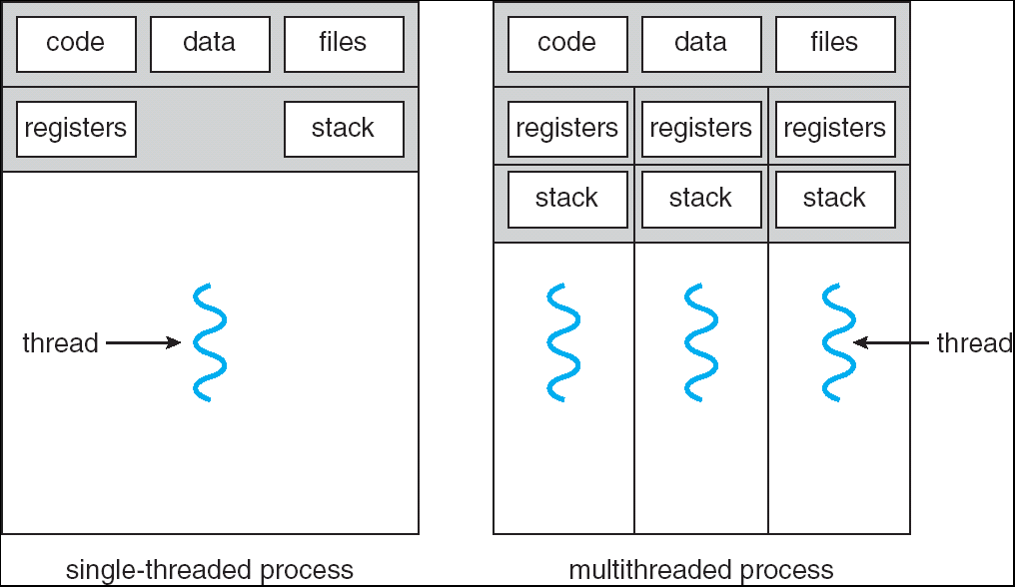
Single and Multithreaded Processes
Threads encapsulate concurrency: “Active” component
Address spaces encapsulate protection: “Passive” part
Keeps buggy program from trashing the system
Why have multiple threads per address space?
Notes:
Sometimes need parallelism for a single job, and processes are very expensive – to start, switch between, and to communicate between

Slide 20
Thread State
State shared by all threads in process/addr space
Content of memory (global variables, heap)
I/O state (file descriptors, network connections, etc)
State “private” to each thread
Kept in TCB ≡ Thread Control Block
CPU registers (including, program counter)
Execution stack – what is this?
Execution Stack
Parameters, temporary variables
Return PCs are kept while called procedures are executing

Slide 21
Execution Stack Example
A: tmp=1
ret=exit
A(int tmp) {
if (tmp<2)
B();
printf(tmp);
}
B() {
C();
}
C() {
A(2);
}
A(1);
B: ret=A+2
C: ret=b+1
A: tmp=2
ret=C+1
Stack
Pointer
Stack Growth
Stack holds temporary results
Permits recursive execution
Crucial to modern languages

Slide 22
Motivational Example for Threads
Imagine the following C program:
main() {
ComputePI(“pi.txt”);
PrintClassList(“clist.text”);
}
What is the behavior here?
Program would never print out class list
Why? ComputePI would never finish

Slide 23
Use of Threads
Version of program with Threads (loose syntax):
main() {
ThreadFork(ComputePI(“pi.txt”));
ThreadFork(PrintClassList(“clist.text”));
}
What does “ThreadFork()” do?
Start independent thread running given procedure
What is the behavior here?
Now, you would actually see the class list
This should behave as if there are two separate CPUs
CPU1
CPU2
CPU1
CPU2
CPU1
CPU2
Time

Slide 24
Memory Footprint: Two-Threads
If we stopped this program and examined it with a debugger, we would see
Two sets of CPU registers
Two sets of Stacks
Questions:
How do we position stacks relative to each other?
What maximum size should we choose for the stacks?
What happens if threads violate this?
How might you catch violations?
Stack 1
Stack 2
Address Space
Heap
Global Data
Code

Slide 25
Actual Thread Operations
thread_fork(func, args)
Create a new thread to run func(args)
Pintos: thread_create
thread_yield()
Relinquish processor voluntarily
Pintos: thread_yield
thread_join(thread)
In parent, wait for forked thread to exit, then return
thread_exit
Quit thread and clean up, wake up joiner if any
Pintos: thread_exit
pThreads: POSIX standard for thread programming

Slide 26
Dispatch Loop
Conceptually, the dispatching loop of the operating system looks as follows:
Loop {
RunThread();
ChooseNextThread();
SaveStateOfCPU(curTCB);
LoadStateOfCPU(newTCB);
}
This is an infinite loop
One could argue that this is all that the OS does
Should we ever exit this loop???
When would that be?
Notes:
Emergency crash of operating system called “panic()”

Slide 27
Running a thread
Consider first portion: RunThread()
How do I run a thread?
Load its state (registers, PC, stack pointer) into CPU
Load environment (virtual memory space, etc)
Jump to the PC
How does the dispatcher get control back?
Internal events: thread returns control voluntarily
External events: thread gets preempted
Notes:
OS’s have almost human characteristics – unpredictable, hard to understand, …
Different things share the same CPU – one thread, then another
Similar to schizophrenia, like the movie Sybil, one body shared by several people, say we start with Dave Patterson
Threads are like the personalities of the CPU. First one thread/personality uses the CPU, then another,…

Slide 28
Internal Events
Blocking on I/O
The act of requesting I/O implicitly yields the CPU
Waiting on a “signal” from other thread
Thread asks to wait and thus yields the CPU
Thread executes a yield()
Thread volunteers to give up CPU
computePI() {
while(TRUE) {
ComputeNextDigit();
yield();
}
}
Notes:
Yield is for really nice people – Ever see two people at the supermarket checkout line? You first, no you first, …

Slide 29
Stack for Yielding Thread
ComputePI
yield
Trap to OS
kernel_yield
Stack growth
run_new_thread
switch
How do we run a new thread?
run_new_thread() {
newThread = PickNewThread();
switch(curThread, newThread);
ThreadHouseKeeping(); /* Do any cleanup */
}
How does dispatcher switch to a new thread?
Save anything next thread may trash: PC, regs, stack
Maintain isolation for each thread

Slide 30
What do the stacks look like?
Consider the following code blocks:
proc A() {
B();
}
proc B() {
while(TRUE) {
yield();
}
}
Suppose we have 2 threads:
Threads S and T
Thread S
Thread T
A
A
B(while)
B(while)
Stack growth
yield
yield
run_new_thread
run_new_thread
switch
switch

Slide 31
Saving/Restoring state (often called “Context Switch)
Switch(tCur,tNew) {
/* Unload old thread */
TCB[tCur].regs.r7 = CPU.r7;
…
TCB[tCur].regs.r0 = CPU.r0;
TCB[tCur].regs.sp = CPU.sp;
TCB[tCur].regs.retpc = CPU.retpc; /*return addr*/
/* Load and execute new thread */
CPU.r7 = TCB[tNew].regs.r7;
…
CPU.r0 = TCB[tNew].regs.r0;
CPU.sp = TCB[tNew].regs.sp;
CPU.retpc = TCB[tNew].regs.retpc;
return; /* Return to CPU.retpc */
}

Slide 32
Switch Details (continued)
What if you make a mistake in implementing switch?
Suppose you forget to save/restore register 4
Get intermittent failures depending on when context switch occurred and whether new thread uses register 4
System will give wrong result without warning
Can you devise an exhaustive test to test switch code?
No! Too many combinations and inter-leavings
Cautionary tail:
For speed, Topaz kernel saved one instruction in switch()
Carefully documented!
Only works As long as kernel size < 1MB
What happened?
Time passed, People forgot
Later, they added features to kernel (no one removes features!)
Very weird behavior started happening
Moral of story: Design for simplicity

Slide 33
Some Numbers
Frequency of performing context switches: 10-100ms
Context switch time in Linux: 3-4 μsecs (Current Intel i7 & E5).
Thread switching faster than process switching (100 ns).
But switching across cores about 2x more expensive than within-core switching.
Context switch time increases sharply with the size of the working set*, and can increase 100x or more. * The working set is the subset of memory used by the process in a time window.
Moral: Context switching depends mostly on cache limits and the process or thread’s hunger for memory.

Slide 34
What happens when thread blocks on I/O?
CopyFile
read
Trap to OS
Stack growth
kernel_read
run_new_thread
switch
What happens when a thread requests a block of data from the file system?
User code invokes a system call
Read operation is initiated
Run new thread/switch
Thread communication similar
Wait for Signal/Join
Networking

Slide 35
External Events
What happens if thread never does any I/O, never waits, and never yields control?
Could the ComputePI program grab all resources and never release the processor?
What if it didn’t print to console?
Must find way that dispatcher can regain control!
Answer: Utilize External Events
Interrupts: signals from hardware or software that stop the running code and jump to kernel
Timer: like an alarm clock that goes off every some many milliseconds
If we make sure that external events occur frequently enough, can ensure dispatcher runs
Notes:
Patterson’s a nice guy, so he gives up the body after using it for awhile and let’s John Kubitowicz have it.
But Kubi’s not so nice, so he won’t give up control…
If you want to wake up for a final, you set your clock, or ask your roommate to pour water over your head – OS does the same

Slide 36
Thread Abstraction
Infinite number of processors
Threads execute with variable speed
Programs must be designed to work with any schedule
Notes:
Execution model: each thread runs on a dedicated virtual processor with unpredictable and variable speed.

Slide 37
Programmer vs. Processor View

Slide 38
Possible Executions

Slide 39
Thread Lifecycle

Slide 40
Shared vs. Per-Thread State

Slide 41
Per Thread State (Kernel Supported Threads)
Each Thread has a Thread Control Block (TCB)
Execution State: CPU registers, program counter (PC), pointer to stack (SP)
Scheduling info: state, priority, CPU time
Various Pointers (for implementing scheduling queues)
Pointer to enclosing process (PCB) – user threads
Etc (add stuff as you find a need)
OS Keeps track of TCBs in “kernel memory”
In Array, or Linked List, or …

Slide 42
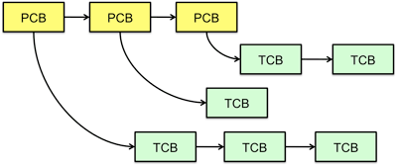
Multithreaded Processes
PCB points to multiple TCBs:
Switching threads within a block is a simple thread switch
Switching threads across blocks requires changes to memory and I/O address tables.

Slide 43
Examples multithreaded programs
Embedded systems
Elevators, Planes, Medical systems, Wristwatches
Single Program, concurrent operations
Most modern OS kernels
Internally concurrent because have to deal with concurrent requests by multiple users
But no protection needed within kernel
Database Servers
Access to shared data by many concurrent users
Also background utility processing must be done
Notes:
DB servers very important – provide “shared data” view to users.
Many users can read/write at once – how is consistency managed?

Slide 44
Example multithreaded programs (con’t)
Network Servers
Concurrent requests from network
Again, single program, multiple concurrent operations
File server, Web server, and airline reservation systems
Parallel Programming (More than one physical CPU)
Split program into multiple threads for parallelism
This is called Multiprocessing
Some multiprocessors are actually uniprogrammed:
Multiple threads in one address space but one program at a time

Slide 45
A typical use case
Client Browser
- process for each tab
- thread to render page
- GET in separate thread
- multiple outstanding GETs
- as they complete, render
portion
Web Server
- fork process for each client connection
- thread to get request and issue response
- fork threads to read data, access DB, etc
- join and respond

Slide 46
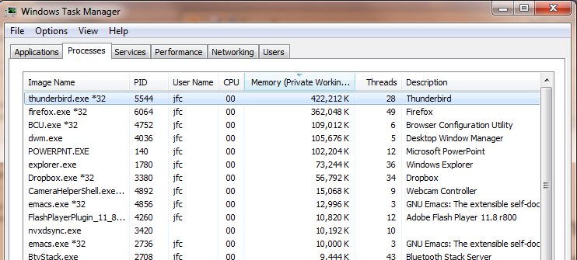
Some Actual Numbers
Many process are multi-threaded, so thread context switches may be either within-process or across-processes.

Slide 47
Kernel Use Cases
Thread for each user process
Thread for sequence of steps in processing I/O
Threads for device drivers
…

Slide 48
Putting it together: Process
(Unix) Process
A(int tmp) {
if (tmp<2)
B();
printf(tmp);
}
B() {
C();
}
C() {
A(2);
}
A(1);
…
Memory
Stack
Resources
I/O State
(e.g., file, socket contexts)
Sequential stream of instructions
CPU state (PC, SP, registers..)
Stored in OS

Slide 49
Putting it together: Processes
Process 1
Process 2
Process N
Switch overhead: high
CPU state: low
Memory/IO state: high
Process creation: high
Protection
CPU: yes
Memory/IO: yes
Sharing overhead: high (involves at least a context switch)
Mem.
Mem.
Mem.
IO
state
IO
state
…
IO
state
CPU
state
CPU
state
CPU
state
CPU sched.
OS
1 process at a time
CPU
(1 core)

Slide 50
Putting it together: Threads
Process 1
Process N
threads
threads
Switch overhead: low (only CPU state)
Thread creation: low
Protection
CPU: yes
Memory/IO: No
Sharing overhead: low (thread switch overhead low)
Mem.
Mem.
…
IO
state
…
…
IO
state
CPU
state
CPU
state
CPU
state
CPU
state
CPU sched.
OS
1 thread at a time
CPU
(1 core)

Slide 51
Kernel versus User-Mode threads
We have been talking about Kernel threads
Native threads supported directly by the kernel
Every thread can run or block independently
One process may have several threads waiting on different things
Downside of kernel threads: a bit expensive
Need to make a crossing into kernel mode to schedule
Even lighter weight option: User Threads
User program provides scheduler and thread package
May have several user threads per kernel thread
User threads may be scheduled non-premptively relative to each other (only switch on yield())
Cheap
Downside of user threads:
When one thread blocks on I/O, all threads block
Kernel cannot adjust scheduling among all threads
Option: Scheduler Activations
Have kernel inform user level when thread blocks…

Slide 52
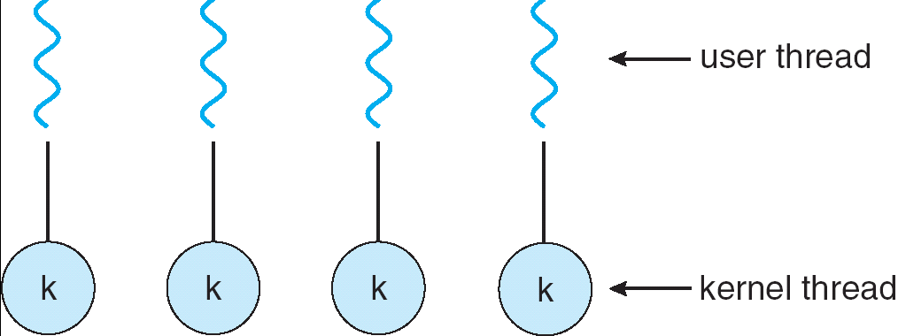
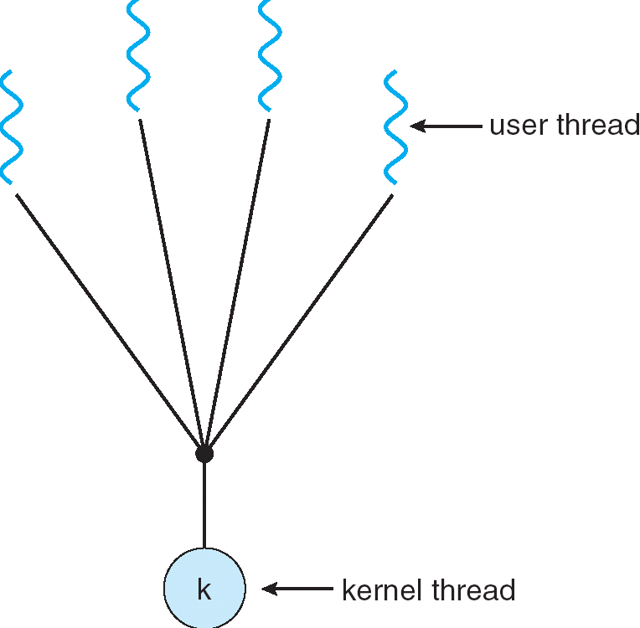
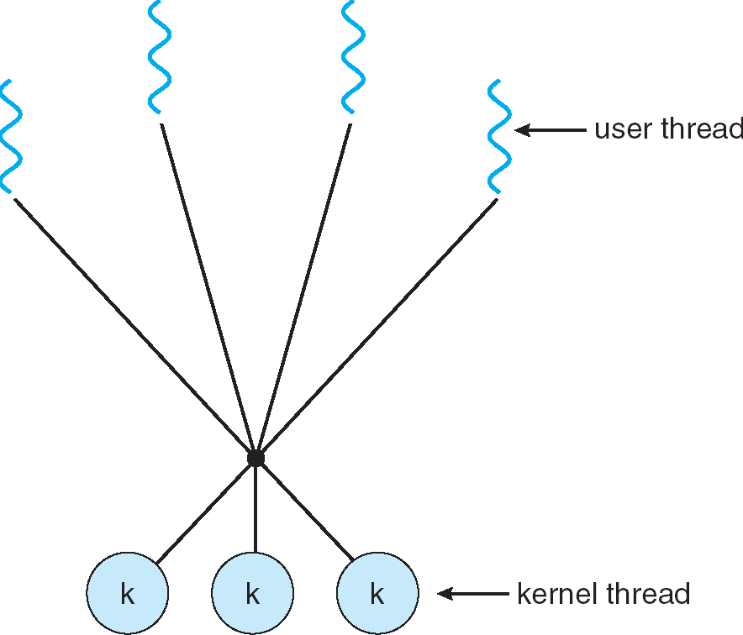
Some Threading Models
Simple One-to-One
Threading Model
Many-to-One
Many-to-Many

Slide 53
Threads in a Process
Threads are useful at user-level
Parallelism, hide I/O latency, interactivity
Option A (early Java): user-level library, within a single-threaded process
Library does thread context switch
Kernel time slices between processes, e.g., on system call I/O
Option B (SunOS, Unix variants): green Threads
User-level library does thread multiplexing
Option C (Windows): scheduler activations
Kernel allocates processors to user-level library
Thread library implements context switch
System call I/O that blocks triggers upcall
Option D (Linux, MacOS, Windows): use kernel threads
System calls for thread fork, join, exit (and lock, unlock,…)
Kernel does context switching
Simple, but a lot of transitions between user and kernel mode

Slide 54
Putting it together: Multi-Cores
Process 1
Process N
threads
threads
Switch overhead: low (only CPU state)
Thread creation: low
Protection
CPU: yes
Memory/IO: No
Sharing overhead: low (thread switch overhead low, may not need to switch at all!)
Mem.
Mem.
…
IO
state
…
…
IO
state
CPU
state
CPU
state
CPU
state
CPU
state
CPU sched.
OS
4 threads at a time
core 1
Core 2
Core 3
Core 4
CPU

Slide 55
Putting it together: Hyper-Threading
Process 1
Process N
threads
threads
Switch overhead between hardware-threads: very-low (done in hardware)
Contention for ALUs/FPUs may hurt performance
Mem.
Mem.
…
IO
state
…
…
IO
state
CPU
state
CPU
state
CPU
state
CPU
state
CPU sched.
OS
hardware-threads
(hyperthreading)
8 threads at a time
core 1
core 2
core 3
core 4
CPU

Slide 56
Multiprocessing vs Multiprogramming
Remember Definitions:
Multiprocessing ≡ Multiple CPUs
Multiprogramming ≡ Multiple Jobs or Processes
Multithreading ≡ Multiple threads per Process
What does it mean to run two threads “concurrently”?
Scheduler is free to run threads in any order and interleaving: FIFO, Random, …
Dispatcher can choose to run each thread to completion or time-slice in big chunks or small chunks
A
Multiprocessing
B
C
A
B
C
Multiprogramming
A
B
C
A
B
C
B

Slide 57
Single and Multithreaded Processes
Notes:
Sometimes need parallelism for a single job, and processes are very expensive – to start, switch between, and to communicate between

Slide 58
Supporting 1T and MT Processes
User
***
System
Notes:
Sometimes need parallelism for a single job, and processes are very expensive – to start, switch between, and to communicate between

Slide 59
Supporting 1T and MT Processes
User
***
***
System
Notes:
Sometimes need parallelism for a single job, and processes are very expensive – to start, switch between, and to communicate between

Slide 60
Correctness for systems with concurrent threads
If dispatcher can schedule threads in any way, programs must work under all circumstances
Can you test for this?
How can you know if your program works?
Independent Threads:
No state shared with other threads
Deterministic ⇒ Input state determines results
Reproducible ⇒ Can recreate Starting Conditions, I/O
Scheduling order doesn’t matter (if switch() works!!!)
Cooperating Threads:
Shared State between multiple threads
Non-deterministic
Non-reproducible
Non-deterministic and Non-reproducible means that bugs can be intermittent
Sometimes called “Heisenbugs”

Slide 61
Interactions Complicate Debugging
Is any program truly independent?
Every process shares the file system, OS resources, network, etc
Extreme example: buggy device driver causes thread A to crash “independent thread” B
You probably don’t realize how much you depend on reproducibility:
Example: Evil C compiler
Modifies files behind your back by inserting errors into C program unless you insert debugging code
Example: Debugging statements can overrun stack
Non-deterministic errors are really difficult to find
Example: Memory layout of kernel+user programs
depends on scheduling, which depends on timer/other things
Original UNIX had a bunch of non-deterministic errors
Example: Something which does interesting I/O
User typing of letters used to help generate secure keys
Notes:
Adding printf statements can cause stack overruns or changing timing/interleaving
What if non-deterministic error only occurs once a week? You’re pulling all-nighters to find it, your eyelids droop, and whiz, the error happens and you missed it.

Slide 62
Why allow cooperating threads?
People cooperate; computers help/enhance people’s lives, so computers must cooperate
By analogy, the non-reproducibility/non-determinism of people is a notable problem for “carefully laid plans”
Advantage 1: Share resources
One computer, many users
One bank balance, many ATMs
What if ATMs were only updated at night?
Embedded systems (robot control: coordinate arm & hand)
Advantage 2: Speedup
Overlap I/O and computation
Many different file systems do read-ahead
Multiprocessors – chop up program into parallel pieces
Advantage 3: Modularity
More important than you might think
Chop large problem up into simpler pieces
To compile, for instance, gcc calls cpp | cc1 | cc2 | as | ld
Makes system easier to extend

Slide 63
High-level Example: Web Server
Server must handle many requests
Non-cooperating version:
serverLoop() {
con = AcceptCon();
ProcessFork(ServiceWebPage(),con);
}
What are some disadvantages of this technique?
Notes:
Expensive to start new process, heavyweight context switch overhead (changing address spaces)

Slide 64


Threaded Web Server
Now, use a single process
Multithreaded (cooperating) version:
serverLoop() {
connection = AcceptCon();
ThreadFork(ServiceWebPage(),connection);
}
Looks almost the same, but has many advantages:
Can share file caches kept in memory, results of CGI scripts, other things
Threads are much cheaper to create than processes, so this has a lower per-request overhead
Question: would a user-level (say one-to-many) thread package make sense here?
When one request blocks on disk, all block…
What about Denial of Service attacks or digg / Slash-dot effects?

Slide 65
Thread Pools
Problem with previous version: Unbounded Threads
When web-site becomes too popular – throughput sinks
Instead, allocate a bounded “pool” of worker threads, representing the maximum level of multiprogramming
Master
Thread
queue
Thread Pool
master() { allocThreads(worker,queue); while(TRUE) { con=AcceptCon(); Enqueue(queue,con); wakeUp(queue); } }
worker(queue) { while(TRUE) { con=Dequeue(queue); if (con==null) sleepOn(queue); else ServiceWebPage(con); } }

Slide 66
Classification
One
Many
# of addr spaces:
# threads
Per AS:
One
MS/DOS, early Macintosh
Traditional UNIX
Many
Embedded systems (Geoworks, VxWorks, JavaOS,etc)
JavaOS, Pilot(PC)
Mach, OS/2, Linux
Windows 9x???
Win NT to XP, Solaris, HP-UX, OS X
Real operating systems have either
One or many address spaces
One or many threads per address space
Did Windows 95/98/ME have real memory protection?
No: Users could overwrite process tables/System DLLs

Slide 67
Summary
Processes have two parts
Threads (Concurrency)
Address Spaces (Protection)
Concurrency accomplished by multiplexing CPU Time:
Unloading current thread (PC, registers)
Loading new thread (PC, registers)
Such context switching may be voluntary (yield(), I/O operations) or involuntary (timer, other interrupts)
Protection accomplished restricting access:
Memory mapping isolates processes from each other
Dual-mode for isolating I/O, other resources
Various Textbooks talk about processes
When this concerns concurrency, really talking about thread portion of a process
When this concerns protection, talking about address space portion of a process

