Slide 1
CS162 Operating Systems and Systems Programming Lecture 6 Concurrency (Continued), Synchronization (Start)
February 9th, 2015
Prof. John Kubiatowicz
http://cs162.eecs.Berkeley.edu

Slide 2
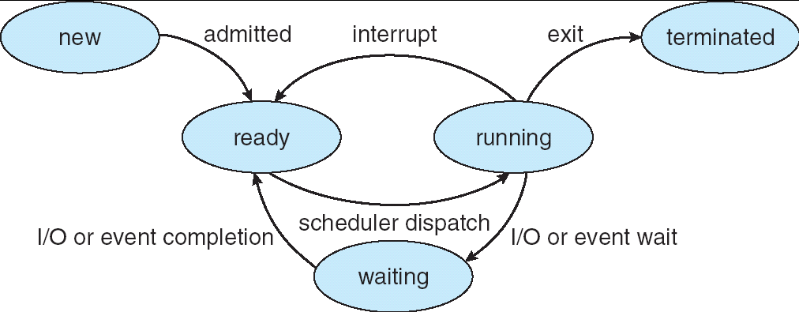
Recall: Lifecycle of a Process
As a process executes, it changes state:
new: The process is being created
ready: The process is waiting to run
running: Instructions are being executed
waiting: Process waiting for some event to occur
terminated: The process has finished execution

Slide 3
Recall: Use of Threads
Version of program with Threads (loose syntax):
main() {
ThreadFork(ComputePI(“pi.txt”));
ThreadFork(PrintClassList(“clist.text”));
}
What does “ThreadFork()” do?
Start independent thread running given procedure
What is the behavior here?
Now, you would actually see the class list
This should behave as if there are two separate CPUs
CPU1
CPU2
CPU1
CPU2
CPU1
CPU2
Time

Slide 4
Recall: Thread Abstraction
Infinite number of processors
Threads execute with variable speed
Programs must be designed to work with any schedule
Notes:
Execution model: each thread runs on a dedicated virtual processor with unpredictable and variable speed.

Slide 5
Recall: Execution Stack Example
A: tmp=1
ret=exit
A(int tmp) {
if (tmp<2)
B();
printf(tmp);
}
B() {
C();
}
C() {
A(2);
}
A(1);
B: ret=A+2
C: ret=B+1
A: tmp=2
ret=C+1
Stack
Pointer
Stack Growth
Stack holds temporary results
Permits recursive execution
Crucial to modern languages

Slide 6
MIPS: Software conventions for Registers
0 zero constant 0
1 at reserved for assembler
2 v0 expression evaluation &
3 v1 function results
4 a0 arguments
5 a1
6 a2
7 a3
8 t0 temporary: caller saves
. . . (callee can clobber)
15 t7
16 s0 callee saves
. . . (callee must save)
23 s7
24 t8 temporary (cont’d)
25 t9
26 k0 reserved for OS kernel
27 k1
28 gp Pointer to global area
29 sp Stack pointer
30 fp frame pointer
31 ra Return Address (HW)
Before calling procedure:
Save caller-saves regs
Save v0, v1
Save ra
After return, assume
Callee-saves reg OK
gp,sp,fp OK (restored!)
Other things trashed

Slide 7
Recall: Multithreaded stack switching
Consider the following code blocks:
proc A() {
B();
}
proc B() {
while(TRUE) {
yield();
}
}
Suppose we have 2 threads:
Threads S and T
Thread S
Thread T
A
A
B(while)
B(while)
Stack growth
yield
yield
run_new_thread
run_new_thread
switch
switch

Slide 8
Example: Network Interrupt
Raise priority
Reenable All Ints
Save registers
Dispatch to Handler
…
Transfer Network Packet from hardware to Kernel Buffers
…
Restore registers
Clear current Int
Disable All Ints
Restore priority
RTI
PC saved
Disable All Ints
Supervisor Mode
…
add $r1,$r2,$r3
subi $r4,$r1,#4
slli $r4,$r4,#2
External Interrupt
Pipeline Flush
“Interrupt Handler”
lw $r2,0($r4)
lw $r3,4($r4)
add $r2,$r2,$r3
sw 8($r4),$r2
…
Restore PC
User Mode
An interrupt is a hardware-invoked context switch
No separate step to choose what to run next
Always run the interrupt handler immediately

Slide 9
Use of Timer Interrupt to Return Control
Solution to our dispatcher problem
Use the timer interrupt to force scheduling decisions
Timer Interrupt routine: TimerInterrupt() { DoPeriodicHouseKeeping(); run_new_thread(); }
I/O interrupt: same as timer interrupt except that DoHousekeeping() replaced by ServiceIO().
Some Routine
Interrupt
TimerInterrupt
Stack growth
run_new_thread
switch

Slide 10
How does Thread get started?
Other Thread
ThreadRoot
A
B(while)
Stack growth
yield
run_new_thread
New Thread
switch
ThreadRoot stub
Eventually, run_new_thread() will select this TCB and return into beginning of ThreadRoot()
This really starts the new thread

Slide 11
What does ThreadRoot() look like?
ThreadRoot() is the root for the thread routine:
ThreadRoot() {
DoStartupHousekeeping();
UserModeSwitch(); /* enter user mode */
Call fcnPtr(fcnArgPtr);
ThreadFinish();
}
Startup Housekeeping
Includes things like recording start time of thread
Other Statistics
Stack will grow and shrink with execution of thread
Final return from thread returns into ThreadRoot() which calls ThreadFinish()
ThreadFinish() wake up sleeping threads
ThreadRoot
Thread Code
Stack growth
Running Stack

Slide 12
Examples multithreaded programs
Embedded systems
Elevators, Planes, Medical systems, Wristwatches
Single Program, concurrent operations
Most modern OS kernels
Internally concurrent because have to deal with concurrent requests by multiple users
But no protection needed within kernel
Database Servers
Access to shared data by many concurrent users
Also background utility processing must be done
Notes:
DB servers very important – provide “shared data” view to users.
Many users can read/write at once – how is consistency managed?

Slide 13
Example multithreaded programs (con’t)
Network Servers
Concurrent requests from network
Again, single program, multiple concurrent operations
File server, Web server, and airline reservation systems
Parallel Programming (More than one physical CPU)
Split program into multiple threads for parallelism
This is called Multiprocessing
Some multiprocessors are actually uniprogrammed:
Multiple threads in one address space but one program at a time

Slide 14
A typical use case
Client Browser
- process for each tab
- thread to render page
- GET in separate thread
- multiple outstanding GETs
- as they complete, render
portion
Web Server
- fork process for each client connection
- thread to get request and issue response
- fork threads to read data, access DB, etc
- join and respond

Slide 15
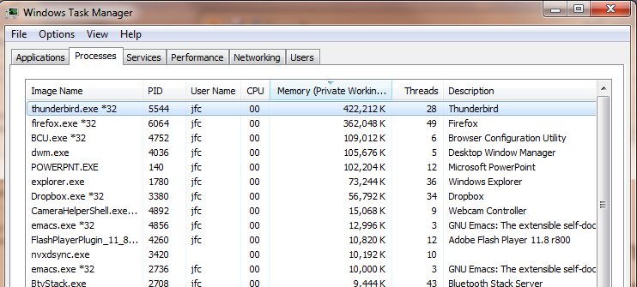
Some Actual Numbers
Many process are multi-threaded, so thread context switches may be either within-process or across-processes.

Slide 16
Kernel Use Cases
Thread for each user process
Thread for sequence of steps in processing I/O
Threads for device drivers
…

Slide 17
Administrivia
Group formation: should be completed
Will handle stragglers tonight
Project #1: Released!
Technically starts today
Autograder should be up by tomorrow.
HW1 due today
Must be submitted via the recommended “push” mechanism through git

Slide 18
Famous Quote WRT Scheduling: Dennis Richie
Dennis Richie, Unix V6, slp.c:
“If the new process paused because it was swapped out, set the stack level to the last call to savu(u_ssav). This means that the return which is executed immediately after the call to aretu actually returns from the last routine which did the savu.”
“You are not expected to understand this.”
Source: Dennis Ritchie, Unix V6 slp.c (context-switching code) as per The Unix Heritage Society(tuhs.org); gif by Eddie Koehler.
Included by Ali R. Butt in CS3204 from Virginia Tech

Slide 19
Putting it together: Process
(Unix) Process
A(int tmp) {
if (tmp<2)
B();
printf(tmp);
}
B() {
C();
}
C() {
A(2);
}
A(1);
…
Memory
Stack
Resources
I/O State
(e.g., file, socket contexts)
Sequential stream of instructions
CPU state (PC, SP, registers..)
Stored in OS

Slide 20
Putting it together: Processes
Process 1
Process 2
Process N
Switch overhead: high
CPU state: low
Memory/IO state: high
Process creation: high
Protection
CPU: yes
Memory/IO: yes
Sharing overhead: high (involves at least a context switch)
Mem.
Mem.
Mem.
IO
state
IO
state
…
IO
state
CPU
state
CPU
state
CPU
state
CPU sched.
OS
1 process at a time
CPU
(1 core)

Slide 21
Putting it together: Threads
Process 1
Process N
threads
threads
Switch overhead: low (only CPU state)
Thread creation: low
Protection
CPU: yes
Memory/IO: No
Sharing overhead: low (thread switch overhead low)
Mem.
Mem.
…
IO
state
…
…
IO
state
CPU
state
CPU
state
CPU
state
CPU
state
CPU sched.
OS
1 thread at a time
CPU
(1 core)

Slide 22
Kernel versus User-Mode threads
We have been talking about Kernel threads
Native threads supported directly by the kernel
Every thread can run or block independently
One process may have several threads waiting on different things
Downside of kernel threads: a bit expensive
Need to make a crossing into kernel mode to schedule
Even lighter weight option: User Threads
User program provides scheduler and thread package
May have several user threads per kernel thread
User threads may be scheduled non-premptively relative to each other (only switch on yield())
Cheap
Downside of user threads:
When one thread blocks on I/O, all threads block
Kernel cannot adjust scheduling among all threads
Option: Scheduler Activations
Have kernel inform user level when thread blocks…

Slide 23
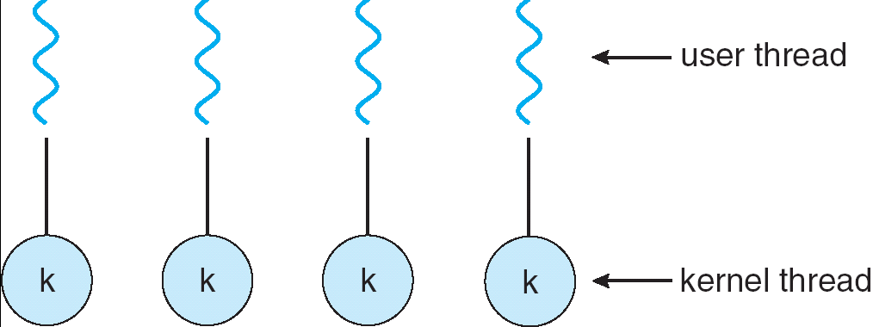
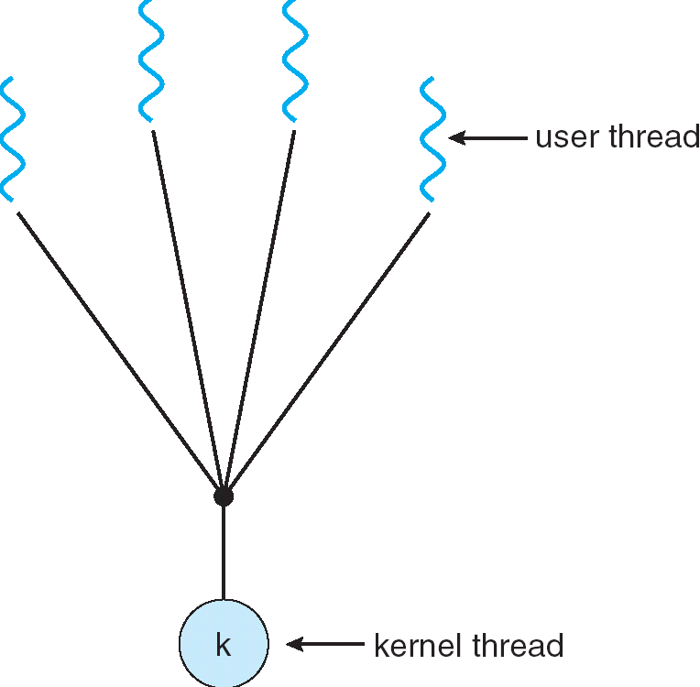
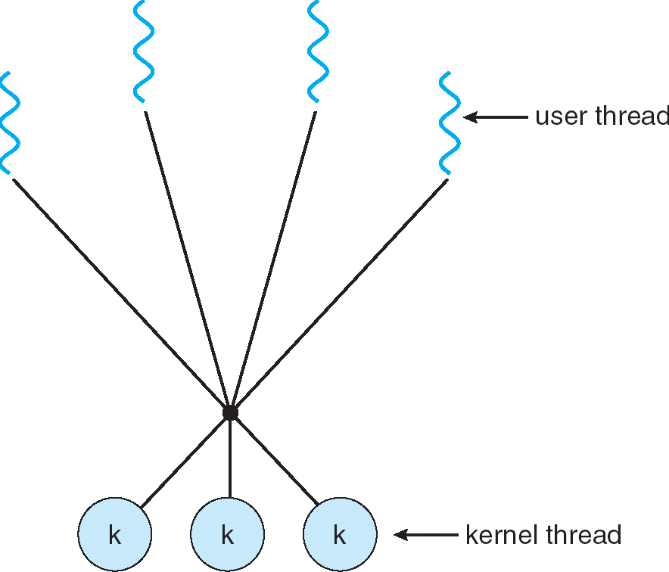
Some Threading Models
Simple One-to-One
Threading Model
Many-to-One
Many-to-Many

Slide 24
Threads in a Process
Threads are useful at user-level
Parallelism, hide I/O latency, interactivity
Option A (early Java): user-level library, within a single-threaded process
Library does thread context switch
Kernel time slices between processes, e.g., on system call I/O
Option B (SunOS, Linux/Unix variants): green Threads
User-level library does thread multiplexing
Option C (Windows): scheduler activations
Kernel allocates processors to user-level library
Thread library implements context switch
System call I/O that blocks triggers upcall
Option D (Linux, MacOS, Windows): use kernel threads
System calls for thread fork, join, exit (and lock, unlock,…)
Kernel does context switching
Simple, but a lot of transitions between user and kernel mode

Slide 25
Putting it together: Multi-Cores
Process 1
Process N
threads
threads
Switch overhead: low (only CPU state)
Thread creation: low
Protection
CPU: yes
Memory/IO: No
Sharing overhead: low (thread switch overhead low, may not need to switch at all!)
Mem.
Mem.
…
IO
state
…
…
IO
state
CPU
state
CPU
state
CPU
state
CPU
state
CPU sched.
OS
4 threads at a time
core 1
Core 2
Core 3
Core 4
CPU

Slide 26
Putting it together: Hyper-Threading
Process 1
Process N
threads
threads
Switch overhead between hardware-threads: very-low (done in hardware)
Contention for ALUs/FPUs may hurt performance
Mem.
Mem.
…
IO
state
…
…
IO
state
CPU
state
CPU
state
CPU
state
CPU
state
CPU sched.
OS
hardware-threads
(hyperthreading)
8 threads at a time
core 1
core 2
core 3
core 4
CPU

Slide 27
Multiprocessing vs Multiprogramming
Remember Definitions:
Multiprocessing ≡ Multiple CPUs
Multiprogramming ≡ Multiple Jobs or Processes
Multithreading ≡ Multiple threads per Process
What does it mean to run two threads “concurrently”?
Scheduler is free to run threads in any order and interleaving: FIFO, Random, …
Dispatcher can choose to run each thread to completion or time-slice in big chunks or small chunks
A
Multiprocessing
B
C
A
B
C
Multiprogramming
A
B
C
A
B
C
B

Slide 28
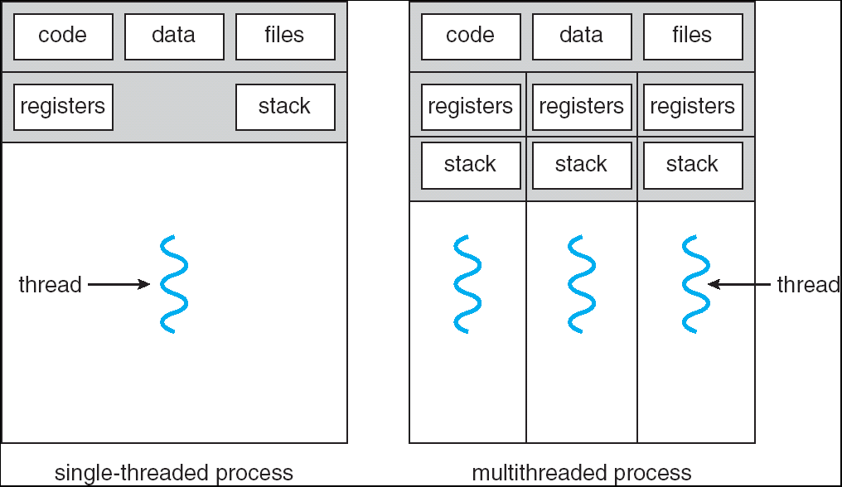
Single and Multithreaded Processes
Notes:
Sometimes need parallelism for a single job, and processes are very expensive – to start, switch between, and to communicate between

Slide 29
Supporting 1T and MT Processes
User
***
System
Notes:
Sometimes need parallelism for a single job, and processes are very expensive – to start, switch between, and to communicate between

Slide 30
Supporting 1T and MT Processes
User
***
***
System
Notes:
Sometimes need parallelism for a single job, and processes are very expensive – to start, switch between, and to communicate between

Slide 31
Classification
One
Many
# of addr spaces:
# threads
Per AS:
One
MS/DOS, early Macintosh
Traditional UNIX
Many
Embedded systems (Geoworks, VxWorks, JavaOS,etc)
JavaOS, Pilot(PC)
Mach, OS/2, Linux
Windows 9x???
Win NT to XP, Solaris, HP-UX, OS X
Real operating systems have either
One or many address spaces
One or many threads per address space
Did Windows 95/98/ME have real memory protection?
No: Users could overwrite process tables/System DLLs

Slide 32
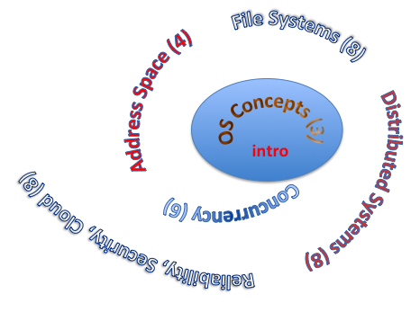
You are here… why?
Processes
Thread(s) + address space
Address Space
Protection
Dual Mode
Interrupt handlers
Interrupts, exceptions, syscall
File System
Integrates processes, users, cwd, protection
Key Layers: OS Lib, Syscall, Subsystem, Driver
User handler on OS descriptors
Process control
fork, wait, signal, exec
Communication through sockets
Integrates processes, protection, file ops, concurrency
Client-Server Protocol
Concurrent Execution: Threads
Scheduling

Slide 33
Perspective on ‘groking’ 162
Historically, OS was the most complex software
Concurrency, synchronization, processes, devices, communication, …
Core systems concepts developed there
Today, many “applications” are complex software systems too
These concepts appear there
But they are realized out of the capabilities provided by the operating system
Seek to understand how these capabilities are implemented upon the basic hardware.
See concepts multiple times from multiple perspectives
Lecture provides conceptual framework, integration, examples, …
Book provides a reference with some additional detail
Lots of other resources that you need to learn to use
man pages, google, reference manuals, includes (.h)
Section, Homework and Project provides detail down to the actual code AND direct hands-on experience

Slide 34
Operating System as Design
Word Processing
Compilers
Web Browsers
Email
Databases
Web Servers
Application / Service
Portable OS Library
OS
User
System Call
Interface
System
Portable OS Kernel
Software
Platform support, Device Drivers
Hardware
x86
PowerPC
ARM
PCI
Ethernet (10/100/1000)
802.11 a/b/g/n
SCSI
IDE
Graphics

Slide 35
Starting today: Pintos Projects
Process 1
Process 2
Process N
Groups almost all formed
Work as one!
10x homework
P1: threads & scheduler
P2: user process
Mem.
Mem.
Mem.
IO
state
IO
state
…
IO
state
CPU
state
CPU
state
CPU
state
CPU sched.
PintOS
CPU
(emulated)

Slide 36
MT Kernel 1T Process ala Pintos/x86
code
data
magic #
list
Kernel
priority
stack
status
User
tid
code
code
data
data
heap
***
heap
User
stack
User
stack
Each user process/thread associated with a kernel thread, described by a 4kb Page object containing TCB and kernel stack for the kernel thread

Slide 37
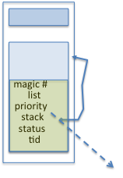
In User thread, w/ k-thread waiting
code
data
magic #
list
Kernel
priority
stack
status
User
tid
code
code
data
data
heap
***
heap
IP
User
stack
User
stack
SP
K SP
Proc Regs
PL: 3
x86 proc holds interrupt SP high system level
During user thread exec, associate kernel thread is “standing by”

Slide 38
In Kernel thread
code
data
magic #
list
Kernel
priority
stack
status
User
tid
code
code
data
data
heap
***
heap
IP
User
stack
User
stack
SP
K SP
Proc Regs
PL: 0
Kernel threads execute with small stack in thread struct
Scheduler selects among ready kernel and user threads

Slide 39
Thread Switch (switch.S)
code
data
magic #
list
Kernel
priority
stack
status
User
tid
code
code
data
data
heap
***
heap
IP
User
stack
User
stack
SP
K SP
Proc Regs
PL: 0
switch_threads: save regs on current small stack, change SP, return from destination threads call to switch_threads

Slide 40
Switch to Kernel Thread for Process
code
data
magic #
list
Kernel
priority
stack
status
User
tid
code
code
data
data
heap
***
heap
IP
User
stack
User
stack
SP
K SP
Proc Regs
PL: 0

Slide 41
Kernel->User
code
data
magic #
list
Kernel
priority
stack
status
User
tid
code
code
data
data
heap
***
heap
IP
User
stack
User
stack
SP
K SP
Proc Regs
PL: 3
iret restores user stack and PL

Slide 42
User->Kernel
code
data
magic #
list
Kernel
priority
stack
status
User
tid
code
code
data
data
heap
***
heap
IP
User
stack
User
stack
SP
K SP
Proc Regs
PL: 0
Mechanism to resume k-thread goes through interrupt vector

Slide 43
User->Kernel via interrupt vector
code
0
data
Kernel
User
code
code
255
intr vector
data
data
heap
***
heap
IP
User
stack
User
stack
SP
K SP
Proc Regs
PL: 3
Interrupt transfers control through the IV (IDT in x86)
iret restores user stack and PL

Slide 44
Pintos Interrupt Processing
stubs
Wrapper for generic handler
***
0
intr_entry:
save regs as frame
set up kernel env.
call intr_handler
intr_exit:
restore regs
iret
push 0x20 (int #)
jmp intr_entry
0x20
push 0x20 (int #)
jmp intr_entry
***
255
Hardware interrupt vector
stubs.S

Slide 45
Recall: cs61C THE STACK FRAME

Slide 46
Pintos Interrupt Processing
interrupt.c
Wrapper for generic handler
Intr_handler(*frame)
- classify
- dispatch
- ack IRQ
- maybe thread yield
stubs
0
***
intr_entry:
save regs as frame
set up kernel env.
call intr_handler
intr_exit:
restore regs
iret
push 0x20 (int #)
jmp intr_entry
0x20
push 0x20 (int #)
jmp intr_entry
timer_intr(*frame)
tick++
thread_tick()
0
***
255
0x20
timer.c
Hardware interrupt vector
stubs.S
Pintos intr_handlers

Slide 47
Timer may trigger thread switch
thread_tick
Updates thread counters
If quanta exhausted, sets yield flag
thread_yield
On path to rtn from interrupt
Sets current thread back to READY
Pushes it back on ready_list
Calls schedule to select next thread to run upon iret
Schedule
Selects next thread to run
Calls switch_threads to change regs to point to stack for thread to resume
Sets its status to RUNNING
If user thread, activates the process
Returns back to intr_handler

Slide 48
Pintos Return from Processing
interrupt.c
Wrapper for generic handler
Intr_handler(*frame)
- classify
- dispatch
- ack IRQ
- maybe thread yield
stubs
0
***
intr_entry:
save regs as frame
set up kernel env.
call intr_handler
intr_exit:
restore regs
iret
push 0x20 (int #)
jmp intr_entry
0x20
push 0x20 (int #)
jmp intr_entry
timer_intr(*frame)
tick++
thread_tick()
0
***
255
0x20
timer.c
Hardware interrupt vector
Hardware interrupt vector
stubs.S
thread_yield()
- schedule
Resume Some Thread
Pintos intr_handlers
schedule()
- switch

Slide 49
Correctness for systems with concurrent threads
If dispatcher can schedule threads in any way, programs must work under all circumstances
Can you test for this?
How can you know if your program works?
Independent Threads:
No state shared with other threads
Deterministic ⇒ Input state determines results
Reproducible ⇒ Can recreate Starting Conditions, I/O
Scheduling order doesn’t matter (if switch() works!!!)
Cooperating Threads:
Shared State between multiple threads
Non-deterministic
Non-reproducible
Non-deterministic and Non-reproducible means that bugs can be intermittent
Sometimes called “Heisenbugs”

Slide 50
Interactions Complicate Debugging
Is any program truly independent?
Every process shares the file system, OS resources, network, etc
Extreme example: buggy device driver causes thread A to crash “independent thread” B
You probably don’t realize how much you depend on reproducibility:
Example: Evil C compiler
Modifies files behind your back by inserting errors into C program unless you insert debugging code
Example: Debugging statements can overrun stack
Non-deterministic errors are really difficult to find
Example: Memory layout of kernel+user programs
depends on scheduling, which depends on timer/other things
Original UNIX had a bunch of non-deterministic errors
Example: Something which does interesting I/O
User typing of letters used to help generate secure keys
Notes:
Adding printf statements can cause stack overruns or changing timing/interleaving
What if non-deterministic error only occurs once a week? You’re pulling all-nighters to find it, your eyelids droop, and whiz, the error happens and you missed it.

Slide 51
Why allow cooperating threads?
People cooperate; computers help/enhance people’s lives, so computers must cooperate
By analogy, the non-reproducibility/non-determinism of people is a notable problem for “carefully laid plans”
Advantage 1: Share resources
One computer, many users
One bank balance, many ATMs
What if ATMs were only updated at night?
Embedded systems (robot control: coordinate arm & hand)
Advantage 2: Speedup
Overlap I/O and computation
Many different file systems do read-ahead
Multiprocessors – chop up program into parallel pieces
Advantage 3: Modularity
More important than you might think
Chop large problem up into simpler pieces
To compile, for instance, gcc calls cpp | cc1 | cc2 | as | ld
Makes system easier to extend

Slide 52
High-level Example: Web Server
Server must handle many requests
Non-cooperating version:
serverLoop() {
con = AcceptCon();
ProcessFork(ServiceWebPage(),con);
}
What are some disadvantages of this technique?
Notes:
Expensive to start new process, heavyweight context switch overhead (changing address spaces)

Slide 53


Threaded Web Server
Now, use a single process
Multithreaded (cooperating) version:
serverLoop() {
connection = AcceptCon();
ThreadFork(ServiceWebPage(),connection);
}
Looks almost the same, but has many advantages:
Can share file caches kept in memory, results of CGI scripts, other things
Threads are much cheaper to create than processes, so this has a lower per-request overhead
Question: would a user-level (say one-to-many) thread package make sense here?
When one request blocks on disk, all block…
What about Denial of Service attacks or digg / Slash-dot effects?

Slide 54
Thread Pools
Problem with previous version: Unbounded Threads
When web-site becomes too popular – throughput sinks
Instead, allocate a bounded “pool” of worker threads, representing the maximum level of multiprogramming
Master
Thread
queue
Thread Pool
master() { allocThreads(worker,queue); while(TRUE) { con=AcceptCon(); Enqueue(queue,con); wakeUp(queue); } }
worker(queue) { while(TRUE) { con=Dequeue(queue); if (con==null) sleepOn(queue); else ServiceWebPage(con); } }

Slide 55
ATM Bank Server
ATM server problem:
Service a set of requests
Do so without corrupting database
Don’t hand out too much money

Slide 56
ATM bank server example
Suppose we wanted to implement a server process to handle requests from an ATM network:
BankServer() { while (TRUE) { ReceiveRequest(&op, &acctId, &amount); ProcessRequest(op, acctId, amount); } }
ProcessRequest(op, acctId, amount) { if (op == deposit) Deposit(acctId, amount); else if … }
Deposit(acctId, amount) { acct = GetAccount(acctId); /* may use disk I/O */ acct->balance += amount; StoreAccount(acct); /* Involves disk I/O */ }
How could we speed this up?
More than one request being processed at once
Event driven (overlap computation and I/O)
Multiple threads (multi-proc, or overlap comp and I/O)

Slide 57
Event Driven Version of ATM server
Suppose we only had one CPU
Still like to overlap I/O with computation
Without threads, we would have to rewrite in event-driven style
Example
BankServer() { while(TRUE) { event = WaitForNextEvent(); if (event == ATMRequest) StartOnRequest(); else if (event == AcctAvail) ContinueRequest(); else if (event == AcctStored) FinishRequest(); } }
What if we missed a blocking I/O step?
What if we have to split code into hundreds of pieces which could be blocking?
This technique is used for graphical programming

Slide 58
Can Threads Make This Easier?
Threads yield overlapped I/O and computation without “deconstructing” code into non-blocking fragments
One thread per request
Requests proceeds to completion, blocking as required:
Deposit(acctId, amount) { acct = GetAccount(actId); /* May use disk I/O */ acct->balance += amount; StoreAccount(acct); /* Involves disk I/O */ }
Unfortunately, shared state can get corrupted: Thread 1 Thread 2 load r1, acct->balance load r1, acct->balance add r1, amount2 store r1, acct->balance add r1, amount1 store r1, acct->balance

Slide 59
Review: Multiprocessing vs Multiprogramming
What does it mean to run two threads “concurrently”?
Scheduler is free to run threads in any order and interleaving: FIFO, Random, …
Dispatcher can choose to run each thread to completion or time-slice in big chunks or small chunks
Also recall: Hyperthreading
Possible to interleave threads on a per-instruction basis
Keep this in mind for our examples (like multiprocessing)
A
Multiprocessing
B
C
A
B
C
Multiprogramming
A
B
C
A
B
C
B

Slide 60
Problem is at the lowest level
Most of the time, threads are working on separate data, so scheduling doesn’t matter:
Thread A Thread B
x = 1; y = 2;
However, What about (Initially, y = 12):
Thread A Thread B
x = 1; y = 2;
x = y+1; y = y*2;
What are the possible values of x?
Or, what are the possible values of x below?
Thread A Thread B
x = 1; x = 2;
X could be 1 or 2 (non-deterministic!)
Could even be 3 for serial processors:
Thread A writes 0001, B writes 0010.
Scheduling order ABABABBA yields 3!
Notes:
X could be (13, 5, 3)

Slide 61
Atomic Operations
To understand a concurrent program, we need to know what the underlying indivisible operations are!
Atomic Operation: an operation that always runs to completion or not at all
It is indivisible: it cannot be stopped in the middle and state cannot be modified by someone else in the middle
Fundamental building block – if no atomic operations, then have no way for threads to work together
On most machines, memory references and assignments (i.e. loads and stores) of words are atomic
Consequently – weird example that produces “3” on previous slide can’t happen
Many instructions are not atomic
Double-precision floating point store often not atomic
VAX and IBM 360 had an instruction to copy a whole array

Slide 62
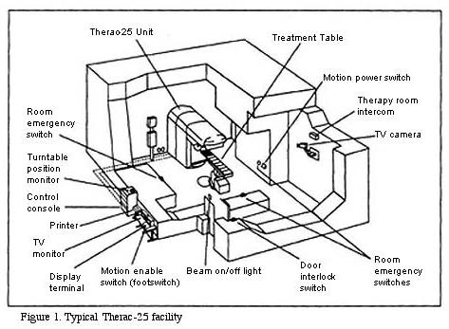
Correctness Requirements
Threaded programs must work for all interleavings of thread instruction sequences
Cooperating threads inherently non-deterministic and non-reproducible
Really hard to debug unless carefully designed!
Example: Therac-25
Machine for radiation therapy
Software control of electron accelerator and electron beam/ Xray production
Software control of dosage
Software errors caused the death of several patients
A series of race conditions on shared variables and poor software design
“They determined that data entry speed during editing was the key factor in producing the error condition: If the prescription data was edited at a fast pace, the overdose occurred.”

Slide 63
Space Shuttle Example
Original Space Shuttle launch aborted 20 minutes before scheduled launch
Shuttle has five computers:
Four run the “Primary Avionics Software System” (PASS)
Asynchronous and real-time
Runs all of the control systems
Results synchronized and compared every 3 to 4 ms
The Fifth computer is the “Backup Flight System” (BFS)
stays synchronized in case it is needed
Written by completely different team than PASS
Countdown aborted because BFS disagreed with PASS
A 1/67 chance that PASS was out of sync one cycle
Bug due to modifications in initialization code of PASS
A delayed init request placed into timer queue
As a result, timer queue not empty at expected time to force use of hardware clock
Bug not found during extensive simulation
PASS
BFS

Slide 64
Another Concurrent Program Example
Two threads, A and B, compete with each other
One tries to increment a shared counter
The other tries to decrement the counter
Thread A Thread B
i = 0; i = 0; while (i < 10) while (i > -10) i = i + 1; i = i – 1; printf(“A wins!”); printf(“B wins!”);
Assume that memory loads and stores are atomic, but incrementing and decrementing are not atomic
Who wins? Could be either
Is it guaranteed that someone wins? Why or why not?
What it both threads have their own CPU running at same speed? Is it guaranteed that it goes on forever?

Slide 65
Hand Simulation Multiprocessor Example
Inner loop looks like this:
Thread A Thread B
r1=0 load r1, M[i]
r1=0 load r1, M[i]
r1=1 add r1, r1, 1
r1=-1 sub r1, r1, 1
M[i]=1 store r1, M[i]
M[i]=-1 store r1, M[i]
Hand Simulation:
And we’re off. A gets off to an early start
B says “hmph, better go fast” and tries really hard
A goes ahead and writes “1”
B goes and writes “-1”
A says “HUH??? I could have sworn I put a 1 there”
Could this happen on a uniprocessor?
Yes! Unlikely, but if you depending on it not happening, it will and your system will break…

Slide 66
Motivation: “Too much milk”
Great thing about OS’s – analogy between problems in OS and problems in real life
Help you understand real life problems better
But, computers are much stupider than people
Example: People need to coordinate:
Time
Person A
Person B
3:00
Look in Fridge. Out of milk
3:05
Leave for store
3:10
Arrive at store
Look in Fridge. Out of milk
3:15
Buy milk
Leave for store
3:20
Arrive home, put milk away
Arrive at store
3:25
Buy milk
3:30
Arrive home, put milk away
Notes:
You’re sitting in class, hot day, milk does a body good. Go home, no milk, so go to store
Roommate leaves class late because prof is more long-winded than I am. Has same idea, but result is too much milk!
Problem: two cooperating threads, not cooperating properly

Slide 67
Definitions
Synchronization: using atomic operations to ensure cooperation between threads
For now, only loads and stores are atomic
We are going to show that its hard to build anything useful with only reads and writes
Mutual Exclusion: ensuring that only one thread does a particular thing at a time
One thread excludes the other while doing its task
Critical Section: piece of code that only one thread can execute at once. Only one thread at a time will get into this section of code.
Critical section is the result of mutual exclusion
Critical section and mutual exclusion are two ways of describing the same thing.

Slide 68
More Definitions
Lock: prevents someone from doing something
Lock before entering critical section and before accessing shared data
Unlock when leaving, after accessing shared data
Wait if locked
Important idea: all synchronization involves waiting
For example: fix the milk problem by putting a key on the refrigerator
Lock it and take key if you are going to go buy milk
Fixes too much: roommate angry if only wants OJ
Of Course – We don’t know how to make a lock yet
#$@%@#$@

Slide 69
Too Much Milk: Correctness Properties
Need to be careful about correctness of concurrent programs, since non-deterministic
Always write down behavior first
Impulse is to start coding first, then when it doesn’t work, pull hair out
Instead, think first, then code
What are the correctness properties for the “Too much milk” problem???
Never more than one person buys
Someone buys if needed
Restrict ourselves to use only atomic load and store operations as building blocks

Slide 70

Too Much Milk: Solution #1
Use a note to avoid buying too much milk:
Leave a note before buying (kind of “lock”)
Remove note after buying (kind of “unlock”)
Don’t buy if note (wait)
Suppose a computer tries this (remember, only memory read/write are atomic):
if (noMilk) { if (noNote) { leave Note; buy milk; remove note; } }
Result?
Still too much milk but only occasionally!
Thread can get context switched after checking milk and note but before buying milk!
Solution makes problem worse since fails intermittently
Makes it really hard to debug…
Must work despite what the dispatcher does!

Slide 71

Too Much Milk: Solution #1½
Clearly the Note is not quite blocking enough
Let’s try to fix this by placing note first
Another try at previous solution:
leave Note;
if (noMilk) { if (noNote) { leave Note; buy milk; } }
remove note;
What happens here?
Well, with human, probably nothing bad
With computer: no one ever buys milk

Slide 72
Too Much Milk Solution #2
How about labeled notes?
Now we can leave note before checking
Algorithm looks like this:
Thread A Thread B
leave note A; leave note B; if (noNote B) { if (noNoteA) { if (noMilk) { if (noMilk) { buy Milk; buy Milk; } } } } remove note A; remove note B;
Does this work?
Possible for neither thread to buy milk
Context switches at exactly the wrong times can lead each to think that the other is going to buy
Really insidious:
Extremely unlikely that this would happen, but will at worse possible time
Probably something like this in UNIX

Slide 73

Too Much Milk Solution #2: problem!
I’m not getting milk, You’re getting milk
This kind of lockup is called “starvation!”

Slide 74
Too Much Milk Solution #3
Here is a possible two-note solution:
Thread A Thread B
leave note A; leave note B; while (note B) { //X if (noNote A) { //Y do nothing; if (noMilk) { } buy milk; if (noMilk) { } buy milk; } } remove note B; remove note A;
Does this work? Yes. Both can guarantee that:
It is safe to buy, or
Other will buy, ok to quit
At X:
if no note B, safe for A to buy,
otherwise wait to find out what will happen
At Y:
if no note A, safe for B to buy
Otherwise, A is either buying or waiting for B to quit

Slide 75
Solution #3 discussion
Our solution protects a single “Critical-Section” piece of code for each thread:
if (noMilk) { buy milk; }
Solution #3 works, but it’s really unsatisfactory
Really complex – even for this simple an example
Hard to convince yourself that this really works
A’s code is different from B’s – what if lots of threads?
Code would have to be slightly different for each thread
While A is waiting, it is consuming CPU time
This is called “busy-waiting”
There’s a better way
Have hardware provide better (higher-level) primitives than atomic load and store
Build even higher-level programming abstractions on this new hardware support

Slide 76
Too Much Milk: Solution #4
Suppose we have some sort of implementation of a lock (more in a moment).
Lock.Acquire() – wait until lock is free, then grab
Lock.Release() – Unlock, waking up anyone waiting
These must be atomic operations – if two threads are waiting for the lock and both see it’s free, only one succeeds to grab the lock
Then, our milk problem is easy:
milklock.Acquire();
if (nomilk)
buy milk;
milklock.Release();
Once again, section of code between Acquire() and Release() called a “Critical Section”
Of course, you can make this even simpler: suppose you are out of ice cream instead of milk
Skip the test since you always need more ice cream.

Slide 77
Where are we going with synchronization?
Programs
Shared Programs
Higher-level
API
Locks Semaphores Monitors Send/Receive
Hardware
Load/Store Disable Ints Test&Set Comp&Swap
We are going to implement various higher-level synchronization primitives using atomic operations
Everything is pretty painful if only atomic primitives are load and store
Need to provide primitives useful at user-level

Slide 78
Summary (1 of 2)
Processes have two parts
Threads (Concurrency)
Address Spaces (Protection)
Concurrency accomplished by multiplexing CPU Time:
Unloading current thread (PC, registers)
Loading new thread (PC, registers)
Such context switching may be voluntary (yield(), I/O operations) or involuntary (timer, other interrupts)
Protection accomplished restricting access:
Memory mapping isolates processes from each other
Dual-mode for isolating I/O, other resources
Various Textbooks talk about processes
When this concerns concurrency, really talking about thread portion of a process
When this concerns protection, talking about address space portion of a process

Slide 79
Summary (2 or 2)
Concurrent threads are a very useful abstraction
Allow transparent overlapping of computation and I/O
Allow use of parallel processing when available
Concurrent threads introduce problems when accessing shared data
Programs must be insensitive to arbitrary interleavings
Without careful design, shared variables can become completely inconsistent
Important concept: Atomic Operations
An operation that runs to completion or not at all
These are the primitives on which to construct various synchronization primitives
Showed how to protect a critical section with only atomic load and store ⇒ pretty complex!

