Slide 1
CS162 Operating Systems and Systems Programming Lecture 8 Semaphores, Monitors, and Readers/Writers
February 18th, 2015
Prof. John Kubiatowicz
http://cs162.eecs.Berkeley.edu

Slide 2
Review: Synchronization problem with Threads
One thread per transaction, each running:
Deposit(acctId, amount) { acct = GetAccount(actId); /* May use disk I/O */ acct->balance += amount; StoreAccount(acct); /* Involves disk I/O */ }
Unfortunately, shared state can get corrupted: Thread 1 Thread 2 load r1, acct->balance load r1, acct->balance add r1, amount2 store r1, acct->balance add r1, amount1 store r1, acct->balance
Atomic Operation: an operation that always runs to completion or not at all
It is indivisible: it cannot be stopped in the middle and state cannot be modified by someone else in the middle

Slide 3
Review: Too Much Milk Solution #3
Here is a possible two-note solution:
Thread A Thread B
leave note A; leave note B; while (note B) {\\X if (noNote A) {\\Y do nothing; if (noMilk) { } buy milk; if (noMilk) { } buy milk; } } remove note B; remove note A;
Does this work? Yes. Both can guarantee that:
It is safe to buy, or
Other will buy, ok to quit
At X:
if no note B, safe for A to buy,
otherwise wait to find out what will happen
At Y:
if no note A, safe for B to buy
Otherwise, A is either buying or waiting for B to quit

Slide 4
Review: Too Much Milk: Solution #4
Suppose we have some sort of implementation of a lock (more in a moment).
Acquire(&mylock) – wait until lock is free, then grab
Release(&mylock) – Unlock, waking up anyone waiting
These must be atomic operations – if two threads are waiting for the lock and both see it’s free, only one succeeds to grab the lock
Then, our milk problem is easy:
Acquire(&milklock);
if (nomilk)
buy milk;
Release(&milklock);
Once again, section of code between Acquire() and Release() called a “Critical Section”
Of course, you can make this even simpler: suppose you are out of ice cream instead of milk
Skip the test since you always need more ice cream.

Slide 5
Goals for Today
Continue with Synchronization Abstractions
Semaphores, Monitors, and Condition variables
Readers-Writers problem and solution
Introduction to scheduling
Note: Some slides and/or pictures in the following are
adapted from slides ©2005 Silberschatz, Galvin, and Gagne
Note: Some slides and/or pictures in the following are
adapted from slides ©2005 Silberschatz, Galvin, and Gagne. Many slides generated from my lecture notes by Kubiatowicz.

Slide 6
Recall: Better Implementation of Locks by Disabling Interrupts
Key idea: maintain a lock variable and impose mutual exclusion only during operations on that variable
Really only works in kernel – why?
int mylock = FREE;
Acquire(&mylock) – wait until lock is free, then grab
Release(&mylock) – Unlock, waking up anyone waiting
Acquire(int *lock) { disable interrupts; if (*lock == BUSY) { put thread on wait queue; Go to sleep(); // Enable interrupts? } else { *lock = BUSY; } enable interrupts; }
Release(int *lock) { disable interrupts; if (anyone on wait queue) { take thread off wait queue Place on ready queue; } else { *lock = FREE; } enable interrupts; }

Slide 7
Recall: How to Re-enable After Sleep()?
Interrupts are disabled when you call sleep:
Responsibility of the next thread to re-enable ints
When the sleeping thread wakes up, returns to acquire and re-enables interrupts
Thread A Thread B
. . disable ints sleep
sleep return enable ints
. . .
disable int sleep
sleep return enable ints . .
Why must Interrupts be disabled during context switch?
context switch
context switch

Slide 8
Review: Examples of Read-Modify-Write
test&set (&address) { /* most architectures */ result = M[address]; M[address] = 1; return result; }
swap (&address, register) { /* x86 */ temp = M[address]; M[address] = register; register = temp; }
compare&swap (&address, reg1, reg2) { /* 68000 */ if (reg1 == M[address]) { M[address] = reg2; return success; } else { return failure; } }
load-linked&store conditional(&address) { /* R4000, alpha */ loop: ll r1, M[address]; movi r2, 1; /* Can do arbitrary comp */ sc r2, M[address]; beqz r2, loop; }

Slide 9
Implementing Locks with test&set
A flawed, but simple solution (that works at user-level!)
int mylock = 0; // Free
Acquire() { while (test&set(&mylock)); // while busy }
Release() { mylock = 0; }
Simple explanation:
If lock is free, test&set reads 0 and sets value=1, so lock is now busy. It returns 0 so while exits.
If lock is busy, test&set reads 1 and sets value=1 (no change). It returns 1, so while loop continues
When we set value = 0, someone else can get lock
Issues with this solution
Busy-Waiting: thread consumes cycles while waiting
Does not take advantage of multi-core/processor caches!

Slide 10
Problem: Busy-Waiting for Lock
Positives for this solution
Machine can receive interrupts
User code can use this lock
Works on a multiprocessor
Negatives
This is very inefficient because the busy-waiting thread will consume cycles waiting
Waiting thread may take cycles away from thread holding lock (no one wins!)
Priority Inversion: If busy-waiting thread has higher priority than thread holding lock ⇒ no progress!
Priority Inversion problem with original Martian rover
For semaphores and monitors, waiting thread may wait for an arbitrary length of time!
Thus even if busy-waiting was OK for locks, definitely not ok for other primitives
Homework/exam solutions should not have busy-waiting!

Slide 11
Multiprocessor Spin Locks: test&test&set
A better solution for multiprocessors:
int mylock = 0; // Free
Acquire() {
do {
while(mylock); // Wait until might be free } while(test&set(&mylock)); // exit if get lock
}
Release() { mylock = 0; }
Simple explanation:
Wait until lock might be free (only reading – stays in cache)
Then, try to grab lock with test&set
Repeat if fail to actually get lock
Issues with this solution:
Busy-Waiting: thread still consumes cycles while waiting
However, it does not impact other processors!

Slide 12
Better Locks using test&set
Can we build test&set locks without busy-waiting?
Can’t entirely, but can minimize!
Idea: only busy-wait to atomically check lock value
Note: sleep has to be sure to reset the guard variable
Why can’t we do it just before or just after the sleep?
int guard = 0;
int mylock = FREE;
Acquire(&mylock) – wait until lock is free, then grab
Release(&mylock) – Unlock, waking up anyone waiting
Acquire(int *lock) {
// Short busy-wait time while (test&set(&guard)); if (*lock == BUSY) {
put thread on wait queue;
go to sleep() & guard = 0; } else { *lock = BUSY; guard = 0; } }
Release(int *lock) { // Short busy-wait time while (test&set(&guard)); if anyone on wait queue { take thread off wait queue Place on ready queue; } else { *lock = FREE; } guard = 0;

Slide 13
Administrivia
First Checkpoint due this Friday 11:59pm PST
Yes this is graded!
Assume design document is high level!
You should think of this as a document for a manager (your TA)
Do your own work!
Please do not try to find solutions from previous terms
We will be look out for this…
Basic semaphores work in PintOS!
However, you will need to implement priority scheduling behavior both in semaphore and ready queue
Still could use more folks in Thursday 12-1 and Friday 10-1 sections!
Much better
Try to attend the section with your project TA…?

Slide 14
Using of Compare&Swap for queues
compare&swap (&address, reg1, reg2) { /* 68000 */ if (reg1 == M[address]) { M[address] = reg2; return success; } else { return failure; } }
Here is an atomic add to linked-list function:
addToQueue(&object) { do { // repeat until no conflict ld r1, M[root] // Get ptr to current head st r1, M[object] // Save link in new object } until (compare&swap(&root,r1,object)); }
root
next
next
next
New
Object

Slide 15
Higher-level Primitives than Locks
Goal of last couple of lectures:
What is the right abstraction for synchronizing threads that share memory?
Want as high a level primitive as possible
Good primitives and practices important!
Since execution is not entirely sequential, really hard to find bugs, since they happen rarely
UNIX is pretty stable now, but up until about mid-80s (10 years after started), systems running UNIX would crash every week or so – concurrency bugs
Synchronization is a way of coordinating multiple concurrent activities that are using shared state
This lecture and the next presents a couple of ways of structuring the sharing

Slide 16
Semaphores
Semaphores are a kind of generalized lock
First defined by Dijkstra in late 60s
Main synchronization primitive used in original UNIX
Definition: a Semaphore has a non-negative integer value and supports the following two operations:
P(): an atomic operation that waits for semaphore to become positive, then decrements it by 1
Think of this as the wait() operation
V(): an atomic operation that increments the semaphore by 1, waking up a waiting P, if any
This of this as the signal() operation
Note that P() stands for “proberen” (to test) and V() stands for “verhogen” (to increment) in Dutch

Slide 17
Semaphores Like Integers Except
Semaphores are like integers, except
No negative values
Only operations allowed are P and V – can’t read or write value, except to set it initially
Operations must be atomic
Two P’s together can’t decrement value below zero
Similarly, thread going to sleep in P won’t miss wakeup from V – even if they both happen at same time
Semaphore from railway analogy
Here is a semaphore initialized to 2 for resource control:
Value=2
Value=1
Value=0
Value=1
Value=0
Value=2

Slide 18
Two Uses of Semaphores
Mutual Exclusion (initial value = 1)
Also called “Binary Semaphore”.
Can be used for mutual exclusion:
semaphore.P(); // Critical section goes here semaphore.V();
Scheduling Constraints (initial value = 0)
Locks are fine for mutual exclusion, but what if you want a thread to wait for something?
Example: suppose you had to implement ThreadJoin which must wait for thread to terminiate:
Initial value of semaphore = 0
ThreadJoin { semaphore.P(); }
ThreadFinish { semaphore.V(); }

Slide 19

Producer-consumer with a bounded buffer
Producer
Consumer
Buffer
Problem Definition
Producer puts things into a shared buffer
Consumer takes them out
Need synchronization to coordinate producer/consumer
Don’t want producer and consumer to have to work in lockstep, so put a fixed-size buffer between them
Need to synchronize access to this buffer
Producer needs to wait if buffer is full
Consumer needs to wait if buffer is empty
Example 1: GCC compiler
cpp | cc1 | cc2 | as | ld
Example 2: Coke machine
Producer can put limited number of cokes in machine
Consumer can’t take cokes out if machine is empty

Slide 20
Correctness constraints for solution
Correctness Constraints:
Consumer must wait for producer to fill buffers, if none full (scheduling constraint)
Producer must wait for consumer to empty buffers, if all full (scheduling constraint)
Only one thread can manipulate buffer queue at a time (mutual exclusion)
Remember why we need mutual exclusion
Because computers are stupid
Imagine if in real life: the delivery person is filling the machine and somebody comes up and tries to stick their money into the machine
General rule of thumb: Use a separate semaphore for each constraint
Semaphore fullBuffers; // consumer’s constraint
Semaphore emptyBuffers;// producer’s constraint
Semaphore mutex; // mutual exclusion

Slide 21
Full Solution to Bounded Buffer
Semaphore fullBuffer = 0; // Initially, no coke
Semaphore emptyBuffers = numBuffers; // Initially, num empty slots
Semaphore mutex = 1; // No one using machine
Producer(item) { emptyBuffers.P(); // Wait until space mutex.P(); // Wait until buffer free Enqueue(item); mutex.V(); fullBuffers.V(); // Tell consumers there is // more coke }
Consumer() { fullBuffers.P(); // Check if there’s a coke mutex.P(); // Wait until machine free item = Dequeue(); mutex.V(); emptyBuffers.V(); // tell producer need more return item; }

Slide 22
Discussion about Solution
Why asymmetry?
Producer does: emptyBuffer.P(), fullBuffer.V()
Consumer does: fullBuffer.P(), emptyBuffer.V()
Is order of P’s important?
Yes! Can cause deadlock:
Producer(item) { mutex.P(); // Wait until buffer free
emptyBuffers.P(); // Could wait forever! Enqueue(item); mutex.V(); fullBuffers.V(); // Tell consumers more coke }
Is order of V’s important?
No, except that it might affect scheduling efficiency
What if we have 2 producers or 2 consumers?
Do we need to change anything?

Slide 23
Motivation for Monitors and Condition Variables
Semaphores are a huge step up, but:
They are confusing because they are dual purpose:
Both mutual exclusion and scheduling constraints
Example: the fact that flipping of P’s in bounded buffer gives deadlock is not immediately obvious
Cleaner idea: Use locks for mutual exclusion and condition variables for scheduling constraints
Definition: Monitor: a lock and zero or more condition variables for managing concurrent access to shared data
Use of Monitors is a programming paradigm
Some languages like Java provide monitors in the language
The lock provides mutual exclusion to shared data:
Always acquire before accessing shared data structure
Always release after finishing with shared data
Lock initially free

Slide 24
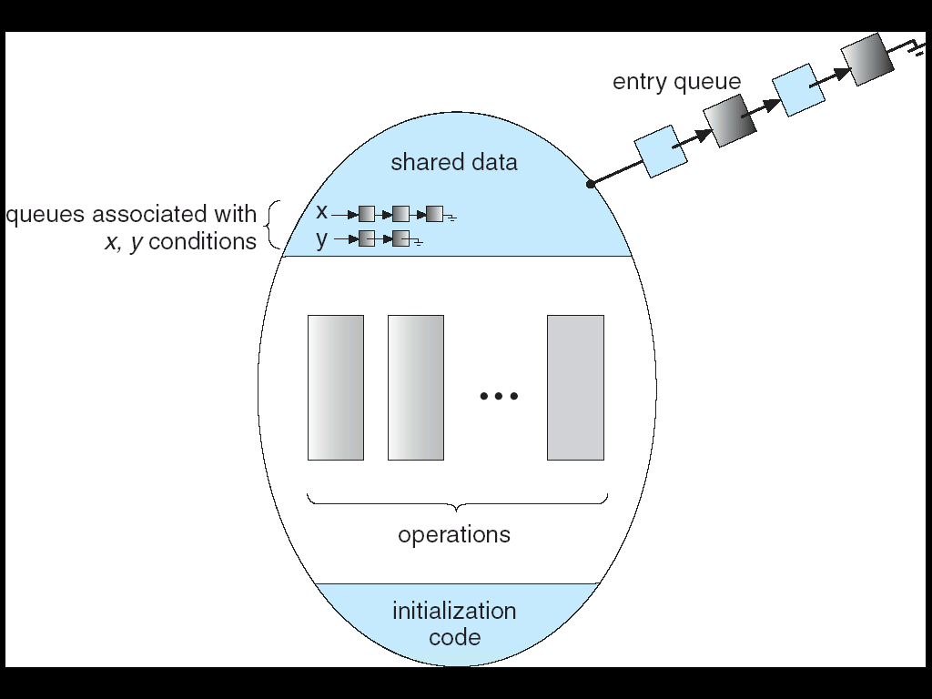
Monitor with Condition Variables
Lock: the lock provides mutual exclusion to shared data
Always acquire before accessing shared data structure
Always release after finishing with shared data
Lock initially free
Condition Variable: a queue of threads waiting for something inside a critical section
Key idea: make it possible to go to sleep inside critical section by atomically releasing lock at time we go to sleep
Contrast to semaphores: Can’t wait inside critical section

Slide 25
Simple Monitor Example (version 1)
Here is an (infinite) synchronized queue
Lock lock; Queue queue;
AddToQueue(item) { lock.Acquire(); // Lock shared data queue.enqueue(item); // Add item lock.Release(); // Release Lock }
RemoveFromQueue() { lock.Acquire(); // Lock shared data item = queue.dequeue();// Get next item or null lock.Release(); // Release Lock return(item); // Might return null }
Not very interesting use of “Monitor”
It only uses a lock with no condition variables
Cannot put consumer to sleep if no work!

Slide 26
Condition Variables
How do we change the RemoveFromQueue() routine to wait until something is on the queue?
Could do this by keeping a count of the number of things on the queue (with semaphores), but error prone
Condition Variable: a queue of threads waiting for something inside a critical section
Key idea: allow sleeping inside critical section by atomically releasing lock at time we go to sleep
Contrast to semaphores: Can’t wait inside critical section
Operations:
Wait(&lock): Atomically release lock and go to sleep. Re-acquire lock later, before returning.
Signal(): Wake up one waiter, if any
Broadcast(): Wake up all waiters
Rule: Must hold lock when doing condition variable ops!
In Birrell paper, he says can perform signal() outside of lock – IGNORE HIM (this is only an optimization)

Slide 27
Complete Monitor Example (with condition variable)
Here is an (infinite) synchronized queue
Lock lock; Condition dataready; Queue queue;
AddToQueue(item) { lock.Acquire(); // Get Lock queue.enqueue(item); // Add item dataready.signal(); // Signal any waiters lock.Release(); // Release Lock }
RemoveFromQueue() { lock.Acquire(); // Get Lock while (queue.isEmpty()) { dataready.wait(&lock); // If nothing, sleep } item = queue.dequeue(); // Get next item lock.Release(); // Release Lock return(item); }

Slide 28
Mesa vs. Hoare monitors
Need to be careful about precise definition of signal and wait. Consider a piece of our dequeue code:
while (queue.isEmpty()) { dataready.wait(&lock); // If nothing, sleep } item = queue.dequeue(); // Get next item
Why didn’t we do this?
if (queue.isEmpty()) { dataready.wait(&lock); // If nothing, sleep } item = queue.dequeue(); // Get next item
Answer: depends on the type of scheduling
Hoare-style (most textbooks):
Signaler gives lock, CPU to waiter; waiter runs immediately
Waiter gives up lock, processor back to signaler when it exits critical section or if it waits again
Mesa-style (most real operating systems):
Signaler keeps lock and processor
Waiter placed on ready queue with no special priority
Practically, need to check condition again after wait

Slide 29
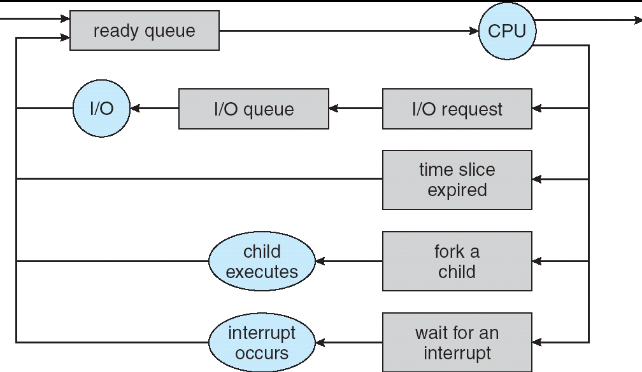
Recall: CPU Scheduling
Earlier, we talked about the life-cycle of a thread
Active threads work their way from Ready queue to Running to various waiting queues.
Question: How is the OS to decide which of several tasks to take off a queue?
Obvious queue to worry about is ready queue
Others can be scheduled as well, however
Scheduling: deciding which threads are given access to resources from moment to moment

Slide 30
Scheduling Assumptions
CPU scheduling big area of research in early 70’s
Many implicit assumptions for CPU scheduling:
One program per user
One thread per program
Programs are independent
Clearly, these are unrealistic but they simplify the problem so it can be solved
For instance: is “fair” about fairness among users or programs?
If I run one compilation job and you run five, you get five times as much CPU on many operating systems
The high-level goal: Dole out CPU time to optimize some desired parameters of system
USER1
USER2
USER3
USER1
USER2
Time

Slide 31
Scheduling Policy Goals/Criteria
Minimize Response Time
Minimize elapsed time to do an operation (or job)
Response time is what the user sees:
Time to echo a keystroke in editor
Time to compile a program
Real-time Tasks: Must meet deadlines imposed by World
Maximize Throughput
Maximize operations (or jobs) per second
Throughput related to response time, but not identical:
Minimizing response time will lead to more context switching than if you only maximized throughput
Two parts to maximizing throughput
Minimize overhead (for example, context-switching)
Efficient use of resources (CPU, disk, memory, etc)
Fairness
Share CPU among users in some equitable way
Fairness is not minimizing average response time:
Better average response time by making system less fair
Notes:
What does CPU scheduling have to do with efficient use of the disk?
A lot! Have to have the CPU to make a disk request
Fairness: Minimize # of angry phone calls? Minimize my response time?

Slide 32
First-Come, First-Served (FCFS) Scheduling
First-Come, First-Served (FCFS)
Also “First In, First Out” (FIFO) or “Run until done”
In early systems, FCFS meant one program scheduled until done (including I/O)
Now, means keep CPU until thread blocks
Example: Process Burst Time P₁ 24 P₂ 3 P₃ 3
Suppose processes arrive in the order: P₁ , P₂ , P₃ The Gantt Chart for the schedule is:
Waiting time for P₁ = 0; P₂ = 24; P₃ = 27
Average waiting time: (0 + 24 + 27)/3 = 17
Average Completion time: (24 + 27 + 30)/3 = 27
Convoy effect: short process behind long process
P₁
P₂
P₃
0
24
27
30

Slide 33
FCFS Scheduling (Cont.)
Example continued:
Suppose that processes arrive in order: P₂ , P₃ , P₁ Now, the Gantt chart for the schedule is:
Waiting time for P₁ = 6; P₂ = 0; P₃ = 3
Average waiting time: (6 + 0 + 3)/3 = 3
Average Completion time: (3 + 6 + 30)/3 = 13
In second case:
average waiting time is much better (before it was 17)
Average completion time is better (before it was 27)
FIFO Pros and Cons:
Simple (+)
Short jobs get stuck behind long ones (-)
Safeway: Getting milk, always stuck behind cart full of small items. Upside: get to read about space aliens!
P₂
P₃
P₁
0
3
6
30

Slide 34
Round Robin (RR)
FCFS Scheme: Potentially bad for short jobs!
Depends on submit order
If you are first in line at supermarket with milk, you don’t care who is behind you, on the other hand…
Round Robin Scheme
Each process gets a small unit of CPU time (time quantum), usually 10-100 milliseconds
After quantum expires, the process is preempted and added to the end of the ready queue.
n processes in ready queue and time quantum is q ⇒
Each process gets 1/n of the CPU time
In chunks of at most q time units
No process waits more than (n-1)q time units
Performance
q large ⇒ FCFS
q small ⇒ Interleaved (really small ⇒ hyperthreading?)
q must be large with respect to context switch, otherwise overhead is too high (all overhead)

Slide 35
Example of RR with Time Quantum = 20
Example: Process Burst Time P₁ 53 P₂ 8 P₃ 68 P₄ 24
The Gantt chart is:
Waiting time for P₁=(68-20)+(112-88)=72 P₂=(20-0)=20 P₃=(28-0)+(88-48)+(125-108)=85 P₄=(48-0)+(108-68)=88
Average waiting time = (72+20+85+88)/4=66¼
Average completion time = (125+28+153+112)/4 = 104½
Thus, Round-Robin Pros and Cons:
Better for short jobs, Fair (+)
Context-switching time adds up for long jobs (-)
P₁
P₂
P₃
P₄
P₁
P₃
P₄
P₁
P₃
P₃
0
20
28
48
68
88
108
112
125
145
153

Slide 36
Round-Robin Discussion
How do you choose time slice?
What if too big?
Response time suffers
What if infinite (∞)?
Get back FIFO
What if time slice too small?
Throughput suffers!
Actual choices of timeslice:
Initially, UNIX timeslice one second:
Worked ok when UNIX was used by one or two people.
What if three compilations going on? 3 seconds to echo each keystroke!
In practice, need to balance short-job performance and long-job throughput:
Typical time slice today is between 10ms – 100ms
Typical context-switching overhead is 0.1ms – 1ms
Roughly 1% overhead due to context-switching

Slide 37
Comparisons between FCFS and Round Robin
Assuming zero-cost context-switching time, is RR always better than FCFS?
Simple example: 10 jobs, each take 100s of CPU time RR scheduler quantum of 1s All jobs start at the same time
Completion Times:
Both RR and FCFS finish at the same time
Average response time is much worse under RR!
Bad when all jobs same length
Also: Cache state must be shared between all jobs with RR but can be devoted to each job with FIFO
Total time for RR longer even for zero-cost switch!
Job # | FIFO | RR
1 | 100 | 991
2 | 200 | 992
… | … | …
9 | 900 | 999
10 | 1000 | 1000

Slide 38
Earlier Example with Different Time Quantum
P₂
[8]
P₄
[24]
P₁
[53]
P₃
[68]
Best FCFS:
0
8
32
85
153
Quantum
P₁
P₂
P₃
P₄
Average
Wait
Time
Best FCFS
32
0
85
8
31¼
Q = 1
84
22
85
57
62
Q = 5
82
20
85
58
61¼
Q = 8
80
8
85
56
57¼
Q = 10
82
10
85
68
61¼
Q = 20
72
20
85
88
66¼
Worst FCFS
68
145
0
121
83½
Completion
Time
Best FCFS
85
8
153
32
69½
Q = 1
137
30
153
81
100½
Q = 5
135
28
153
82
99½
Q = 8
133
16
153
80
95½
Q = 10
135
18
153
92
99½
Q = 20
125
28
153
112
104½
Worst FCFS
121
153
68
145
121¾

Slide 39
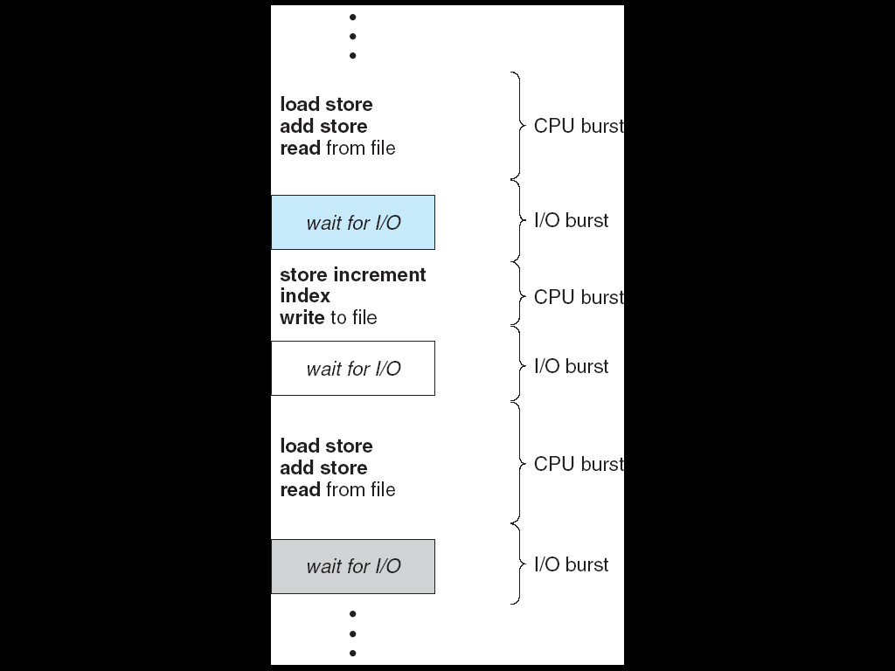
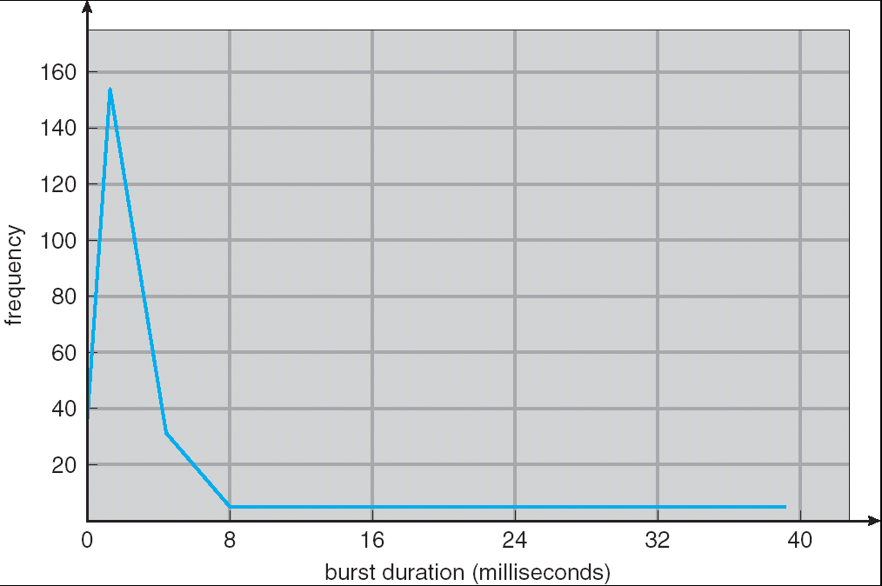
Assumption: CPU Bursts
Weighted toward small bursts
Execution model: programs alternate between bursts of CPU and I/O
Program typically uses the CPU for some period of time, then does I/O, then uses CPU again
Each scheduling decision is about which job to give to the CPU for use by its next CPU burst
With timeslicing, thread may be forced to give up CPU before finishing current CPU burst

Slide 40
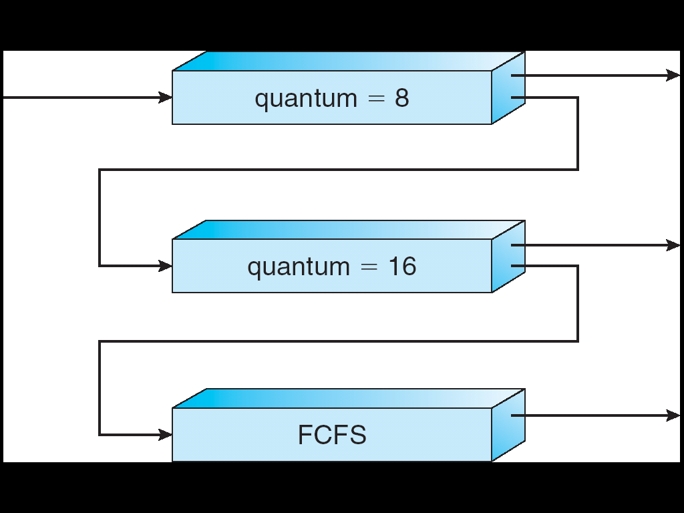
First peak at responsiveness scheduler: Multi-Level Feedback Scheduling
A method for exploiting past behavior
First used in CTSS
Multiple queues, each with different priority
Higher priority queues often considered “foreground” tasks
Each queue has its own scheduling algorithm
e.g. foreground – RR, background – FCFS
Sometimes multiple RR priorities with quantum increasing exponentially (highest:1ms, next:2ms, next: 4ms, etc)
Adjust each job’s priority as follows (details vary)
Job starts in highest priority queue
If timeout expires, drop one level
If timeout doesn’t expire, push up one level (or to top)
Long-Running Compute Tasks Demoted to Low Priority

Slide 41
Break

Slide 42
Extended example: Readers/Writers Problem
W
R
R
R
Motivation: Consider a shared database
Two classes of users:
Readers – never modify database
Writers – read and modify database
Is using a single lock on the whole database sufficient?
Like to have many readers at the same time
Only one writer at a time

Slide 43
Basic Readers/Writers Solution
Correctness Constraints:
Readers can access database when no writers
Writers can access database when no readers or writers
Only one thread manipulates state variables at a time
Basic structure of a solution:
Reader() Wait until no writers Access data base Check out – wake up a waiting writer
Writer() Wait until no active readers or writers Access database Check out – wake up waiting readers or writer
State variables (Protected by a lock called “lock”):
int AR: Number of active readers; initially = 0
int WR: Number of waiting readers; initially = 0
int AW: Number of active writers; initially = 0
int WW: Number of waiting writers; initially = 0
Condition okToRead = NIL
Conditioin okToWrite = NIL

Slide 44
Code for a Reader
Reader() { // First check self into system lock.Acquire();
while ((AW + WW) > 0) { // Is it safe to read? WR++; // No. Writers exist okToRead.wait(&lock); // Sleep on cond var WR--; // No longer waiting }
AR++; // Now we are active! lock.release();
// Perform actual read-only access AccessDatabase(ReadOnly);
// Now, check out of system lock.Acquire(); AR--; // No longer active if (AR == 0 && WW > 0) // No other active readers okToWrite.signal(); // Wake up one writer lock.Release(); }
Why Release the Lock here?

Slide 45
Code for a Writer
Writer() { // First check self into system lock.Acquire();
while ((AW + AR) > 0) { // Is it safe to write? WW++; // No. Active users exist okToWrite.wait(&lock); // Sleep on cond var WW--; // No longer waiting }
AW++; // Now we are active! lock.release();
// Perform actual read/write access AccessDatabase(ReadWrite);
// Now, check out of system lock.Acquire(); AW--; // No longer active if (WW > 0){ // Give priority to writers okToWrite.signal(); // Wake up one writer } else if (WR > 0) { // Otherwise, wake reader okToRead.broadcast(); // Wake all readers } lock.Release(); }
Why Give priority to writers?
Why broadcast() here instead of signal()?

Slide 46
Simulation of Readers/Writers solution
Consider the following sequence of operators:
R1, R2, W1, R3
On entry, each reader checks the following:
while ((AW + WW) > 0) { // Is it safe to read? WR++; // No. Writers exist okToRead.wait(&lock); // Sleep on cond var WR--; // No longer waiting }
AR++; // Now we are active!
First, R1 comes along: AR = 1, WR = 0, AW = 0, WW = 0
Next, R2 comes along: AR = 2, WR = 0, AW = 0, WW = 0
Now, readers make take a while to access database
Situation: Locks released
Only AR is non-zero

Slide 47
Simulation(2)
Next, W1 comes along: while ((AW + AR) > 0) { // Is it safe to write? WW++; // No. Active users exist okToWrite.wait(&lock); // Sleep on cond var WW--; // No longer waiting }
AW++;
Can’t start because of readers, so go to sleep:
AR = 2, WR = 0, AW = 0, WW = 1
Finally, R3 comes along: AR = 2, WR = 1, AW = 0, WW = 1
Now, say that R2 finishes before R1: AR = 1, WR = 1, AW = 0, WW = 1
Finally, last of first two readers (R1) finishes and wakes up writer:
if (AR == 0 && WW > 0) // No other active readers okToWrite.signal(); // Wake up one writer

Slide 48
Simulation(3)
When writer wakes up, get: AR = 0, WR = 1, AW = 1, WW = 0
Then, when writer finishes:
if (WW > 0){ // Give priority to writers okToWrite.signal(); // Wake up one writer } else if (WR > 0) { // Otherwise, wake reader okToRead.broadcast(); // Wake all readers }
Writer wakes up reader, so get:
AR = 1, WR = 0, AW = 0, WW = 0
When reader completes, we are finished

Slide 49
Questions
Can readers starve? Consider Reader() entry code:
while ((AW + WW) > 0) { // Is it safe to read? WR++; // No. Writers exist okToRead.wait(&lock); // Sleep on cond var WR--; // No longer waiting }
AR++; // Now we are active!
What if we erase the condition check in Reader exit?
AR--; // No longer active if (AR == 0 && WW > 0) // No other active readers okToWrite.signal(); // Wake up one writer
Further, what if we turn the signal() into broadcast()
AR--; // No longer active okToWrite.broadcast(); // Wake up one writer
Finally, what if we use only one condition variable (call it “okToContinue”) instead of two separate ones?
Both readers and writers sleep on this variable
Must use broadcast() instead of signal()

Slide 50
Can we construct Monitors from Semaphores?
Locking aspect is easy: Just use a mutex
Can we implement condition variables this way?
Wait() { semaphore.P(); }
Signal() { semaphore.V(); }
Doesn’t work: Wait() may sleep with lock held
Does this work better?
Wait(Lock lock) { lock.Release(); semaphore.P(); lock.Acquire(); } Signal() { semaphore.V(); }
No: Condition vars have no history, semaphores have history:
What if thread signals and no one is waiting? NO-OP
What if thread later waits? Thread Waits
What if thread V’s and noone is waiting? Increment
What if thread later does P? Decrement and continue

Slide 51
Construction of Monitors from Semaphores (con’t)
Problem with previous try:
P and V are commutative – result is the same no matter what order they occur
Condition variables are NOT commutative
Does this fix the problem?
Wait(Lock lock) { lock.Release(); semaphore.P(); lock.Acquire(); } Signal() { if semaphore queue is not empty semaphore.V(); }
Not legal to look at contents of semaphore queue
There is a race condition – signaler can slip in after lock release and before waiter executes semaphore.P()
It is actually possible to do this correctly
Complex solution for Hoare scheduling in book
Can you come up with simpler Mesa-scheduled solution?

Slide 52
Monitor Conclusion
Monitors represent the logic of the program
Wait if necessary
Signal when change something so any waiting threads can proceed
Basic structure of monitor-based program:
lock while (need to wait) { condvar.wait(); } unlock do something so no need to wait lock
condvar.signal();
unlock
Check and/or update state variables
Wait if necessary
Check and/or update
state variables

Slide 53
C-Language Support for Synchronization
C language: Pretty straightforward synchronization
Just make sure you know all the code paths out of a critical section
int Rtn() { lock.acquire(); … if (exception) { lock.release(); return errReturnCode; } … lock.release(); return OK; }
Watch out for setjmp/longjmp!
Can cause a non-local jump out of procedure
In example, procedure E calls longjmp, poping stack back to procedure B
If Procedure C had lock.acquire, problem!
Proc A
Proc B
Calls setjmp
Stack growth
Proc C
lock.acquire
Proc D
Proc E
Calls longjmp

Slide 54
C++ Language Support for Synchronization
Languages with exceptions like C++
Languages that support exceptions are problematic (easy to make a non-local exit without releasing lock)
Consider:
void Rtn() { lock.acquire(); … DoFoo(); … lock.release(); } void DoFoo() { … if (exception) throw errException; … }
Notice that an exception in DoFoo() will exit without releasing the lock

Slide 55
C++ Language Support for Synchronization (con’t)
Must catch all exceptions in critical sections
Catch exceptions, release lock, and re-throw exception: void Rtn() { lock.acquire(); try { … DoFoo(); … } catch (…) { // catch exception lock.release(); // release lock throw; // re-throw the exception } lock.release(); } void DoFoo() { … if (exception) throw errException; … }
Even Better: auto_ptr<T> facility. See C++ Spec.
Can deallocate/free lock regardless of exit method

Slide 56
Java Language Support for Synchronization
Java has explicit support for threads and thread synchronization
Bank Account example: class Account { private int balance; // object constructor public Account (int initialBalance) { balance = initialBalance; } public synchronized int getBalance() { return balance; } public synchronized void deposit(int amount) { balance += amount; } }
Every object has an associated lock which gets automatically acquired and released on entry and exit from a synchronized method.

Slide 57
Java Language Support for Synchronization (con’t)
Java also has synchronized statements:
synchronized (object) { … }
Since every Java object has an associated lock, this type of statement acquires and releases the object’s lock on entry and exit of the body
Works properly even with exceptions:
synchronized (object) { … DoFoo(); … } void DoFoo() { throw errException; }

Slide 58
Java Language Support for Synchronization (con’t 2)
In addition to a lock, every object has a single condition variable associated with it
How to wait inside a synchronization method of block:
void wait(long timeout); // Wait for timeout
void wait(long timeout, int nanoseconds); //variant
void wait();
How to signal in a synchronized method or block:
void notify(); // wakes up oldest waiter
void notifyAll(); // like broadcast, wakes everyone
Condition variables can wait for a bounded length of time. This is useful for handling exception cases:
t1 = time.now(); while (!ATMRequest()) { wait (CHECKPERIOD); t2 = time.new(); if (t2 – t1 > LONG_TIME) checkMachine(); }
Not all Java VMs equivalent!
Different scheduling policies, not necessarily preemptive!

Slide 59
Summary
Semaphores: Like integers with restricted interface
Two operations:
P(): Wait if zero; decrement when becomes non-zero
V(): Increment and wake a sleeping task (if exists)
Can initialize value to any non-negative value
Use separate semaphore for each constraint
Monitors: A lock plus one or more condition variables
Always acquire lock before accessing shared data
Use condition variables to wait inside critical section
Three Operations: Wait(), Signal(), and Broadcast()
Scheduling: selecting a waiting process from the ready queue and allocating the CPU to it
FCFS Scheduling:
Run threads to completion in order of submission
Pros: Simple
Cons: Short jobs get stuck behind long ones
Round-Robin Scheduling:
Give each thread a small amount of CPU time when it executes; cycle between all ready threads
Pros: Better for short jobs
Cons: Poor when jobs are same length

