Slide 1
CS162 Operating Systems and Systems Programming Lecture 9 Readers/Writers example, Scheduling
February 23rd, 2015
Prof. John Kubiatowicz
http://cs162.eecs.Berkeley.edu

Slide 2
Review: Semaphores
Definition: a Semaphore has a non-negative integer value and supports the following two operations:
P(): an atomic operation that waits for semaphore to become positive, then decrements it by 1
Think of this as the wait() operation
V(): an atomic operation that increments the semaphore by 1, waking up a waiting P, if any
This of this as the signal() operation
Only time can set integer directly is at initialization time
Semaphore from railway analogy
Here is a semaphore initialized to 2 for resource control:
Value=2
Value=1
Value=0
Value=1
Value=0
Value=2

Slide 3
Review: Full Solution to Bounded Buffer
Semaphore fullBuffer = 0; // Initially, no coke
Semaphore emptyBuffers = numBuffers; // Initially, num empty slots
Semaphore mutex = 1; // No one using machine
Producer(item) { emptyBuffers.P(); // Wait until space mutex.P(); // Wait until buffer free Enqueue(item); mutex.V(); fullBuffers.V(); // Tell consumers there is // more coke }
Consumer() { fullBuffers.P(); // Check if there’s a coke mutex.P(); // Wait until machine free item = Dequeue(); mutex.V(); emptyBuffers.V(); // tell producer need more return item; }

Slide 4
Monitors and Condition Variables
Monitor: a lock and zero or more condition variables for managing concurrent access to shared data
Use of Monitors is a programming paradigm
Some languages like Java provide monitors in the language
Condition Variable: a queue of threads waiting for something inside a critical section
Key idea: allow sleeping inside critical section by atomically releasing lock at time we go to sleep
Contrast to semaphores: Can’t wait inside critical section
Operations:
Wait(&lock): Atomically release lock and go to sleep. Re-acquire lock later, before returning.
Signal(): Wake up one waiter, if any
Broadcast(): Wake up all waiters
Rule: Must hold lock when doing condition variable ops!
In Birrell paper, he says can perform signal() outside of lock – IGNORE HIM (this is only an optimization)

Slide 5
Complete Monitor Example (with condition variable)
Here is an (infinite) synchronized queue
Lock lock; Condition dataready; Queue queue;
AddToQueue(item) { lock.Acquire(); // Get Lock queue.enqueue(item); // Add item dataready.signal(); // Signal any waiters lock.Release(); // Release Lock }
RemoveFromQueue() { lock.Acquire(); // Get Lock while (queue.isEmpty()) { dataready.wait(&lock); // If nothing, sleep } item = queue.dequeue(); // Get next item lock.Release(); // Release Lock return(item); }

Slide 6
Recall: Mesa vs. Hoare monitors
Need to be careful about precise definition of signal and wait. Consider a piece of our dequeue code:
while (queue.isEmpty()) { dataready.wait(&lock); // If nothing, sleep } item = queue.dequeue(); // Get next item
Why didn’t we do this?
if (queue.isEmpty()) { dataready.wait(&lock); // If nothing, sleep } item = queue.dequeue(); // Get next item
Answer: depends on the type of scheduling
Hoare-style (most textbooks):
Signaler gives lock, CPU to waiter; waiter runs immediately
Waiter gives up lock, processor back to signaler when it exits critical section or if it waits again
Mesa-style (most real operating systems):
Signaler keeps lock and processor
Waiter placed on ready queue with no special priority
Practically, need to check condition again after wait

Slide 7
Extended example: Readers/Writers Problem
W
R
R
R
Motivation: Consider a shared database
Two classes of users:
Readers – never modify database
Writers – read and modify database
Is using a single lock on the whole database sufficient?
Like to have many readers at the same time
Only one writer at a time

Slide 8
Basic Readers/Writers Solution
Correctness Constraints:
Readers can access database when no writers
Writers can access database when no readers or writers
Only one thread manipulates state variables at a time
Basic structure of a solution:
Reader() Wait until no writers Access data base Check out – wake up a waiting writer
Writer() Wait until no active readers or writers Access database Check out – wake up waiting readers or writer
State variables (Protected by a lock called “lock”):
int AR: Number of active readers; initially = 0
int WR: Number of waiting readers; initially = 0
int AW: Number of active writers; initially = 0
int WW: Number of waiting writers; initially = 0
Condition okToRead = NIL
Conditioin okToWrite = NIL

Slide 9
Code for a Reader
Reader() { // First check self into system lock.Acquire();
while ((AW + WW) > 0) { // Is it safe to read? WR++; // No. Writers exist okToRead.wait(&lock); // Sleep on cond var WR--; // No longer waiting }
AR++; // Now we are active! lock.release();
// Perform actual read-only access AccessDatabase(ReadOnly);
// Now, check out of system lock.Acquire(); AR--; // No longer active if (AR == 0 && WW > 0) // No other active readers okToWrite.signal(); // Wake up one writer lock.Release(); }
Why Release the Lock here?

Slide 10
Code for a Writer
Writer() { // First check self into system lock.Acquire();
while ((AW + AR) > 0) { // Is it safe to write? WW++; // No. Active users exist okToWrite.wait(&lock); // Sleep on cond var WW--; // No longer waiting }
AW++; // Now we are active! lock.release();
// Perform actual read/write access AccessDatabase(ReadWrite);
// Now, check out of system lock.Acquire(); AW--; // No longer active if (WW > 0){ // Give priority to writers okToWrite.signal(); // Wake up one writer } else if (WR > 0) { // Otherwise, wake reader okToRead.broadcast(); // Wake all readers } lock.Release(); }
Why Give priority to writers?
Why broadcast() here instead of signal()?

Slide 11
Simulation of Readers/Writers solution
Consider the following sequence of operators:
R1, R2, W1, R3
On entry, each reader checks the following:
while ((AW + WW) > 0) { // Is it safe to read? WR++; // No. Writers exist okToRead.wait(&lock); // Sleep on cond var WR--; // No longer waiting }
AR++; // Now we are active!
First, R1 comes along: AR = 1, WR = 0, AW = 0, WW = 0
Next, R2 comes along: AR = 2, WR = 0, AW = 0, WW = 0
Now, readers make take a while to access database
Situation: Locks released
Only AR is non-zero

Slide 12
Simulation(2)
Next, W1 comes along: while ((AW + AR) > 0) { // Is it safe to write? WW++; // No. Active users exist okToWrite.wait(&lock); // Sleep on cond var WW--; // No longer waiting }
AW++;
Can’t start because of readers, so go to sleep:
AR = 2, WR = 0, AW = 0, WW = 1
Finally, R3 comes along: AR = 2, WR = 1, AW = 0, WW = 1
Now, say that R2 finishes before R1: AR = 1, WR = 1, AW = 0, WW = 1
Finally, last of first two readers (R1) finishes and wakes up writer:
if (AR == 0 && WW > 0) // No other active readers okToWrite.signal(); // Wake up one writer

Slide 13
Simulation(3)
When writer wakes up, get: AR = 0, WR = 1, AW = 1, WW = 0
Then, when writer finishes:
if (WW > 0){ // Give priority to writers okToWrite.signal(); // Wake up one writer } else if (WR > 0) { // Otherwise, wake reader okToRead.broadcast(); // Wake all readers }
Writer wakes up reader, so get:
AR = 1, WR = 0, AW = 0, WW = 0
When reader completes, we are finished

Slide 14
Questions
Can readers starve? Consider Reader() entry code:
while ((AW + WW) > 0) { // Is it safe to read? WR++; // No. Writers exist okToRead.wait(&lock); // Sleep on cond var WR--; // No longer waiting }
AR++; // Now we are active!
What if we erase the condition check in Reader exit?
AR--; // No longer active if (AR == 0 && WW > 0) // No other active readers okToWrite.signal(); // Wake up one writer
Further, what if we turn the signal() into broadcast()
AR--; // No longer active okToWrite.broadcast(); // Wake up one writer
Finally, what if we use only one condition variable (call it “okToContinue”) instead of two separate ones?
Both readers and writers sleep on this variable
Must use broadcast() instead of signal()

Slide 15
Administrivia
Midterm coming up soon
Currently scheduled for Wednesday 3/11
Still working out the details
Intend this to be a 1.5-2 hour exam in 3 hour slot
Topics will include the material from that Monday
No class that day, extra office hours

Slide 16
Can we construct Monitors from Semaphores?
Locking aspect is easy: Just use a mutex
Can we implement condition variables this way?
Wait() { semaphore.P(); }
Signal() { semaphore.V(); }
Doesn’t work: Wait() may sleep with lock held
Does this work better?
Wait(Lock lock) { lock.Release(); semaphore.P(); lock.Acquire(); } Signal() { semaphore.V(); }
No: Condition vars have no history, semaphores have history:
What if thread signals and no one is waiting? NO-OP
What if thread later waits? Thread Waits
What if thread V’s and noone is waiting? Increment
What if thread later does P? Decrement and continue

Slide 17
Construction of Monitors from Semaphores (con’t)
Problem with previous try:
P and V are commutative – result is the same no matter what order they occur
Condition variables are NOT commutative
Does this fix the problem?
Wait(Lock lock) { lock.Release(); semaphore.P(); lock.Acquire(); } Signal() { if semaphore queue is not empty semaphore.V(); }
Not legal to look at contents of semaphore queue
There is a race condition – signaler can slip in after lock release and before waiter executes semaphore.P()
It is actually possible to do this correctly
Complex solution for Hoare scheduling in book
Can you come up with simpler Mesa-scheduled solution?

Slide 18
Monitor Conclusion
Monitors represent the logic of the program
Wait if necessary
Signal when change something so any waiting threads can proceed
Basic structure of monitor-based program:
lock while (need to wait) { condvar.wait(); } unlock do something so no need to wait lock
condvar.signal();
unlock
Check and/or update state variables
Wait if necessary
Check and/or update
state variables

Slide 19
C-Language Support for Synchronization
C language: Pretty straightforward synchronization
Just make sure you know all the code paths out of a critical section
int Rtn() { lock.acquire(); … if (exception) { lock.release(); return errReturnCode; } … lock.release(); return OK; }
Watch out for setjmp/longjmp!
Can cause a non-local jump out of procedure
In example, procedure E calls longjmp, poping stack back to procedure B
If Procedure C had lock.acquire, problem!
Proc A
Proc B
Calls setjmp
Stack growth
Proc C
lock.acquire
Proc D
Proc E
Calls longjmp

Slide 20
C++ Language Support for Synchronization
Languages with exceptions like C++
Languages that support exceptions are problematic (easy to make a non-local exit without releasing lock)
Consider:
void Rtn() { lock.acquire(); … DoFoo(); … lock.release(); } void DoFoo() { … if (exception) throw errException; … }
Notice that an exception in DoFoo() will exit without releasing the lock

Slide 21
C++ Language Support for Synchronization (con’t)
Must catch all exceptions in critical sections
Catch exceptions, release lock, and re-throw exception: void Rtn() { lock.acquire(); try { … DoFoo(); … } catch (…) { // catch exception lock.release(); // release lock throw; // re-throw the exception } lock.release(); } void DoFoo() { … if (exception) throw errException; … }
Even Better: auto_ptr<T> facility. See C++ Spec.
Can deallocate/free lock regardless of exit method

Slide 22
Java Language Support for Synchronization
Java has explicit support for threads and thread synchronization
Bank Account example: class Account { private int balance; // object constructor public Account (int initialBalance) { balance = initialBalance; } public synchronized int getBalance() { return balance; } public synchronized void deposit(int amount) { balance += amount; } }
Every object has an associated lock which gets automatically acquired and released on entry and exit from a synchronized method.

Slide 23
Java Language Support for Synchronization (con’t)
Java also has synchronized statements:
synchronized (object) { … }
Since every Java object has an associated lock, this type of statement acquires and releases the object’s lock on entry and exit of the body
Works properly even with exceptions:
synchronized (object) { … DoFoo(); … } void DoFoo() { throw errException; }

Slide 24
Java Language Support for Synchronization (con’t 2)
In addition to a lock, every object has a single condition variable associated with it
How to wait inside a synchronization method of block:
void wait(long timeout); // Wait for timeout
void wait(long timeout, int nanoseconds); //variant
void wait();
How to signal in a synchronized method or block:
void notify(); // wakes up oldest waiter
void notifyAll(); // like broadcast, wakes everyone
Condition variables can wait for a bounded length of time. This is useful for handling exception cases:
t1 = time.now(); while (!ATMRequest()) { wait (CHECKPERIOD); t2 = time.new(); if (t2 – t1 > LONG_TIME) checkMachine(); }
Not all Java VMs equivalent!
Different scheduling policies, not necessarily preemptive!

Slide 25
Recall: Better Implementation of Locks by Disabling Interrupts
Key idea: maintain a lock variable and impose mutual exclusion only during operations on that variable
Really only works in kernel – why?
int mylock = FREE;
Acquire(&mylock) – wait until lock is free, then grab
Release(&mylock) – Unlock, waking up anyone waiting
Acquire(int *lock) { disable interrupts; if (*lock == BUSY) { put thread on wait queue; Go to sleep(); // Enable interrupts? } else { *lock = BUSY; } enable interrupts; }
Release(int *lock) { disable interrupts; if (anyone on wait queue) { take thread off wait queue Place on ready queue; } else { *lock = FREE; } enable interrupts; }

Slide 26
Kernel Lock: Simulation
FREE
waiters
owner
READY
Running
INIT
int value = 0;
Acquire() { disable interrupts; if (value == 1) {
put thread on wait-queue;
go to sleep() //?? } else { value = 1; }
enable interrupts; }
Thread A
Thread B
lock.Acquire();
…
critical section;
…
lock.Release();
lock.Acquire();
…
critical section;
…
lock.Release();
Release() { disable interrupts; if anyone on wait queue { take thread off wait-queue Place on ready queue; } else { value = 0; } enable interrupts; }

Slide 27
Kernel Lock: Simulation
BUSY
waiters
owner
READY
Running
INIT
int value = 0;
Acquire() { disable interrupts; if (value == 1) {
put thread on wait-queue;
go to sleep() //?? } else { value = 1; }
enable interrupts; }
Thread A
Thread B
lock.Acquire();
…
critical section;
…
lock.Release();
lock.Acquire();
…
critical section;
…
lock.Release();
Release() { disable interrupts; if anyone on wait queue { take thread off wait-queue Place on ready queue; } else { value = 0; } enable interrupts; }

Slide 28
Kernel Lock: Simulation
BUSY
waiters
owner
READY
Running
Running
INIT
int value = 0;
Acquire() { disable interrupts; if (value == 1) {
put thread on wait-queue;
go to sleep() //?? } else { value = 1; }
enable interrupts; }
Thread A
Thread B
lock.Acquire();
…
critical section;
…
lock.Release();
lock.Acquire();
…
critical section;
…
lock.Release();
Release() { disable interrupts; if anyone on wait queue { take thread off wait-queue Place on ready queue; } else { value = 0; } enable interrupts; }

Slide 29
Kernel Lock: Simulation
BUSY
waiters
owner
READY
Running
Running
INIT
int value = 0;
Acquire() { disable interrupts; if (value == 1) {
put thread on wait-queue;
go to sleep() //?? } else { value = 1; }
enable interrupts; }
Thread A
Thread B
lock.Acquire();
…
critical section;
…
lock.Release();
lock.Acquire();
…
critical section;
…
lock.Release();
Release() { disable interrupts; if anyone on wait queue { take thread off wait-queue Place on ready queue; } else { value = 0; } enable interrupts; }

Slide 30
Kernel Lock: Simulation
BUSY
waiters
owner
READY
Running
INIT
int value = 0;
Acquire() { disable interrupts; if (value == 1) {
put thread on wait-queue;
go to sleep() //?? } else { value = 1; }
enable interrupts; }
Thread A
Thread B
lock.Acquire();
…
critical section;
…
lock.Release();
lock.Acquire();
…
critical section;
…
lock.Release();
Release() { disable interrupts; if anyone on wait queue { take thread off wait-queue Place on ready queue; } else { value = 0; } enable interrupts; }

Slide 31
Kernel Lock: Simulation
BUSY
waiters
owner
READY
Running
Running
INIT
int value = 0;
Acquire() { disable interrupts; if (value == 1) {
put thread on wait-queue;
go to sleep() //?? } else { value = 1; }
enable interrupts; }
Thread A
Thread B
lock.Acquire();
…
critical section;
…
lock.Release();
lock.Acquire();
…
critical section;
…
lock.Release();
Release() { disable interrupts; if anyone on wait queue { take thread off wait-queue Place on ready queue; } else { value = 0; } enable interrupts; }

Slide 32
Discussion
Notice that Scheduling here involves deciding who to take off the wait queue
Could do by priority, etc.
Same type of code works for condition variables
The Wait queue becomes unique for each condition variable
Once again, transition two and from queues occurs with interrupts disabled

Slide 33
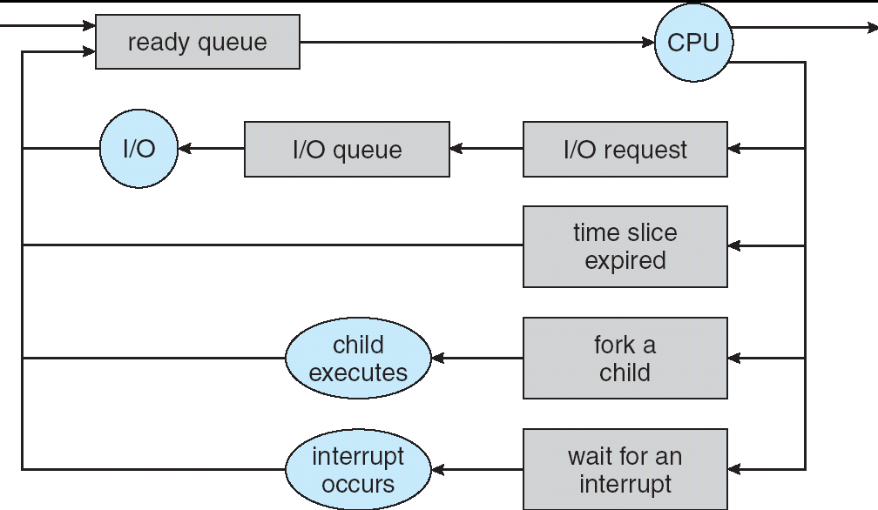
Recall: CPU Scheduling
Earlier, we talked about the life-cycle of a thread
Active threads work their way from Ready queue to Running to various waiting queues.
Question: How is the OS to decide which of several tasks to take off a queue?
Obvious queue to worry about is ready queue
Others can be scheduled as well, however
Scheduling: deciding which threads are given access to resources from moment to moment

Slide 34
Scheduling Assumptions
CPU scheduling big area of research in early 70’s
Many implicit assumptions for CPU scheduling:
One program per user
One thread per program
Programs are independent
Clearly, these are unrealistic but they simplify the problem so it can be solved
For instance: is “fair” about fairness among users or programs?
If I run one compilation job and you run five, you get five times as much CPU on many operating systems
The high-level goal: Dole out CPU time to optimize some desired parameters of system
USER1
USER2
USER3
USER1
USER2
Time

Slide 35
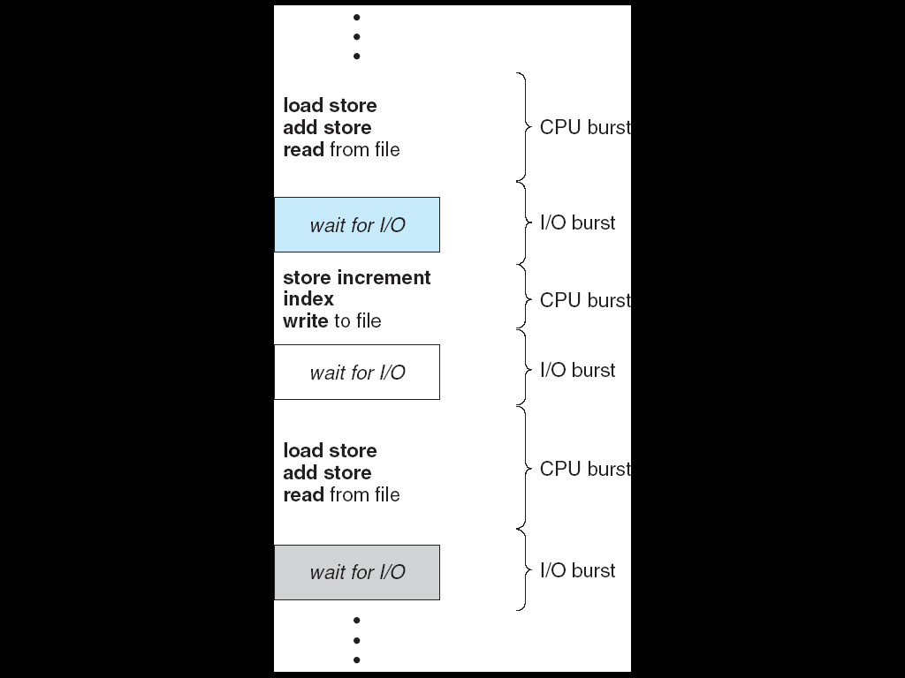
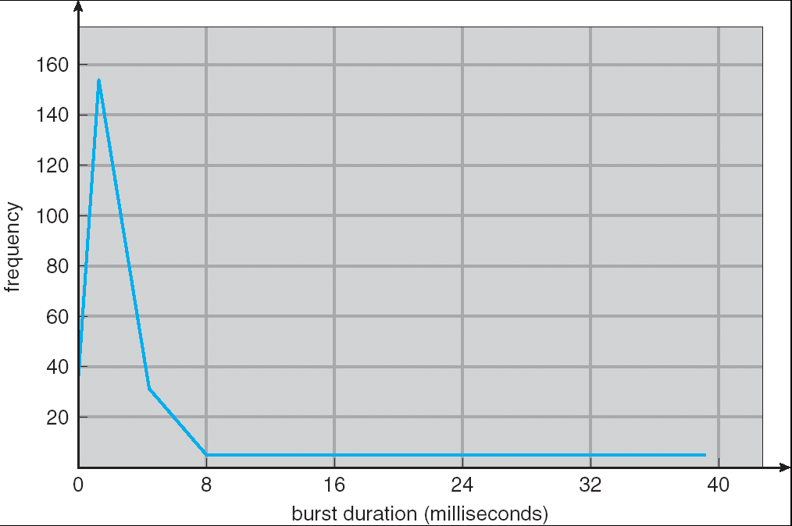
Assumption: CPU Bursts
Weighted toward small bursts
Execution model: programs alternate between bursts of CPU and I/O
Program typically uses the CPU for some period of time, then does I/O, then uses CPU again
Each scheduling decision is about which job to give to the CPU for use by its next CPU burst
With timeslicing, thread may be forced to give up CPU before finishing current CPU burst

Slide 36
Scheduling Policy Goals/Criteria
Minimize Response Time
Minimize elapsed time to do an operation (or job)
Response time is what the user sees:
Time to echo a keystroke in editor
Time to compile a program
Real-time Tasks: Must meet deadlines imposed by World
Maximize Throughput
Maximize operations (or jobs) per second
Throughput related to response time, but not identical:
Minimizing response time will lead to more context switching than if you only maximized throughput
Two parts to maximizing throughput
Minimize overhead (for example, context-switching)
Efficient use of resources (CPU, disk, memory, etc)
Fairness
Share CPU among users in some equitable way
Fairness is not minimizing average response time:
Better average response time by making system less fair
Notes:
What does CPU scheduling have to do with efficient use of the disk?
A lot! Have to have the CPU to make a disk request
Fairness: Minimize # of angry phone calls? Minimize my response time?

Slide 37
First-Come, First-Served (FCFS) Scheduling
First-Come, First-Served (FCFS)
Also “First In, First Out” (FIFO) or “Run until done”
In early systems, FCFS meant one program scheduled until done (including I/O)
Now, means keep CPU until thread blocks
Example: Process Burst Time P₁ 24 P₂ 3 P₃ 3
Suppose processes arrive in the order: P₁ , P₂ , P₃ The Gantt Chart for the schedule is:
Waiting time for P₁ = 0; P₂ = 24; P₃ = 27
Average waiting time: (0 + 24 + 27)/3 = 17
Average Completion time: (24 + 27 + 30)/3 = 27
Convoy effect: short process behind long process
P₁
P₂
P₃
0
24
27
30

Slide 38
FCFS Scheduling (Cont.)
Example continued:
Suppose that processes arrive in order: P₂ , P₃ , P₁ Now, the Gantt chart for the schedule is:
Waiting time for P₁ = 6; P₂ = 0; P₃ = 3
Average waiting time: (6 + 0 + 3)/3 = 3
Average Completion time: (3 + 6 + 30)/3 = 13
In second case:
average waiting time is much better (before it was 17)
Average completion time is better (before it was 27)
FIFO Pros and Cons:
Simple (+)
Short jobs get stuck behind long ones (-)
Safeway: Getting milk, always stuck behind cart full of small items. Upside: get to read about space aliens!
P₂
P₃
P₁
0
3
6
30

Slide 39
Round Robin (RR)
FCFS Scheme: Potentially bad for short jobs!
Depends on submit order
If you are first in line at supermarket with milk, you don’t care who is behind you, on the other hand…
Round Robin Scheme
Each process gets a small unit of CPU time (time quantum), usually 10-100 milliseconds
After quantum expires, the process is preempted and added to the end of the ready queue.
n processes in ready queue and time quantum is q ⇒
Each process gets 1/n of the CPU time
In chunks of at most q time units
No process waits more than (n-1)q time units
Performance
q large ⇒ FCFS
q small ⇒ Interleaved (really small ⇒ hyperthreading?)
q must be large with respect to context switch, otherwise overhead is too high (all overhead)

Slide 40
Example of RR with Time Quantum = 20
Example: Process Burst Time P₁ 53 P₂ 8 P₃ 68 P₄ 24
The Gantt chart is:
Waiting time for P₁=(68-20)+(112-88)=72 P₂=(20-0)=20 P₃=(28-0)+(88-48)+(125-108)=85 P₄=(48-0)+(108-68)=88
Average waiting time = (72+20+85+88)/4=66¼
Average completion time = (125+28+153+112)/4 = 104½
Thus, Round-Robin Pros and Cons:
Better for short jobs, Fair (+)
Context-switching time adds up for long jobs (-)
P₁
P₂
P₃
P₄
P₁
P₃
P₄
P₁
P₃
P₃
0
20
28
48
68
88
108
112
125
145
153

Slide 41
Round-Robin Discussion
How do you choose time slice?
What if too big?
Response time suffers
What if infinite (∞)?
Get back FIFO
What if time slice too small?
Throughput suffers!
Actual choices of timeslice:
Initially, UNIX timeslice one second:
Worked ok when UNIX was used by one or two people.
What if three compilations going on? 3 seconds to echo each keystroke!
In practice, need to balance short-job performance and long-job throughput:
Typical time slice today is between 10ms – 100ms
Typical context-switching overhead is 0.1ms – 1ms
Roughly 1% overhead due to context-switching

Slide 42
Comparisons between FCFS and Round Robin
Assuming zero-cost context-switching time, is RR always better than FCFS?
Simple example: 10 jobs, each take 100s of CPU time RR scheduler quantum of 1s All jobs start at the same time
Completion Times:
Both RR and FCFS finish at the same time
Average response time is much worse under RR!
Bad when all jobs same length
Also: Cache state must be shared between all jobs with RR but can be devoted to each job with FIFO
Total time for RR longer even for zero-cost switch!
Job # | FIFO | RR
1 | 100 | 991
2 | 200 | 992
… | … | …
9 | 900 | 999
10 | 1000 | 1000

Slide 43
Earlier Example with Different Time Quantum
P₂
[8]
P₄
[24]
P₁
[53]
P₃
[68]
Best FCFS:
0
8
32
85
153
Quantum
P₁
P₂
P₃
P₄
Average
Wait
Time
Best FCFS
32
0
85
8
31¼
Q = 1
84
22
85
57
62
Q = 5
82
20
85
58
61¼
Q = 8
80
8
85
56
57¼
Q = 10
82
10
85
68
61¼
Q = 20
72
20
85
88
66¼
Worst FCFS
68
145
0
121
83½
Completion
Time
Best FCFS
85
8
153
32
69½
Q = 1
137
30
153
81
100½
Q = 5
135
28
153
82
99½
Q = 8
133
16
153
80
95½
Q = 10
135
18
153
92
99½
Q = 20
125
28
153
112
104½
Worst FCFS
121
153
68
145
121¾

Slide 44
What if we Knew the Future?
Could we always mirror best FCFS?
Shortest Job First (SJF):
Run whatever job has the least amount of computation to do
Sometimes called “Shortest Time to Completion First” (STCF)
Shortest Remaining Time First (SRTF):
Preemptive version of SJF: if job arrives and has a shorter time to completion than the remaining time on the current job, immediately preempt CPU
Sometimes called “Shortest Remaining Time to Completion First” (SRTCF)
These can be applied either to a whole program or the current CPU burst of each program
Idea is to get short jobs out of the system
Big effect on short jobs, only small effect on long ones
Result is better average response time
Notes:
Rich get richer, and poor get poorer = short jobs get through the system faster, long jobs take even longer

Slide 45
Discussion
SJF/SRTF are the best you can do at minimizing average response time
Provably optimal (SJF among non-preemptive, SRTF among preemptive)
Since SRTF is always at least as good as SJF, focus on SRTF
Comparison of SRTF with FCFS and RR
What if all jobs the same length?
SRTF becomes the same as FCFS (i.e. FCFS is best can do if all jobs the same length)
What if jobs have varying length?
SRTF (and RR): short jobs not stuck behind long ones

Slide 46
Example to illustrate benefits of SRTF
A or B
C
C’s
I/O
C’s
I/O
C’s
I/O
Three jobs:
A,B: both CPU bound, run for week C: I/O bound, loop 1ms CPU, 9ms disk I/O
If only one at a time, C uses 90% of the disk, A or B could use 100% of the CPU
With FIFO:
Once A or B get in, keep CPU for two weeks
What about RR or SRTF?
Easier to see with a timeline

Slide 47
SRTF Example continued:
Disk Utilization:
9/201 ~ 4.5%
C
A
B
C
RR 100ms time slice
Disk Utilization:
~90% but lots of wakeups!
C’s
I/O
C’s
I/O
CABAB…
C
RR 1ms time slice
C’s
I/O
C’s
I/O
Disk Utilization:
90%
C
A
A
A
SRTF
C’s
I/O
C’s
I/O

Slide 48
SRTF Further discussion
Starvation
SRTF can lead to starvation if many small jobs!
Large jobs never get to run
Somehow need to predict future
How can we do this?
Some systems ask the user
When you submit a job, have to say how long it will take
To stop cheating, system kills job if takes too long
But: Even non-malicious users have trouble predicting runtime of their jobs
Bottom line, can’t really know how long job will take
However, can use SRTF as a yardstick for measuring other policies
Optimal, so can’t do any better
SRTF Pros & Cons
Optimal (average response time) (+)
Hard to predict future (-)
Unfair (-)

Slide 49
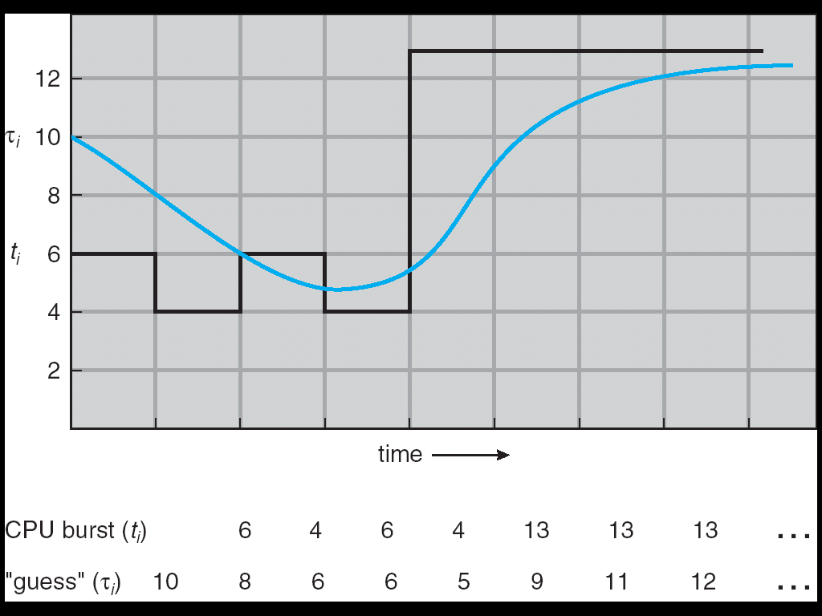
Predicting the Length of the Next CPU Burst
Adaptive: Changing policy based on past behavior
CPU scheduling, in virtual memory, in file systems, etc
Works because programs have predictable behavior
If program was I/O bound in past, likely in future
If computer behavior were random, wouldn’t help
Example: SRTF with estimated burst length
Use an estimator function on previous bursts: Let t_{n-1}, t_{n-2}, t_{n-3}, etc. be previous CPU burst lengths. Estimate next burst τ_{n} = f(t_{n-1}, t_{n-2}, t_{n-3}, …)
Function f could be one of many different time series estimation schemes (Kalman filters, etc)
For instance, exponential averaging τ_{n} = αt_{n-1}+(1-α)τ_{n-1} with (0<α≤1)

Slide 50
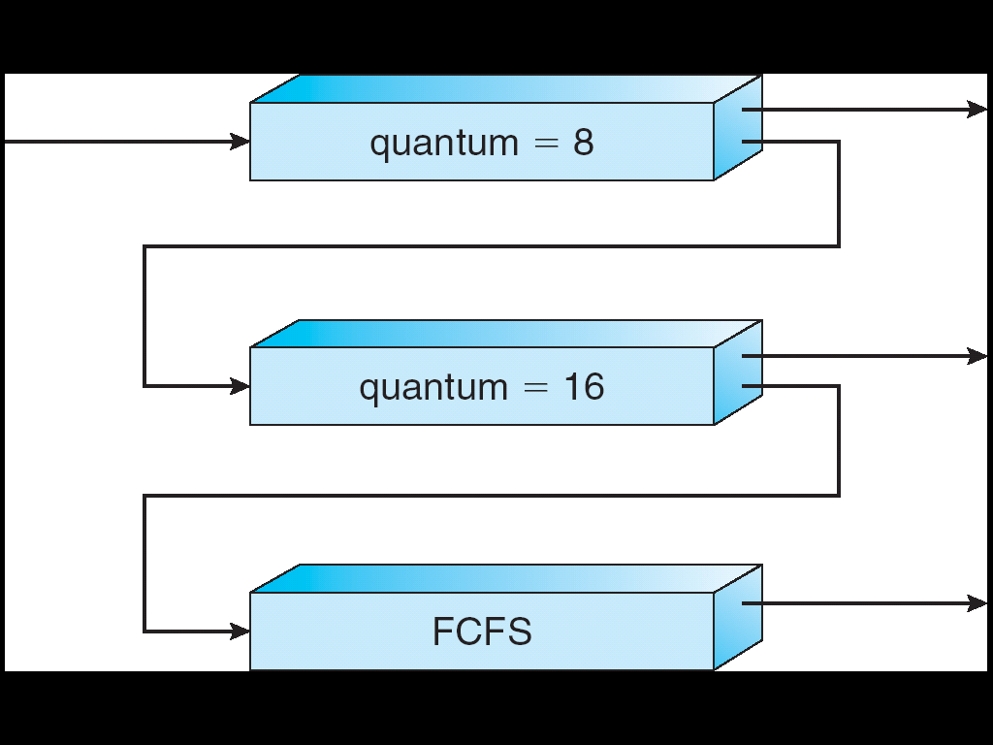
Multi-Level Feedback Scheduling
Another method for exploiting past behavior
First used in CTSS
Multiple queues, each with different priority
Higher priority queues often considered “foreground” tasks
Each queue has its own scheduling algorithm
e.g. foreground – RR, background – FCFS
Sometimes multiple RR priorities with quantum increasing exponentially (highest:1ms, next:2ms, next: 4ms, etc)
Adjust each job’s priority as follows (details vary)
Job starts in highest priority queue
If timeout expires, drop one level
If timeout doesn’t expire, push up one level (or to top)
Long-Running Compute Tasks Demoted to Low Priority

Slide 51
Scheduling Details
Result approximates SRTF:
CPU bound jobs drop like a rock
Short-running I/O bound jobs stay near top
Scheduling must be done between the queues
Fixed priority scheduling:
serve all from highest priority, then next priority, etc.
Time slice:
each queue gets a certain amount of CPU time
e.g., 70% to highest, 20% next, 10% lowest
Countermeasure: user action that can foil intent of the OS designer
For multilevel feedback, put in a bunch of meaningless I/O to keep job’s priority high
Of course, if everyone did this, wouldn’t work!
Example of Othello program:
Playing against competitor, so key was to do computing at higher priority the competitors.
Put in printf’s, ran much faster!

Slide 52
Scheduling Fairness
What about fairness?
Strict fixed-priority scheduling between queues is unfair (run highest, then next, etc):
long running jobs may never get CPU
In Multics, shut down machine, found 10-year-old job
Must give long-running jobs a fraction of the CPU even when there are shorter jobs to run
Tradeoff: fairness gained by hurting avg response time!
How to implement fairness?
Could give each queue some fraction of the CPU
What if one long-running job and 100 short-running ones?
Like express lanes in a supermarket—sometimes express lanes get so long, get better service by going into one of the other lines
Could increase priority of jobs that don’t get service
What is done in UNIX
This is ad hoc—what rate should you increase priorities?
And, as system gets overloaded, no job gets CPU time, so everyone increases in priority⇒Interactive jobs suffer

Slide 53
Lottery Scheduling
Yet another alternative: Lottery Scheduling
Give each job some number of lottery tickets
On each time slice, randomly pick a winning ticket
On average, CPU time is proportional to number of tickets given to each job
How to assign tickets?
To approximate SRTF, short running jobs get more, long running jobs get fewer
To avoid starvation, every job gets at least one ticket (everyone makes progress)
Advantage over strict priority scheduling: behaves gracefully as load changes
Adding or deleting a job affects all jobs proportionally, independent of how many tickets each job possesses

Slide 54
Lottery Scheduling Example
Lottery Scheduling Example
Assume short jobs get 10 tickets, long jobs get 1 ticket
What if too many short jobs to give reasonable response time?
In UNIX, if load average is 100, hard to make progress
One approach: log some user out
# short jobs/ # long jobs | % of CPU each short jobs gets | % of CPU each long jobs gets
1/1 | 91% | 9%
0/2 | N/A | 50%
2/0 | 50% | N/A
10/1 | 9.9% | 0.99%
1/10 | 50% | 5%

Slide 55
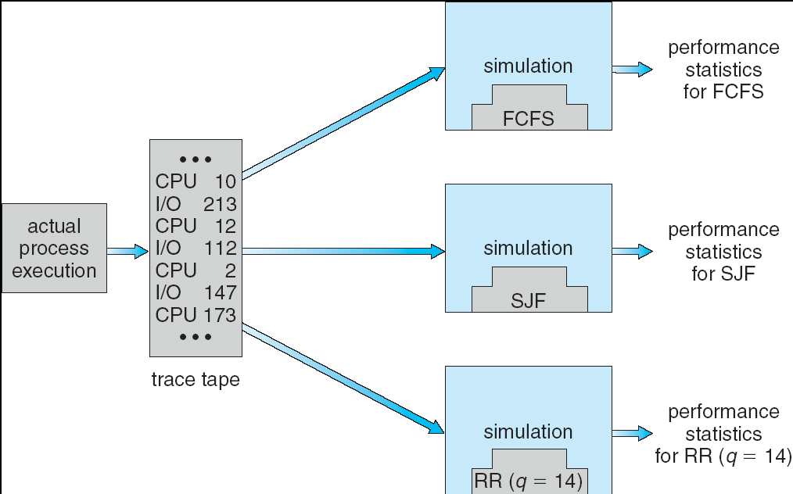
How to Evaluate a Scheduling algorithm?
Deterministic modeling
takes a predetermined workload and compute the performance of each algorithm for that workload
Queueing models
Mathematical approach for handling stochastic workloads
Implementation/Simulation:
Build system which allows actual algorithms to be run against actual data. Most flexible/general.

Slide 56
Summary
Semaphores: Like integers with restricted interface
Two operations:
P(): Wait if zero; decrement when becomes non-zero
V(): Increment and wake a sleeping task (if exists)
Can initialize value to any non-negative value
Use separate semaphore for each constraint
Monitors: A lock plus one or more condition variables
Always acquire lock before accessing shared data
Use condition variables to wait inside critical section
Three Operations: Wait(), Signal(), and Broadcast()
Scheduling: selecting a waiting process from the ready queue and allocating the CPU to it
FCFS Scheduling:
Run threads to completion in order of submission
Pros: Simple
Cons: Short jobs get stuck behind long ones
Round-Robin Scheduling:
Give each thread a small amount of CPU time when it executes; cycle between all ready threads
Pros: Better for short jobs
Cons: Poor when jobs are same length

Slide 57
Summary (2)
Shortest Job First (SJF)/Shortest Remaining Time First (SRTF):
Run whatever job has the least amount of computation to do/least remaining amount of computation to do
Pros: Optimal (average response time)
Cons: Hard to predict future, Unfair
Multi-Level Feedback Scheduling:
Multiple queues of different priorities
Automatic promotion/demotion of process priority in order to approximate SJF/SRTF
Lottery Scheduling:
Give each thread a priority-dependent number of tokens (short tasks⇒more tokens)
Reserve a minimum number of tokens for every thread to ensure forward progress/fairness
Evaluation of mechanisms:
Analytical, Queuing Theory, Simulation

