Slide 1
Predicting Unplanned 30-day Readmission Using MIMICIII Discharge Notes
By:
Sue

Slide 2
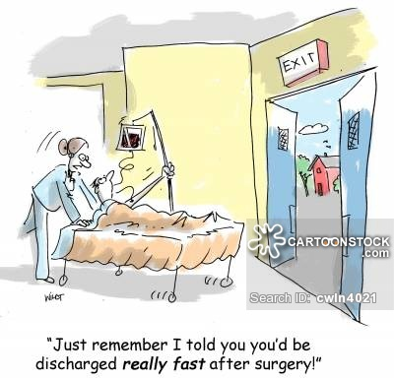
Introduction
Avoidable hospital readmissions:
Contribute to the high costs of healthcare
Have an impact on the quality of care for patients
A policy priority:
The need for an accurate predictive model still exists
Doctors’ notes can be utilized for predictive models
https://www.cartoonstock.com/directory/d/discharged.asp

Slide 3

Objective
In this project I am investigating the performances of different NLP techniques in predicting 30-day unplanned readmission using MIMICIII discharge notes.

Slide 4
Related works: Predicting early readmission
Craig et al. (2017): deep learning NLP on 300,000 patients of Sutter Health. (AUC = 70%)
Rajkomar et al. (2018): state-of-the-art deep learning + NlP on all hospital data of more than 200,000 patients of UCSF and UCM. (AUC = 76-77 %)

Slide 5
data
MIMICIII dataset, a free hospital database of 50,000 patients of Beth Israel Deaconess Medical Center in Boston:
ADMISSIONS : a table containing admission and discharge dates
NOTEEVENTS : contains all notes for each hospitalization

Slide 6




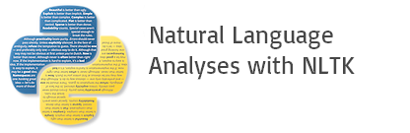

Software and Libraries
Apache Spark with Scala: Cleaning the data
Apache cTAKES : to extract CUIs for diseases and disorders
NLTK : Cleaning texts
Scikitlearn : BoW and TF-IDF
Keras : Deep Learning
gensim : Word2Vec

Slide 7
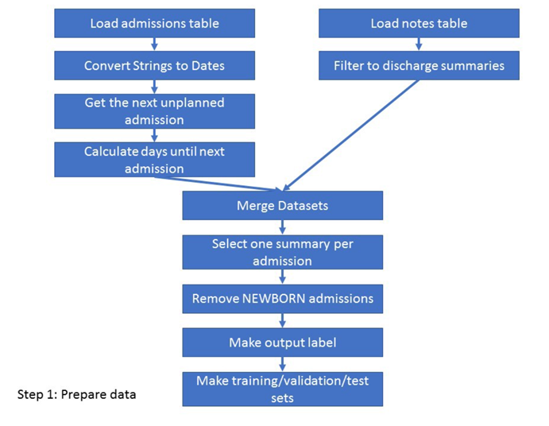
Preparing data
https://towardsdatascience.com/introduction-to-clinical-natural-language-processing-predicting-hospital-readmission-with-1736d52bc709

Slide 8
Down sampling of highly Imbalanced data
Test: 20% of the data (the same distribution as the whole dataset)
Train: The rest of positive cases + equal number of negative cases
Total Number of Patients
48,109
3,000
Train
2,400
2,400
Test
9,622
600

Slide 9
Bow and Tf-IDf
Cleaning discharge texts:
Deleting stop words
Stemming and Lemmatization
Tokenization with up to 3-ngrams
BoW and TF-IDF
Machine Learning:
Logistic Regression (LR)
Naïve Bayes (NB)
Random Forest (RF)
Neural Networks (NN)

Slide 10
Bow and Tf-Idf …
Three different options:
Bag of Words (BoW): Analyzing only discharge notes
Bag of CUIs (BoC): Analyzing extracted disease & disorder CUIs taking into account the polarity
BoW + BoC: Combining text with polarized CUIs

Slide 11
Deep learning Approaches
CNN-BiLSTM
CNN
BiLSTM

Slide 12
First Step: Word Embedding
Keras
Keras Embedding layer using Tokenizer API
GloVe
6B token and 400k words -Wikipedia 2014 + Gigaword5 (100D)
Word2Vec
Pretrain corpus of 2 million texts using genism (100D)

Slide 13
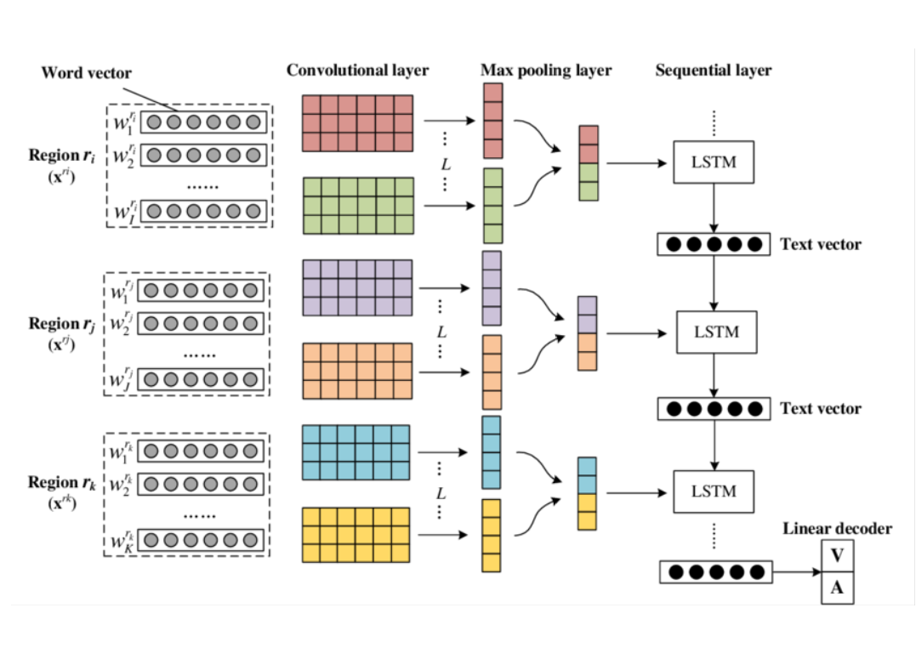
CNN and Bidirectional-LSTM
CNN can do feature extraction
CNN also improves the speed
BiLSTMs can understand context better than LSTM
https://www.researchgate.net/publication/306093564_Dimensional_Sentiment_Analysis_Using_a_Regional_CNN-LSTM_Model

Slide 14
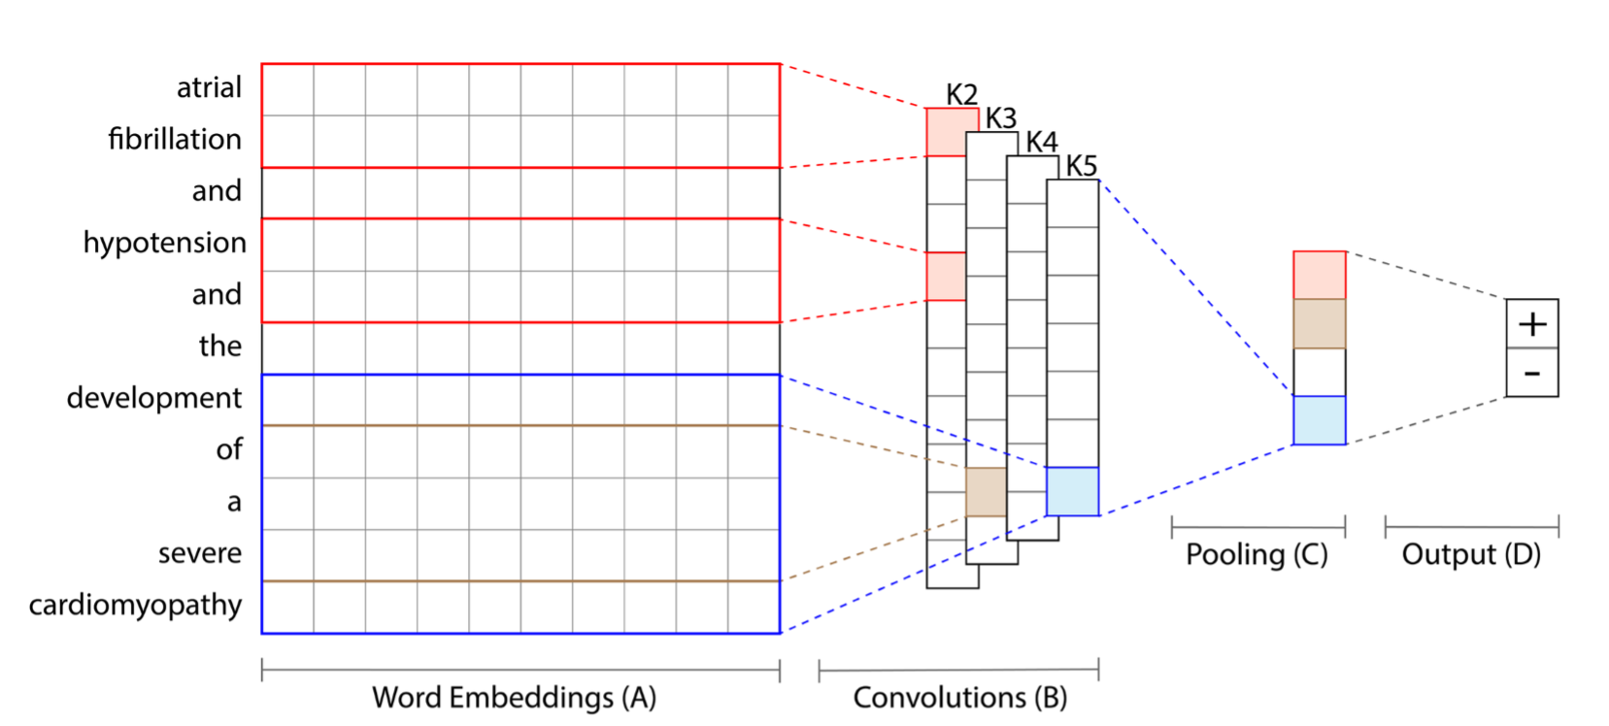
Collobert et al. (2011) CNN Architecture
Multiple convolutions of different size from 1 to 5.
https://arxiv.org/abs/1703.08705

Slide 15
Results
Model | Area Under Curve (AUC)
BoW + (LR/NN) | 70%
BoW + BoC + (LR/NN) | 71%
TF-ITF of (Texts + CUIS) + LR | 65%
CNN + BiLSTM | 62%
CNN with Stacked BiLSTM | 68%
Collbert et al. Architecture | 70%

Slide 16
conclusions
I need to Work more on the architectures and training of NNs. For now:
Naïve approach of BoW yields the same result of sophisticated NN models.
LR has the best performance for BoW method.
Adding polar CUIS can improve AUC by 1%.
Collbert et al. CNN model outperforms CNN-BiLSTM model.
Using Glove and Word2Vec Embedding can improve the performance of the models by (3-4%)
LSTM and BiLSTM are susceptible to overfitting.

Slide 17

Thank you!
This Photo by Unknown Author is licensed under CC BY-NC

Slide 18
References
https://towardsdatascience.com/introduction-to-clinical-natural-language-processing-predicting-hospital-readmission-with-1736d52bc709
https://www.researchgate.net/publication/306093564_Dimensional_Sentiment_Analysis_Using_a_Regional_CNN-LSTM_Model
https://arxiv.org/abs/1703.08705
https://www.ncbi.nlm.nih.gov/pmc/articles/PMC5510858/
https://www.nature.com/articles/sdata201635

