Slide 1

KC House Sales
What factors contribute to an increase in
House Price?

Slide 2

Selling or Buying a house in the KC Area?
Over 21,000 House Sales Data
Between 2014 – 2015
Average house price was $540,000
Max house price was
$7 700,000

Slide 3

Take a Guess
Square Footage of Neighbors' House ?
Waterfront ?
Grade?
Year Built?
Zip Code ?
Number of Bathrooms?
Number of Bedrooms?
Has been Viewed ?
Renovated?
Date Sold ?
Longitude / Latitude?
Lot Size?
Basement Size?
Condition?
Floors?
Square Footage ?

Slide 4

Top 4

Slide 5


1 Bathrooms
WATERFRONTX CONDITIONX TOTAL NUMBER

Slide 6
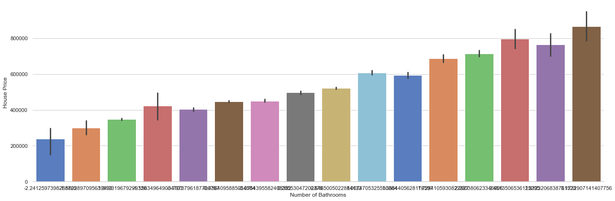
HOUSE PRICES VS NO. OF BATHROOMS
Increase in Number of Bathrooms

Slide 7
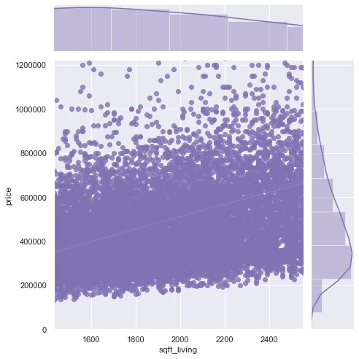

2 Square Foot Living
HOUSE PRICES VS SQUARE FOOT LIVING

Slide 8

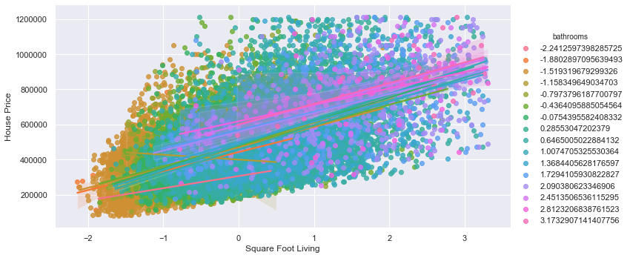
Adding Bathrooms to that extra space in the House
HOUSE PRICES VS SQUARE FOOT LIVING AND BATHROOMS

Slide 9
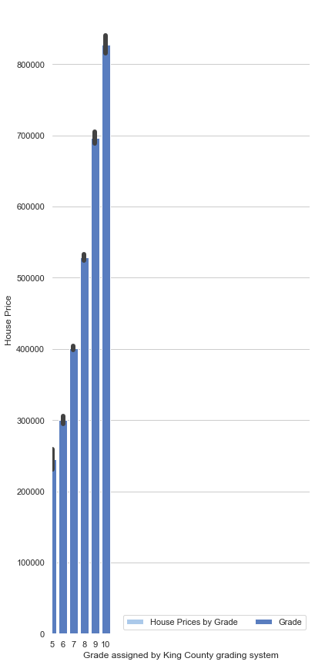
3 Grade
HOUSE PRICES VS KC GRADING

Slide 10
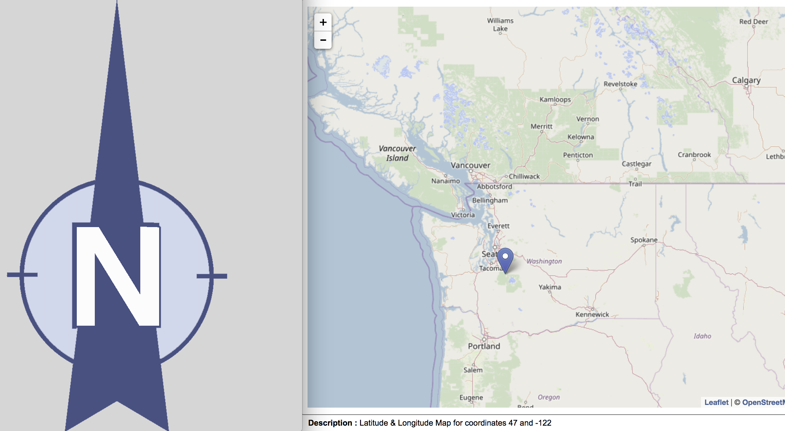
4 Latitude Selling/Buying North?

Slide 11
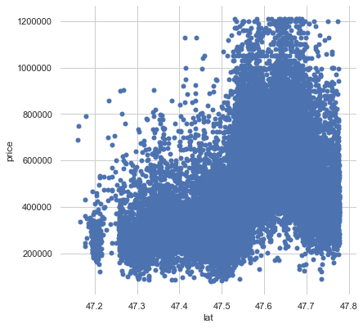
HOUSE PRICES VS LATITUDE
NORTH

Slide 12

RECOMMENDATIONS How to invest for a rainy day?
Add Bathrooms
Increase KC Grading
Increase the House Living Area
Move North

Slide 13
Future Work
For more current recommendations in line with todays’ house prices, we would value KC House Sale Data that is up to date.
KC House Data was not 100% complete, a number of sales transactions had missing detail.

Slide 14


