Slide 1

Does Discount have a significant effect on order detail?

Slide 2
1] Does Discount have a significant effect on the Quantity of products in an order?
2] Does Discount have a significant effect on the Total Price paid in an order?
3] Do any months with discounts have a significant effect on the Quantity in an order?
4] Do any months with discounts have a significant effect on the Total Price paid in an order?

Slide 3
Data Analysed
Northwind Database
830 Orders
Between May/2014 - July/2012

Slide 4


Discount effect on Quantity of products in an order
1
Discount had a slight - medium effect on the quantity of products in an order

Slide 5

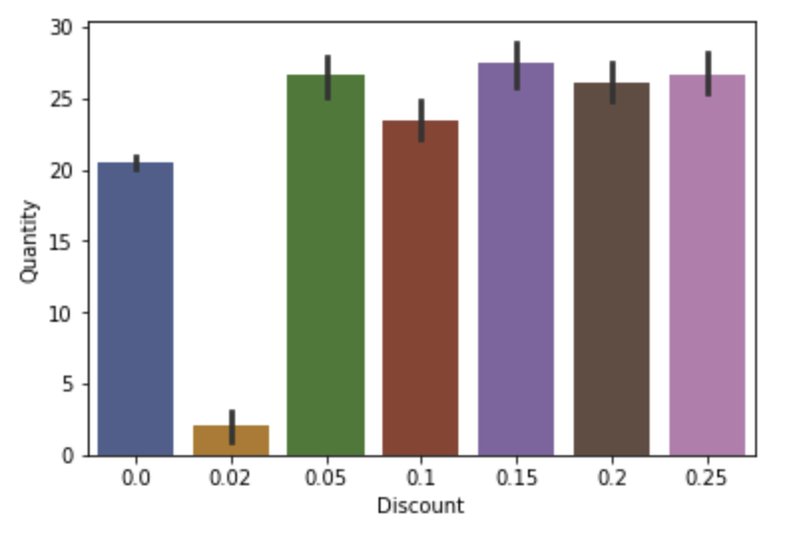
Most Effective Discounts?
1 15%
2 25%
3 5%
4 20%
Discounts were of similar effect

Slide 6


5% or 25% ?
Quantity purchased from these two discounts were very similar.

Slide 7
Discount effect on Total Spent on products in an order
2
Discount had a slight - medium effect on the total spent on products in an order

Slide 8
Most Effective Discounts?
5%
25%
Discounts were of similar effect

Slide 9
Month with discounts effect on Quantity of products in an order
3
There were no months with discounts that had a particularly significant effect on the quantity as compared to other months with discounts.

Slide 10

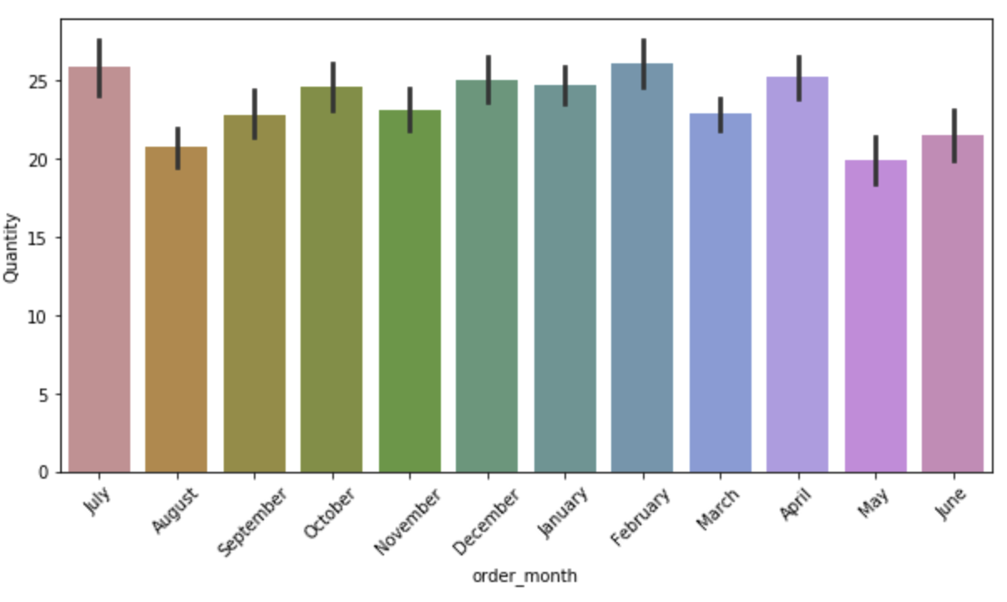

Slide 11
Month with discounts effect on Total Spent on products in an order
4
There were no months with discounts that had a particularly significant effect on the total spent as compared to other months with discounts.

Slide 12
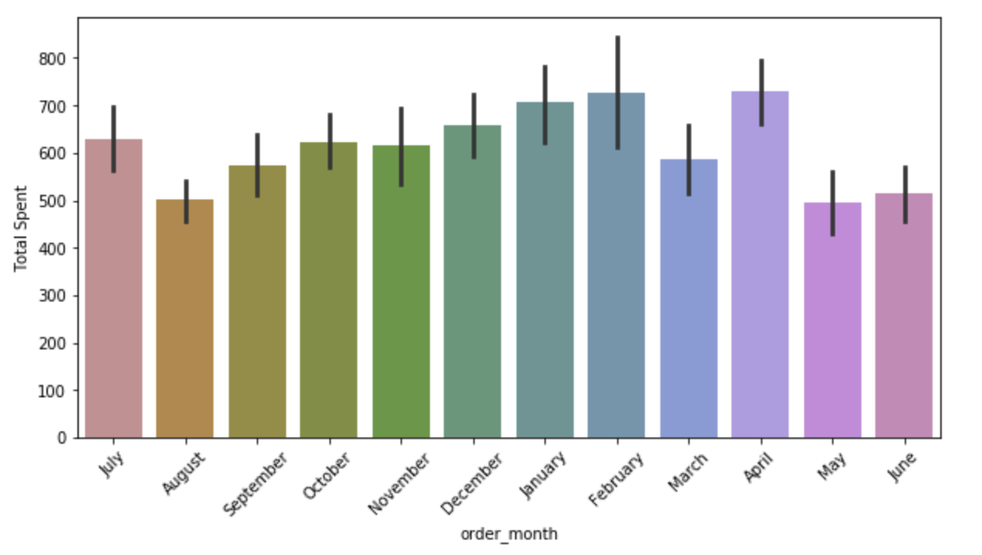

Slide 13
Recommendations
The discount amounts 15%, 25%, 5%, 25% had slight – medium effect on quantity ordered.
The discount amounts 5%, 25% had slight – medium effect on total sales in an order.
Offering a 5% discount instead of 25% may be profitable as they both have similar effects on the quantity and total sale of products.
The discounted month does not have a significantly different effect to other discounted months.
A larger amount of even sales data between discounted orders and full price orders may be more effective.

Slide 14


