Slide 1

Does Discount have a significant effect on the quantity of products ordered?

Slide 2


Increase - Quantity of Products Ordered - Total Price Ordered

Slide 3
Orders Detail
Northwind Database
830 Orders
Between May/2014 - July/2012
Shipped to France, Germany, Brazil, Switzerland

Slide 4
RESULTS
Discount had a slight effect on the quantity
or total price of products in an order

Slide 5
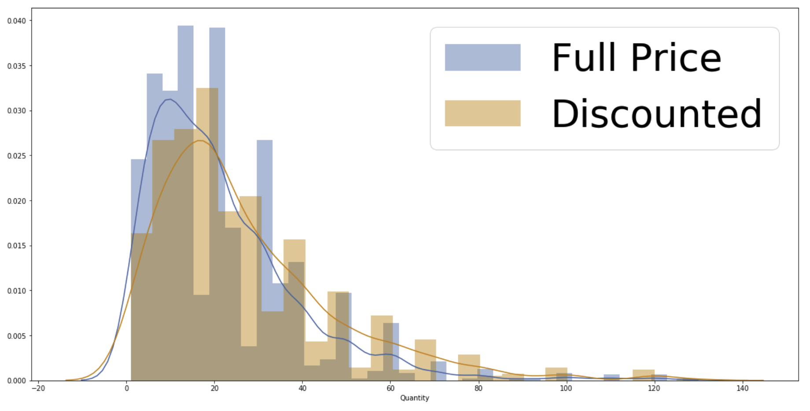

Slide 6

Most Effective Discounts?
1 15%
2 25%
3 5%
4 20%

Slide 7


5% or 25% ?
Quantity purchased from these two discounts were very similar.

Slide 8

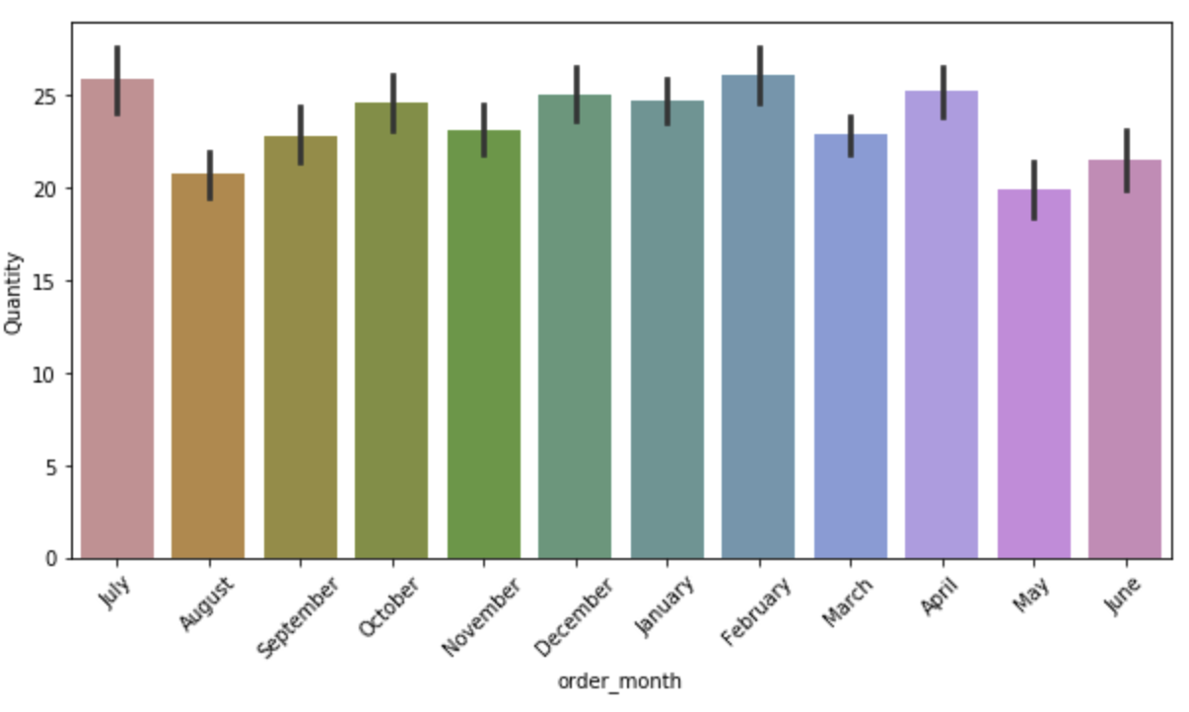
Did Month have an effect on the quantity or total sale of products?

Slide 9
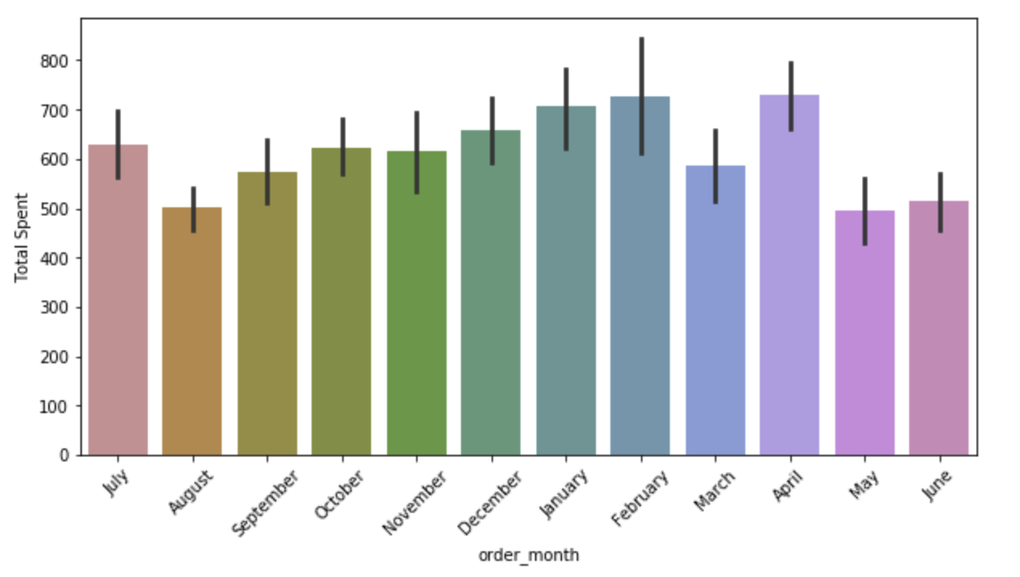

Slide 10
Recommendations
The discount amounts 15%, 25%, 5%, 25% did not have significantly different effects.
Offering a 5% discount instead of 25% may be profitable as they both have similar effects on the quantity and total sale of products.
A larger amount of even sales data between discounted orders and full price orders may be more effective.

Slide 11


