Slide 1
NYSE Modeling Predictive Performance
S&P 500
Net Cash Flow

Slide 2
COMPANY DATA
Annual SEC Filings
2012 - 2016

Slide 3

Which features increase predictive power on Positive Net Cash Flow

Slide 4
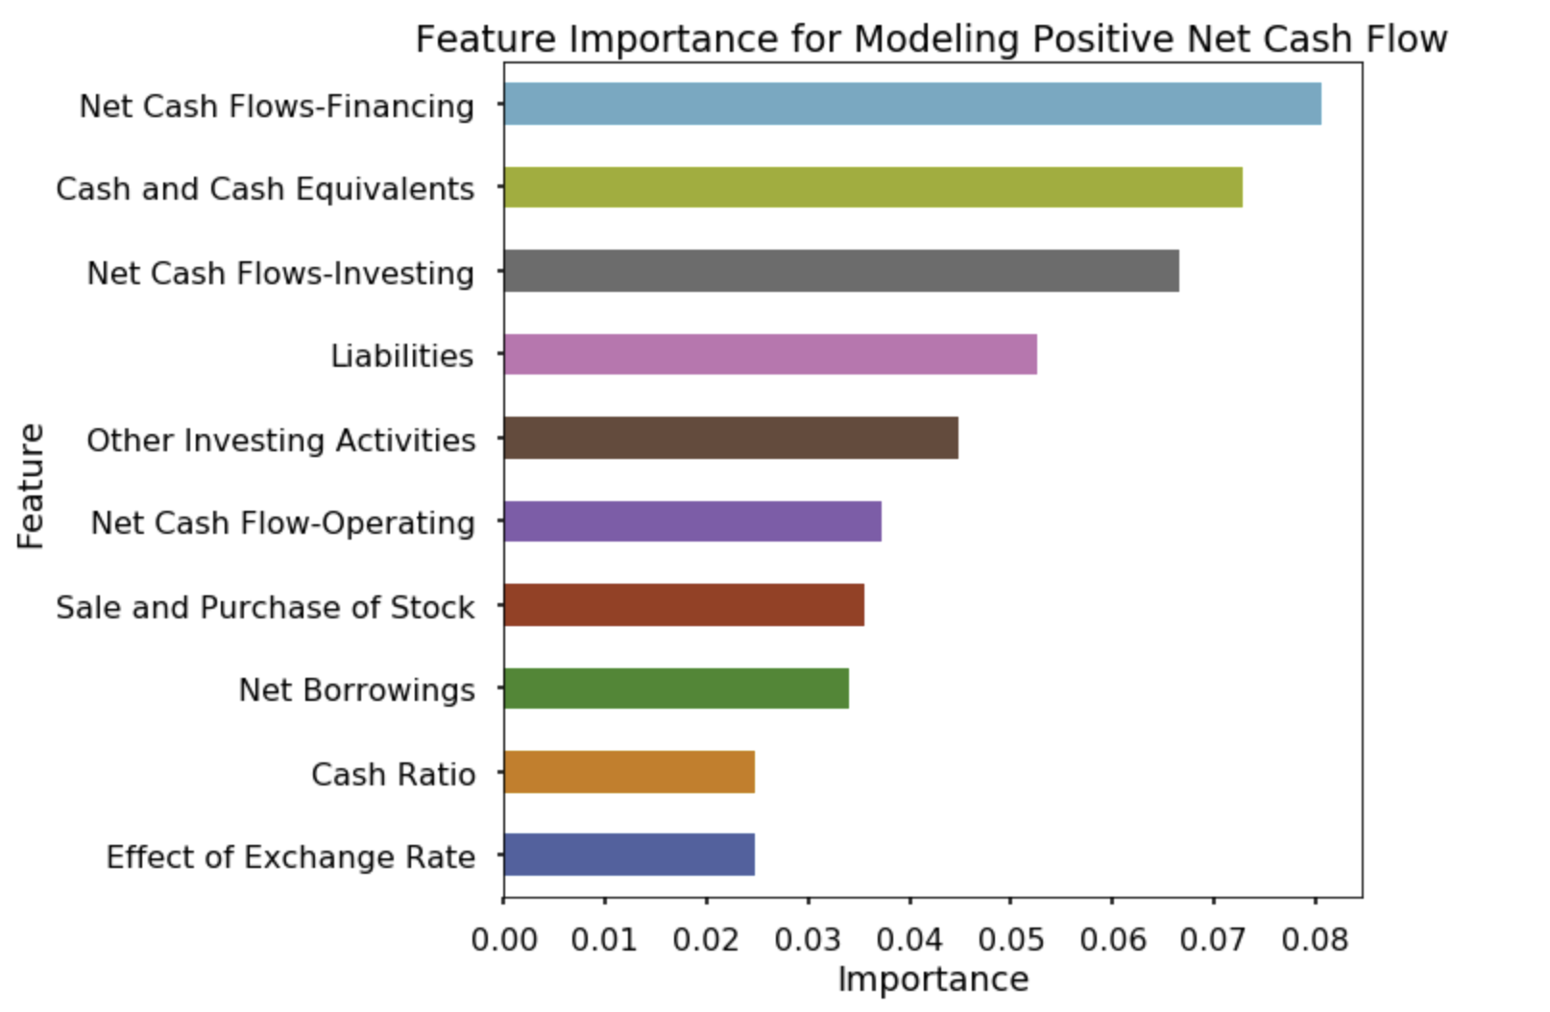

Slide 5
Accuracy of model
62% chance of a positive net cash flow prediction
58% chance of a negative net cash flow prediction

Slide 6
Recommendations
Net cash financing and Net borrowings are strong predictors for positive net cash profit
Net cash flow operating is a strong predictor for positive negative net cash profit
The accuracy of this model has above average balance for both positive and negative net cash flow prediction
This model may result in a very small percentage of companies listed with strong predictions

Slide 7
Future Work
One day ahead prediction with rolling linear regression
Indicator data including for example Momentum and Moving Average values on stock price
Categorizing of data / Further classification of companies depending on industry
Further modeling algorithms on the data to find a stronger predictive performance

Slide 8
THANKYOU
Presented by Sue Mir 07/May/2019

