Slide 1
NYSE Modeling Predictive Performance
S&P 500
Net Cash Flow

Slide 2
COMPANY DATA
Annual SEC Filings
2012 - 2016

Slide 3

Which features increase predictive power on Positive Net Cash Flow?

Slide 4
Models Used
Decision Trees are a type of Supervised Machine Learning (that is you explain what the input is and what the corresponding output is in the training data) where the data is continuously split according to a certain parameter.
This model tests all the different features of the data to see which are best to split with a number of different approaches – resulting in feature importance.

Slide 5
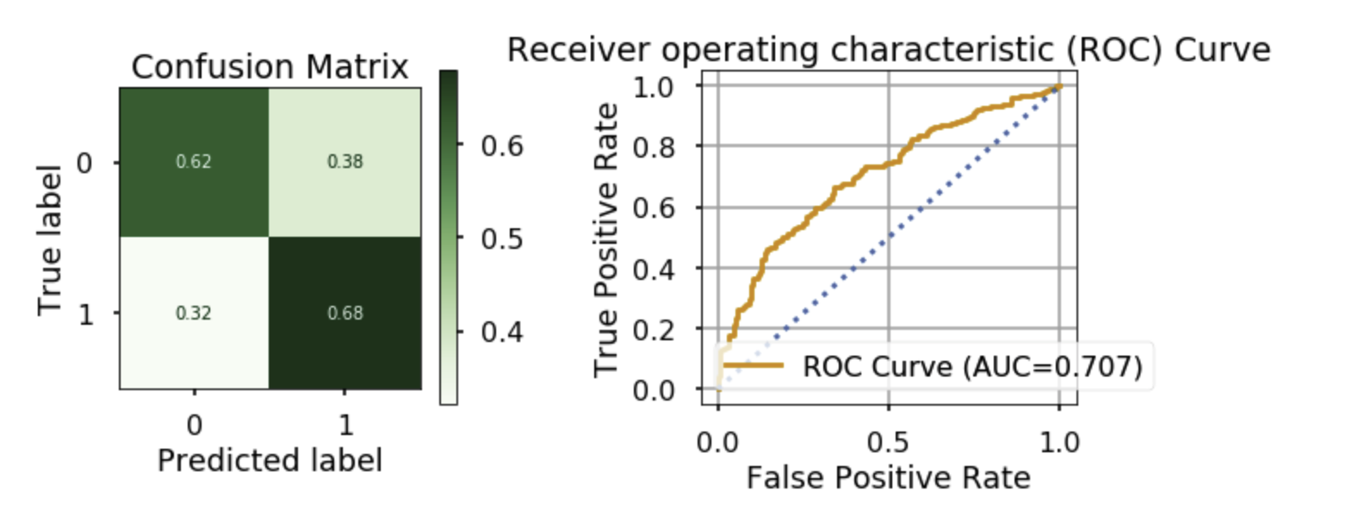
Accuracy of model
62% chance of a correct positive net cash flow prediction
58% chance of a correct negative net cash flow prediction

Slide 6
The accuracy of this model has above average balance for both positive and negative net cash flow prediction.
This model may result in a very small percentage of companies with accurate predictions.

Slide 7
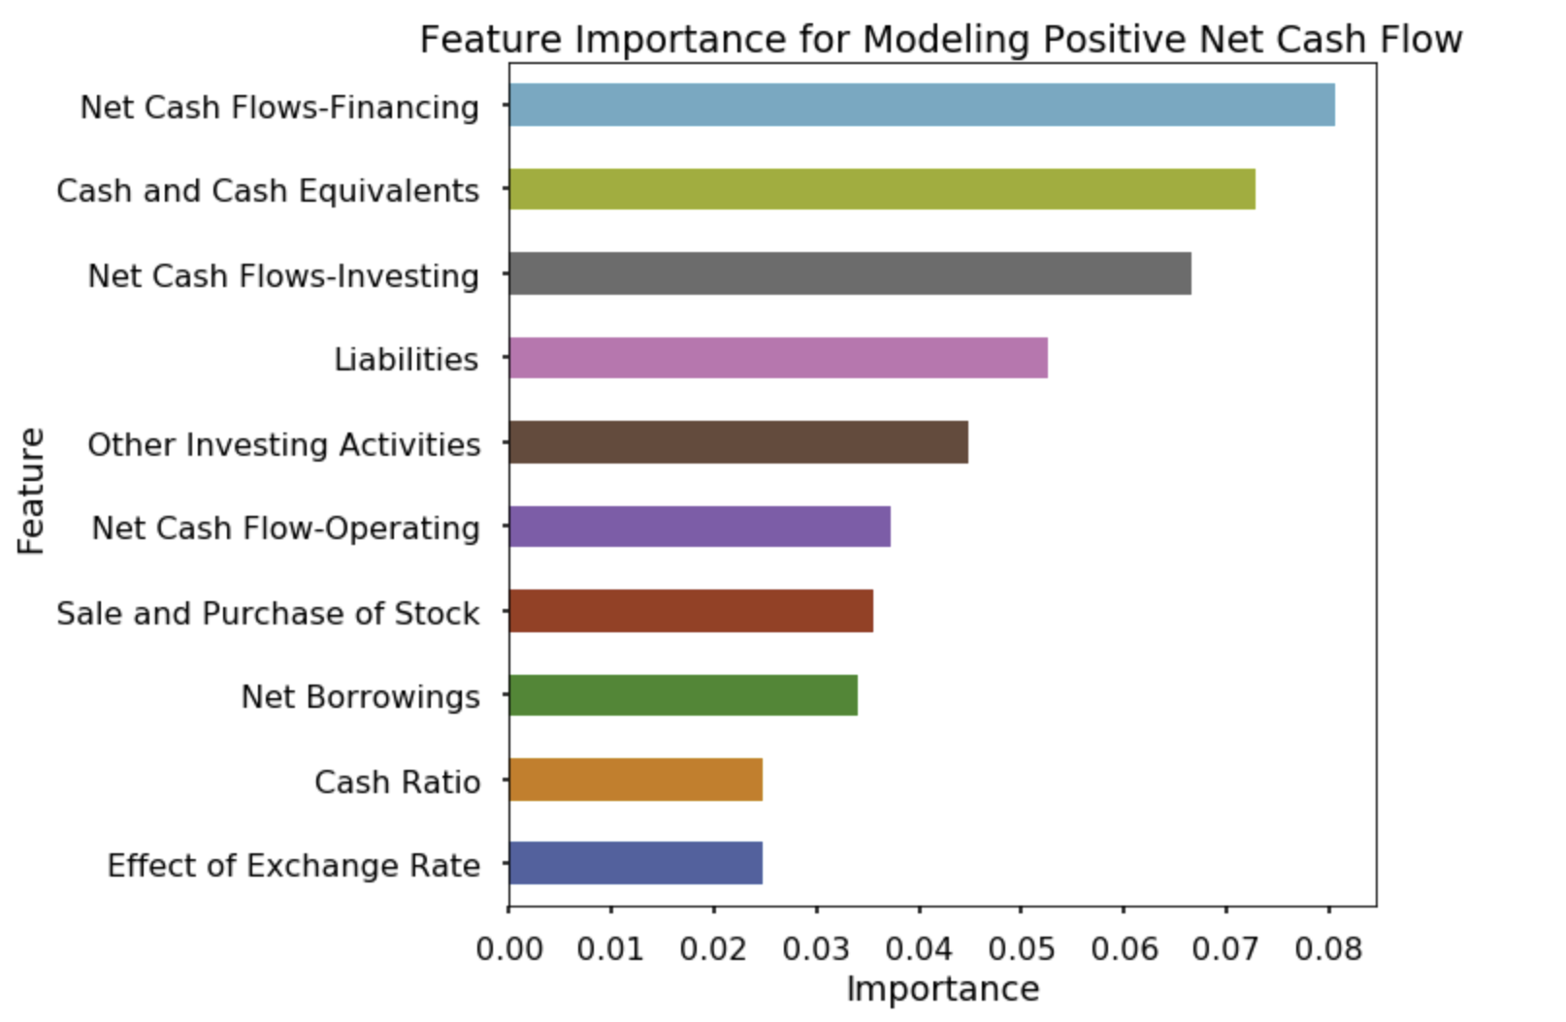

Slide 8
Recommendations
Focus on increasing sales ratio to purchase of stock.
Ensure financing and borrowing have a relative balance to liabilities and cash.
Decrease operating costs.
A strong $US exchange rate will effect positive net cash flow balance.

Slide 9
Future Work
One day ahead prediction with rolling linear regression
Indicator data including for example Momentum and Moving Average values on stock price
Categorizing of data / Further classification of companies depending on industry
Further modeling algorithms on the data to find a stronger predictive performance

Slide 10
THANKYOU
Presented by Sue Mir 07/May/2019

