Slide 1
Time Series Modeling
Zillow House Sales Data
Real Estate Investment Analysis

Slide 2
Overview
To provide analysis and predictions for investing in U.S real estate given the investor's risk and investment profile.

Slide 3

Data Analyzed
Data is provided by Zillow and represents U.S monthly sales data by region, state and zipcode for the periods 1996-04 - 2018-04.

Slide 4

Target
To predict the Top 5 Zipcodes to invest in from 2018-04

Slide 5
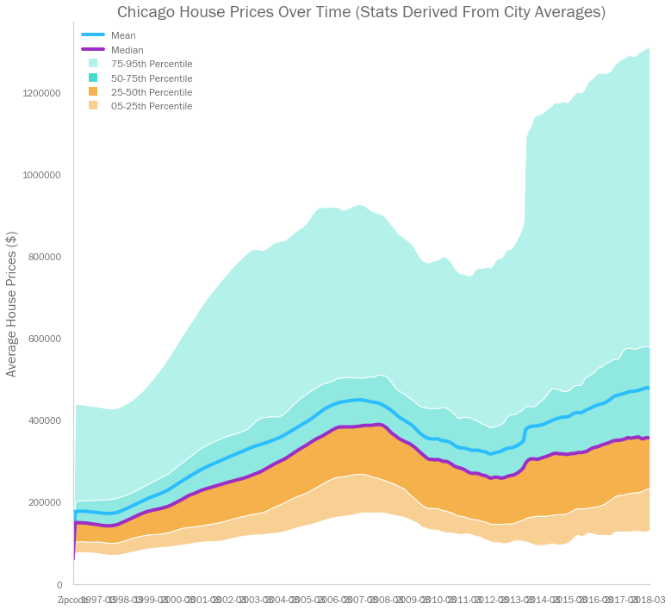
Investor Pre-requisite 1
Invest in the city of Chicago.

Slide 6
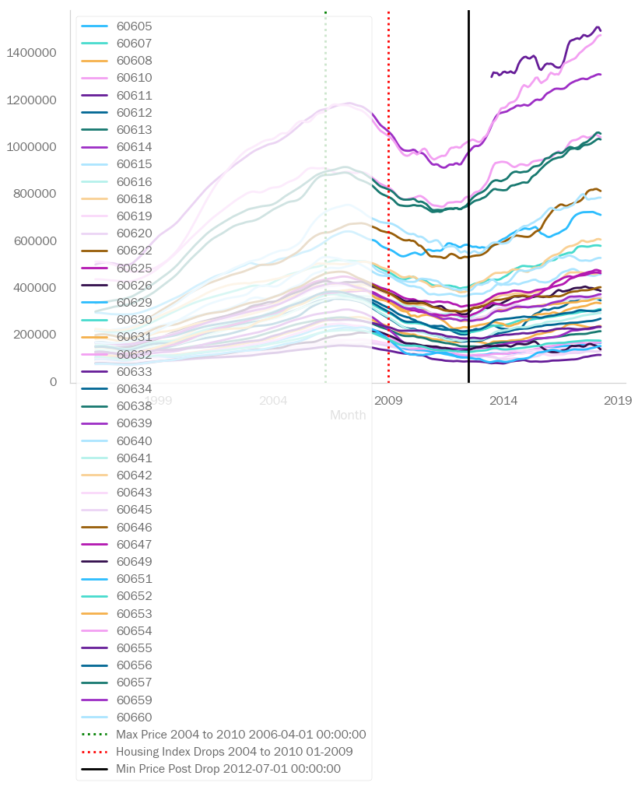
Investor Pre-requisite 2
Zipcodes’ average price did not decrease in value by more than the average price during the property market crash.

Slide 7
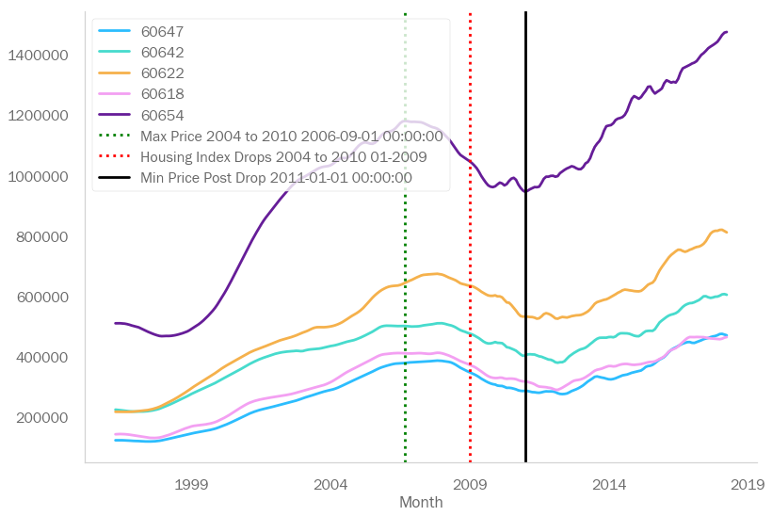
Investor Pre-requisite 3
Zipcodes’ average price was in the top 5 highest ROI% in the period following the market crash.

Slide 8
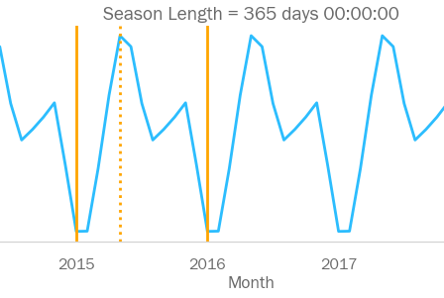
Zipcode Analysis By Season
Example Results: Zipcode 60647
SELL
BUY

Slide 9
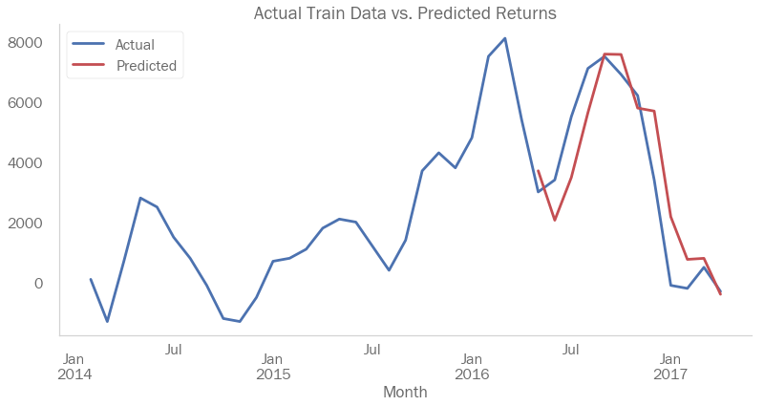
Zipcode Analysis Price Prediction
Example Results: Zipcode 60647

Slide 10
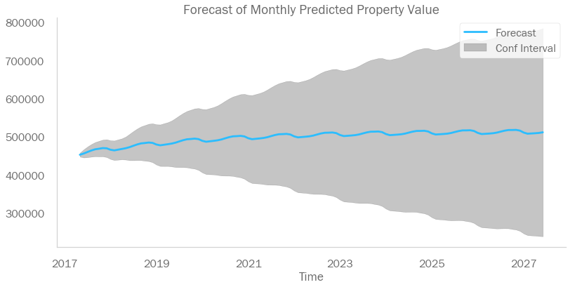
Zipcode Analysis Price Prediction
Example Results: Zipcode 60647

Slide 11
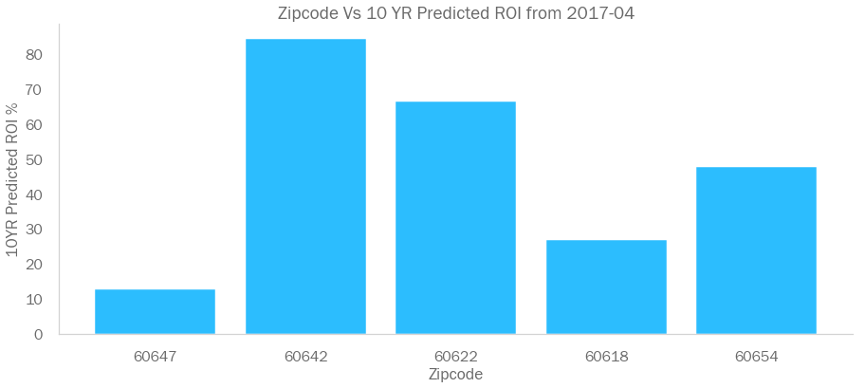
Zipcode Analysis Price Prediction

Slide 12

Predicted 10 YR ROI $100k Investment
ZIPCODE
60647 $12,630
60642 $84,370
60622 $66,530
60618 $26,650
60654 $47,660

Slide 13
Recommendations
This analysis may be adjusted to analyze data of a number of permutations of risk profiles including for example:
- By Country, city, state or region code
- At different time periods including the full time period or other entry points depending on the requirements of the investor.
Some zipcodes showed a strong investment entry strategy at the beginning of each year and some showed more than one strong investment entry point at the beginning and mid year.
The Data can be analyzed over different time period averages for example yearly, monthly and daily

Slide 14
Thank You!
Presented by: Susanna Mir
29th October 2020

