Slide 1


Chapter 9: Common Industrial Protocol (CIP™) and the Family of CIP Networks
Jayanthreddy Donthireddy fs6740
CSC 8260 : Wireless Networking and Cyber Physical Systems

Slide 2

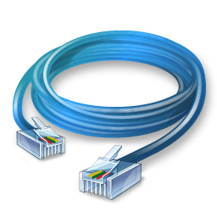
CONTENTS
Introduction
CIP Networks
Description Of The CIP Networks Library
DeviceNet
ControlNet
EtherNet/IP
CompoNet
Benefits of CIP Family
Application Layer Enhancements

Slide 3
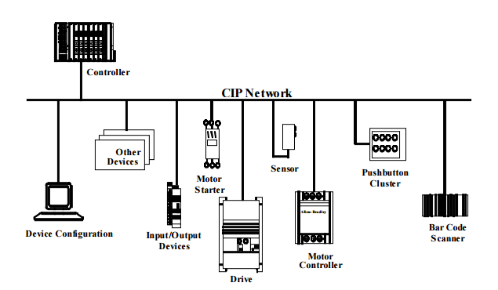
INTRODUCTION
The Common Industrial Protocol (CIP) is a peer to peer object oriented protocol that provides connections between industrial devices (sensors, actuators) and higher-level devices (controllers). CIP is physical media and data link layer independent.
Transport of control-oriented data associated with I/O devices.
Transport of other information that is related to the system being controlled, such as configuration parameters and diagnostics.
Structural View of a General CIP network

Slide 4
CIP NETWORKS
With media independence comes choice — the ability to choose the CIP Network best suited for your application. As a single, media-independent platform that is shared by a variety of networking technologies, CIP provides the interoperability and interchangeability that is essential to open networks and open systems.
FOUR MAJOR NETWORKS
ETHERNET/IP CIP ON ETHERNET TECHNOLOGY
DeviceNet CIP ON CAN TECHNOLOGY
CONTROLNET CIP ON CTDMA TECHNOLOGY
COMPONET CIP ON TDMA TECHNOLOGY

Slide 5
CIP NETWORKS (Contd..)
ETHERNET/IP CIP ON ETHERNET TECHNOLOGY
EtherNet/IP provides users with the network tools to deploy standard Ethernet technology (IEEE 802.3 combined with the TCP/IP Suite) for industrial automation applications while enabling Internet and enterprise connectivity…data anytime, anywhere. EtherNet/IP offers various topology options including a conventional star with standard Ethernet infrastructure devices, or device level ring (DLR) with EtherNet/IP devices so enabled. Quick Connect™ functionality allows devices to be exchanged while the network is running.
DeviceNet CIP ON CAN TECHNOLOGY
DeviceNet provides users with a cost-effective network to distribute and manage simple devices throughout their architecture. DeviceNet uses a trunkline-dropline topology and has DC power available on the network cable to simplify installations by providing a single connection point for network communications and device power up to 24 Vdc, 8 Amps. QuickConnect functionality allows devices to be exchanged while the network is running.

Slide 6
CIP NETWORKS (Contd..)
CotnrolNET CIP ON CTDMA TECHNOLOGY
ControlNet provides users with the tools to achieve deterministic, high-speed transport of time-critical I/O and peer-to-peer interlocks. ControlNet offers a choice of topology options including trunkline-dropline, star or tree. Hardware options are also offered for applications requiring intrinsically safe hardware. Redundant network communication is also available.
CompoNET CIP ON TDMA TECHNOLOGY
CompoNet enables users to maximize network throughput for applications needing to transmit small packets of data quickly between controllers, sensors and actuators. Its simple network connector and cabling scheme reduces overall system cost and time.

Slide 7

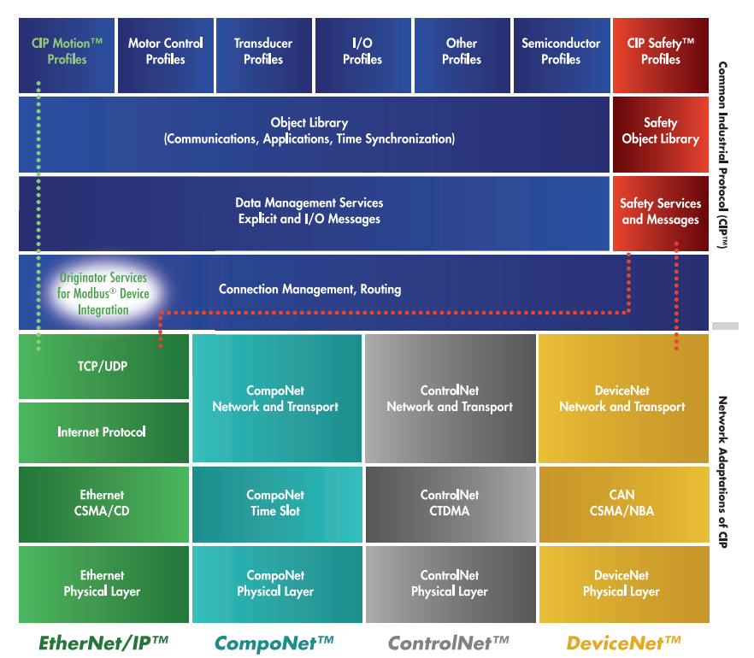
CIP NETWORKS (Cont...)
The Common Industrial Protocol and its network adaptations

Slide 8
DESCRIPTION OF THE CIP NETWORKS LIBRARY
CIP is a very versatile protocol designed with the automation industry in mind. However, due to its open nature, it can be and has been applied to many more areas.
The CIP Networks Library contains seven major volumes
Volume 1: Common Aspects of CIP
Volume 2: EtherNet/IP Adaptation of CIP
Volume 3: DeviceNet Adaptation of CIP
Volume 4: ControlNet Adaptation of CIP
Volume 5: CIP Safety
Volume 6: CompoNet Adaption of CIP
Volume 7: Integration of Modbus Devices into the CIP Architecture

Slide 9
DESCRIPTION OF THE CIP NETWORKS LIBRARY (Cont…)
KEY FEATURES OF THE PROTOCOL AND THE AUXILIARY POWER DISTRIBUTION SYSTEM
Object modeling
Services
Messaging protocol
Communication objects
Object library
Device profiles
Configuration and electronic data sheets (EDSs)
Bridging and routing
Data management
Auxiliary power distribution system

Slide 10
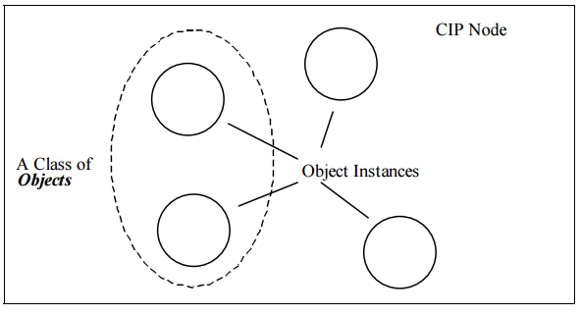
DESCRIPTION OF THE CIP NETWORKS LIBRARY (Cont…)
OBJECT MODELING
The suite of communication services available
The externally visible behavior of a CIP node
A common means by which information within CIP products is accessed and exchanged
Every CIP node is modeled as a collection of objects. An object provides an abstract representation of a particular component within a product. Anything not described in object form is not visible through CIP. CIP objects are structured into classes, instances, and attributes.
The objects and their components are addressed by a uniform addressing scheme consisting of the following:
Node Address
Class Identifier(Class ID)
Instance Identifier(Instance ID)
Attribute Identifier(Attribute ID)
Service Code
A Class of Objects

Slide 11
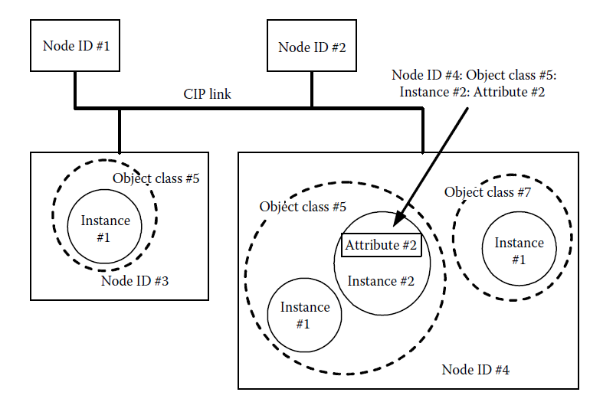
DESCRIPTION OF THE CIP NETWORKS LIBRARY (Cont…)
SERVICES
Service codes are used to define the action that is requested to take place when an object or parts of an object are addressed through explicit messages using the addressing scheme.
Apart from simple read and write functions, a set of CIP services has been defined. These CIP services are common in nature, meaning they may be used in all CIP Networks and they are useful for a variety of objects.
Object addressing example

Slide 12
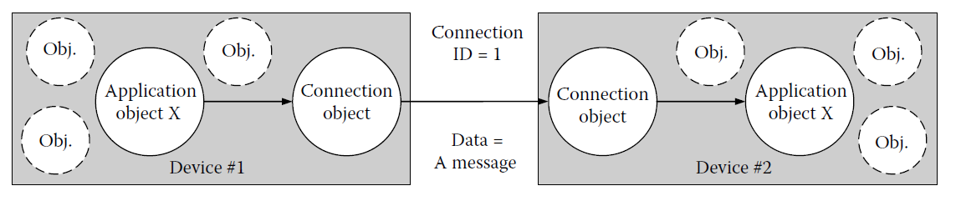
DESCRIPTION OF THE CIP NETWORKS LIBRARY (Cont…)
MESSAGING PROTOCOL
CIP is a connection-based protocol. A CIP connection provides a path between multiple application objects. When a connection is established, the transmissions associated with that connection are assigned a CID.
Establishing a CIP connection is generally accomplished by sending a UCMM Forward_Open service request message. The Forward_Open is required for all devices that support connections on ControlNet and EtherNet/IP.
Connection and Connection IDs

Slide 13
DESCRIPTION OF THE CIP NETWORKS LIBRARY (Cont…)
MESSAGING PROTOCOL (Cont…)
In particular, the Forward_Open request contains information on the following:
Timeout information for this connection
Network CID for the connection from the originator to the target
Network CID for the connection from the target to the originator
Information about the identity of the originator (vendor ID and serial number)
Maximum data sizes of the messages on this connection
Whether it will be unicast or multicast
Trigger mechanisms, for example, cyclic, change of state (COS)
Electronic key so the target node can verify that it is the proper type of node (optional)
Connection path for the application object data in the node that will be produced and consumed
Data Segment containing configuration information for the node (optional)
Routing information if the connection is to span more than one network (optional)

Slide 14
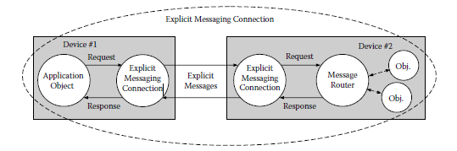
DESCRIPTION OF THE CIP NETWORKS LIBRARY (Cont…)
COMMUNICATION OBJECTS
CIP communication objects manage and provide the runtime exchange of messages. Communication objects are unique in that they are the focal points for all CIP communication.
The attribute values of a connection object specify whether it is an I/O connection or an explicit messaging connection, the maximum size of the data to be exchanged across this connection, and the source and destination of the data.
Particularly important behaviors include how messages are triggered and the timing of the connections
CIP explicit messaging connection

Slide 15
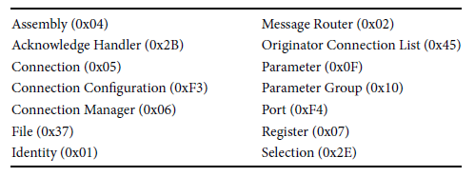
DESCRIPTION OF THE CIP NETWORKS LIBRARY (Cont…)
OBJECT LIBRARY
The CIP family of protocols contains a large collection of commonly defined objects. The overall set of object classes can be subdivided into three types:
1. General-use
2. Application-specific
3. Network-specific
General use objects (Object IDs in brackets)

Slide 16
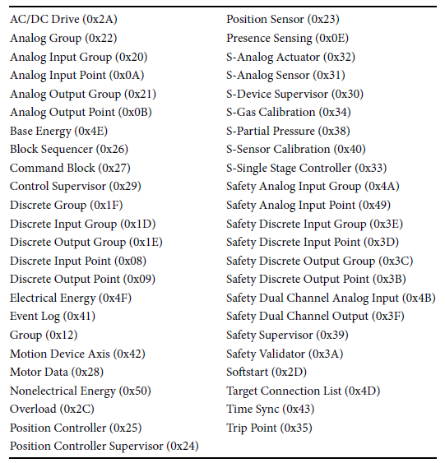
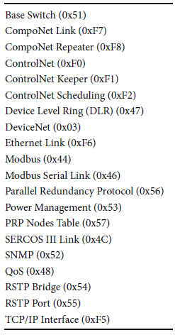
DESCRIPTION OF THE CIP NETWORKS LIBRARY (Cont…)
OBJECT LIBRARY (Cont…)
Application-specific (Object IDs in brackets)
Network-specific (Object IDs in brackets)

Slide 17
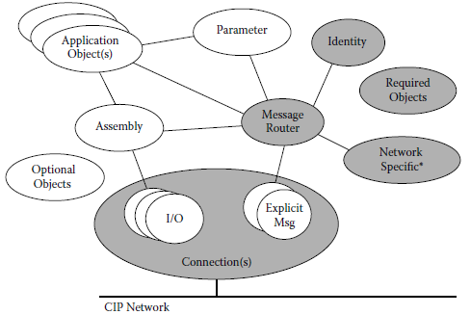
DESCRIPTION OF THE CIP NETWORKS LIBRARY (Cont…)
IDENTITY OBJECT (CLASS ID: 0X01)
The Identity Object is described in greater detail because, being a relatively simple object, it can
serve to illustrate the general principles of CIP objects. In addition, every device must have an
Identity Object.
MANDATORY ATTRIBUTES
Vendor ID
Device Type
Product Code
Revision
Status
Serial Number
Product Name
Typical device object model

Slide 18
DESCRIPTION OF THE CIP NETWORKS LIBRARY (Cont…)
IDENTITY OBJECT (CLASS ID: 0X01)( Cont…)
The Vendor ID attribute identifies the vendor that markets the device. This Unsigned Integer
(UINT) value is assigned to a specific vendor by ODVA.
The Device Type, again a UINT value, specifies which profile has been used for this device. It
must be one of the Device of the CIP Networks Library or a vendor-specific type.
The Product Code is a UINT number defined by the vendor of the device. This code is used to distinguish multiple products of the same Device Type from the same vendor.
The Revision is split into two Unsigned Short Integer (USINT) values specifying a Major Revision and a Minor Revision. Any device change(s) that results in modifying the behavior of the device on the network must be reflected in a change to the Minor Revision at minimum.
The Status attribute provides information on the status of the device, for example, whether it is owned or configured, and whether any major or minor faults have occurred.
The Serial Number is used to uniquely identify individual devices in conjunction with the Vendor ID, that is, no two CIP devices from one vendor may carry the same Serial Number.
The Product Name attribute allows the vendor to give a meaningful ASCII name string (up to 32 characters) to the device.

Slide 19
DESCRIPTION OF THE CIP NETWORKS LIBRARY (Cont…)
IDENTITY OBJECT (CLASS ID: 0X01)( Cont…)
OPTIONAL OR CONDITIONAL ATTRIBUTES
State
Configuration Consistency Value
Heartbeat Interval
Active Language
Supported Language List
International Product Name
Semaphore
Assigned_Name
Assigned_Description
Geographic_Location
Modbus Identity Info

Slide 20
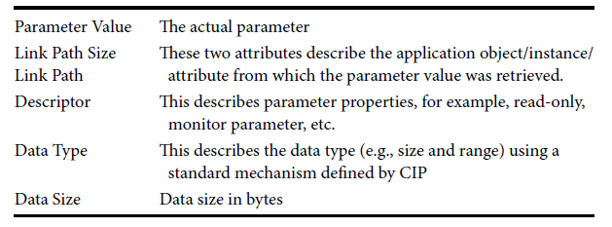
DESCRIPTION OF THE CIP NETWORKS LIBRARY (Cont…)
PARAMETER OBJECT (CLASS ID: 0X0F)
The Parameter Object comes in two types: A complete object and an abbreviated version (Parameter Object Stub). This abbreviated version is used primarily by DeviceNet and CompoNet devices that have only small amounts of memory available. The Parameter Object Stub, in conjunction with the EDS, has roughly the same functionality as the full object.
The first six Instance Attributes are required for the Object Stub.

Slide 21
DESCRIPTION OF THE CIP NETWORKS LIBRARY (Cont…)
PARAMETER OBJECT (CLASS ID: 0X0F) (Cont..)
The next three attributes provide ASCII strings with the name of the parameter, its engineering units, and an associated help text.
Another three attributes contain the minimum, maximum, and default values of the parameter.
Four more attributes can link the scaling of the parameter value so that the parameter can displayed in a more meaningful way, for example, raw value in multiples of 10 mA, scaled value displayed in Amps.
Another four attributes can link the scaling values to other parameters. This feature allows variable scaling of parameters, for example, percentage scaling to a full range value that is set by another parameter.
Attribute #21 defines how many decimal places are to be displayed if the parameter value is scaled.
Finally, the last three attributes are an international language version of the parameter name, its engineering units, and the associated help text.

Slide 22
DESCRIPTION OF THE CIP NETWORKS LIBRARY (Cont…)
ASSEMBLY OBJECT (CLASS ID: 0X04)
Assembly Objects provide the option of mapping data from the attributes of different instances of various classes into one single attribute (#3) of an Assembly Object. This mapping is generally used for I/O Messages to maximize the efficiency of the control data exchange on the network.
Assembly mapping makes the I/O data available in one block; thus, there are fewer Connection Object instances and fewer transmissions on the network.
An Assembly Object also can be used to configure a device with a single data block,
alleviating the need to set individual parameters.
Output Assembly in a device consumes data that the controlling element sends to the network and writes that data to the output application
Assemblies also can be used to transmit a complete set of configurable parameters instead of accessing them individually.

Slide 23
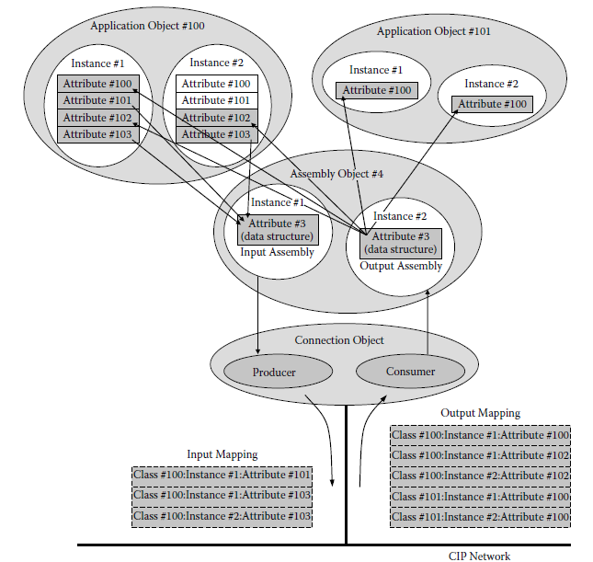
DESCRIPTION OF THE CIP NETWORKS LIBRARY (Cont…)
ASSEMBLY OBJECT (CLASS ID: 0X04) (Cont..)
Example of an Assembly mapping in a typical I/O device.

Slide 24
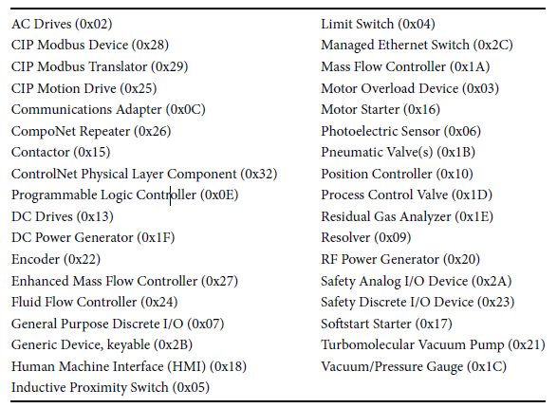
DESCRIPTION OF THE CIP NETWORKS LIBRARY (Cont…)
DEVICE PROFILES
Device developers must use a Device Type ID to uniquely identify their product. Any device that does not fall into the scope of one of the specialized device profiles must use the Generic Device profile (0x2B) or a vendor-specific profile.
Device Types and associated
profiles are defined in Volume 1

Slide 25
DESCRIPTION OF THE CIP NETWORKS LIBRARY (Cont…)
CONFIGURATION AND ELECTRONIC DATA SHEETS
CIP provides several options for configuring devices:
A printed data sheet
Parameter Objects and Parameter Object Stubs
An EDS
A combination of an EDS and Parameter Object Stubs
A Configuration Assembly combined with any of the methods provided earlier
EDS supplies all of the information that a full Parameter Object contains, in addition to I/O Connection information, so the EDS provides the full functionality and ease of use of the Parameter Object without imposing an excessive burden on the individual device.

Slide 26
DESCRIPTION OF THE CIP NETWORKS LIBRARY (Cont…)
CONFIGURATION AND ELECTRONIC DATA SHEETS(Cont..)
Let’s look at some details of the EDS. First, an EDS is structured into sections, each of which starts
with a section name in square brackets []. The first two sections are mandatory for all EDS files.
[File]
[Device]
[Device Classification]
[ParamClass]
[Params]
[Groups]
[Assembly]
[Connection Manager]
[Connection ManagerN]
[Port]
[Capacity]
[Connection Configuration]
[Event Enumeration]
[Symbolic Translation]
[Internationalization]
[Modular]
[IO_Info]
[Variant_IO_Info]
[EnumPar]
[ControlNet Physical Layer]
[CompoNet_Device]
[CompoNet_IO]
[Modbus Mapper]
[Object Class Sections]

Slide 27
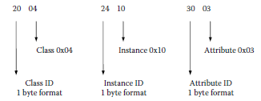
DESCRIPTION OF THE CIP NETWORKS LIBRARY (Cont…)
DATA MANAGEMENT
The data management part of the CIP Specification describes addressing models for CIP entities and the
data structures of the entities themselves.
Logical Segments
Logical Segments (first byte = 0x20–0x3F) are addressing Segments that can be used to address objects and their attributes within a device. They are typically structured as follows: [Class ID] [Instance ID] [Attribute ID, if required].
Each element of this structure allows various formats (1 byte, 2 bytes, and 4 bytes). Figure 9.10 show a typical example of this addressing method.
Logical segment encoding example

Slide 28
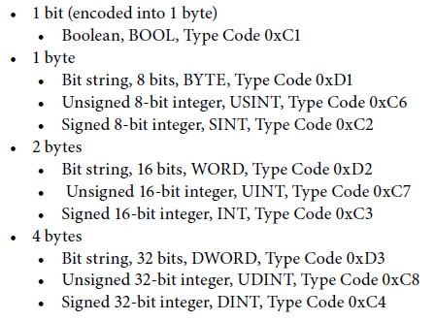
DESCRIPTION OF THE CIP NETWORKS LIBRARY (Cont…)
DATA MANAGEMENT(cont..)
Data Types
Types can be either structured or elementary Structured Data Types can be arrays of elementary Data Types or a collection of arrays or elementary Data Types.
Commonly used Data Types

Slide 29
DESCRIPTION OF THE CIP NETWORKS LIBRARY (Cont…)
AUXILIARY POWER DISTRIBUTION SYSTEM
The CIP application layer can be used on a variety of network technologies. Each CIP network specification consists of two volumes. The physical layer behavior defined on a particular network is described in the appropriate CIP network adaptation volume.
Auxiliary power may be used to provide application power for such devices as Input/output modules, Emergency Stop circuitry, and other application-specific needs. The cabling system provides 4-wire, two-circuit wiring that supplies 24 V switched and unswitched power.
MAINTENANCE AND FURTHER DEVELOPMENT OF THE SPECIFICATIONS
ODVA has a set of working groups that maintain the specifications and create protocol extensions, for example, new profiles or functional enhancements such as CIP Sync and CIP Safety. These groups are called Special Interest Groups (SIGs).
Only ODVA members can work within the SIGs. These participants have the advantage of advance knowledge of technical changes coming to the specifications.

Slide 30
DeviceNet
INTRODUCTION
DeviceNet was the first implementation of CIP. DeviceNet is based on the Controller Area Network (CAN). DeviceNet uses a subset of the CAN protocol (11-bit identifier only, no remote frames). The DeviceNet adaptation of CIP accommodates the 8-byte packet size limitation of the CAN protocol and allows the use of simple devices with minimal processing power.
RELATIONSHIP TO STANDARDS
Like other CIP Networks, DeviceNet follows the OSI model, an ISO standard for network communications that is hierarchical in nature. Networks that follow this model define all necessary functions, from physical implementation up to the protocol and methodology to communicate control and information data within and across networks.

Slide 31
DeviceNet(Cont...)
DeviceNet FEATURES
DeviceNet is a communication system at the low end (sensors and actuators) of the industrial communication
spectrum with the following features:
Trunkline/dropline configuration
Support for up to 64 nodes
Node insertion or removal while the network is up and running
QuickConnect for devices that are frequently removed from and added to the network, for example, robot tools
Simultaneous support for both network-powered devices, for example, sensors, and separately powered devices, for example, actuators
Use of sealed or open-style connectors
Protection from wiring errors
Selectable data rates of 125, 250, and 500 kBaud
Adjustable power configuration to meet individual application needs
High current capability (up to 16 A per supply)
Operation with off-the-shelf power supplies
Power taps that allow the connection of several power supplies from multiple vendors that comply with DeviceNet standards
Built-in overload protection
Power available along the bus: both signal and power lines contained in the cable
Several cables that are suitable for a number of different applications

Slide 32
DeviceNet(Cont...)
DeviceNet PHYSICAL LAYER AND RELATIONSHIP TO CAN
The physical layer of DeviceNet is an extension of the ISO 11898 standard [8]. This extension defines the following additional details:
Improved transceiver characteristics that allow the support of up to 64 nodes per network
Additional circuitry for overvoltage and mis-wiring protection
Several types of cables for a variety of applications
Several types of connectors for open (IP 20) and sealed (IP 65/67) devices
The cables described in the CIP Networks Library were designed specifically to meet minimum propagation speed requirements to ensure that they can be used up to the maximum system length. Developers of DeviceNet devices can create DeviceNet circuits with or without physical layer isolation (both versions are fully specified). Furthermore, a device may take some or all of its power from the bus, thus avoiding extra power lines for devices that can live on the power supplied through the DeviceNet cable.

Slide 33
DeviceNet(Cont...)
PROTOCOL ADAPTATIONS
On the protocol side, there are basically two adaptations of CIP that have been made to better accommodate it to the CAN data frame:
Shortening CIP Explicit Messages to 8 bytes or less where possible, with the use of message fragmentation for longer messages
Definition of a Master Slave communications option to minimize the connection establishment overhead
The message fragmentation mentioned previously comes in two varieties:
1. For I/O Messages, the use of fragmentation is defined by the maximum length of the data to be transmitted through a connection. Any connection that has more than 8 bytes to transmit always uses the fragmentation protocol, even if the actual data to be transmitted is 8 bytes or less, for example, an Idle Message.
2. For Explicit Messaging, the use of the fragmentation protocol is indicated in the header of every message, since the actual frame size can vary in length, depending on the content of the Explicit Message. The actual fragmentation protocol is contained in one extra byte within the message that indicates whether the fragment is a start fragment, a middle fragment, or an end fragment. A modulo 64 rolling fragment counter allows very long fragmented messages and is limited in theory only by the maximum Produced or Consumed Connection sizes (65,535 bytes). In reality, the capabilities of the devices limit the message sizes.

Slide 34
DeviceNet(Cont...)
INDICATORS AND SWITCHES
Indicators and switches are optional on DeviceNet. However, certain DeviceNet users not only require indicators and switches; they also specify what type to use. Many factors must be considered before implementing these devices, including packaging, accessibility, and customer expectations.
Similarly, devices may be built with or without switches or other directly accessible means for configuration of MAC ID and baud rate. If these switches are used, certain rules apply to how these values are used at power-up and during the operation of the device.
Network Access
DeviceNet uses the network access mechanisms described in the CAN specification, that is, bitwise arbitration through the CAN Identifier for every frame to be sent. This requires a system design that does not allow multiple uses of any of these identifiers. Since the node number of every device is coded into the CAN Identifier, it is generally sufficient to make sure that none of the node numbers exists more than once on any given network.

Slide 35
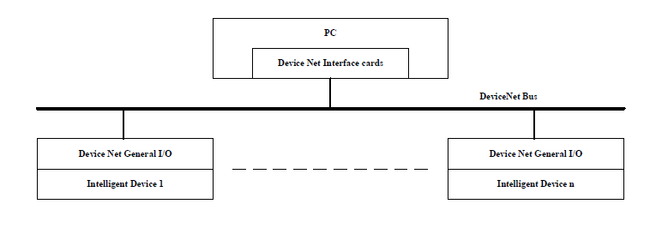
DeviceNet(Cont...)
Network Access(Cont…)
Intelligent device achieves information control and network management, it changes traditional on-site switch and analog signal control into the network control through fieldbus. It achieves network, open, distributed and digital control. The control network system structure bases on the DeviceNet that is indicated. It mainly composes of three parts: DeviceNet bus, host computer (master) and intelligent device node (slave).
The control network system structure base on the device net.

Slide 36
DeviceNet(Cont...)
GOING ONLINE
Any device that wants to communicate on DeviceNet must go through a Network Access algorithm before any communication is allowed. The main purpose of this process is to avoid duplicate Node IDs on the same network; a secondary purpose is to announce a node’s presence on the link for nodes that maintain an Active Node Table.
If two or more devices with the same MAC ID happen to transmit the Duplicate MAC ID Check Message at exactly the same time, all of them will win arbitration at the same time and will proceed with their message.
OFFLINE CONNECTION SET
The Offline Connection Set is a set of messages created to communicate with devices that have failed to go Online, to allow a new MAC ID to be set. Once a tool has successfully claimed ownership, it can check whether there are any nodes on the network that are in the offline state. If such nodes exist, the tool can then determine their Vendor ID(s) and Serial Number(s).

Slide 37
DeviceNet(Cont...)
DeviceNet STATUS INDICATION MESSAGES
There are two optional DeviceNet messages that indicate a status or a status transition of a device. One of them is called Device Heartbeat and the other is called Device Shutdown.
The Device Heartbeat Message, sent at a heartbeat interval set in the ID Object, provides a way for a device to indicate its presence on the network and its current health condition.
CONNECTION ESTABLISHMENT
Messages on DeviceNet are always exchanged in a connection-based manner. Communication objects must be set up for this purpose. These are not initially available when a device is powered on; they first have to be created. There are two ports by which a DeviceNet device can be addressed when first powered on, the UCMM port or the Group 2 Only Unconnected Explicit Request port, which is defined by the Predefined Master Slave Connection Set. Picture these ports as doors to the device.

Slide 38
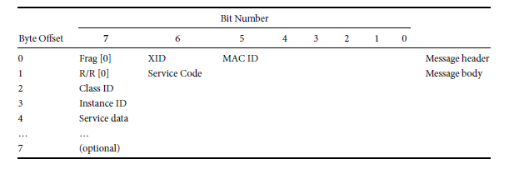
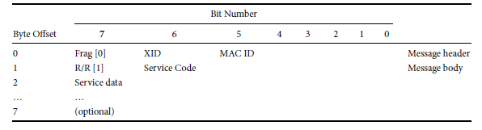
DeviceNet(Cont...)
EXPLICIT MESSAGING
All Explicit Messaging in DeviceNet is done via connections and the associated Connection Object instances. However, these objects first must be set up in the device. This can be done by using the Predefined Master Slave Connection Set to activate a static Connection Object already available in the device or by using the UCMM port of a device, to dynamically set up a Connection Object for Explicit Messaging.
Nonfragmented Explicit Request Message Format
Nonfragmented Explicit Response Message Format

Slide 39
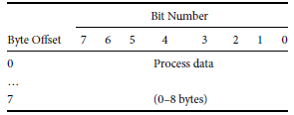
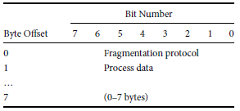
DeviceNet(Cont...)
I /O MESSAGING
Since DeviceNet does not use a Real-Time Header or Sequence Count Value like ControlNet and EtherNet/IP do, I/O Messages in DeviceNet have a very compact structure. For I/O data transfers up to 8 bytes long, the data are sent in a nonfragmented message, which uses the entire CAN data field for I/O data. For I/O data transfers longer than 8 bytes, a fragmentation protocol spreads the data over multiple frames.
Nonfragmented I/O Message Format
Fragmented I/O Message Format

Slide 40
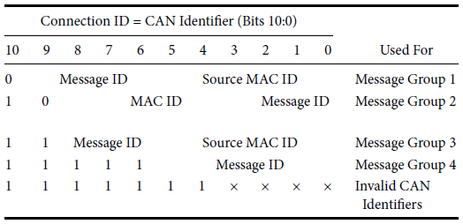
DeviceNet(Cont...)
USING THE CAN IDENTIFIER
DeviceNet is based on the standard CAN protocol and therefore uses an 11-bit message identifier. A distinction therefore can be made between 211 = 2048 messages. The 6-bit MAC ID field is sufficient to identify a device because a DeviceNet Network is limited to a maximum of 64 participants.
The bitwise arbitration mechanism of CAN determines the priority of messages on DeviceNet. When two nodes transmit simultaneously, the numerically lower CAN Identifier value will win arbitration. The arbitration mechanism is explained in the CAN specification [11]. A detailed description is beyond the scope of this document, but in short, transmitted bits are shifted onto the wire most significant bit first, so a zero in the upper bit positions will take precedence over a one.
Definition of the Message Groups.

Slide 41
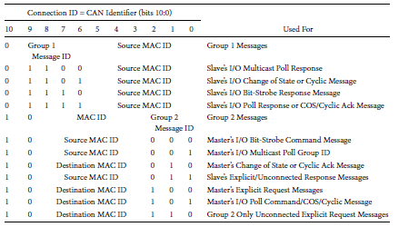
DeviceNet(Cont...)
PREDEFINED MASTER SLAVE CONNECTION SET
Establishing a connection via the UCMM port requires a relatively large number of steps that must be completed to allow data exchange via DeviceNet, and the devices must provide resources to administer the dynamic connections. Because every device can set up a connection with every other device and the source MAC ID of the devices is contained in the CID, the CAN Identifier (CID) may have to be filteredvia software.
The Predefined Master Slave Connection Set defines an alternate way to establish connections called the Group 2 Only Unconnected Explicit Request Port. This method allows a device to limit the messages received to only those in Group 2 with its own MAC ID.
CONNECTIONS
Polled I/O Connection
Bit-Strobe I/O Connection
Change of State/Cyclic I/O Connection
Multicast Polled I/O Connection
I/O Data Sharing
Typical Master Slave Start Sequence
QuickConnect Connection Establishment
Master Slave Summary
Connection IDs of the Predefined Master Slave Connection Set

Slide 42
DeviceNet(Cont...)
CONFIGURATION
DeviceNet devices typically come with EDSs as described in Section 9.2.7. EDS files for DeviceNet devices can make full use of all EDS features, but they do not necessarily contain all sections. Typical DeviceNet devices contain (apart from the mandatory sections) at least an IO_Info section.
This section specifies which types of Master Slave connections are supported and which one(s) should be enabled as defaults. It also tells which I/O Connections may be used simultaneously
TOOLS
Physical layer (hardware and/or software)
Configuration tools (software tools)
Monitoring tools(PC-based software packages)

Slide 43
DeviceNet(Cont...)
ADVICE FOR DEVELOPERS
Slave functionality
Group 2 Server vs. Group 2 Only Server.
Master functionality
Combination of Master and Slave functionality
What are the configuration requirements?
What design and verification tools should be used?
What type of hardware should be chosen for this product?
DeviceNet SUMMARY
Since its introduction in 1994, DeviceNet has been used successfully in tens of millions of nodes in many different applications. It is a de facto standard in many countries, which is reflected in several national and international standards.
Due to its universal communication characteristics, it is one of the most versatile networks for low-end devices.

Slide 44
ControlNet
INTRODUCTION
Introduced in 1997, ControlNet is a deterministic digital communications network that provides highspeed transport of time-critical I/O and explicit messaging data—including upload/download of programming and configuration data and peer-to-peer messaging—on a single physical media link. Each device and/or controller is a node on the network.
ControlNet is a producer/consumer network that supports multiple communication hierarchies and message prioritization. ControlNet systems offer a single point of connection for configuration and control by supporting both implicit (I/O) and explicit messaging.
RELATIONSHIP TO STANDARDS
Like other CIP Networks, ControlNet follows the OSI model, an ISO standard for network communications that is hierarchical in nature. Networks that follow this model define all necessary functions, from physical implementation up to the protocol and methodology to communicate control and information data within and across networks.

Slide 45
ControlNet(Cont…)
ControlNet Features
ControlNet is a high-speed deterministic industrial communication system with the following features:
Trunkline/dropline configuration (copper media), star configuration (optical media)
Support for media redundancy
Support for up to 99 nodes
Node insertion or removal while the network is up and running
Use of sealed or open-style connectors
Fixed baud rate (5 Mbaud)

Slide 46
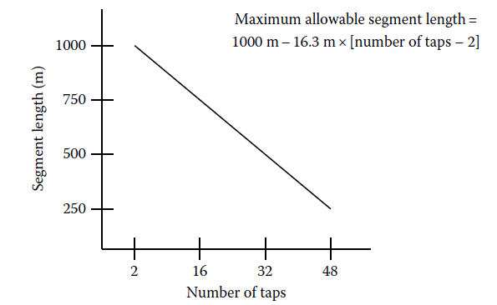
ControlNet(Cont…)
CONTROLNET PHYSICAL LAYER
The physical layer of ControlNet has been designed specifically for this network; it does not reuse any existing open technology. The basis of the physical layer is a 75 Ω coaxial trunkline (typically of RG-6 type cable) terminated at both ends with 75 Ω terminating resistors.
This physical layer limitation is addressed by including repeaters that can increase the network size without lowering the speed. Therefore, if a network is to be built with a higher number of nodes (up to 99 nodes are possible) or with a topology that goes beyond the single trunk line limitations, repeaters can be used to extend the bus.
The number of repeaters between any two nodes was initially limited to five, but further technology developments now allow up to 20 repeaters in series.
Coax medium topology limits

Slide 47
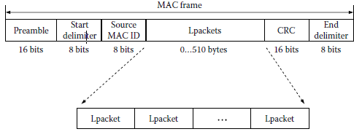
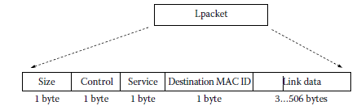
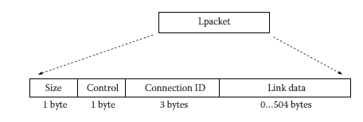
ControlNet(Cont…)
FRAME STRUCTURE
Within every MAC frame, a field of up to 510 bytes is available for transmitting data or messages. This field may be populated with one or several Lpackets (link packets).
There are two types of Lpacket formats: fixed tag and generic tag. Fixed tag Lpackets are used for Unconnected Messaging and network administration packets, while the generic tag Lpackets are used for all Connected Messaging (I/O and Explicit).
MAC Frame Format
Fixed tag Lpacket format.
Generic tag Lpacket format.

Slide 48
ControlNet(Cont…)
PROTOCOL ADAPTATION
ControlNet can use all features of CIP. The ControlNet frame is big enough that fragmentation is rarely required and thus is only provided by application-specific services that might require it. Since ControlNet is not used in very simple devices, no scaling is required.
INDICATORS AND SWITCHES
ControlNet devices must be built with Device Status and Network Status indicators as described in the specification. Devices may have additional indicators that must not carry any of the names of those described in the specification.
Devices may be built with or without switches or other directly accessible means for configuration. If switches for the MAC ID exist, then certain rules apply regarding how these values must be used at power-up and during the operation of the device.

Slide 49
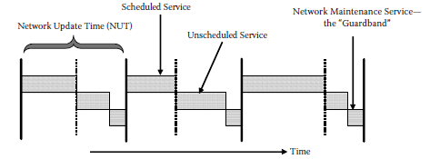
ControlNet(Cont…)
ADDITIONAL OBJECTS
ControlNet Object (Class ID: 0xF0)
Keeper Object (Class ID: 0xF1)
Scheduling Object (Class ID: 0xF2)
NETWORK ACCESS
ControlNet’s bus access mechanism allows full determinism and repeatability while still maintaining sufficient flexibility for various I/O Message triggers and Explicit Messaging. This bus access mechanism is called
Concurrent Time Domain Multiple Access (CTDMA)
Media access through CTDMA (Concurrent Time Domain Multiple Access).

Slide 50
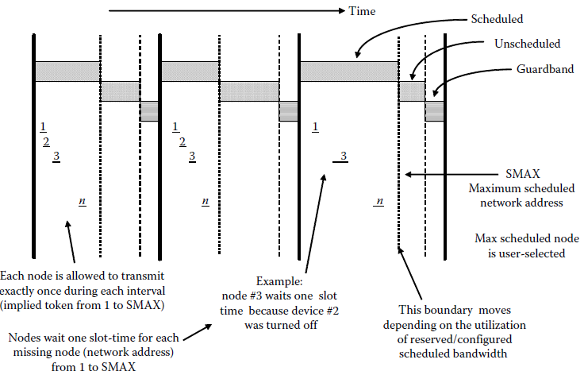
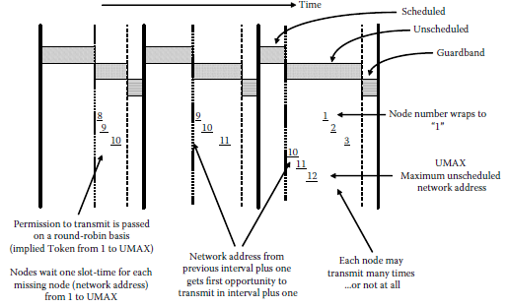
ControlNet(Cont…)
NETWORK ACCESS(Cont…)
Scheduled Service
UnScheduled Service
Every node up to, and including, the SMAX node (maximum node number participating in the Scheduled Service) has a chance to send a message within the Scheduled Service.
Since this service is designed for nontime-critical messages, only one node is guaranteed access to the bus during the Unscheduled ServiceTime.

Slide 51
ControlNet(Cont…)
EXPLICIT MESSAGING
Explicit Messages on ControlNet, unlike those on DeviceNet, can be sent either connected or unconnected; both are transmitted within the unscheduled part of the NUT. Connected Explicit Messaging requires setting up a connection before messages are exchanged.
Unconnected explicit messaging should be used only when the application requires very irregular and infrequent request intervals.
I/O MESSAGING
ControlNet I/O Messaging is accomplished using connections and always takes place in the scheduled part of the NUT.
Only one MAC frame may be transmitted by any device within its time slot, but this MAC frame may contain multiple Lpackets so that data can be sent to multiple nodes in one NUT.
I/O Messages use the generic tag Lpacket format. The link data field contains the I/O data prefixed with a 16-bit Sequence Count Value for the packet.

Slide 52
ControlNet(Cont…)
DEVICE CLASSES
The minimal device function is that of an Explicit Message Server, which is used for Explicit Messaging applications only and acts as a target for Unconnected and (optionally) Connected Explicit Messages, for example, for program upload/download, data collection, status monitoring, etc.
The next device class is an I/O Server, which adds I/O Messaging Support to an Explicit Message Server device and acts as a target for both Explicit and I/O Messages, for example, simple I/O Devices, Pneumatic Valves, and AC Drives. These devices are also called I/O Adapters.
Another device class is an Explicit Message Client, which adds client support to Explicit Message Server applications and acts as a target and as an originator for explicit messaging applications, for example, computer interface cards and HMI devices.
The most powerful type of device is an I/O Scanner, which adds I/O Message origination support to the functionality of all the other device classes and which acts as a target and as an originator for Explicit and I/O Messages, for example, PLCs and I/O Scanners.

Slide 53
ControlNet(Cont…)
CONFIGURATION
ControlNet devices typically come with EDSs as described. For EDS-based configuration tools, the EDS should contain a Connection Manager section to describe the details of the connections that can be made into the device.
An EDS may also contain individual parameters and/or a Configuration Assembly with a complete description of all parameters within this assembly.
TOOLS
Physical layer (hardware and/or software)
Configuration tools (software tools)
Monitoring tools(PC-based software packages)

Slide 54
ControlNet(Cont…)
ADVICE FOR DEVELOPERS
What functionality does the product require today and in future applications?
Explicit Messaging server only.
I/O Adapter functionality.
Explicit Messaging client.
I/O Scanner functionality.
What are the physical layer requirements? Is IP 65/67 required, or is IP 20 good enough?
Will the development be based on commercially available hardware components and software packages (recommended) or designed from scratch (possible but costly)?
What are the configuration requirements?
What design and verification tools should be used?
When and where will the product be tested for conformance and interoperability?
What is an absolute must before products can be placed on the market (own the specification, have the company’s own Vendor ID, and have the product conformance tested)?

Slide 55
EtherNet/IP
INTRODUCTION
Introduced in 2000, EtherNet/IP is another member of the CIP family. Using CIP as its upper-layer protocol, EtherNet/IP extends the application of Ethernet TCP/IP to the plant floor.
Due to the length of Ethernet frames and the typical multi-master structure of Ethernet networks, there are no particular limitations in the EtherNet/IP implementation of CIP. Basically, all that is required is a mechanism to encode CIP messages into Ethernet frames.
RELATIONSHIP TO STANDARDS
Like other CIP Networks, EtherNet/IP follows the OSI model, an ISO standard for network communications that is hierarchical in nature.
Ethernet has its roots in the office computing environment, which is not traditionally concerned with determinism like industrial applications.
EtherNet/IP is also described in international standards, that is, the IEC fieldbus standards.

Slide 56
EtherNet/IP(Cont..)
ETHERNET/IP FEATURES
EtherNet/IP is a communication system built on standard, unmodified Ethernet with the following features:
Built on and compliant with the relevant Ethernet standards, not just compatible with them.
Fully independent of data rate: 10, 100, 1000 Mbps.
Systems can be built with standard infrastructure.
Virtually unlimited number of nodes in a network.
Networks can be structured into subnets with IP routers.
Full support of communication across subnets since EtherNet/IP uses IP addressing for all communication.
Non-real-time communication and real-time communication can coexist in the same subnet.
Support for coordinated drives and motion control.
Support for DLR that provides single fault tolerance through media redundancy
QuickConnect for devices that are frequently removed from and added to the network.
Coexistence with other upper-layer protocols, such as HTTP, FTP, and VOIP

Slide 57
EtherNet/IP(Cont..)
ETHERNET/IP PHYSICAL LAYER
Since EtherNet/IP takes the Ethernet protocol to the factory floor, recommendations are made in regarding grounding, isolation, and cable and connector construction that are designed to make EtherNet/IP successful in a typical factory automation environment.
The two levels of performance criteria are:
The commercial off-the-shelf (COTS) EtherNet/IP Level provides basic Ethernet connectivity.
The industrial EtherNet/IP Level goes beyond the COTS Level by specifying minimum environmental, cabling, and connector requirements that include IEC, ANSI/TIA/EIA standards.

Slide 58
EtherNet/IP(Cont..)
PROTOCOL ADAPTATION
EtherNet/IP can use all features of CIP. The Ethernet frame is big enough that fragmentation is rarely required. If it is required, fragmentation is automatically handled by IP fragmentation provided by TCP/IP and UDP/IP.
INDICATORS AND SWITCHES
EtherNet/IP devices that need to conform to the industrial EtherNet/IP Level must have the two indicators set forth in the specification: Module Status and Network Status. Devices may have additional indicators that must not carry any of the names of those described in the specification.

Slide 59
EtherNet/IP(Cont..)
ADDITIONAL OBJECTS
TCP/IP Interface Object (Class ID: 0xF5)
Ethernet Link Object (Class ID: 0xF6)
Device Level Ring Object (Class ID: 0x47)
QoS Object (Class ID: 0x48)
Base Switch Object (Class ID: 0x51)
Simple Network Management Object (Class ID: 0x52)
Power Management Object (Class ID: 0x53)
RSTP Bridge Object (Class ID: 0x54)
RSTP Port Object (Class ID: 0x55)
Parallel Redundancy Protocol Object (Class ID: 0x56)
PRP Nodes Table Object (Class ID: 0x57)

Slide 60
EtherNet/IP(Cont..)
IP ADDRESS ASSIGNMENT
Since the initial development of TCP/IP, numerous methods for configuring a device’s IP address have evolved. Not all of these methods are suitable for industrial control devices.
However, for an industrial control device that is a target of communication requests, the IP address cannot change at each power-up. A PLC, for example, must be at the same address each time it powers up.
ADDRESS CONFLICT DETECTION
Since IP addresses are often assigned by human interaction or as a default private address by the device manufacturer (e.g., 192.168.1.1), it is not uncommon to find multiple devices on the same network with the same IP address. This situation is undesirable; therefore, duplicate IP address detection and the subsequent address conflict resolution have been defined for EtherNet/IP.

Slide 61
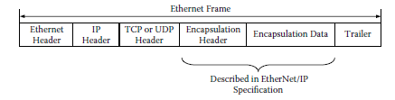
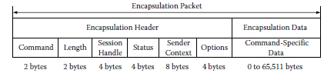
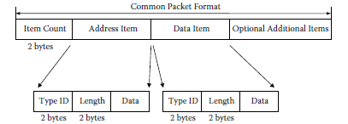
EtherNet/IP(Cont..)
ETHERNET/IP ENCAPSULATION
EtherNet/IP is based entirely on existing TCP/IP and UPD/IP technologies and uses them without any modification. TCP/IP is mainly used for the transmission of Explicit Messages while UDP/IP is used mainly for I/O Messaging.
Relationship between CIP and Ethernet frames.
Structure of the encapsulation packet.
Example of the Common Packet Format.

Slide 62
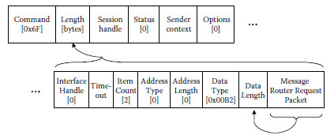
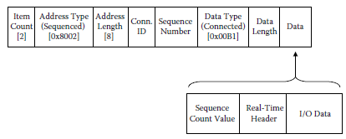
EtherNet/IP(Cont..)
USE OF THE ENCAPSULATION DATA
Explicit Messaging
Explicit Messages on EtherNet/IP can be sent either connected or unconnected.
This means that all resources required for managing the connection are reserved for this purpose as long as the connection exists, which allows for more timely responses to message requests.
UCMM request encapsulation
I/O Messaging
The data field contains the I/O data prefixed with a 16-bit Sequence Count Value for the packet. I/O data transmission without the Sequence Count Value is possible, but it is used only for CIP Safety connections.
I/O Messages from the originator to the target are typically sent as UDP unicast frames, while those sent from the target to the originator can be sent as UDP multicast or unicast frames.
I/O Message encapsulation.

Slide 63
EtherNet/IP(Cont..)
QUICKCONNECT CONNECTION ESTABLISHMENT
While most applications can wait several seconds until a connection is established, there are certain application scenarios that require a device to be operational with only a very short delay after the application of power.
Fast establishment of I/O connections:
If more than one EtherNet/IP device is mounted onto the exchangeable tool, embedded infrastructure with defined start-up behavior must be used.
In preparation of a restart, every connection that participates in the QuickConnect application must be shut down using the Forward_Close service before disconnecting the device.
When the device has responded to the Forward_Close request, it closes the TCP connection with the I/O Scanner.
At the restart of any QuickConnect device, the I/O Scanner receives notification of power reapplication through a contact in the tool changer.
The I/O Scanner then waits for a predetermined time (described in the EDS) before a connection is reestablished.

Slide 64
EtherNet/IP(Cont..)
CONFIGURATION
EtherNet/IP devices typically come with EDSs. For EDS-based configuration tools, the EDS should contain a Connection Manager section to describe the details of the connections that can be made into the device.
An EDS also may contain individual parameters and/or a Configuration Assembly with a complete description of all parameters within this assembly.
REQUIREMENTS FOR TC P/IP SUPPORT
All EtherNet/IP devices shall at a minimum support
Internet Protocol (IP version 4) (RFC 791 [21])
User Datagram Protocol (UDP) (RFC 768 [20])
Transmission Control Protocol (TCP) (RFC 793 [22])
Address Resolution Protocol (RFC 826 [30])
Internet Control Messaging Protocol (RFC 792 [31])
Internet Group Management Protocol (IGMP) (RFC 1112 [32] and 2236 [26])
IEEE 802.3 (Ethernet) as defined in RFC 894 [33]

Slide 65
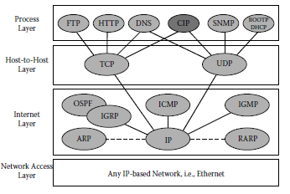
EtherNet/IP(Cont..)
COEXISTENCE OF ETHERNET/IP AND OTHER ETHERNET-BASED PROTOCOLS
EtherNet/IP devices are encouraged, but not required, to support other Ethernet-based protocols and applications not specified in the EtherNet/IP Specification.
This means that anyone who is already using some or all of these popular Ethernet services can add CIP without undue burden; the existing services like HTTP or FTP may remain as before, and CIP will become another service on the process layer.
Relationship of CIP to other typical Ethernet protocols.

Slide 66

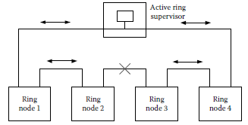
EtherNet/IP(Cont..)
TOPOLOGIES
Many end-user applications benefit from connecting devices in a linear or ring topology. With such a topology, end devices typically have two Ethernet ports (with an embedded switch) and are connected in sequence, one device to the next.
Linear topology.
Normal DLR Operation (Device Level Ring)
Each node has two Ethernet ports, has implemented an embedded switch, and supports DLR. When a ring node receives a packet on one of its Ethernet ports, it determines whether the packet needs to be received by the ring node itself (e.g., the packet has this node’s MAC address as the destination MAC address) or whether the packet should be sent out the other Ethernet port.
The presence of Beacon and Announce frames inform ring nodes to transition from linear topology mode to ring topology mode.
Loss of Beacon frames at the supervisor enables detection of certain types of ring faults. (Note that normal ring nodes are also able to detect and announce ring faults.)
The Beacon frames carry a precedence value, allowing selection of an active supervisor when multiple ring supervisors are configured.
Normal DLR Operation

Slide 67
EtherNet/IP(Cont..)
RING FAULTS
Ring faults may include common link failures such as device power failure or media disconnection, or higher-level failures where the physical layer is active but the device has failed. Ring nodes also flush their unicast MAC tables upon detecting loss of the Beacon in one direction or upon receipt of Beacon or Announce frames with the ring state value indicating the ring fault state. Flushing the unicast MAC tables at both supervisor and ring nodes is necessary for network traffic to reach its intended destination after the network reconfiguration.
ETHERNET/IP SUMMARY
A major strength of EtherNet/IP is the fact that it does not require a modified or highly segregated network: standard switches and routers used in the office world can be used for industrial applications without modification.

Slide 68
CompoNet
INTRODUCTION
CompoNet is a low-level network that provides high-speed communication between higher-level devices such as controllers and simple industrial devices such as sensors and actuators.
COMPONET FEATURES
Selectable data rates: 4 Mbps/3 Mbps/1.5 Mbps/93.75 kbps.
Single master network with a large number of slave nodes: 384 slave devices maximum including WordIN: 64; WordOUT: 64; BitIN: 128; BitOUT: 128.
Up to 64 repeaters per network to expand physical covering area and to adapt different cables.
Up to 32 nodes (slaves and repeaters) per segment.
I/O capacity: 1280 input/1280 output points.
Support for flat 4-wire, round 4-wire, and 2-wire cables in bus and branch topologies.
Maximum of three segment layers. This means up to two repeaters are allowed between any slaveand the master.
30/30/100/500 m maximum trunk cable distance with respect to data rates, Trunkline/dropline except for 4 Mbps.

Slide 69

CompoNet(Cont..)
COMPONET PHYSICAL LAYER
The physical layer of CompoNet has been designed specifically for this network; it does not reuse any existing open technology.
CompoNet uses a transformer-coupled transmission method and a Manchester-encoded signal on the wire; the principal circuit of the physical media attachment.
Physical media attachment of CompoNet.
RELATIONSHIP TO STANDARDS
Like other CIP Networks, CompoNet follows the OSI model, an ISO standard for network communications that is hierarchical in nature.

Slide 70

CompoNet(Cont..)
FRAME STRUCTURE
A typical message frame is composed of the Preamble, Command Code, Command Code–Dependent Block(s), and Cyclic Redundancy Code (CRC).
There are seven types of frames with varying lengths of command codes
OUT Frame
TRG Frame
CN Frame
IN Frame
A_EVENT Frame
B_EVENT Frame
BEACON Frame
General frame.

Slide 71

CompoNet(Cont..)
NETWORK ACCESS
In a CompoNet network, the master controls bus communications according to its configuration. A master divides a communication cycle into several time domains or time slots.
Time domains.
OUT Time Domain
The master sends an OUT frame or a TRG frame in this period.
CN Time Domain
CN frames are sent in this period. The number of CN frames sent in this time domain is determined by the master.
IN Time Domain
IN frames are sent in this period consecutively by all input-type devices.
EXTEND Time Domain
The master executes message communications in this period. Event frames, that is, A_EVENT frames and B_EVENT frames, can be sent in this period. BEACON frames shall be sent periodically. The master can send a BEACON before every OUT Time Domain starts or in an idle EXTEND Time Domain.

Slide 72
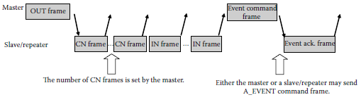
CompoNet(Cont..)
NETWORK ACCESS(Cont…)
During the IN Time Domain, IN frames are sent by any IN devices that are in the Participated State, at the predefined time sequence
A typical communication cycle.
CompoNet has an algorithm that controls the network access of any of the slaves and repeaters. This is a combination of actions taken by the slave itself and commands from the master using Status Read and Status Write (STW) operation.
The detection of duplicate node IDs is also a combination of master and slave actions. The slave will go to the Communication Fault state if told to do so by the master through an STW_Dup command or when its CN Counter overflows due to communication errors caused by duplicate node IDs.

Slide 73

CompoNet(Cont..)
EXPLICIT MESSAGING
CompoNet uses UCMM for explicit messaging; there is no connection-based Explicit Messaging.
Explicit Messages are encapsulated into A_EVENT frames.
A_EVENT frame format.
Two types of explicit message formats are defined:
Compact 1 Octet Class ID and Instance ID (required)
Expanded—CIP EPATH (optional)

Slide 74
CompoNet(Cont..)
I/O MESSAGING
I/O Messages on CompoNet, like on any other CIP network, are always exchanged in a connection based manner. Communication Objects must be set up for this purpose.
CompoNet uses OUT frames to deliver output data to consuming slaves and to trigger IN frame transmission, IN frames to deliver produced data to the master, and TRG frames to trigger IN frame transmission when the master has no output data to send.
I/O CONNECTION ESTABLISHMENT
Similar to DeviceNet, a CompoNet slave is allocated by the master by sending an Allocate Service to the CompoNet Link Object of the slave that is to be allocated.
When an I/O Connection is no longer needed, a slave can be released by sending a Release Service to the slave’s CompoNet Link Object.

Slide 75
CompoNet(Cont..)
DEVICE PROFILES
Bit Slave or Word Slave
Byte size differences
CONFIGURATION
CompoNet devices typically come with EDSs.
To support EDS-based configuration, several CompoNet-specific EDS keywords have been added.
CompoNet can also be configured by FDT/DTM
CONCLUSIONS
CompoNet is a well-adapted CIP network. It complies with the CIP object modeling, object addressing, as well as the CIP communication model and its configuration rules. It is easy to realize CIP network routing and bridging.

Slide 76
Benefits of the CIP Family
CIP offers distinct benefits for two groups:
1. Device manufacturers
2. Users of devices and systems
BENEFITS FOR DEVICE MANUFACTURERS
For device manufacturers, a major benefit of using CIP is the fact that existing knowledge can be reused from one protocol to another, resulting in lower training costs for development, sales, and support personnel.
Another important advantage for manufacturers is the easy routing of messages from one system to another. Any routing device can be designed very easily since there is no need to invent a translation from one system to another; both systems already speak the same language.

Slide 77
Benefits of the CIP Family (Cont…)
Benefits for the Users of Devices and Systems
For users of devices and systems, a major benefit of using CIP is the fact that existing knowledge can be reused from one protocol to another.
CIP advantage is the ease of bridging and routing between CIP Networks.
Services and status codes share the same benefit, as these, too, are identical over all CIP Networks.
Even though these networks may be used in different parts of the application, messaging from beginning to end really functions as if there is only one network.
Finally, the Producer/Consumer mechanisms used in all CIP Networks provide highly efficient use of transmission bandwidth, resulting in system performance that often is much higher than that of other networks running at higher raw baud rates.

Slide 78
Application Layer Enhancements
CIP SYNC AND CIP MOTION
General Considerations
Real-Time
Determinism
Reaction Time
Jitter
Synchronicity
Data Throughput
Using IEEE 1588 Clock Synchronization
The published IEEE standard 1588—Standard for a Precision Clock Synchronization Protocol for Networked Measurement and Control Systems [48]—lays the foundation for a precise synchronization of real-time clocks in a distributed system.
An IEEE 1588 system consists of a Time Master that distributes its system time to Time Slaves in a tree-like structure.
This protocol has been fully defined for Ethernet UDP/IP systems, and the protocol details for further industrial communication systems will follow.

Slide 79
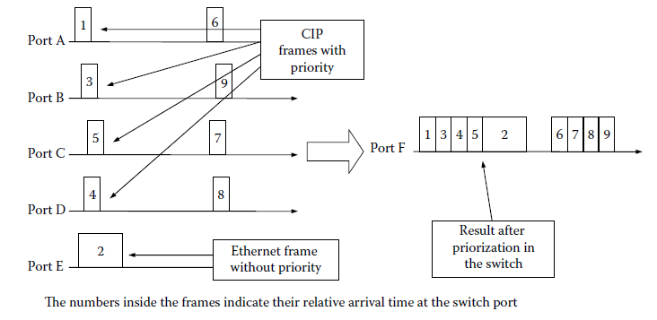
Application Layer Enhancements(Cont…)
CIP SYNC AND CIP MOTION(Cont…)
Message Prioritization
Ethernet Frame Prioritization.

Slide 80
Application Layer Enhancements(Cont…)
CIP SYNC AND CIP MOTION(Cont…)
Message Prioritization(Cont…)
For CIP transport class 0 and 1 connections (i.e., UDP-based), there is a defined mapping of CIP priorities to 802.1D priorities and DiffServ Code Points.
For UCMM and CIP transport class 3 connections (i.e., TCP-based), there is a single defined
DiffServ Code Point and 802.1D priority value. For PTP (IEEE 1588) messages, there are DiffServ Code Points and 802.1D priority values corresponding to the two different types of PTP messages.
The QoS Object provides a means to configure DSCP values and a means to enable/disable sending of 802.1Q tagged frames.
There are no requirements for devices to mark traffic other than CIP or IEEE 1588, but devices are free to do so.

Slide 81
Application Layer Enhancements(Cont…)
CIP SYNC AND CIP MOTION(Cont…)
Applications of CIP Sync
Typical applications for CIP Sync are time-stamping sensor inputs, distributed time-triggered outputs, and distributed motion, such as electronic gearing or camming applications.
The application master then calculates the new reference values and sends them to the motion drives. Using CIP Sync, the communication system is not required to have extremely low jitter; it is sufficient to transmit all time-critical messages, and their exact arrival time becomes irrelevant.
As a result of these measures, CIP Sync devices can coexist side by side with other EtherNet/IP devices without any need for network segmentation or special hardware.
CIP Motion
The CIP application profile used on EtherNet/IP provides a comprehensive set of services and device profiles that provide a wide range of functionality and device support.
The CIP Motion profile takes advantage of the latest advances in motion control technology to provide a comprehensive, state-of-the-art profile.

Slide 82
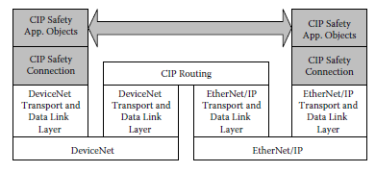
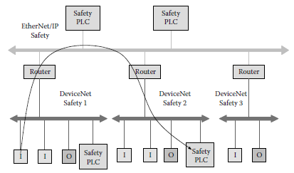
Application Layer Enhancements(Cont…)
CIP SAFETY
Like other safety protocols based on industry standard networks, CIP Safety adds additional services to transport data with high integrity.
General Considerations
Routing of safety data.
Network routing.

Slide 83
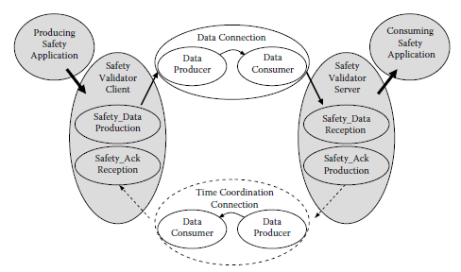
Application Layer Enhancements(Cont…)
CIP SAFETY(Cont…)
Implementation of Safety
The producing safety application uses an instance of a Client Validator to produce safety data and ensure time coordination.
The client uses a link data producer to transmit the data and a link consumer to receive time coordination messages.
The consuming safety application uses a Server Validator to receive and check data.
The server uses a link consumer to receive data and a link producer to transmit time coordination messages.
Relationship of Safety Validators, Unicast Connection

Slide 84
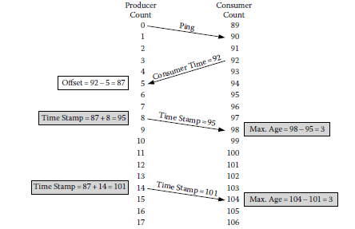
Application Layer Enhancements(Cont…)
CIP SAFETY(Cont…)
Ensuring Integrity
(Time Expectation via Time Stamp, Production Identifier, Safety Cyclic Redundancy Code, Redundancy and Cross-Check, Diverse Measures for Safety and Standard)
CIP Safety does not prevent communication errors from occurring; rather, it ensures transmission integrity by detecting errors and allowing devices to take appropriate actions.
All CIP Safety data are produced with a time stamp that allows Safety Consumers to determine the age of the produced data.
A time stamp allows transmission, media access/arbitration, queuing, retry, and routing delays to be detected.
Time stamp.

Slide 85
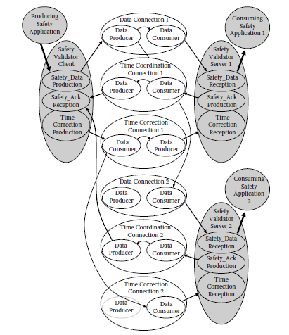
Application Layer Enhancements(Cont…)
CIP SAFETY(Cont…)
Safety Connections
CIP Safety provides two types of Safety Connections:
Unicast Connections
Multicast Connections
When multicast messages are routed off-link, the router combines the data-and-time correction messages from DeviceNet and separates them when messages reach DeviceNet. Since the safety message contents are unchanged, the router provides no safety function.
Multicast Connection on DeviceNet

Slide 86
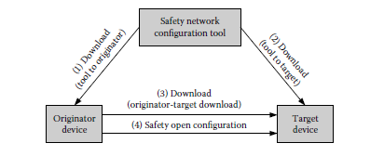
Application Layer Enhancements(Cont…)
CIP SAFETY(Cont…)
Message Packet Sections
CIP Safety has four message sections:
1. Data
2. Time stamp
3. Time correction
4. Time coordination
Configuration
There are two possible sequences for configuration:
1. Configuration tool directly to device
2. Via an intermediate device
Configuration transfers.

Slide 87
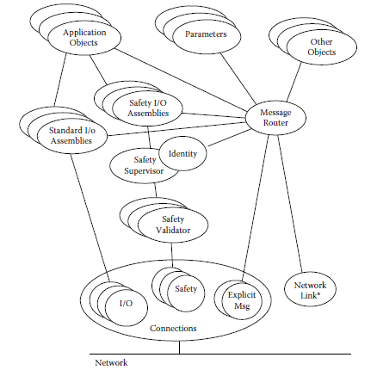
Application Layer Enhancements(Cont…)
CIP SAFETY(Cont…)
Configuration Implementation
CIP Safety provides the following protection measures to ensure configuration integrity:
Safety Network Number
Password Protection
Configuration Ownership
Configuration Locking
Safety Devices
CIP Safety extends the CIP object model, with the addition of Safety I/O Assemblies, Safety Validator, and Safety Supervisor Objects.
Safety device objects

Slide 88
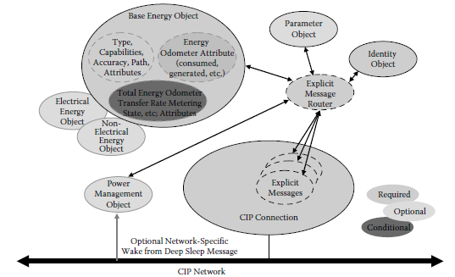
Application Layer Enhancements(Cont…)
CIP Energy
The optimization of energy usage is a natural expansion of ODVA’s application coverage for industrial automation.
The management of energy usage methodology described in the specification defines a set of standard attributes, services, and behaviors that will facilitate the reporting of industrial devices’ use of operational energy and the control of industrial devices into and out of nonoperational energy conserving states.
Additional Objects:
Base Energy Object (Class ID: 0x4E)
Electrical Energy Object (Class ID: 0x4F)
Nonelectrical Energy Object (Class ID: 0x50)
Power Management Object (Class ID: 0x53)
CIP Energy Objects.

Slide 89
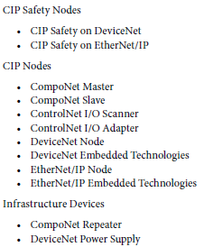
Application Layer Enhancements(Cont…)
Conformance Testing
The ODVA conformance test is typically a composite test comprised of three parts:
An automated software test
A hardware test
An interoperability test
The range of composite conformance tests available from ODVA included those for DeviceNet, ControlNet, EtherNet/IP, and CompoNet devices or family of devices as listed :

Slide 90



