Slide 1
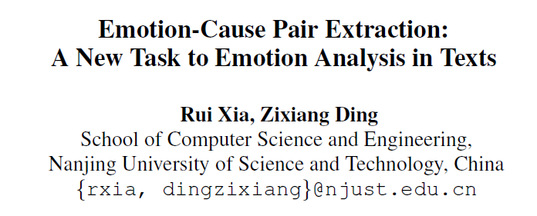
09118120 Haoqing Xu
09118102 Yan Zhang
09118104 Xiao Tan
09118117 Zhengxuan Lu
School of Artificial Intelligence
Southeast University

Slide 2
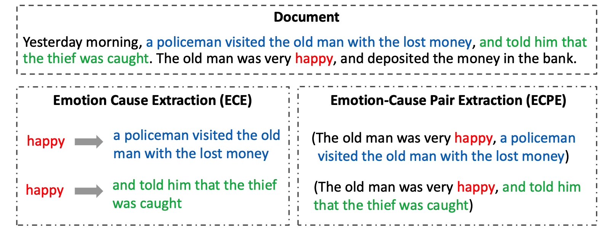
What is Emotion Cause Extraction?
Emotion Cause Extraction Task
There are five clauses in a document. We denote the clause “happy” as an emotion.
We denote “a policeman visited ……” in the second clause and “told him that ……” in the third clause as cause clause.
Fig: An example showing the difference between the ECE task and the ECPE task

Slide 3


What is Emotion Cause Extraction?
Emotion Cause Extraction Task
ECE task: A clause-level binary classification problem
Documents are divided into clauses
Goal: To decide whether a clause is a cause for the given emotion
Find an emotion
Search cause in the text
Find the answer
The lost money was found!
happy

Slide 4
Drawbacks of Emotion Cause Extraction
Emotion Cause Extraction Task
Emotions must be annotated before cause extraction in the test set, which limits the applications of ECE in real-world scenarios.
The way to first annotate the emotion and then extract the cause ignores the fact that emotions and causes are mutually indicative.
Find an emotion
Search cause in the text
Find the answer
The lost money was found!
happy

Slide 5
A New Task: Emotion-Cause Pair Extraction
Emotion-Cause Pair Extraction (ECPE)
We directly extract an emotion-cause pair that detects an emotion together with its cause.
The output result contains an emotion clause (“The old man was very happy”) and a corresponding cause clause (“a policaman…” or “and told him…”)
Fig: An example showing the difference between the ECE task and the ECPE task

Slide 6
A New Task: Emotion-Cause Pair Extraction
Emotion-Cause Pair Extraction (ECPE)
Emotion-Cause Pair Extraction(ECPE) solves the shortcomings of the traditional ECE task
Does not need annotation of emotion before extracting cause
Allows emotion cause analysis to be applied to real-world scenarios
The lost money was found!
Divide into clauses
Find the answer
Causes
happy

Slide 7
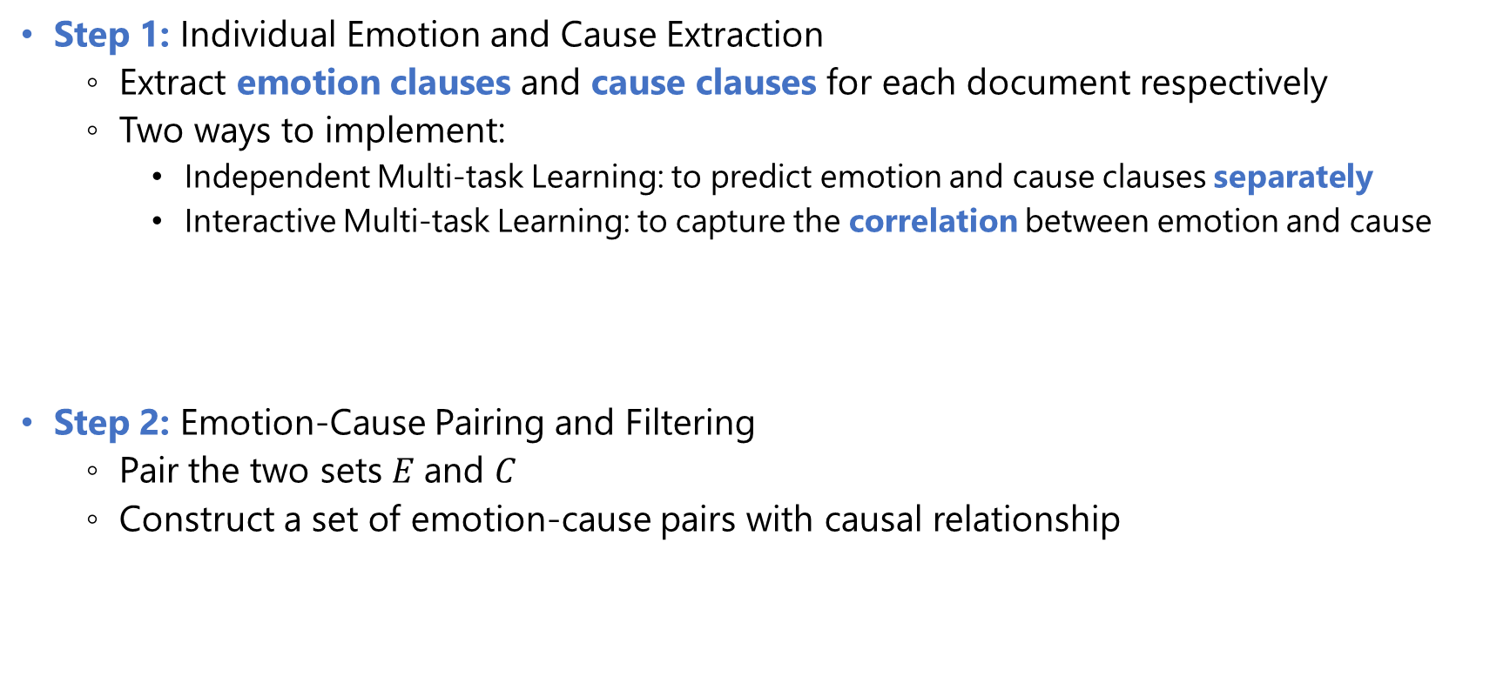
Two-step Framework for ECPE (Original Paper)
Original Two-step Framework for ECPE
Step 1: Individual Emotion and Cause Extraction
Extract emotion clauses and cause clauses for each document respectively
Two ways to implement:
Independent Multi-task Learning: to predict emotion and cause clauses separately
Interactive Multi-task Learning: to capture the correlation between emotion and cause
Step 2: Emotion-Cause Pairing and Filtering
Pair the two sets $E$and $C$
Construct a set of emotion-cause pairs with causal relationship
a set of emotion clauses $E$and a set of cause clauses $C$

Slide 8
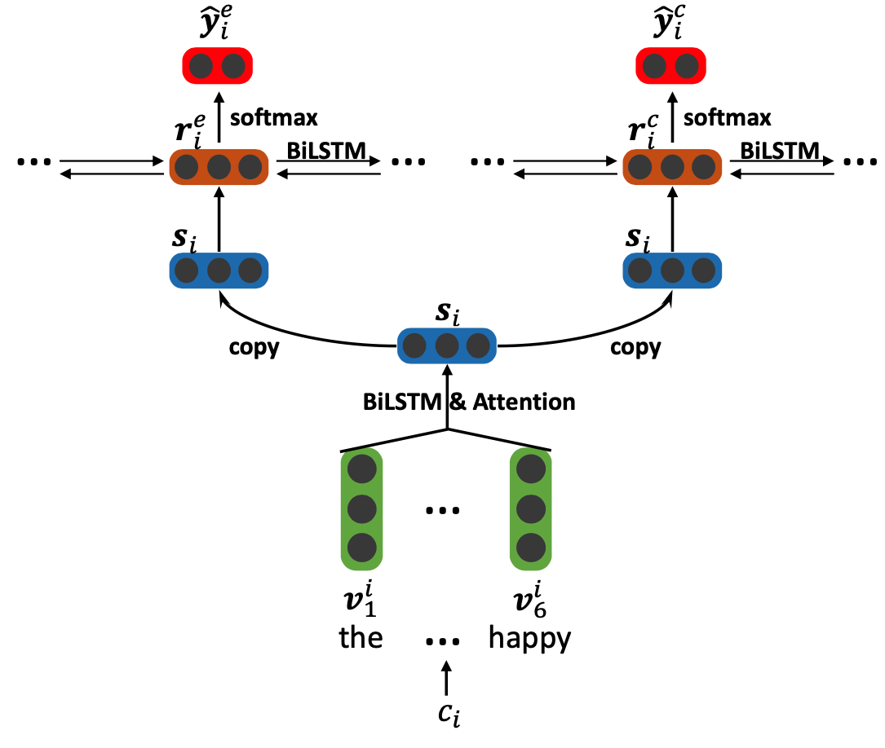
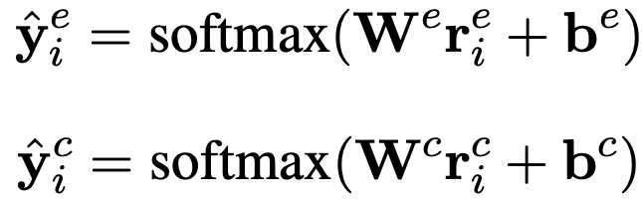

Step 1: Individual Emotion and Cause Extraction
Original Two-step Framework for ECPE
Independent Multi-task Learning
Emotion extraction
Cause extraction
Emotion prediction and cause prediction:
Clause
level
Loss function:
Word
level
clause representation

Slide 9
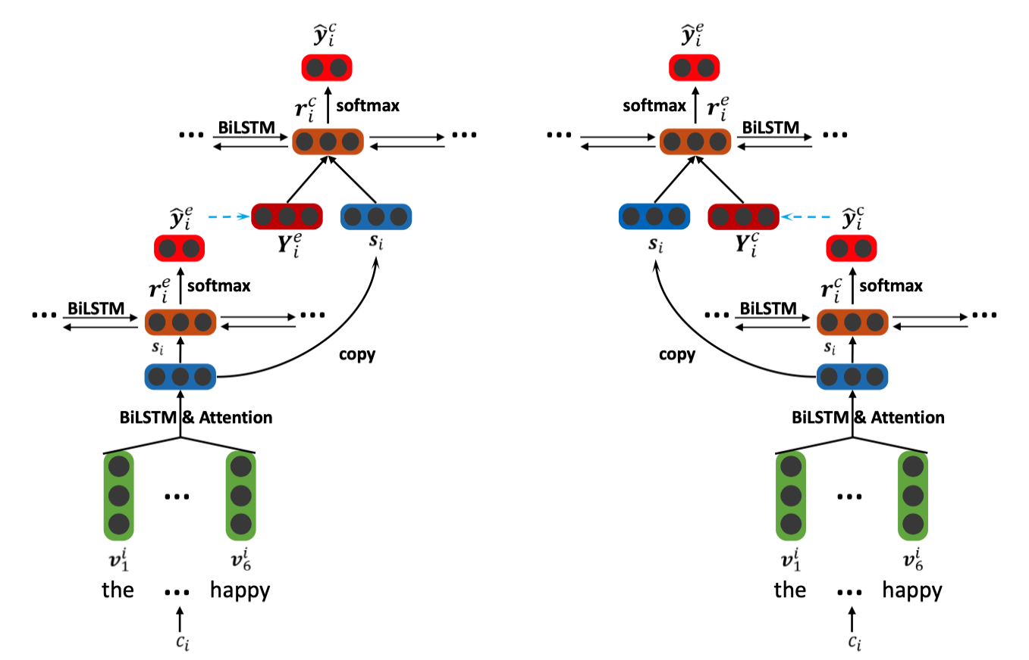





Step 1: Individual Emotion and Cause Extraction
Original Two-step Framework for ECPE
Interactive Multi-task Learning
Motivation: emotion extraction and cause extraction are not mutually independent
Inter-EC
Inter-CE
emotion extraction
cause extraction
cause extraction
emotion extraction
Lower LSTM: similar to Individual MTL
Upper LSTM:
Use the independent clause representation to predict
Use
to predict
Loss function:
Inter-EC
Inter-CE

Slide 10
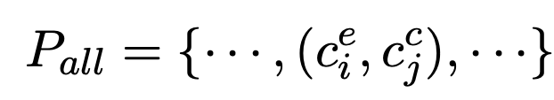
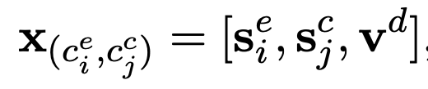

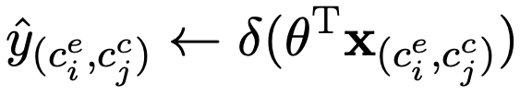
Step 2: Emotion-Cause Pairing and Filtering
Original Two-step Framework for ECPE
Goal: To pair emotions and causes and construct a set of emotion-cause pairs with causal relationship.
Obtain the set of all possible pairs:
Represent each pair by a feature vector:
Train a logistic regression model for each pair
Embeds the distance between clauses

Slide 11




Drawback
Original Two-step Framework for ECPE
End-to-end model
Document
Individual Emotion
and Cause Extraction
Emotion-Cause Pairing and Filtering
Emotion-Cause
Pair Extraction
Two step model

Slide 12
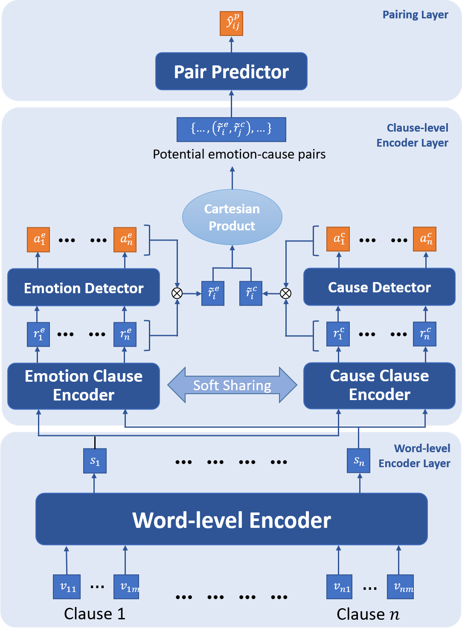
Emiece: An End-to-end Mutually Interactive Emotion-Cause Pair Extractor
Emiece: An End-to-end Mutually Interactive Emotion-Cause Pair Extractor
Our improvement: we propose an end-to-end framework called Emiece to deal with ECPE task
End-to-end emotion-cause pair extraction:
We use an FC layer (the Pair Predictor) for pair prediction and cross entropy for the loss
Mutual soft sharing between clause encoders:
We penalize the distance of the parameters in encoders to share the information
Emotion/Cause soft filtering:
We multiply the clause embeddings with their possibility to be an emotion/cause to help predict the causal pairs

Slide 13
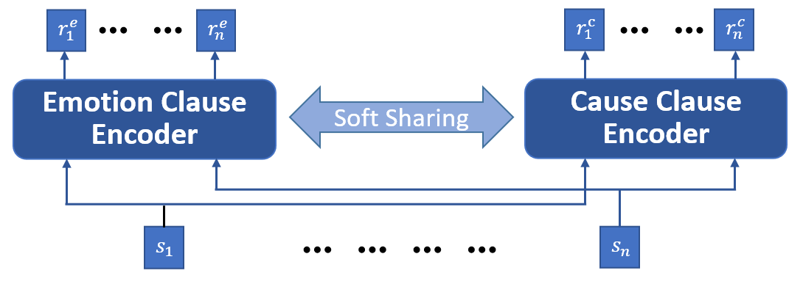



Emiece: An End-to-end Mutually Interactive Emotion-Cause Pair Extractor
Emiece: An End-to-end Mutually Interactive Emotion-Cause Pair Extractor
Mutual soft sharing between clause encoders:
We penalize the distance of the parameters in encoders to share the information
Soft sharing loss:
: the set of shared parameter indices.
: the parameters of emotion encoder and cause encoder, respectively.

Slide 14
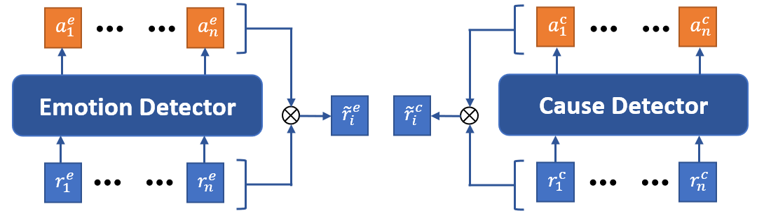
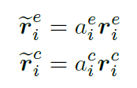
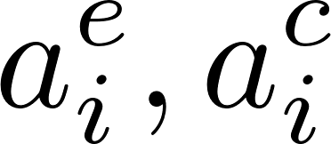
Emiece: An End-to-end Mutually Interactive Emotion-Cause Pair Extractor
Emiece: An End-to-end Mutually Interactive Emotion-Cause Pair Extractor
Emotion/Cause soft filtering:
We multiply the clause embeddings with their possibility to be an emotion/cause to help predict the causal pairs
Emotion/Cause-weighted clause representation:
: the probability predicted by emotion/cause detector (to be an emotion/cause clause)

Slide 15
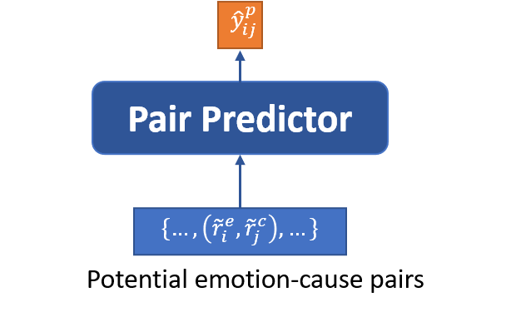

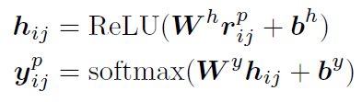
Emiece: An End-to-end Mutually Interactive Emotion-Cause Pair Extractor
Emiece: An End-to-end Mutually Interactive Emotion-Cause Pair Extractor
End-to-end emotion-cause pair extraction:
We use an FC layer (the Pair Predictor) for pair prediction and cross entropy for the loss
Pair representation:
Fully connected predictor:
Embeds the distance between clauses

Slide 16
Results
Experiments
Dataset: The ECPE Corpus in the original paper
The results of different methods (Bold for the best performance, underlined for the 2nd-best)
Baseline:
ECPE: Original Two-step ECPE method
E2E-PExt_{E}: Another end-to-end model with unidirectional information transfer
 | Emotion Extraction |  |  | Cause Extraction |  |  | Pair Extraction
 | Precision | Recall | F1 Score | Precision | Recall | F1 Score | Precision | Recall | F1 Score
ECPE (Origin) | 67.41 | 71.60 | 69.40 | 60.39 | 47.34 | 53.01 | 46.94 | 41.02 | 43.67
E2E-PExt_{E} | 71.63 | 67.49 | 69.43 | 66.36 | 43.75 | 52.26 | 51.43 | 49.29 | 50.17
Emiece (Ours) | 75.16 | 64.85 | 69.38 | 69.22 | 44.26 | 53.80 | 54.38 | 47.73 | 50.70

Slide 17
Contribution
Contribution
 | Survey | Improvement | Coding | Report | Slides
Haoqing Xu
Yan Zhang
Xiao Tan
Zhengxuan Lu

Slide 18
Thanks for Your Attention!

