Slide 1
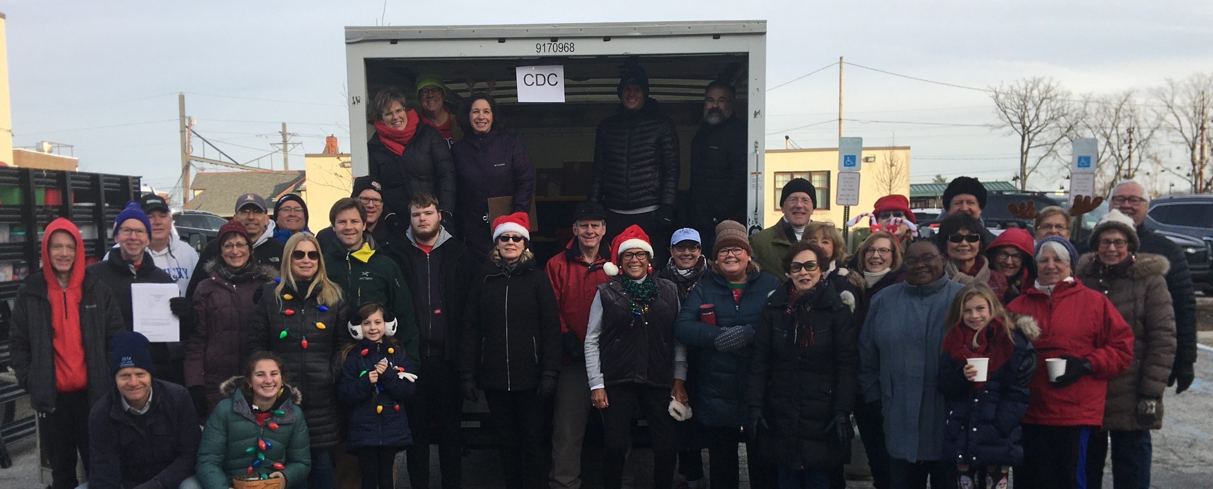
Congregational Care
Care & Compassion
Community Service
Deacons serving every day in so many ways …
Celebrate individual milestones
Record church services
Provide rides to church
Ensure special events for seniors
Support American Red Cross Blood Drives
Collect Christmas and Easter meals & gifts for local partners to provide love our community partners
Twice monthly host Career Networking events for persons underemployed
Provide visitations and connections
Delivery meals at times of need
Support memorial service needs families may have

