Slide 1

Safety Reporting System
Arvinder dhanoa
SuengJun Jung

Slide 2
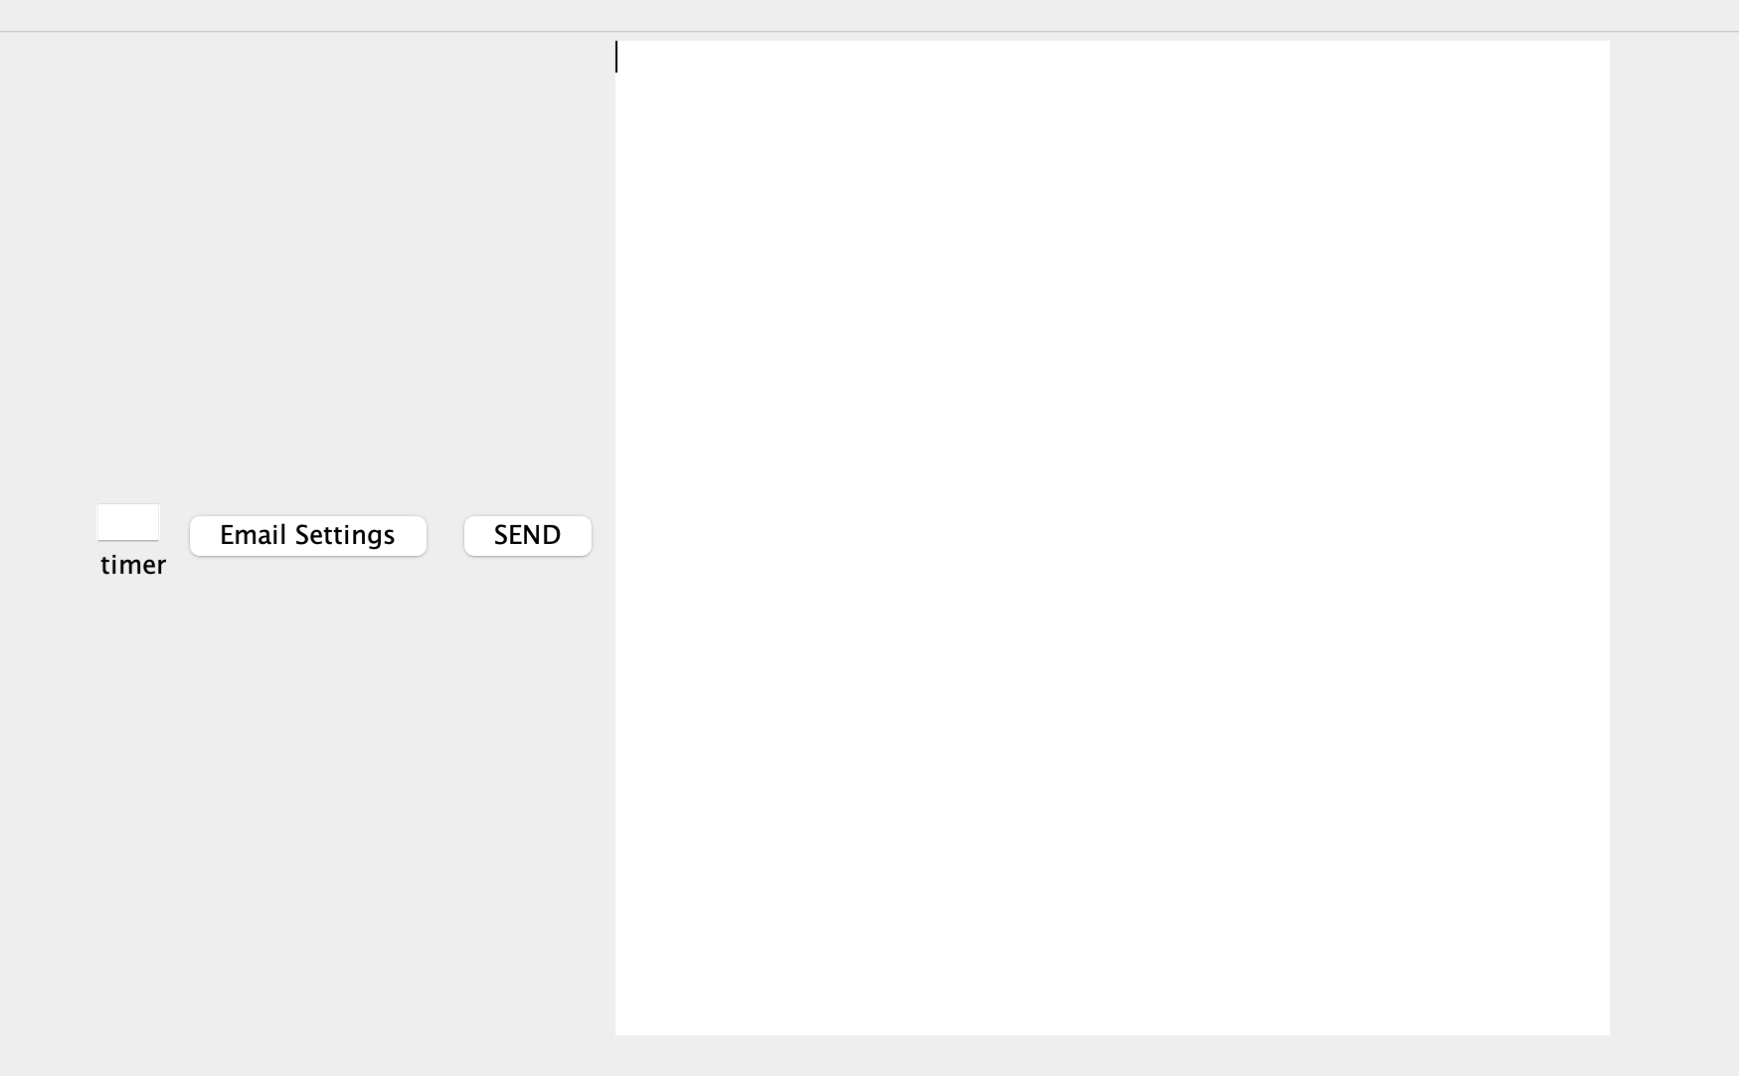
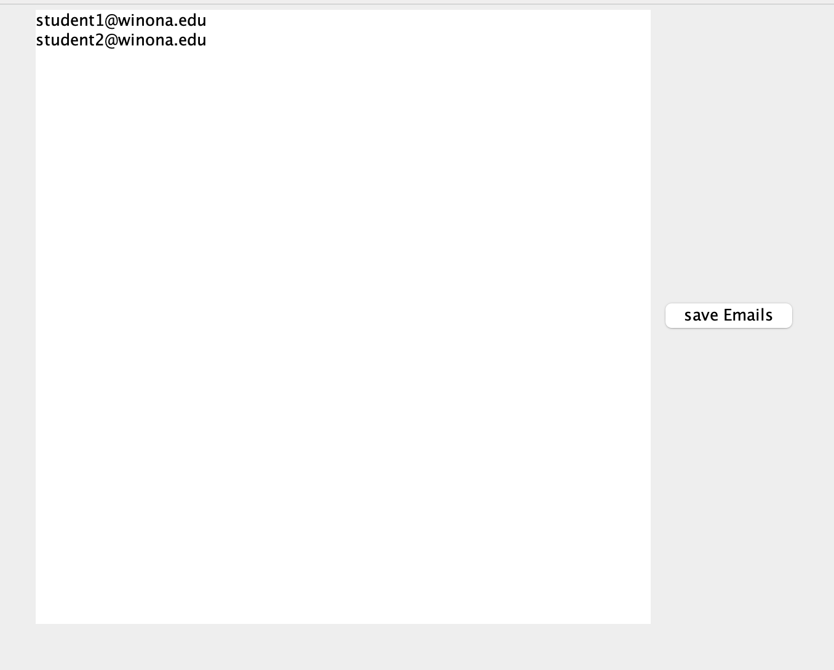
GUI

Slide 3
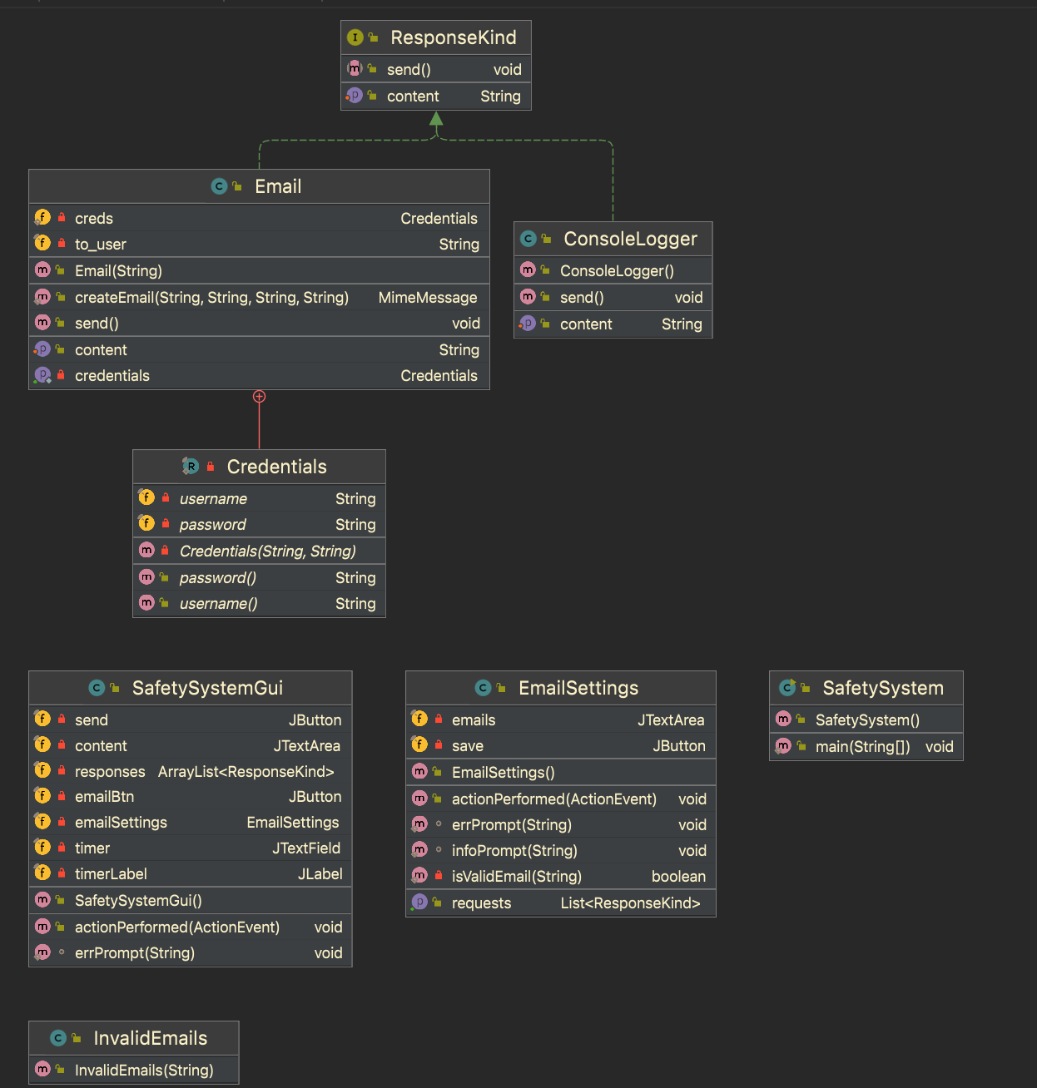
Architecture

Slide 4
Difficulties
Maven
Google API

Slide 5
Things we learned
How to use Git to manage and merge code we both worked on separately
How to send email in Java using SMTP

