Slide 1
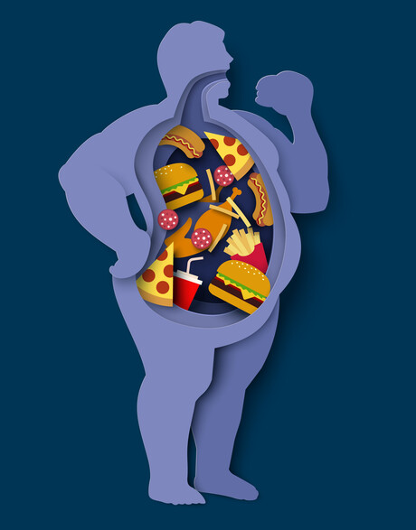
Predicting Obesity Levels Based on Lifestyle Factors
Presented By
Sunera Athukorala
Steph Adey
Laura Liu
John Robertson
Notes:
Laura

Slide 2
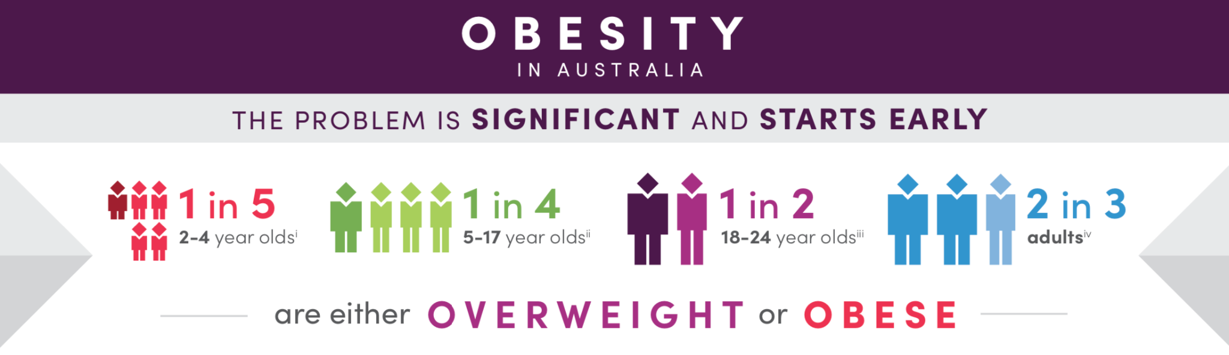
BACKGROUND
OF THE STUDY | OBESITY EPIDEMIC
Overweight and obesity refers to excess body weight. It is a risk factor for many chronic conditions and is associated with higher rates of death.
31.3% of Australian adults live with obesity.
In 2022, 1 in 8 people in the world were living with obesity.
Obesity is a complex issue with many causes. It's caused when extra calories are stored in the body as fat.
Notes:
Laura

Slide 3
DATA COLLECTION & PROCESSING
Data processing, cleaning and feature engineering to apply defined conversions and handle missing values
Split the data into training and testing sets for machine learning model training and evaluation
Logistic Regression model with the use of GridSearchCV
Model comparison
1
3
5
7
2
4
6
8
Data sourced from UC Irvine Machine Learning Repository using ‘unimlrepo’
Data Transformation
converting categorical variables to numerical and scaling to ensure comparable
Support Vector Machine (SVM)
Neural Network
Notes:
Laura

Slide 4
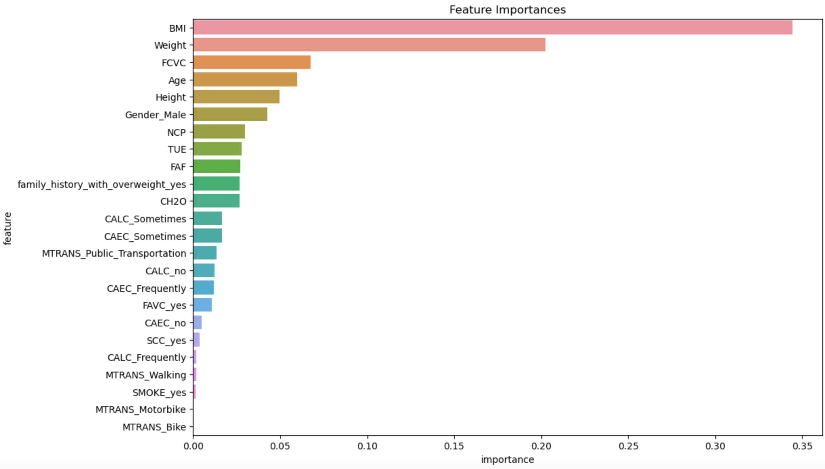
FEATURE ENGINEERING
Data Conversion Functions
Binary Conversion: Transformed categorical variables with 'yes' and 'no' responses into binary values (1 for 'yes' and 0 for 'no').
Weight Replacement: Mapped descriptive weight categories (e.g., 'insufficient', 'normal', 'overweight', 'obesity') to numerical values (0 to 3).
Integer and Categorical Buckets: Grouped continuous variables into discrete buckets to simplify data representation.
Encoding Techniques: Used pd.get_dummies to encode categorical variables into numerical values.
Data Preprocessing Steps
Rounding Values: Applied rounding to certain features like age and water consumption to reduce precision and standardise the data.
Scaling Features: Standardised features using StandardScaler to ensure all features have a mean of 0 and a standard deviation of 1.
Data Splitting: Divided the dataset into training and testing sets, ensuring an appropriate split for model training and evaluation.
Feature Selection and Model Preparation
Feature Selection: Dropped irrelevant features such as 'BMI', 'Height', and 'Weight' from the dataset to focus on the most impactful features.
Target Variable Transformation: Converted the target variable 'NObeyesdad' to a more intuitive 'Obesity_Level' and cast it as an integer type.
Notes:
Sunera

Slide 5
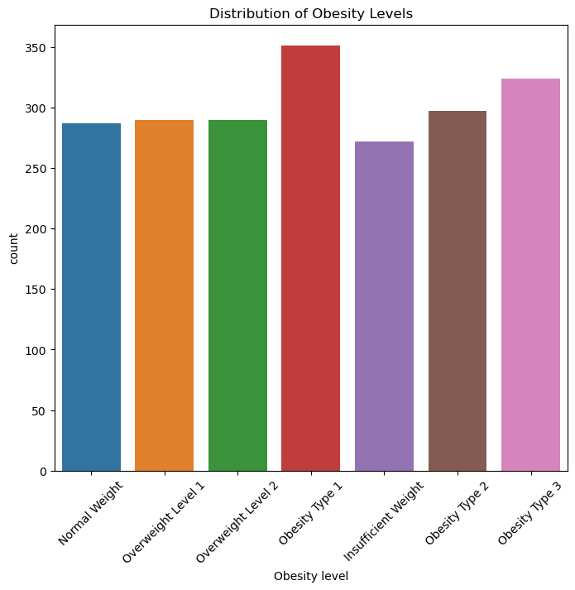
EXPLORATORY DATA ANALYSIS
Distribution of obesity levels:
This bar chart shows the distribution of obesity levels across six categories.
"Obesity Type I" has the highest count, suggesting that mild obesity is quite prevalent.
"Obesity Type II" and "Obesity Type III" also have substantial counts, indicating the presence of severe obesity.
Conclusions:
High Prevalence of Obesity: Shows a high prevalence of obesity, with "Obesity Type I" being the most common.
Balanced Distribution in Overweight Categories: The counts for "Overweight Level I" and "Overweight Level II" are relatively balanced, indicating that overweight individuals are fairly common.
Notes:
Sunera

Slide 6
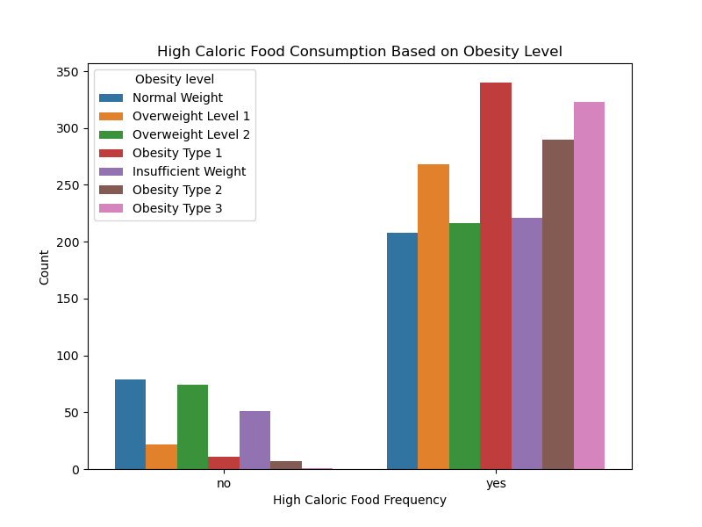
EXPLORATORY DATA ANALYSIS
High Calorie Food Consumption based on obesity levels:
The bar plot above shows the relationship between high caloric food consumption and obesity levels.
High Caloric Food Frequency ("no"):
- The majority of individuals who do not frequently consume high caloric food fall into the "Normal Weight" category.
High Caloric Food Frequency ("yes"):
-A significant portion of individuals who frequently consume high caloric food fall into the "Obesity Type I" category
Conclusions:
There is a strong association between frequent high caloric food consumption and higher obesity levels. The majority of individuals in the "Obesity Type I", "Obesity Type II", and "Obesity Type III" categories frequently consume high caloric food.
Notes:
Sunera

Slide 7
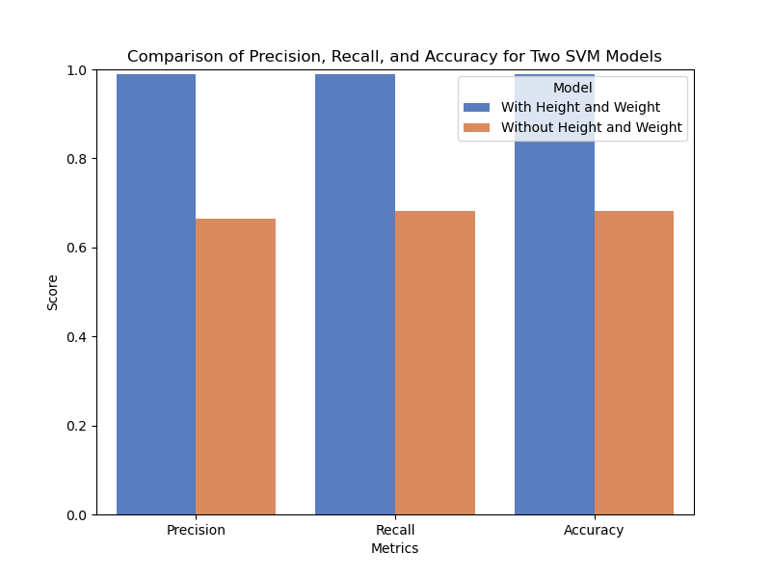
MODEL SELECTION, TRAINING & EVALUATION
Support Vector Machine (SVM) for Predicting Obesity Levels:
Modelling Technique:
SVM is a supervised machine learning algorithm used for classification.
It works by finding the hyperplane that best separates the data into different classes
The features are various attributes related to individuals' lifestyle and physical characteristics, which are used to predict obesity levels such as age, height, weight and e.t.c
Model Accuracy:
High Accuracy with Height and Weight: The model that includes height and weight as features achieves a very high accuracy of 99%. This suggests that these features are significant predictors of obesity levels in the dataset.
Lower Accuracy without Height and Weight: When height and weight are excluded from the features, the model's accuracy drops significantly to 68%. This indicates that without these key physical lifestyle factors, the model's ability to accurately classify obesity levels is compromised
Notes:
Steph

Slide 8
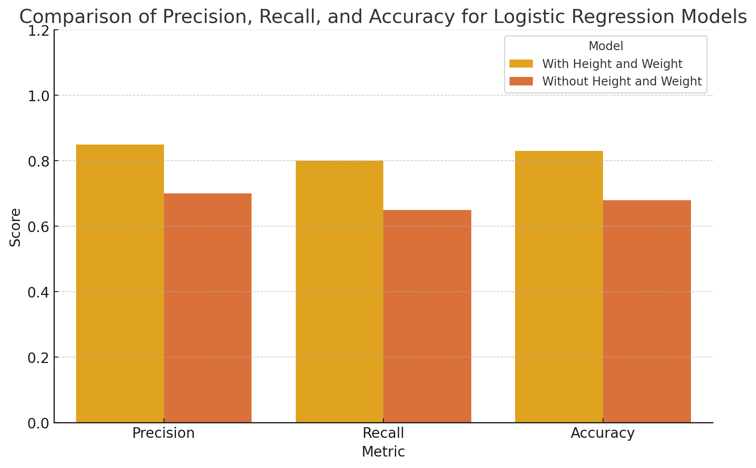
MODEL SELECTION, TRAINING & EVALUATION
Logistic Regression for Predicting Obesity Levels:
Training and Predictions
Training: Logistic Regression model trained with 1000 iterations and fixed random state for reproducibility.
Predictions: Model made predictions on the test set to evaluate generalisation.
Initial Evaluation
Accuracy: Indicates satisfactory correct classification rate.
Precision: Reasonable proportion of correct positive predictions.
Recall: Effective identification of positive instances.
F1 Score: Balanced performance between precision and recall.
Model Optimisation
Grid Search: Hyperparameter tuning conducted to find best values for regularisation strength (C) and solver.
Best Parameters: Identified through cross-validation for improved accuracy.
Optimised Model Evaluation
Improved Metrics: Optimised model showed better accuracy, precision, recall, and F1 score.
Notes:
Steph

Slide 9
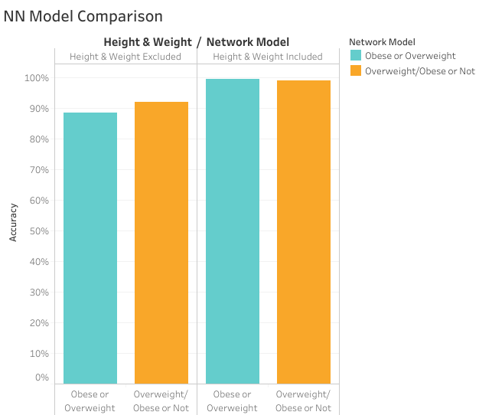
MODEL SELECTION, TRAINING & EVALUATION
Neural Network (NN) for Predicting Obesity Levels:
Training and Predictions
Training: Two NN Models were trained in parallel, one without and one with BMI, height & weight.
Predictions: Two sets of predictions were made:
Normal Weight or Overweight/Obese
Overweight or Obese
Initial Evaluation
Accuracy: How well a model can predict outcomes.
Loss: The difference between the model’s predictions and true outcomes.
Model Optimisation
Activation Functions: ReLu, Softmax or SeLu
Neurons: 25 - 40, in increments of 5
Hidden Layers: 2 - 3
Optimised Model Evaluation
Optimised Outcome: NN Models with similar accuracies yielded similar loss values. The model with the highest accuracy score was identified as the most optimal for each model iteration.
Notes:
Steph

Slide 10
MODEL SELECTION, TRAINING & EVALUATION
Logistic Regression Modelling
Support Vector Machine (SVM)
Neural Network (NN)
Variables to optimise:
C - Inverse of regularisation strength.
Solver - Algorithm to use in the optimization problem.
Evaluated against:
Accuracy score
Precision
F1 Score
Recall Score
Evaluated against:
Accuracy score
Precision
Recall Score
Variables to optimise:
Activation Function - Function applied to neuron output in layer
Neurons - Applies weights & biases using function
Hidden layers - Layers where computation is done
Evaluated against:
Accuracy score
Loss
Effective models:
Maximise accuracy
Maximise Precision / Reduce Loss
Notes:
John

Slide 11
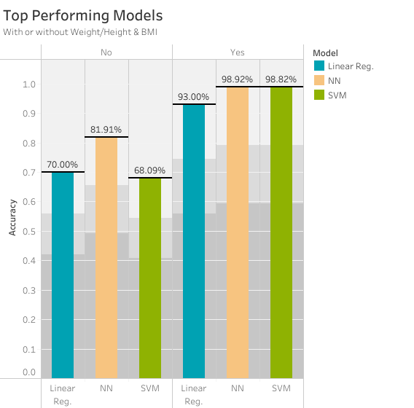
RESULTS & COMPARISON
All models performed incredibly well, >93%
Height, weight & BMI are physical indicators directly linked to BMI
Physical indicators dominate all other lifestyle factors in predicting obesity
Excluding Height, Weight & BMI
All models performed well.
Neural Network model accurate above 81%
Lifestyle factors can be obtained easily through patient questionnaires
Omitting medical indicators reduces the stigma or anxiety some patients face from health classification.
Including Height, Weight & BMI
Notes:
John

Slide 12
MODEL APPLICATION
Community Deployment
Assess Outcome
Reassess at end of treatment regime
Complete questionnaire
Measure progress
Suggest treatments based on outcome
03
Identify & Examine
Questionnaire on lifestyle choices
In-person or remote
Reduces examination time
Removes travel requirements
Improves access
01
02
Classify & Designate
Medical treatment regime
Social programs
Living assistance
In-home education
Improve access to equipment & amenities
Notes:
John

Slide 13
Thank you for your attendance
Presented By
Sunera Athukorala
Steph Adey
Laura Liu
John Robertson
Notes:
Laura

