Slide 1

Project 1
Members/Presenters
Olivia
Sunera
Aryan
Pradeepan

Slide 2
Journey
Planning
Research
Design
Methodology
Present
Selection of research project Topic.
Identify the data source.
Data Cleansing & formatting
Create common Github Repository with necessary files and folders.
Data Access.
Data Analysis using Python/ Pandas functions.
Data Visualization
Compilation & Presentation

Slide 3



How we get there
Initial Work
Decided to go ahead with “Tobacco and E-Cigarettes” as project topic
Decided to use following resources as data source
- World Health Organization Global Health Observatory.
- National Adult Tobacco Survey (NATS).
- CDC STATE System E-Cigarette Legislation - Youth Access.
Research, Data Analysis & Visualization
Use of .read_csv() function to understand the data.
Use of different Pandas/Python conditions/functions for data cleansing, formatting and for analysis of cleansed data.
Creation of Data frames and graphs using Pandas/Python functions for data visualization.
Data Storage, Compilation and Presentation
Creation of Common repository for the project with other team members as collaborators.
Creation of Necessary folders and files in Project Repo for organized data storage and sharing.
Creation of Readme.md file with necessary details.
Creation of PowerPoint Presentation.

Slide 4
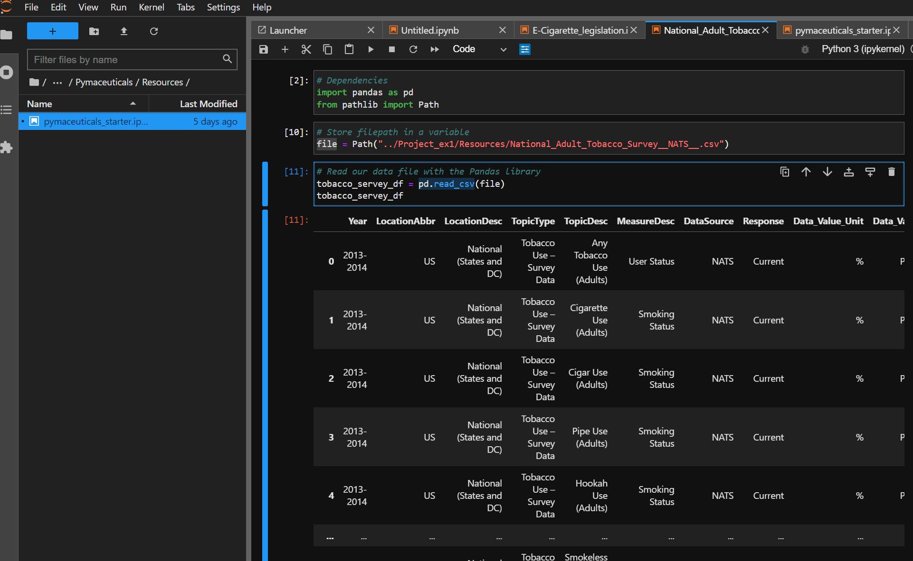
Reading .Csv file using .read_csv() function

Slide 5
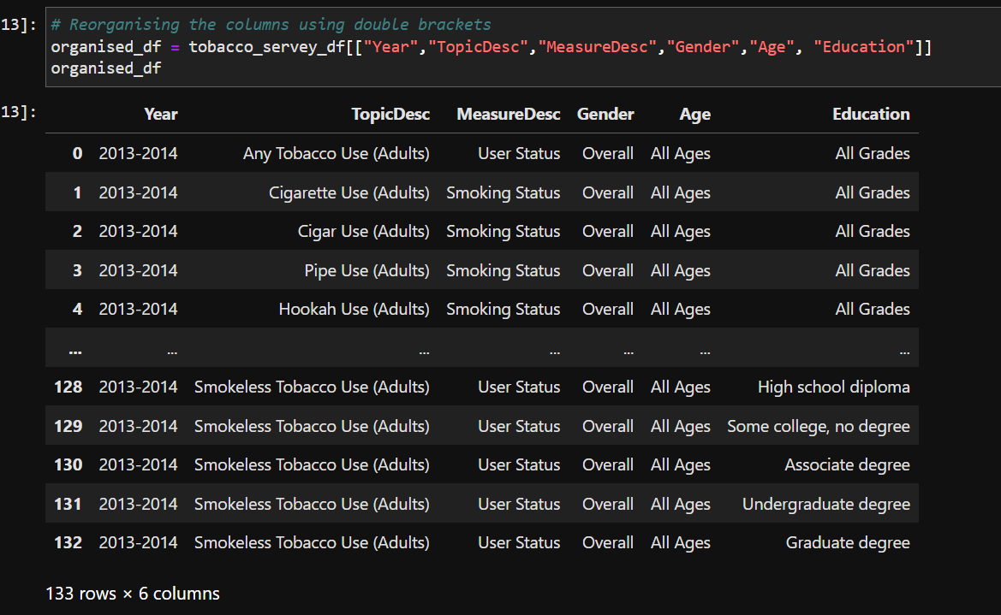
Creating Data frame using conditions

Slide 6
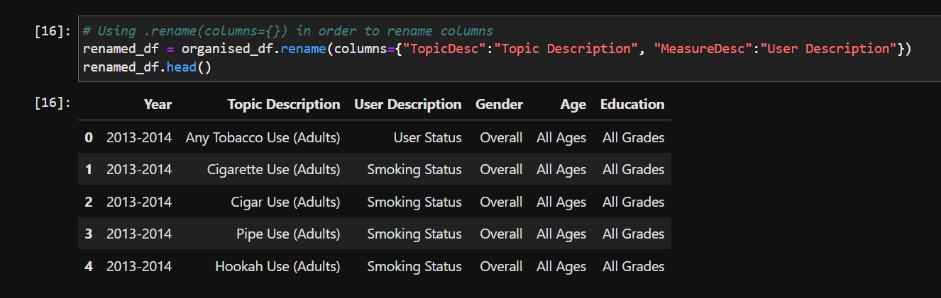
Renaming Column name using .rename() function

Slide 7
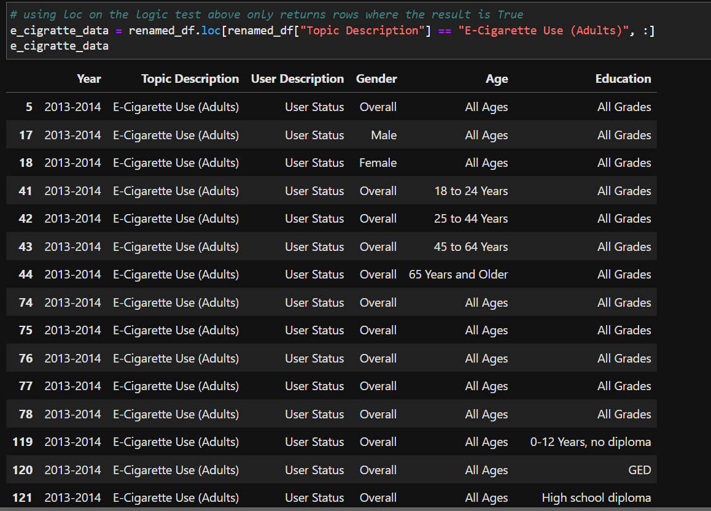
Data frame creation using .loc[] function

Slide 8
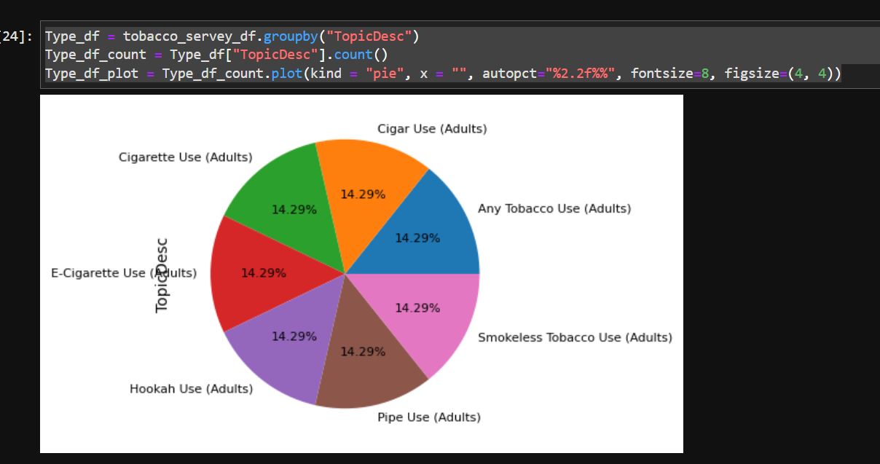
Creating Pie Chart using .plot() function

Slide 9
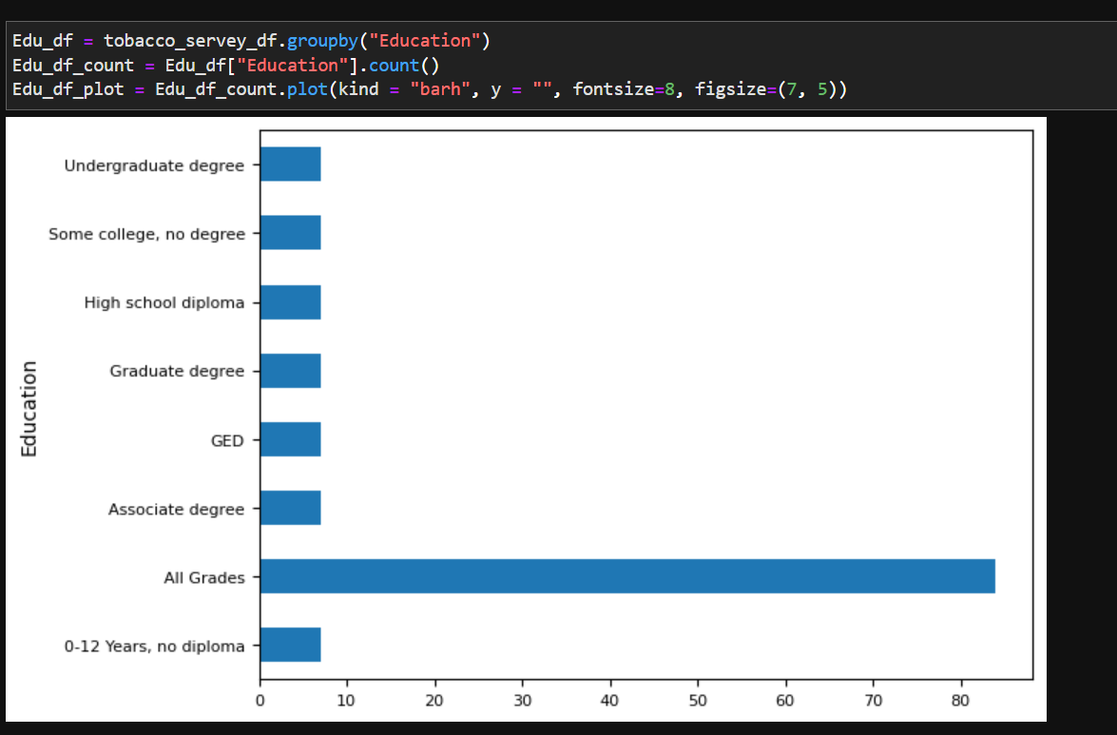
Horizontal bar chart Creation using .plot() function

Slide 10


Summary
With this project, we were able to understand
- End to end concept of how to visualize, strategies, analyze
as a data analyst.
- Understand how important is data source, data quality &
analytical tools which we use throughout the process.

Slide 11




Thank you

