Slide 1

E-cigarette use
Members
Olivia
Sunera
Aryan
Pradeepan

Slide 2
Research Question Motivation
In Australia, e-cigarettes entered the market in the mid-2000s¹
There is a lot of research on the impacts of nicotine e-cigarettes informing campaigns, however, use of e-cigarettes has been significantly increasing since 2013², particularly among adolescents and young adults
The true long-term impacts of e-cigarettes are yet to be concluded as vaping and e-cigarette use is still considered relatively new compared to tobacco smoking
Anecdotally, e.g. in the news, adolescents have been presenting with respiratory symptoms
Want to investigate/determine on a broad scale and with publicly available data, who is the typical e-cigarette user, and most popular products
¹ https://www.nzvapor.com/au/blog/company-news/history-of-vaping-law-in-australia/
² https://www.tobaccoinaustralia.org.au/chapter-18-e-cigarettes/18-3-extent
Notes:
Questions that you found interesting and what motivated you to answer them

Slide 3
Ideal target audience for anti e-cigarette campaigns
What products are popular?
Product types, flavours
Who are using e-cigarettes?
Age groups, sex, education levels, countries

Slide 4
Conclusion Who is the target audience for an anti e-cigarette campaign?
Adolescents (10-19 years old) in Iceland, New Zealand, Czech Republic, France, Canada
Adults in Iceland, New Zealand, Great Britain, Czech Republic
Males (of all ages) are more likely to smoke e-cigarettes

Slide 5
Journey
Planning
Research
Design
Methodology
Present
Selection of research project Topic.
Identify the data source.
Data Cleansing & formatting
Create common Github Repository with necessary files and folders.
Data Access.
Data Analysis using Python/ Pandas functions.
Data Visualization
Compilation & Presentation

Slide 6



How we get there
Initial Work
Decided to go ahead with “Tobacco and E-Cigarettes” as project topic
Decided to use following resources as data source
- World Health Organization Global Health Observatory.
- National Adult Tobacco Survey (NATS).
- CDC STATE System E-Cigarette Legislation - Youth Access.
Research, Data Analysis & Visualization
Use of .read_csv() function to understand the data.
Use of different Pandas/Python conditions/functions for data cleansing, formatting and for analysis of cleansed data.
Creation of Data frames and graphs using Pandas/Python functions for data visualization.
Data Storage, Compilation and Presentation
Creation of Common repository for the project with other team members as collaborators.
Creation of Necessary folders and files in Project Repo for organized data storage and sharing.
Creation of Readme.md file with necessary details.
Creation of PowerPoint Presentation.

Slide 7
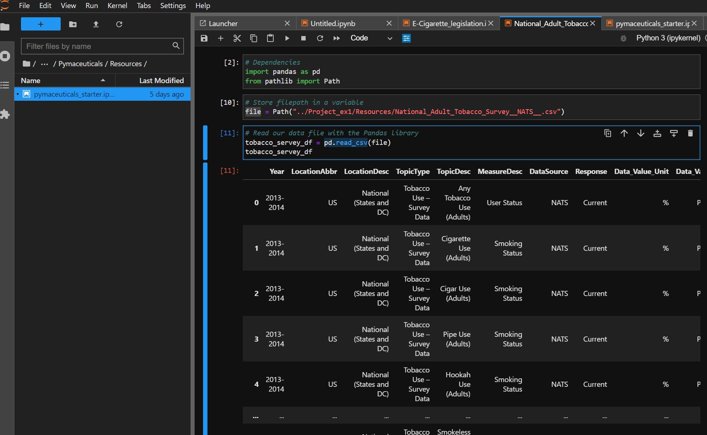
Reading .Csv file using .read_csv() function

Slide 8
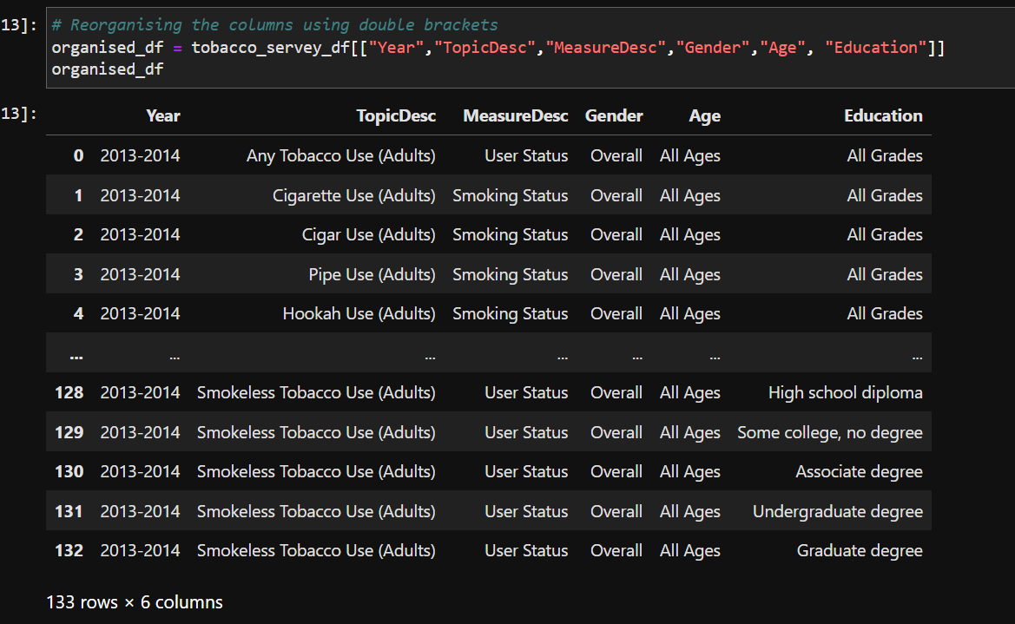
Creating Data frame using conditions

Slide 9
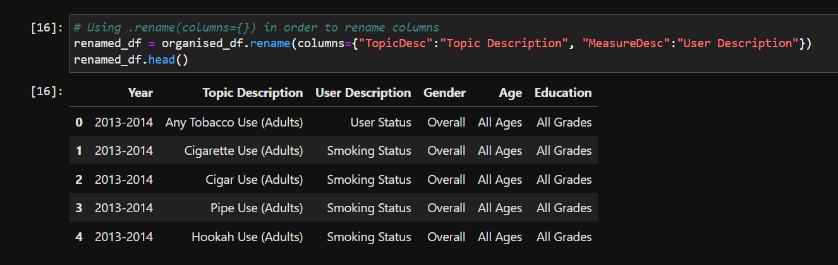
Renaming Column name using .rename() function

Slide 10
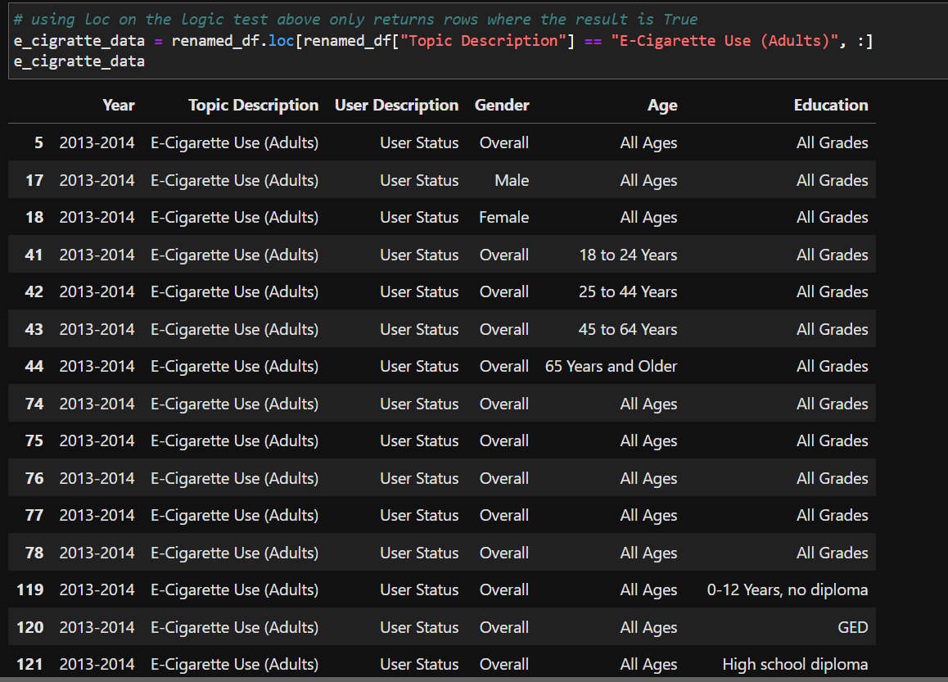
Data frame creation using .loc[] function

Slide 11
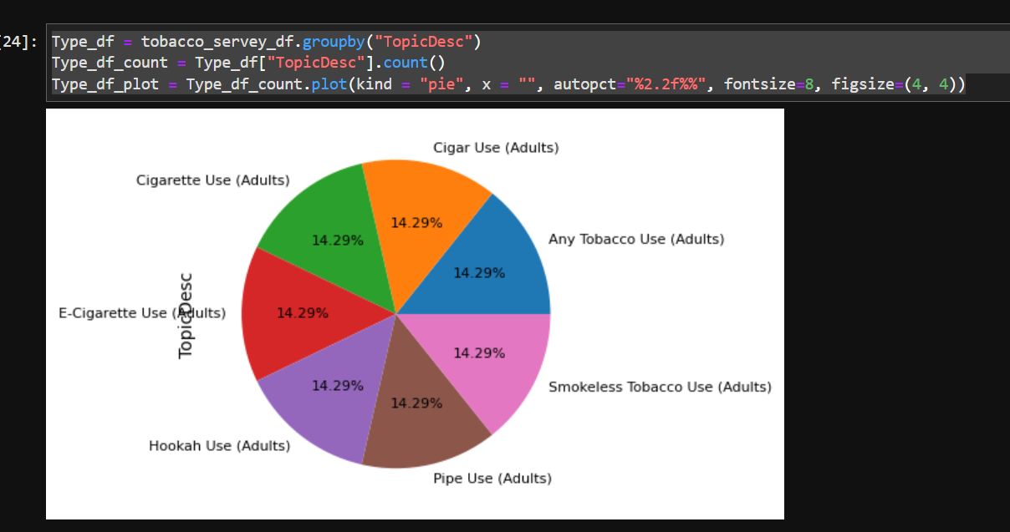
Creating Pie Chart using .plot() function

Slide 12
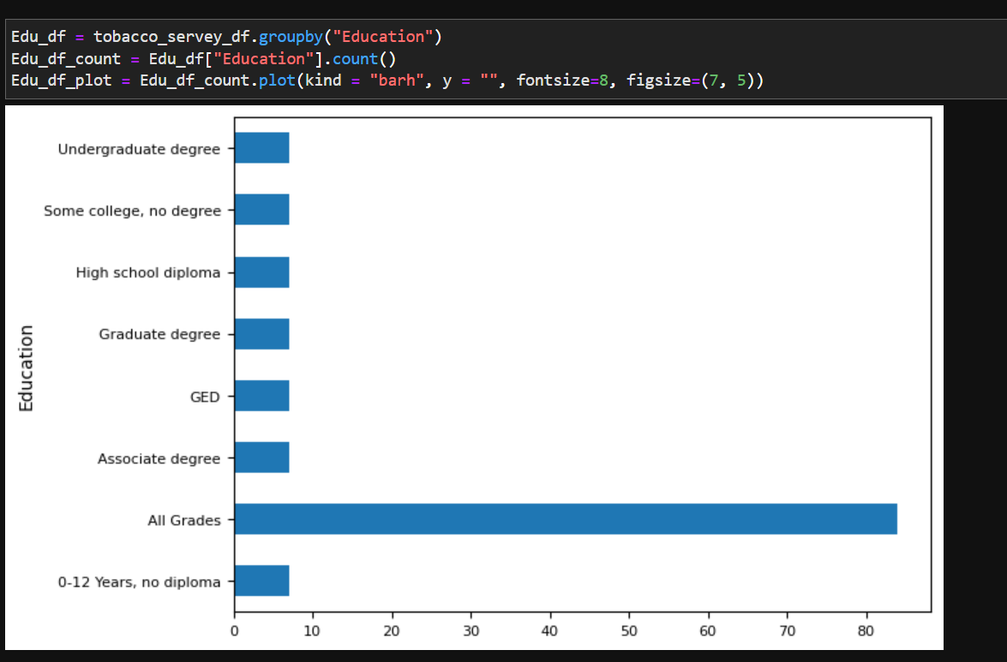
Horizontal bar chart Creation using .plot() function

Slide 13


Summary
With this project, we were able to understand
- End to end concept of how to visualize, strategies, analyze
as a data analyst.
- Understand how important is data source, data quality &
analytical tools which we use throughout the process.

Slide 14




Thank you

