Slide 1
FINAL YEAR PROJECT • DEEP LEARNING
BreadGuard AI
AI-Based Bread Spoilage Detection
Using Deep Learning
Hafiz Muhammad Sufiyan Khan | BSCS7A
Department of Computer Science • Instructor: Dr. Munir
DATASET
BEST TEST ACCURACY
DEPLOYMENT
unique images
MobileNetV2
Vercel + Render
472
94.52%
LIVE
01

Slide 2
BREADGUARD AI
The Problem
Bread can develop visible mold and spoilage during storage.
Human inspection varies with lighting, image quality, and judgment.
A browser-based screening tool can make image assessment more accessible.
Scope: visual image classification — not food-safety certification.
02

Slide 3
BREADGUARD AI
Project Objectives
Curate a labeled dataset of Fresh and Spoiled bread images.
Train a custom CNN and a transfer-learning MobileNetV2 model.
Evaluate on unseen test images with accuracy and class recall.
Deploy an easy-to-use web interface backed by a prediction API.
03

Slide 4
BREADGUARD AI
System Workflow
Upload image
→
Resize + RGB
→
Model inference
→
Fresh / Spoiled
→
Show result
Frontend: Vercel • API: FastAPI on Render • Models: TensorFlow / Keras
04

Slide 5
BREADGUARD AI
Dataset at a Glance
TOTAL IMAGES
FRESH
SPOILED
472
374
98
SHA-256 deduplicated
79.2% of dataset
20.8% of dataset
Image preprocessing: RGB • 224 × 224 pixels
Note: the dataset is class-imbalanced; spoiled-class recall is important.
05

Slide 6
BREADGUARD AI
Train / Validation / Test Split
Split | Fresh | Spoiled | Total
Training | 261 | 68 | 329
Validation | 56 | 14 | 70
Testing | 57 | 16 | 73
Total | 374 | 98 | 472
Held-out test set: 73 images, including 16 spoiled examples.
06

Slide 7
BREADGUARD AI
Model A: Custom CNN
Custom convolutional network trained for two-class classification.
Learns bread-specific image patterns from the project dataset.
Test accuracy: 89.04%.
Spoiled-class recall: 75.00% (12 of 16).
07

Slide 8
BREADGUARD AI
Model B: MobileNetV2
ImageNet-pretrained MobileNetV2 adapted using transfer learning.
Uses previously learned visual features to support classification.
Test accuracy: 94.52%.
Spoiled-class recall: 81.25% (13 of 16).
08

Slide 9
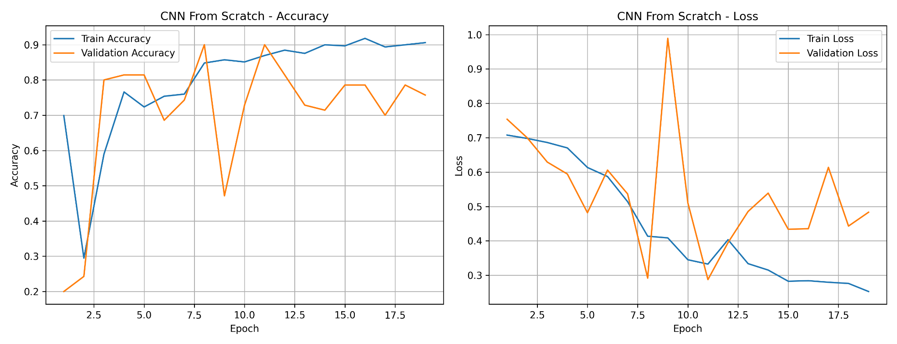
BREADGUARD AI
Training Curves — Custom CNN
Training and validation behavior of the custom CNN.
09

Slide 10
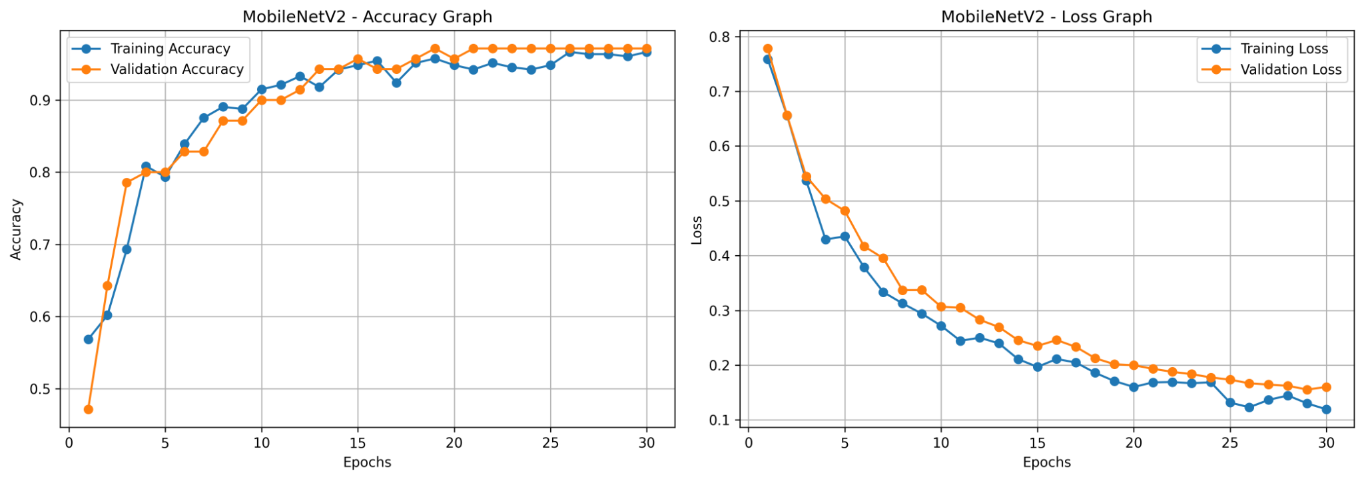
BREADGUARD AI
Training Curves — MobileNetV2
Training and validation behavior of the transfer-learning model.
10

Slide 11
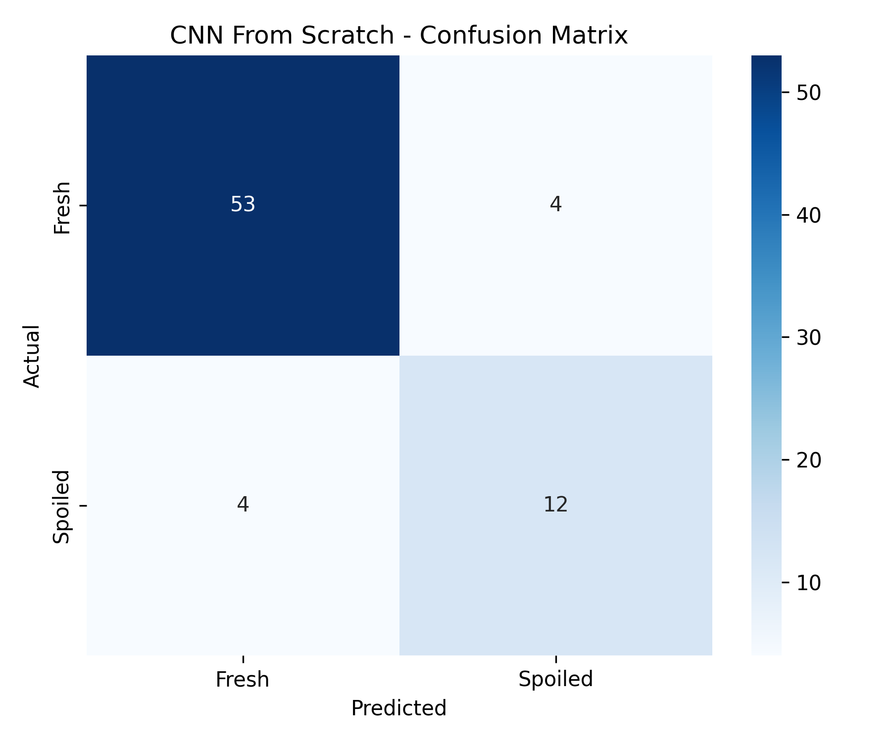
BREADGUARD AI
Confusion Matrix — Custom CNN
CORRECT PREDICTIONS
65 / 73
53 fresh + 12 spoiled
MISCLASSIFICATIONS
8
4 false positives + 4 false negatives
11

Slide 12
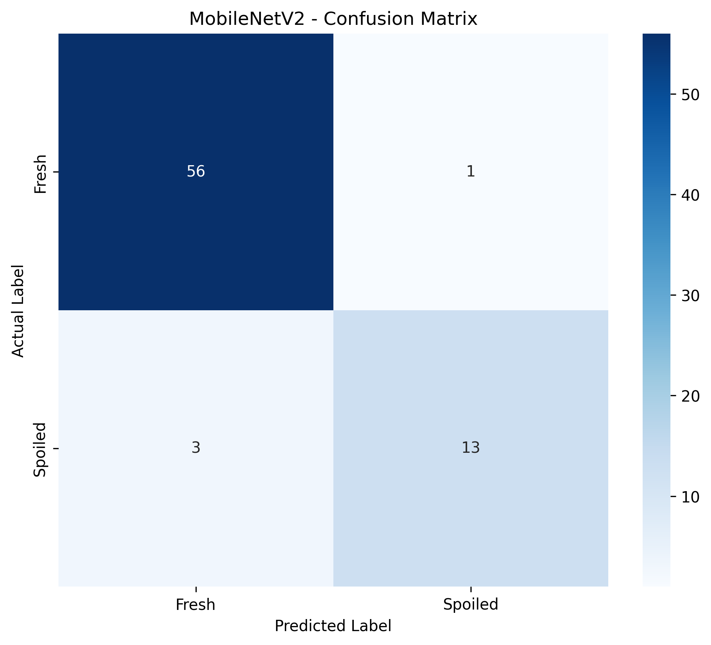
BREADGUARD AI
Confusion Matrix — MobileNetV2
CORRECT PREDICTIONS
69 / 73
56 fresh + 13 spoiled
MISCLASSIFICATIONS
4
1 false positive + 3 false negatives
12

Slide 13
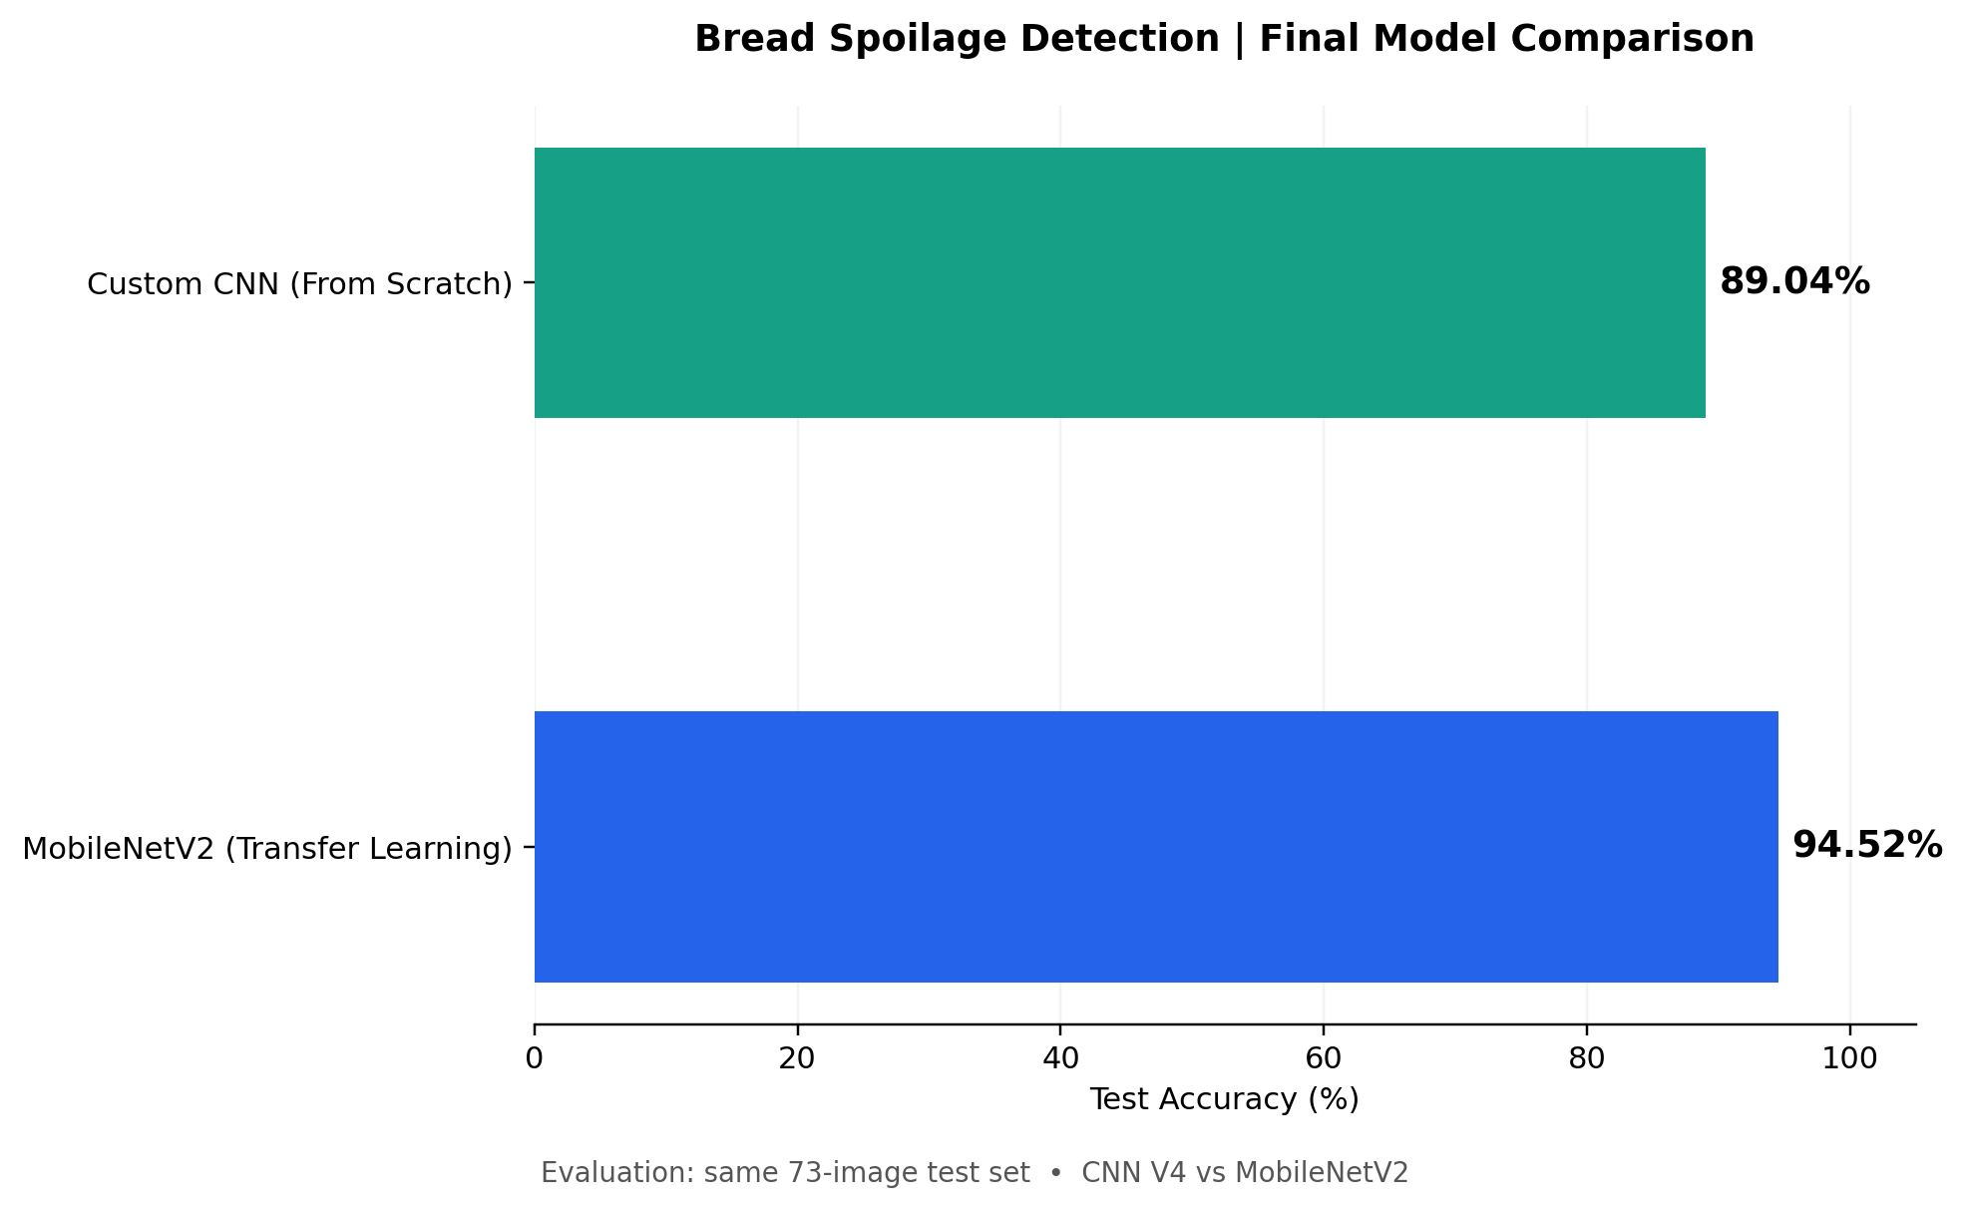
BREADGUARD AI
Head-to-Head Model Comparison
CUSTOM CNN
89.04%
test accuracy
MOBILENETV2
94.52%
test accuracy
13

Slide 14
BREADGUARD AI
Live Web Application
Open the BreadGuard AI website.
Upload a fresh bread image and request a prediction.
Upload a spoiled bread image and compare the output.
Review the predicted class and confidence displayed in the UI.
https://breadguard-ai-frontend.vercel.app/
14

Slide 15
BREADGUARD AI
Architecture & Project Resources
FRONTEND
BACKEND
Vercel
FastAPI
Browser interface
Render + TensorFlow
GitHub repository and README documentation
Project report, dataset archive, and trained models
Model evaluation plots and confusion matrices
github.com/Suf-tech/BreadGuard-AI
15

Slide 16
BREADGUARD AI
Conclusion & Future Work
MobileNetV2 achieved the best test accuracy: 94.52%.
The deployed application demonstrates end-to-end image classification.
Improve spoiled-class coverage with more diverse, licensed images.
Expand testing under varied lighting, backgrounds, and bread types.
Thank you!
16

