Slide 1



easyGUI
“Probably the Easiest GUI in the world”

Slide 2
Assumptions (Teachers’ Notes)
This resources sets out an introduction to using easyGUI and Python 2.7.3
It assume that students have a basic understanding of the Python programming language
It also assumes that both easyGUI and Python have been installed.
All program code is shown in purple Consolas

Slide 3
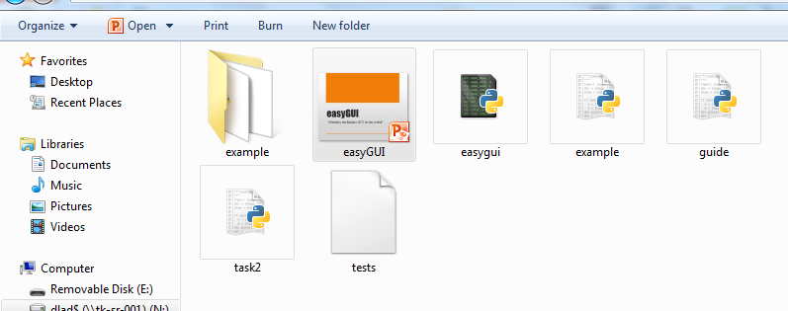
Assumptions 2 (Teachers’ Notes)
easyGUI can be installed but it does not have to.
If the file is in the same folder as the program code is stored, it will execute
easyGUI complier
My program

Slide 4

Starter
Design an ICON for a new or existing app
Design the landing screen for the app

Slide 5
Learning Objectives
Today you are learning how to:
Create a message box
Create a variable
Print the variable value
Creating Button
Selecting button
Adding an Image
While statement
Use If statement Elif

Slide 6
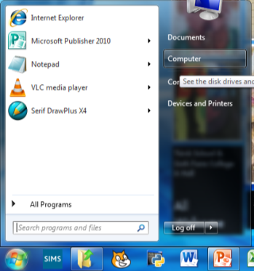
What is a GUI
A GUI stands for Graphical User Interface
A common form of GUI is WIMP, (Windows, Icons, Menus, Pointer)

Slide 7
Importing easyGUI
First easyGUI has to be imported, this is achieved with the simple command:
import easygui as eg
This allows python to work with the easyGUI commands

Slide 8
The Message Box
To display a message box use the code;
eg.msgbox
Add the message you want to display using the code;
(“message you want to display")
Example: (Have a go)
eg.msgbox(“Hello there!”)

Slide 9
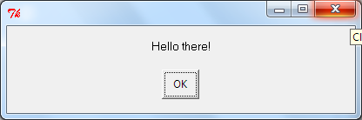
Student Task
Create a message box that says “Hello world”
Create a message box that tells you what the weather is like today
Create an example of your own

Slide 10
Variable (string)
Information form the user needs to be collected.
This can be achieved by creating a variable
Call the variable an appropriate name
Add the code;
eg.enterbox(“your prompt:“)
Example: (Have a go)
yourname = eg.enterbox(“Hi, what’s your name?:")

Slide 11
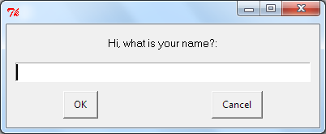
Variable (string) 2
Always remember the colon at the end of the prompt
Add a print variable to return the value of the input
It should print the name you enter in the console window
Create two examples of your own

Slide 12
Returning a Stored Value
Returning the value entered is inputted
Use the msg.box code to print a message that contains the pervious variable value that was entered
Can you write the code? (Try it)
eg.msgbox(name of the variable)

Slide 13
Returning a Stored Value 2
A message box can also print a message and the variable input value.
Can you write the code? (Try it)
eg.msgbox(“message”, name of the variable)

Slide 14
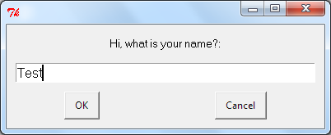
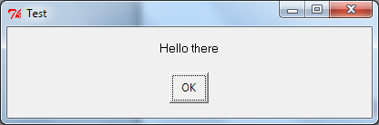
Returning a Stored Value 3
yourname = eg.enterbox("Hi, what is your name?:")
eg.msgbox("Hello there", yourname)

Slide 15
RECAP
Create a message box
eg.msgbox(“Hello there!”)
Create a variable
nameofthevariable = eg.enterbox(“message:")
Print the variable value
eg.msgbox(“message", variablename)

Slide 16
Variable (integer)
The previous code only works for strings, if you require a number / integer use the following code;
eg.integerbox
nameofthevariable = eg.integerbox(“message:")
Create a variable that asks for a number?

Slide 17
Student Task 2
Create a two variables, one called name, that asks for your name, the second called age that asks for your age
Create a third variable called days that calculates how many days the person has been alive for.
Return a message box that states;
“hello …….., you have been alive for ….. days”
Where the message returns the name of the person and the number of days alive
HINT, be aware if integers and strings, you cannot add an integer to a string, str()

Slide 18
Result
import easygui as eg
name = eg.enterbox("Hi, what is your name?")
age = eg.integerbox("Hi, how old are you?")
days = age * 365
eg.msgbox("Hello " + name + " you are, " + str(days) + " days old")

Slide 19
RECAP 2
Create a message box
eg.msgbox(“Hello there!”)
Create a variable
nameofthevariable = eg.enterbox(“message:")
nameofthevariable = eg.integerbox(“message:")
str()
Print the variable value
eg.msgbox(“message", variablename)

Slide 20
Creating Buttons
Buttons allow the user to interact and select options in your program
To create buttons use the code;
Buttons = [“Button 1”, “button 2”, “Help”]
Replace the Button with the name you ant displayed on the button
Then create a variable with and call the eg.buttonbox function
This is similar to the integer and enter box
Note the choices=buttons at the end of the code.
Variable = eg.buttonbox(“This is an example of buttons”, choices=buttons)

Slide 21
Creating Buttons 2
Let’s us create a button;
Buttons = [“Good”, “Bad”, “ok”]
Create a variable called feeling and ask the user how they are feeling.
Add the choices=buttons to the code
= eg.buttonbox(“ ”, choices=buttons)

Slide 22
Adding an Image
An image can be added to a message box or other.
Images must be in GIF format
Images must saved in the same folder as the program
Images will appear in their original size
Call the image using the code;
image=“name of the image file.gif"
Add the code to the end of previous code
Variable = eg.buttonbox(“This is an example of buttons”, choices=buttons, image=“name of the image file.gif")

Slide 23
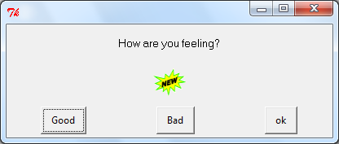
Adding an Image 2
Add an image of your choice
Variable = eg.buttonbox(“This is an example of buttons”, choices=buttons, image=“name of the image file.gif")
Image can also be added to a message box;
eg.msgbox(“Hello there!”, image=“name of the file.gif”)

Slide 24
RECAP 3
Create a message box
eg.msgbox(“Hello there!”)
Create a variable
nameofthevariable = eg.enterbox(“message:")
nameofthevariable = eg.integerbox(“message:")
str()
Print the variable value
eg.msgbox(“message", variablename)
Creating Buttons:
Buttons = [“Good”, “Bad”, “ok”]
Selecting buttons:
Variable = eg.buttonbox(“This is an example of buttons”, choices=buttons)
Adding an Image:
image=“name of the image file.gif"

Slide 25
Student Task 3
Create a message box that says “Welcome to the Quiz”
The message box shows a picture of a questions mark
Think of a question
Create three buttons with answers to the questions
Create a variable called question one which asks the user the questions, presents three buttons and includes a picture related to your question.

Slide 26
Result
import easygui as eg
eg.msgbox("Welcome to the quiz", image="question mark.gif")
buttons = ["3.5", "3.16", "3.15"]
questionone = eg.buttonbox("what is the value of Pi?", choices=buttons, image="pi.gif")

Slide 27
While Statement
A While statement can be used to keep the question box open, this is useful if the user selects the incorrect answer.
Add a While True: statement to the previous task 3 code
Don’t forget the colon and the indentation
while True:
questionone = ……....

Slide 28
While Statement 2
To allow the user to select the correct answer and close the message box, use an if statement.
If variable == “answer”:
break
Add this to your previous program

Slide 29
RECAP 4
Create a message box
eg.msgbox(“Hello there!”)
Create a variable
nameofthevariable = eg.enterbox(“message:")
nameofthevariable = eg.integerbox(“message:")
str()
Print the variable value
eg.msgbox(“message", variablename)
Creating Buttons:
Buttons = [“Good”, “Bad”, “ok”]
Selecting buttons:
Variable = eg.buttonbox(“This is an example of buttons”, choices=buttons)
Adding an Image:
image=“name of the image file.gif“
While statement:
while True:
questionone = eg.buttonbox("what is the value of Pi?", choices=buttons, image="pi.gif")
if questionone == "3.14":
break

Slide 30
import easygui as eg
eg.msgbox("Welcome to the quiz", image="question mark.gif")
buttons = ["3.5", "3.16", "3.14"]
while True:
questionone = eg.buttonbox("what is the value of Pi?", choices=buttons, image="pi.gif")
if questionone == "3.14":
break

Slide 31
Else, Elif, Statements
Else, Elif and else statements can be sued to give different responses to different buttons, this can make the program more interactive
If a user selects one button, a particular picture and response are displayed
if questionone == "3.14":
eg.msgbox("Well done", image="wrong.gif")
elif questionone == "3.5":
eg.msgbox("Sorry you are wrong, Try again", image="wrong.gif")

Slide 32
EXAMPLE (Video)
import easygui as eg
eg.msgbox("Welcome to the quiz", image="question mark.gif")
buttons = ["3.5", "3.16", "3.14"]
while True:
questionone = eg.buttonbox("what is the value of Pi?", choices=buttons, image="pi.gif")
if questionone == "3.14":
break
elif questionone == "3.5":
eg.msgbox("Sorry you are wrong, Try again", image="question mark.gif")

Slide 33
FINAL TASK
Use and combine all the code you have learnt to create your own project

Slide 34
RECAP5
Create a message box
eg.msgbox(“Hello there!”)
Create a variable
nameofthevariable = eg.enterbox(“message:")
nameofthevariable = eg.integerbox(“message:")
str()
Print the variable value
eg.msgbox(“message", variablename)
Creating Buttons:
Buttons = [“Good”, “Bad”, “ok”]
Selecting buttons:
Variable = eg.buttonbox(“This is an example of buttons”, choices=buttons)
Adding an Image:
image=“name of the image file.gif“
While statement:
while True:
questionone = eg.buttonbox("what is the value of Pi?", choices=buttons, image="pi.gif")
if questionone == "3.14":
break
If statement elif:
elif variable == “a value":
eg.msgbox(“your message", image=“name of file,gif")

