Slide 1
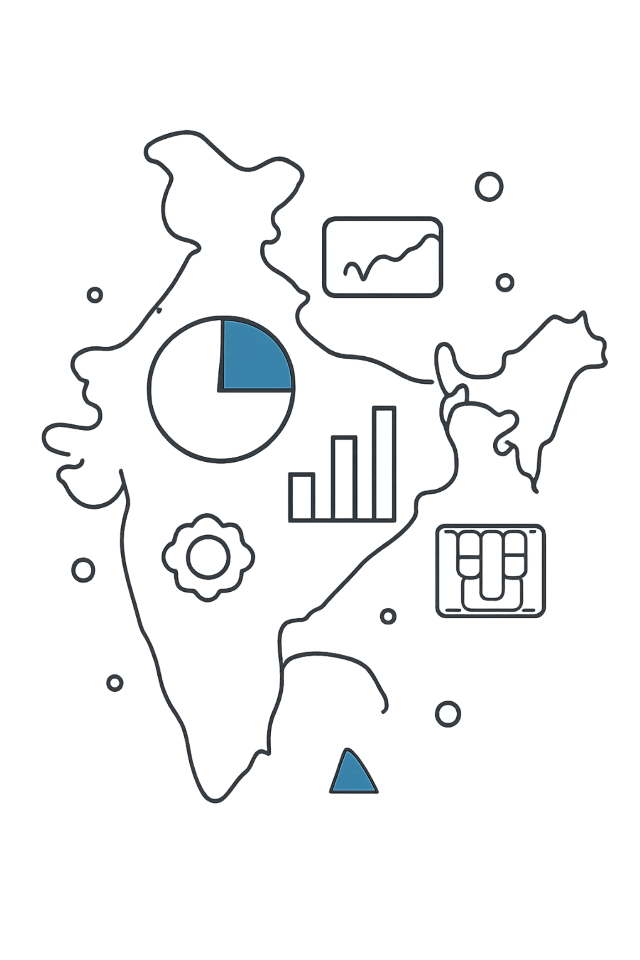


AI-Based Economic Intelligence and Risk Forecasting System for India
Predictive Economic Analytics using Artificial Intelligence and Machine Learning
ACADEMIC PROJECT
50 YEARS OF DATA

Slide 2
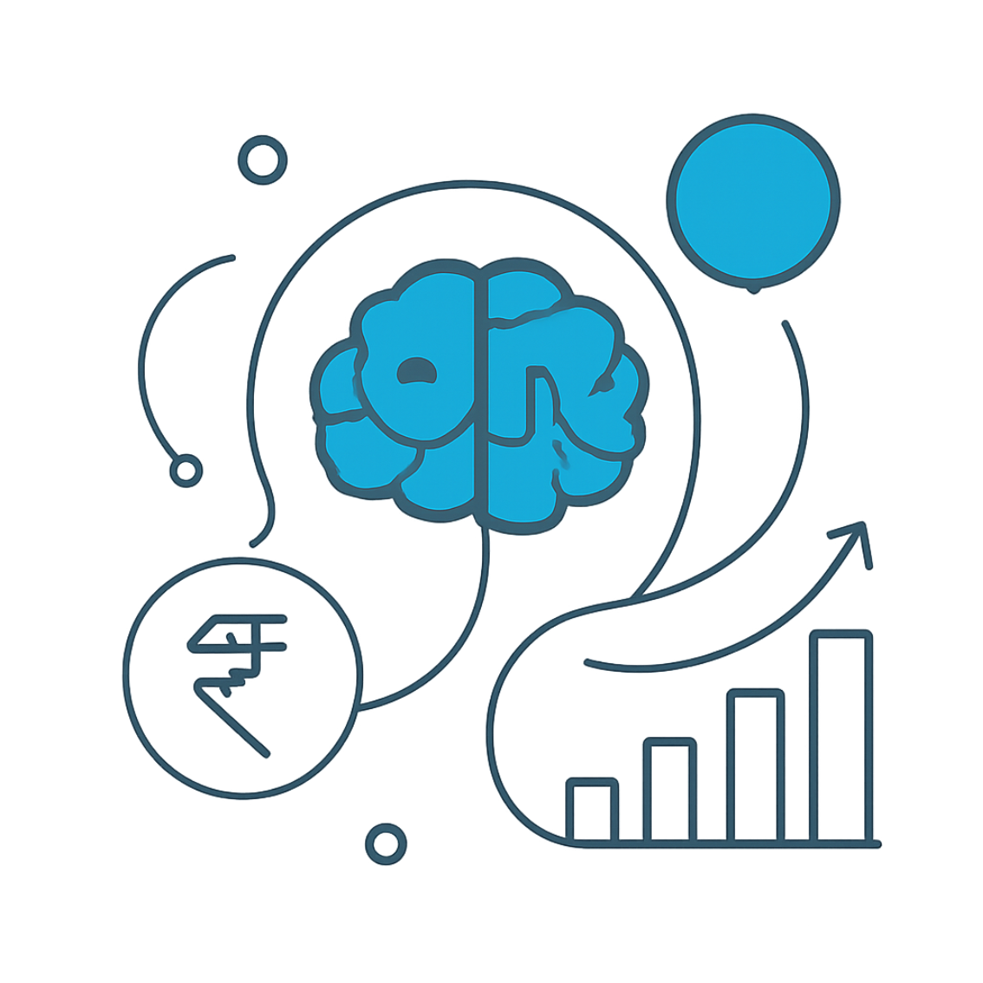
Introduction
This project leverages Artificial Intelligence, Machine Learning, and Time Series Forecasting to analyze India's economic performance using 50 years of historical data — generating forecasts, identifying risks, and delivering actionable intelligence for policymakers and analysts.
Objective
Generate future forecasts, identify economic risks, and provide data-driven insights for decision-making.
GDP Growth
Inflation Rate
Unemployment
Govt. Debt
Trade Indicators
Population Metrics
Real Interest Rates

Slide 3
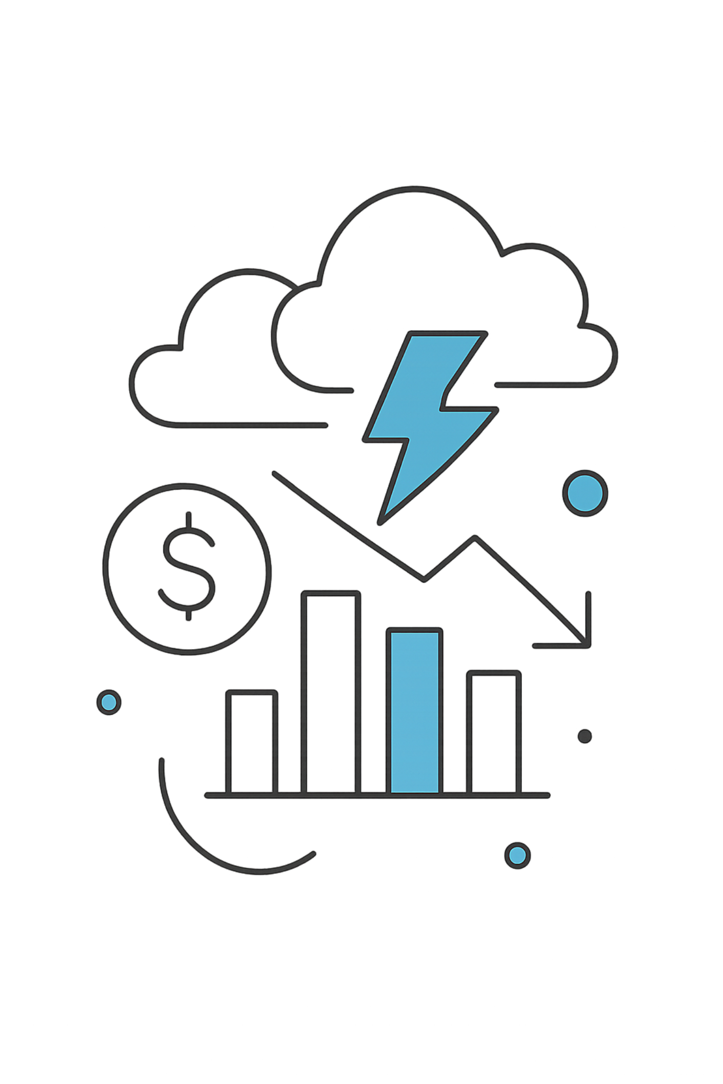


Problem Statement
Economic conditions are shaped by multiple interconnected indicators. Traditional analysis methods fall short in today's dynamic environment.
Manual Interpretation
Requires extensive human effort and is prone to cognitive bias.
Pattern Blindness
Struggles to detect long-term, cross-indicator trends.
No Predictive Power
Lacks the ability to forecast future economic conditions.
Delayed Risk Detection
Early warning signals go unnoticed until damage is done.
The Need: An intelligent, AI-driven system that forecasts trends and detects economic risks proactively.

Slide 4
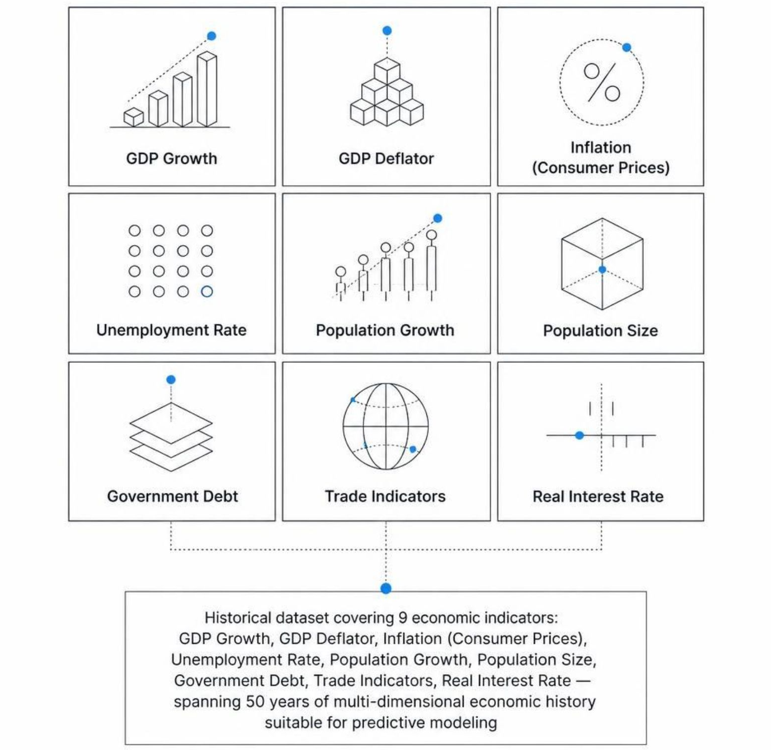


50 Years of Economic Data
CHARACTERISTICS
• Multi-dimensional economic indicators
• Long-term historical trends
• Suitable for predictive modeling
• Suitable for economic analysis
Multi-dimensional indicators
Long-term historical trends
Suitable for ML & forecasting

Slide 5
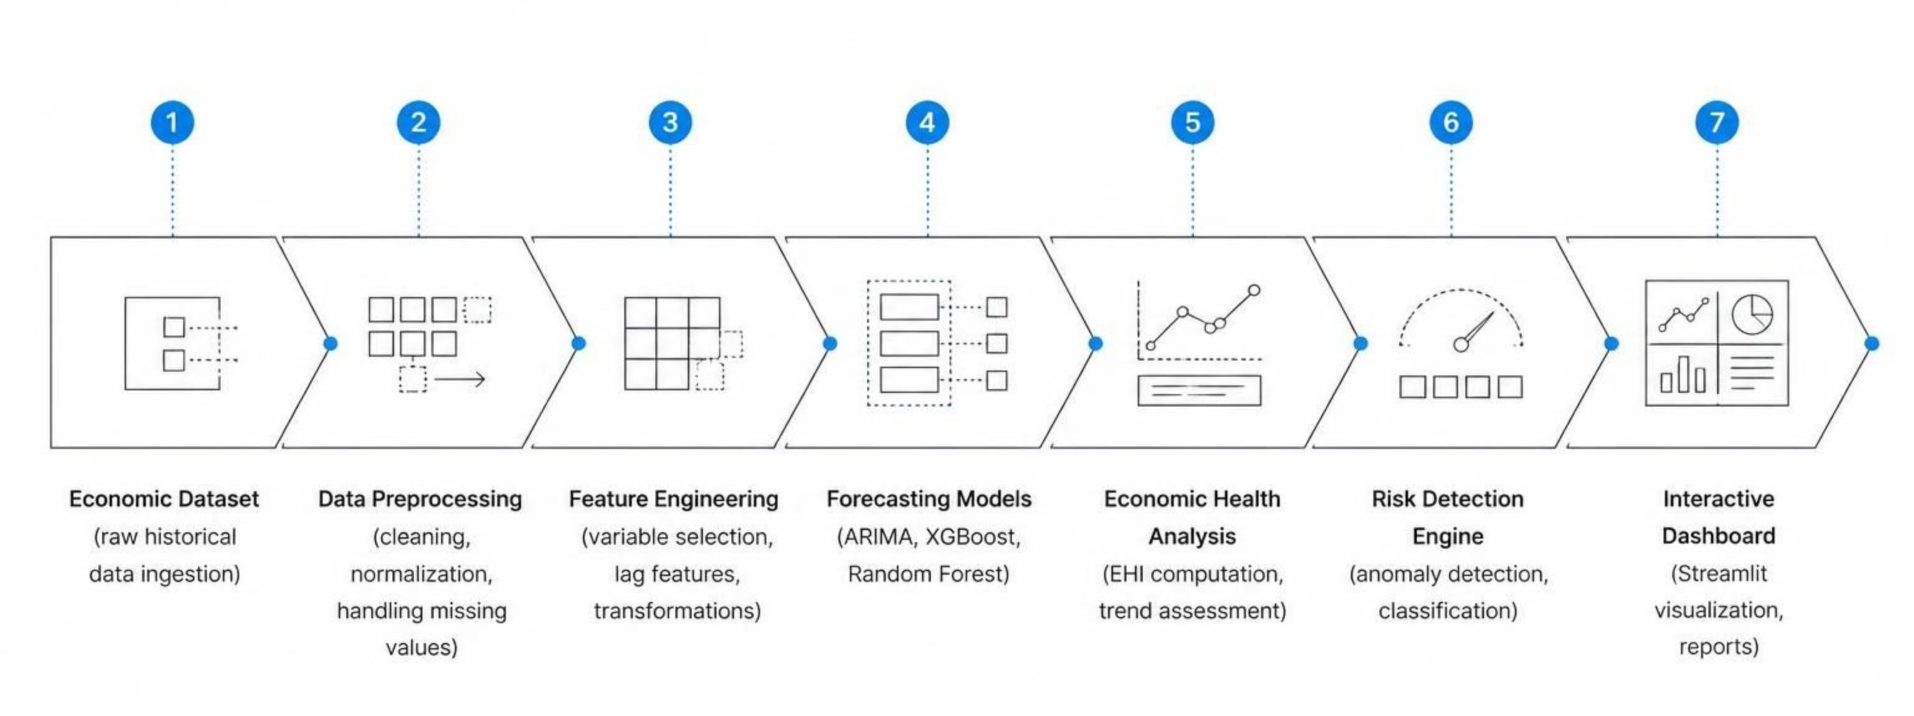
Project Workflow & Architecture
A structured, end-to-end pipeline transforms raw economic data into interactive intelligence —
from ingestion to insight.

Slide 6





TOOLS & FRAMEWORKS
Technology Stack
PROGRAMMING
FRONTEND
DEV ENVIRONMENT
Python
Streamlit
VS Code
CORE LIBRARIES
TECHNIQUES
Pandas
NumPy
Matplotlib
• Machine Learning
• Time Series Forecasting
Scikit-Learn
Statsmodels
XGBoost
• Economic Analytics
• Data Visualization
AI ECONOMIC INTELLIGENCE | RISK FORECASTING SYSTEM
06

Slide 7
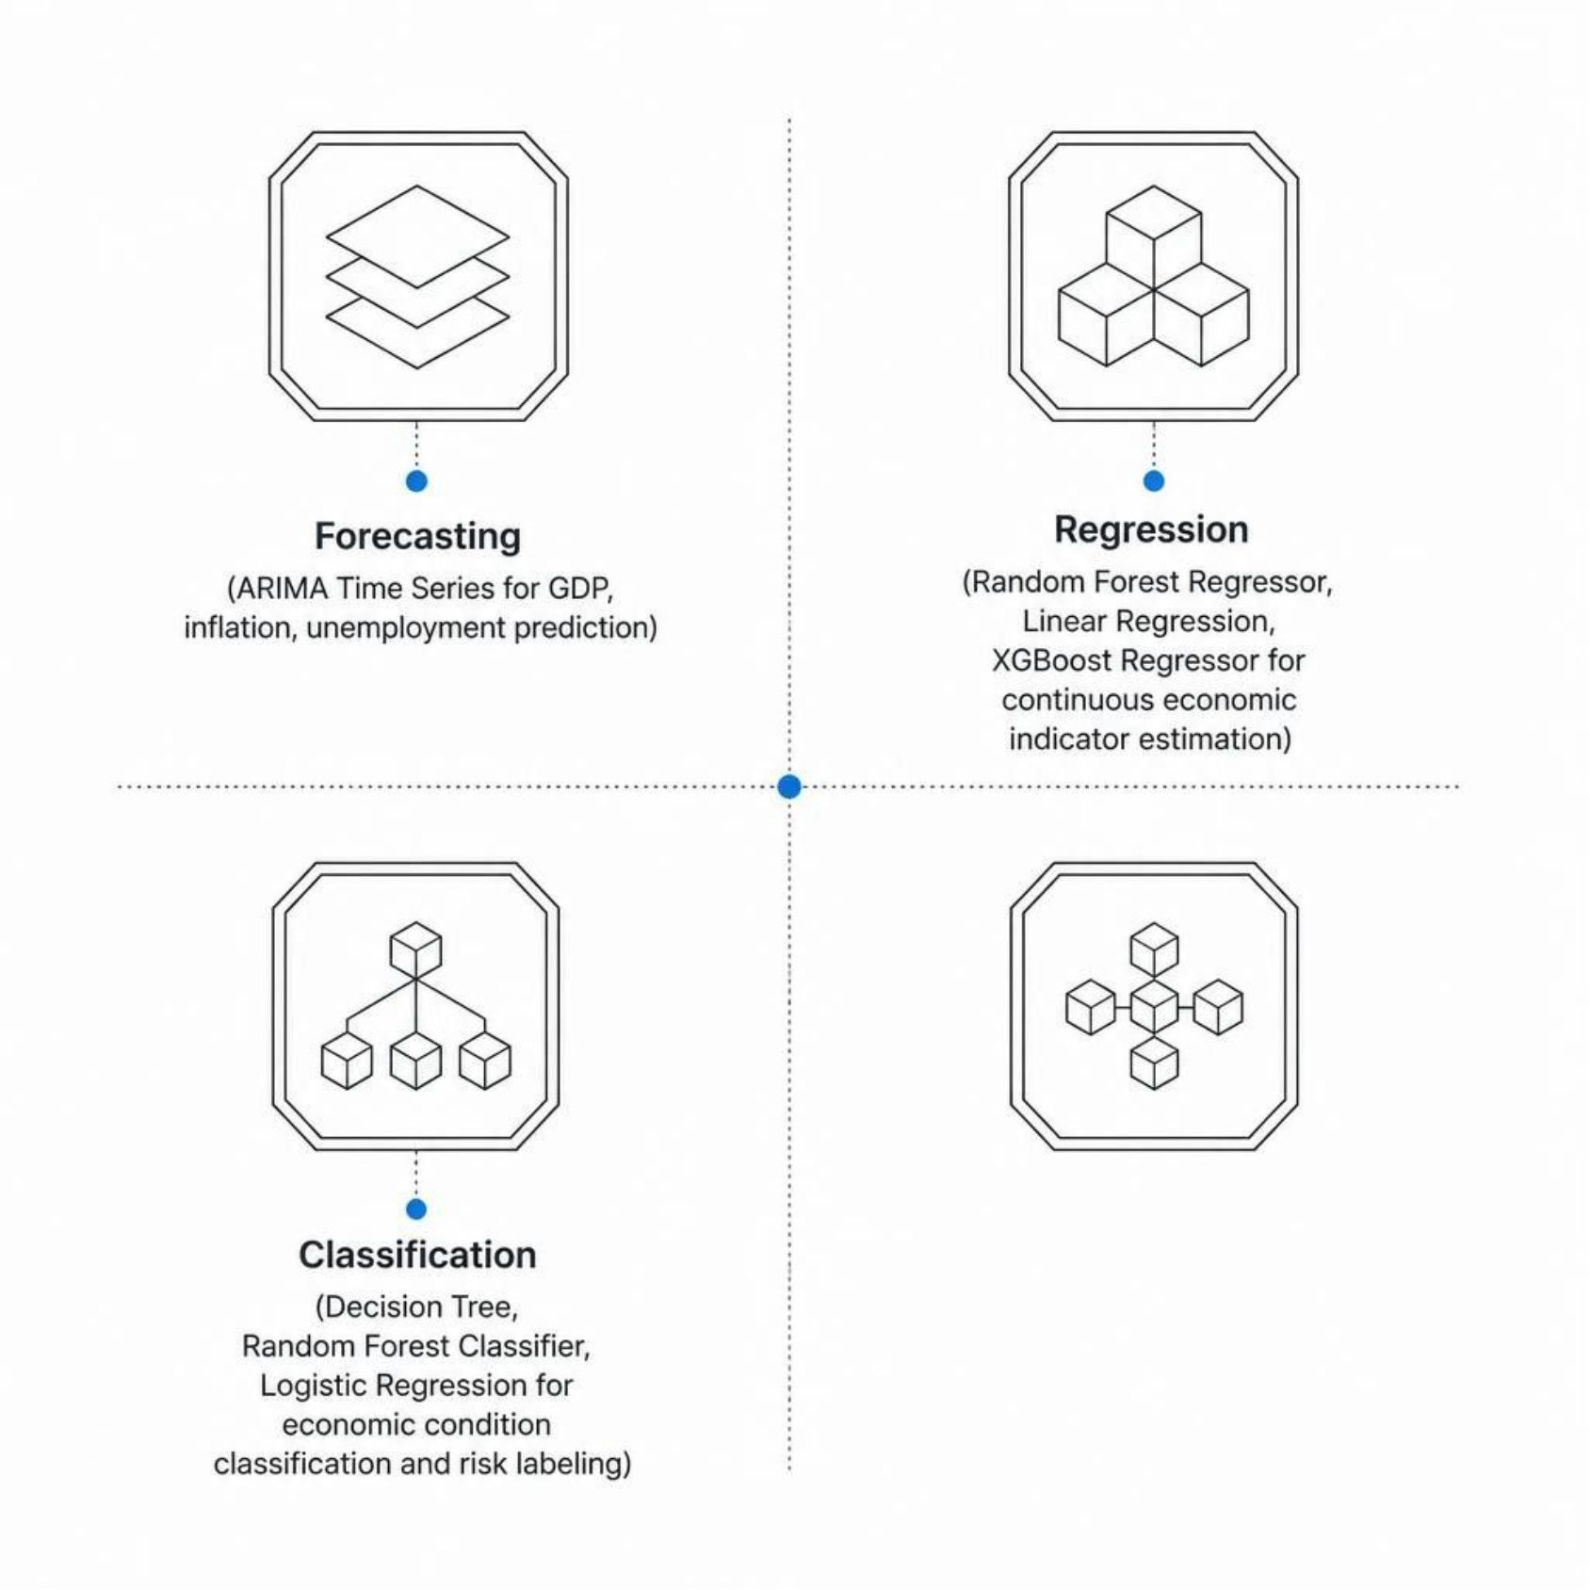
Machine Learning &
Forecasting Models
Why Multiple Models?
Diverse modeling approaches ensure robustness. Time series models capture temporal dynamics, regression models estimate continuous outcomes, and classifiers categorize economic states — together forming a comprehensive analytical engine.
Forecast Future Indicators
Analyze Economic Conditions
Support Policy Decisions

Slide 8








System Features
GDP Forecasting
Inflation Forecasting
Multi-year GDP growth projections using ARIMA and XGBoost.
Consumer price trend prediction for policy planning.
Unemployment Forecasting
Economic Health Index
Labor market trend analysis and risk signals.
Composite EHI score for overall economic assessment.
Condition Classification
Risk Detection System
Automated labeling of economic states: stable, stressed, or critical.
Early warning engine for inflation and employment risks.
Correlation Analysis
Interactive Dashboard
Inter-indicator relationship mapping for deeper insights.
Streamlit-powered real-time visual exploration of all outputs.

Slide 9
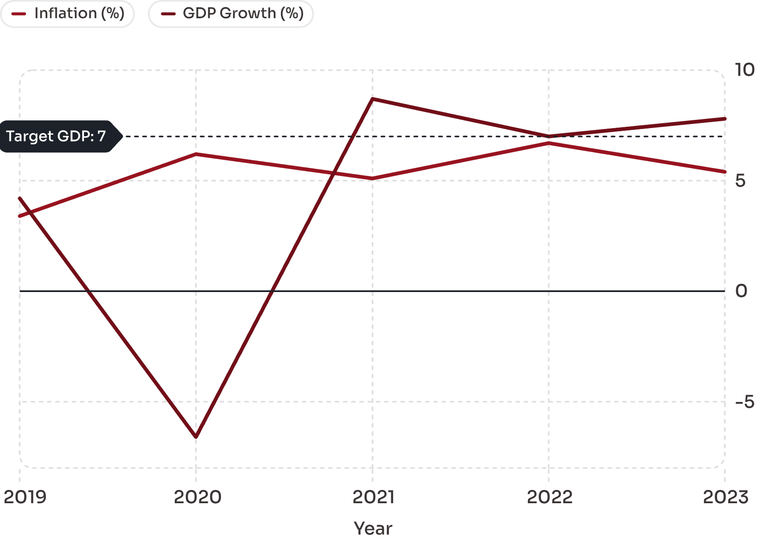

Results & System Interface
Outputs Generated
1
Economic Trend Forecasts
Multi-year projections for GDP, inflation, and unemployment.
2
Economic Health Assessment
EHI scores classifying economic conditions over time.
3
Risk Detection Reports
Automated alerts for inflation and employment risk thresholds.
4
Correlation Matrix
Inter-indicator relationship analysis for strategic insight.
Illustrative GDP & Inflation trend — actual outputs generated by the system.
System Interface: Insert Streamlit Dashboard Screenshots Here — 3 to 4 annotated screenshots recommended for live demo or project submission.

Slide 10
Future Scope & Conclusion
Future Enhancements
01
02
Real-Time Data Integration
Deep Learning Models
Live economic feeds for up-to-date forecasting.
LSTM and Transformer architectures for higher accuracy.
03
04
Global Economic Comparison
Policy Recommendation Engine
Cross-country benchmarking and peer analysis.
AI-generated, evidence-based policy suggestions.
05
06
Automated Report Generation
Explainable AI (XAI)
Scheduled, shareable intelligence briefs.
Transparent, interpretable model decisions for stakeholders.
"Transforming Historical Economic Data into Actionable Intelligence Through AI."
This system successfully combines machine learning, forecasting, and economic analysis to enable trend prediction, early risk identification, and data-driven policy support for India's economic future.

