Slide 1
Title: SqueezeNet-Enhanced Histopathological Image Analysis for Efficient Colon Cancer Detection: A Lightweight Deep Learning Approach
Abu Sufian(23366011) Instructor: Annajiat Alim Rasel
TEAM 10 Course : CSE707

Slide 2
Idea Behind The Paper
Optimize Distributed Training
Facilitate Over-the-Air Updates
Evaluate FPGA and ASIC Deployment
Efficient Histopathological Image Analysis
Balancing Accuracy and Model Efficiency

Slide 3
Related Work
CNN Applications in Histopathological Image Analysis by Cruz-Roa et al. (2014)
Deep Learning for Colorectal Cancer Detection by Ehteshami Bejnordi et al. (2017)

Slide 4
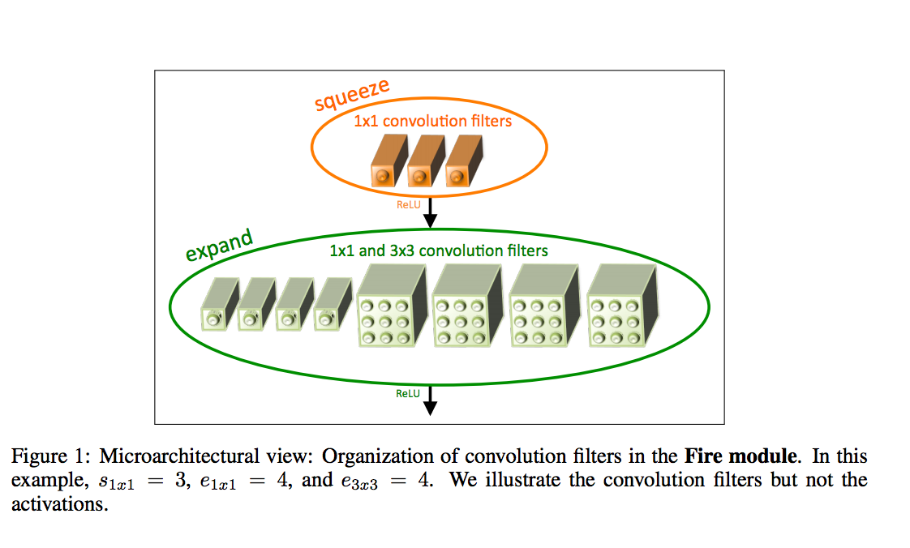
Proposed Model
SqueezeNet Model Summary
Overview
Mathematical Representation
The Squeeze layer in SqueezeNet is represented by the equation: Zsq ​ =X∗Wsq ​ +Bsq ​
Expand Layers
Model Size Reduction in SqueezeNet
Fire Module Architecture
Reduced Number of Parameters
Parallel Paths and Concatenation

Slide 5
AlexNet Model Summary
Overview
Deep convolutional neural network architecture
Architecture Highlights
Comprises five convolutional layers
Using 3x3 convolutions, followed by 5x5 convolutions in later layers
Regularization

Slide 6
SqueezeNet VS AlexNet
Depth and Complexity
SqueezeNet is shallower with fewer parameters
Parameter Efficiency
AlexNet, has more parameters, requires more memory
Computational Efficiency
SqueezeNet reduced parameter size

Slide 7
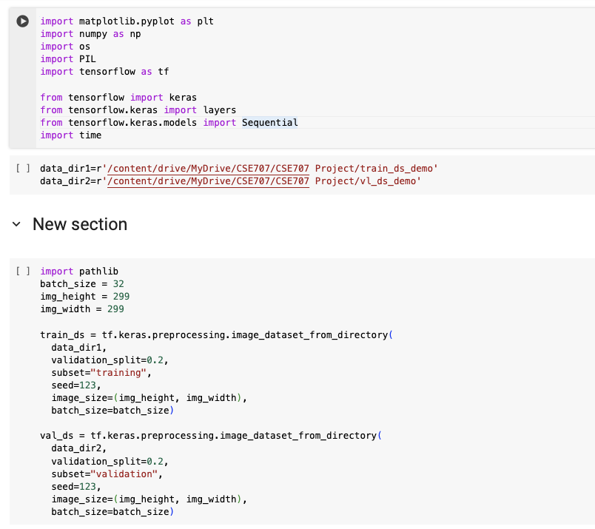
Implementation
Data Loading and Preprocessing
Model Defition
Compiling the Model
Training
Evaluation and Testing

Slide 8
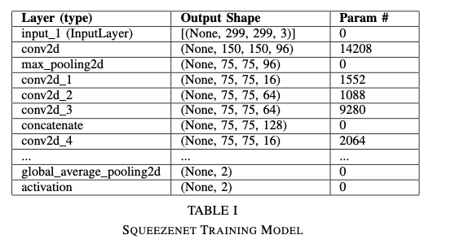
Result Analysis
Model Architectures
Squeezenet:
Designed with smaller filters and clever architectural decisions to reduce the number of parameters.
Employs "Fire" modules, utilizing 1x1 and 3x3 convo-lutions to minimize the model’s size while maintaining performance.
Trainable parameters: 736,450 (2.81 MB).
Significantly fewer parameters than AlexNet, making it more lightweight and suitable for low-end devices.

Slide 9
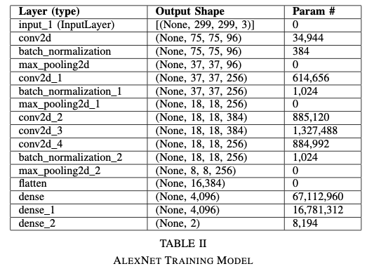
AlexNet
Utilizes larger filter sizes and deeper layers compared to Squeezenet.
Incorporates standard convolutional layers, pooling layers, and dense layers.
Trainable parameters: 87,650,098 (334.37 MB).
Larger number of parameters compared to Squeezenet, making it more computationally expensive and larger in size

Slide 10
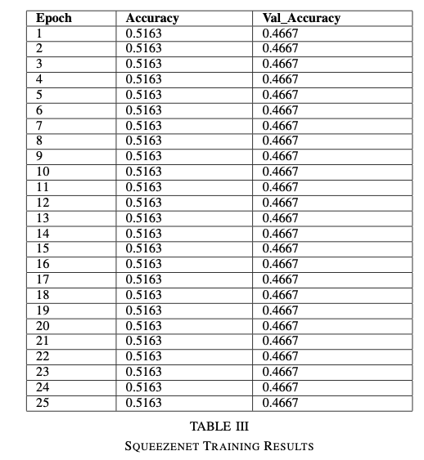
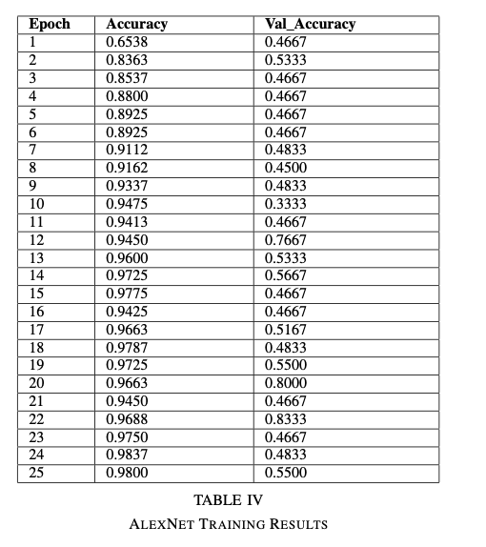
Training Results(25 Epocs)

Slide 11
Performance Comparison
Squeezenet:
• Despite a slightly lower accuracy, it offers a balance between size and performance.
• With fewer parameters, it’s faster and more efficient for low-end devices.
AlexNet:
• Despite its potentially higher accuracy at times, it’s computationally more intensive and larger in size, mak-ing it less suitable for resource-constrained devices.

Slide 12
Limitations
Limited Model Capacity for Complex Data
Reduction in Information Flow
Struggle with Capturing Fine Details
Limited Performance for Specific Use Cases
Sensitivity to Initial Configurations

Slide 13
Future Work Scope
Accuracy Level Increase
Channel Attention
Squeeze & Excitation Block

Slide 14
Thank You
Any Questions?

