Slide 1
Constraint Layout (overview + tutorial)
By Sufian Farouk Babri

Slide 2
Why Constriant Layout?
Flat hierarchy.
Easier to read and modify.
Like Relative Layout … on steroids.

Slide 3
Constraints
Top, right, bottom, left.
Horizontal / vertical bias.
Baseline (for widgets with texts).

Slide 4
Helpers
Guideline
Group
Barrier

Slide 5
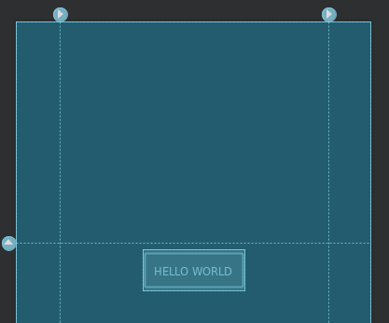
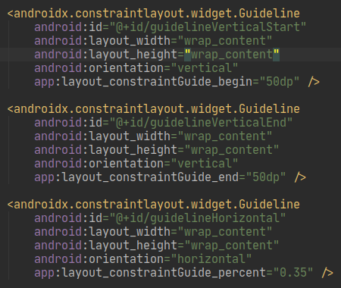
Guideline
Place horizontally / vertically.
Position in dp or percentage.

Slide 6
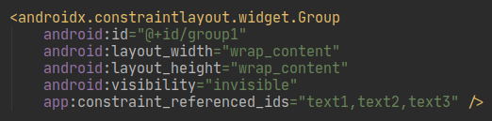
Group
Clump together views.
Change visibility easily.

Slide 7
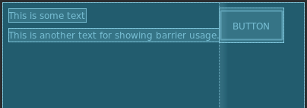
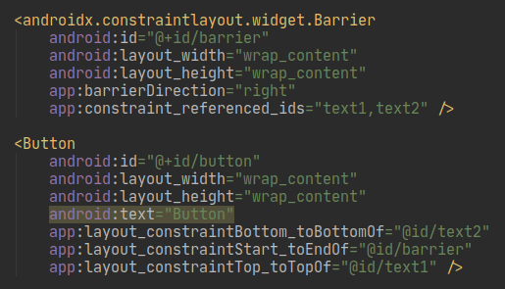
Barriers
Constrain against multiple views.

Slide 8
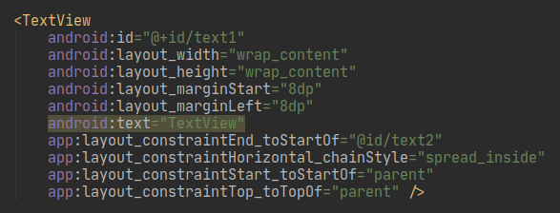
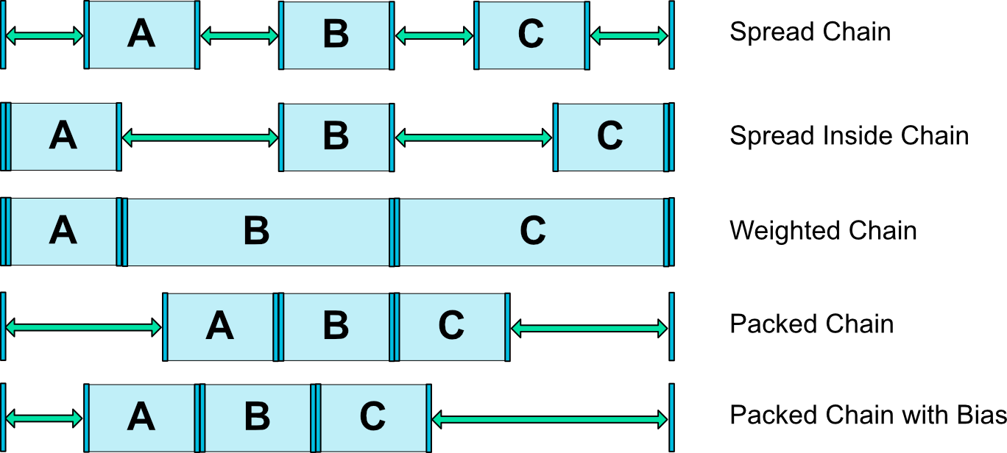
Chaining
Place views horizontally / vertically.
Various ways to arrange.

Slide 9
Common problems & solutions
Background in flat hierarchy?
View at the bottom of a screen?
  Refer to view_at_bottom_in_scroll_view.xml in the repo.

Slide 10
References
Resources:
  ConstraintLayout Docs
  Constraint Layout == Relative Layout on roids?
  ConstraintLayout – Guidelines, Barriers, Chains and Groups
GitHub repository:
  https://github.com/SufianBabri/ConstraintLayoutTutorial

