Slide 1




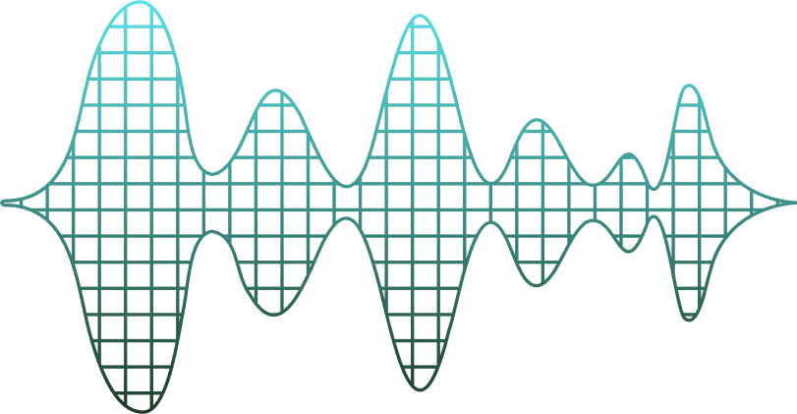
Introduction To AI Cyberbullying Guardian
Team Members:
Md. Abu Sufian Tonmoy 011221191
Shariful Islam Likhon 0112230271
- Nafees Shahriar 0112230432

Slide 2



Introduction
Objective: Detect and classify cyberbullying using NLP and ML.
Why it Matters:
- Growing concern of cyberbullying on social media.
- Need for real-time, automated detection tools.
- Ensures safer digital communication.

Slide 3



Statistics On Cyberbullying
- 1 in 3 young people has experienced
cyberbullying." (Source: UNICEF)
- 60% of victims don’t report it.
- Girls are twice as likely as boys
to be targeted.

Slide 4


Project Overview
Our system uses advanced machine learning techniques to analyze text and identify potentially harmful content. The key features include:
Real-time text analysis and classification
High accuracy detection using ensemble learning
Enhanced preprocessing for better text understanding
User-friendly interface for easy interaction

Slide 5
Data Preprocessing
Dataset: cyberbullying_tweets.csv
Steps:
- Text cleaning: lowercasing, removing URLs, mentions, punctuation.
- Handled contractions and stopwords (preserved negation).
- Applied sentiment analysis using VADER.
- Extracted features: length, punctuation, sentiment, offensive words.

Slide 6



Feature Engineering
Text Features:
TF-IDF vectorization with 8,000 features
N-gram analysis (unigrams, bigrams, trigrams)
Text statistics (length, word count, average word length)

Slide 7
Feature Engineering
Behavioral Features:
Punctuation patterns (exclamation marks, question marks)
Capitalization ratio
Sentiment analysis using VADER
Offensive word pattern detection

Slide 8
Data Balancing & Preparation
To ensure fair training, we balanced our dataset:
Identified class imbalances
Applied strategic resampling
Created stratified train-test splits
Scaled features for optimal model performance

Slide 9
Model Training
For maximum accuracy, we implemented an ensemble learning approach combining four powerful algorithms:
Linear SVM - Excellent for text classification with clear decision boundaries
Logistic Regression - Provides probability estimates and fast training
Random Forest - Handles feature interactions and reduces overfitting
Naive Bayes - Effective for text data with strong independence assumptions"
Data Split:
- 80% train, 20% test with stratification.

Slide 10
Ensemble Strategy
Our voting classifier combines predictions from all four models using hard voting, where the final prediction is determined by majority vote. This approach typically outperforms individual models by reducing bias and variance.

Slide 11

Model Evaluation
We used comprehensive evaluation metrics:
Classification reports showing precision, recall, and F1-scores
Confusion matrices to understand prediction patterns
5-fold cross-validation for reliable performance estimates

Slide 12
Model Evaluation
Accuracy Scores:
- Ensemble : 83.35%
SVM: 81.13%
Logistic Regression : 82.59%
Random Forest : 83.88%
Naive Bayes : 79.02%
Cross-Validation :
- Average Accuracy: 83.88%

Slide 13


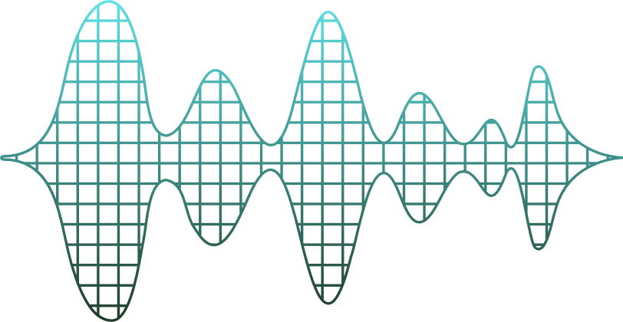
Key Takeaways
Ensemble methods boost robustness and performance.
Combining TF-IDF with engineered features improves
accuracy.
Proper preprocessing and balance are crucial.
Model architecture is scalable for real-time use.

Slide 14
Real-world Applications
This system can be deployed for:
Social media content moderation
Online forum monitoring
Educational platform safety
Real-time chat filtering

Slide 15

Future Work
Deploy as web/mobile application.
Expand to multi-class classification (types of cyberbullying).
Integrate deep learning models (e.g., BERT, LSTM).
Support multilingual detection across platforms.

Slide 16

Thank You

