Slide 1
Food Bank Resource Allocation Optimizer
RL decision-support prototype for fair, nutritious and low-waste food distribution
CT-469 Reinforcement Learning
Instructor: Dr. Murk Marvi
Group: AI 22041 Talha Noor, AI 22047 Sufiyan Nadeem, AI 22044 Ali Rana
NED University of Engineering and Technology

Slide 2
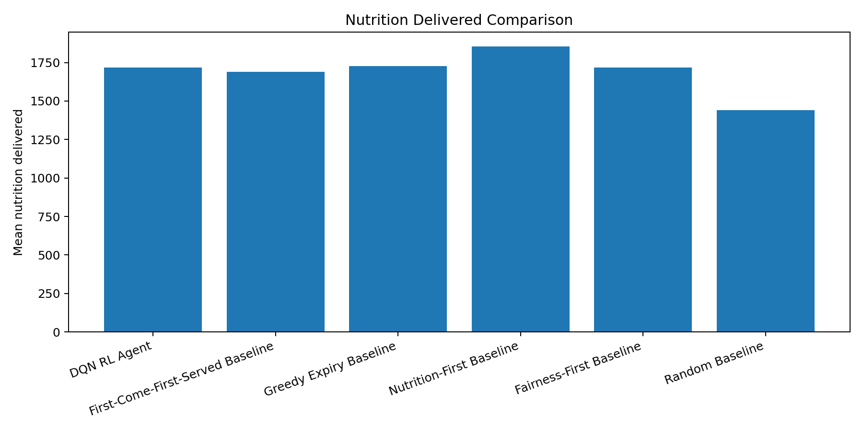
Problem
Food bank allocation is not only a queue problem
Limited donations must be allocated before expiry.
Families have different sizes, need levels and dietary restrictions.
Manual rules can maximize one metric but fail on fairness or dignity.
Goal: learn a balanced allocation policy and compare it to non-RL baselines.

Slide 3
Deliverables Covered
Source code repository structure with modular files.
README setup instructions.
Browser-based Streamlit web interface.
Standalone training script: train.py.
Saved DQN model: models/dqn_foodbank.pt.
Custom environment and multiple non-RL baselines.
Report and presentation with final results.

Slide 4
System Architecture
environment/foodbank_env.py -> custom simulation
agents/dqn_agent.py -> dueling Double-DQN
agents/baselines.py -> non-RL comparison methods
train.py -> learning loop and saved model
test.py -> final evaluation graphs/CSV
app.py -> live Streamlit dashboard
Saved model
included
Baselines
5
Reward
positive
Demo
browser

Slide 5
RL Formulation
State: inventory quantity, days-to-expiry, nutrition, category, budget, need, coverage and fairness.
Action: choose an allocation strategy rather than a raw family ID.
Reward: positive points for useful allocation behavior.
Objective: maximize a balanced score across nutrition, fairness, waste and dietary compatibility.

Slide 6
DQN Agent
Dueling network: separates state value from action advantage.
Double-DQN target: reduces Q-value overestimation.
Replay buffer: learns from past allocation transitions.
Target network: improves training stability.
Evaluation uses epsilon=0 for the learned greedy policy.

Slide 7
Non-RL Baselines
First-Come-First-Served: queue-based manual rule.
Greedy Expiry: prioritizes food closest to expiry.
Nutrition-First: maximizes raw nutrition only.
Fairness-First: prioritizes under-covered families.
Random: lower-bound reference.

Slide 8
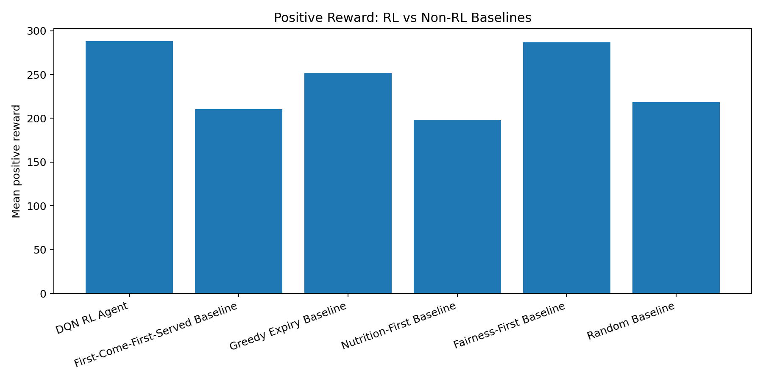
Final Result: Positive Reward

Slide 9
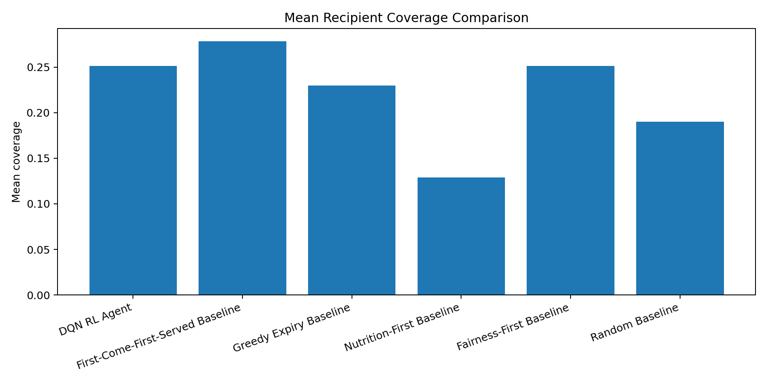
Result Interpretation
DQN achieved the highest mean reward: 288.21.
Fairness-First was the strongest non-RL competitor: 286.86.
Nutrition-First delivered high raw nutrition but had weak fairness and coverage balance.
DQN reduced dietary mismatches to 2.58, far below FCFS (14.50).
Conclusion: DQN learned the best overall multi-objective policy.

Slide 10
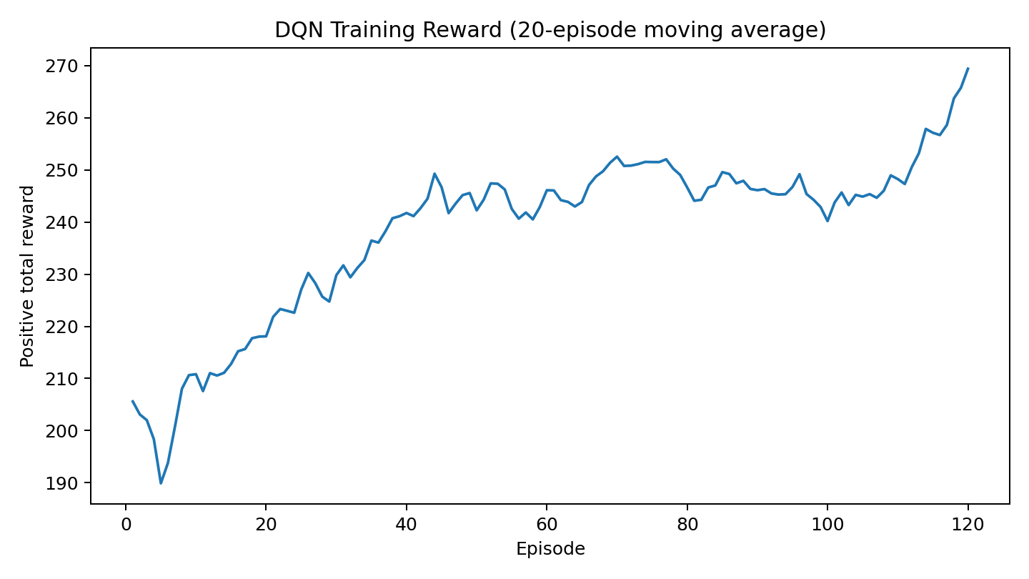
Training Progress

Slide 11
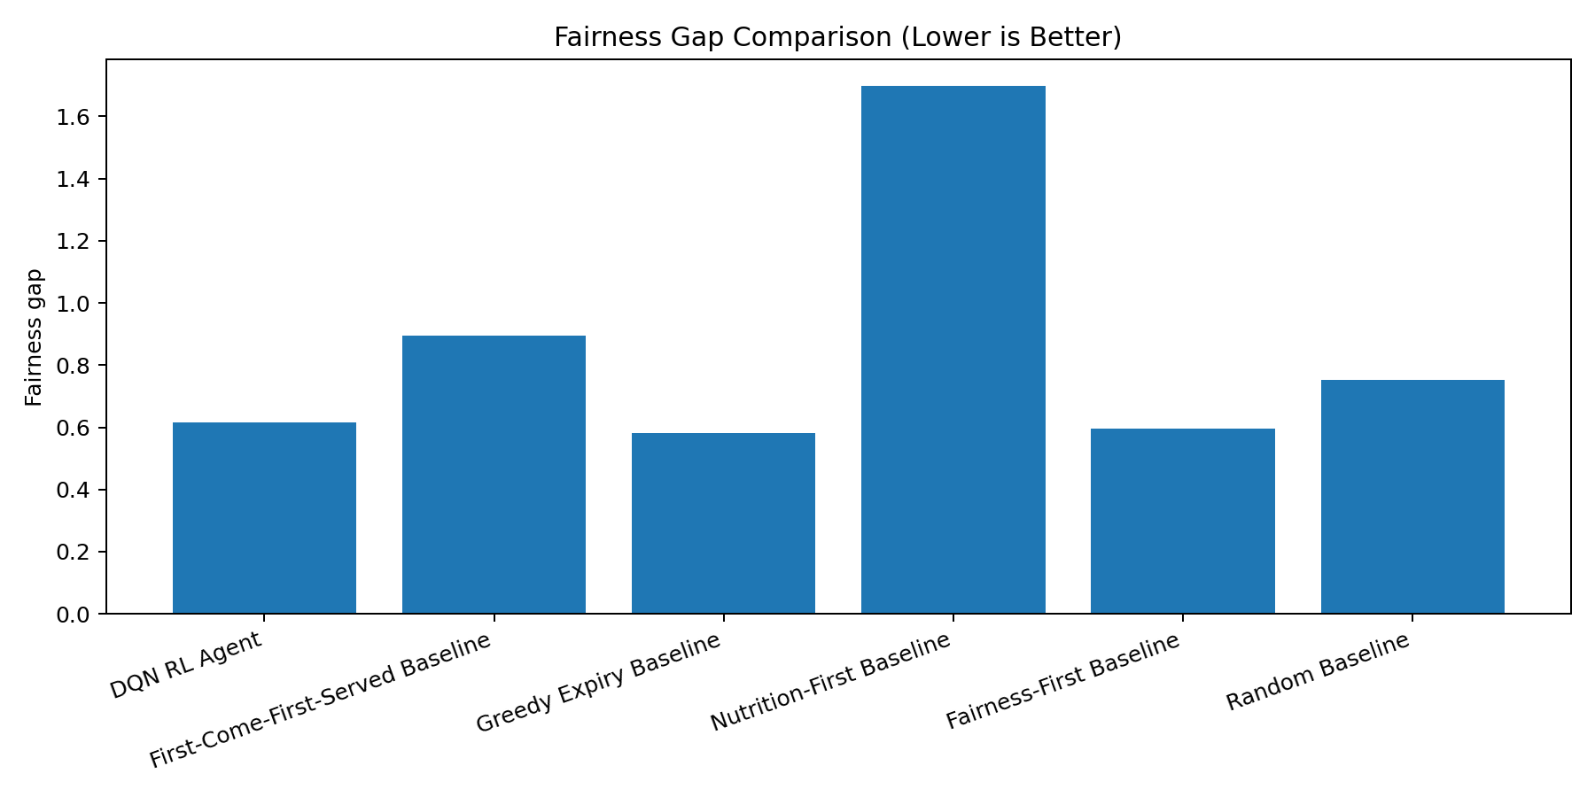
Fairness and Constraints

Slide 12
Live Demo Plan
Run: python -m streamlit run app.py
Show starting inventory and recipient snapshot.
Click “Run one full comparison episode”.
Explain Reward, Nutrition, Expired Units, Fairness Gap, Mean Coverage and Mismatches.
Mention that final evaluation is based on repeated test.py episodes.

Slide 13
Limitations and Future Work
Data is simulated, not collected from a real food bank.
Expiry dynamics are simplified.
Future: real donation data, multi-location routing, demand forecasting, stronger constrained RL and recipient self-selection.

Slide 14
Conclusion
Complete working RL prototype.
Positive, explainable reward system.
DQN trained and saved for immediate testing.
Five non-RL baselines included.
Final results show DQN has the best overall reward.

