Slide 1





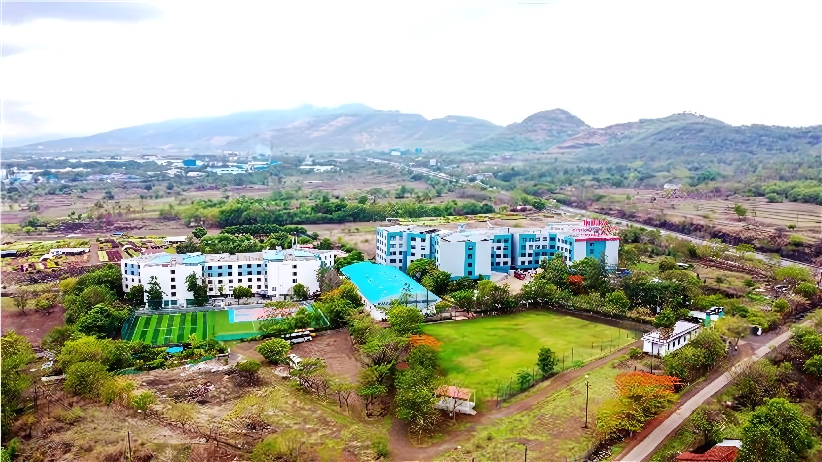
MINI PROJECT REVIEW – 2 • ACADEMIC YEAR 2026–2027
EduVerse AI
An Animated Virtual Tutor for Personalized Learning
Department of Artificial Intelligence & Data Science
Indira College of Engineering & Management, Pune (Autonomous)
PRESENTED BY
• Aryan Shinde
• Huzaifa Sheikh
• Sufiyan Surve
B.E. Artificial Intelligence & Data Science
UNDER THE GUIDANCE OF
Prof. Monika Patil
Assistant Professor & Project Mentor
Dept. of Artificial Intelligence & Data Science
ICEM, Pune
AI-Assisted Contextual Learning & Virtual Tutoring System

Slide 2











PROJECT REVIEW – 2 • PRESENTATION STRUCTURE
Agenda
SECTION 01
Introduction
FOCUS: IDEA & PROBLEM
Problem context, fragmented study resources, and proposed virtual tutor concept.
SECTION 02
Aim & Objectives
FOCUS: TARGET & GOALS
Primary project goal and 6 core functional engineering deliverables.
SECTION 03
Tools Used
FOCUS: TECH STACK
Proposed technology stack across UI, API, LLM, document engine, and 3D avatar.
SECTION 04
Proposed Solution / Overview
FOCUS: SYSTEM FLOW
End-to-end system architecture, PDF ingestion pipeline, and data flow.
SECTION 05
Implementation / Prototype
FOCUS: FUNCTIONAL UI
Interactive web UI demonstration, dialogue stream, and active quiz module.
SECTION 06
Applications
FOCUS: PRACTICAL VALUE
Practical student self-learning, exam revision, and interactive practice use cases.
SECTION 07
Future Scope
FOCUS: ROADMAP
Phased development roadmap, voice integration, and adaptive difficulty.
SECTION 08
Conclusion & References
FOCUS: WRAP-UP & DOCS
Project summary, key takeaways, and verified technical documentation.
www.indiraicem.ac.in
EduVerse AI • Mini Project Review-2

Slide 3

CONTEXT & PROBLEM STATEMENT
Introduction
THE PROBLEM
Limitations of Static Learning
• Fragmented Study Material
Students depend on disconnected textbook scans, static PDFs, and lengthy video lectures without unified assistance.
• Difficult Contextual Doubts
Finding clear explanations for specific course doubts requires switching across generic web platforms, losing syllabus focus.
• No Instant Practice Loop
Passive reading material does not automatically convert into interactive exercises, flashcards, or practice questions.
THE GAP
The Learning Bottleneck
OUR IDEA
EduVerse AI Virtual Tutor
An interactive AI tutor bridging course documents with animated virtual guidance:
📚 Study Material: Direct upload and ingestion of syllabus notes and textbook chapters.
🧠 AI Understanding: Contextual parsing of text to anchor responses in student documents.
💬 Interactive Q&A: Real-time conversational explanations tailored to student doubts.
📝 Quiz Generation: Automated MCQ creation from study content for instant practice.
🤖 Animated Tutor: A WebGL 3D virtual avatar interface that increases engagement.
📄 Static Content
Unstructured lecture slides, dense textbooks, and static PDF notes.
⏸️ Limited Interaction
One-way passive reading with zero real-time question answering.
⚠️ Generic Explanations
Non-personalized explanations without student-paced breakdown.
CORE INTERACTIVE LEARNING PIPELINE
1. UPLOAD PDF
2. UNDERSTAND
3. ASK DOUBT
4. EXPLAIN
5. PRACTICE QUIZ
6. REVIEW FEEDBACK
www.indiraicem.ac.in
EduVerse AI • Mini Project Review-2

Slide 4
PROJECT GOAL & ENGINEERING DELIVERABLES
Aim & Objectives
CORE PROJECT AIM
“To develop an AI-powered animated virtual tutor that helps students interact with their study material, obtain contextual explanations and practice concepts through automatically generated quizzes.”
OBJECTIVE 01 • CONVERSATION
Interactive AI Tutor
Provide an engaging virtual learning assistant capable of answering student queries in a natural, conversational manner.
OBJECTIVE 02 • DOCUMENT PARSING
Study Material Understanding
Parse and extract machine-readable text from student-uploaded PDF documents for contextual grounding.
OBJECTIVE 03 • TARGETED DOUBTS
Contextual Q&A
Deliver accurate, document-relevant explanations tailored to specific student doubts, minimizing generic answers.
OBJECTIVE 04 • CLARITY & DEPTH
Simplified Explanations
Deconstruct complex theoretical definitions and formulas into structured, student-friendly conceptual analogies.
OBJECTIVE 05 • ACTIVE ASSESSMENT
AI Quiz Generation
Automatically generate multiple-choice practice questions directly from the uploaded material for self-testing.
OBJECTIVE 06 • EVALUATION
Learning Feedback
Provide instant scoring, answer rationales, and self-assessment insights to reinforce student understanding.
www.indiraicem.ac.in
EduVerse AI • Mini Project Review-2

Slide 5
ENGINEERING DESIGN & END-TO-END PIPELINE
System Architecture & Technology Stack
PROPOSED TECHNOLOGY STACK
Frontend Interface: React
Component-based single page application & interactive dashboard.
Backend Services: Python / FastAPI
High-performance asynchronous REST API routing and logic.
AI Processing Layer: LLM API
Contextual reasoning, explanation generation & quiz creation.
Document Processing: PyMuPDF
High-speed text extraction from uploaded student PDF files.
Database Layer: SQLite / PostgreSQL
Session state, document metadata, and quiz scores storage.
Avatar Technology: Three.js / WebGL
Web-based animated 3D virtual assistant display.
VCS & API Testing: Git, GitHub & Postman
Version control workflow and automated API verification.
END-TO-END SYSTEM ARCHITECTURE
👨‍🎓 Student User
Uploads PDF • Asks Doubts • Takes Quizzes
🖥️ React Web Interface
Dashboard • Dialogue Stream • Avatar Canvas
⚙️ FastAPI Backend
REST Endpoints • Session Coordinator
📑 Document Processing Pipeline (PyMuPDF)
1. Student uploads syllabus PDF / lecture notes.
2. PyMuPDF extracts machine-readable text and clean chapters.
3. Formats document context for grounded LLM prompts.
🧠 AI Processing Engine (LLM API)
• Receives user doubt + extracted document context
• Performs grounded semantic reasoning
• Formats natural language explanations & MCQ questions
💬 Contextual Q&A & Explanation Engine
• Answers student doubts grounded in syllabus notes.
• Breaks down complex formulas into intuitive analogies.
📝 Dynamic Quiz Generator & Scoring
• Creates multiple-choice questions from ingested chapters.
• Delivers immediate evaluation and answer rationales.
VIVA EXPLAINABILITY & DATA FLOW RATIONALE
“The student interacts via the React dashboard. Uploaded PDFs are parsed into text using PyMuPDF. When a doubt is submitted, the backend provides the relevant document text alongside the prompt to the LLM API, ensuring syllabus-grounded explanations. Quizzes are generated from the same context for self-assessment.”
Implementation Status: Core PDF ingestion, REST endpoints, and prompt integration under active development (Prototype Architecture).
www.indiraicem.ac.in
EduVerse AI • Mini Project Review-2

Slide 6
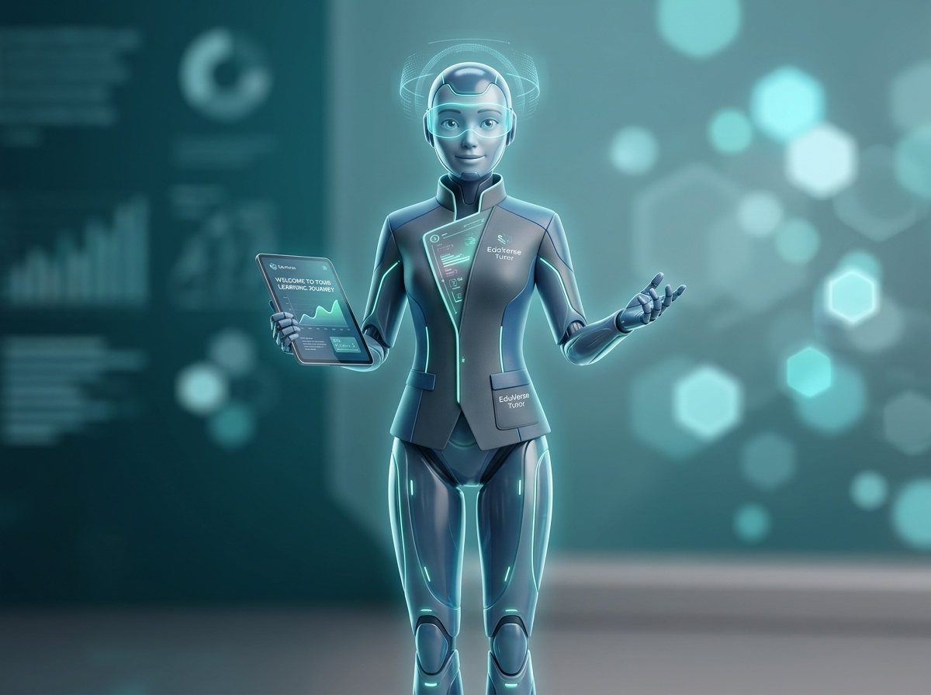
FUNCTIONAL INTERFACE DEMONSTRATION & EXECUTION PIPELINE
Implementation / Prototype
🔒 https://eduverse-ai.local/app/tutor-workspace
PROTOTYPE INTERFACE (DEMONSTRATION)
EduVerse AI
📊 Dashboard
📚 My Material
🤖 Virtual Tutor
📝 Practice Quizzes
📈 Progress Analytics
⚙️ Settings
Build: v0.2-alpha
Status: Local Prototype
📄 ACTIVE DOCUMENT: Machine_Learning_Basics.pdf
Unit 4: Supervised Learning • 24 Pages Parsed (PyMuPDF) • Context Grounded
👨‍🎓 Student Doubt:
“Explain supervised learning in simple terms with an example from my notes.”
🤖 EduVerse AI Tutor (Context-Grounded Explanation):
“Supervised learning is a machine learning approach where a model learns from labeled training examples (pairs of input features and expected target outputs).
• Analogy: Learning with an answer key.
• Example from Chapter 4: Predicting real-estate house prices based on known square footage and past transaction records.”
🟢 EduVerse 3D Tutor • Active Session
LIVE CONCEPT CHECK (AUTO-GENERATED)
Q1: In supervised learning, what do training samples consist of?
[ ] A. Unlabeled data patterns
[ ✓ ] B. Features paired with ground-truth labels (Correct)
[ ] C. Reinforcement reward signals only
💬 Ask Follow-Up Question
📝 Generate Concept Practice Quiz
IMPLEMENTATION PIPELINE & EXECUTION WORKFLOW
1. PDF Upload ➔ 2. Text Extraction (PyMuPDF) ➔ 3. AI Context Grounding ➔ 4. Contextual Q&A ➔ 5. Quiz Generation ➔ 6. Instant Evaluation
Note: Screen demonstrates designed software prototype layout and functional workflow components. Advanced 3D avatar rigging and adaptive analytics are under development.
www.indiraicem.ac.in
EduVerse AI • Mini Project Review-2

Slide 7
PRACTICAL USE CASES & DEVELOPMENT ROADMAP
Applications & Future Scope
PRACTICAL APPLICATIONS
🎓 Student Self-Learning
Supports independent study sessions, self-paced revision, and instant clarification of complex textbook paragraphs without waiting for office hours.
📚 Exam Preparation
Quickly transforms voluminous semester PDFs into structured summaries, key formula explanations, and revision practice sets.
🔁 Targeted Concept Revision
Allows students to revisit difficult mathematical or theoretical topics on-demand with simplified breakdowns before laboratory viva.
📝 Practice Assessment
Generates instant, topic-wise practice MCQs directly from uploaded chapters to evaluate retention and conceptual understanding.
💻 Interactive Digital Learning
Serves as an engaging, multimodal virtual tutor module for institutional learning management systems (LMS).
PHASED DEVELOPMENT ROADMAP
PHASE 1: Core AI Tutor (Current Prototype)
Document parsing via PyMuPDF, document-grounded contextual Q&A, and basic multiple-choice quiz generation.
PHASE 2: Voice Interaction (Planned)
Integrating Speech-to-Text (STT) and natural Text-to-Speech (TTS) for natural voice-driven student tutoring.
PHASE 3: Personalized Learning (Planned)
Adaptive quiz difficulty that dynamically scales based on individual student accuracy and mastery.
PHASE 4: Learning Analytics (Planned)
Long-term student progress tracking, weak-topic identification, and targeted revision recommendations.
PHASE 5: Cross-Platform Mobile App (Planned)
Dedicated mobile deployment for smartphone-based portable studying and instant doubt solving.
Planned Technology Badges: Speech-to-Text • Text-to-Speech • Multi-Language Support • RAG Document Grounding • Three.js Avatar Lip-Sync
www.indiraicem.ac.in
EduVerse AI • Mini Project Review-2

Slide 8






PROJECT SUMMARY, DOCUMENTATION & ACKNOWLEDGMENTS
Thank you!
Conclusion & References
CONCLUSION
“EduVerse AI demonstrates how generative AI can be integrated with educational content to create an interactive virtual learning assistant. The proposed workflow connects study-material processing, contextual Q&A, explanation generation and quiz-based practice through a unified interface.”
THANK YOU!
EduVerse AI
An Animated Virtual Tutor for Personalized Learning
Department of Artificial Intelligence & Data Science
Indira College of Engineering & Management, Pune
(An Autonomous Institute Affiliated to SPPU)
Academic Year: 2026–2027
👥 PROJECT TEAM:
• Aryan Shinde
• Huzaifa Sheikh
• Sufiyan Surve
🎓 UNDER THE GUIDANCE OF:
Prof. Monika Patil (Project Mentor)
GET IN TOUCH
WITH US
KEY TAKEAWAY WORKFLOW
Study Material ➔ AI Understanding ➔ Interactive Tutor ➔ Practice ➔ Feedback
Project Team
TECHNICAL DOCUMENTATION & REFERENCES
• React Documentation — Official documentation for React component lifecycle & UI architecture (react.dev).
• FastAPI Documentation — High-performance Python API framework for asynchronous request handling (fastapi.tiangolo.com).
• PyMuPDF Documentation — High-speed PDF text parsing, chapter extraction, and document processing (pymupdf.readthedocs.io).
• LLM API Documentation — Large language model interfaces, prompting strategies, and contextual comprehension APIs.
• Three.js Documentation — WebGL JavaScript 3D library for browser-based character animation & rendering (threejs.org).
• Academic Literature — Recent research on AI-assisted personalized tutoring, generative learning interfaces, and automated assessment.
Mentor
EduVerse AI • Mini Project Review-2

