Slide 1

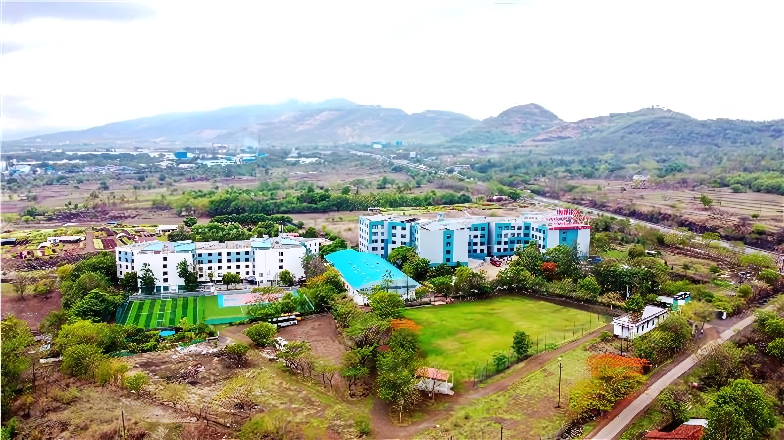



Department of Artificial Intelligence & Data Science​
Academic year 2026-2027​
Mini Project Review-2 Presentation
On
EduVerse AI
An Animated Virtual Tutor for Personalized Learning
Presented By
Aryan Shinde
Huzaifa Sheikh
Sufiyan Surve
Mentor
Prof. Monika Patil

Slide 2











Agenda
Introduction
01
Implementation
05
Aim and Objectives of the project
02
Applications of System
06
Tools Used
03
Future Scope of System
07
Proposed Solution /
System Overview
04
Conclusion & References
08
www.indiraicem.ac.in

Slide 3

Introduction
Introduction
Why EduVerse AI?
THE PROBLEM
THE SOLUTION
Learning resources are fragmented
EduVerse AI
• Students rely on static PDFs, notes and videos.
• Doubts often require switching between multiple resources.
• Creating practice questions from study material is time-consuming.
• Students need faster, contextual feedback while learning.
An AI-powered animated virtual tutor that connects study material with contextual Q&A, simplified explanations and AI-generated quizzes in one learning workflow.
Study
Material
AI
Processing
Contextual
Q&A
Quiz
Generation
Feedback
The goal is to make learning more interactive, contextual and self-assessment driven.
www.indiraicem.ac.in
EduVerse AI • Mini Project Review-2

Slide 4
Aim & Objectives
What the project is designed to achieve
AIM
Develop an AI-powered animated virtual tutor that provides interactive, contextual and personalized learning assistance using student study material.
OBJECTIVES
01
Interactive AI Tutor
02
Material-Based Q&A
03
Simple Explanations
Provide an AI-based learning assistant for student queries.
Answer questions using the student's learning content.
Turn difficult concepts into clearer explanations.
04
Quiz Generation
05
Self Assessment
06
Animated Experience
Generate practice questions from study material.
Display quiz results for quick feedback.
Use an animated tutor interface to improve engagement.
www.indiraicem.ac.in
EduVerse AI • Mini Project Review-2

Slide 5
Tools Used & Proposed System Overview
Prototype technology stack and end-to-end architecture
Frontend
Backend
AI
Documents
Data
Versioning
React
Python / FastAPI
LLM API
PyMuPDF
SQLite / PostgreSQL
Git / GitHub
SYSTEM ARCHITECTURE
STUDENT
WEB INTERFACE
BACKEND
AI ENGINE
Login • Upload • Ask • Quiz
React-based interaction layer
Python / FastAPI
LLM-based processing
PDF / STUDY MATERIAL
Q&A + EXPLANATION
QUIZ GENERATOR
Text extraction & context
Contextual AI response
Questions + evaluation
Prototype flow: Student → Interface → Backend → AI → Learning response → Quiz / Feedback
Implementation status: prototype workflow and interface are being developed; advanced AI, avatar and analytics features remain under development.
www.indiraicem.ac.in
EduVerse AI • Mini Project Review-2

Slide 6
Implementation & Applications
Prototype workflow and practical use cases
IMPLEMENTATION
PROTOTYPE UI VIEW
01
User Interface
EduVerse AI • Virtual Tutor
02
Study Material Upload
Learning
AI Tutor
Dashboard
“Explain this topic in simple terms.”
03
PDF → Text Extraction
My Material
Ask Tutor
AI explanation appears here using the selected study material.
04
AI Question Answering
Generate Quiz
05
Quiz Generation
Progress
Ask Question
Generate Quiz
06
Result / Feedback
APPLICATIONS
Self-learning
Exam preparation
Concept revision
Interactive study
Practice quizzes
UI shown above is a conceptual prototype view, not a final production screenshot.
www.indiraicem.ac.in
EduVerse AI • Mini Project Review-2

Slide 7
Future Scope, Conclusion & References
Planned enhancements beyond the current prototype
FUTURE SCOPE
01
Voice interaction
02
3D animated tutor
03
Personalized recommendations
04
Learning analytics
05
Multi-language support
06
Adaptive quiz difficulty
07
RAG-based grounding
08
Mobile application
CONCLUSION
REFERENCES
EduVerse AI demonstrates how generative AI can be integrated with educational content to create an interactive virtual learning assistant. The prototype brings document-based learning, contextual Q&A, explanation generation and quiz-based self-assessment into a unified workflow.
• React documentation
• FastAPI documentation
• PyMuPDF documentation
• LLM API documentation
• Three.js documentation
Future items are planned enhancements; they are not presented as completed features.
Prototype
Integration
Testing
Enhancement
www.indiraicem.ac.in
EduVerse AI • Mini Project Review-2

Slide 8






Thank you!
GET IN TOUCH
WITH US
Project Team
Mentor
Aryan Shinde • Huzaifa Sheikh • Sufiyan Surve
EduVerse AI
Prof. Monika Patil
An Animated Virtual Tutor for Personalized Learning

