Slide 1
PRESENTATION

Slide 2
TUMOR DETECTION
USING
IMAGE PROCESSING

Slide 3



OUR TEAM
SAAD
SUFYAN
ESHA
SARFARAZ
BILAL

Slide 4
Image processing
What Is Image Processing?
Image processing is a method to perform some operations on an image
in order to get an enhanced image or to extract some useful information
from it. It is a type of signal processing in which input is an image and
output may be image or characteristics/features associated with that image.

Slide 5
Image processing
Use Of Image Processing In Tumor Detection?
Computed Tomography scans (CT scans), X-rays and
Magnetic Resonance Imaging (MRI) technologies allow us to detect even the
smallest defects in the human body.Abnormal growth of tissues in the brain which
affect proper brain functions is considered as a brain tumor.The main goal of medical
image processing is to identify accurate and meaningful information using images with the
minimum error possible. MRI is mainly used to get imagesof the human body
and cancerous tissues because of its high resolution and better quality
images compared with other imaging technologies.
MRI images can be processed and
the brain tumor can be segmented..

Slide 6
LET’S DISCUSS THE WHOLE PROCESS
HOW WE USE IMAGE PROCESSING
TO IDENTIFY TUMOR IN BRAIN

Slide 7
STEPS NEEDED
Image
Segmentation
Feature
Extraction
PreProcessing
Classification

Slide 8
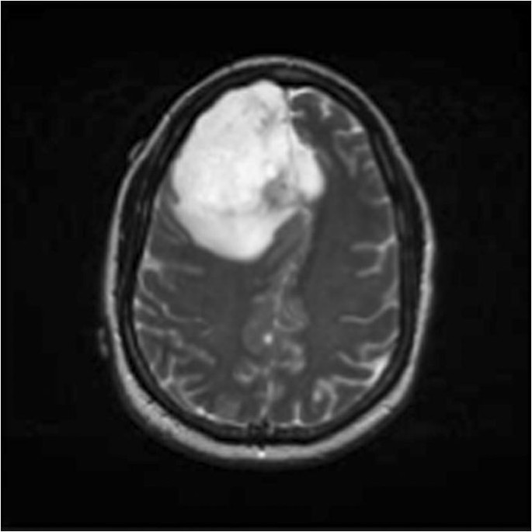
Pre-Processing
It is very significant to remove unnecessary items from an image.
After removing unnecessary artifacts, the image can be processed successfully. The initial step of image processing is Image Pre-Processing, Pre-processing involves-processes like conversion to grayscale image, noise removal and image reconstruction.Conversion to grey scale image is the most common pre-processing practice.After the image is converted to grayscale, then remove excess noise using different filtering methods.

Slide 9
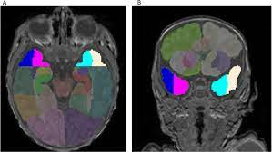
Segementation
Segmentation of images is important as large numbers of images are generated during the scan and it is unlikely for clinical experts to manually divide these images in a reasonable time. Image segmentation refers to segregation of given image into multiple non-overlapping regions. Segmentation represents the
image into sets of pixels that are more significant and easier for analysis. It is applied to approximately locate the boundaries or objects in an image and the resulting segments collectively cover
the complete image.

Slide 10
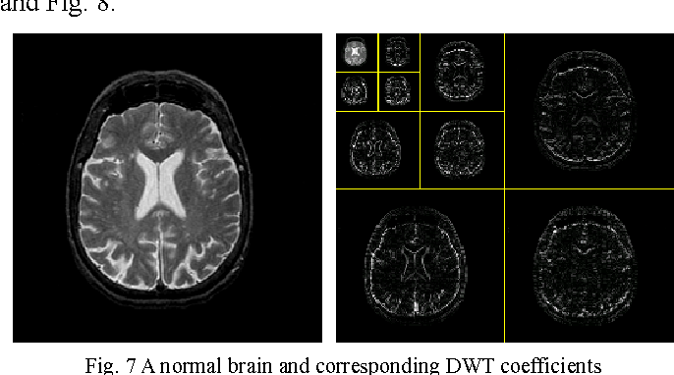
Feature Extraction
Feature extraction is an important step in the construction of any pattern classification and aims at the extraction of the relevant information that characterizes each class.
In this process relevant features are extracted from objects/ alphabets to form feature vectors. It becomes easier for the classifier to classify between different classes by looking at these features as it allows fairly easy to distinguish. Feature extraction is the process to
retrieve the most important data from the raw data.

Slide 11
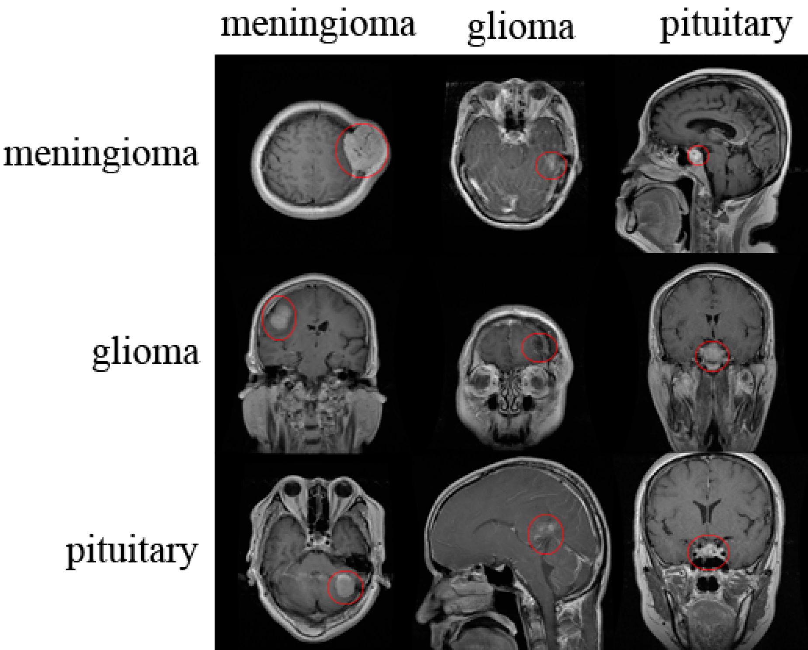
Classification
Classification is used to classify each item in a
set of data into one of predefined set of classesor groups. In other words, classification is an important technique used widely to differentiatenormal and tumor brain images. The data analysis task classification is where a model or classifier is constructed to predict categorical labels (the class label attributes). Classification is a data mining function that assigns items in a collection to target categories or classes. The goal of classification is to accurately predict the target class for each case in the data

Slide 12
WE HAVE TRIED ALL THIS IN PYTHON USING GUI.......
LETS HAVE A LOOK AT OUR RESULTS........

Slide 13
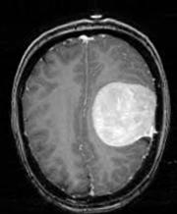
Picture having brain tumor

Slide 14
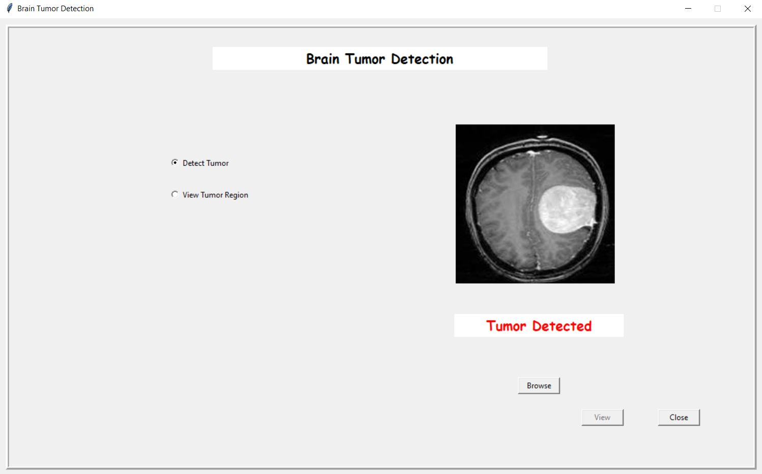

Slide 15
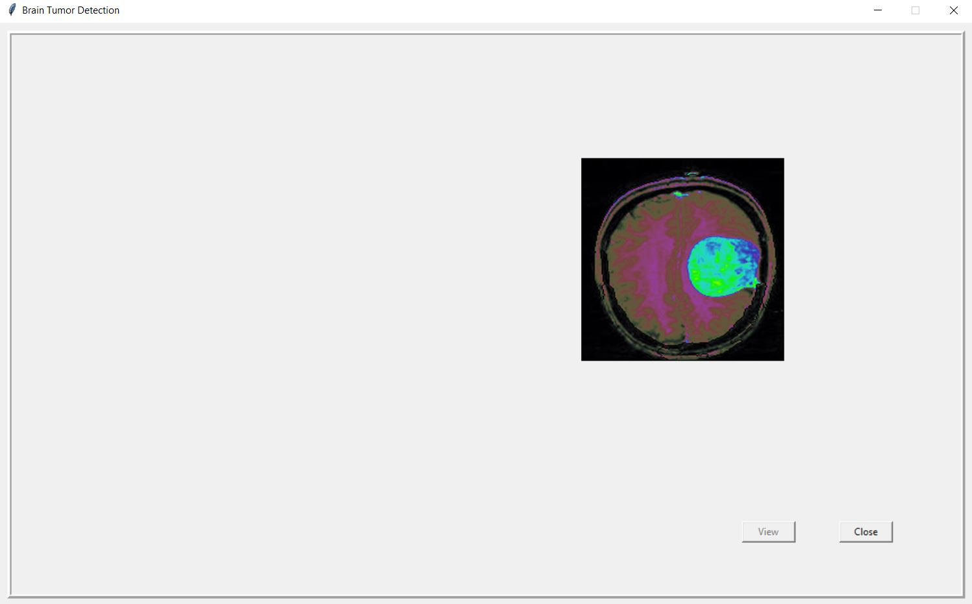

Slide 16
JAZAK
ALLAH
HOPE WE EXPLAINED WELL

