Slide 1
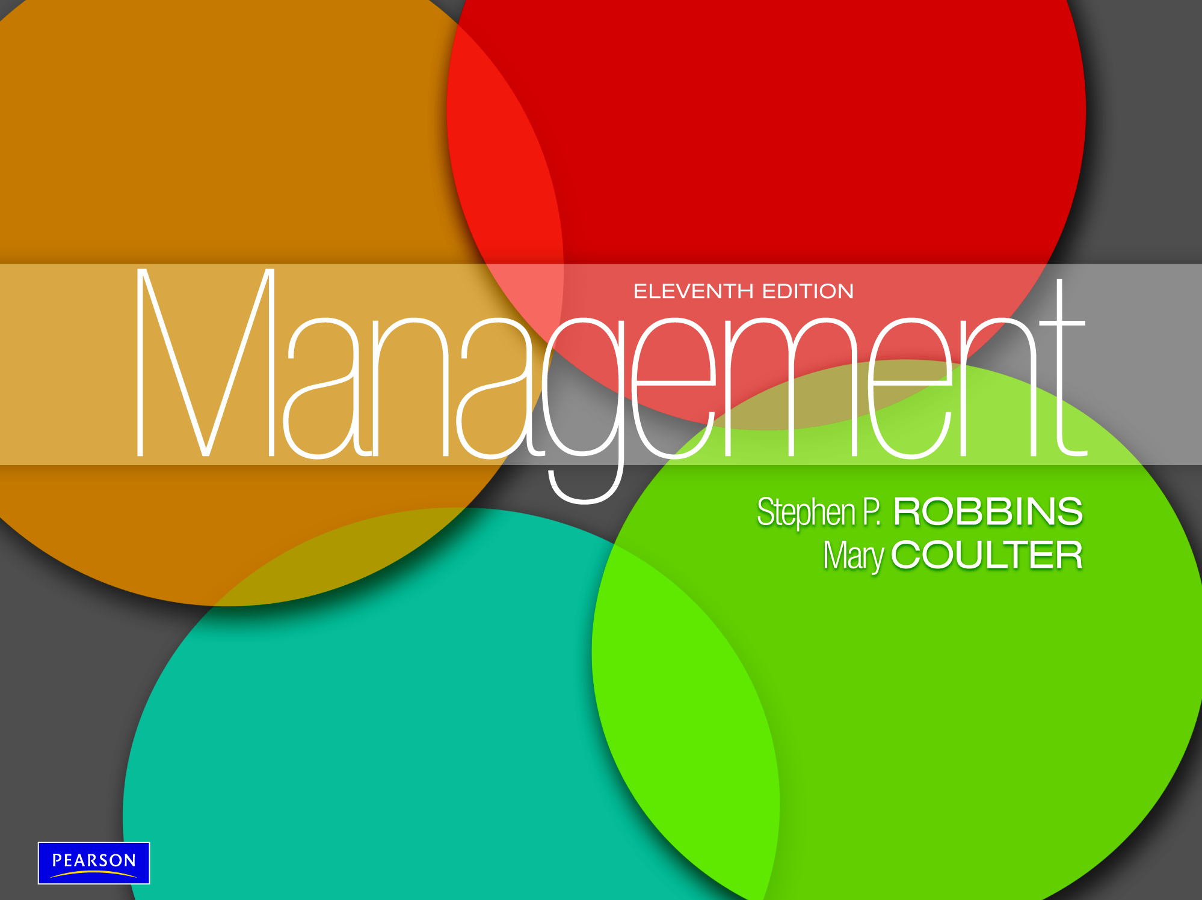

Slide 2
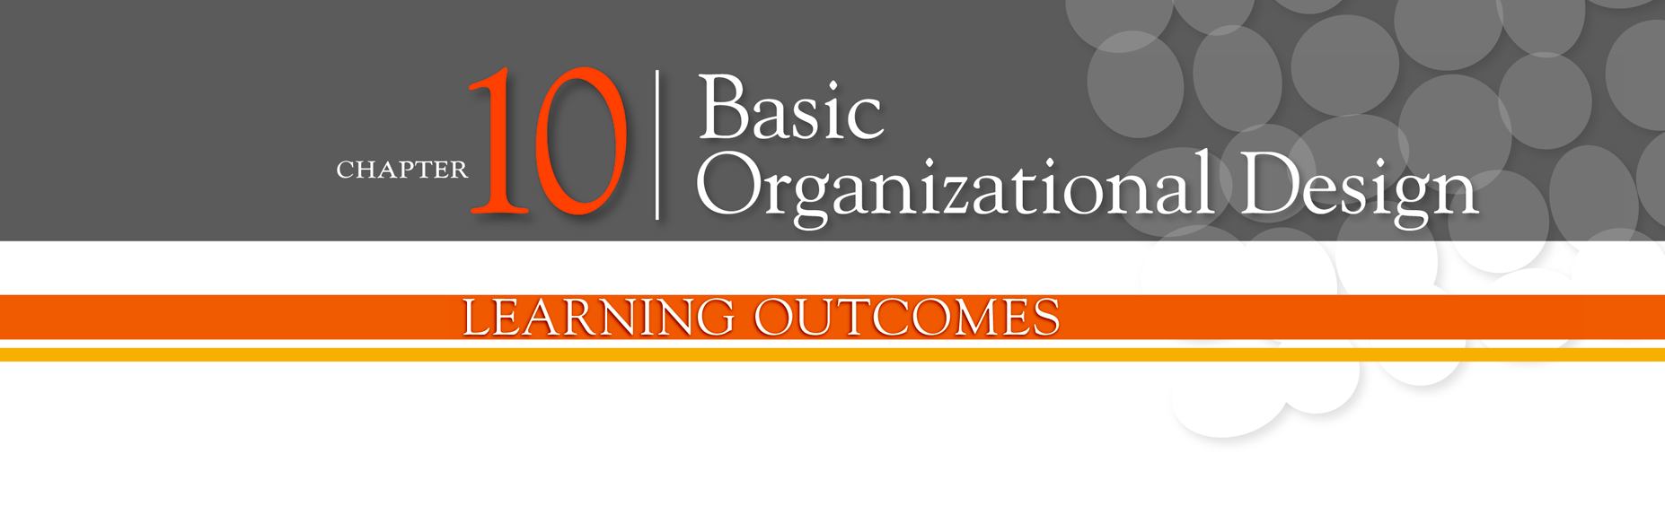
Describe six key elements in organizational design
Contrast mechanistic and organic structures
Discuss the contingency factors that favor either the mechanistic model or the organic model of organizational design
Describe traditional organizational designs

Slide 3
Designing Organizational Structure
Organizing - arranging and structuring work to accomplish an organization’s goals.
Organizational Structure - the formal arrangement of jobs within an organization.
Organizational Design - a process involving decisions about six key elements:
    Work specialization
    Departmentalization
    Chain of command
    Span of control
    Centralization and decentralization
    Formalization

Slide 4
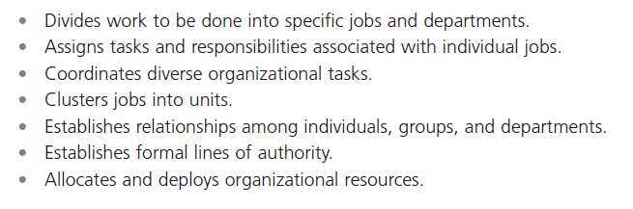
Exhibit 10-1: Purposes of Organizing
Notes:
Organizational structure is the formal arrangement of jobs within an organization. This structure, which can be shown visually in an organizational chart, also serves many purposes. (See Exhibit 10-1.)

Slide 5
Organizational Structure
Work Specialization
  The degree to which tasks in the organization are divided into separate jobs with each step completed by a different person.
  Overspecialization can result in human diseconomies such as boredom, fatigue, stress, poor quality, increased absenteeism, and higher turnover.

Slide 6
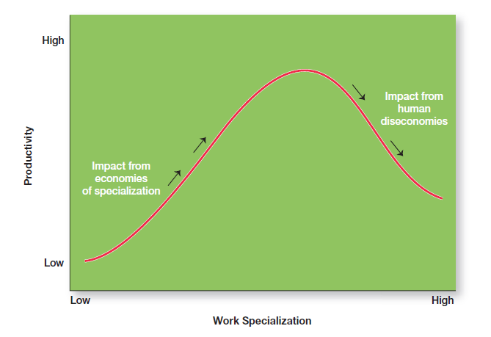
Exhibit 10-2: Economies and Diseconomies of Work Specialization
Notes:
As Exhibit 10-2 illustrates, at some point, the human diseconomies from division of labor—boredom, fatigue, stress, low productivity, poor quality, increased absenteeism, and high turnover—exceed the economic advantages.

Slide 7
Departmentalization by Type
Functional
  Grouping jobs by functions performed
Product
  Grouping jobs by product line
Geographical
  Grouping jobs on the basis of territory or geography
Process
  Grouping jobs on the basis of product or customer flow
Customer
  Grouping jobs by type of customer and needs

Slide 8
Organizational Structure (cont.)
Chain of Command - the continuous line of authority that extends from upper levels of an organization to the lowest levels of the organization—clarifies who reports to whom.

Slide 9
Organizational Structure (cont.)
Authority - the rights inherent in a managerial position to tell people what to do and to expect them to do it.
Responsibility - the obligation or expectation to perform.
Unity of Command - the concept that a person should have one boss and should report only to that person.

Slide 10
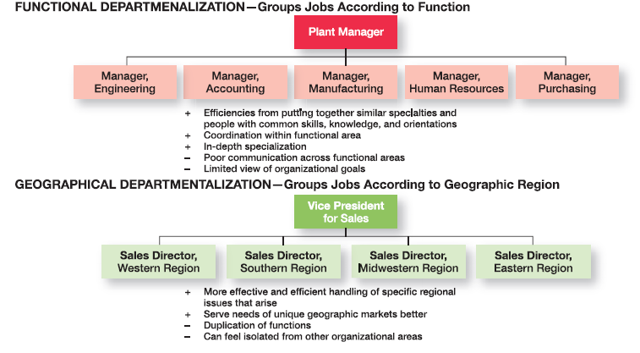
Exhibit 10-3: The Five Common
Forms of Departmentalization
Notes:
Five common forms of departmentalization are used, although an organization may develop its own unique classification. (For instance, a hotel might have departments such as front desk operations, sales and catering, housekeeping and laundry, and maintenance.) Exhibit 10-3 illustrates each type of departmentalization as well as the advantages and disadvantages of each.

Slide 11
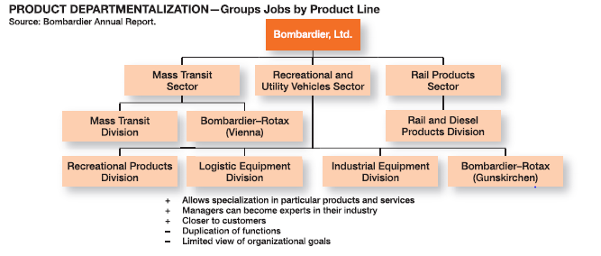
Exhibit 10-3: The Five Common Forms of Departmentalization (cont.)

Slide 12
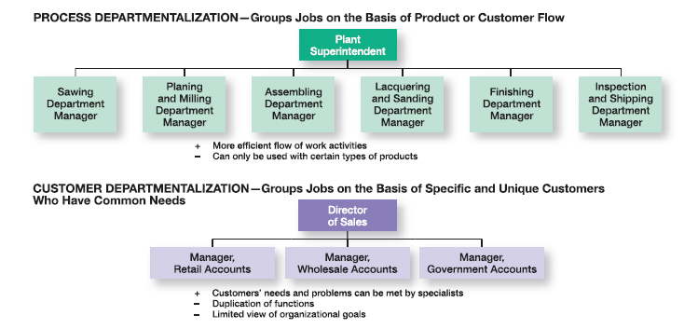
Exhibit 10-3: The Five Common Forms of Departmentalization (cont.)

Slide 13
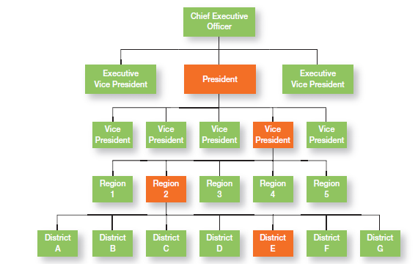
Exhibit 10-4: Chain of Command and Line Authority
Notes:
Line authority entitles a manager to direct the work of an employee. It is the employer-employee authority relationship that extends from the top of the organization to the lowest echelon, according to the chain of command, as shown in Exhibit 10-4.

Slide 14
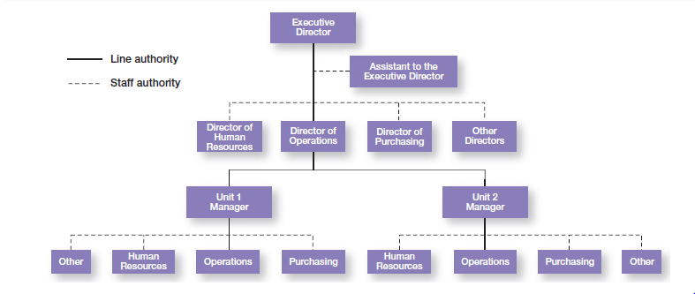
Exhibit 10-5: Line vs. Staff Authority
Notes:
Exhibit 10-5 illustrates line and staff authority.

Slide 15
Span of Control
Span of Control - the number of employees who can be effectively and efficiently supervised by a manager.

Slide 16
Width of span is affected by:
    Skills and abilities of the manager
    Employee characteristics
    Characteristics of the work being done
    Similarity of tasks
    Complexity of tasks
    Physical proximity of subordinates
    Standardization of tasks
    Sophistication of the organization’s information system
    Strength of the organization’s culture
    Preferred style of the manager

Slide 17
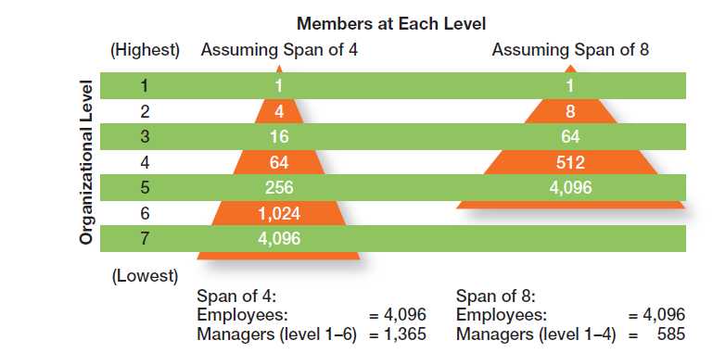
Exhibit 10-6: Contrasting Spans of Control
Notes:
Assume two organizations, both of which have approximately 4,100 employees. As Exhibit 10-6 shows, if one organization has a span of four and the other a span of eight, the organization with the wider span will have two fewer levels and approximately 800 fewer managers.

Slide 18
Centralization
Centralization - the degree to which decision making is concentrated at upper levels in the organization.
    This is common in organizations in which top managers make all the decisions and lower-level employees simply carry out those orders.

Slide 19
Decentralization
Decentralization - when an organization relegates decision making to managers who are closest to the action.
Employee Empowerment
  Increasing the decision-making authority (power) of employees

Slide 20
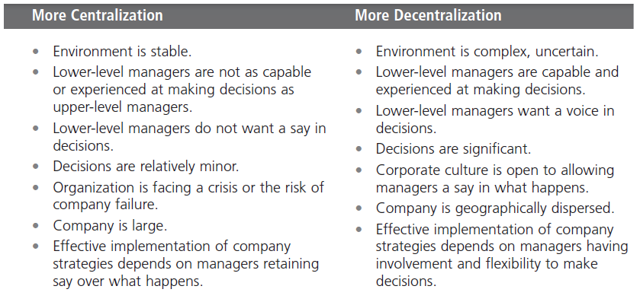
Exhibit 10-7: Centralization or Decentralization
Notes:
Exhibit 10-7 lists some of the factors that affect an organization’s use of centralization or decentralization.

Slide 21
Formalization
Formalization - the degree to which jobs within the organization are standardized and the extent to which employee behavior is guided by rules and procedures.
  Highly formalized jobs offer little discretion over what is to be done.
  Low formalization means fewer constraints on how employees do their work.

Slide 22
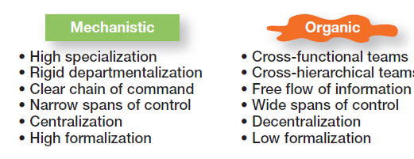
Exhibit 10-8: Mechanistic Versus
Organic Organizations
Notes:
Designing (or redesigning) an organizational structure that works is important. Basic organizational design revolves around two organizational forms that are described in Exhibit 10-8

Slide 23
Contingency Factors
Structural decisions are influenced by:
  Overall strategy of the organization
  Size of the organization
  Technology use employed by the organization
  Degree of environmental uncertainty

Slide 24
Contingency Factors (cont.)
Strategy Frameworks:
  Innovation
    Pursuing competitive advantage through meaningful and unique innovations favors an organic structuring
  Cost minimization
    Focusing on tightly controlling costs requires a mechanistic structure for the organization

Slide 25
Contingency Factors (cont.)
Strategy and Structure
  Achievement of strategic goals is facilitated by changes in organizational structure that accommodate and support change.
Size and Structure
  As an organization grows larger, its structure tends to change from organic to mechanistic with increased specialization, departmentalization, centralization, and rules/regulations.

Slide 26
Contingency Factors (cont.)
Technology and Structure
  Organizations adapt their structures to their technology.
  Woodward’s classification of firms based on the complexity of the technology employed:
    Unit production of single units or small batches
    Mass production of large batches of output
    Process production in continuous process of outputs
  Routine technology = mechanistic organizations
  Non-routine technology = organic organizations

Slide 27
Contingency Factors (cont.)
Environmental Uncertainty and Structure
  Mechanistic organizational structures tend to be most effective in stable and simple environments.
  The flexibility of organic organizational structures is better suited for dynamic and complex environments.

Slide 28
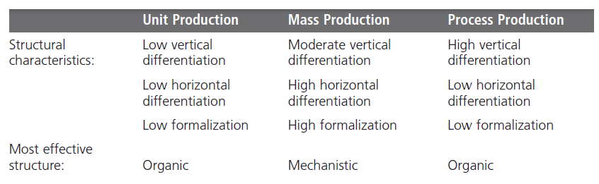
Exhibit 10-9: Woodward’s Findings on
Technology and Structure
Notes:
Joan Woodward linked structural design elements to organizational success when she divided firms into three distinct technologies that had increasing levels of complexity and sophistication. The first category, unit production, described the production of items in units or small batches. The second category, mass production, described large-batch manufacturing. Finally, the third and most technically complex group, process production, included continuous process production. A summary of her findings is shown in
Exhibit 10-9.

Slide 29
Traditional Designs
Simple structure
    Low departmentalization, wide spans of control, centralized authority, little formalization
Functional structure
    Departmentalization by function
    Operations, finance, marketing, human resources, and product research and development
Divisional structure
    Composed of separate business units or divisions with limited autonomy under the coordination and control of the parent corporation

Slide 30
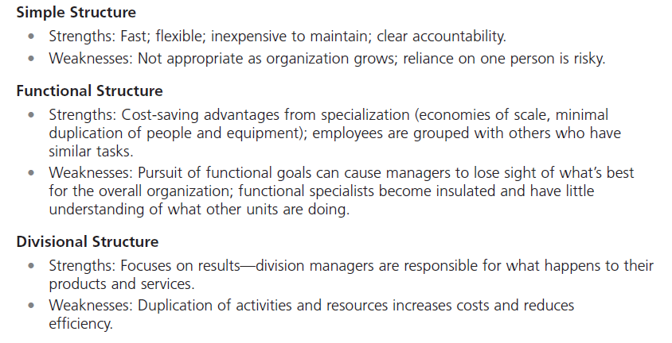
Exhibit 10-10: Traditional
Organizational Designs
Notes:
When designing a structure, managers may choose one of the traditional organizational designs. These structures tend to be more mechanistic in nature. A summary of the strengths and weaknesses of each can be found in Exhibit 10-10

Slide 31
Terms to Know
organizing
organizational structure
organizational chart
organizational design
work specialization
departmentalization
cross-functional teams
chain of command
authority
responsibility
unity of command
span of control
centralization
decentralization
employee empowerment
formalization
mechanistic organization
organic organization
unit production
mass production
process production
simple structure
functional structure
divisional structure
team structure
matrix structure
project structure
boundaryless organization
virtual organization
network organization
learning organization

Slide 32
